Slide 1

CLOUD DATA ENGINEERING · END-TO-END CASE STUDY
InsightStream
Cloud Data Warehouse & Analytics
Architecture · Testing · Documentation · Results
Team Leader
Youssef Ahmed Mohamed Alkamashany
Team Members
Abdelrahman Adel Abdelmola Abu Taleb • Abdullah Mohamed Ahmed • Omar Abdelgawad Mahmoud

Slide 2
WELCOME TO THE REPORT
A Complete, Reproducible Analytics Platform
Raw, messy e-commerce order data from a Brazilian marketplace is ingested, staged, cleaned, modeled, tested, orchestrated daily, documented at three independent levels, and surfaced as a live BI dashboard — every step reproduced and explained.
≈100K
Real customer orders processed
4
Warehouse layers: raw → silver → gold → BI
The real engineering value isn't the dashboard — it's everything invisible built correctly first: a layered warehouse architecture, a four-level testing strategy that caught three real infrastructure defects, and documentation deep enough to rebuild the system from a blank machine.
3
Real infrastructure defects found & fixed
24/7
Daily automated orchestration
InsightStream · Cloud Data Warehouse & Analytics
2

Slide 3





ROADMAP
What You'll Find Inside
01 · System Architecture
The ELT design, medallion data model, and the real-world dataset that powers it all.
02 · Testing
A four-level testing strategy, three real defects, and proof of reproducible runs.
03 · Documentation
Three independent layers designed so the system outlives its author.
04 · Results
A live Power BI dashboard built on governed data — and what the numbers say.
05 · Conclusion & Roadmap
What InsightStream proves, and the concrete next steps.
InsightStream · Cloud Data Warehouse & Analytics
3

Slide 4
01 · SYSTEM ARCHITECTURE
Why ELT Instead of ETL?
InsightStream implements a modern ELT pipeline built entirely on cloud-native, industry-standard tools. Raw data is loaded first and transformed afterward inside the warehouse — taking advantage of Snowflake's elastic compute to run transformations at scale using SQL.
Traditional ETL
ELT (InsightStream)
Transformation logic lives in a separate processing engine before data reaches the warehouse.
Every schema change requires touching pipeline code outside the warehouse.
A single ETL server can bottleneck at scale.
Raw data lands first, untouched; every transformation is a version-controlled SQL model.
Snowflake's compute scales independently of storage — transformations run as parallel, elastic SQL jobs.
Raw source-of-truth stays in Bronze, ready to be re-run through corrected logic anytime.
InsightStream · Cloud Data Warehouse & Analytics
4

Slide 5
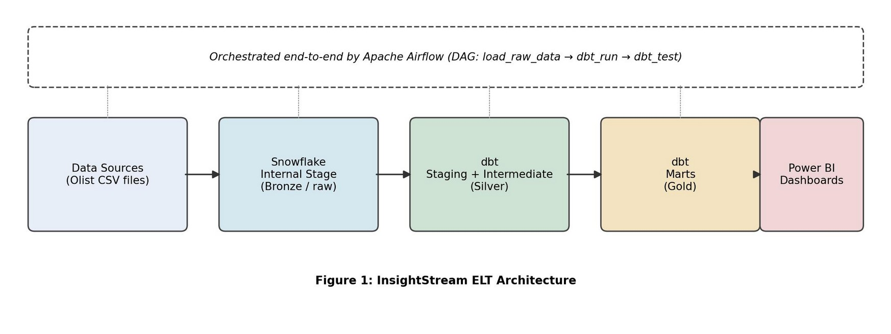
01 · SYSTEM ARCHITECTURE
End-to-End ELT Architecture
Orchestrated end-to-end by Apache Airflow — DAG: load_raw_data → dbt_run → dbt_test
Figure 1: InsightStream End-to-End ELT Architecture
Bronze never lies — an exact, immutable copy of what arrived. Silver is where messy reality gets cleaned up: types fixed, columns renamed, entities joined. Gold is the only layer a business user should ever query directly, since every quality check has already been applied.
InsightStream · Cloud Data Warehouse & Analytics
5

Slide 6
01 · SYSTEM ARCHITECTURE
Component Breakdown
Layer | Technology | Purpose
Ingestion | Python + snowflake-connector-python | Reads local CSV source files and loads them into Snowflake
Bronze (raw) | Snowflake Internal Stage + raw schema | Stores untransformed source data exactly as ingested
Silver | dbt staging & intermediate models | Cleans column types, renames fields, joins related entities
Gold | dbt marts (fact / dimension models) | fct_orders, dim_customers, dim_products, mart_sales_summary
Orchestration | Apache Airflow (Dockerized, LocalExecutor) | Schedules ingestion → dbt run → dbt test daily
Presentation | Power BI Desktop | Interactive dashboards connected directly to the Gold layer
InsightStream · Cloud Data Warehouse & Analytics
6

Slide 7

01 · SYSTEM ARCHITECTURE
Data Model — dbt Layers
Staging
Intermediate
Marts
One model per source table. Only type casting and column renaming — no business logic.
int_orders_enriched joins orders, order items, products, customers, and aggregated payments into a single denormalized view.
dim_customers & dim_products (dimensions), fct_orders (fact), mart_sales_summary (pre-aggregated by state, category, month).
Engineering Insight — Separation of Concerns
Staging models do exactly one thing, so they stay trivially easy to audit. Business logic lives only in intermediate and marts. If a dashboard number looks wrong, an engineer walks backward through exactly three well-defined hops — mart → intermediate → staging → raw — instead of untangling one monolithic script.
InsightStream · Cloud Data Warehouse & Analytics
7

Slide 8


01 · SYSTEM ARCHITECTURE
Orchestration Design
The Airflow DAG (insightstream_elt_pipeline) is intentionally linear with three sequential tasks. Each task only proceeds once the previous one succeeds — guaranteeing transformations never run against incomplete or stale raw data.
load_raw_data_to_snowflake
dbt_run
dbt_test
A linear DAG is trivial to reason about during a 2 a.m. on-call page — there is exactly one possible point of failure to check at a time. As the pipeline grows, it can be incrementally parallelized (e.g. running independent dbt model groups concurrently) without ever losing the simple, auditable backbone of load → transform → test.
InsightStream · Cloud Data Warehouse & Analytics
8

Slide 9
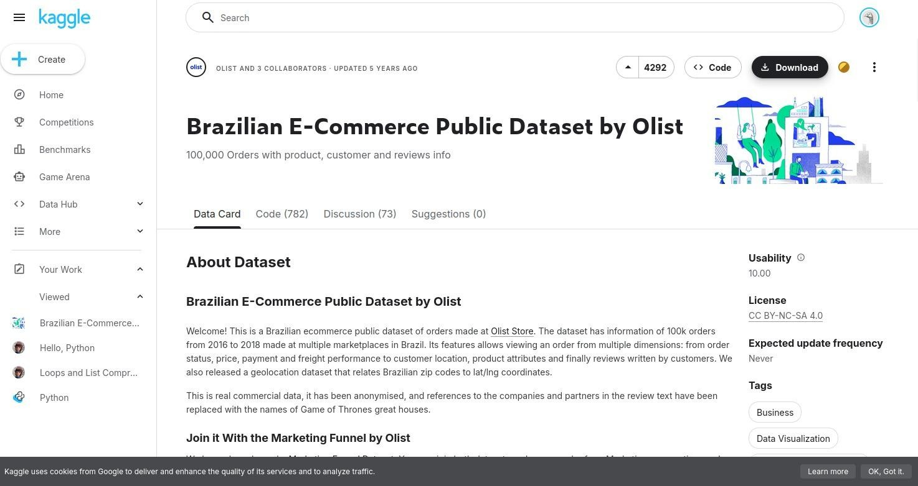
01 · SYSTEM ARCHITECTURE
Data Source — Real, Not Synthetic
The pipeline is fed by the Brazilian E-Commerce Public Dataset by Olist (Kaggle): close to 100,000 real orders placed between 2016–2018 across customers, products, sellers, payments and reviews — split across 8 related CSV files.
Product category names recorded only in Portuguese
Payments split across multiple installments and methods per order
Geolocation data that must survive every join without dropping rows
Figure 2: Source Dataset — Brazilian E-Commerce Public Dataset by Olist (Kaggle)
Why real data matters: synthetic data is clean by construction — real data offers no such guarantees, which is exactly why it's a more valuable, more realistic testing ground.
InsightStream · Cloud Data Warehouse & Analytics
9

Slide 10
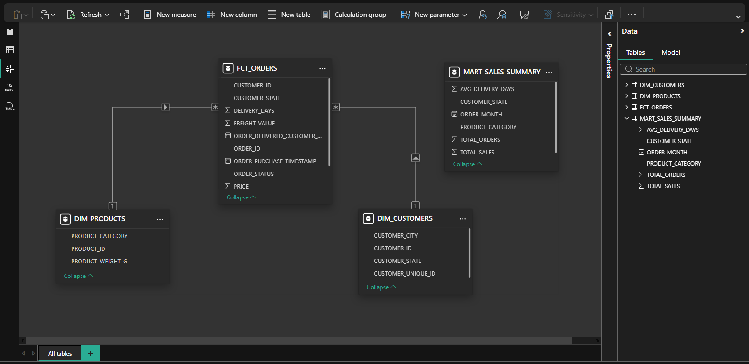
01 · SYSTEM ARCHITECTURE
Data Modeling — How the Tables Connect
The governed Gold-layer tables — fct_orders, dim_products, dim_customers, and mart_sales_summary — are wired together with real relationships directly inside Power BI's Model view.
Figure: Power BI Model View — InsightStream Gold-Layer Relationships
InsightStream · Cloud Data Warehouse & Analytics
10

Slide 11
02 · TESTING
A Four-Level Testing Strategy
Testing moves from the smallest unit of logic up to the full pipeline running end-to-end — the classic “testing pyramid” applied to a data pipeline.
Performance
dbt build time & Power BI query response
Integration
Full Bronze → Gold flow via Airflow DAG run
Data Quality
Uniqueness, not-null, referential integrity (dbt test)
Unit
Individual Python ingestion functions, isolated
InsightStream · Cloud Data Warehouse & Analytics
11

Slide 12

02 · TESTING
Testing Levels & Data Quality Checks
Type | What Was Tested | Tool
Unit | Python ingestion functions (table creation, file upload, COPY INTO) verified in isolation | Manual execution in Airflow container
Data Quality | Uniqueness/not-null on primary keys; referential integrity between fct_orders & dim_customers | dbt test (schema.yml)
Integration | Full flow: source CSVs → Snowflake raw → dbt transforms → queryable marts | Airflow DAG run
Performance | dbt model build time and Power BI dashboard query response time | dbt run timing / Power BI
Key checks: unique + not_null on customer_id and product_id · not_null on order_id · not_null + relationships on fct_orders.customer_id → dim_customers
InsightStream · Cloud Data Warehouse & Analytics
12

Slide 13
02 · TESTING
Three Real Defects — Found & Fixed
Issue | Root Cause | Resolution
Airflow task logs returned HTTP 403 and were unreadable | Webserver and scheduler containers each generated a different random Flask secret key | Set a fixed AIRFLOW__WEBSERVER__SECRET_KEY identically across all Airflow services
Snowflake error 090105: no current database for CREATE TABLE | The Python connector session did not retain the database/schema context | Added explicit role plus USE WAREHOUSE / DATABASE / SCHEMA statements right after connecting
Snowflake error 002043: object does not exist | Warehouse/database objects had not been created successfully beforehand | Re-ran setup with fully qualified object names and verified with SHOW WAREHOUSES
Worth highlighting, not hiding: none of these were SQL logic bugs — every one was an infrastructure/config issue that only became visible once components were forced to talk to each other in a real Docker/Airflow/Snowflake environment. That's exactly what integration testing exists to catch.
InsightStream · Cloud Data Warehouse & Analytics
13

Slide 14
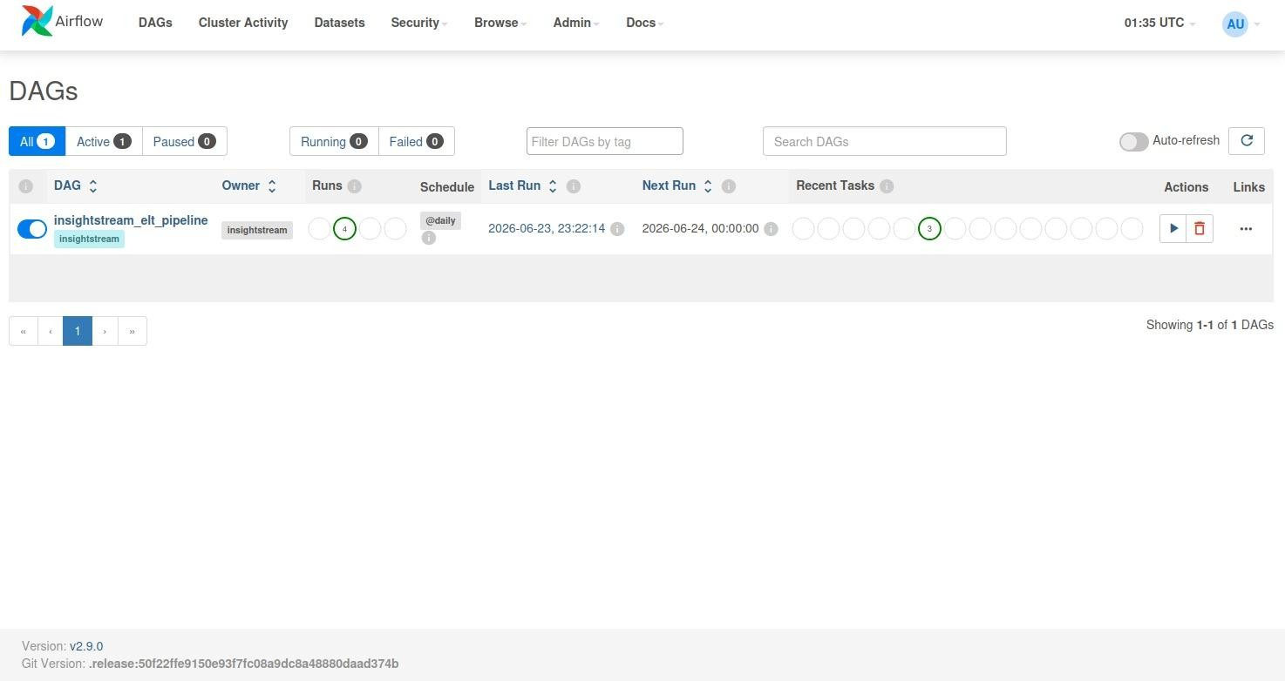
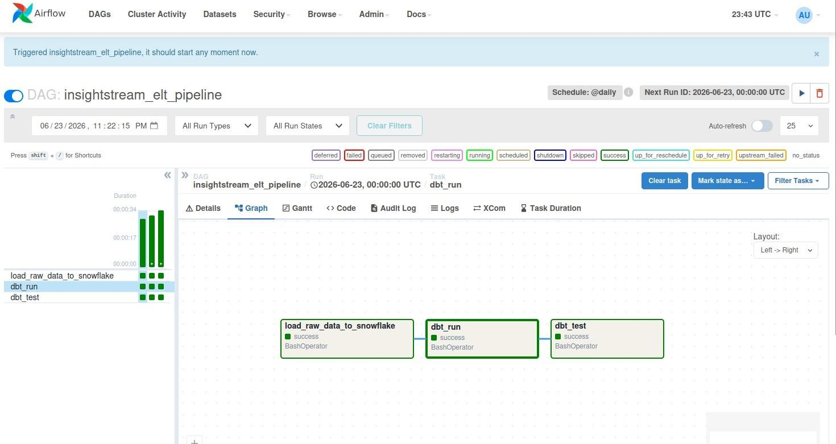
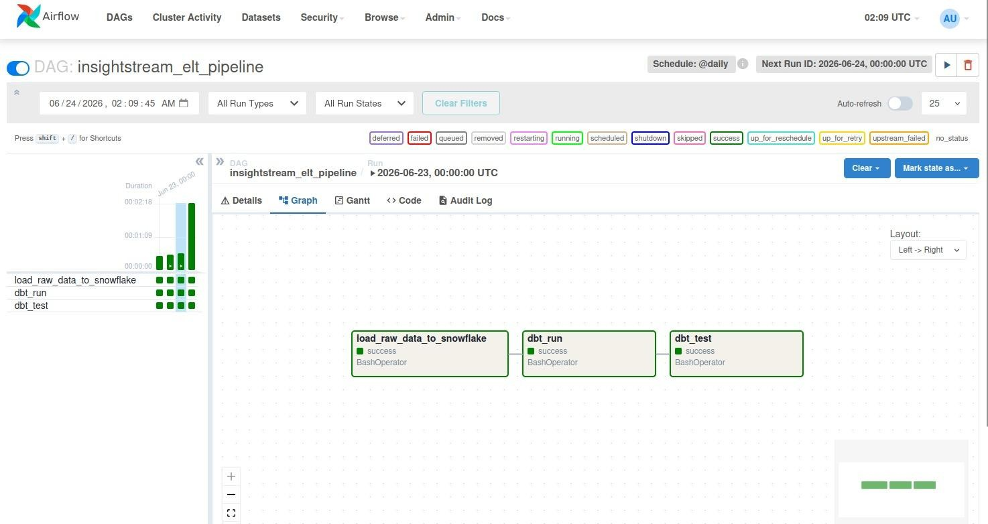
02 · TESTING
Execution Evidence & Reproducibility
The insightstream_elt_pipeline DAG is active, scheduled to run @daily, with a history of completed runs and the next run already queued — confirming the orchestration layer is live, not a one-off manual script.
Figure 3: DAG Registered with a Daily Schedule
Figure 4: Successful Pipeline Run — Attempt 1
Figure 5: Successful Run — Attempt 2 (Reproducibility)
Reproducibility is an underrated quality signal — a pipeline that succeeds twice, independently, on different days is starting to demonstrate the reliability a production schedule demands.
InsightStream · Cloud Data Warehouse & Analytics
14

Slide 15
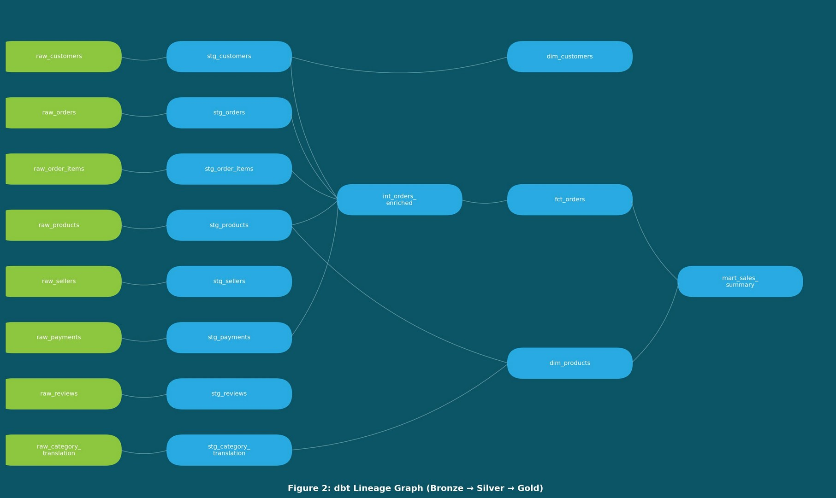


03 · DOCUMENTATION
Three Layers That Outlive the Author
Documentation was produced at three levels — auto-generated technical docs from dbt, human-written setup/run instructions, and inline code documentation — so a new team member could operate the system without the original author.
README (Setup)
Environment prerequisites, Snowflake setup, credentials, Docker stack, DAG triggering, and table verification.
Inline Code Docs
Docstrings and single-purpose ingestion functions; dbt models organized into staging/intermediate/marts; DAG dependencies via >>.
Bus factor: redundant docs are insurance, not waste.
Figure 6: dbt Lineage Graph (Bronze → Silver → Gold)
InsightStream · Cloud Data Warehouse & Analytics
15

Slide 16
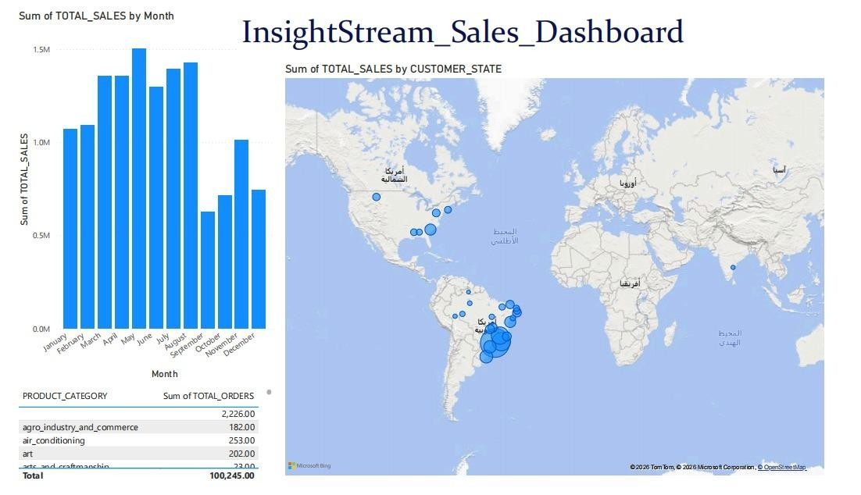
04 · RESULTS
Business Intelligence Dashboard
Gold-layer tables (fct_orders, dim_products, mart_sales_summary) are consumed directly by Power BI Desktop over a live Snowflake connection.
Figure 7: InsightStream Sales Dashboard (Power BI)
Total recorded sales: 100,245 units of value, aggregated entirely through the dbt-modelled Gold layer.
InsightStream · Cloud Data Warehouse & Analytics
16

Slide 17



04 · RESULTS
Key Observations
Seasonality signal
Geography validated
Monthly sales peak around May, dip around September, and recover by November — a clear planning signal for inventory and staffing.
Order volume concentrates in Brazil, consistent with the dataset's origin — confirming location data survived every join.
Category breakdown
Governed numbers
Product category totals support fast inventory and marketing prioritization decisions.
All totals are aggregated entirely through the dbt-modelled Gold layer, not raw, unprocessed data.
InsightStream · Cloud Data Warehouse & Analytics
17

Slide 18
05 · CONCLUSION
What InsightStream Demonstrates
A small, carefully layered pipeline can deliver the same core guarantees as a much larger enterprise data platform: clean separation between raw and modeled data, automated data-quality enforcement, daily unattended orchestration, multi-level documentation, and a governed, trustworthy path through to a business-facing dashboard.
Where InsightStream Goes Next
Incremental loading — dbt incremental models + Snowflake Streams/Tasks
CI/CD — GitHub Actions running dbt build & dbt test on every pull request
Alerting — Airflow task failures routed to Slack or email
Deeper BI — DAX measures (MoM growth, CLV) and row-level security
Forecasting — extend the seasonality pattern into a demand-forecasting model
“Build the foundation so solidly that the dashboard becomes the easy part.”

