Slide 1


Slide 2

Difficulty in Multi-Sectoral
Decision Support
Lack of Accessible and Actionable Insights
Difficulty in
Understanding Complex Data for Non-Tech Users
Difficulty in market trend assessments and demographic shifts

Slide 3

Human Development
Economic Development
Social Development
Environment Development

Slide 4

Enhanced Data Accessibility and Al-Driven Insights
Analytics for Strategic Planning
Multi-Sectoral Decision Support
Make Informed Predictions

Slide 5


Slide 6
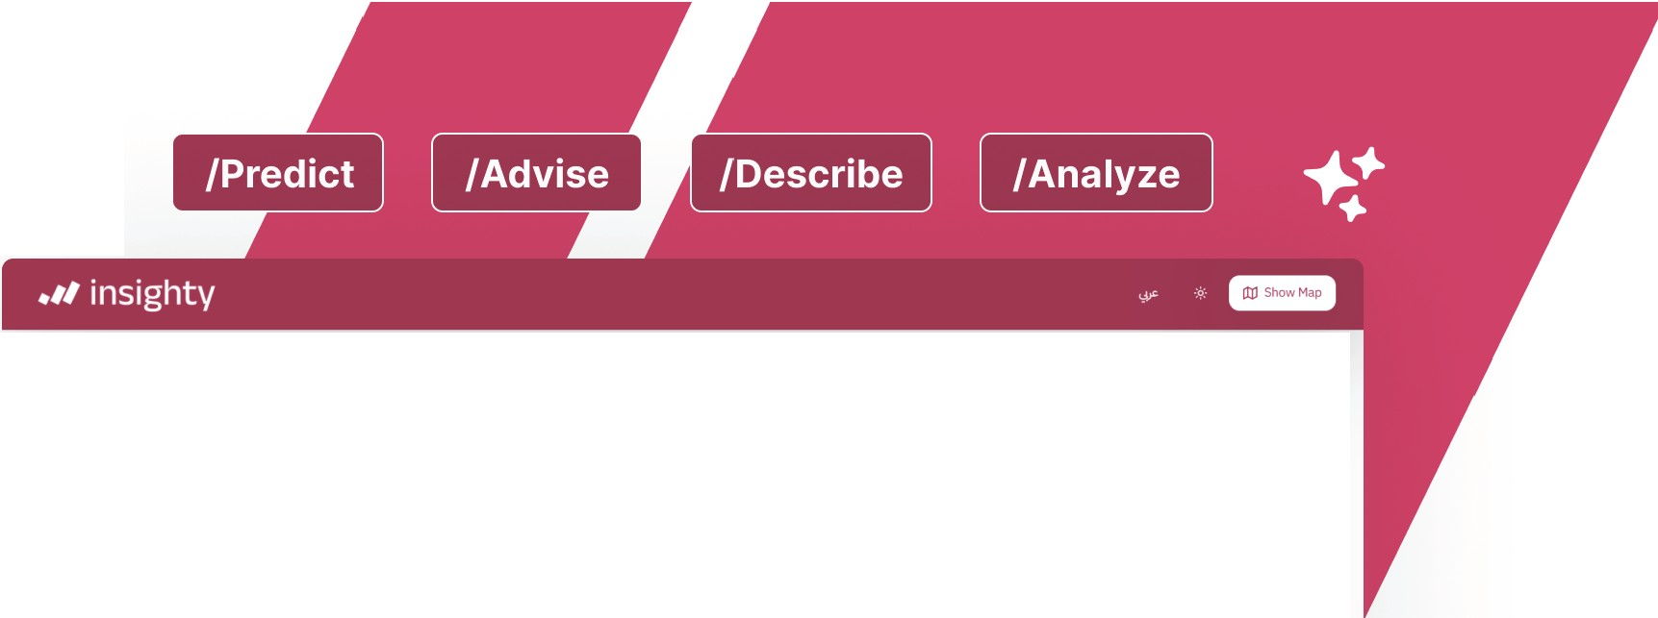


+!
Predict Predict the number of patients in the emergency department
Advise Show help message Describe Describethe data Analyze Analyze the data

Slide 7
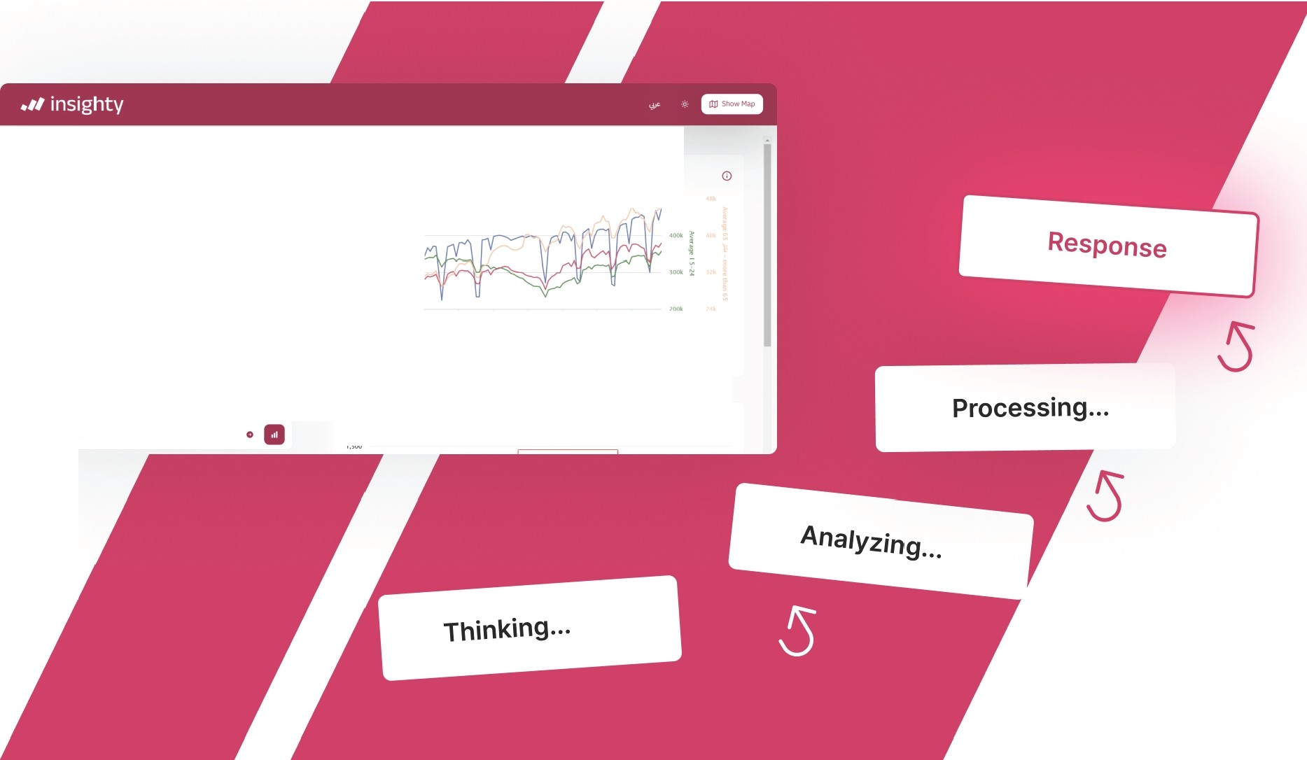
You
Popu ation Age Group
,_Populat1en Age Group, Mamages Vs
l.lloolt
....
'°""
Nationality
G 1nsighty
l.400!< _{j}
To effectively describe the data regarding population age groups and marriages versus national ty, please provide specific insights or trends from the graph related to these variables. This would enable me to offer aconcise andclear description based on the provk:led data.
• '·-
l ,61)111<
""'
i
2•0k
,·,
,•
,. ., ,,,,,.
Month(Month)
-I'
-AwRge 15 .;... ,,- lustmn 15 -AWfle 15-2-4 -ARge 25-64 Avu'f.ge 55 JM - more thiin 65
Ask me anything .
Marriages Vs National ty
0
'·"'°

Slide 8

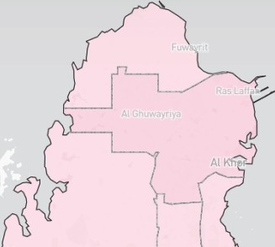

You
ad To 11
I
Glnsighty
Hello! How can Iassist you today?If you have any questions or need analysis on specific data or graphs, feel free to share!
Bahrain
II f
l
Al Sheehaniya | x
Deaths | 7
 | 14
Minor Injuries | 95
 | 235
"
Ask me anything...

Slide 9

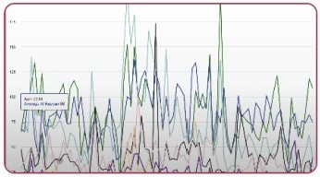
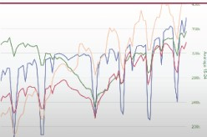
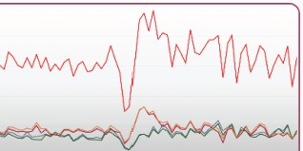

Select Datasets to Explore
Chooseoneor moredatasets toanalyzeandvisualizeinsi!V>ts
All
Properties Population Trade
Finance
Electronic
Price ndex
Traffic
Environment Energy
,.·- ....
·.
Num Sold Properties By Municipality
Click to select this dataset and exploreinsights
Population Age Group
Click to se ect this dataset and explore insights
Marriages Vs Nationality
Click toselect thisdataset andexploreinsights
re Nodatasets selected
Cancel ffj§M

Slide 10
IU" !,JIy'
b b..;j.JJ
National Planning Council
St.tt• of Q•t;v •
i.......J9>

Slide 11


Slide 12


