Slide 1


Slide 2
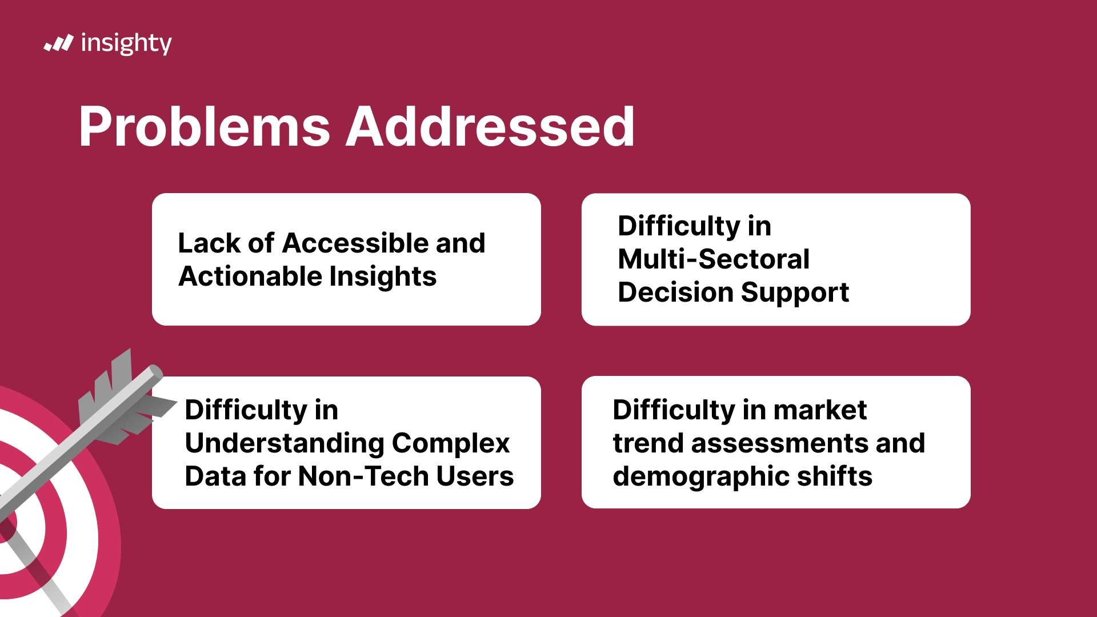

Slide 3
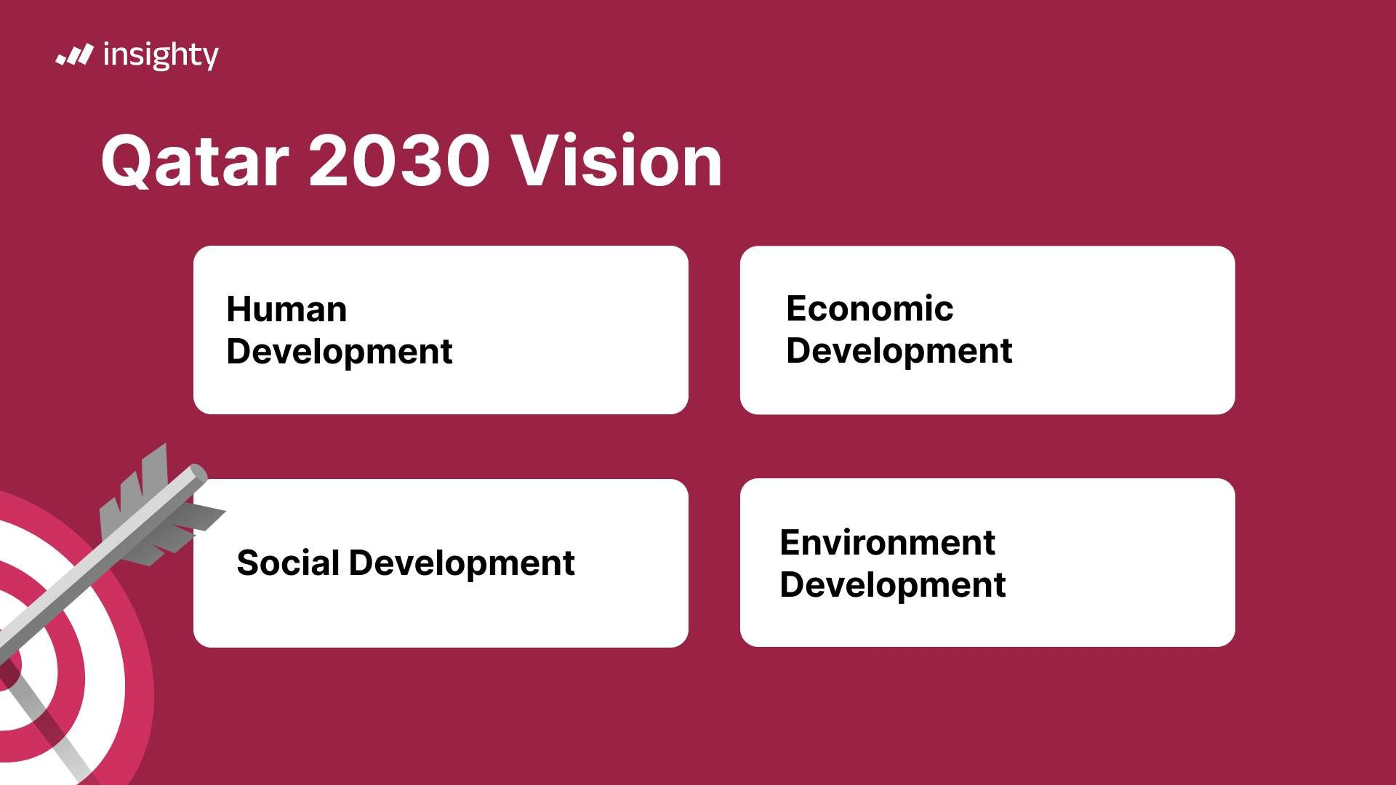

Slide 4


Slide 5


Slide 6



ShovvYap
Predict
Predim the number of patients In the emergency department
Show helg message
Describe
Describe the data
Analyze
Analyze the data

Slide 7
Respons_{e}
ins hty
To ei1'ectively describe The oata boarding popufat on age groups and mar rtaqes versus nationality. please provide specific irSights or
This would enable me \o offer a concise and clear desc 'ption baserl on the provided data
Processing...
Think***9•-

Slide 8

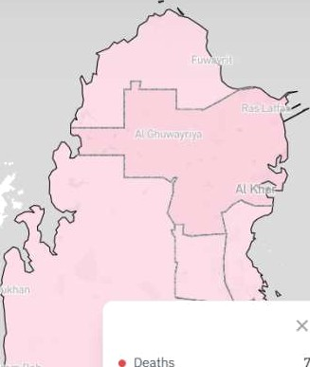



Insighty
Hello! How can I a ssist you today? If IDU have any quest io ns or need analysis on specific data or graph s, feel fre•. to sl are!
Al Sheehaniya
235

Slide 9

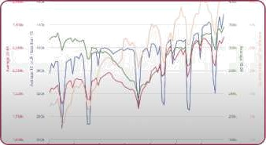
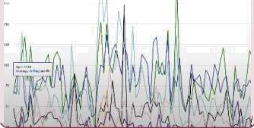



Select Datasets to Exp(ore
Num Sold Properties By fflunicipality
Population Age Group
Marriages Vs Nationality

Slide 10



National Planning Council

Slide 11


Slide 12











Ahmed Ashraf
Youssef Aly
"Osama Hardän
Mohaned Walid
UI/UX / Frontend
Backend Engineer /
Data Scientist /
Data Scientist /
Frontend Developer
Developer
AI/ML Engineer
Aì/ ML Eng ineer
AI/ ML Engineer

