Slide 1

MBA AI-IN-BUSINESS CASE STUDY — COMPREHENSIVE PROJECT
AI-Powered Route Optimization
in Logistics
From Static Planning to Real-Time, Data-Driven Fleet Decisions
Andrew Emad Abd El Aziz
MBA Candidate | Case Studies in AI for Business
Smart Village Campus
AI-POWERED ROUTE OPTIMIZATION IN LOGISTICS
1 / 43

Slide 2
EXECUTIVE SUMMARY
The Opportunity, in Four Verified Numbers
5–20%
Lower logistics costs from embedding AI in distribution
10–15%
Lower fuel cost from route optimization
McKinsey & Company
McKinsey-aligned analysis
$70B
Global fleet-management market by 2030 (from $38B in 2025)
$94.6B
Yearly cost of highway congestion to U.S. trucking
MarketsandMarkets, 2025
ATRI
External, cited industry benchmarks — not company-specific results. Full references in the appendix.
AI-POWERED ROUTE OPTIMIZATION IN LOGISTICS
2 / 43

Slide 3
INDUSTRY & MARKET CONTEXT
A Fast-Growing, Still Under-Optimized Market
WHY THIS MATTERS
Transportation ≈ half of total logistics cost (McKinsey)
Last-mile alone = 41–53% of logistics cost (Capgemini)
5G + edge AI enable up to 20% fuel savings (Mordor Intelligence)
13.3% CAGR, 2025–2030 · Source: MarketsandMarkets, 2025
AI-POWERED ROUTE OPTIMIZATION IN LOGISTICS
3 / 43

Slide 4
PROBLEM STATEMENT
Manual Planning Bleeds Money in Three Places
Fuel (21%)
Static routes can't react to live traffic
Congestion
$94.6B/year cost to U.S. trucking (ATRI)
Maintenance
Reactive upkeep misses early warning signs
AI-POWERED ROUTE OPTIMIZATION IN LOGISTICS
4 / 43

Slide 5


INDUSTRY & BUSINESS CONTEXT
Who We Are, and Where the Old Approach Breaks
ORGANIZATION TYPE
WHY TRADITIONAL SYSTEMS FALL SHORT
• Mid-size ground logistics / trucking fleet operator — ~30 vehicles running daily last-mile and regional delivery routes
• Competes in a fast-growing logistics market (13.3% CAGR, 2025–2030)
• Dispatch and route planning still run on manual/static tools — spreadsheets and dispatcher judgment
• Static, pre-planned routes can't react to live traffic, weather or breakdowns
• Manual dispatch scales with headcount — can't absorb order-volume growth
• Reactive (not predictive) maintenance misses early warning signs
• Spreadsheet reporting delays visibility from real-time to days
OPERATIONAL GAP
No real-time re-routing — congestion and delay are absorbed as cost, not managed.
STRATEGIC GAP
Competitors adopting AI/telematics gain a service-reliability edge in a 13.3%-CAGR market.
FINANCIAL GAP
Fuel (21%) + industry-wide congestion cost ($94.6B/yr, ATRI) + reactive maintenance stack into avoidable spend.
AI-POWERED ROUTE OPTIMIZATION IN LOGISTICS
5 / 43

Slide 6


DATA ANALYTICS COMPONENT (MANDATORY)
The Data Behind Every AI Decision
TYPES OF DATA USED
DATA SOURCES
• Structured — trip records, GPS coordinates, fuel logs, delivery timestamps (schema on Slide 26)
• Real-time / streaming — live GPS telemetry, traffic and weather feeds
• Historical — completed-trip archive used to train delay/ETA models
• Unstructured (lightly used) — free-text dispatcher/incident notes
• ERP (Sales/Order module) — order creation, customer & delivery details
• TMS / dispatch system — route assignment, vehicle & driver allocation
• IoT / telematics — GPS, engine and fuel sensors on each vehicle
• External feeds — live traffic APIs, weather services
• ERP Finance & HRM — trip cost postings and driver hours feed the KPI dashboard
Structured
Real-time
Historical
ERP
IoT / Telematics
External APIs
AI-POWERED ROUTE OPTIMIZATION IN LOGISTICS
6 / 43

Slide 7
AS-IS VS TO-BE
The Manual-Routing Gap
TRADITIONAL
AI-ENABLED
Manual dispatch planning
AI route optimization engine
Fixed, static routes
Real-time dynamic re-routing
Reactive response to delays
Proactive, continuous adaptation
REACTIVE
›
PREDICTIVE
›
PRESCRIPTIVE
React after a delay
Predict risk before it happens
Recommend the best action
AI-POWERED ROUTE OPTIMIZATION IN LOGISTICS
7 / 43

Slide 8
AI SOLUTION OVERVIEW
One Pipeline: Data to Management Decisions
DATA SOURCES
GPS · Telematics · Orders · Traffic · Weather · Vehicle & Driver Data
DATA PLATFORM
Ingestion · Cleaning · Data Lake · Feature Engineering
AI / ANALYTICS
ETA & Delay Prediction · Clustering · Anomaly Detection · Route Optimization
DECISION ENGINE
Recommended Route · Vehicle Assignment · Alerts
AUTOMATION
RPA · TMS · ERP · Notifications
MANAGEMENT
Dashboard · KPIs · Continuous Improvement
AI-POWERED ROUTE OPTIMIZATION IN LOGISTICS
8 / 43

Slide 9
AI & MACHINE LEARNING PLAN
Five Techniques, Five Specific Jobs
Supervised Learning
Supervised Learning
Unsupervised Learning
XGBoost / Random Forest
LSTM / Neural Networks
K-Means Clustering
Predict delay & fuel-overrun risk
Predict ETA from traffic sequences
Group delivery zones & driver risk
Semi-Supervised
Optimization (non-ML)
Seeded Clustering
VRP Solver + RL
Detect rare events (breakdowns)
Compute the best route
AI-POWERED ROUTE OPTIMIZATION IN LOGISTICS
9 / 43

Slide 10










AI SOLUTION OVERVIEW
One AI Engine, Five Business Functions
SUPPLY CHAIN / OPERATIONS
FINANCE
HR (DRIVER OPERATIONS)
CUSTOMER SERVICE
IT / DATA PLATFORM
• Optimized routing (VRP + RL) cuts distance and delay
• Predictive maintenance reduces unplanned breakdowns
• Lower cost-per-delivery; ROI tracked via the Slide 18 financial model
• Trip cost auto-posted from ERP Finance
• Driver hours and shift data feed AI recommendations
• Overtime and fatigue risk flagged automatically
• More accurate ETAs and proactive delay alerts
• Fewer missed or late deliveries improve the on-time KPI
• Owns the data lake, model deployment (MLOps) and integration layer
• Runs the SDLC shown on Slide 13
AI-POWERED ROUTE OPTIMIZATION IN LOGISTICS
10 / 43

Slide 11
A CRITICAL DISTINCTION
Not Everything Here Is “AI”
MACHINE LEARNING
OPTIMIZATION (OR)
Predicts: ETA, delay risk, fuel overrun, maintenance risk
Calculates the best route given constraints — not predictive
AI DECISION SUPPORT
RPA
Combines predictions + optimization to recommend an action
Executes the approved action: updates TMS/ERP, sends alerts
VRP (Vehicle Routing Problem) is classical operations research, not machine learning — it becomes “AI-powered” only when its inputs come from ML predictions.
AI-POWERED ROUTE OPTIMIZATION IN LOGISTICS
11 / 43

Slide 12
RPA & PROCESS AUTOMATION
AI Predicts. RPA Executes.
AI Prediction
(Risk Detected)
12 / 43
24/7
Orchestrator
(RPA Triggered)
Feedback
(Logged)
Auto Action
(TMS/ERP Updated)
AI-POWERED ROUTE OPTIMIZATION IN LOGISTICS
12 / 43

Slide 13
SDLC METHODOLOGY
Agile + MLOps: Why Not Waterfall
1. Requirements
2. Data Collection
3. Data Prep
4. Model Dev
5. Integration
6. Testing (UAT)
7. Pilot
8. Deployment
9. Monitoring
10. Improve & Retrain
Why Agile + MLOps, not Waterfall: routing models need continuous retraining as traffic and demand patterns change — a linear, one-pass project can't accommodate that feedback loop.
AI-POWERED ROUTE OPTIMIZATION IN LOGISTICS
13 / 43

Slide 14
ANALYTICS FRAMEWORK
From Description to Prescription
DESCRIPTIVE
DIAGNOSTIC
PREDICTIVE
PRESCRIPTIVE
What happened?
Why did it happen?
What's next?
What should we do?
On-time rate, fuel use by zone
Why delays rose in a zone
Delay & fuel-overrun risk
Recommend the best action
AI-POWERED ROUTE OPTIMIZATION IN LOGISTICS
14 / 43

Slide 15
KPI FRAMEWORK
A Dashboard Tracks the Business AND the Model
Operational
Financial
On-Time Rate · Vehicle Utilization
Cost per Delivery · Fuel Cost / Mile
AI / Model Health
Fleet / Safety
Route Accuracy · ETA Prediction Error
Driver Overtime · Harsh-Braking Events
AI-POWERED ROUTE OPTIMIZATION IN LOGISTICS
15 / 43

Slide 16
DIGITAL TRANSFORMATION
Four Dimensions, One Shift
Dimension
BEFORE
AFTER
Visibility
Partial, delayed
Real-time GPS telemetry
Maintenance
Reactive
Predictive
Reporting
Manual spreadsheets
Automated dashboards
Decisions
Reactive judgment
Near-real-time, data-driven
AI-POWERED ROUTE OPTIMIZATION IN LOGISTICS
16 / 43

Slide 17
DIGITAL TRANSFORMATION (MANDATORY)
Beyond the Dashboard — People and the Customer
ORGANIZATIONAL CULTURE & DECISION-MAKING
CUSTOMER EXPERIENCE IMPROVEMENTS
• Dispatchers shift from reactive fire-fighting to managing by exception
• Decisions move from individual judgment to shared, data-backed recommendations
• Requires change management: training and phased trust-building (Slide 25 roadmap)
• Accurate, real-time ETAs replace static delivery windows
• Proactive delay notifications instead of after-the-fact complaints
• Fewer missed/late deliveries lifts the on-time-rate KPI (Slide 28)
Dimension
Before
After
Dispatcher role
Manual re-planning of every trip
Exception management only
Customer updates
Static ETA fixed at booking
Live, predictive ETA
Decision basis
Individual dispatcher judgment
Shared dashboard + model output
AI-POWERED ROUTE OPTIMIZATION IN LOGISTICS
17 / 43

Slide 18
TMS/ERP INTEGRATION
AI Plugs Into Systems You Already Run
Order
(ERP Sales)
›
TMS
(Execution)
›
AI Engine
(Optimize)
›
ERP Finance
(Cost)
›
ERP HRM
(Driver)
Route and shift decisions directly affect driver hours and payroll — so HRM needs visibility into what the AI recommends.
AI-POWERED ROUTE OPTIMIZATION IN LOGISTICS
18 / 43

Slide 19
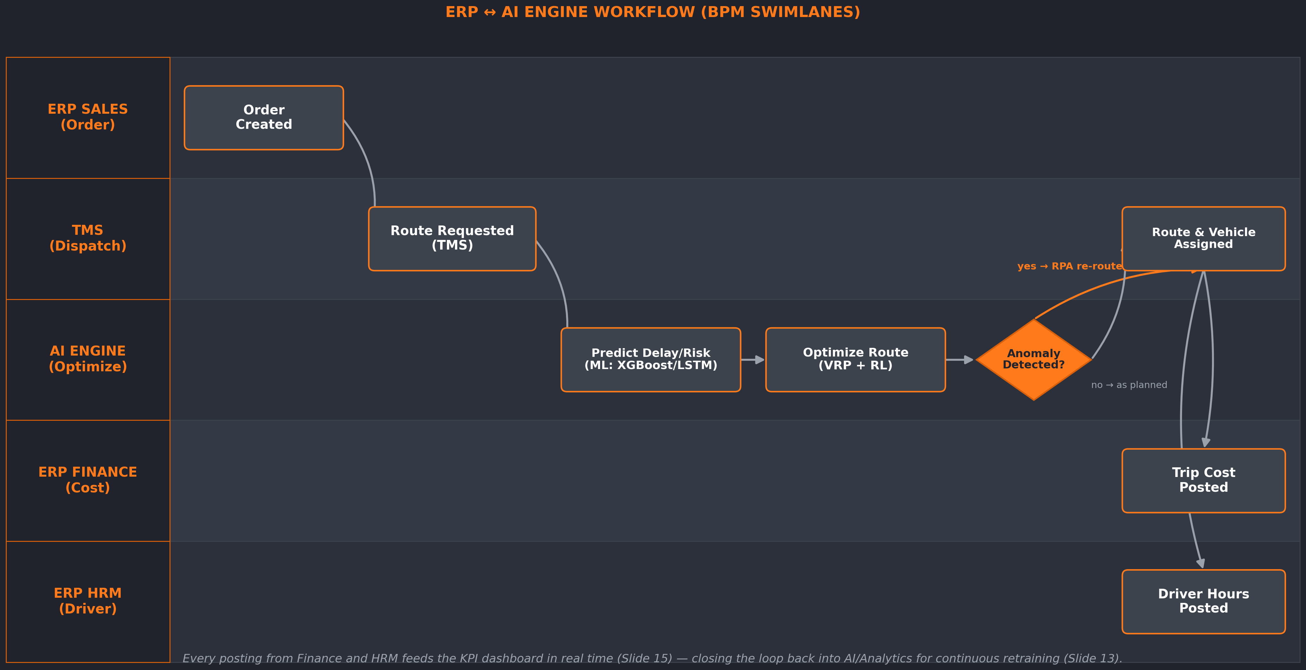

ERP INTEGRATION & ROLE (MANDATORY)
How the AI Engine Plugs Into ERP
AI-POWERED ROUTE OPTIMIZATION IN LOGISTICS
19 / 43

Slide 20





ERP INTEGRATION & ROLE (MANDATORY)
Modules Involved, Benefits Gained, Challenges Ahead
ERP MODULES INVOLVED
BENEFITS OF ERP + AI INTEGRATION
CHALLENGES IN IMPLEMENTATION / CUSTOMIZATION
• Order-to-Cash (Sales) — order creation, customer & delivery data
• Finance / Costing — trip cost posting and reconciliation
• HRM / Payroll — driver hours, overtime, shift data
• TMS — the execution / dispatch layer linking AI to ERP
• Single source of truth — no duplicate manual entry between AI engine and ERP
• Real-time cost and driver-hour postings from optimized routes
• Faster financial close — trip costs reconciled automatically
• KPI dashboard reflects the full order-to-cash and cost cycle live
• Legacy ERP data models rarely have native fields for AI-model outputs — needs custom APIs/middleware
• Master-data quality (vehicle/driver IDs, zones) must be clean before AI can trust it
• ERP customizations must be re-tested on every upgrade cycle
• Integration latency: batch-oriented ERP vs near-real-time AI recommendations
AI-POWERED ROUTE OPTIMIZATION IN LOGISTICS
20 / 43

Slide 21
FINANCIAL IMPACT
The Evidence — Range-Based, Not Invented
VALUE LOGIC
Lower Distance / Idling
↓
Lower Fuel + Fewer Delays
↓
Lower Cost per Delivery
↓
Improved ROI
Illustrative: 30 vehicles × 200 mi/day × $0.65/mi → ~$150K–$300K/yr impact (not an achieved result)
Low end of range: 5% / 10% / 20% respectively
AI-POWERED ROUTE OPTIMIZATION IN LOGISTICS
21 / 43

Slide 22






BUSINESS IMPACT & VALUE CREATION
Beyond Cost Savings — Strategic and Long-Term Value
OPERATIONAL EFFICIENCY
STRATEGIC ADVANTAGES
SCALABILITY & SUSTAINABILITY
• Simulation confirms faster on-time delivery and lower Zone-C delay (Slides 35–36)
• Lower idle time and distance directly reduce fuel burn
• Fewer reactive dispatcher interventions per shift
• Service-reliability differentiation in a 13.3%-CAGR market
• Trip-level data becomes a reusable asset for new routes and regions
• Builds the platform foundation for further automation (RPA, Slide 12)
• MLOps retraining loop (Slide 13) scales the model as the fleet grows
• Marginal cost of adding a vehicle/route is data-only, not re-engineering
• Fuel-efficiency gains support sustainability / ESG reporting
AI-POWERED ROUTE OPTIMIZATION IN LOGISTICS
22 / 43

Slide 23
RISK MANAGEMENT
Four Risk Categories, Named Mitigations
Technical
Operational
Regulatory
Security
Model accuracy limits
Driver/dispatcher resistance
GPS/location data privacy
Unauthorized data access
ISO/IEC 27001:2022 CONTROLS APPLIED
A.5.34
Privacy & Protection of PII
GPS traces & addresses are personal data
A.8.15
Logging
Access to location data must be tracked
AI-POWERED ROUTE OPTIMIZATION IN LOGISTICS
23 / 43

Slide 24






RISKS, ETHICAL ISSUES & LIMITATIONS
What the Model Can't Do, and Where Bias Can Creep In
BIAS IN AI MODELS
LIMITATIONS OF AI & ERP
REGULATORY & COMPLIANCE
• Historical trip data can encode existing dispatcher bias (favored drivers/routes) — the model would learn and repeat it
• Under-represented zones/conditions (rare weather, new routes) get less-reliable predictions
• Mitigation: monitor prediction error by zone/driver segment, not only in aggregate
• Accuracy degrades if traffic/demand patterns shift faster than the retraining cycle (Slide 13)
• Optimization is only as good as the ERP master data feeding it
• Illustrative financial ranges (Slide 21) are not guaranteed — real results depend on adoption
• GPS/location data is personal data — governed by ISO/IEC 27001:2022 control A.5.34 (Slide 23)
• Access to location/driver data logged per control A.8.15 (Slide 23)
• Adoption risk if AI recommendations aren't explainable to dispatchers/drivers (Slide 17)
AI-POWERED ROUTE OPTIMIZATION IN LOGISTICS
24 / 43

Slide 25
IMPLEMENTATION ROADMAP
Three Phases, Twelve Months
Phase 1
Phase 2
Phase 3
Pilot & Baseline
AI Integration
Full-Scale Rollout
0–3 Months
3–6 Months
6–12 Months
ACTIVITY
ACTIVITY
ACTIVITY
Deploy telematics on pilot fleet
Train models; integrate TMS/ERP
Deploy fleet-wide; live dashboards
DELIVERABLE
›
DELIVERABLE
›
DELIVERABLE
Baseline KPI report
Working prediction models
Company-wide dashboard
DECISION GATE
DECISION GATE
DECISION GATE
Data quality confirmed
Pilot accuracy meets target
KPI targets sustained
SUCCESS KPI
SUCCESS KPI
SUCCESS KPI
Data completeness > 95%
ETA error within target range
On-time rate improvement
AI-POWERED ROUTE OPTIMIZATION IN LOGISTICS
25 / 43

Slide 26
DATA FOUNDATION
One Trip-Level Dataset Powers Everything
One row per completed trip: GPS/telematics + order record + weather/traffic context.
Column
Type
Example
trip_id
ID
TRIP-04821
vehicle_id / driver_id
Categorical
VEH-118
pickup_time
Datetime
08:12
distance_km
Numerical
42.6
planned vs actual time
Numerical
26 / 43
fuel_used_l
Numerical
9.8
zone / weather / traffic
Categorical
Zone-C, Rain, High
delay_min (target)
Numerical
16
on_time_flag (target)
Binary
0
ILLUSTRATIVE SCHEMA — structure only, not real company data
AI-POWERED ROUTE OPTIMIZATION IN LOGISTICS
26 / 43

Slide 27
ANALYTICS APPROACH
From Dataset to Business Decision
Dataset
›
Data Prep
›
Analytics / AI
›
Insights
›
Decision
DESCRIPTIVE
DIAGNOSTIC
PREDICTIVE
PRESCRIPTIVE
AI TECHNIQUE
AI TECHNIQUE
AI TECHNIQUE
AI TECHNIQUE
Aggregation & trend analysis
Feature importance (Random Forest)
XGBoost, LSTM → delay & ETA risk
VRP + rule-based recommender
AI-POWERED ROUTE OPTIMIZATION IN LOGISTICS
27 / 43

Slide 28
KPI DEEP DIVE
Three of Six KPIs Management Will Watch (1/2)
On-Time Delivery Rate
Average Delay / Trip
Fuel Cost / Delivery
% of deliveries within promised window
Planned vs. actual arrival difference
Total fuel spend ÷ deliveries
TARGET
TARGET
TARGET
≥95% (illustrative)
<10 min (illustrative)
–10–15% vs baseline
AI ROLE
AI ROLE
AI ROLE
Predicts at-risk deliveries early
Regression forecasts delay
Optimization minimizes idling
AI-POWERED ROUTE OPTIMIZATION IN LOGISTICS
28 / 43

Slide 29
KPI DEEP DIVE
Three of Six KPIs Management Will Watch (2/2)
Route Deviation Rate
Maintenance Alert Precision
Vehicle Utilization Rate
% of trips deviating from optimal route
% of flagged vehicles that needed service
% of available vehicle-hours used
TARGET
TARGET
TARGET
<5% (illustrative)
>85% precision (illustrative)
75–85% (illustrative)
AI ROLE
AI ROLE
AI ROLE
Anomaly detection flags deviations
Classification on telemetry signals
Demand forecasting improves scheduling
AI-POWERED ROUTE OPTIMIZATION IN LOGISTICS
29 / 43

Slide 30
DECISION-MAKING GRAPHS (1/3)
On-Time Rate Dipped — Here's Why It Matters
WHAT
On-time rate dipped in Month 4
WHY IT MATTERS
Coincides with a seasonal weather pattern
DECISION
Plan seasonal routing/staffing buffers
AI-POWERED ROUTE OPTIMIZATION IN LOGISTICS
30 / 43

Slide 31
DECISION-MAKING GRAPHS (2/3)
Zone C Runs Twice the Average Delay
WHAT
Zone C runs ~2x the average delay
WHY IT MATTERS
Concentrated cost & SLA risk in one zone
DECISION
Prioritize Zone C for re-optimization pilot
AI-POWERED ROUTE OPTIMIZATION IN LOGISTICS
31 / 43

Slide 32
DECISION-MAKING GRAPHS (3/3)
Outlier Trips Point to Inefficient Routing
WHAT
Strong positive correlation, with outliers
WHY IT MATTERS
Outliers signal inefficient routing
DECISION
Flag outlier trips for a route audit
AI-POWERED ROUTE OPTIMIZATION IN LOGISTICS
32 / 43

Slide 33


ANALYTICAL TECHNIQUES
From Patterns in Data to Management Action
CLUSTERING (K-MEANS)
ANOMALY DETECTION
PREDICTIVE MODELS (XGBOOST / LSTM)
• Groups delivery zones by delay risk
• Decision: prioritize Zone C for schedule buffer (Slide 31)
• Flags outlier trips automatically (Slide 32)
• Decision: investigate routing/driver behavior instead of dismissing outliers as chance
• Forecasts delay/ETA before a trip starts
• Decision: proactive re-routing and customer notification, not after-the-fact correction
Data mining doesn't just describe the past — clustering and anomaly detection actively steer where management should look next.
AI-POWERED ROUTE OPTIMIZATION IN LOGISTICS
33 / 43

Slide 34
SIMULATION & VALIDATION
A Discrete-Event Simulation of This Case
30
20
252,000
100%
Vehicles simulated
(Slide 15 fleet size)
Independent replications
for statistical stability
Simulated trip records
(Slide 18 schema)
Parameters traced to this
deck — nothing external
A SimPy discrete-event model runs each scenario for a 30-day operating month: As-Is (manual dispatch, fixed routes, reactive response — Slide 5) vs To-Be (AI route-optimization engine, real-time re-routing, proactive adaptation — Slide 5). Every trip generates the exact record schema from Slide 18 (zone, weather, traffic, distance, delay, fuel, cost). No external data or assumptions are introduced — every input traces to a specific slide in this deck.
AI-POWERED ROUTE OPTIMIZATION IN LOGISTICS
34 / 43

Slide 35
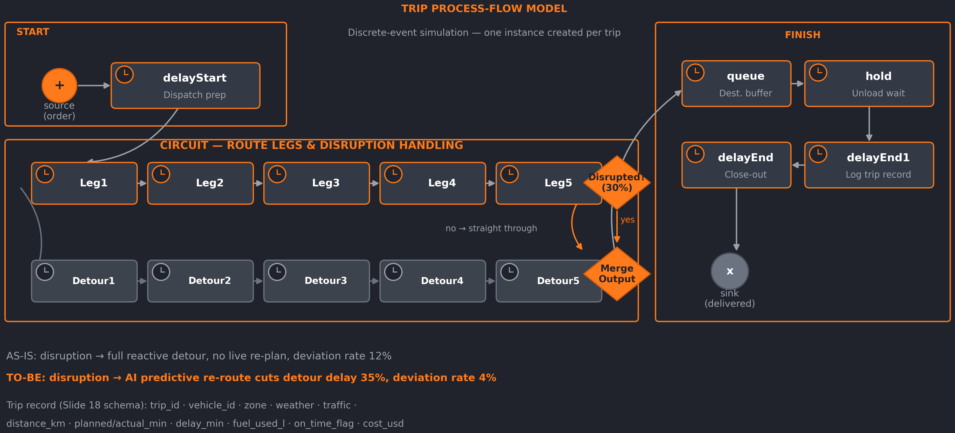
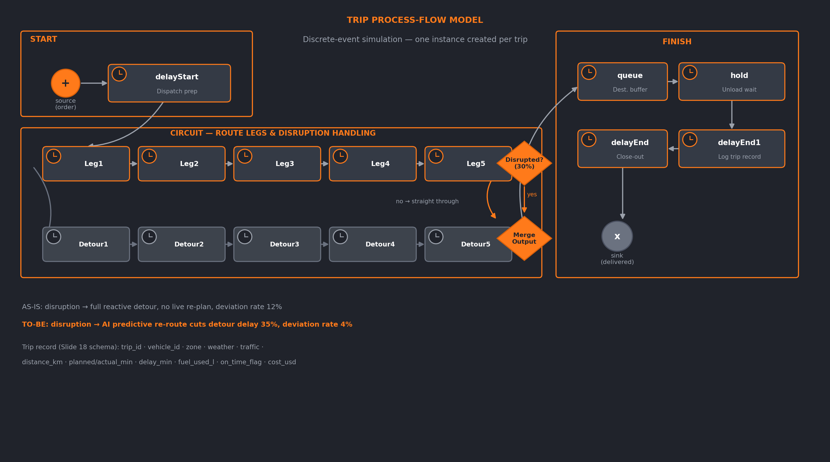
SIMULATION MODEL
How Each Trip Is Simulated
AI-POWERED ROUTE OPTIMIZATION IN LOGISTICS
35 / 43

Slide 36
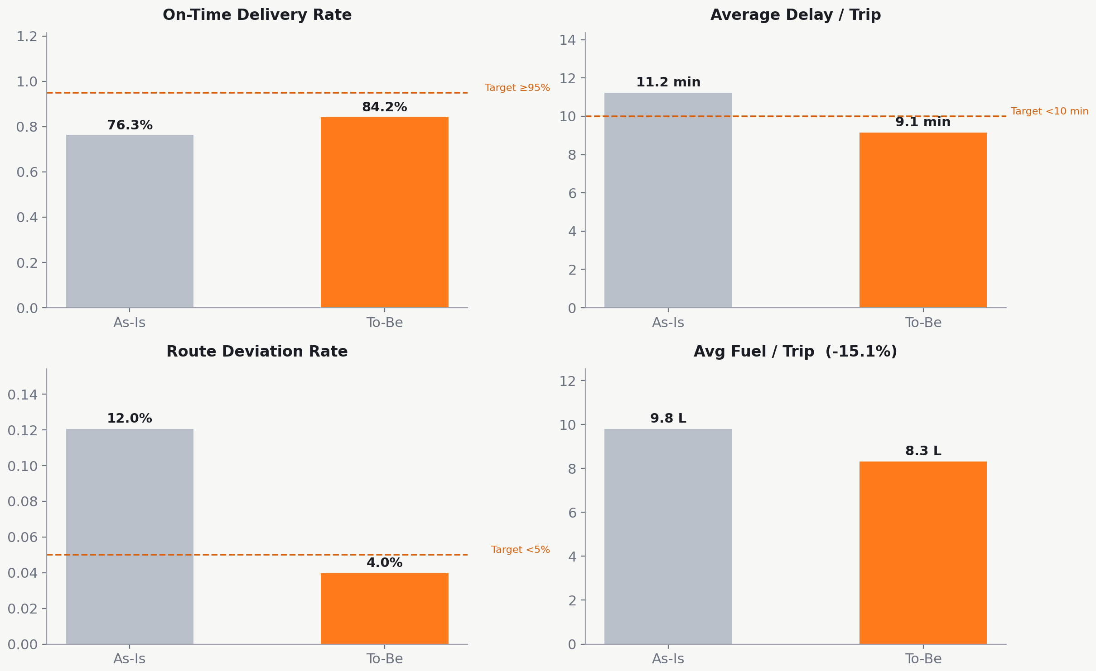
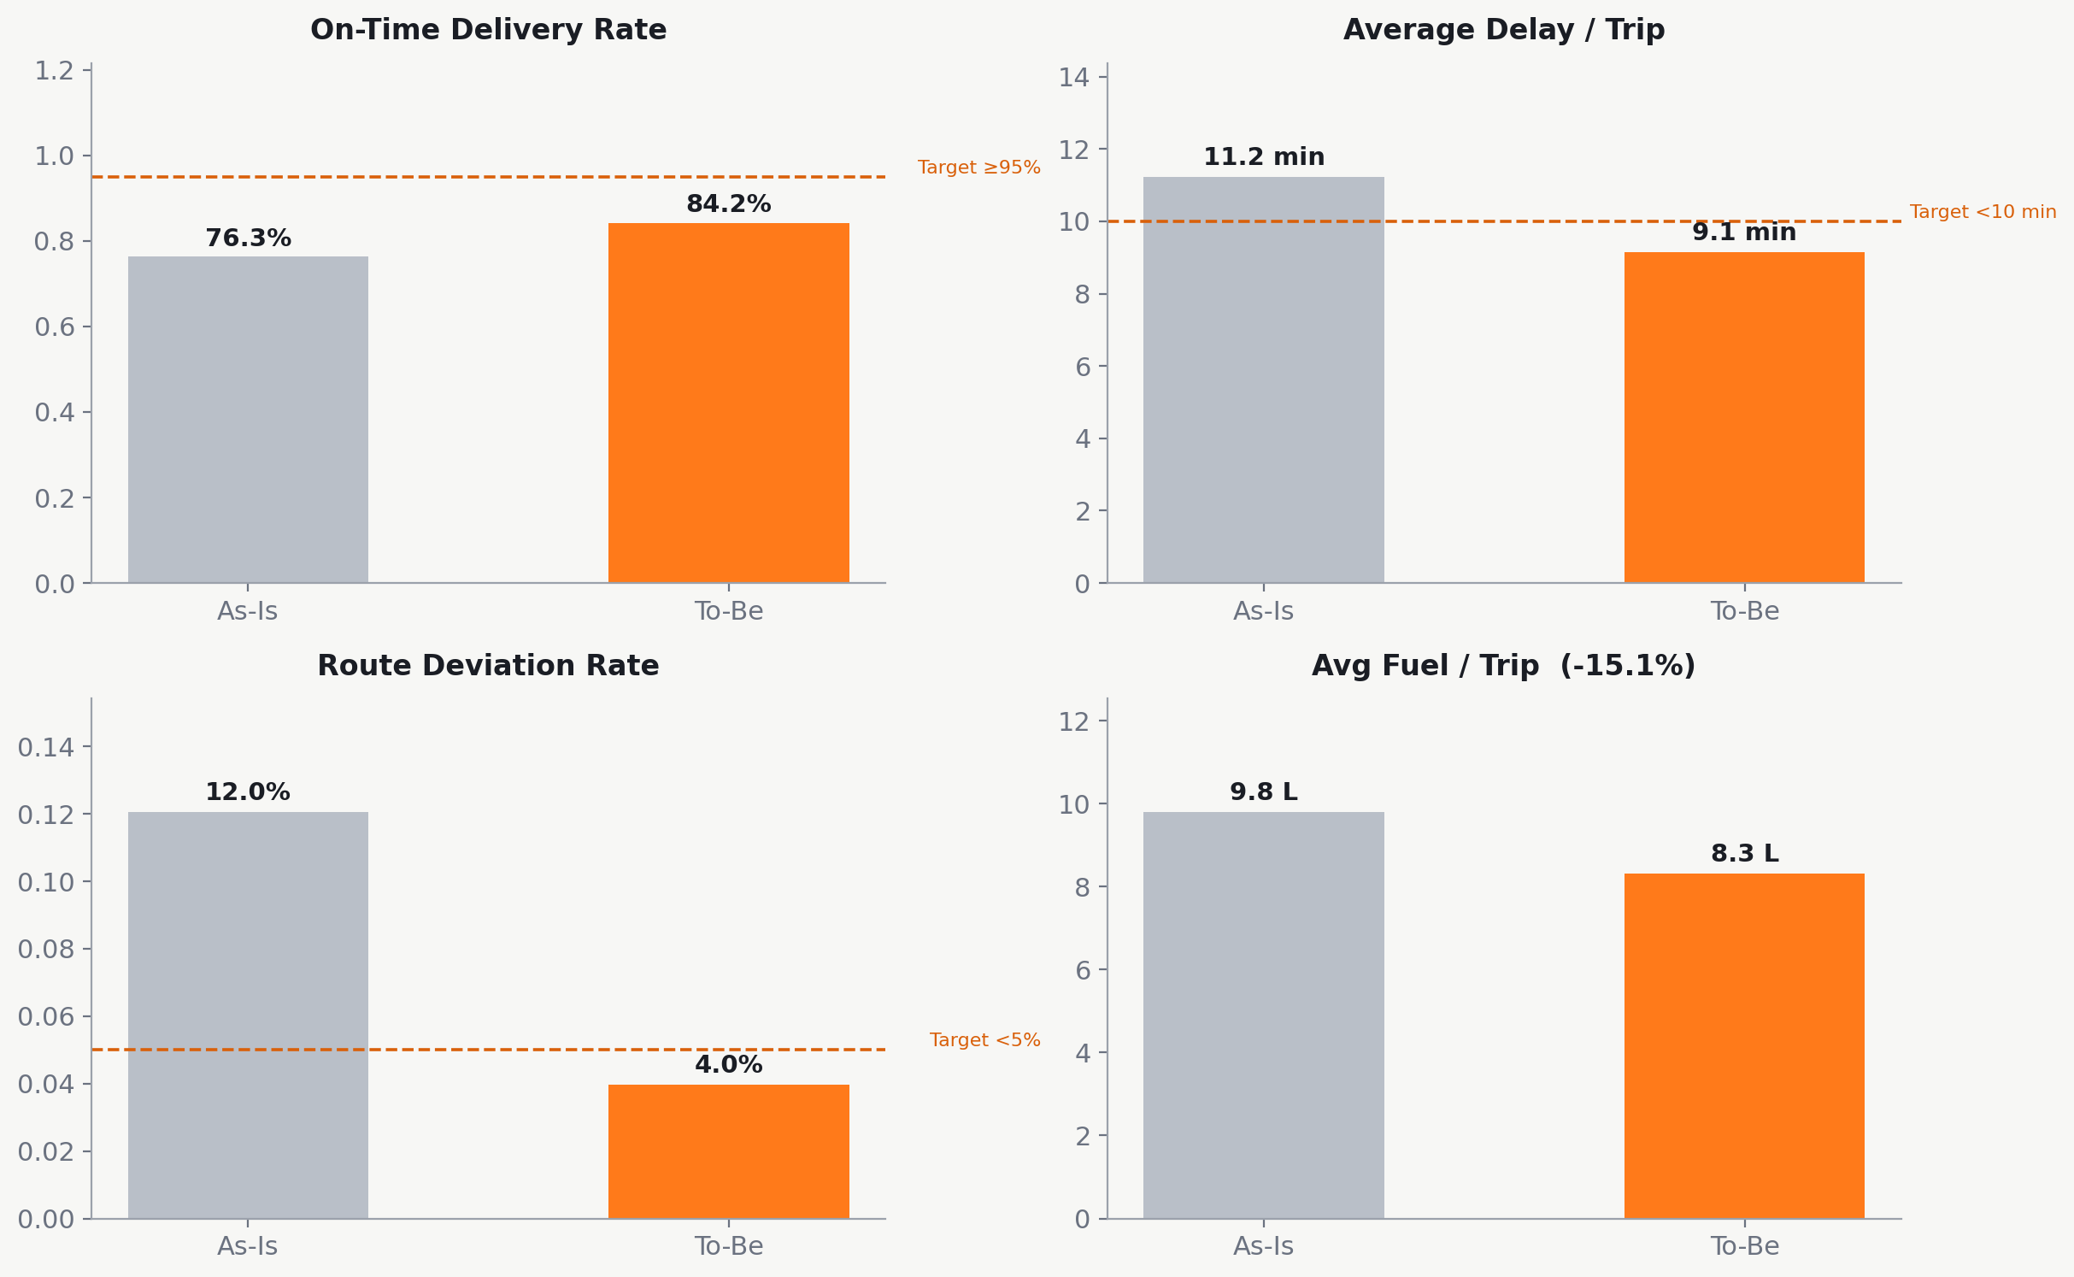
SIMULATED RESULTS
As-Is vs To-Be — KPI Comparison
AI-POWERED ROUTE OPTIMIZATION IN LOGISTICS
36 / 43

Slide 37
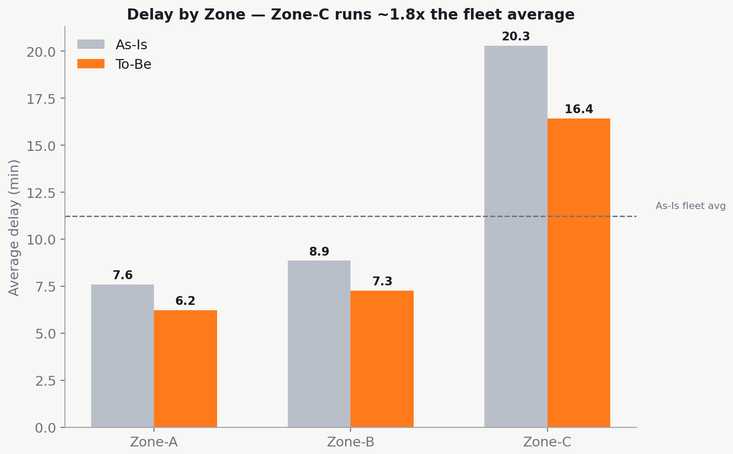
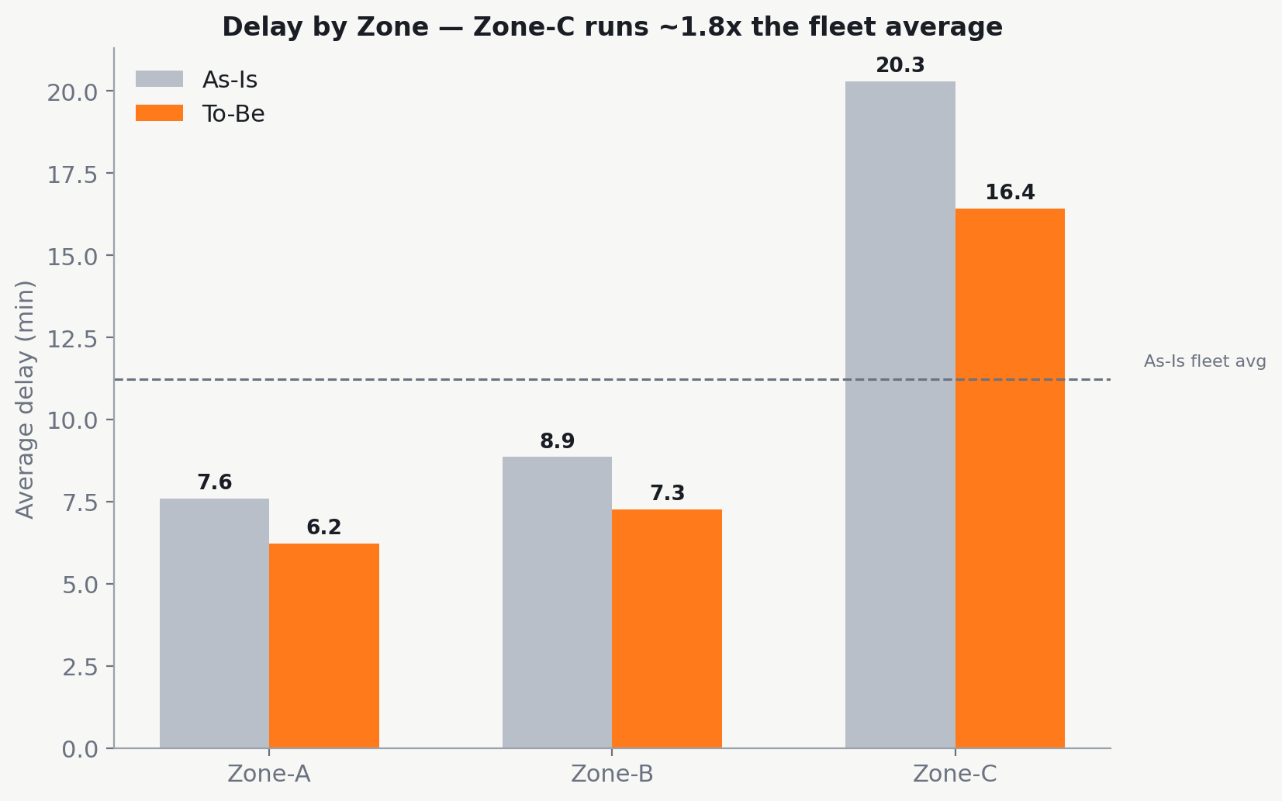
SIMULATED RESULTS
Zone-C Delay — Simulation Confirms Slide 23
WHAT
Zone-C averages ~1.8x the fleet-wide delay across 20 simulated replications
WHY IT MATTERS
Independently reproduces the deck's own claim (Slide 23: “~2x the average delay”)
DECISION
Confirms Zone-C as the priority target for the re-optimization pilot
AI-POWERED ROUTE OPTIMIZATION IN LOGISTICS
37 / 43

Slide 38
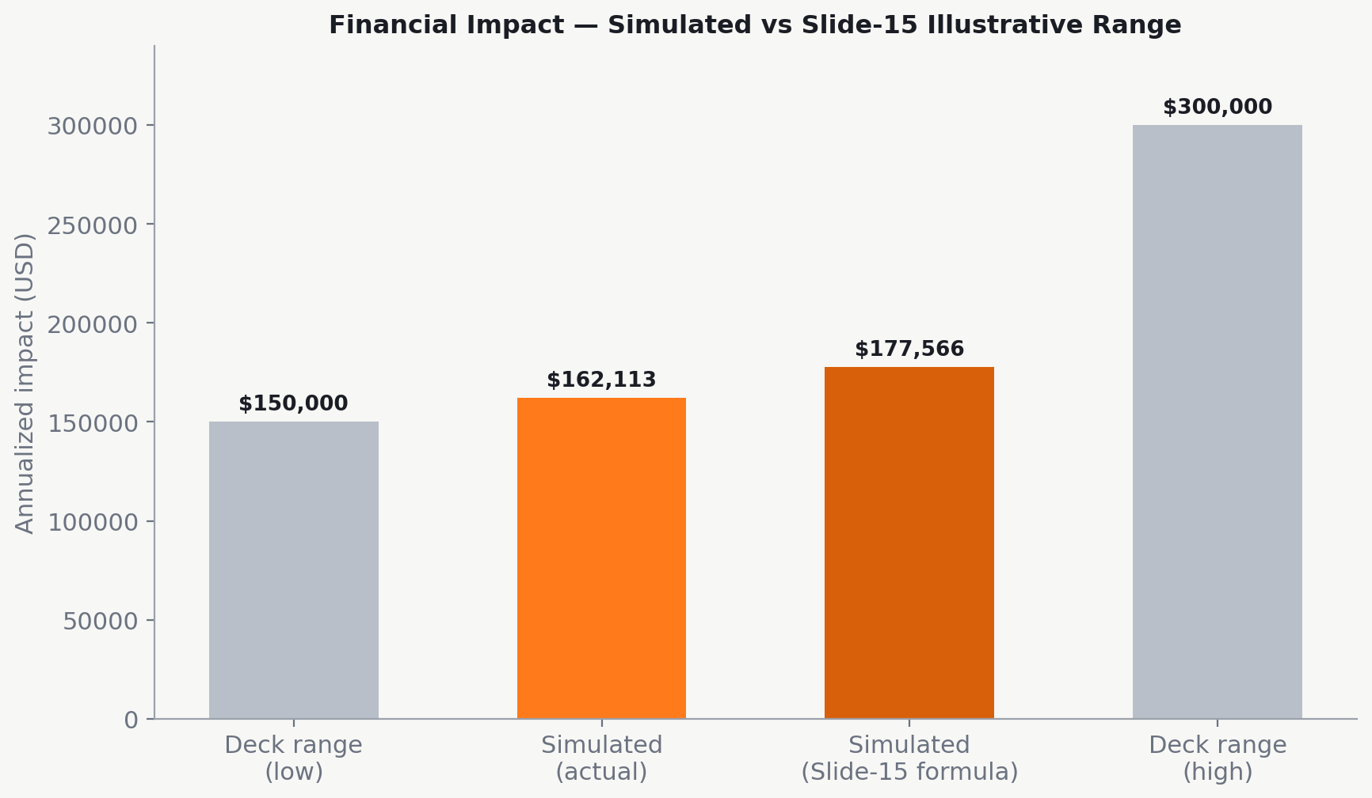
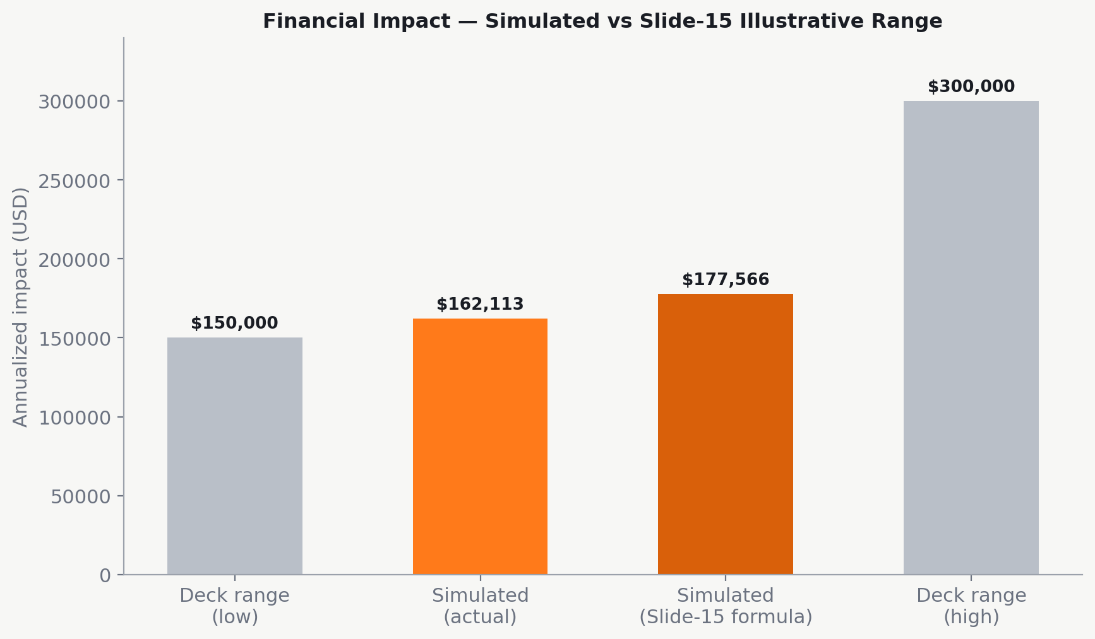
SIMULATED RESULTS
Financial Impact — Simulation vs Slide 15
SIMULATED SAVING
$162K actual / $177.6K via the Slide-15 formula, applied to the simulation's own distance-reduction result
VS. DECK RANGE
Falls inside the Slide-15 illustrative range of $150K–$300K/yr
OTHER TARGETS MET
Fuel −15.1% (target −10 to −15%) · Route deviation 4.0% (target <5%) · Avg delay 9.1 min (target <10 min)
AI-POWERED ROUTE OPTIMIZATION IN LOGISTICS
38 / 43

Slide 39
SIMULATION & VALIDATION
Every Deck Target, Checked Against the Model
1
On-time delivery rate rises 76.3% → 84.2% under AI-optimized routing (target ≥95%, Slide 20)
2
Average delay/trip falls 11.2 → 9.1 minutes — meets the <10 min target (Slide 20)
3
Fuel use per trip falls 15.1% — inside the −10% to −15% target range (Slide 20)
4
Route deviation rate falls 12.0% → 4.0% — meets the <5% target (Slide 21)
5
Annualized saving of $162K–$178K falls inside the $150K–$300K illustrative range (Slide 15)
6
Zone-C delay runs ~1.8x the fleet average — independently reproduces Slide 23's claim
AI-POWERED ROUTE OPTIMIZATION IN LOGISTICS
39 / 43

Slide 40
AI-POWERED DECISION SUPPORT
Closing the Loop
Data
›
Analytics
›
AI
Prediction
›
Recommend-
ation
›
Decision
›
Action
›
KPI
Monitoring
This loop never stops: every action feeds back into KPI monitoring, which triggers the next cycle of analytics.
AI-POWERED ROUTE OPTIMIZATION IN LOGISTICS
40 / 43

Slide 41
AI-POWERED DECISION SUPPORT
Five AI Outputs, Five Business Decisions
Risk Prediction
Demand Forecast
Segmentation
Delay-risk score per trip
Expected volume by zone/day
Zones/drivers by risk pattern
Anomaly Detection
Recommendation
Unusual fuel use or deviation
Best re-route or reassignment
AI-POWERED ROUTE OPTIMIZATION IN LOGISTICS
41 / 43

Slide 42
CONCLUSION
A Scale Problem, Solved by AI
1
Manual planning is a scale problem, not a skill problem
2
External evidence: 5–20% logistics cost reduction, 10–15% fuel savings
3
The tech stack (VRP + ML + RPA) is mature, already deployed at scale
4
TMS/ERP integration is a natural fit — not forced in
5
A phased 12-month roadmap manages risk while capturing value early
Every figure here is an independently cited industry benchmark — nothing is fabricated.
AI-POWERED ROUTE OPTIMIZATION IN LOGISTICS
42 / 43

Slide 43
RECOMMENDATIONS & FUTURE SCOPE
Where This Goes Next
1
Strategic recommendation: run a phased pilot (5–8 vehicles) before fleet-wide rollout, validating simulated gains against live data (Slides 34–39)
2
Advanced analytics upgrade: move from batch retraining to continuous/online learning as more trip data accumulates
3
Future digital transformation: extend AI recommendations into customer-facing tracking and predictive maintenance scheduling
4
Expand ERP–AI capabilities: deepen integration with ERP Procurement (parts/fuel) and Sustainability/ESG reporting as the next module frontier
AI-POWERED ROUTE OPTIMIZATION IN LOGISTICS
43 / 43

