Slide 1
Vocoder
By Youssef Beltagy for EE235
Discord: Chicken Lord
I’m in the class server. Feel free to DM for questions!

Slide 2
Outline
- Design
- Visual results of “The fire is very hot.” for 4 bands
- Demo with “The fire is very hot.” with 1, 4, 10, 30, 100, and 400 bands.
- Limitations
- Experiment
- Next Steps

Slide 3
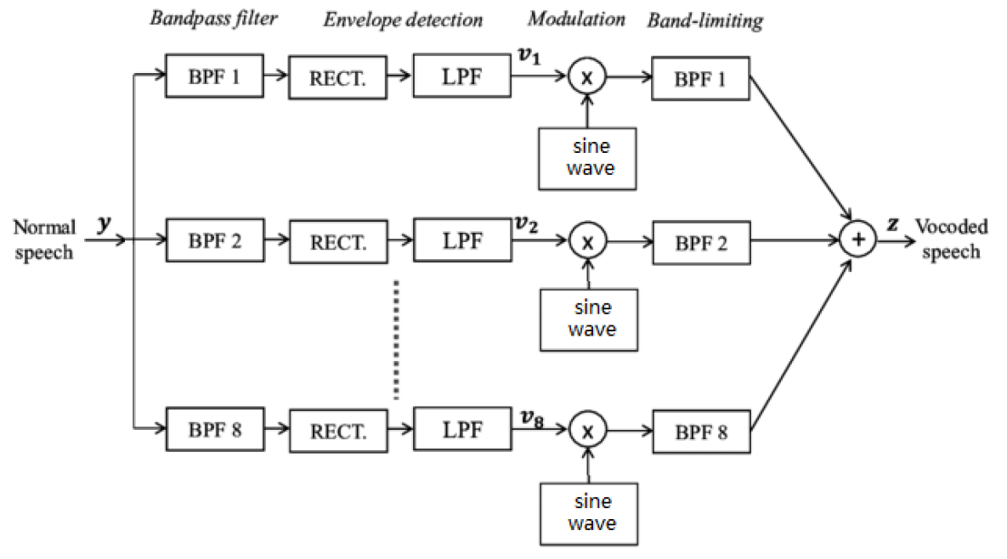
Design
- Split frequency into bands.
- Convert every band into a single sine wave.
- Add the sine waves.

Slide 4

“The fire is very hot” with 4 bands

Slide 5
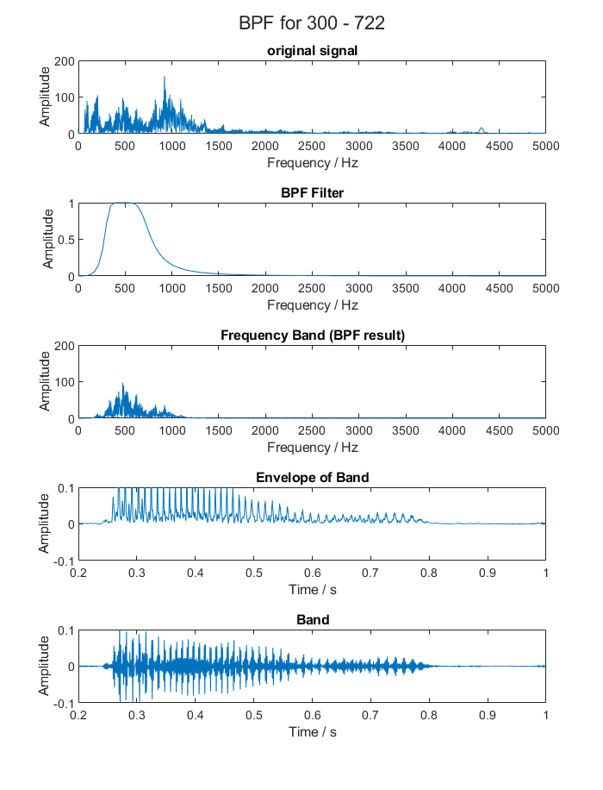
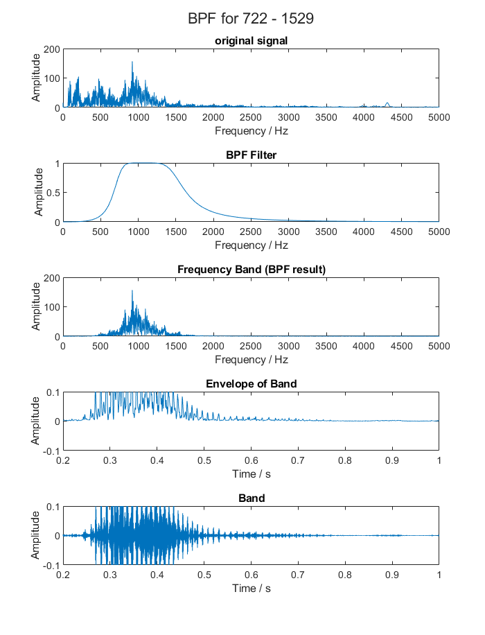
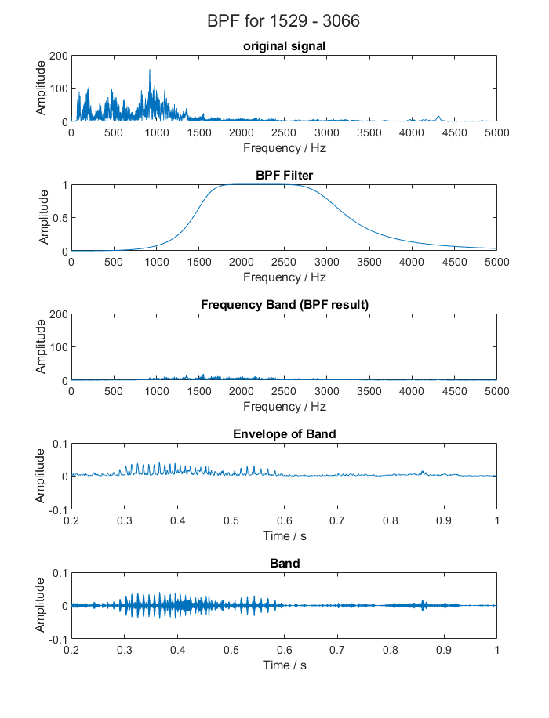
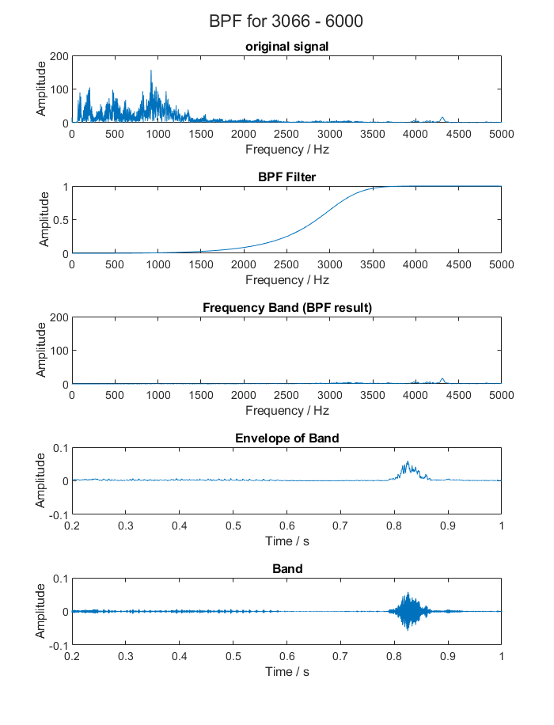

Slide 6
Demo!
1 Bands
Original
4 Bands
10 Bands
30 Bands
100 Bands
500 Bands

Slide 7
Observations
- When the number of bands is small, the signal is hard to understand.
- When the number of bands is large, the code is slow.
- When the number of bands is very large, aliens start speaking.
- For speech, the lower numbered bands are more relevant. Could the audio be more understandable if we narrow the window of frequencies to 300-2000 instead of 300-6000?
- What is the minimum number of bands humans need to understand if the range is 300-6000? This will maximize the code’s efficiency.

Slide 8
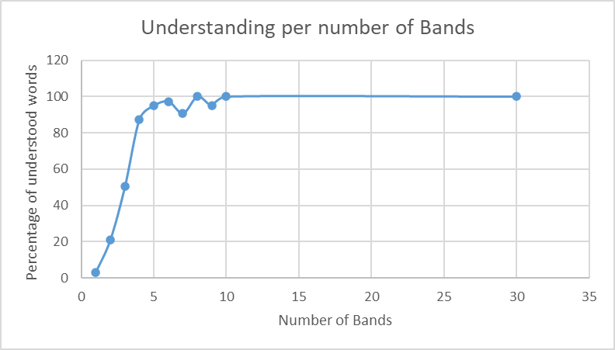
Experiment
- Asked two listeners to tell me the words they understood in a sentence.
- Calculated the percentage of understanding of each listener
- For each number of bands, plotted the average percentage of the two listeners
- 4 / 5 seems like the minimum but listeners preferred 8 / 9
- I added more sentences to the professor’s 15 to increase the accuracy of the data.

Slide 9
Thank you!
- If we have time, we can try to limit the range to 300-2000 with a low number of bands like 2.
- My next steps are
- Analyzing the spectrogram
- Using white noise instead of a sine wave
- Chimerization.

