Slide 1
Notebook
Salary prediction
Supervised by :
Dr. Doaa Mahmoud & Eng. Haneen Eldaly
Notes:
Start

Slide 2




Contact info
Youssef Ahmed

Slide 3
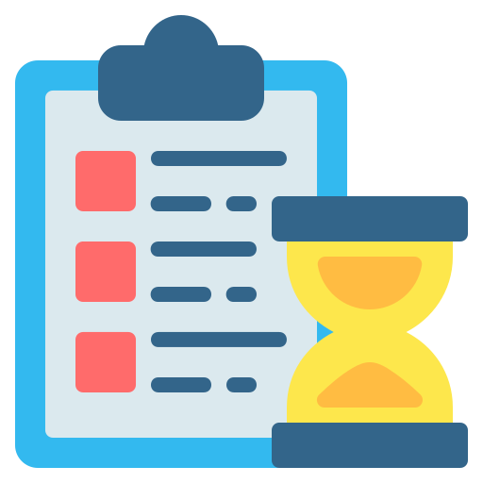
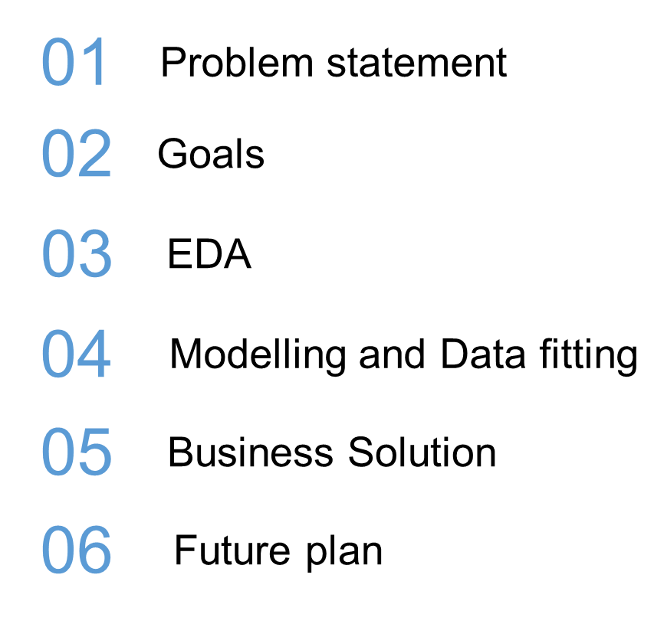
Agenda

Slide 4
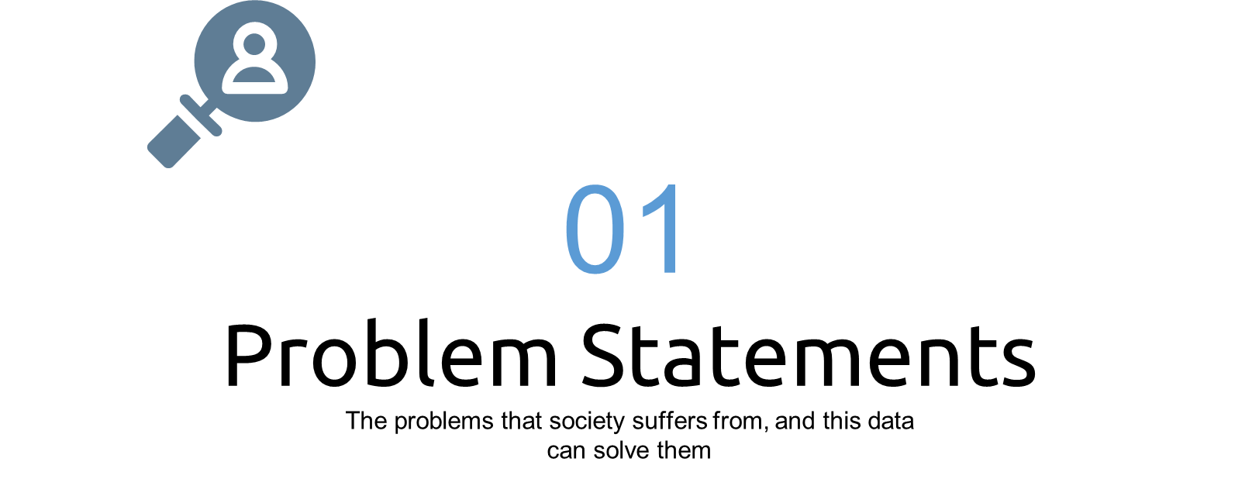

Slide 5
Salary problem
Joining new company ?
Searching for a better opportunity?
Want to if you are paid equally with your experience or less ?

Slide 6
Underpaid feelings

Slide 7


Slide 8
The goal to be achieved from the project
Help people ask for the right salary in the interview for avoiding regret in the future
Help employees know if they are appreciated and have the right salary or underpaid

Slide 9


Slide 10
About data
This data was scraped off levels.fyi
The dataset contains salary and employee data that links compensation to education, experience, race, and location. It contains 62,000 records and many of them are in the United States.

Slide 11
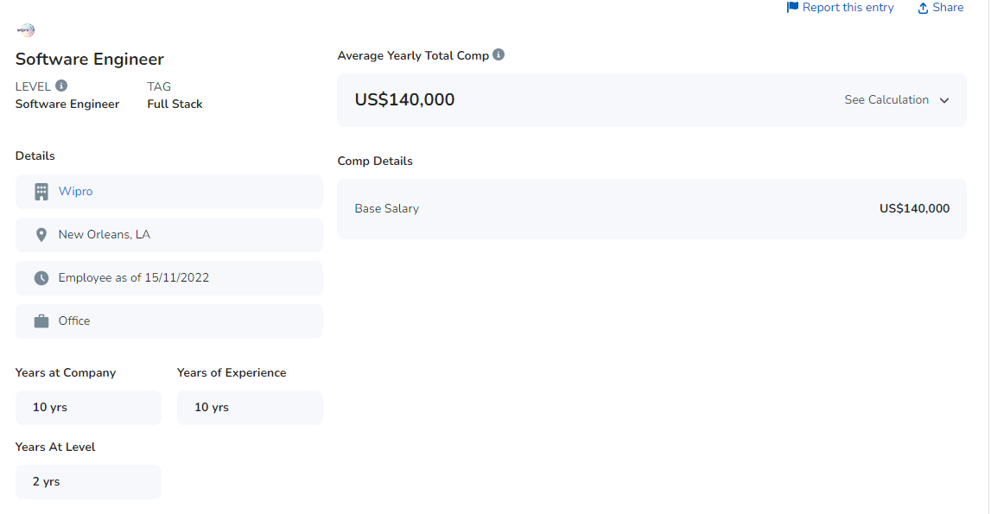
Have a look at website

Slide 12
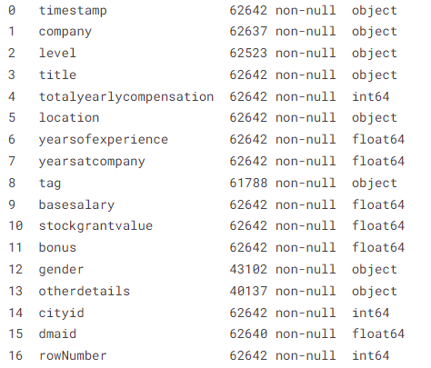
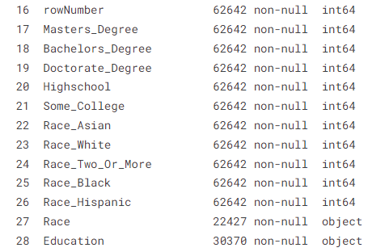
Data columns

Slide 13
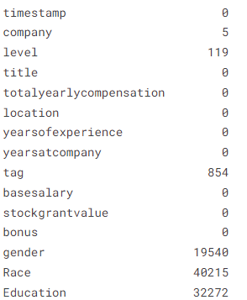

Data Preprocessing
#N of missing values
#N of duplicates

Slide 14
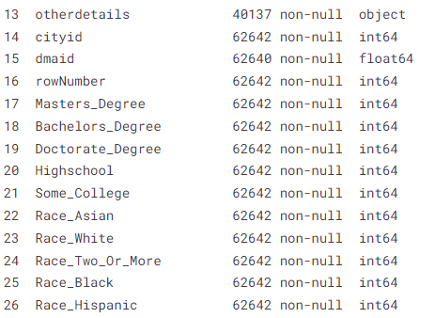






Data cleaning
Dropped columns
Dropped NA in [gender, level, tag]
Removed inconsistent values in gender column
Filled NA values with random between male and female

Slide 15
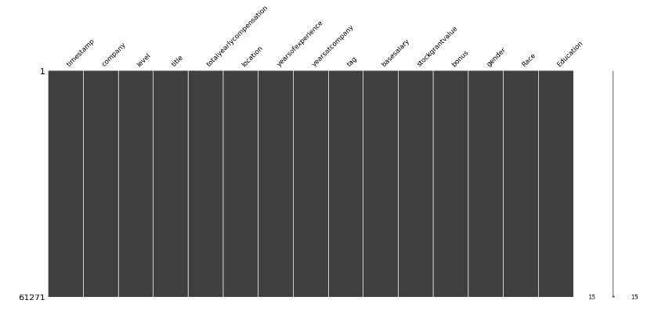
Data cleaning
Our data after handling NA

Slide 16
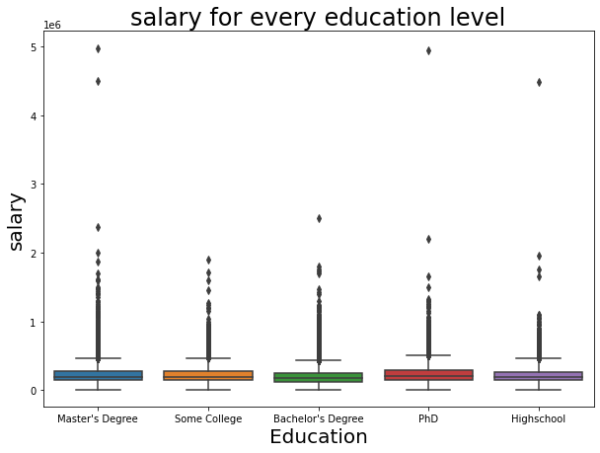
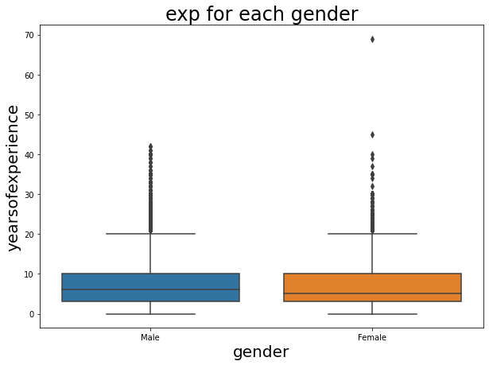
Data cleaning
Outlier detection

Slide 17
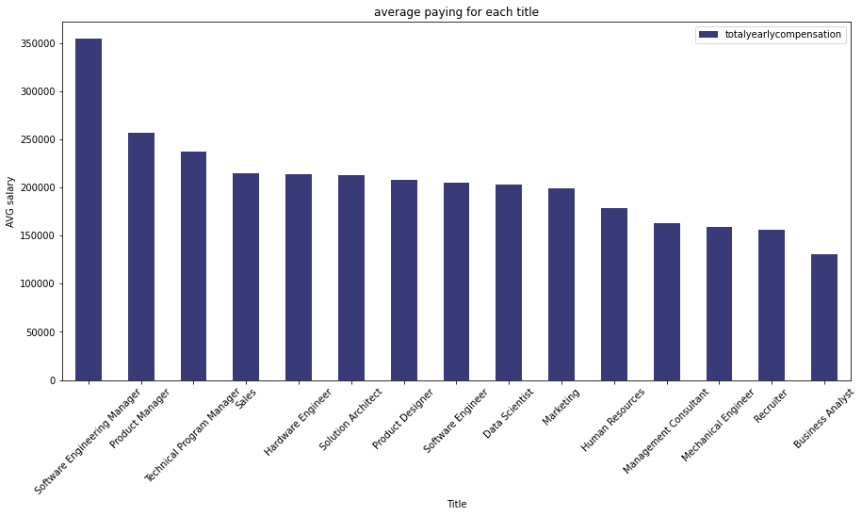
Highest paid jobs

Slide 18
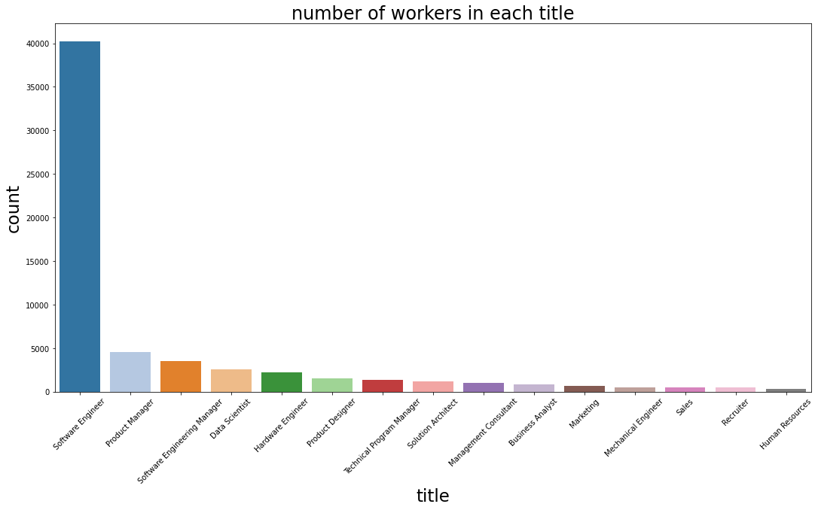
Number of workers in each title

Slide 19
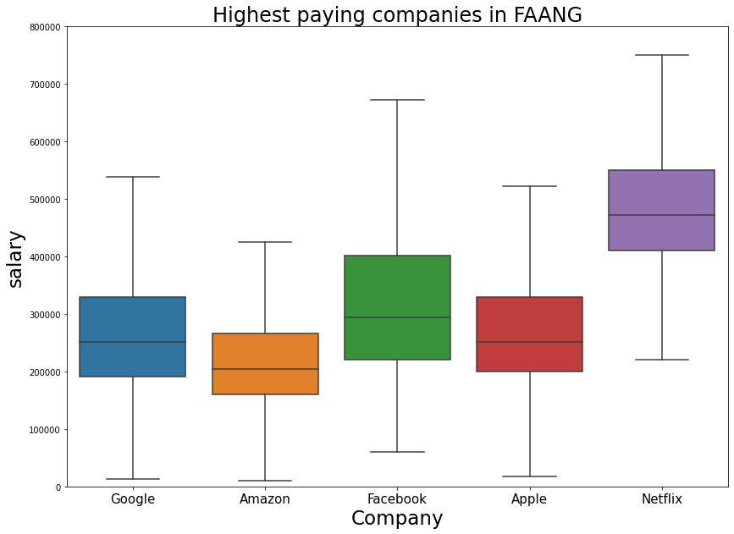
Highest paying companies in FAANG

Slide 20
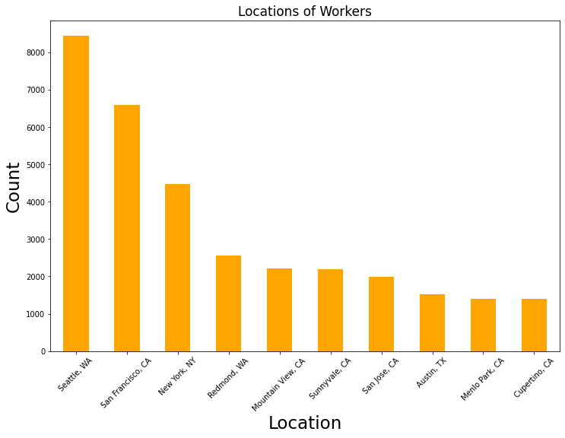
Top 10 locations have jobs

Slide 21
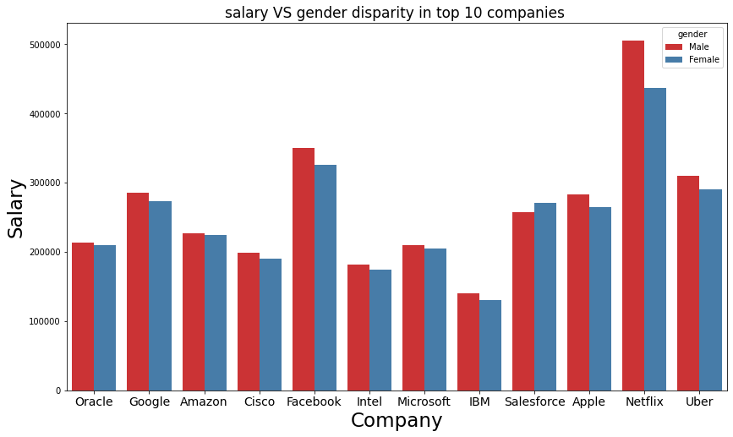
Disparity in salaries depending on gender

Slide 22
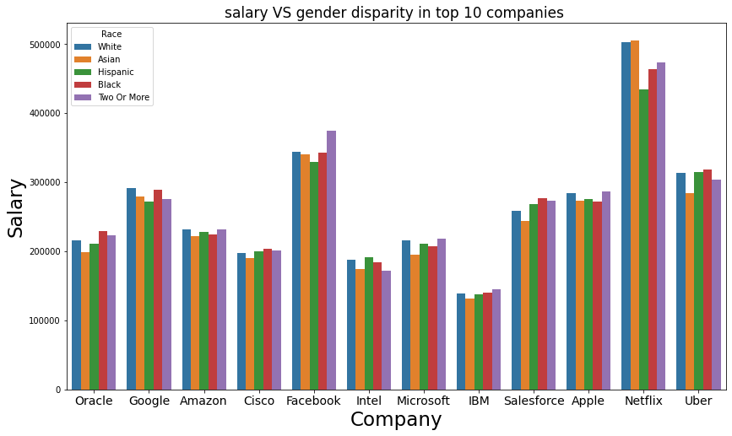
Disparity in salaries depending on Race

Slide 23
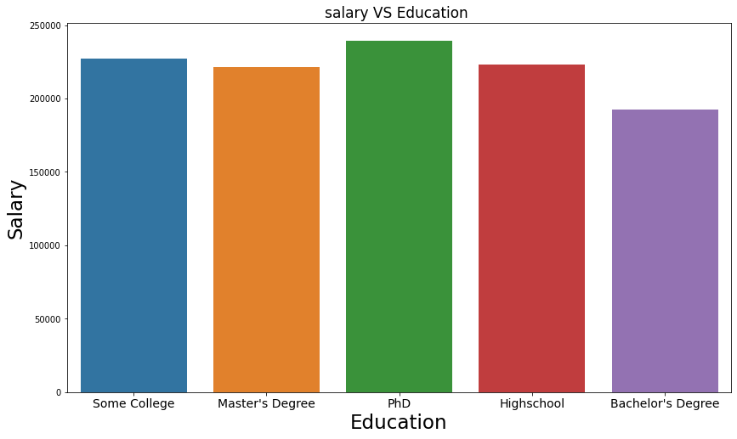
Salary and education relationship

Slide 24
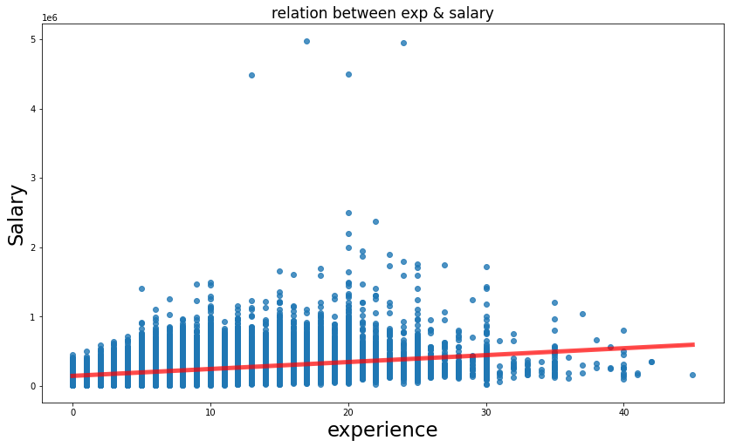
Relation between experience and salary

Slide 25
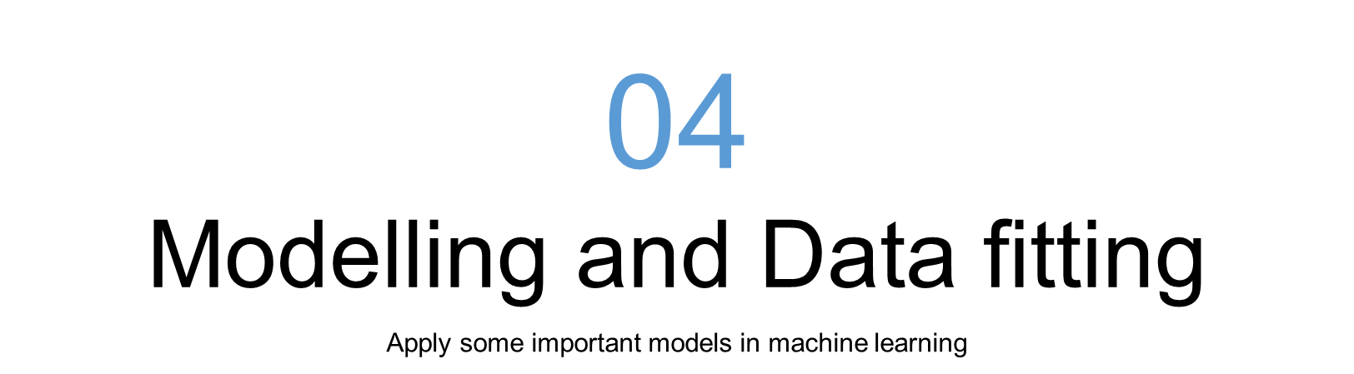

Slide 26


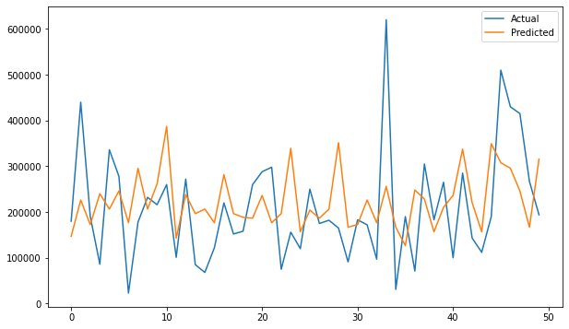
Linear regression
Train acc →
Test acc →

Slide 27
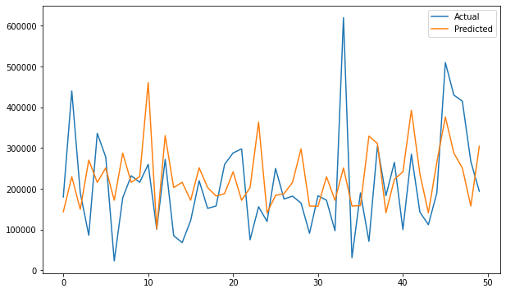
Gradient boosting regression
Train acc →
Test acc →

Slide 28
XGBOOST
Train acc →
Test acc →

Slide 29

Random forest
Train acc →
Test acc →

Slide 30
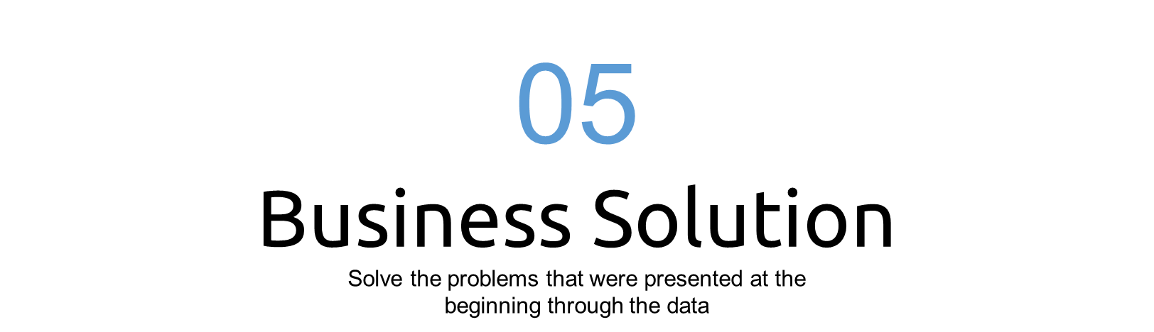

Slide 31

Help employees
Using this website, we can easily predict the salary if we are going to apply for a new one
Help current employees know their worth

Slide 32
Any question
We hope everyone enjoys and takes advantage of the presentation
Thank You

