Slide 1
KIVA
Microloan Intelligence
Exploratory Analysis & Data Preparation | Phase 1 Report
Business Intelligence Project | Data Science Track | May 2026

Slide 2
Agenda
Six-phase project plan
01
Understand the Dataset
04
Power BI Dashboard
PHASE 2
Define project objectives, scope, and key business questions.
Build interactive visuals from the cleaned dataset in Power BI.
02
Exploratory Data Analysis
05
Machine Learning Model
PHASE 2
Apply summary statistics and visualization methods to surface insights.
Develop and evaluate a regression model to predict funded amount.
03
Data Cleaning & Transformation
06
Time Series Forecasting
PHASE 2
Handle missing values, duplicates, outliers, encoding, and scaling.
Analyze funded_amount vs. date to forecast future lending trends.
▌ Phase 1 — This Report
▌ Phase 2 — Upcoming

Slide 3
Introduction — Who Is Kiva?
What is Kiva?
By the Numbers
Kiva is a non-profit crowdfunding platform founded in 2005 that connects individual lenders worldwide with underserved borrowers in developing economies through small-dollar microloans.
33,561
Loan Records
79
Countries Served
Why Does It Matter?
Kiva has facilitated over $1.8 billion in loans across 80+ countries, empowering entrepreneurs to grow businesses and break cycles of poverty across agriculture, retail, education, and more.
15
Loan Sectors
$26.5M
Total Funded
Project Motivation
$790
Average Loan
Understanding which loans get funded, by how many lenders, and across which sectors optimizes Kiva's outreach, improves lender engagement, and enables forecasting of future capital deployment.
72.5%
Female Borrowers

Slide 4
Project Objectives & Dataset
Three core business questions driving this analysis
Q1
Q2
Q3
Which sectors receive the highest funding, and how does this evolve over time?
Is there a measurable relationship between lender count and funded loan amount?
Can we build a reliable model to predict future funded amounts from historical data?
Dataset Schema
Column | Type | Description
id | Integer | Unique loan identifier
funded_amount | Integer | Amount funded by lenders (USD)
loan_amount | Integer | Total loan requested (USD)
sector | String | Business sector (15 categories)
country | String | Borrower's country (79 countries)
partner_id | Float | Kiva field partner ID
term_in_months | Integer | Loan repayment duration
lender_count | Integer | Number of individual lenders
borrower_genders | String | Gender(s) of borrower group
repayment_interval | String | Monthly / Irregular / Bullet
date | Date | Loan posting date (2014–2017)
33,561
15
Total Records
Sectors
2014–2017
$26.5M
Date Range
Total Funded
79
829
Countries
Missing Values (raw)

Slide 5
STEP 1 — EDA
Step 1 — Summary Statistics
Exploratory Data Analysis · Key numeric and categorical findings
Numeric Feature Summary
Missing Value Profile
Feature | Mean | Median | Std Dev | Max
Funded Amount | $790 | $450 | $1,177 | $50,000
Loan Amount | $843 | $500 | $1,222 | $50,000
Term (months) | 13.7 | 13 | 8.6 | 145
Lender Count | 20.6 | 13 | 28.5 | 1,481
partner_id
634 missing
borrower_genders
195 missing
Key Observations
Mean funded amount ($790) is 75% higher than the median ($450) — confirming strong right skew driven by large outliers.
All other columns: 0 missing
→ Only 2.5% of records affected overall
Loan terms average 13.7 months — most Kiva loans are short-to-medium-term microfinance instruments.
Lender count median of 13 vs. max 1,481 — most loans attract few lenders; viral campaigns attract thousands.
Only 2 columns have missing values: partner_id (634) and borrower_genders (195) — clean and addressable.

Slide 6
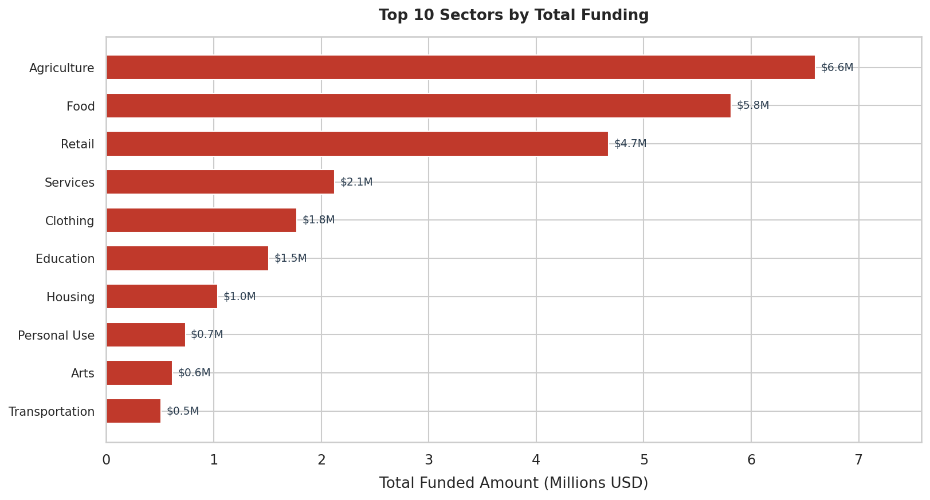
STEP 2 — VIZ
Step 2 — Top 10 Sectors by Total Funding
Visualization · Answers Business Question 1: Which sectors lead?
Agriculture leads
At $6.6M, Agriculture receives nearly double the funding of the next sector, reflecting Kiva's rural development focus.
Top 3 = 64% of all funds
Agriculture, Food & Retail together account for nearly two-thirds of all disbursed capital.
Long tail of sectors
Arts, Transport & Entertainment each receive under $0.6M — niche but underserved opportunity areas.
Key Takeaway
Agriculture + Food = the backbone of Kiva's microfinance mission.

Slide 7
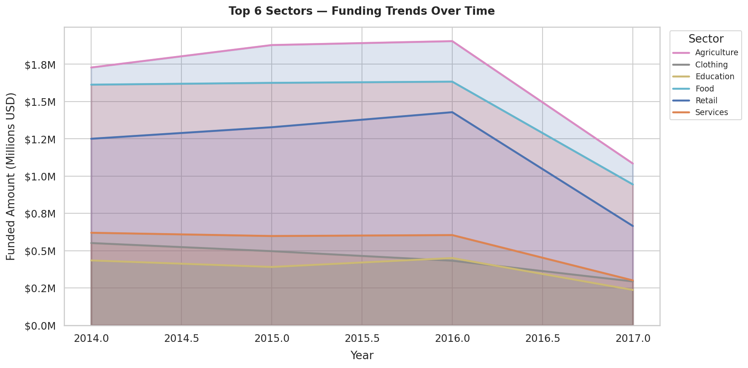
STEP 2 — VIZ
Step 2 — Sector Funding Trends Over Time
Visualization · How did sector funding evolve year by year?
All sectors peaked in 2016
Agriculture held dominance
2017 drop is a data artifact
A clear growth trajectory from 2014 to a 2016 peak, followed by a notable decline entering 2017.
Agriculture maintained the highest funding consistently across the entire 2014–2017 window.
The sharp decline after mid-2016 is partially explained by the dataset ending in July 2017 (incomplete year).

Slide 8
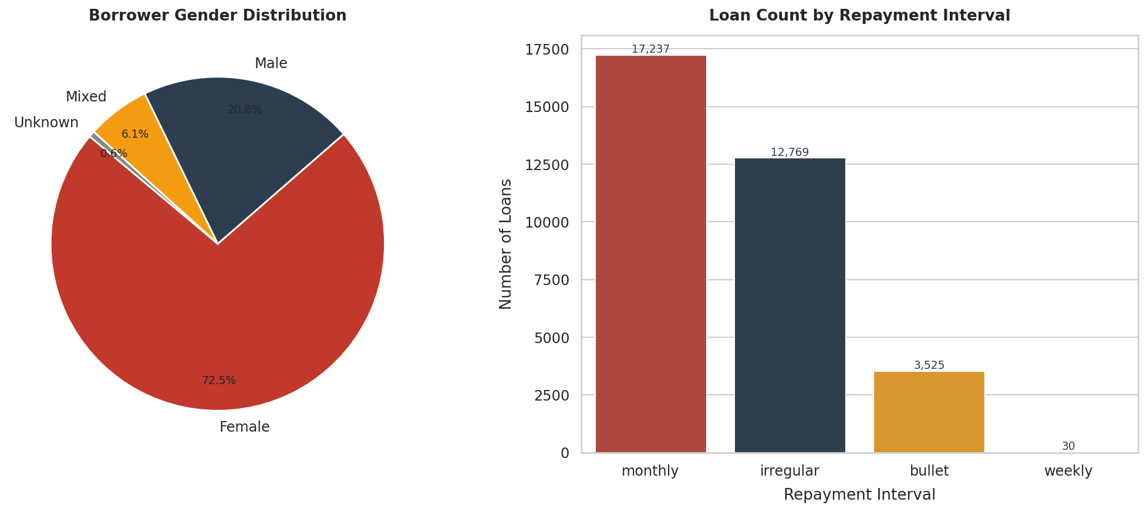
STEP 2 — VIZ
Step 2 — Borrower Demographics
Visualization · Gender distribution and repayment structure
72.5% Female
Monthly Repayment Dominates
Irregular = Agriculture Proxy
Kiva intentionally focuses on female economic empowerment — consistent with global microfinance research showing women are more reliable repayers.
51.3% of loans use monthly repayment (17,237 loans) — borrowers prefer predictable, smaller recurring payments.
38% of loans are irregular-repayment, common in agricultural contexts where income is seasonal rather than monthly.

Slide 9
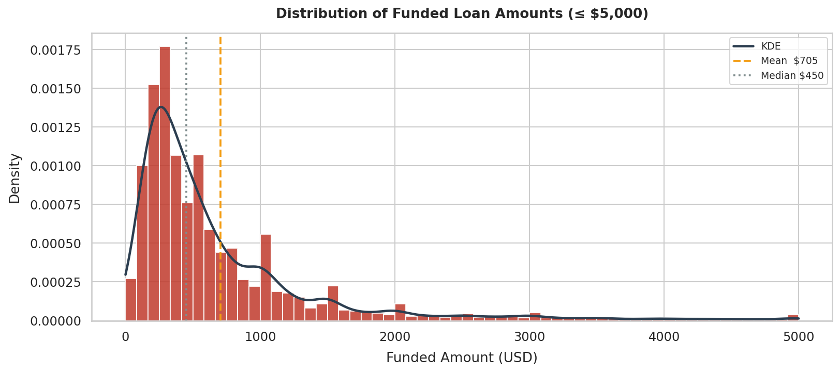
STEP 2 — VIZ
Step 2 — Funded Amount Distribution
Visualization · Proves right-skew and validates outlier removal
$450
Median Loan (typical)
$705
Mean Loan (skewed by outliers)
$50K
Maximum (extreme outlier)
Strong right skew: majority of loans fall below $1,000 — Kiva serves small-dollar borrowers.
Mean > median by 56%: the average is pulled up significantly by large outliers, making median the truer measure.
Secondary peak at ~$1,000–1,500 suggests a distinct tier of slightly larger business loans.

Slide 10
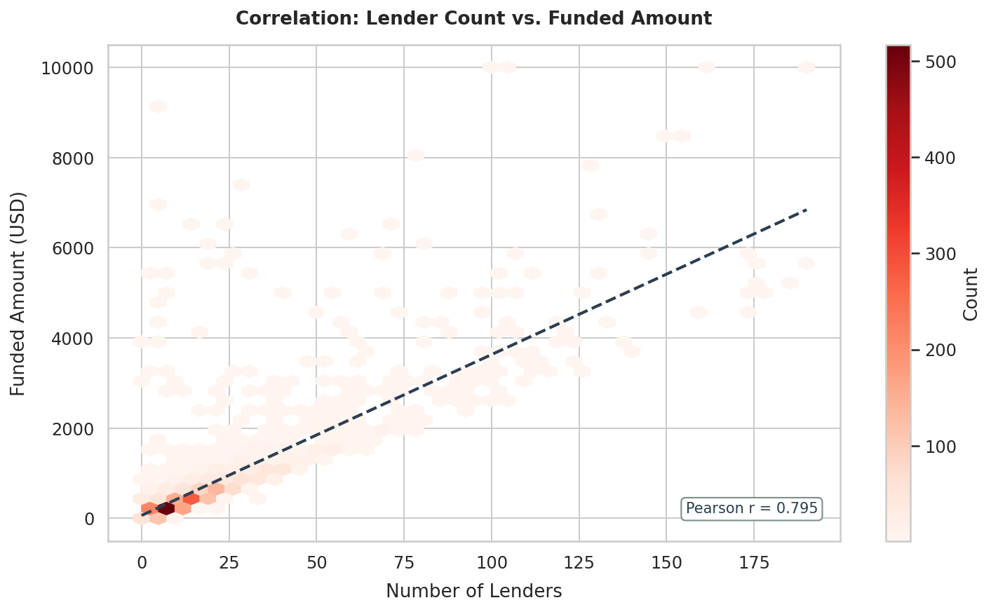
STEP 2 — VIZ
Step 2 — Lender Count vs. Funded Amount
Visualization · Directly answers Business Question 2
Pearson r
0.795
Strong Positive Correlation
Predictive signal confirmed
r = 0.795 is strong — lender_count will be a primary feature in the ML model (Phase 2, Step 5).
Density in lower-left
Most loans cluster at 0–25 lenders and under $500 — typical small microloans attracting small lender groups.
Linear growth holds
The regression line stays consistent across the full range, not just the high-density cluster.

Slide 11
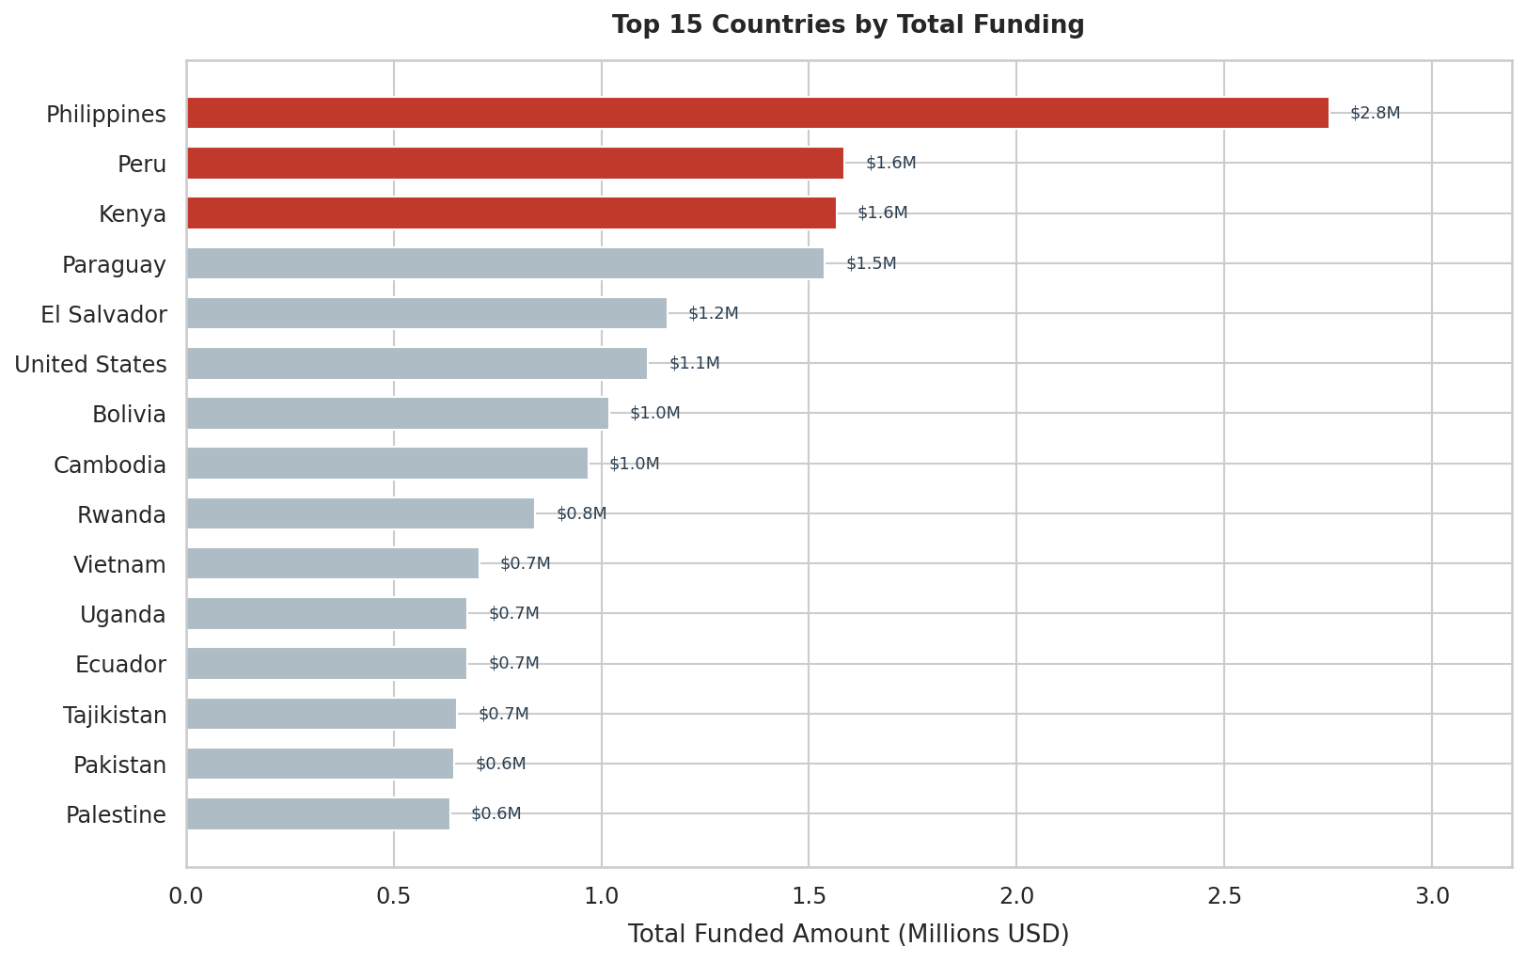
STEP 2 — VIZ
Step 2 — Geographic Distribution
Visualization · Top 15 countries by total funded amount
Philippines #1
$2.8M
Southeast Asia anchors Kiva's largest regional presence — nearly double the next country.
Peru & Kenya
$1.6M each
Latin America and Sub-Saharan Africa are Kiva's two other major operational hubs.
Top 3 = 38% of total
Just 3 countries out of 79 account for nearly two-fifths of all capital deployed.
Countries 4–15 cluster
$0.6–1.5M range
Broad but fairly even geographic spread beyond the top three.

Slide 12
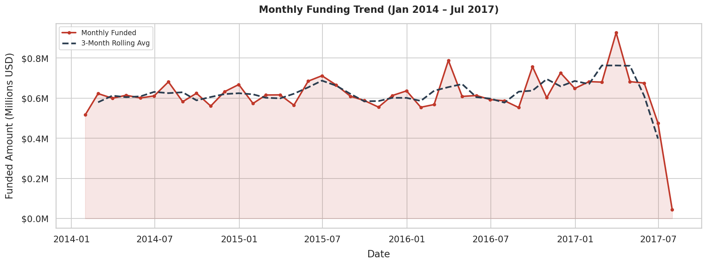
STEP 2 — VIZ
Step 2 — Monthly Funding Trend
Visualization · Baseline for Step 6 time-series forecasting
Stable 2014–2016 Plateau
Early 2017 Spike (~$0.92M)
End-of-Data Artifact
Monthly funding held consistently between $0.55M–$0.70M — a mature, predictable lending operation.
A notable peak in early 2017 may reflect a seasonal agricultural borrowing cycle or a fundraising campaign.
The sharp drop at the chart's end is simply the dataset ending mid-July 2017 — not a real operational decline.

Slide 13
STEP 3 — CLEAN
Step 3 — Data Cleaning & Transformation
Six systematic steps applied to prepare data for Power BI and ML
Step | Action | Method | Result
01 | Remove Duplicates | drop_duplicates() | 0 duplicates found — data integrity confirmed
02 | Handle Missing Values | Median for partner_id; 'Unknown' for categoricals | 829 null entries resolved cleanly
03 | Remove Outliers | ±3 standard deviations on funded_amount | 756 records removed; bounds $0–$4,322
04 | Categorical Encoding | .cat.codes on repayment_interval & gender | ML-ready integer features created
05 | Feature Scaling | StandardScaler → stored in _scaled columns | Originals preserved for Power BI; z-scores for ML
06 | Export Cleaned Dataset | df_clean.to_csv('kiva_loans_cleaned.csv') | 32,805 rows × 19 cols ready for Phase 2
Key Design Decision:
Scaled values are stored in dedicated _scaled columns — original numerics (loan_amount, term_in_months, lender_count) are fully preserved. Power BI receives human-readable data (e.g. $500, 13 months) while the ML pipeline uses the normalized z-score columns.

Slide 14
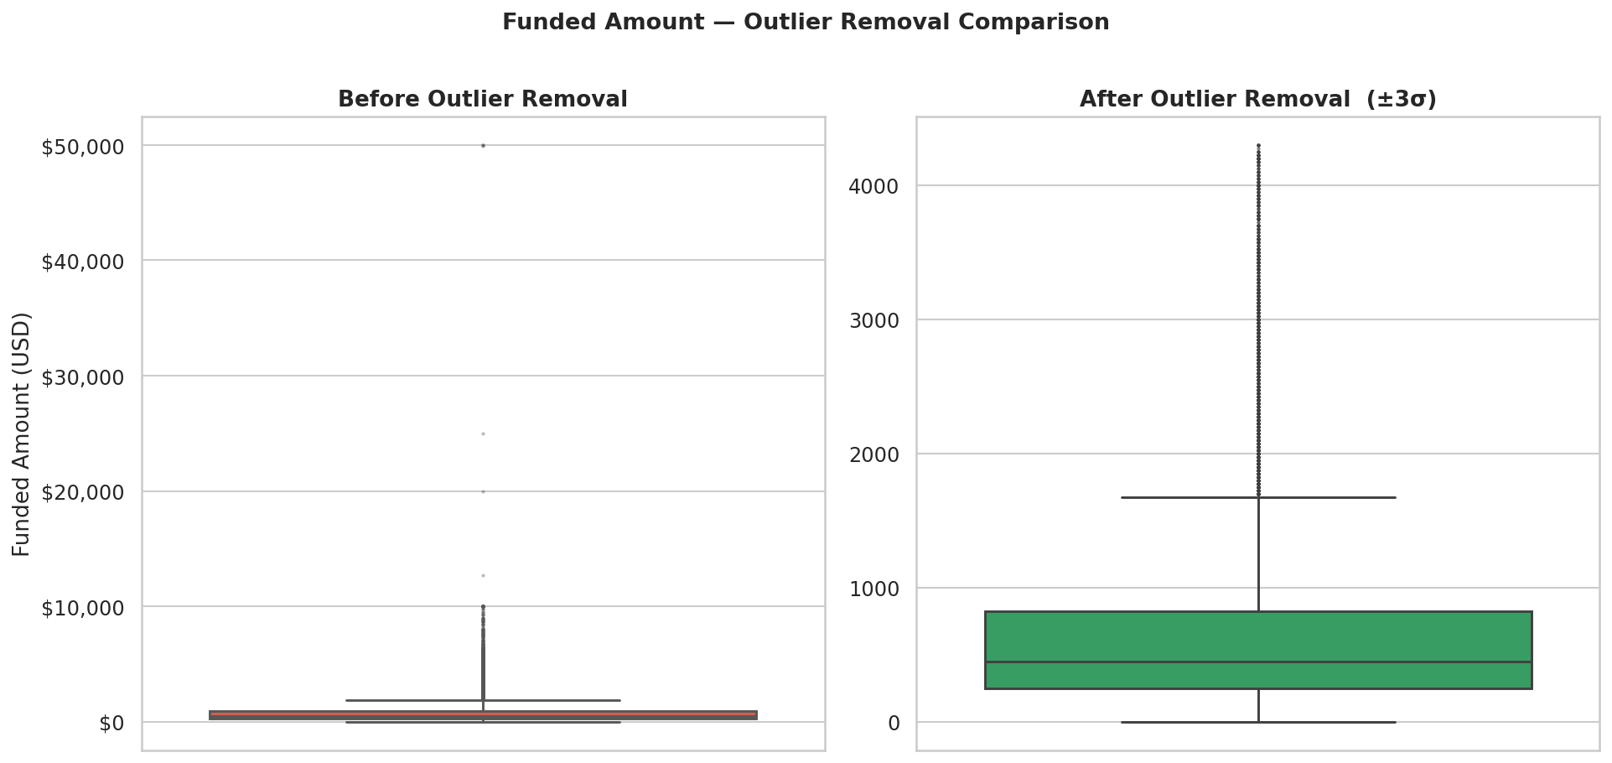
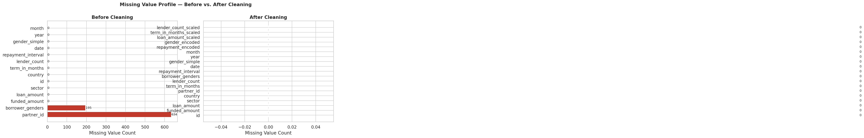
STEP 3 — CLEAN
Step 3 — Visual Proof of Cleaning Quality
Before vs. After comparison for outlier removal and missing value imputation
Outlier Removal — Funded Amount Boxplot
Before (red):
IQR is invisible — extreme outliers up to $50,000 crush the entire box to a thin line at the bottom.
After (green):
IQR fully visible ($250–$900), whiskers meaningful. 756 extreme values removed. Data is now model-ready.
Missing Value Profile — Before vs. After Imputation
After cleaning, every single column shows zero missing values — confirming complete data coverage for Power BI import.
32,805 rows · 19 columns · 0 nulls

Slide 15
Step 4 — Machine Learning Model
STEP 4 — ML
Four regression models trained to predict funded_amount on 32,805 cleaned records
Input Features
Linear Regression
Baseline model using z-score scaled features. Establishes the performance floor for comparison.
Feature | Description
loan_amount_scaled | Z-score normalized loan amount
term_in_months_scaled | Z-score normalized term length
lender_count_scaled | Z-score normalized lender count
repayment_encoded | Encoded repayment interval type
gender_encoded | Encoded borrower gender
1
2
Polynomial Regression
Degree-2 polynomial expansion of scaled features. Captures non-linear interactions between predictors.
3
Decision Tree
Non-parametric tree regressor (max_depth=8) on raw features. No scaling required.
Target: funded_amount | Train/Test split: 80% / 20% | random_state=42
4
Random Forest
Ensemble of 100 decision trees (n_estimators=100). Best generalization and noise resistance.

Slide 16
Step 4 — Model Evaluation Results
STEP 4 — ML
Regression metrics across all four models · Test set (20% = 6,561 records)
Performance Metrics by Model
Model | MSE | RMSE | MAE | R² Score
Linear Regression | 54,285.00 | 232.99 | 105.43 | 0.8806
Polynomial Regression | 30,521.34 | 174.70 | 66.18 | 0.9329
Decision Tree | 21,041.81 | 145.06 | 38.06 | 0.9537
Random Forest ★ | 16,176.08 | 127.19 | 32.37 | 0.9644
Lower MSE / RMSE / MAE = less prediction error in USD. Higher R² = more variance explained. Best values highlighted in the Random Forest row.
R² Progression:
Linear 0.8806 → Polynomial 0.9329 → Decision Tree 0.9537 → Random Forest 0.9644

Slide 17
Step 4 — Best Model: Random Forest
STEP 4 — ML
Highest predictive accuracy across all evaluation metrics
0.9644
127.19
32.37
R² Score
RMSE (USD)
MAE (USD)
96.44% of variance in funded_amount explained
Average prediction error of only $127 per loan
Median absolute error of just $32 per loan
Why Random Forest Wins
Feature Importance Ranking
Ensemble advantage: 100 trees vote together, reducing overfitting vs. a single Decision Tree.
lender_count
72%
Non-linear capture: Naturally models complex interactions without needing polynomial expansion.
loan_amount
14%
term_in_months
8%
Outlier robustness: Tree-based splits are unaffected by residual scale in the cleaned dataset.
repayment_encoded
4%
No scaling needed: Raw feature values used directly — no StandardScaler required.
gender_encoded
2%

Slide 18
Phase 2 — Next Steps
Work in progress · Building on the cleaned dataset produced in Phase 1
04
Power BI Dashboard
05
Machine Learning Model
06
Time Series Forecasting
Import kiva_loans_cleaned.csv directly into Power BI. Build interactive visuals: sector funding comparisons, geographic borrower maps, gender breakdowns by country, and year-over-year trend slicers.
Train regression models (Linear, Random Forest, Gradient Boosting) to predict funded_amount. Use the pre-built _scaled columns. Pearson r = 0.795 confirms lender_count as the primary predictor. Evaluate via RMSE and R².
Apply ARIMA or Prophet to the monthly funded_amount time series established in Step 2. The stable 2014–2016 baseline provides a clean, low-volatility training window ideal for forecasting future capital deployment.
Data already exported & ready
Features already scaled & encoded
Baseline visualized in Step 2
All three Phase 2 steps depend entirely on the cleaned, encoded, and scaled dataset produced in Phase 1.

Slide 19
Conclusion
Agriculture & Food lead
Philippines, Peru & Kenya
Together accounting for 64% of all capital — Kiva's mission is clearly agricultural and food-sector focused.
The top 3 countries account for 38% of all funding — clear geographic priorities for resource allocation.
72.5% of borrowers are female
Stable $0.55–0.70M/month
Confirming Kiva's alignment with female economic empowerment — a key impact metric for stakeholders.
Monthly funding was predictable across 2014–2016, providing a clean baseline for time-series forecasting.
Pearson r = 0.795
32,805 clean records exported
Lender count is a strong predictor of funded amount — a confirmed feature for the ML model in Phase 2.
97.7% retention rate post-cleaning — a fully validated, analysis-ready dataset for Power BI and ML.
Phase 1 is complete. The pipeline is ready for Power BI · Machine Learning · Time Series Forecasting.

Slide 20
Thank You
"Data is the foundation. Insight is the goal."
Questions & Discussion Welcome
Kiva Loans Business Intelligence Project · Phase 1 · May 2026

