Slide 1

From ER Diagram to Visuals
Using MySQL Workbench
Youssef Fahmy

Slide 2





AGENDA OVERVIEW
Exploring, Analyzing and Visualizing Sakila Database
Data Exploration
ER Diagram
Explore the Data to understand their main characteristics and identify patterns,
Re-arrange Tables and Identify the relationships.
Database Analysis
Visualization
Write a SQL code to answer
Client questions.
Visualize the output.
Summary
Summarize outputs

Slide 3

Data Exploration
SELECT * FROM actor;
SELECT * FROM address;
SELECT * FROM category;
SELECT * FROM city;
SELECT * FROM country;
SELECT * FROM customer;
SELECT * FROM film;
SELECT * FROM film_actor;
SELECT * FROM film_category;
SELECT * FROM film_text;
SELECT * FROM inventory;
SELECT * FROM language;
SELECT * FROM payment;
SELECT * FROM rental;
SELECT * FROM staff;
SELECT * FROM store;

Slide 4
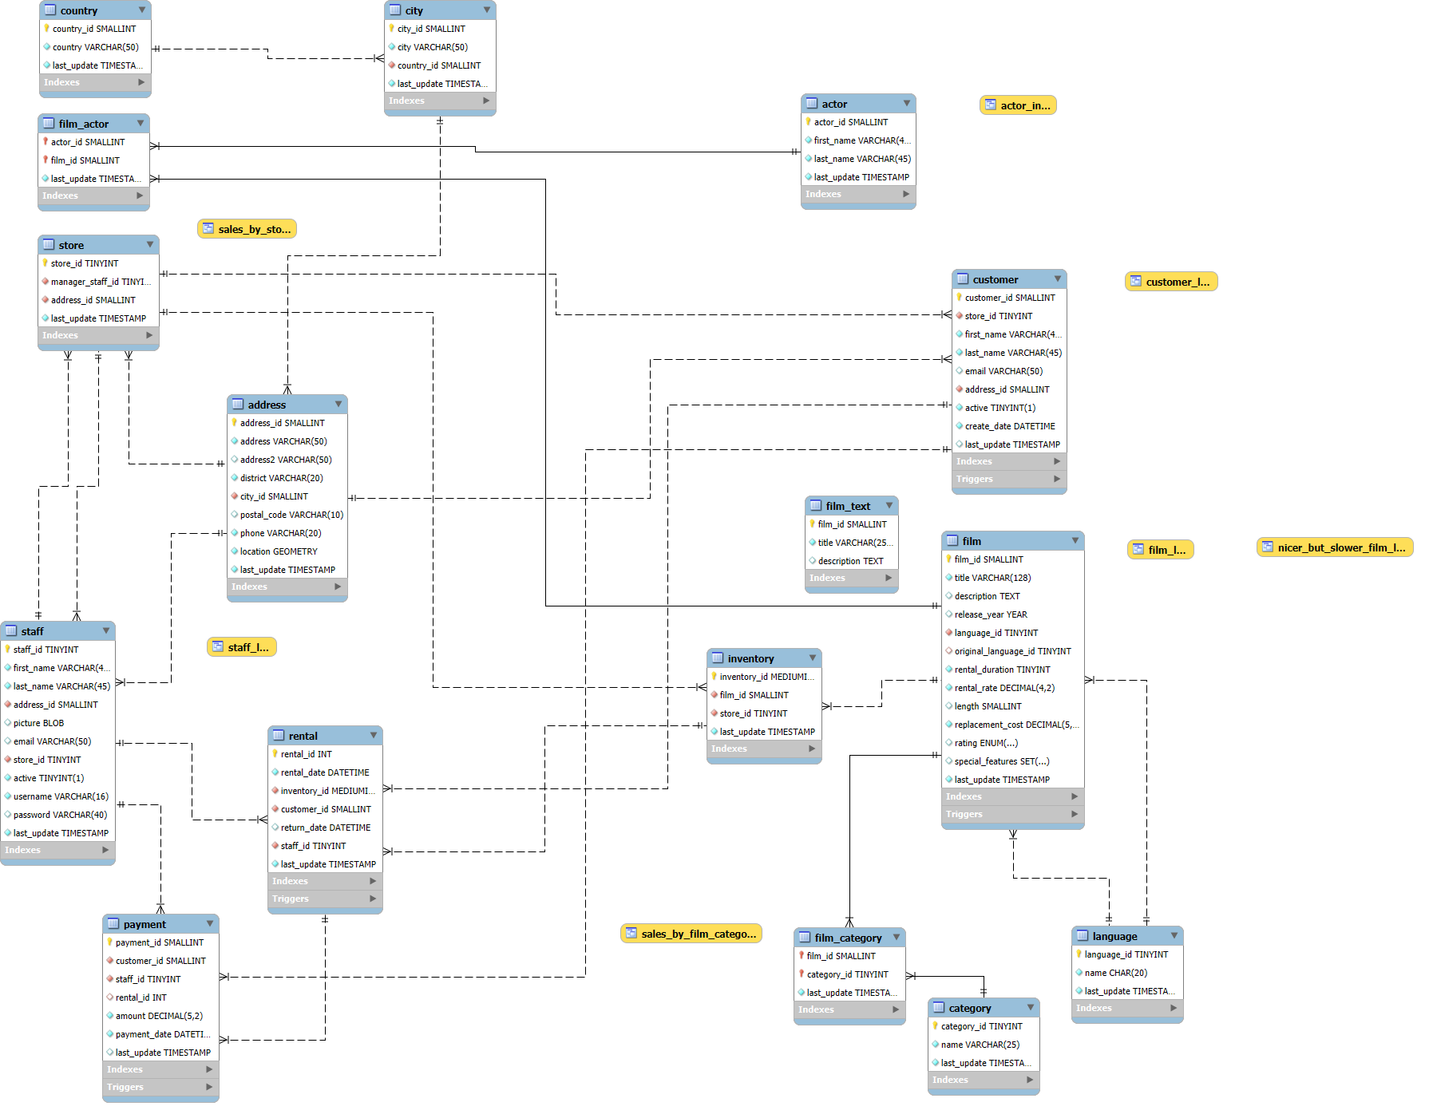
ER Diagram

Slide 5
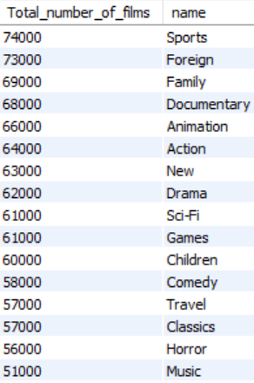
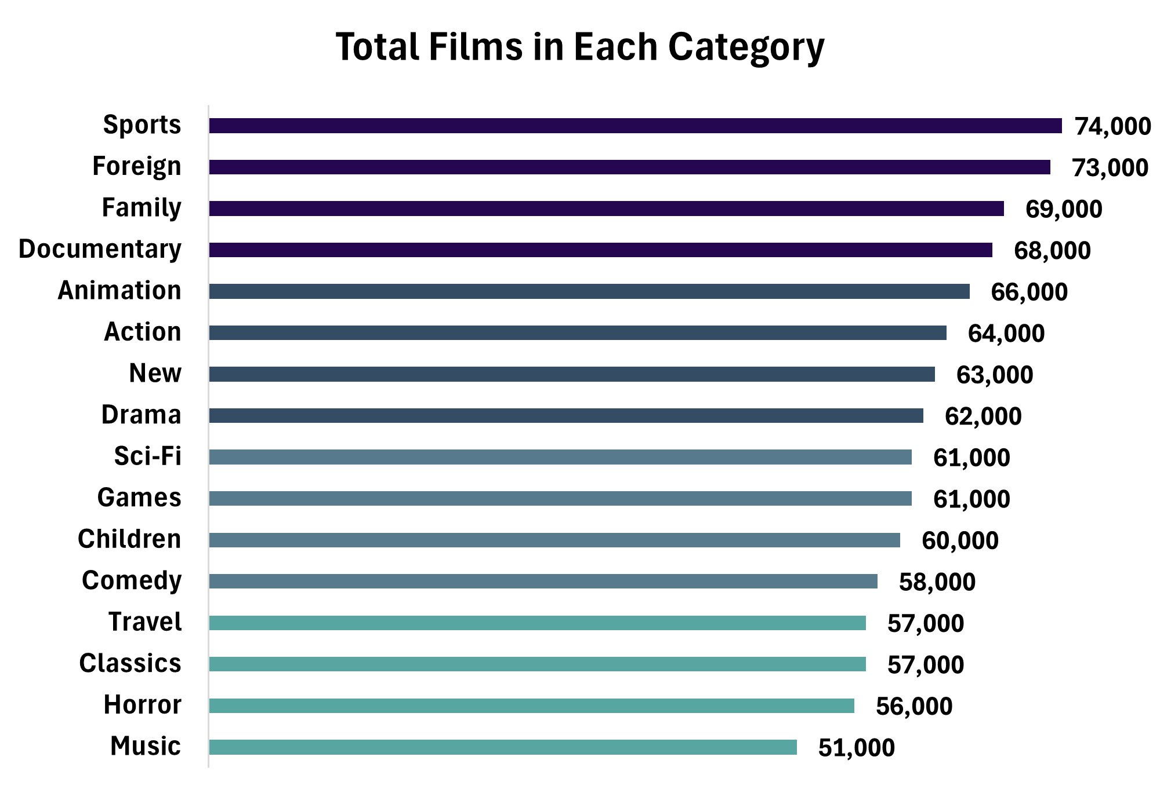
Q1-What is the total number of films in each category?
SELECT COUNT(film.film_id) AS Total_number_of_films,category.name
FROM film
INNER JOIN film_category
ON film.film_id = film.film_id
INNER JOIN category
ON film_category.category_id = category.category_id
GROUP BY category.category_id
ORDER BY Total_number_of_films DESC ;
Chart
Output

Slide 6

Q2- What is the language most used for films?
SELECT COUNT(film.film_id) AS Total_films,language.name
FROM film
INNER JOIN language
ON film.language_id = language.language_id
GROUP BY language.language_id ;
Output

Slide 7

Q3- Which film Category has the highest revenue?
SELECT category, total_sales
FROM sales_by_film_category
ORDER BY total_sales DESC
LIMIT 1 ;
Output

Slide 8

Q4- Which film has the highest revenue?
SELECT SUM(payment.amount) AS Total_Revenue,film.title
FROM payment
INNER JOIN rental
ON payment.rental_id = rental.rental_id
INNER JOIN inventory
ON rental.inventory_id = inventory.inventory_id
INNER JOIN film
ON inventory.film_id = film.film_id
GROUP BY film.film_id
ORDER BY Total_Revenue DESC
LIMIT 1 ;
Output

Slide 9
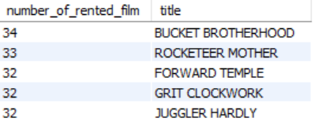
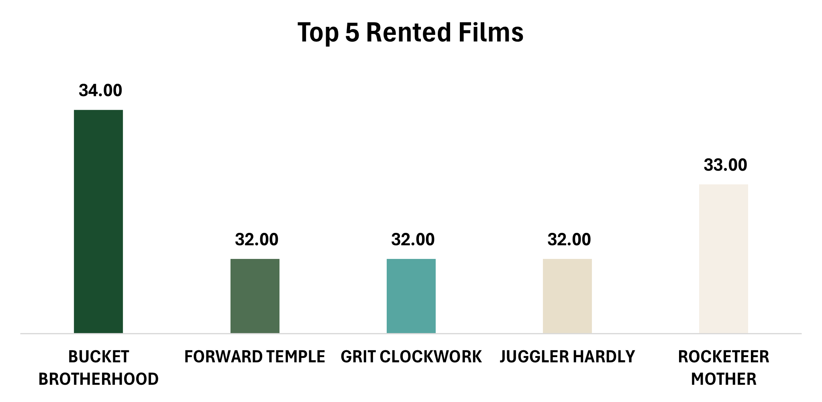
Q5- What are the top 5 most rented films?
SELECT COUNT(rental.rental_id) AS number_of_rented_film,film.title
FROM film
INNER JOIN inventory
ON film.film_id = inventory.film_id
INNER JOIN rental
ON inventory.inventory_id = rental.inventory_id
GROUP BY film.film_id
ORDER BY number_of_rented_film DESC
LIMIT 5 ;
Chart
Output

Slide 10
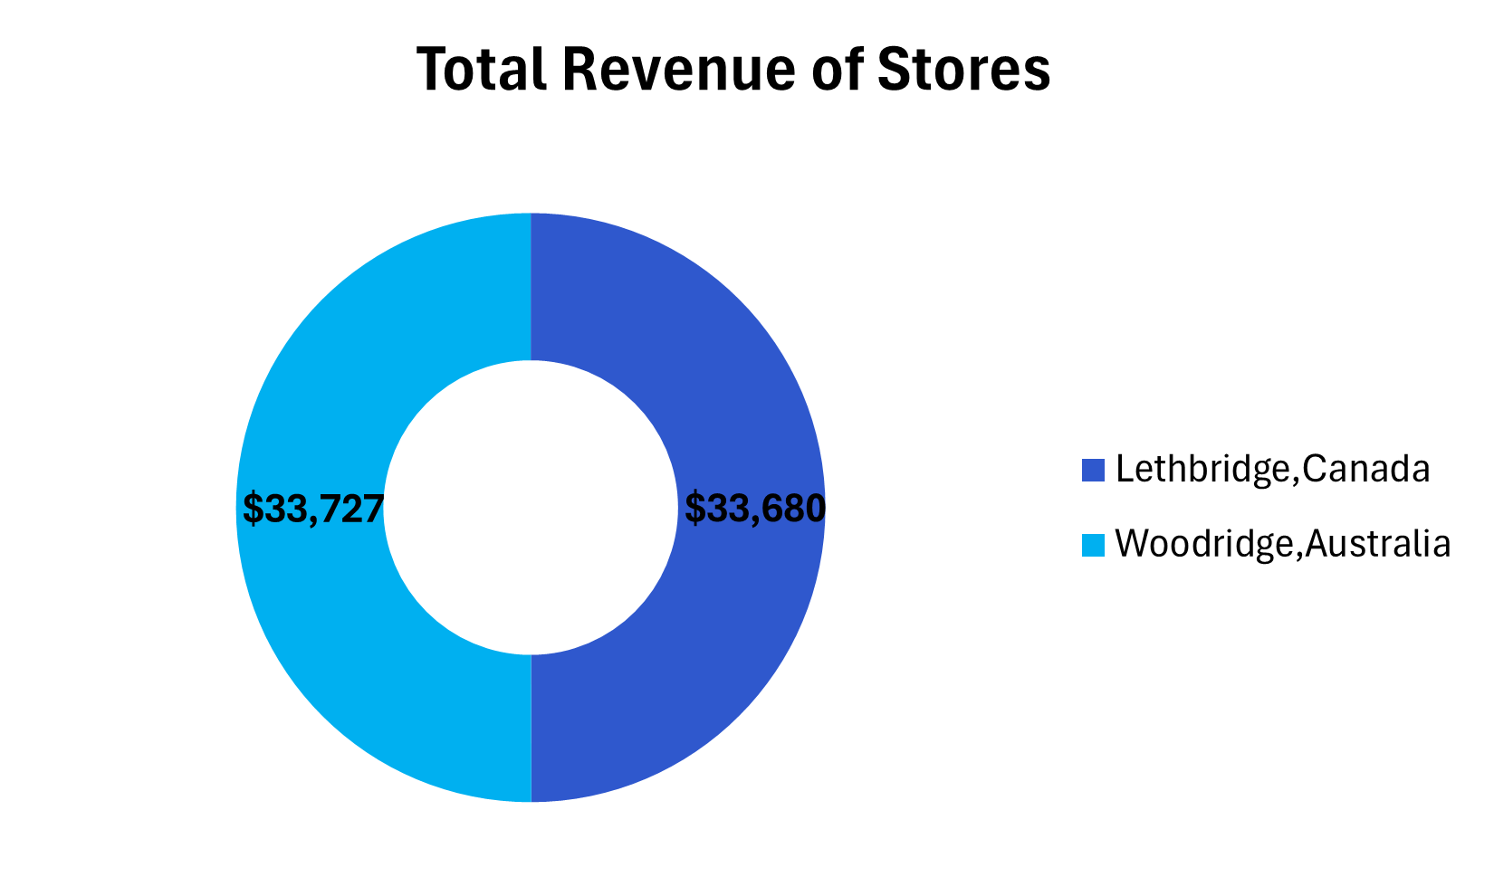

Q6- What is the total revenue of each store?
SELECT total_sales AS Total_store_sales,store
FROM sales_by_store ;
Chart
Output

Slide 11
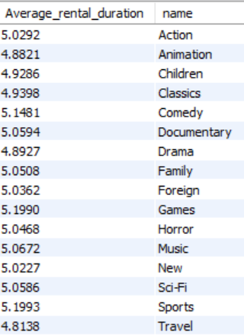
Q7- What is the average rental duration by film category?
SELECT AVG(datediff(return_date,rental_date)) AS Average_rental_duration,category.name
FROM rental
INNER JOIN inventory
ON rental.inventory_id = inventory.inventory_id
INNER JOIN film
ON inventory.film_id = film.film_id
INNER JOIN film_category
ON film.film_id = film_category.film_id
INNER JOIN category
ON category.category_id = film_category.category_id
GROUP BY category.category_id ;
Output

Slide 12
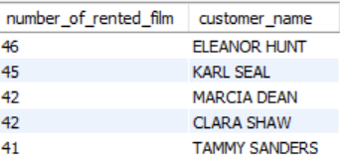
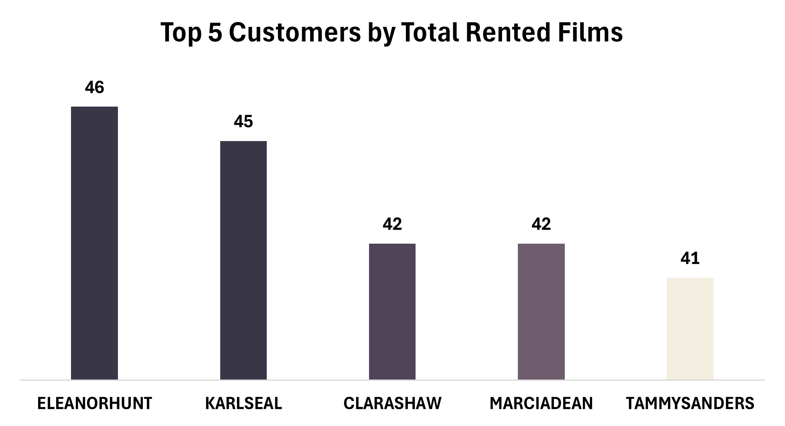
Q8- List the top 5 customers with the number of rented film.
SELECT COUNT(rental.rental_id) AS number_of_rented_film,CONCAT(customer.first_name," ",customer.last_name) AS customer_name
FROM rental
INNER JOIN customer
ON customer.customer_id = rental.customer_id
GROUP BY customer.customer_id
ORDER BY number_of_rented_film DESC
LIMIT 5;
Chart
Output

Slide 13
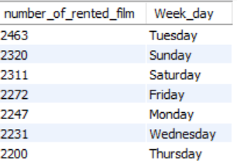
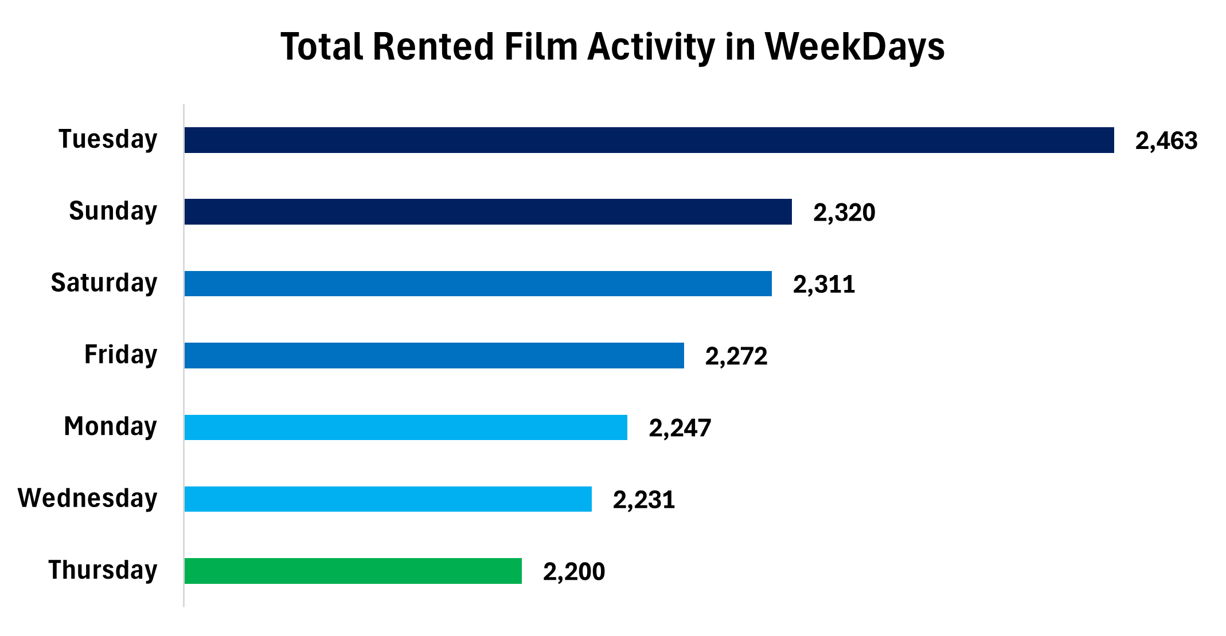
Q9- Which days of the week generate the highest rental activity?
SELECT COUNT(rental.rental_id) AS number_of_rented_film,DAYNAME(rental.rental_date) AS Week_day
FROM rental
GROUP BY Week_day
ORDER BY number_of_rented_film DESC ;
Chart
Output

Slide 14
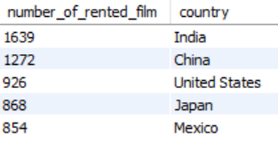
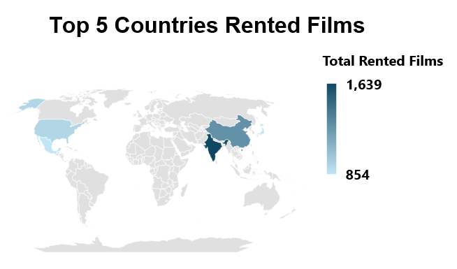
Q10- What are the top 5 countries with the highest rental activity?
SELECT COUNT(rental.rental_id) AS number_of_rented_film, country.country
FROM rental
INNER JOIN customer
ON customer.customer_id = rental.customer_id
INNER JOIN address
ON address.address_id = customer.customer_id
INNER JOIN city
ON city.city_id = address.city_id
INNER JOIN country
ON country.country_id = city.country_id
GROUP BY country.country_id
ORDER BY number_of_rented_film DESC
LIMIT 5;
Chart
Output

Slide 15
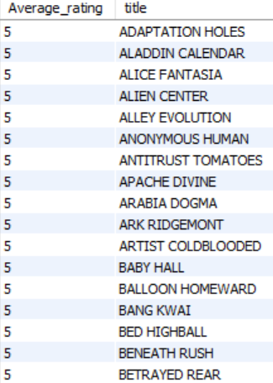
Q11- Which films have the highest average rating?
SELECT AVG(film.rating) AS Average_rating,film.title
FROM film
GROUP BY film.film_id
ORDER BY Average_rating DESC ;
Output

Slide 16
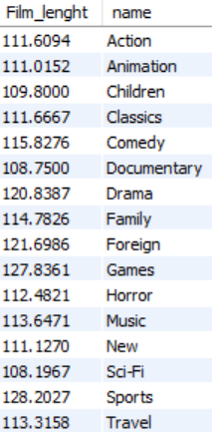
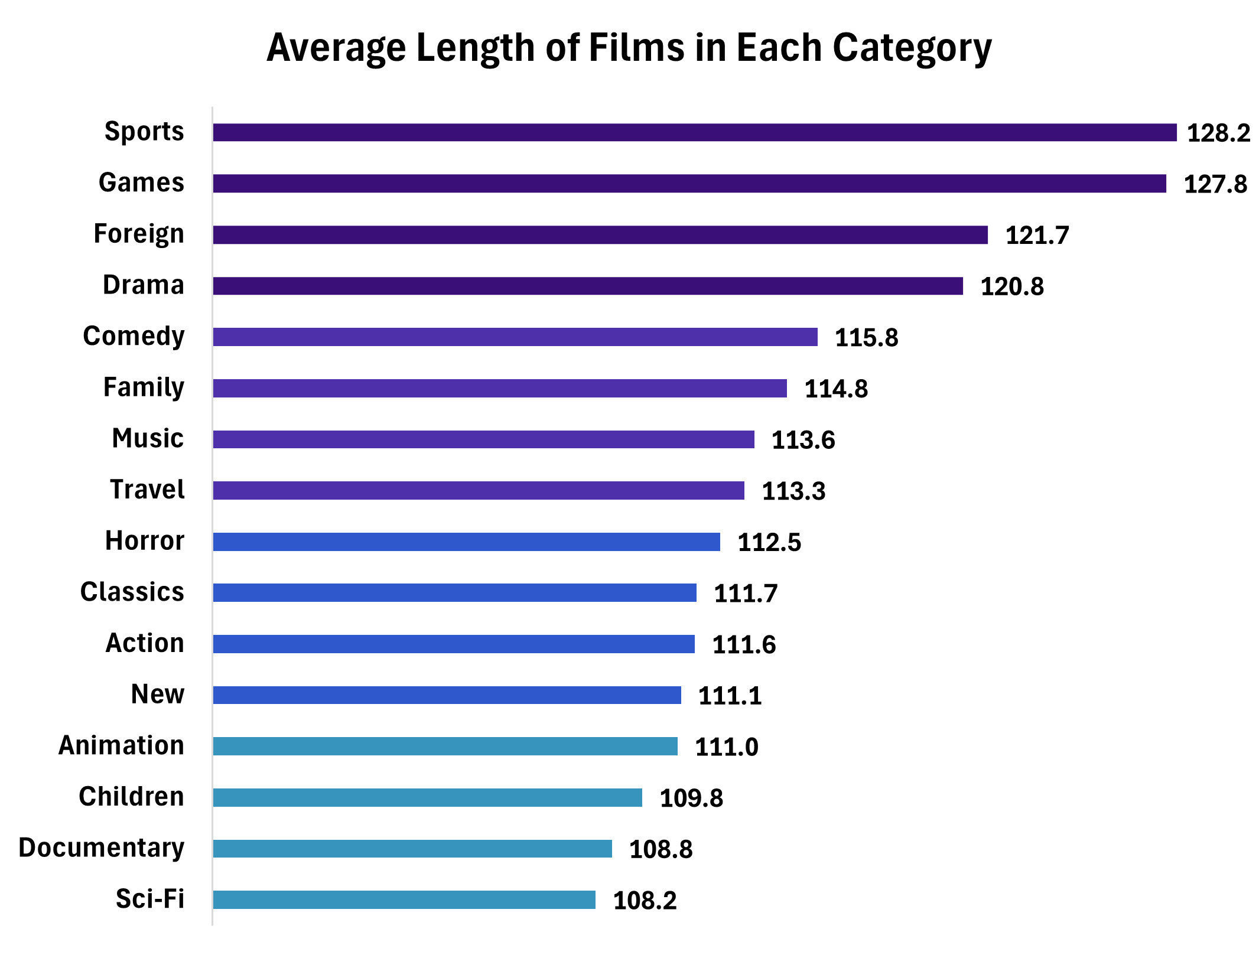
Q12- What is the average length of films in each category?
SELECT AVG(film.length) AS Film_lenght,category.name
FROM film
INNER JOIN film_category
ON film.film_id = film_category.film_id
INNER JOIN category
ON film_category.category_id = category.category_id
GROUP BY category.category_id ;
Chart
Output

Slide 17
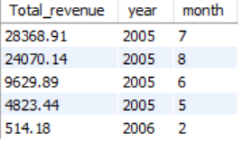
Q13- Which year and month generates the highest rental revenue?
SELECT SUM(payment.amount) AS Total_revenue , YEAR(rental.rental_date) AS year , MONTH(rental.rental_date) AS month
FROM payment
INNER JOIN rental
ON rental.rental_id = payment.rental_id
GROUP BY year , month
ORDER BY Total_revenue DESC ;
Output

Slide 18
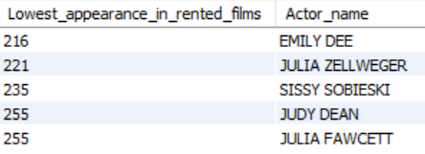
Q14- Which Bottom 5 actors appear in the most rented films?
SELECT COUNT(rental.rental_id) AS Lowest_appearance_in_rented_films , CONCAT(actor.first_name," ",actor.last_name) AS Actor_name
FROM rental
INNER JOIN inventory
ON rental.inventory_id = inventory.inventory_id
INNER JOIN film
ON inventory.film_id = film.film_id
INNER JOIN film_actor
ON film.film_id = film_actor.film_id
INNER JOIN actor
ON film_actor.actor_id = actor.actor_id
GROUP BY film_actor.actor_id
ORDER BY Lowest_appearance_in_rented_films
LIMIT 5 ;
Output

Slide 19
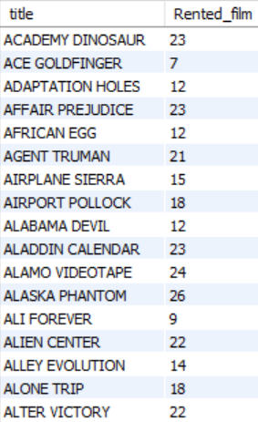
Q15- List films have been rented more than one time?
SELECT film.title,COUNT(rental.rental_id) AS Rented_film
FROM film
INNER JOIN inventory
ON film.film_id = inventory.film_id
INNER JOIN rental
ON inventory.inventory_id = rental.inventory_id
GROUP BY film.film_id
HAVING Rented_film > 1 ;
Output

Slide 20
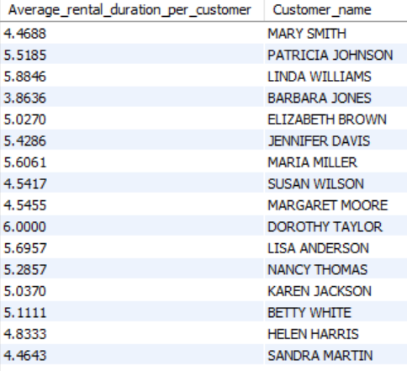
Q16- What is the average time between rentals for each customer?
SELECT AVG(datediff(rental.return_date,rental.rental_date)) AS Average_rental_duration_per_customer,CONCAT(customer.first_name," ",customer.last_name) AS Customer_name
FROM rental
INNER JOIN customer
ON rental.customer_id = customer.customer_id
GROUP BY customer.customer_id ;
Output

Slide 21

Q17- How many customers have rented films in multiple categories?
SELECT DISTINCT COUNT(customer.customer_id) AS Number_of_unique_customers
FROM customer
INNER JOIN rental
ON customer.customer_id = rental.customer_id
INNER JOIN inventory
ON rental.inventory_id = inventory.inventory_id
INNER JOIN film
ON inventory.film_id = film.film_id
INNER JOIN film_category
ON film.film_id = film_category.film_id
INNER JOIN category
ON film_category.category_id = category.category_id
HAVING COUNT(DISTINCT film_category.category_id) > 1 ;
Output

Slide 22

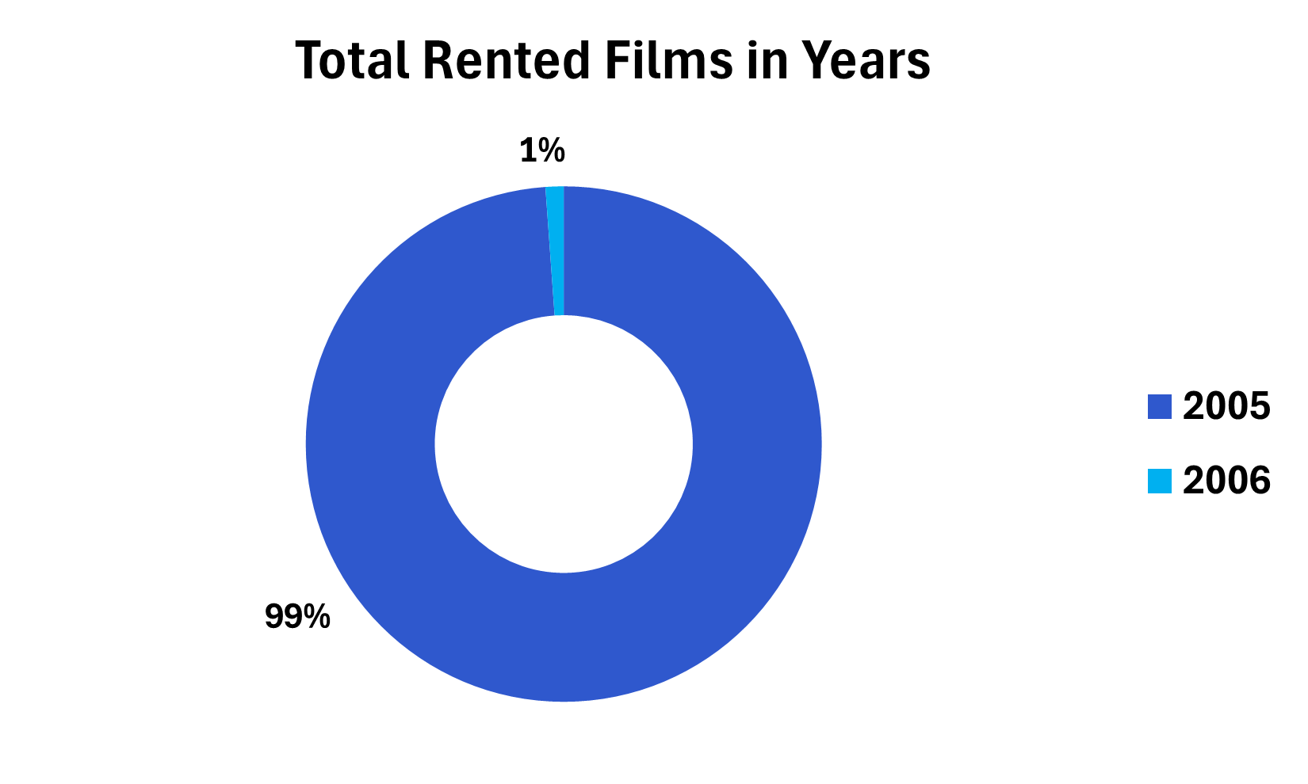
Q18- What is the total number of films rented per year?
SELECT COUNT(rental.rental_id) AS Total_number_of_films, YEAR(rental.rental_date) as year
FROM rental
GROUP BY year ;
Chart
Output

Slide 23
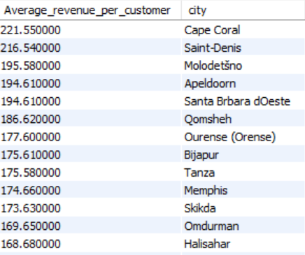
Q19- What is the average revenue per customer by city?
SELECT (SUM(payment.amount) / COUNT(DISTINCT customer.customer_id)) AS Average_revenue_per_customer,city.city
FROM customer
INNER JOIN rental
ON customer.customer_id = rental.customer_id
INNER JOIN payment
ON rental.rental_id = payment.rental_id
INNER JOIN address
ON customer.address_id = address.address_id
INNER JOIN city
ON address.city_id = city.city_id
GROUP BY city.city_id
ORDER BY Average_revenue_per_customer DESC ;
Output

Slide 24
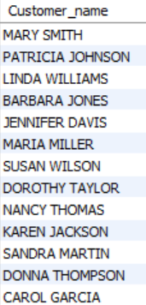
Q20- Which customers who rented films in previous year have not rented any films in 2006?
SELECT DISTINCT CONCAT(customer.first_name," ",customer.last_name) AS Customer_name
FROM customer
WHERE customer.customer_id IN (SELECT DISTINCT rental.customer_id FROM rental WHERE YEAR(rental_date) = 2005) AND
customer.customer_id NOT IN (SELECT DISTINCT rental.customer_id FROM rental WHERE YEAR(rental_date) = 2006) ;
Output

Slide 25
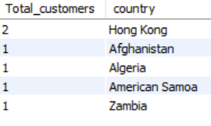
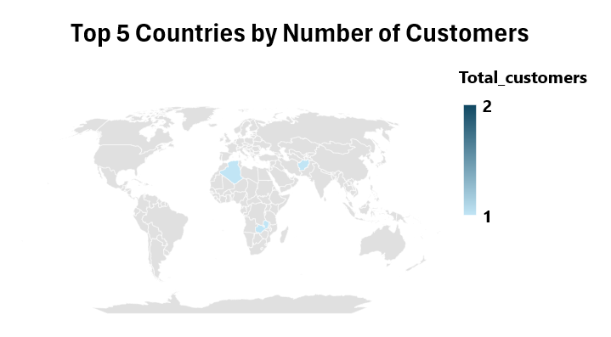
Q21- What are the top 5 countries by number of customers?
SELECT COUNT(customer.customer_id) AS Total_customers,country.country
FROM customer
INNER JOIN address
ON customer.address_id = address.address_id
INNER JOIN city
ON address.city_id = city.city_id
INNER JOIN country
ON city.city_id = country.country_id
GROUP BY country.country_id
ORDER BY Total_customers DESC
LIMIT 5 ;
Chart
Output

Slide 26
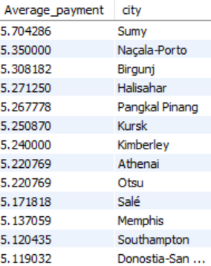
Q22- Which cities have the highest average payment per rented films?
SELECT AVG(payment.amount) AS Average_payment,city.city
FROM payment
INNER JOIN rental
ON payment.rental_id = rental.rental_id
INNER JOIN customer
ON rental.customer_id = customer.customer_id
INNER JOIN address
ON customer.address_id = address.address_id
INNER JOIN city
ON address.city_id = city.city_id
GROUP BY city.city_id
ORDER BY Average_payment DESC ;
Output

Slide 27

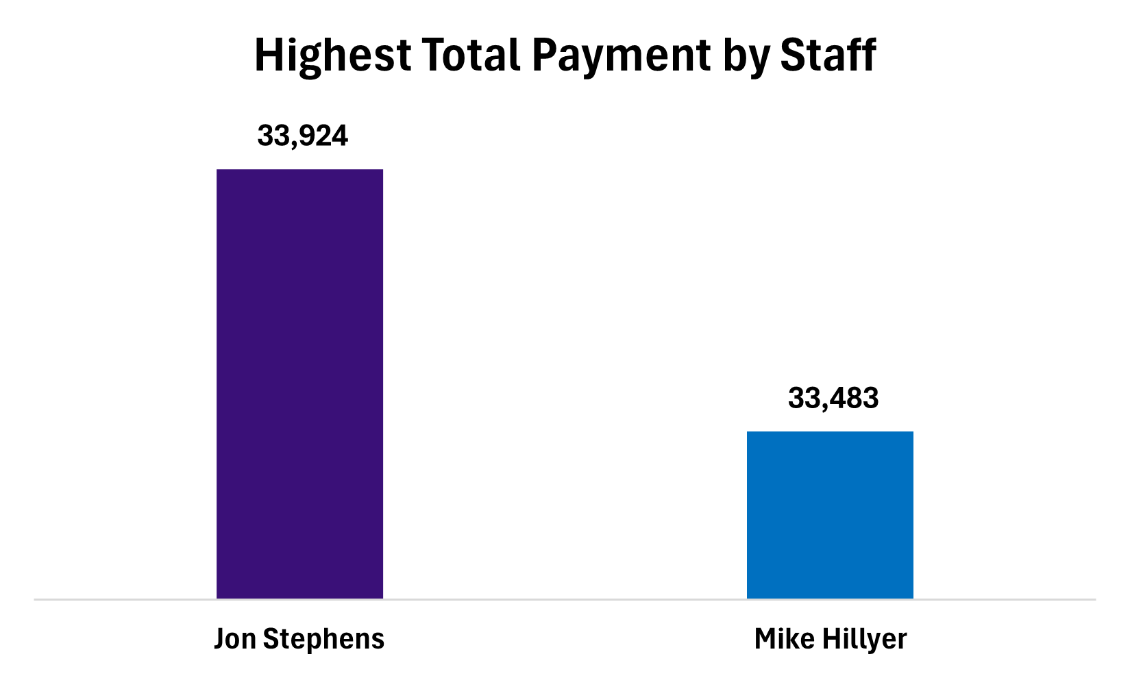
Q23- Which staff members have processed the highest total payments?
SELECT SUM(payment.amount) AS Total_payment,concat(staff.first_name," ",staff.last_name) AS Staff_fullname
FROM payment
INNER JOIN staff
ON payment.staff_id = staff.staff_id
GROUP BY staff.staff_id
ORDER BY Total_payment DESC ;
Chart
Output

Slide 28

Q24- Which customers who have not rented any films?
SELECT CONCAT(customer.first_name, " ", customer.last_name) AS Customer_name
FROM customer
LEFT JOIN rental
ON customer.customer_id = rental.customer_id
WHERE rental.rental_id IS NULL ;
Output

Slide 29
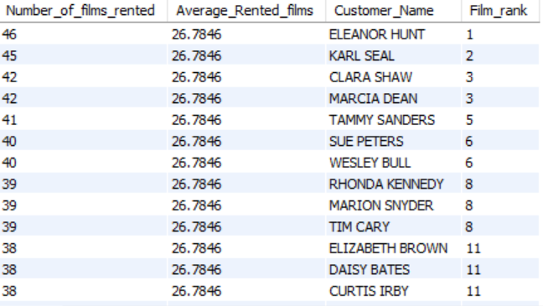
Q25- What is the rank of each customer based on the total number of films rented, and how does it compare to the overall average number of rentals per customer?
SELECT COUNT(rental.rental_id) AS Number_of_films_rented,AVG(COUNT(rental.rental_id)) OVER() AS Average_Rented_films,CONCAT(customer.first_name, ' ', customer.last_name) AS Customer_Name,RANK() OVER(ORDER BY COUNT(rental.rental_id) DESC) AS Film_rank
FROM customer
LEFT JOIN rental
ON customer.customer_id = rental.customer_id
LEFT JOIN payment
ON rental.rental_id = payment.rental_id
GROUP BY customer.customer_id ;
Output

Slide 30
Recommendations
1- Expand High-Revenue Categories:
Increase inventory in top-performing film categories to boost profitability.
2- Promote Underperforming Categories:
Implement targeted promotions and bundles to drive interest in less popular films.
3- Engage Frequent Renters:
Develop loyalty programs and personalized offers for customers who rent frequently or across multiple categories.
4- Optimize Operations on Peak Rental Days:
Align staffing and marketing efforts with peak rental days to enhance efficiency and capture higher demand.

Slide 31
Recommendations
5- Prioritize High-Revenue Stores and Cities:
Focus investments on stores and cities with higher rental revenue while reevaluating strategies for lower-performing locations.
6- Re-engage Inactive Customers:
Target customers who haven't rented recently with personalized offers to encourage their return.
7- Monitor Trends and Adjust Strategies:
Continuously track rental trends and adjust inventory and marketing strategies to align with customer preferences.

Slide 32
Thank You!

