Slide 1
DATA ANALYST TRAINING · 2026
Real Estate
Machine Learning Project
Predicting property prices and sale likelihood across Greater Cairo using end-to-end data science — from raw data to a live interactive web app.
Prepared by a team of 10 · Real Estate Price Predictor
🏠
250 Properties
🤖
8 ML Models
📊
5 Streamlit Pages

Slide 2
WHAT WE'LL COVER
Agenda
01
Introduction & Objectives
05
Classification: Predicting Sale Status
02
Project Pipeline Overview
06
The Streamlit Web App
03
Data & Exploratory Analysis
07
Tools, Team & Challenges
04
Regression: Predicting Price
08
Recommendations & Conclusion
Real Estate ML Project
2

Slide 3
01 · INTRODUCTION
Solving Two Real Questions in Real Estate
Any real estate company needs answers to two practical questions before listing a property. This project builds machine learning models to answer both.
💰
REGRESSION
📊
CLASSIFICATION
How much should it cost?
Will it sell?
Predict a property's price (EGP_Price) from its features — a continuous numeric target.
Classify whether a property will be sold or not (Is_Sold) — a binary yes/no target.
PROJECT OBJECTIVES
✓ Apply the full data science lifecycle on a realistic Greater Cairo dataset
✓ Compare 5+ algorithms and tune the best performers with GridSearchCV
✓ Ship an interactive Streamlit app for live, non-technical predictions
Real Estate ML Project
3

Slide 4
02 · PROJECT OVERVIEW
One Pipeline, Five Sequential Stages
Each stage's output feeds the next stage's input — from raw CSV to a live prediction app, built by 4 sub-teams across 10 members.
1
2
3
4
5
🗂️
→
🔍
→
🤖
→
💻
→
🎤
Data
EDA
Modeling
Web App
Presentation
Raw + cleaned data, data dictionary
Cleaning, insights, 5 key charts
Regression + Classification
5-page Streamlit application
Demo to evaluation committee
Dataset: 250 properties · 5 districts · 4 property types · 9 features · 0 missing values
Real Estate ML Project
4

Slide 5
03 · DATA
The Dataset
250
Properties
Column | Type | Description
Location | Categorical | 5 districts (Nasr City, New Cairo, Maadi, Sheikh Zayed, 5th Settlement)
Property_Type | Categorical | Apartment / Villa / Duplex / Penthouse
SqM_Area | Numeric | Property area in square meters
Bedrooms / Bathrooms | Numeric | 1–5 bedrooms, 1–3 bathrooms
EGP_Price | Numeric | Price in EGP — regression target
Is_Sold | Categorical | Sold? Yes/No — classification target
Days_On_Market | Numeric | Days the property was listed
9
Feature columns
5
Districts
0
Missing / duplicate rows
Real Estate ML Project
5

Slide 6
03 · DATA CLEANING
Validation Over Heavy Cleaning
Given the high quality of the source data, this stage served more as a validation step than an intensive cleaning process.
📥
🕳️
📑
Load raw data
Check missing values
Check duplicates
raw_data.csv loaded, shape & columns checked
Confirmed: zero missing values in any column
Confirmed: zero duplicate rows
🔤
📈
💾
Verify data types
Descriptive stats
Save clean copy
Matched against the data dictionary
Mean, std, min, max for every numeric column
Exported as cleaned_data.csv for all later stages
Real Estate ML Project
6

Slide 7
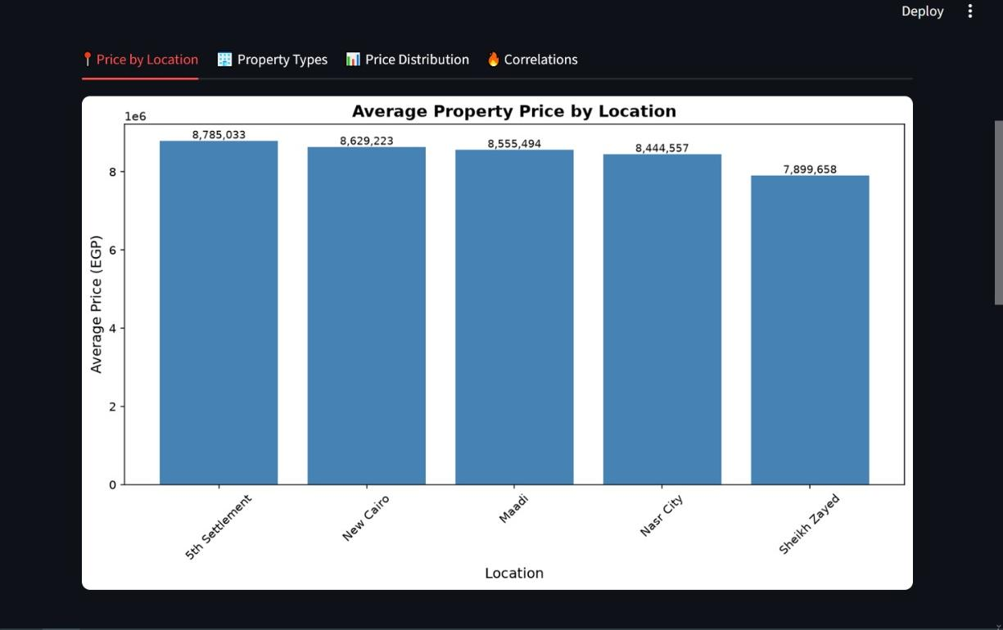
03 · EXPLORATORY DATA ANALYSIS
What the Data Told Us
🏙️
5th Settlement leads pricing
Highest average price at EGP 8,785,033 — Sheikh Zayed lowest at 7,899,658
🏢
Apartments dominate
50.8% of all listings (127 of 250) — Duplex is rarest at 11.6%
📉
Area barely predicts price
Correlation between area and price is just r = 0.059
✅
No outliers detected
1.5×IQR rule found no outliers across numeric columns
Real Estate ML Project
7

Slide 8
03 · EXPLORATORY DATA ANALYSIS
Price by Location & Property Mix
Average Price by Location (EGP)
Property Type Distribution
Real Estate ML Project
8

Slide 9
04 · REGRESSION MODELING
Predicting Property Price
A 3-member modeling team worked across sequential notebooks, each building on the last.
PREPROCESSING
• Dropped Property_ID (no predictive value)
HYPERPARAMETER GRIDS
• Encoded Is_Sold as 1/0; One-Hot Encoded Location & Property_Type
XGBoost
• 80/20 train/test split, random_state=42 for reproducibility
n_estimators: [100, 200, 300]
learning_rate: [0.01, 0.05, 0.1]
max_depth: [3, 5, 7]
• StandardScaler applied only before Linear Regression
MODELS TRAINED
Random Forest
Linear Regression
Decision Tree
Random Forest
n_estimators: [100, 200]
max_depth: [5, 10, 15]
min_samples_split: [2, 5]
XGBoost
Tuned RF
Tuned XGBoost
GridSearchCV with 5-fold cross-validation tuned XGBoost (n_estimators, learning_rate, max_depth) and Random Forest (n_estimators, max_depth, min_samples_split).
Evaluated with MAE, RMSE, and R² on the held-out test set.
Real Estate ML Project
9

Slide 10
04 · REGRESSION MODELING
Results: An Honest Negative
BEST MODEL
Linear Regression
MAE 3,157,737 · RMSE 3,866,100 · R² -0.033
WHY NEGATIVE R²?
A negative R² means a model performs worse than simply predicting the average price every time. This reflects the weak correlation between available features and price (area↔price r = 0.059) — not a coding error.
The simplest model won. Complex models (Decision Tree, untuned XGBoost) overfit random training patterns on this small 250-row dataset — tuning helped, but couldn't overcome the data's weak signal.
Real Estate ML Project
10

Slide 11
05 · CLASSIFICATION MODELING
Engineering Features, Then Classifying
7 new engineered features were added before tackling Is_Sold — capturing composite patterns the raw columns missed.
Total_Rooms
Area_per_Bedroom
Ratio_Bathroom
Is_Luxury
Price_per_SqM
Is_Expensive
Category_Days
THREE MODEL VERSIONS
V1
Baseline
Random Forest + XGBoost on original features, Stratified Split
V2
After Feature Engineering
RF (300 trees, balanced), Gradient Boosting, XGBoost with scale_pos_weight
V3
Final Cross-Validation
10-fold Stratified CV, best model retrained on final 80/20 split
Real Estate ML Project
11

Slide 12
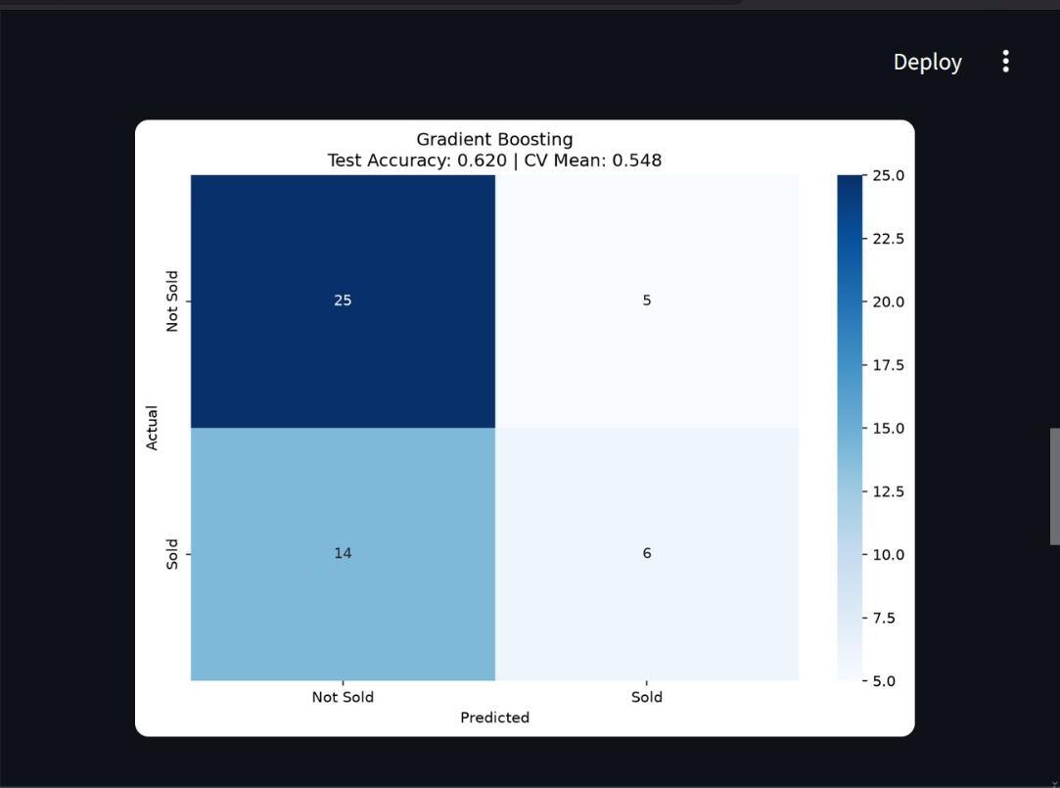
05 · CLASSIFICATION MODELING
62% Accuracy — Reading the Confusion Matrix
ACCURACY BY VERSION
Winner: Gradient Boosting — 62% test accuracy, 54.8% avg CV accuracy.
Class imbalance: correctly identifies 25/30 "Not Sold" but only 6/20 "Sold" properties (~30% recall on the minority class) — despite class_weight and scale_pos_weight balancing.
Real Estate ML Project
12

Slide 13
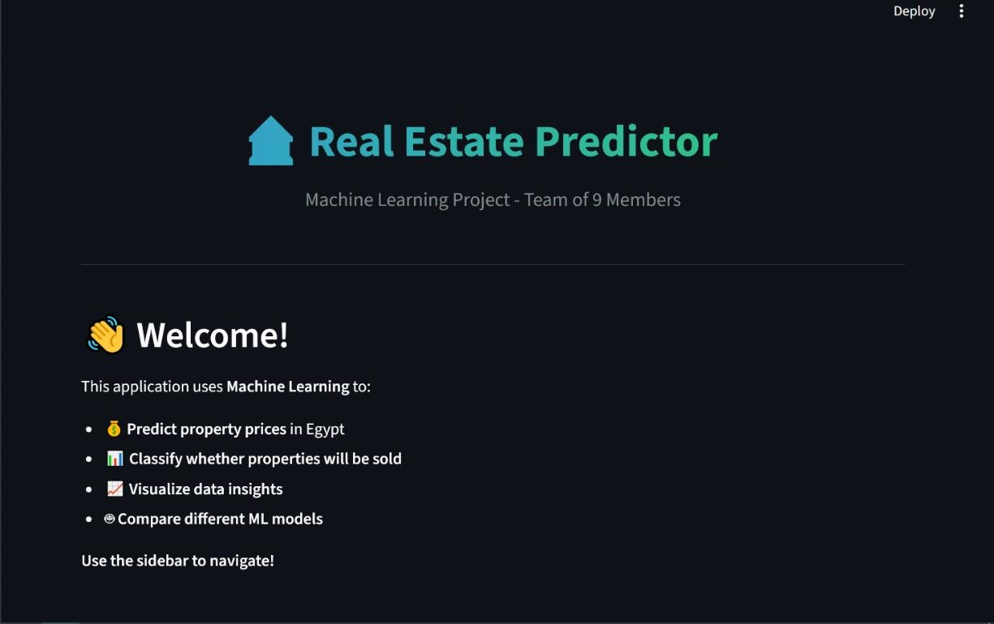
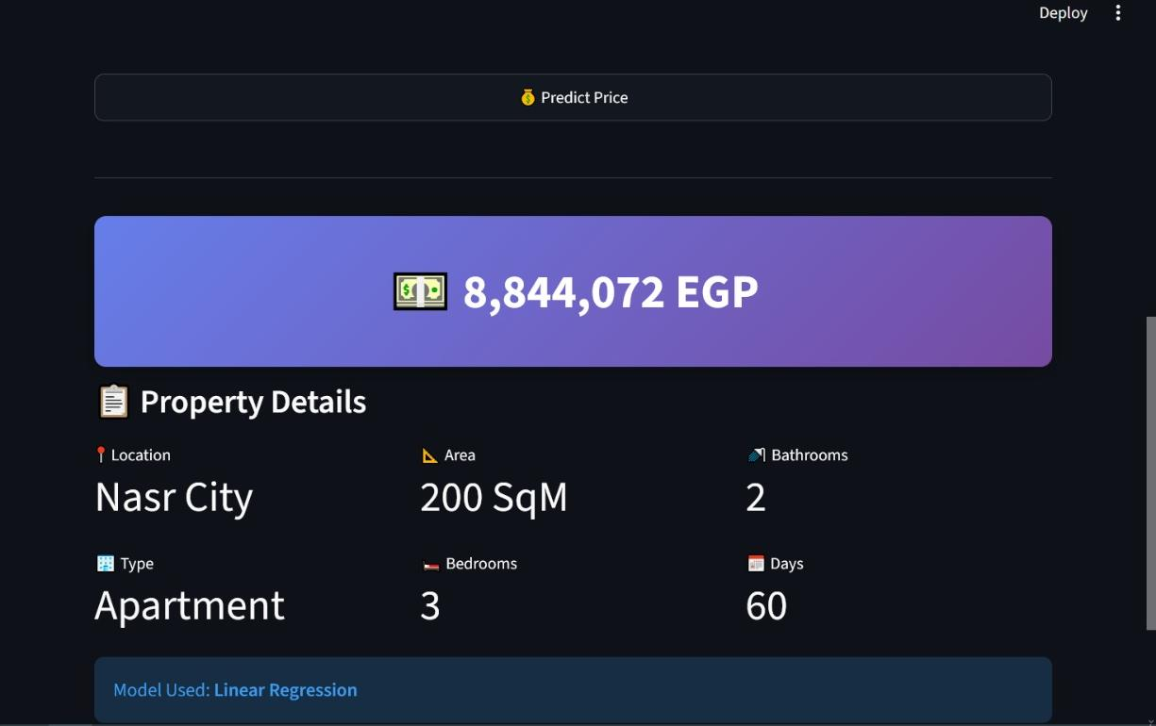
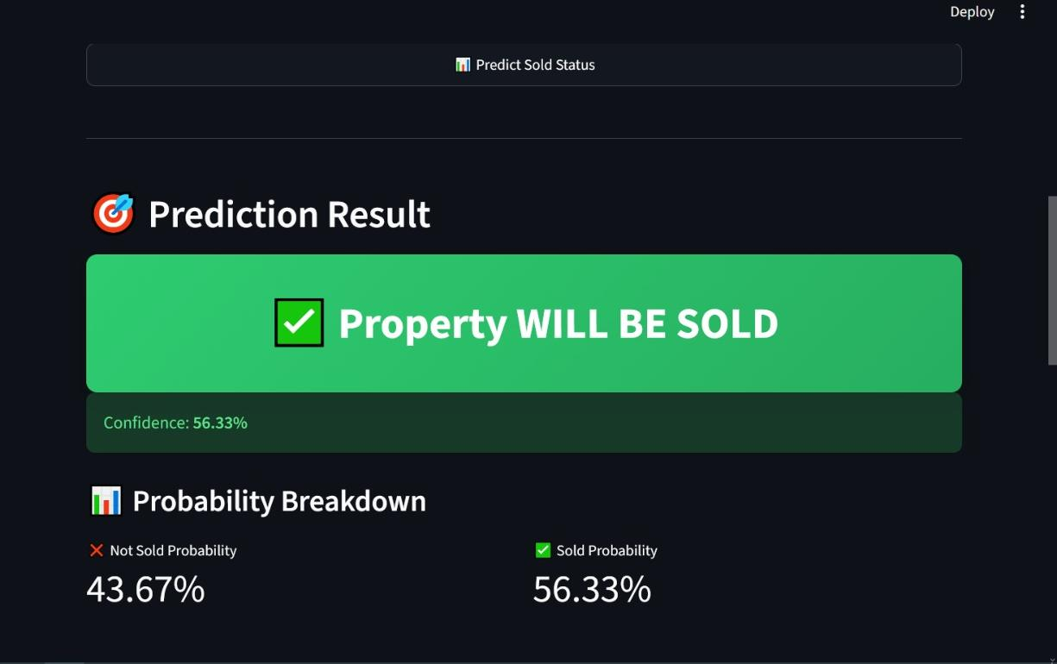
06 · INTERACTIVE WEB APP
The Real Estate Predictor — Streamlit App
A 5-page app built with Streamlit lets any non-technical user get instant predictions from the saved models.
Price Prediction — live estimate (Linear Regression)
Home — project overview & key figures
Is_Sold Classification — sale-probability estimate
• Home • Price Prediction • Is_Sold Classification • EDA Insights • Models Comparison
Real Estate ML Project
13

Slide 14
07 · TEAM & CHALLENGES
Built by Ten, Limited by Data
TEAM STRUCTURE
Sub-team | Focus
Data & EDA | Cleaning, exploratory analysis
Modeling (3) | Regression + classification models
Web App (2) | Streamlit app + custom CSS
Presentation (2) | Reporting & committee demo
CHALLENGES & LIMITATIONS
▸
Small dataset
Only 250 properties — ~200 train / 50 test — sensitive to random fluctuation
▸
Weak feature-price link
Area, bedrooms, location, type poorly explain price variation
KEY TOOLS
Python
Pandas / NumPy
scikit-learn
▸
Class imbalance
Fewer "Sold" than "Not Sold" hurt minority-class recall
XGBoost
Streamlit
Seaborn
Git
joblib
▸
Missing real-world features
No floor number, finishing, transit proximity, or building age
Real Estate ML Project
14

Slide 15
CONCLUSION
Methodology Over Metrics
The quantitative results were modest — negative R² on price, 62% accuracy on sale status — but the project's real value is the process: cleaning and analyzing data rigorously, comparing algorithms scientifically, understanding weak performance instead of hiding it, and shipping a working interactive product.
250
Properties analyzed
8
Models trained & compared
NEXT STEPS
→ Collect a few hundred more properties
62%
Best classification accuracy
→ Add real-world features (floor, finishing, transit)
→ Try SMOTE, LightGBM/CatBoost, and Nested CV
→ Deploy on Streamlit Community Cloud
5
Live app pages
Thank You · Real Estate ML Project · Data Analyst Training 2026

