Slide 1


IIPC Assistant
Title: IIPC Assistant: An AI-Powered Web Archiving Platform
Name: Youssef Wael Nabil
Student ID: 21100877
Department: Artificial Intelligence, Faculty of Computer Science & Engineering
University: Al Alamein International University

Slide 2
Agenda
The Problem
Aim
Why RAG? (Architectural Decision)
System Architecture
Development Journey: Milestones 1 & 2
Optimization
Conclusion & Future Work
The Final Application (Demo)

Slide 3

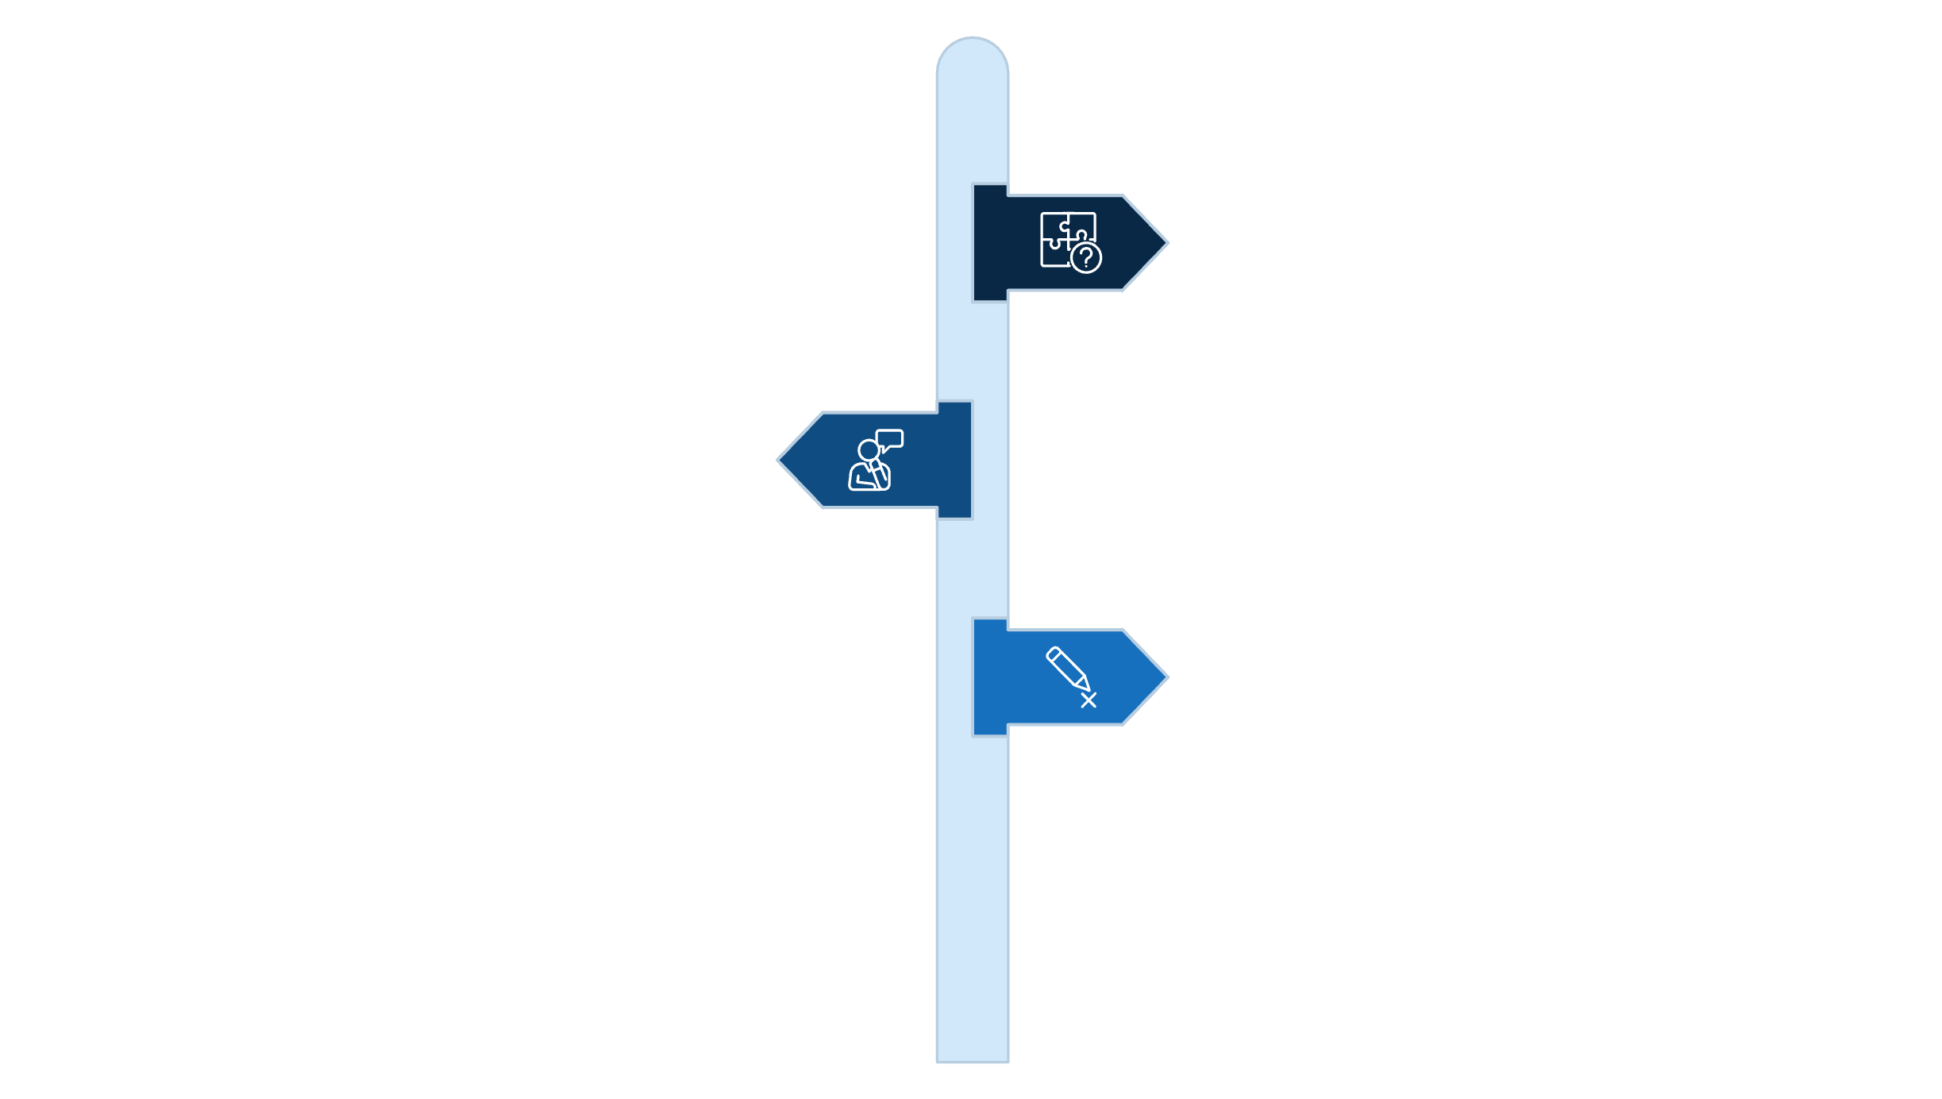



Problem
Valuable IIPC resources (conference posters, presentations) are hard to access and search.
Traditional search lacks semantic understanding.
Extracted text from PDFs/Video is unstructured and noisy (OCR errors, fragmented slides).

Slide 4

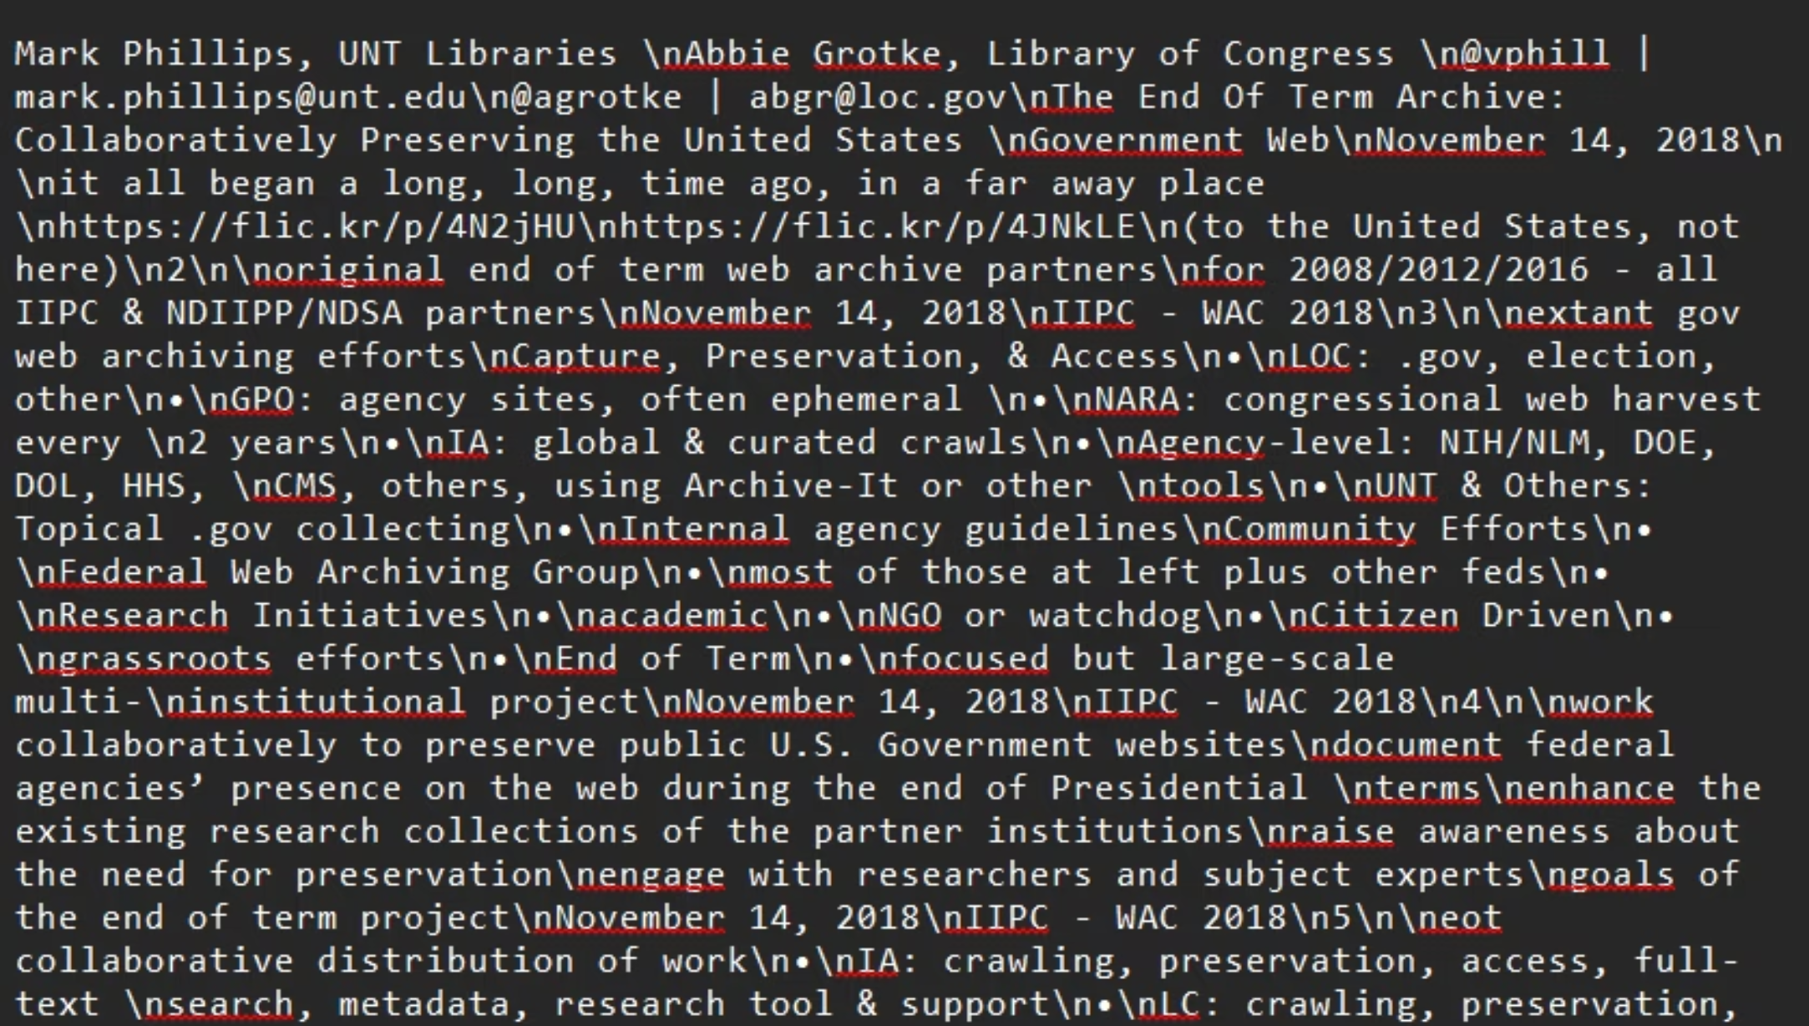
Example
raw text extracted from conference presentation slides:

Slide 5

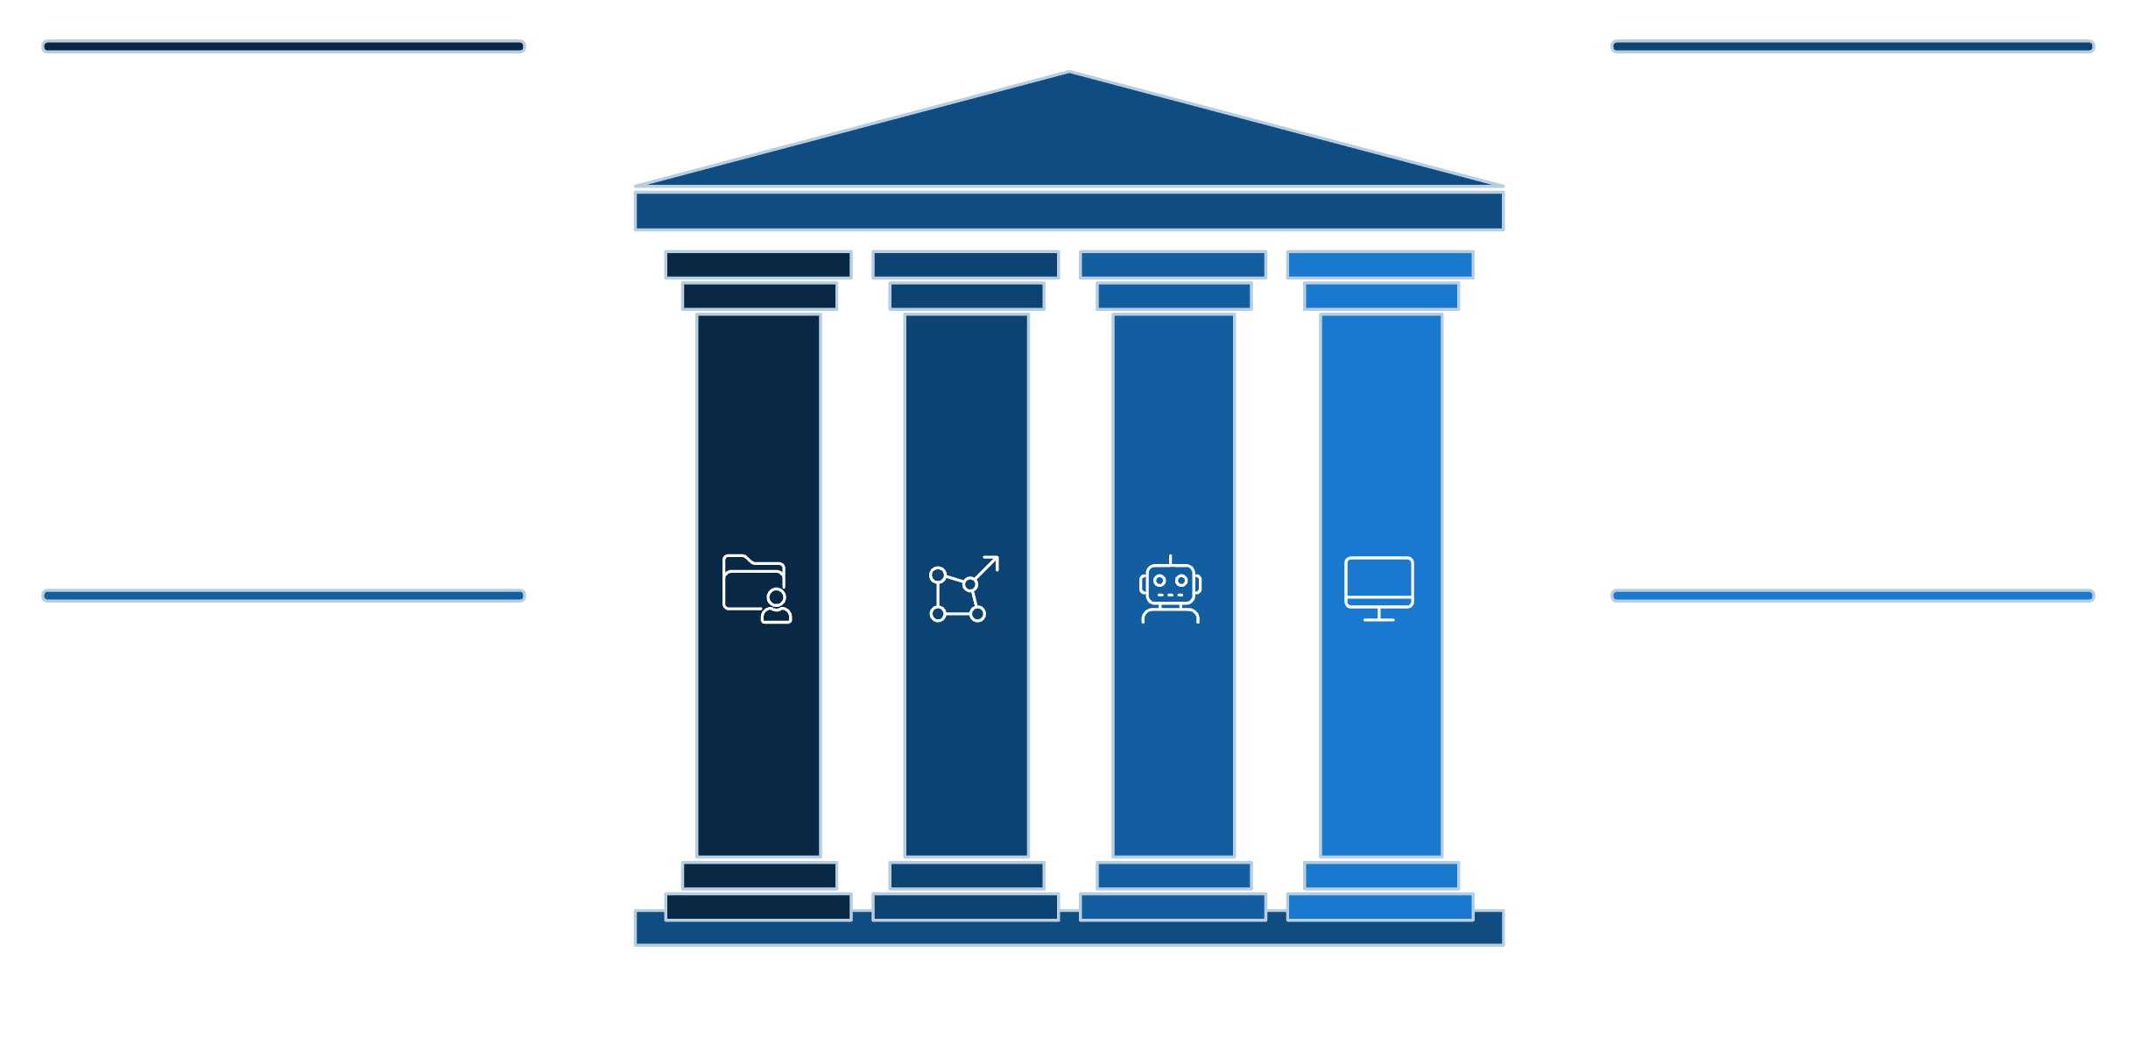




Aim & Objectives
Primary Aim: To build an AI-powered platform for natural-language querying of IIPC materials.
Knowledge Base
Semantic Search
Searchable repository of 587+ documents
Vector embeddings for relevance-ranked retrieval
AI ChatBot
Modern UI
Context-aware assistant with verifiable sources
Responsive web interface for seamless access

Slide 6

Available data
Volume: 587 IIPC documents harvested via OAI-PMH from UNT Digital Library.
IIPC_materials extracted:
title – text field for the material’s title
Types: Conference posters, presentation slides, and video transcripts.
creator – text field for the author or contributor
Challenge: The extracted text was noisy and poorly structured.
date – date of the material
description – detailed text description
Specific Problems: OCR errors and formatting artifacts from PDFs.
subject – topic or keywords
item_type – type of item (e.g., paper, presentation, video)
ark_url – link to the material
source_url – link to the item
content – extracted text or content

Slide 7

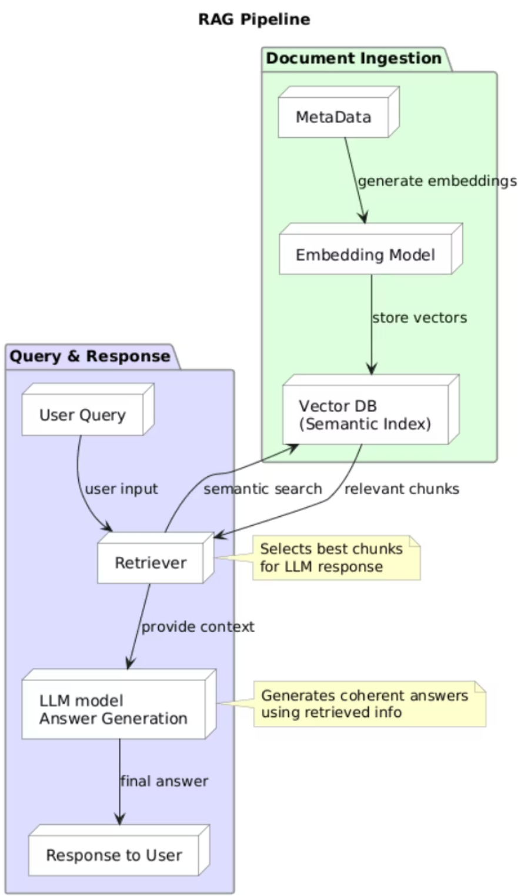
Why RAG?
Challenge: Dataset is unstructured and lacks QA pairs for fine-tuning.
Solution: Retrieval-Augmented Generation (RAG)
Advantages:
Scalable: Add new content without retraining.
Transparent: Every answer is based on grounded sources.

Slide 8

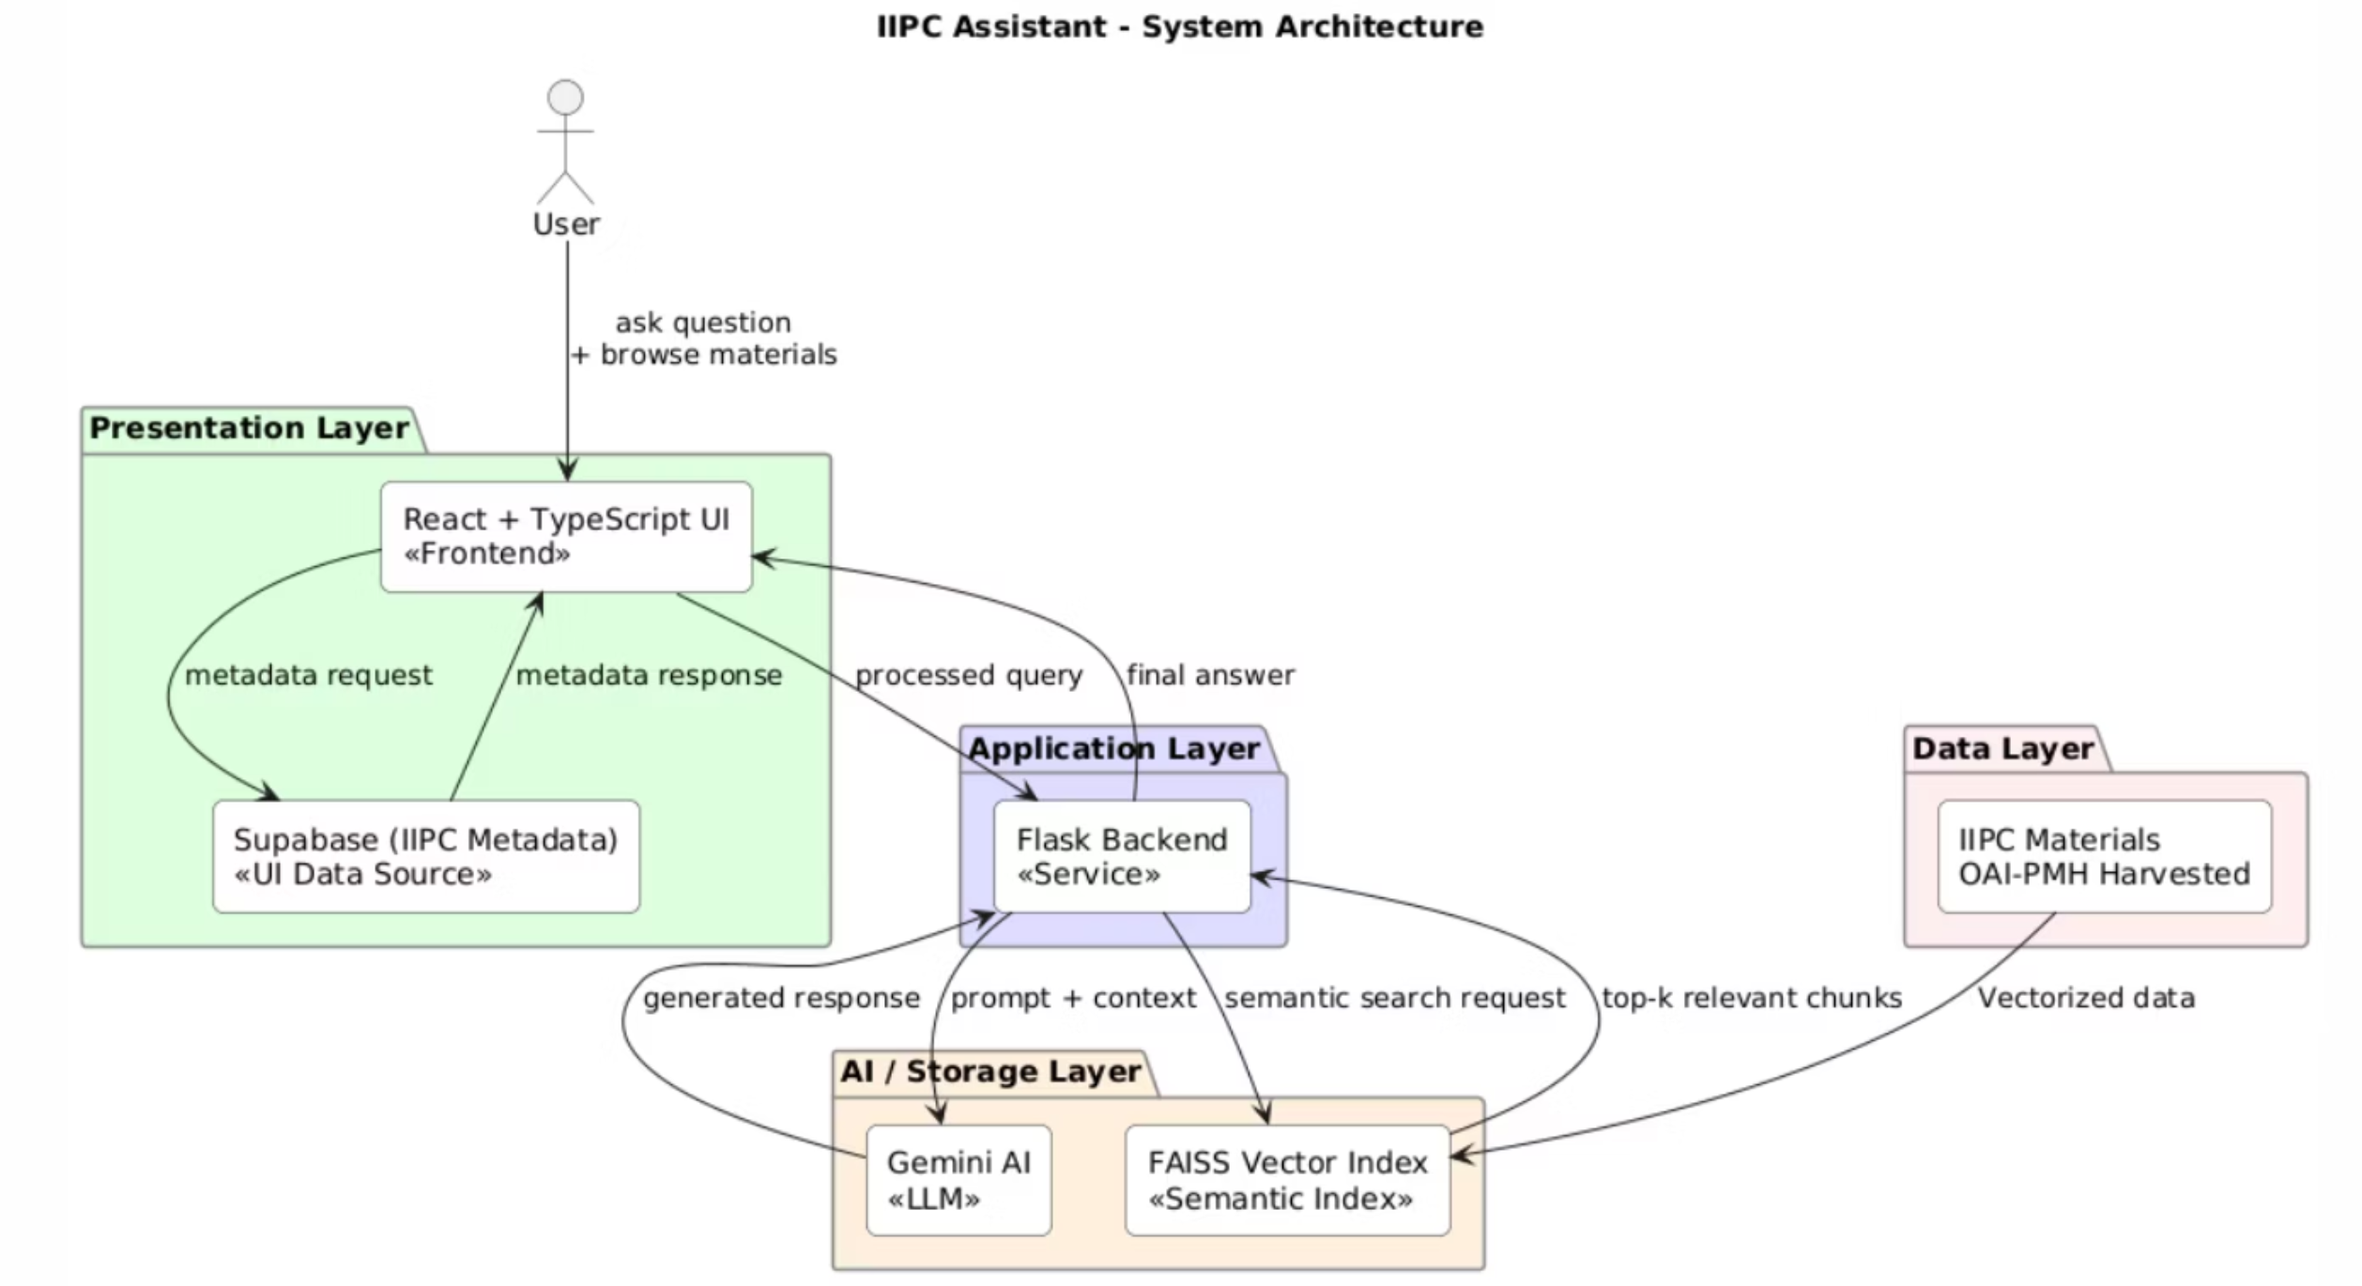
System Architecture

Slide 9
Milestone 1:
Accomplishment 1: Data Harvesting
Automated collection of 587 documents via OAI-PMH.
Preserved full metadata (title, creator, date, ARK URL).
Accomplishment 2: Tech Stack Selection
Embeddings: BAAI/bge-base-en-v1.5
LLM: tiiuae/falcon-7b-instruct (Initial)
Challenge Identified: Raw text quality was poor, limiting answer accuracy.

Slide 10

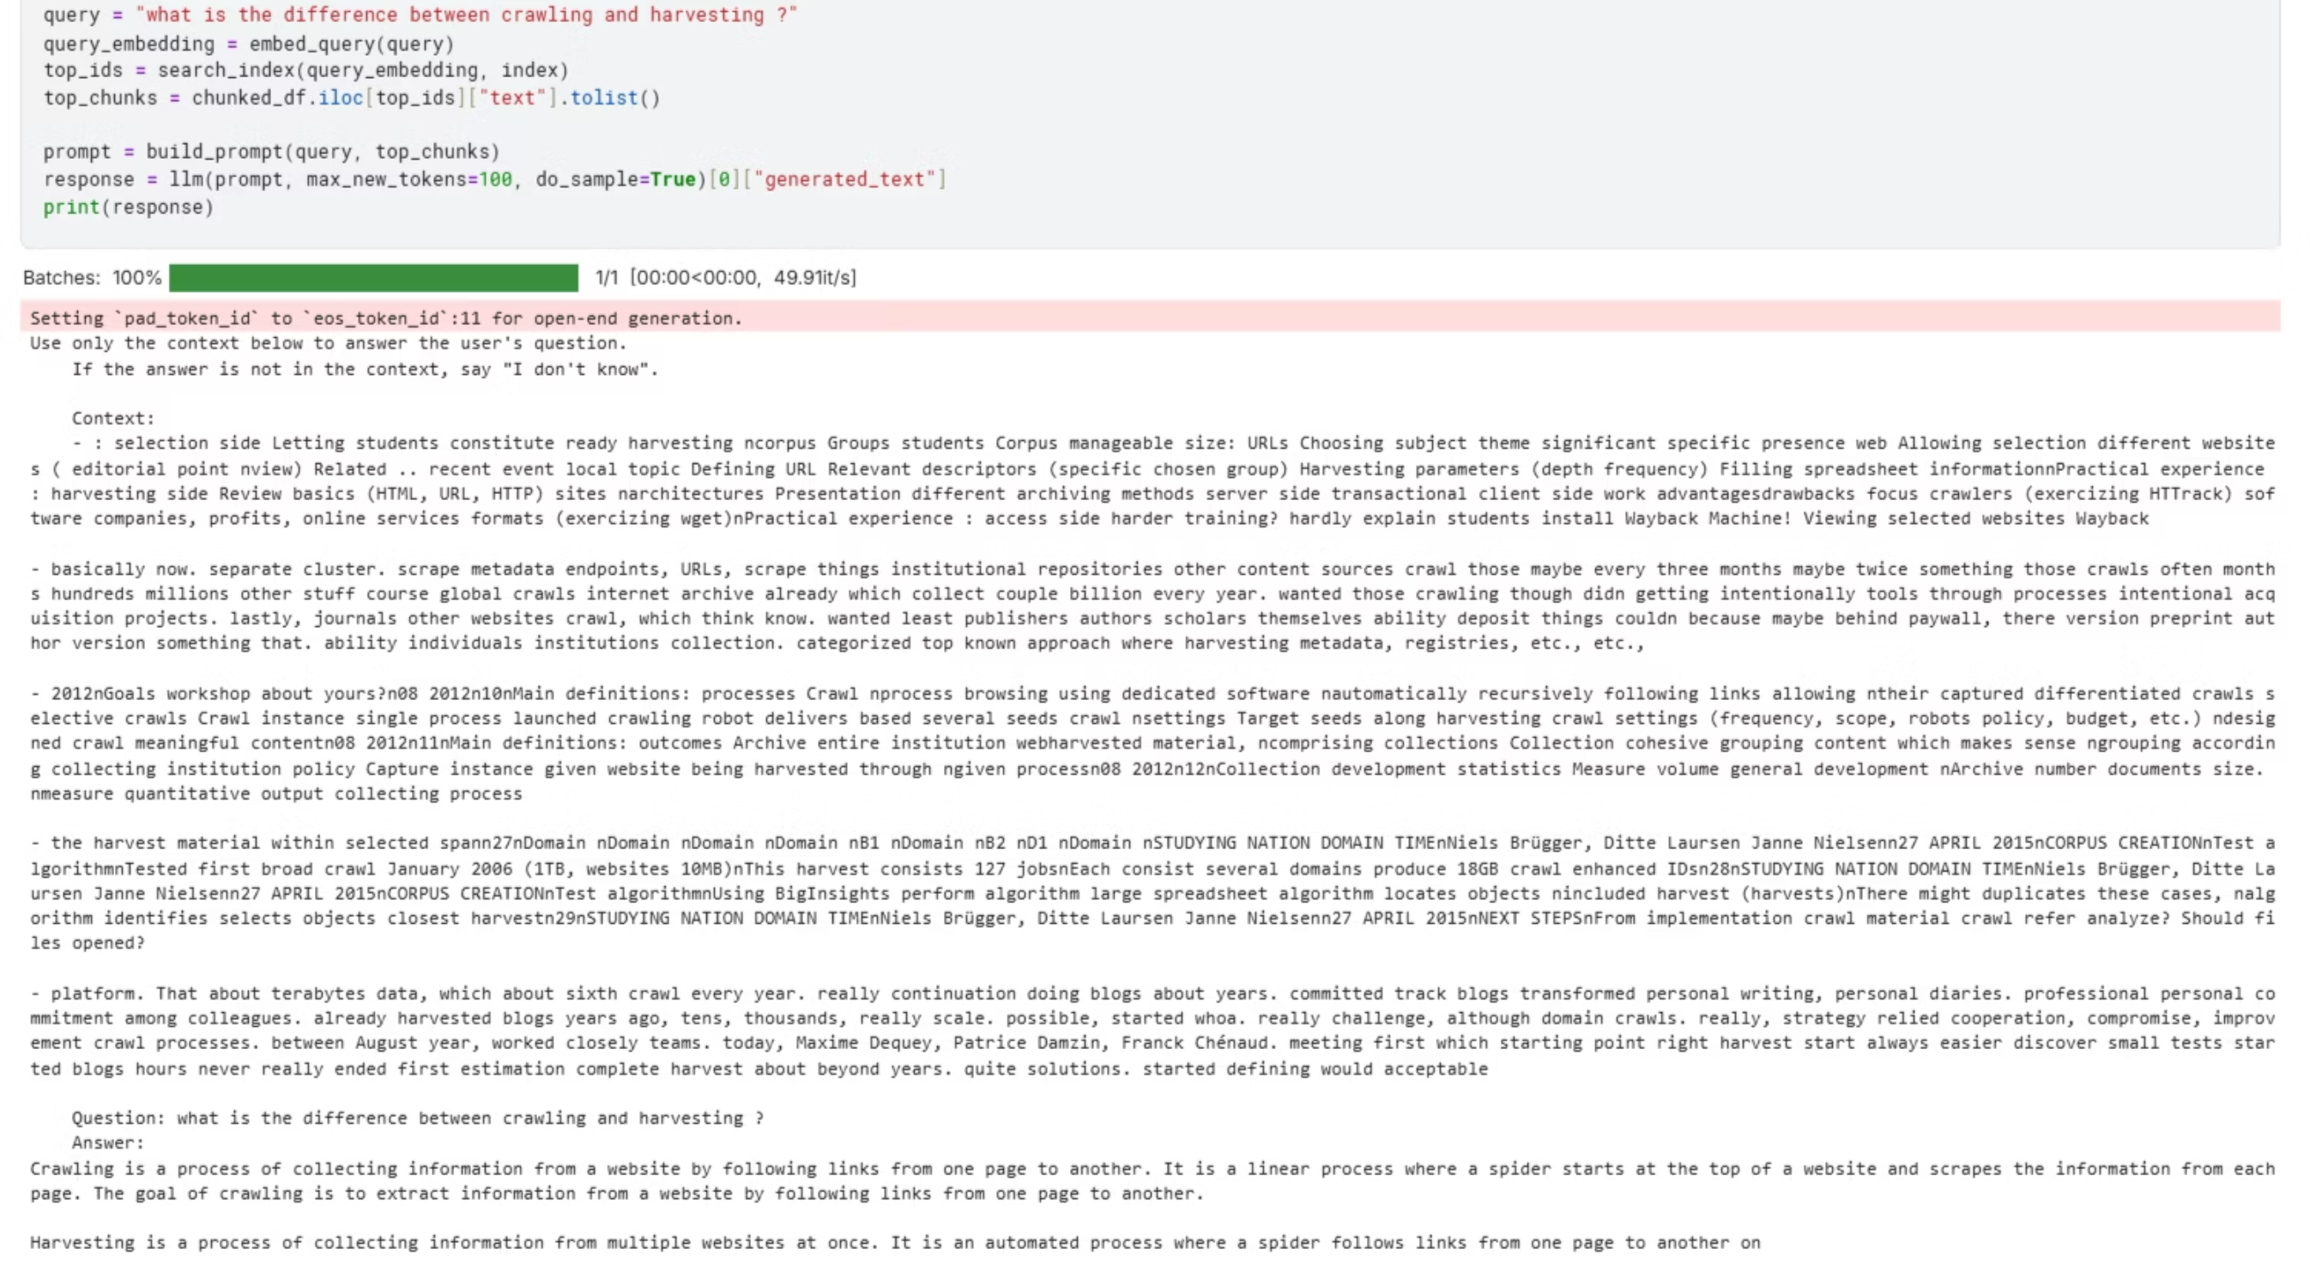
Results after Milestone 1

Slide 11

Milestone 2
Accomplishment 1: AI-Powered Text Enhancement
Used Google Gemini 2.5 Flash-Lite to restructure all documents.
Transformed messy text into coherent narratives.
Result: A high-quality, semantically rich dataset.
Accomplishment 2: Functional Prototype
Built a Streamlit app for testing.
Then build web interface
Upgraded LLM to Google Gemini for generation.
New Challenge: Retrieval needed optimization for broader context.

Slide 12
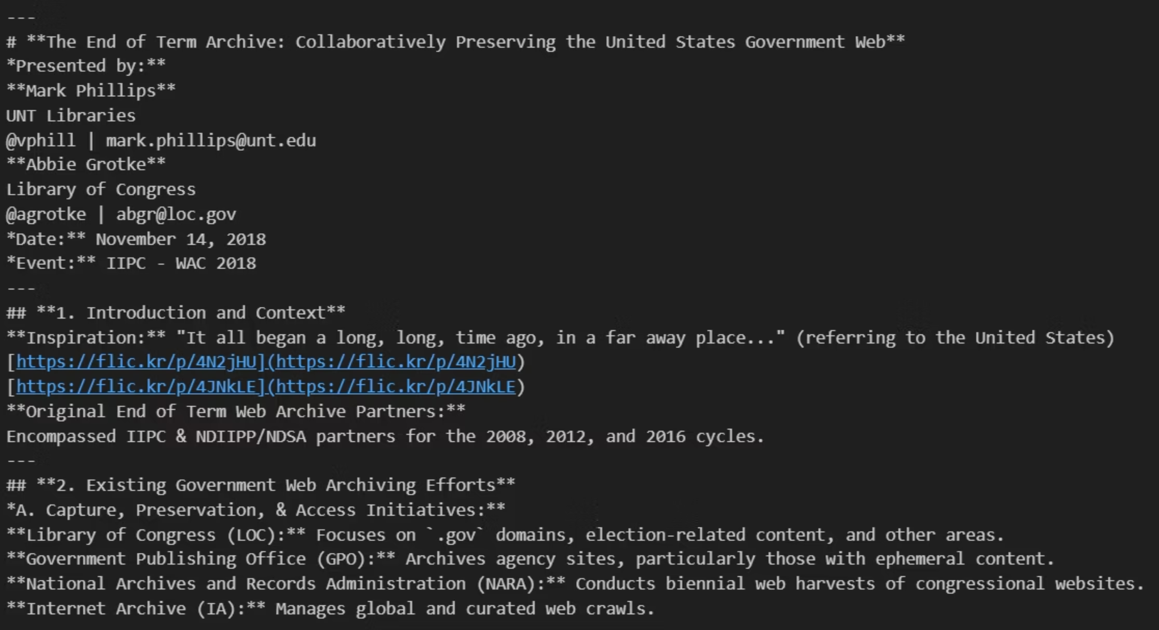
Text Enhancement

Slide 13

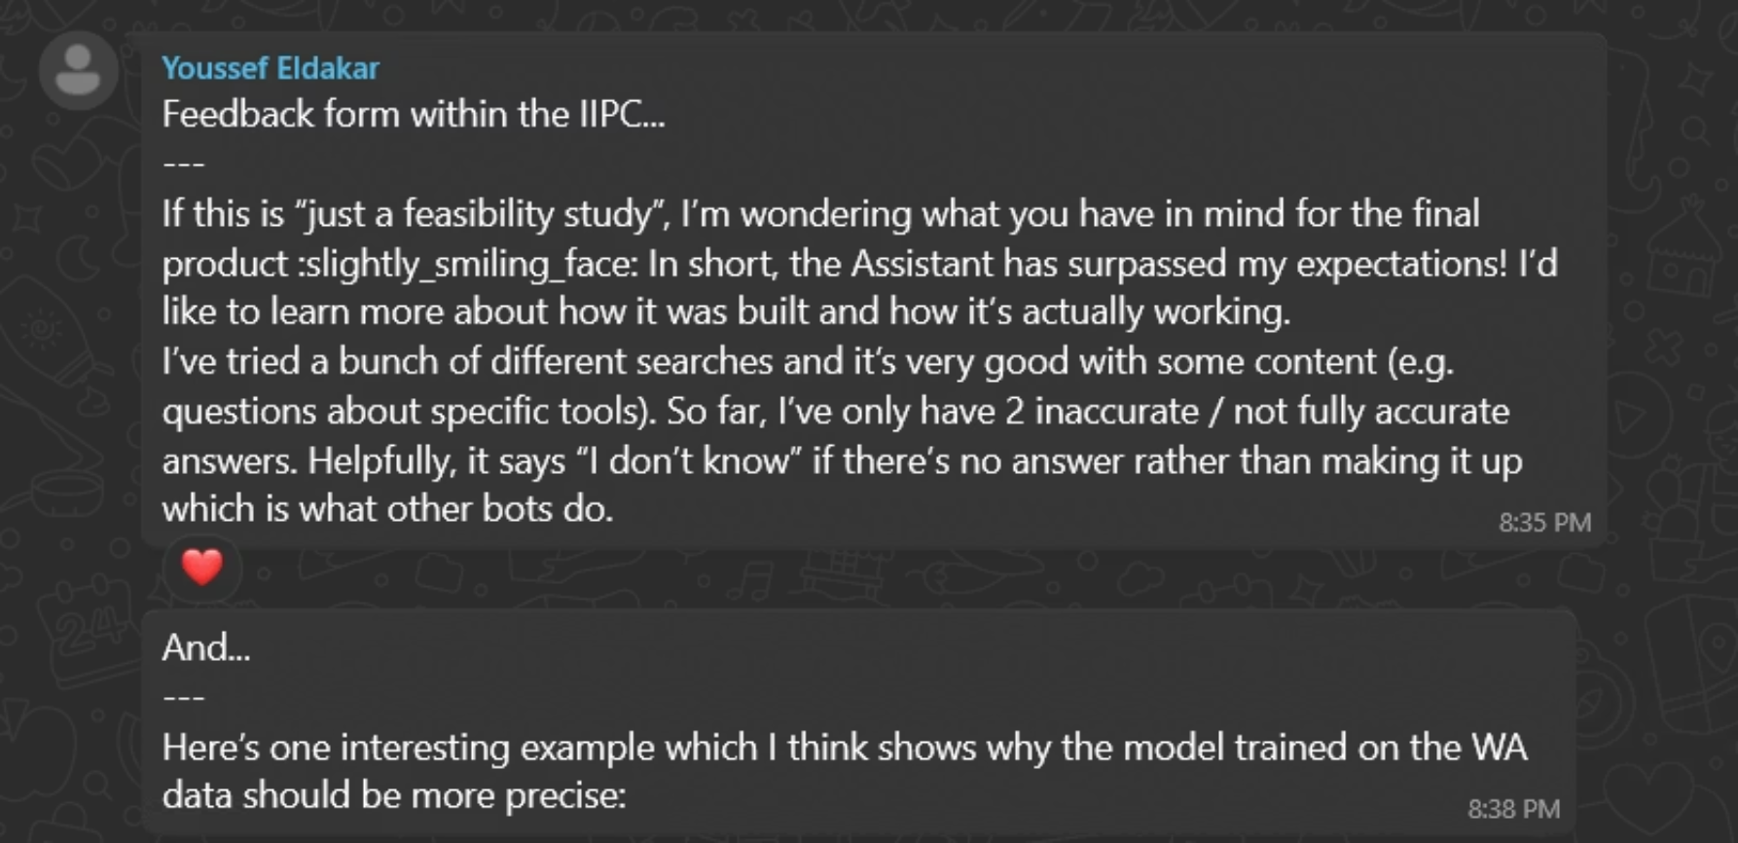
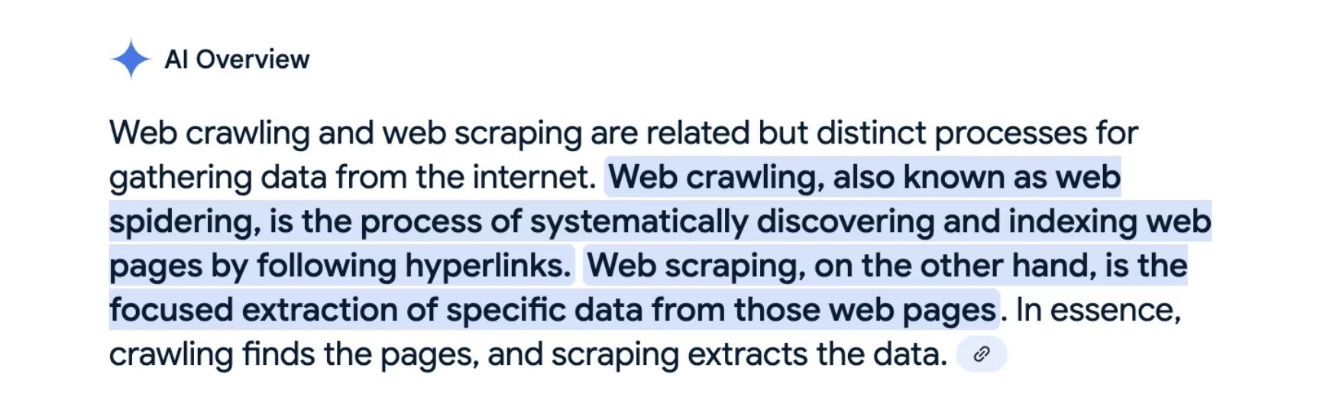
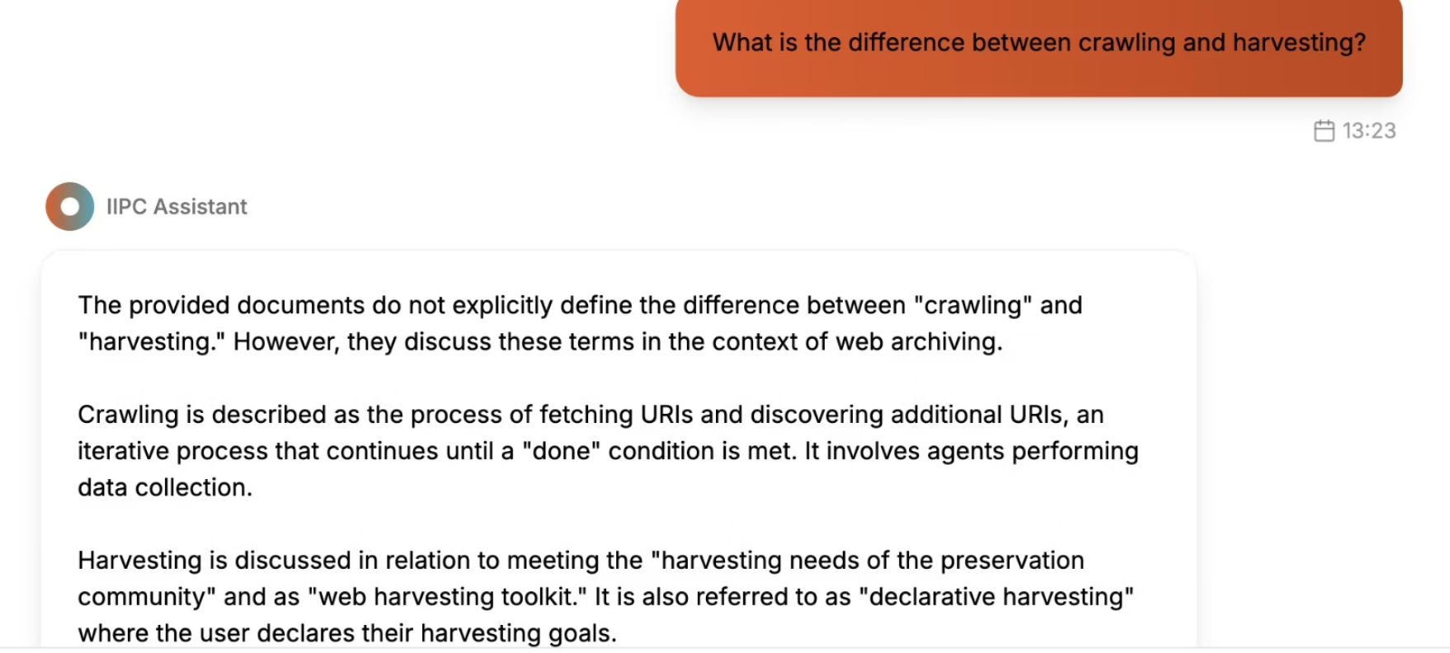
Results after Milestone 2
Our chatBot response

Slide 14

Optimized Retrieval Method and Prompt
Old Method
New Method
Retrieve top-k chunks by score.
Retrieve top 30 chunks.
Risk: Gets details but misses the big picture."
Group by Document ID.
Rank documents by their best chunk.
Select top 3 documents.
Take best chunks from them.
Optimized Prompt: Summarize IIPC conference content using correct web archiving terms and always include where it came from (title, author, date, ARK URL)."
Conclusion: Ensures answers are comprehensive and document-aware.

Slide 15

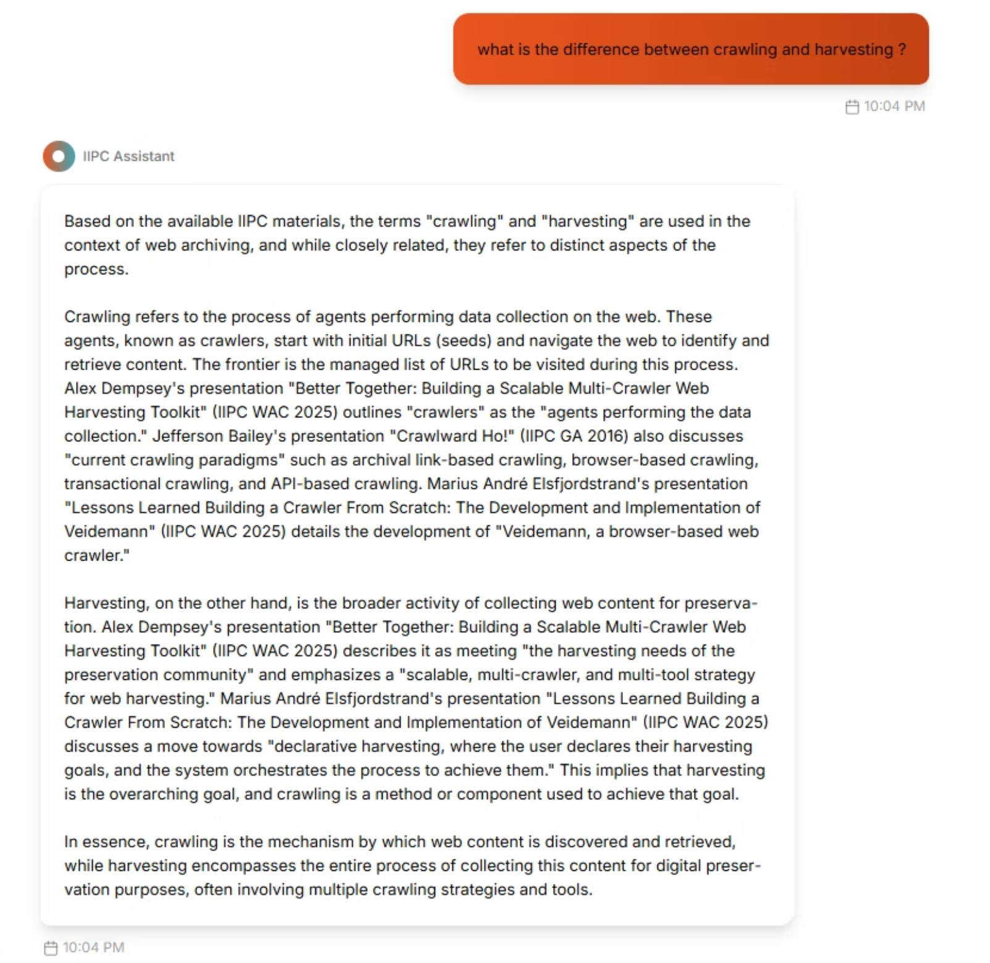
Results after Optimization

Slide 16
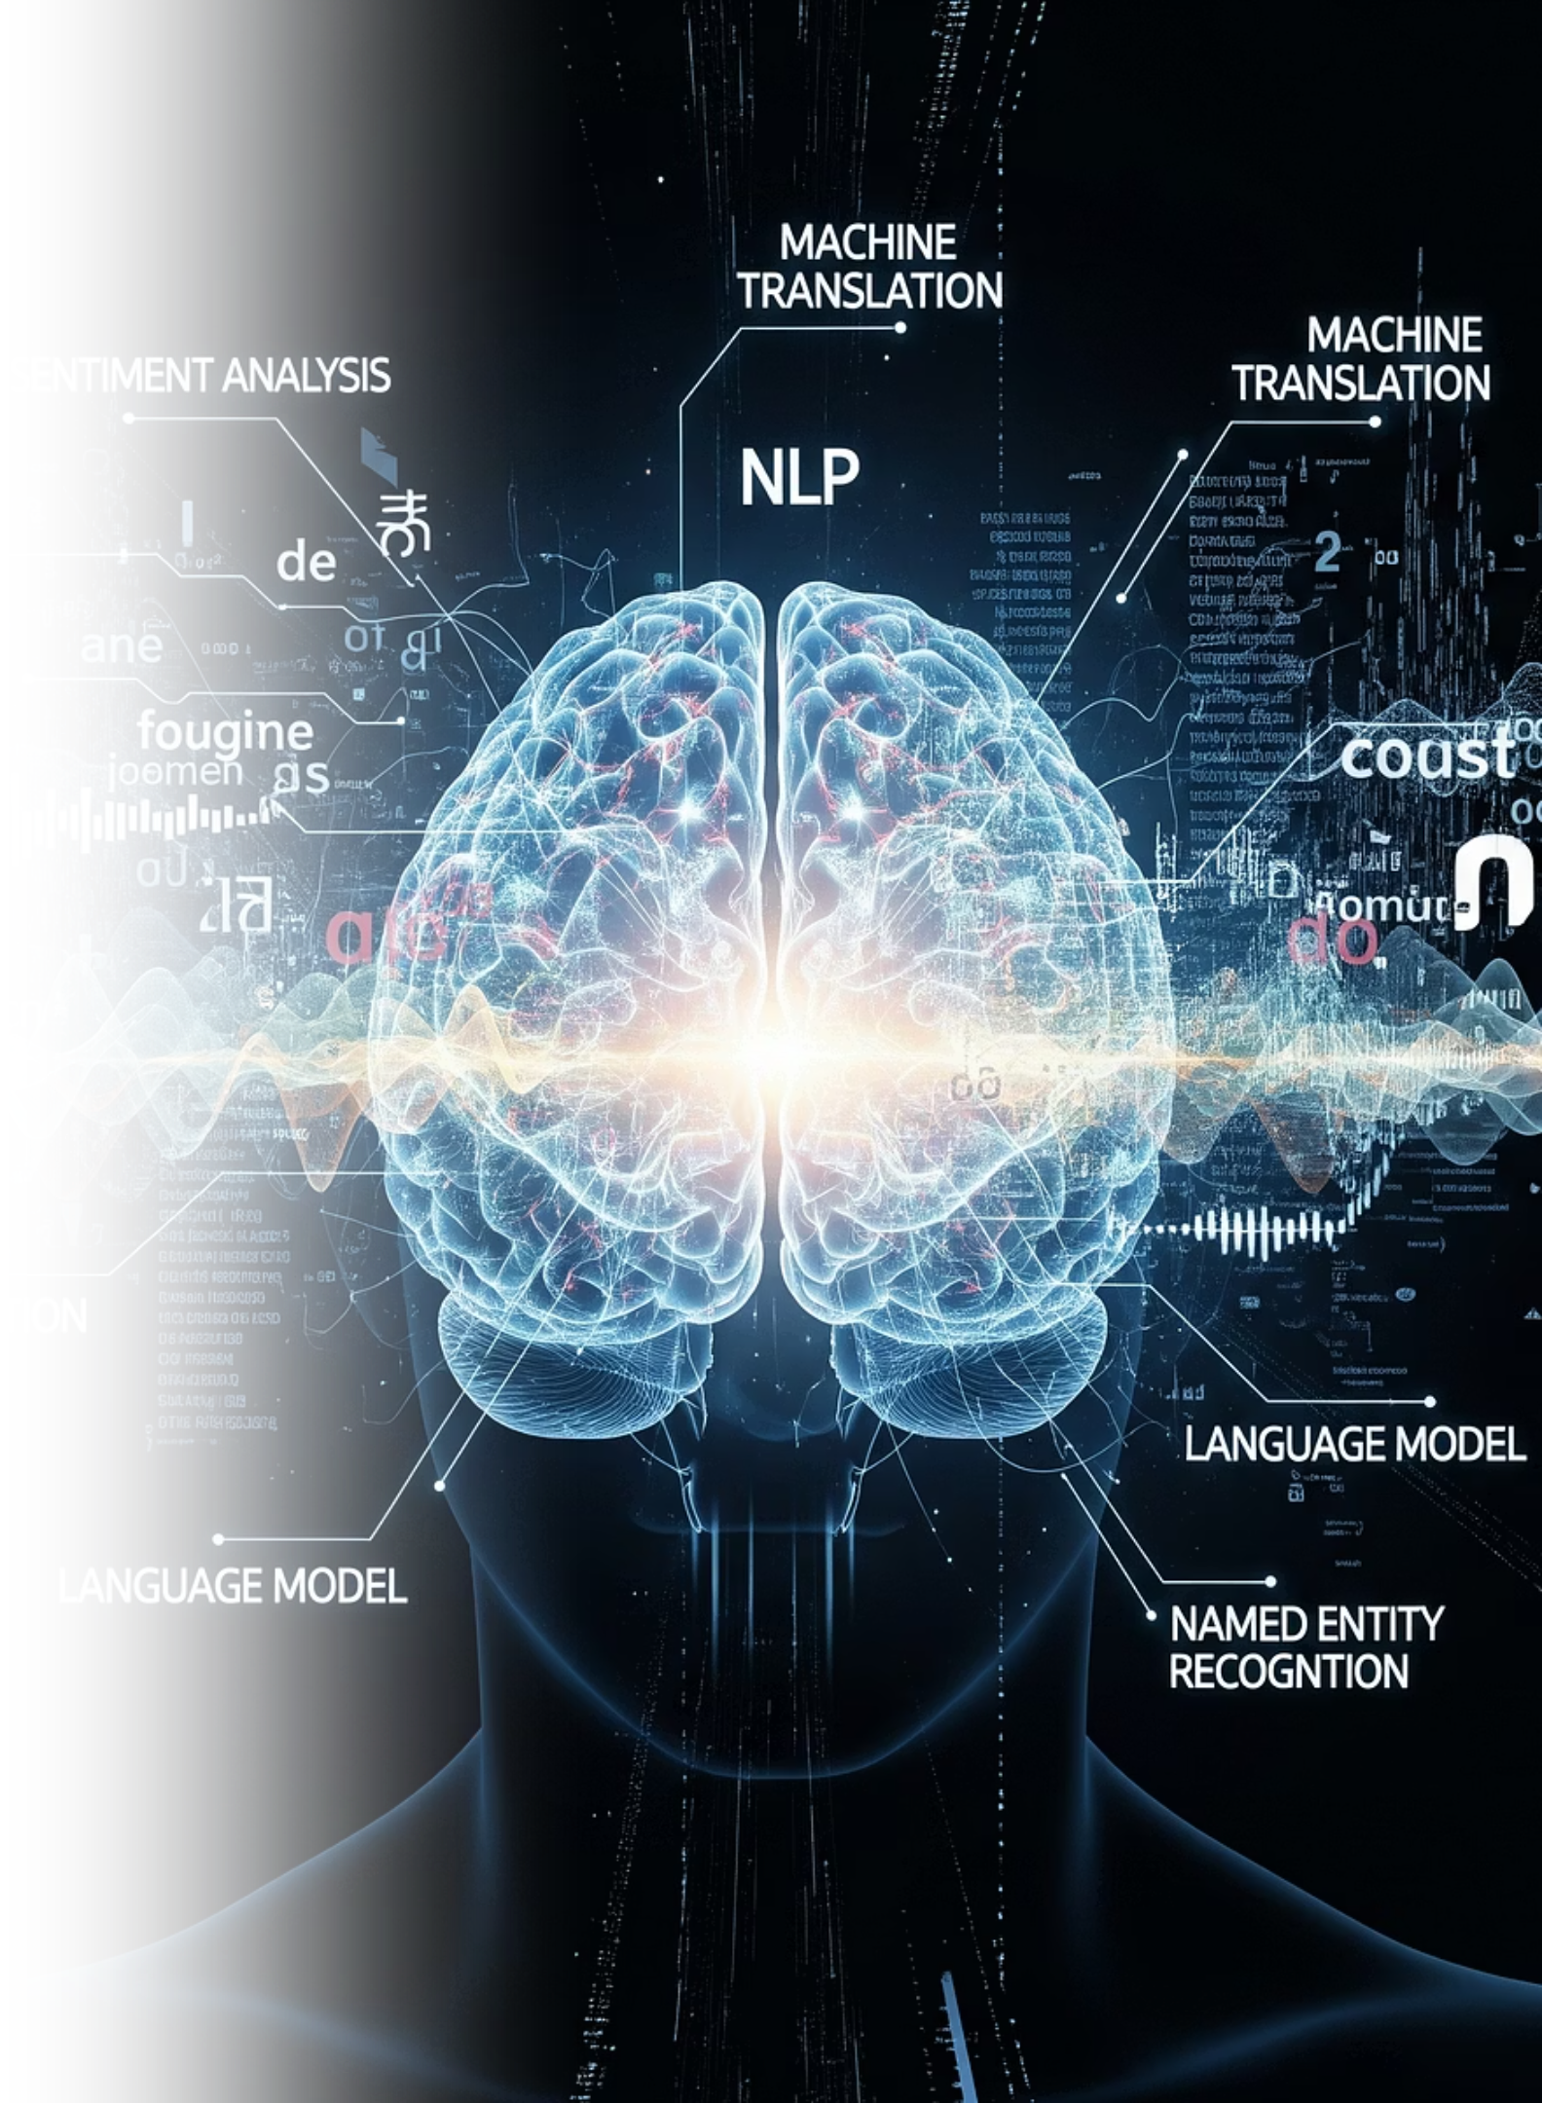
Conclusion & Future Work
Conclusion: Successfully delivered an AI platform that significantly enhances access to IIPC's specialized knowledge.
Key Innovations: AI Text Enhancement, Document-Grouped Retrieval, Domain-Specific RAG.
Future Work:
Expand document collection.
Add user accounts and query history.

Slide 17
Demo

