Slide 1
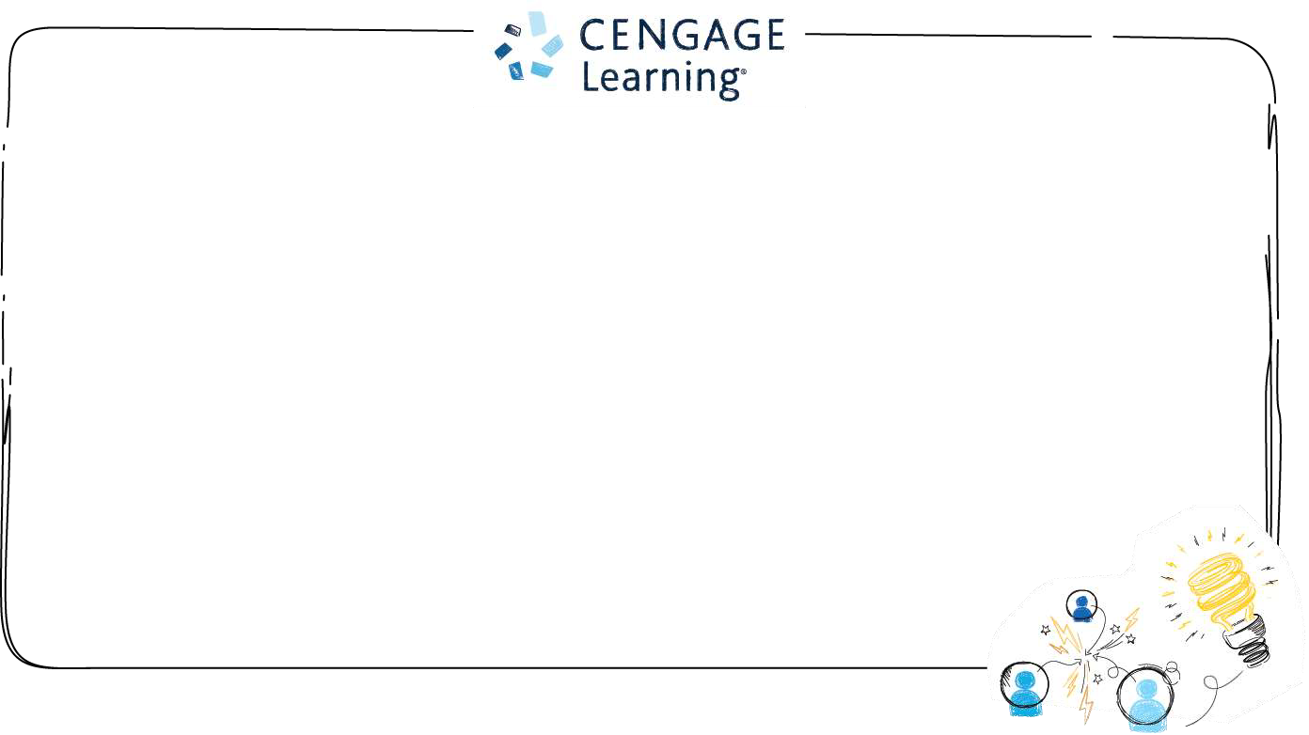


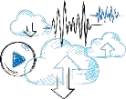



CompTIA Security+ Guide to Network
Security Fundamentals, Sixth Edition
Chapter 1
Introduction to Security
© 2018 Cengage. All Rights Reserved. May not be copied, scanned, or duplicated, in whole or in part, except for use
as permitted in a license distributed with a certain product or service or otherwise on a password-protected website for
classroom use.
1

Slide 2


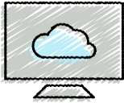



Objectives
1.1Describe the challenges of securing information
1.2Define information security and explain why it is
important
1.2 Identify the types of attackers that are common
today
1.3Describe the five basic principles of defense
© 2018 Cengage. May not be copied, scanned, or duplicated, in whole or in part, except for use as permitted in a license distributed with a certain
product or service or otherwise on a password-protected website for classroom use.

Slide 3

Challenges of Securing Information
•Securing information
•No simple solution
•Many different types of attacks
•Defending against attacks is often difficult
© 2018 Cengage. All Rights Reserved. May not be copied, scanned, or duplicated, in whole or in part, except for use as permittedin a license
distributed with a certain product or service or otherwise on a password-protected website for classroom use.
3

Slide 4
Today’s Security Attacks
•Examples of recent attacks
•Remotely controlling a car
•Tampering with aircraft systems
•Yahoo accounts compromised by attackers
•USB flash drive malware/USB Killer
•WINVote voting machine tampering
•Vtech security breach
•Stolen data from the European Space Agency
• Internal Revenue Service (IRS) fraud
•Hyatt Hotels Corporation hacked
© 2018 Cengage. All Rights Reserved. May not be copied, scanned, or duplicated, in whole or in part, except for use as permittedin a license
distributed with a certain product or service or otherwise on a password-protected website for classroom use.
4
Notes:
-half a billion Yahoo accounts were compromised by attackers who gained unauthorized access to its web servers.
-The AVS WINVote voting machine passed state voting system standards and has been used in Virginia, Pennsylvania, and Mississippi. However, the security on the machine was alarmingly weak. Easily guessed passwords like admin, abcde, and shoup were used to lock down its administrator account and wireless network settings, as well as the voting results database. Because these passwords were hard-coded into the machines they could not be changed. The wireless network settings used to transmit results relied upon a configuration that could
easily be broken in fewer than 10 minutes. These tabulating machines lacked even basic security like a firewall and exposed several Internet openings to attackers.
-The educational toy maker VTech revealed that millions of accounts containing information on children were stolen. Approximately 11.6 million accounts were compromised in an attack that included information on 6.4 million children. The data on children that was stolen included name, gender, birth date, profile photo, and progress log. As with many recent breaches, VTech did not know that it had been a victim until it was approached by a security research firm that had discovered the attack.
-The European Space Agency (ESA) is an intergovernmental organization made up of 22 countries and states that explores space. They are involved in the International Space Station and launch unmanned space exploration missions to different planets through their spaceport in French Guiana. A group of attackers stole data from the ESA, including information on 8107 of its users, and then posted it online. Even though the ESA information regarding space exploration needed to be kept secure so that it was not altered, the passwords used by ESA scientists were alarmingly weak. Of the passwords exposed, 39 percent (or 3191) were only three characters long, such as 410, 832, 808, and 281. Only 22 total users had a strong password of a recommended length of 20 characters.
-The Internal Revenue Service is the revenue service for the United States federal government, which is responsible for collecting U.S. federal taxes and administering the Internal Revenue Code
-Hyatt Hotels Corporation reported that cybercriminals successfully attacked restaurants, front desks, spas, and parking facilities at 250 of their hotels worldwide over a four-month period. The attacker’s software was installed on the Hyatt computers and could capture payment card details like cardholder names, card numbers, expiration dates, and verification codes when the cards were swiped. Other hotel chains have likewise been compromised. Security researchers speculate that attackers are keenly interested in attacking the hospitality industry. Hotels today are rarely owned by the big companies themselves, but instead the hotels are owned by separate investors with the hotel chains simply collecting management and franchise fees. This creates uneven security at the different hotels, and even within the hotels: hotel-based restaurants, spas, and gift shops are often owned and managed by third-party companies. While the hotel brands may require property owners to follow specific standards—such as using pillowcases of 100 percent Egyptian cotton with a 1500 thread count—they often do not have the same requirements for security. There is even speculation that the hotel brands are hesitant to mandate strict security guidelines, because if a hotel is attacked then the hotel brand may be legally liable. Another reason for the popularity of hacking hotels is that hotel brands cater to high-end, frequent business travelers. These customers often make charges on their trips using a corporate credit card and can be slower to spot unusual transactions compared to using their personal card. And many hotels keep multiple cards on file for their frequent guests. This makes it easy to not only check in and out, but also allows guests to use their door key card to make purchases instead of giving a specific credit card. Having multiple instances of credit card data scattered throughout the hotel makes for multiple targets for attackers.1

Slide 5
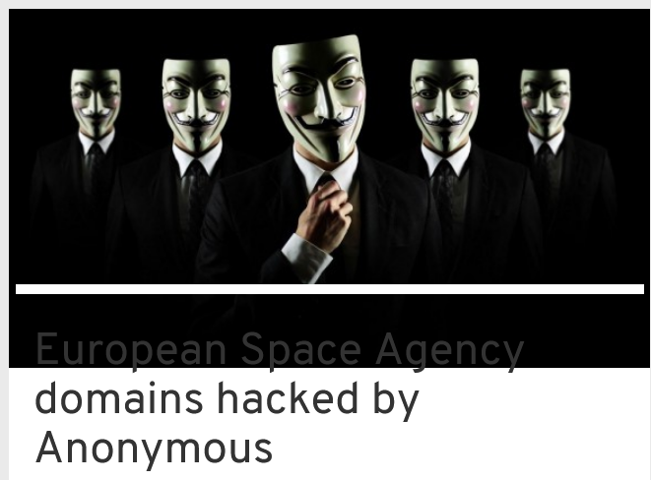
https://www.cyberdefensemagazine.com/european-space-agency-domains-hacked-by-anonymous/
© 2018 Cengage. All Rights Reserved. May not be copied, scanned, or duplicated, in whole or in part, except for use as permittedin a license
distributed with a certain product or service or otherwise on a password-protected website for classroom use.
4

Slide 6
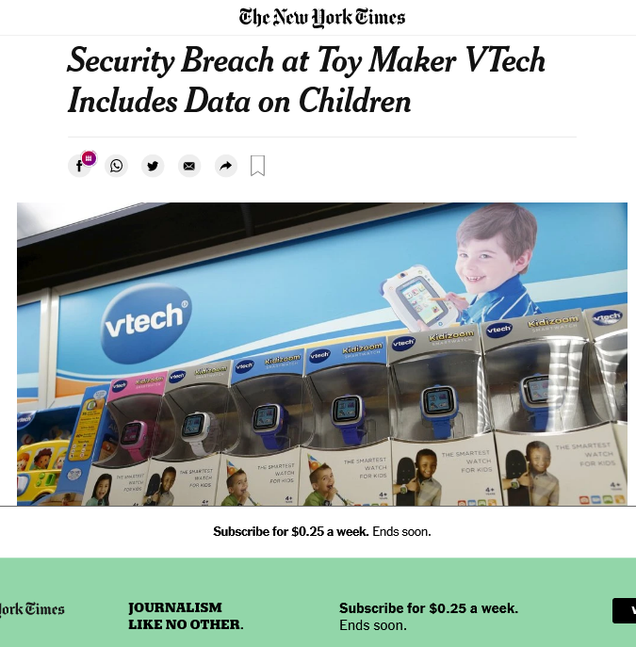
© 2018 Cengage. All Rights Reserved. May not be copied, scanned, or duplicated, in whole or in part, except for use as permittedin a license
distributed with a certain product or service or otherwise on a password-protected website for classroom use.
4

Slide 7
Reasons for Successful Attacks
•Widespread vulnerabilities نقاط الضعف كتير
•Configuration issues
•Poorly designed software
•Hardware limitations
•Enterprise-based issues
© 2018 Cengage. All Rights Reserved. May not be copied, scanned, or duplicated, in whole or in part, except for use as permittedin a license
distributed with a certain product or service or otherwise on a password-protected website for classroom use.
5

Slide 8


Difficulties in Defending Against Attacks
Reason Description
Universallyconnected devices Attackers from anywhere in the world can send
attacks
Increased speed of attacks Attackers can launch attacks against millions
of computer withinminutes
Greater sophisticationof attacks Attack tools vary their behavior so the same
attack appears differently each time
Availability and simplicity of attack
tools
Attacks are no longer limited to highly skilled
attackers
Faster detection of vulnerabilities Attackers can discover security holes in
hardware or softwaremore quickly
Delays in security updating Vendors are overwhelmed trying to keep pace
updating their products against the latest
attacks
Weak security update distribution Many software products lack a means to
distribute security updates in a timely fashion
Distributed attacks Attackers use thousandsof computers in an
attack against a single computer or network
Use of personal devices Enterprises are having difficultyproviding
security for a wide array of personal devices
User confusion Users are required to make difficult security
decisions with little or no instruction
© 2018 Cengage. All Rights Reserved. May not be copied, scanned, or duplicated, in whole or in part, except for use as permittedin a license
distributed with a certain product or service or otherwise on a password-protected website for classroom use.
6

Slide 9
What is Information Security?
•Before defense is possible, one must understand:
•Exactly what security is
•How security relates to information security
•The terminology that relates to information security
© 2018 Cengage. All Rights Reserved. May not be copied, scanned, or duplicated, in whole or in part, except for use as permittedin a license
distributed with a certain product or service or otherwise on a password-protected website for classroom use.
7
Notes:
-Several terms are used when describing security in an IT environment: computer security, IT security, cybersecurity, and information assurance, to name just a few. Whereas each has its share of proponents and slight variations of meanings, the term information security may be the most appropriate because it is the broadest: protecting information from harm. Information security is often used to describe the tasks of securing information that is in a digital format, whether it be manipulated by a microprocessor (such as on a personal computer), preserved on a storage device (like a hard drive or USB flash drive), or transmitted over a network (such as a local area network or the Internet).
-The goal of information security is to ensure that protective measures are properly implemented to ward off attacks and prevent the total collapse of the system when a successful attack does occur. Thus, information security is first protection

Slide 10
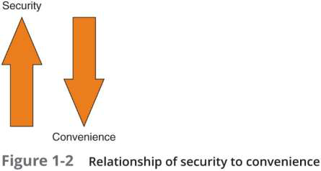
Understanding Security
•Security is:
•To be free from danger is the goal
•The process that achieves that freedom
•As security is increased, convenience is often decreased زياده الامان تقل الراحه
•The more secure something is, the less convenient it may become to use
© 2018 Cengage. All Rights Reserved. May not be copied, scanned, or duplicated, in whole or in part, except for use as permittedin a license
distributed with a certain product or service or otherwise on a password-protected website for classroom use.
8
Notes:
-What is security? The word comes from the Latin, meaning free from care. Sometimes security is defined as the state of being free from danger, which is the goal of security. It is also defined as the measures taken to ensure safety, which is the process of security. Since complete security can never be fully achieved, the focus of security is more often on the process instead of the goal. In this light, security can be defined as the necessary steps to protect from harm.
-It is important to understand the relationship between security and convenience. As security is increased, convenience is often decreased. That is, the more secure something is, the less convenient it may become to use (security is said to be inversely proportional to convenience).

Slide 13
Defining Information Security (1 of 4)
•Information security -the tasks of securing information that is in a
digital format:
•Manipulated by a microprocessor
•Preserved on a storage device
•Transmitted over a network
•Information security goal -to ensure that protective measures are
properly implemented to ward off attacks and prevent the total collapse
of the system when a successful attack occurs
© 2018 Cengage. All Rights Reserved. May not be copied, scanned, or duplicated, in whole or in part, except for use as permittedin a license
distributed with a certain product or service or otherwise on a password-protected website for classroom use.
9

Slide 14
Information Security Terminology (1 of 4)
•Asset الاصل
•Item that has value
•Threat
•Type of action that has the potential to cause harm
•Threat actor
•A person or element with power to carry out a threat
© 2018 Cengage. All Rights Reserved. May not be copied, scanned, or duplicated, in whole or in part, except for use as permittedin a license
distributed with a certain product or service or otherwise on a password-protected website for classroom use.
13

Slide 15
Defining Information Security (2 of 4)
•Three types of information protection (often called CIA) :
•Confidentiality
-Only approved individuals may access information
•Integrity
-Information is correct and unaltered
•Availability
-Information is accessible to authorized users
© 2018 Cengage. All Rights Reserved. May not be copied, scanned, or duplicated, in whole or in part, except for use as permittedin a license
distributed with a certain product or service or otherwise on a password-protected website for classroom use.
10
Notes:
-There are three protections that must be extended over information: confidentiality, integrity, and availability—or CIA:
-1. Confidentiality. It is important that only approved individuals can access important information. For example, the credit card number used to make an online purchase must be kept secure and not made available to other parties. Confidentiality ensures that only authorized parties can view the information. Providing confidentiality can involve several different security tools, ranging from software to scramble the credit card number stored on the web server to door locks to prevent access to those servers.
2. Integrity. Integrity ensures that the information is correct and no unauthorized person or malicious software has altered the data. In the example of the online purchase, an attacker who could change the amount of a purchase from $10,000.00 to $1.00 would violate the integrity of the information.
3. Availability. Information has value if the authorized parties who are assured of its integrity can access the information. Availability ensures that data is accessible to authorized users. This means that the information cannot be “locked up” so tight that no one can access it. It also means that attackers have not performed an attack so that the data cannot be reached. In this example the total number of items ordered as the result of an online purchase must be made available to an employee in a warehouse so that the correct items can be shipped to the customer

Slide 16
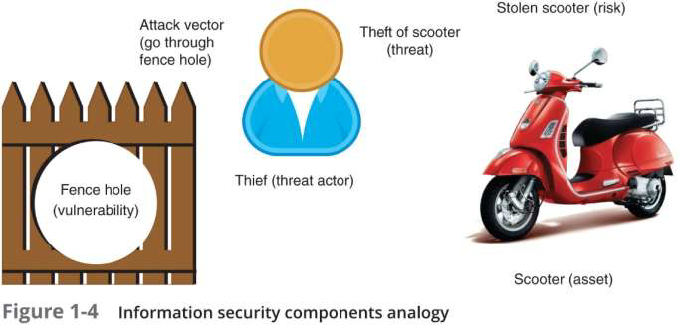
Information Security Terminology (2 of 4)
© 2018 Cengage. All Rights Reserved. May not be copied, scanned, or duplicated, in whole or in part, except for use as permittedin a license
distributed with a certain product or service or otherwise on a password-protected website for classroom use.
14
Notes:
-Suppose that Ellie wants to purchase a new motorized Italian scooter to ride from her apartment to school and work. However, because several scooters have been stolen near her apartment she is concerned about its protection. Although she parks the scooter in the gated parking lot in front of her apartment, a hole in the fence surrounding the apartment complex makes it possible for someone to access the parking lot without restriction. The threat to Ellie’s scooter is illustrated in Figure 1-4.
-Ellie’s new scooter is an asset, which is defined as an item that has value. In an enterprise, assets have the following qualities: they provide value to the enterprise; they cannot easily be replaced without a significant investment in expense, time, worker skill, and/or resources; and they can form part of the enterprise’s corporate identity. Based on these qualities not all elements of an enterprise’s information technology infrastructure may be classified as an asset. For example, a faulty desktop computer that can easily be replaced would generally not be considered an asset, yet the information contained on that computer can be an asset. Table 1-4 lists a description of the elements of an enterprise’s information technology infrastructure and whether they would normally be considered as an asset
-What Ellie is trying to protect her scooter from is a threat, which is a type of action that has the potential to cause harm. Information security threats are events or actions that represent a danger to information assets. A threat by itself does not mean that security has been compromised; rather, it simply means that the potential for creating a loss is real. For Ellie, the threat could result in the theft of her scooter; in information security, a threat can result in the corruption or theft of information, a delay in information being transmitted, or even the loss of good will or reputation.
-A threat actor is a person or element that has the power to carry out a threat. For Ellie, the threat actor is a thief. In information security, a threat actor could be a person attempting to break into a secure computer network. It could also be malicious software that attacks the computer network, or even a force of nature such as a hurricane that could destroy computer equipment and its information.

Slide 17
Information Security Terminology (3 of 4)
•Vulnerability
•Flaw or weakness that allows a threat agent to bypass security
•Threat vector
•The means by which an attack can occur هيعملها ازاي
•Risk
•A situation that involves exposure to some type of danger
•Risk response techniques:
•Accept–risk is acknowledged but no steps are taken to address it الريسك اتعمل لكن مخدش خطوة وعمل حاجه
•Transfer –transfer risk to a third party
•Avoid–identifying risk but making the decision to not engage in the activity
•Mitigate–attempt to address risk by making the risk less serious بحاول اقلل الخطر
© 2018 Cengage. All Rights Reserved. May not be copied, scanned, or duplicated, in whole or in part, except for use as permittedin a license
distributed with a certain product or service or otherwise on a password-protected website for classroom use.
15
Notes:
-A risk is a situation that involves exposure to some type of danger. There are different options available when dealing with risks, called risk response techniques

Slide 18
Understanding the Importance of Information
Security
•Information security can be helpful in:
•Preventing data theft
•Thwarting identity theft
•Avoiding the legal consequences of not securing information
•Maintaining productivity
•Foiling cyberterrorism
© 2018 Cengage. All Rights Reserved. May not be copied, scanned, or duplicated, in whole or in part, except for use as permittedin a license
distributed with a certain product or service or otherwise on a password-protected website for classroom use.
17
Notes:
-Information security is important to enterprises as well as to individuals. That is because information security can be helpful in preventing data theft, thwarting identity theft, avoiding the legal consequences of not securing information, maintaining productivity, and foiling cyberterrorism
-Security is often associated with theft prevention: Ellie could park her scooter in a locked garage to prevent it from being stolen. The same is true with information security: preventing data from being stolen is often cited by enterprises as a primary objective of their information security. Enterprise data theft involves stealing proprietary business information, such as research for a new drug or a list of customers that competitors would be eager to acquire. Stealing user personal data such as credit card numbers is also a prime action of attackers. This data can then be used to purchase thousands of dollars of merchandise online before the victim is even aware the number has been stolen.

Slide 19
Preventing Data Theft
•Preventing data from being stolen is often the primary objective of an
organization’s information security
•Enterprise data theft involves stealing proprietary business information
•Personal data theft involves stealing credit card numbers
© 2018 Cengage. All Rights Reserved. May not be copied, scanned, or duplicated, in whole or in part, except for use as permittedin a license
distributed with a certain product or service or otherwise on a password-protected website for classroom use.
18

Slide 20
Thwarting Identity Theft
•Identity theft
•Stealing another person’s personal information
•Usually using it for financial gain
•Example:
•Steal person’s SSN
•Create new credit card account to charge purchases and leave them
unpaid
•File fraudulent tax returns
© 2018 Cengage. All Rights Reserved. May not be copied, scanned, or duplicated, in whole or in part, except for use as permittedin a license
distributed with a certain product or service or otherwise on a password-protected website for classroom use.
19

Slide 21
v
Avoiding Legal Consequences
•Laws protecting electronic data privacy:
•The Health Insurance Portability and Accountability Act of 1996 (HIPAA)
•The Sarbanes-Oxley Act of 2002 (Sarbox)
•The Gramm-Leach-Bliley Act (GLBA)
•Payment Card Industry Data Security Standard (PCI DSS)
•State notification and security laws
-California’s Database Security Breach Notification Act (2003)
© 2018 Cengage. All Rights Reserved. May not be copied, scanned, or duplicated, in whole or in part, except for use as permittedin a license
distributed with a certain product or service or otherwise on a password-protected website for classroom use.
20
Notes:
-Several federal and state laws have been enacted to protect the privacy of electronic data. Businesses that fail to protect data they possess may face serious financial penalties. Some of these laws include the following: • The Health Insurance Portability and Accountability Act of 1996 (HIPAA). Under the Health Insurance Portability and Accountability Act (HIPAA), healthcare enterprises must guard protected healthcare information and implement policies and procedures to safeguard it, whether it be in paper or electronic format. Those who wrongfully disclose individually identifiable health information can be fined up to $50,000 for each violation up to a maximum of $1.5 million per calendar year and sentenced up to 10 years in prison.

Slide 22
Maintaining Productivity
•Post-attack clean up diverts resources away from normal activities
•Time, money, and other resources
•Table 1-6 shows the cost of attacks
Number of
total
employees
Average
hourly salary
Number of
employees to
combat attack
Hours required
to stop attack
and clean up
Total lost
salaries
Total lost
hours of
productivity
100 $25 1 48 $4066 81
250 $25 3 72 $17,050 300
500 $30 5 80 $28,333 483
1000 $30 10 96 $220,000 1293
© 2018 Cengage. All Rights Reserved. May not be copied, scanned, or duplicated, in whole or in part, except for use as permittedin a license
distributed with a certain product or service or otherwise on a password-protected website for classroom use.
21
Notes:
-Cleaning up after an attack diverts time, money, and other resources away from normal activities. Employees cannot be productive and complete important tasks during or after an attack because computers and networks cannot function properly.

Slide 23
Foiling Cyberterrorism
•Cyberterrorism
•Any premeditated, politically motivated attack against information,
computer systems, computer programs, and data
© 2018 Cengage. All Rights Reserved. May not be copied, scanned, or duplicated, in whole or in part, except for use as permittedin a license
distributed with a certain product or service or otherwise on a password-protected website for classroom use.
22
Notes:
The FBI defines cyberterrorism as any “premeditated, politically motivated attack against information, computer systems, computer programs, and data which results in violence against noncombatant targets by subnational groups or clandestine agents.”21 Unlike an attack that is designed to steal information or erase a user’s hard disk drive, cyberterrorism attacks are intended to cause panic or provoke violence among citizens. Attacks are directed at targets such as the banking industry, military installations, power plants, air traffic control centers, and water systems. These are desirable targets because they can significantly disrupt the normal activities of a large population. For example, disabling an electrical power plant could cripple businesses, homes, transportation services, and communications over a wide area.

Slide 24

Who Are the Threat Actors?
•Threat actor –a generic term used to describe individuals who launch
attacks against other users and their computers
•Most have a goal of financial gain
•Financial cybercrime is often divided into two categories:
•First category focuses on individuals as the victims
•Second category focuses on enterprises and government
•Different groups of threat actors can vary widely, based on:
•Attributes
•Funding and resources
•Whether internal or external to the enterprise or organization
•Intent and motivation
© 2018 Cengage. All Rights Reserved. May not be copied, scanned, or duplicated, in whole or in part, except for use as permittedin a license
distributed with a certain product or service or otherwise on a password-protected website for classroom use.
23

Slide 25
Layering
•Information security must be created in layers
•A single defense mechanism may be easy to circumvent
•Making it unlikely that an attacker can break through all defense layers
•Layered security approach (also called defense-in-depth)
•Can be useful in resisting a variety of attacks
•Provides the most comprehensive protection
© 2018 Cengage. All Rights Reserved. May not be copied, scanned, or duplicated, in whole or in part, except for use as permittedin a license
distributed with a certain product or service or otherwise on a password-protected website for classroom use.
31

Slide 26
Limiting
•Limiting access to information:
•Reduces the threat against it
•Only those who must use data should be granted access
•Should be limited to only what they need to do their job
•Methods of limiting access
•Technology-based -such as file permissions
•Procedural -such as prohibiting document removal from premises
© 2018 Cengage. All Rights Reserved. May not be copied, scanned, or duplicated, in whole or in part, except for use as permittedin a license
distributed with a certain product or service or otherwise on a password-protected website for classroom use.
32

Slide 27
Defending Against Attacks
•Five fundamental security principles for defenses:
•Layering
•Limiting
•Diversity
•Obscurity
•Simplicity
© 2018 Cengage. All Rights Reserved. May not be copied, scanned, or duplicated, in whole or in part, except for use as permittedin a license
distributed with a certain product or service or otherwise on a password-protected website for classroom use.
30
Notes:
-Diversity is closely related to layering. Just as it is important to protect data with layers of security, the layers also must be different (diverse). This means that if attackers penetrate one layer, they cannot use the same techniques to break through all other layers. A jewel thief, for instance, might be able to foil the security camera by dressing in black clothing but should not be able to use the same technique to trick the motion detection system. Using diverse layers of defense means that breaching one security layer does not compromise the whole system

Slide 28
Diversity
•Closely related to layering
•Layers must be different (diverse)
•If attackers penetrate one layer:
•Same techniques will be unsuccessful in breaking through other layers
•Breaching one security layer does not compromise the whole system
•Example of diversity
•Using security products from different manufacturers
•Groups who are responsible for regulating access (control diversity)
are different
© 2018 Cengage. All Rights Reserved. May not be copied, scanned, or duplicated, in whole or in part, except for use as permittedin a license
distributed with a certain product or service or otherwise on a password-protected website for classroom use.
33

Slide 29
Obscurity
•Obscuring inside details to outsiders
•Example: not revealing details
•Type of computer
•Operating system version
•Brand of software used
•Difficult for attacker to devise attack if system details are unknown
© 2018 Cengage. All Rights Reserved. May not be copied, scanned, or duplicated, in whole or in part, except for use as permittedin a license
distributed with a certain product or service or otherwise on a password-protected website for classroom use.
34

Slide 30
Simplicity
•Nature of information security is complex
•Complex security systems:
•Can be difficult to understand and troubleshoot
•Are often compromised for ease of use by trusted users
•A secure system should be simple from the inside
•But complex from the outside
© 2018 Cengage. All Rights Reserved. May not be copied, scanned, or duplicated, in whole or in part, except for use as permittedin a license
distributed with a certain product or service or otherwise on a password-protected website for classroom use.
35

Slide 31
Frameworks and Reference Architectures
•Industry-standard frameworks and reference architectures
•Provide a resource of how to create a secure IT environment
•Give an overall program structure and security management guidance
to implement and maintain an effective security program
•Various frameworks/architectures are specific to a particular sector
(industry-specific frameworks)
•Such as the financial industry
•Some frameworks/architectures are domestic
•While others are world wide
© 2018 Cengage. All Rights Reserved. May not be copied, scanned, or duplicated, in whole or in part, except for use as permittedin a license
distributed with a certain product or service or otherwise on a password-protected website for classroom use.
36

Slide 32
Chapter Summary (1 of 2)
•Information security attacks have grown exponentially in recent years
•There are many reasons for the high number of successful attacks
•It is difficult to defend against today’s attacks
•Information security protects information’s integrity, confidentiality, and
availability:
•On devices that store, manipulate, and transmit information
•Using products, people, and procedures
© 2018 Cengage. All Rights Reserved. May not be copied, scanned, or duplicated, in whole or in part, except for use as permittedin a license
distributed with a certain product or service or otherwise on a password-protected website for classroom use.
37

Slide 33
Chapter Summary (2 of 2)
•Main goals of information security
•Prevent data theft
•Thwart identity theft
•Avoid legal consequences of not securing information
•Maintain productivity
•Foil cyberterrorism
•Threat actors fall into several categories and exhibit different attributes
•Although multiple defenses may be necessary to withstand the steps of
an attack, these defenses should be based on five security principles:
•Layering, limiting, diversity, obscurity, and simplicity
© 2018 Cengage. All Rights Reserved. May not be copied, scanned, or duplicated, in whole or in part, except for use as permittedin a license
distributed with a certain product or service or otherwise on a password-protected website for classroom use.
38

