Slide 1


E-Commerce System

Slide 2
ID | Name
20211072 | يوسف حسن عبد الرحيم ابراهيم
20210642 | عمرو عادل منصور تهامي
20210658 | فارس عدلى بكرى عبد العزيز
20210595 | عمر احمد محمد محمد شريف
20210532 | عبد الرحمن مصطفى سعد
20210858 | محمود جمال ابو سريع

Slide 3
INDEX:
0) INTRODUCTION.
6) USE-CASE DIAGRAM.
Page: 4
Page: 10~ 11
1) SYSTEM ARCHITECTURE.
7) ACTIVITY DIAGRAM.
Page: 5
Page: 12~ 13
2) TECHNOLOGIES USED.
8) ERD DIAGRAM.
Page: 6
Page: 14~15
3) FEATURES.
9) SEQUENCE DIAGRAM.
Page: 7
Page: 16 ~ 17
4) DATABASE DESIGN.
10) CLASS DIAGRAM.
Page: 8
Page: 18~19
5) API DOCUMENTATION.
11) OCL.
Page: 9
Page: 20 ~ 21

Slide 4
INTRODUCTION:
The e-commerce system is a web application designed to enable users to buy and sell products online easily and securely. The system provides a simple and efficient interface for managing products, orders, and users.

Slide 5
SYSTEM ARCHITECTURE:
The e-commerce system relies on the three-tier architecture pattern, consisting of:
the presentation layer (Frontend).
the application logic layer (Backend).
the database layer (Database).
Communication between these layers is facilitated using various protocols and technologies.

Slide 6
TECHNOLOGIES USED:
Backend: Spring Boot Framework (Java), Spring Security for authentication and authorization.
Frontend: React.js for building dynamic user interfaces.
Database: PostgreSQL for data storage.
Web Framework: RESTful APIs for data exchange between the client and server.

Slide 7
FEATURES:
User login and account creation.
Browsing and searching for products based on different categories.
Adding products to the shopping cart and completing the purchase process.
Order management and tracking.
Allowing users to add new products for sale.
Admin dashboard for managing products, orders, and users.

Slide 8
Database Design
The database consists of several tables that are related to each other, allowing for organized and structured storage and management of information. A foreign key is used to link the tables together.

Slide 9
API DOCUMENTATION
The system provides a set of APIs for interaction with the servers.
Detailed documentation for each endpoint including request methods, response structures, and required information for each request.
Authentication and authorization methods to ensure security.

Slide 10
USE-CASE DIAGRAM

Slide 11
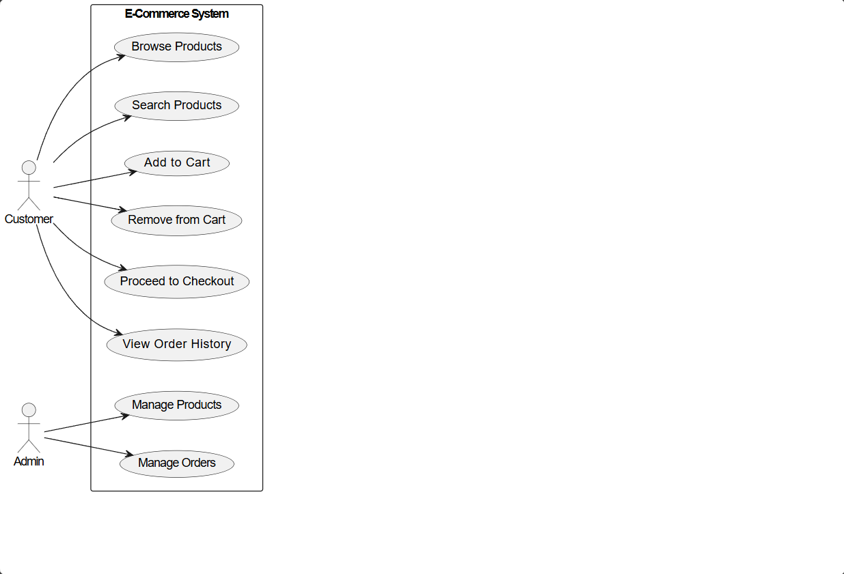

Slide 12
ACTIVITY DIAGRAM

Slide 13
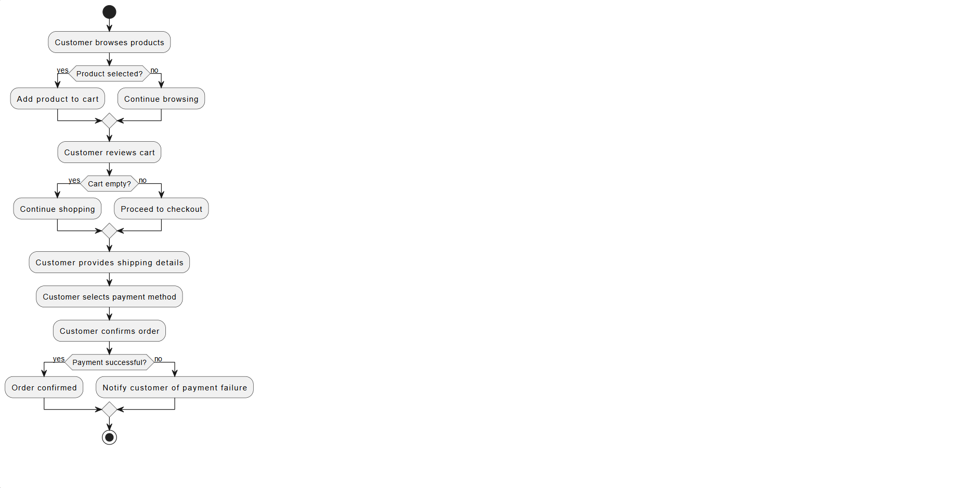

Slide 14
ERD DIAGRAM

Slide 15
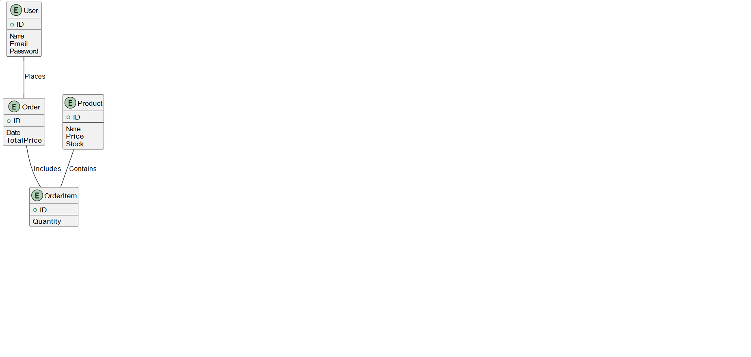

Slide 16
SEQUENCE DIAGRAM

Slide 17
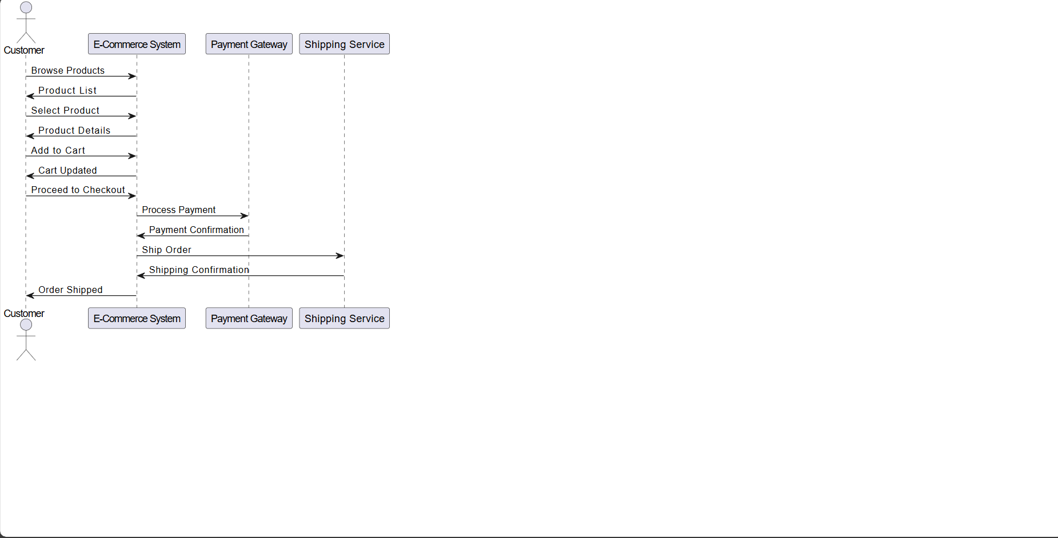

Slide 18
CLASS DIAGRAM

Slide 19
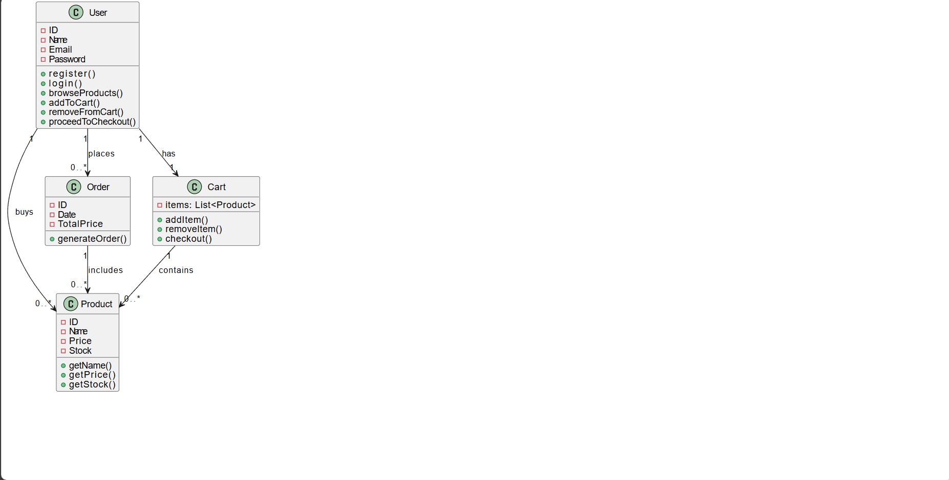

Slide 20
OCL

Slide 21
