Slide 1

2026
B&B
REAL ESTATE & HOME SERVICES
Premium Property & Service Platform | Mobile Application
TEAM LEADER
يوسف حسن محمد محمود
Team Leader | ID: 2320751
TEAM MEMBERS
ياسر علاء إبراهيم — 2320731 | Sec 4
أحمد محمد محمود عبدالكريم — 2320904 | Sec 4
يوسف محمد عيد رزق — 2320766 | Sec 4
بثينة مجدي أحمد محمد — 2320157 | Sec 1
يوسف مصطفى كامل — 2320771 | Sec 4
مازن محمد إسماعيل أحمد — 2320470 | Sec 2
عمر ذكي محمد ذكي — 2320405 | Sec 4
خلود عاطف عبداللطيف والى — 2320213
رحمه عبدالحميد فؤاد — 2320223
B&B Real Estate & Home Services
01 / 12

Slide 2
PROJECT OVERVIEW
What is B&B?
B&B is a full-stack real estate and home services platform connecting property owners, buyers, and skilled workers through an elegant, premium mobile experience.
12
3
REST
Flutter
MySQL
GoRouter
App Screens
User Roles
Laravel API
Framework
Database
Navigation
TECH STACK
Flutter 3.x
Dart
Laravel 11
PHP 8.2
MySQL 8
REST API
Sanctum Auth
Provider
GoRouter
http package
USER ROLES
User
Worker
Admin
Browse listings, request home services, manage profile and track requests
List services with pricing, accept bookings, manage active service requests
Full control: manage users, properties, services, reviews and system stats
B&B Real Estate & Home Services
02 / 12

Slide 3
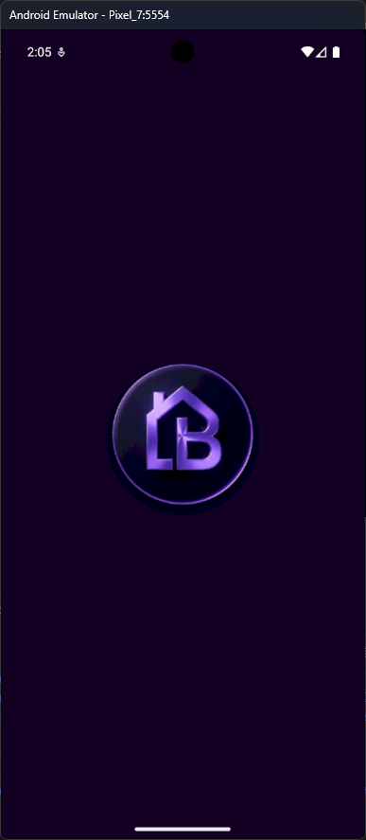
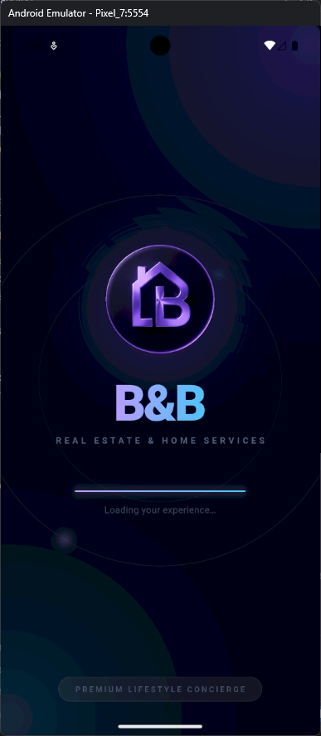
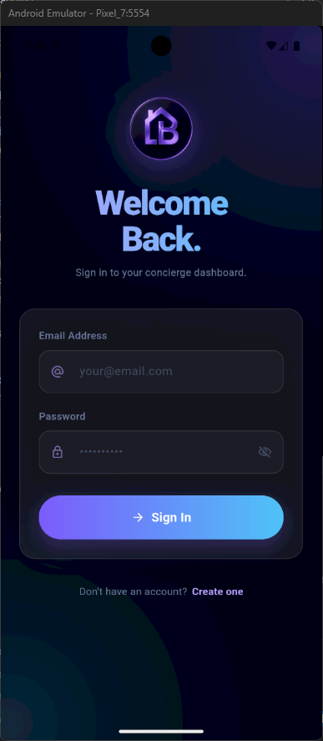
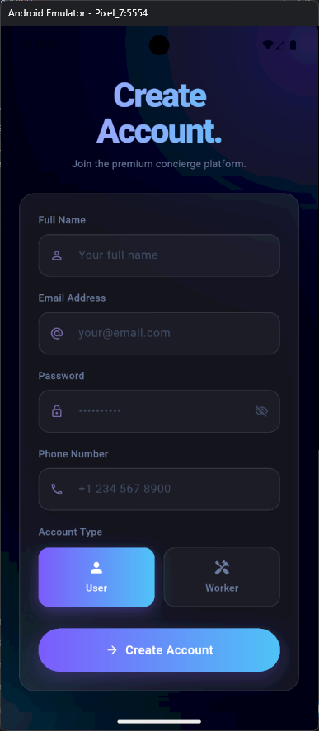
ONBOARDING
First Impressions
A seamless dark-luxury onboarding experience from the very first native pixel.
Native Splash
Animated Splash
Sign In
Sign Up
Dark Native Splash
Glassmorphism UI
Animated Entry
Dual Auth Flow
Pixel-perfect dark background matching in-app Flutter splash
Ambient orbs, blur layers and premium gradient typography
Elastic scale + fade + progress bar animation over 2.8 seconds
Email/password auth with role selection: User or Worker
B&B Real Estate & Home Services
03 / 12

Slide 4
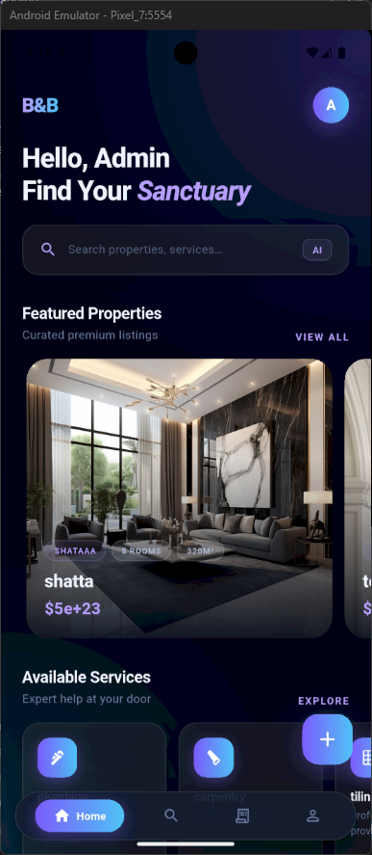
HOME DASHBOARD
Browse & Discover
A curated feed of premium properties and on-demand services, personalised by role.
HOME SCREEN FEATURES
🏠
Featured Properties
Curated hero cards with real imagery, instant pricing & city tags
🔍
Smart Global Search
Real-time search across all properties and available services
⚡
Available Services
Browse and book home services with a single tap from the home screen
📌
City-Based Filters
Filter by Cairo, Giza, Alexandria, Luxor, Sharm El-Sheikh and more
👤
Role-Aware UI
Dashboard content adapts to User / Worker / Admin role automatically
🎨
Glassmorphism Cards
Home Dashboard
Layered dark cards with border glow and ambient background gradients
B&B Real Estate & Home Services
04 / 12

Slide 5
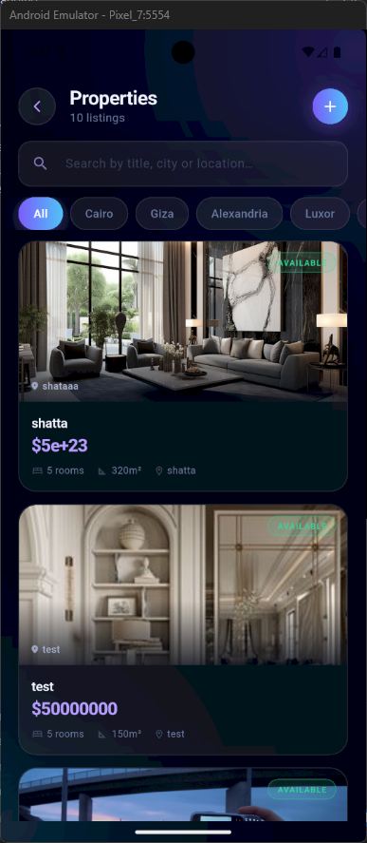
PROPERTIES
Property Listings
Searchable, filterable property listings with full detail views and status management.
LISTINGS FEATURES
🔎
Search by Title / City
Instant filter by property title, city or location keyword
🏙️
City Filter Chips
One-tap city filters: All, Cairo, Giza, Alexandria, Luxor
🖼️
Full-Bleed Image Cards
Hero images with overlay gradient, price badge and status chip
💰
Formatted Pricing
Currency-formatted price display with room and area metadata
📊
Live Count
Listing count badge always reflects the current filtered results
➕
Quick Add Button
Property Listings
Floating action button for owners to add a new property instantly
B&B Real Estate & Home Services
05 / 12

Slide 6
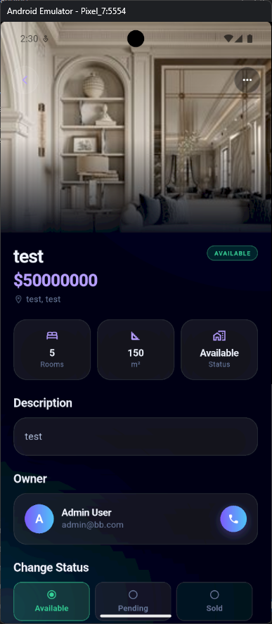
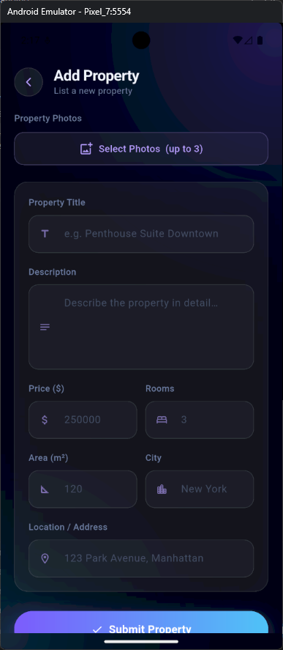
PROPERTY MANAGEMENT
Details & Creation
Full property lifecycle — view, create and manage listings with rich metadata.
PROPERTY DETAIL FEATURES
📷
Photo Gallery
Swipeable image gallery with full-bleed hero layout
💰
Price & Specs
Rooms, area m2, city — clean formatted data display
🏷️
Status Transitions
Available / Pending / Sold — one-tap segmented control
👤
Owner Profile
Linked owner details with name, avatar and contact access
⭐
Review System
Integrated star ratings and text reviews from verified users
📝
Add Property Form
Property Details
Add Property
Full form: title, description, price, rooms, area, city, photos
B&B Real Estate & Home Services
06 / 12

Slide 7
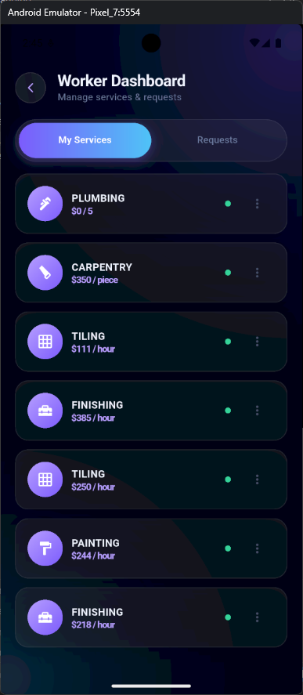
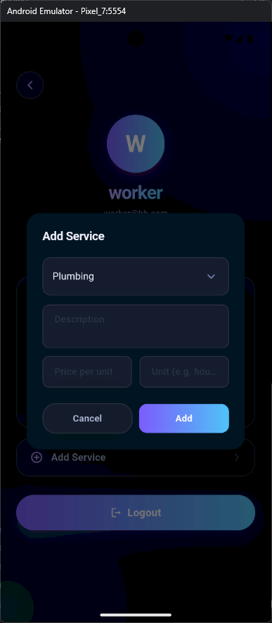
WORKER DASHBOARD
Service Management
Workers manage their service catalogue and incoming requests from a unified dashboard.
WORKER FEATURES
🔧
Service Catalogue
List multiple services with category, description and pricing
💵
Flexible Pricing
Set price per hour, per piece or per unit per service
🟢
Availability Toggle
Instantly toggle each service on/off for availability
📋
Incoming Requests
Dedicated tab showing all booking requests with status
✅
Accept / Decline
One-tap accept or decline with automatic client notification
➕
Add Service Dialog
Quick-add modal: category, description, price, unit type
SERVICE CATEGORIES
Worker Dashboard
Add Service
Plumbing
Carpentry
Tiling
Finishing
Painting
Electrical
B&B Real Estate & Home Services
07 / 12

Slide 8
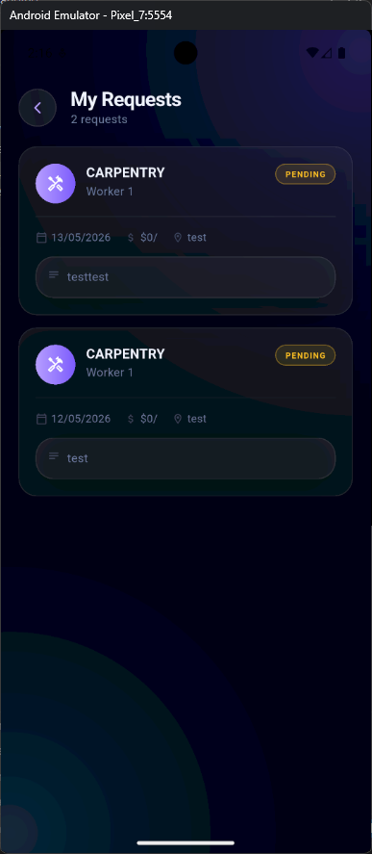
REQUESTS & REVIEWS
Booking Lifecycle
End-to-end request tracking with status management and a built-in review system.
REQUEST LIFECYCLE
User Submits Request
Worker Reviews
Accept / Decline
Service Delivered
Review Submitted
>
>
>
>
STATUS DEFINITIONS
PENDING
Request submitted, awaiting worker response
ACCEPTED
Worker confirmed — service in progress
COMPLETED
Service delivered and marked done by worker
CANCELLED
Request cancelled by user or worker
REVIEW SYSTEM
Star Ratings (1-5) | Written Text Reviews | Worker Profile Feedback | Admin Moderation
My Requests
B&B Real Estate & Home Services
08 / 12

Slide 9
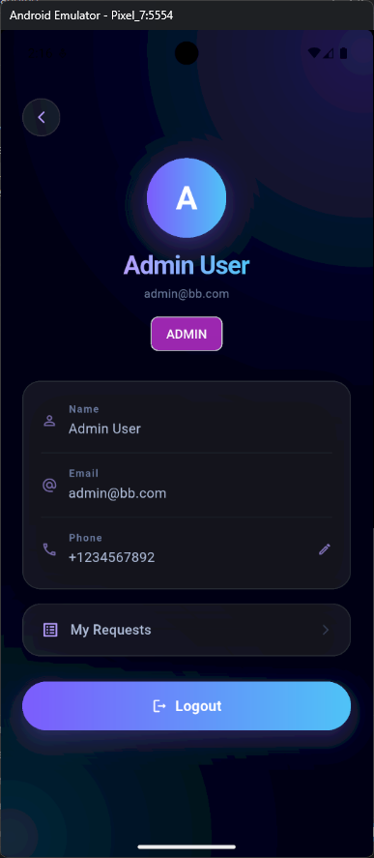
PROFILE & AUTHENTICATION
User Account Management
Persistent sessions, role-based UI, editable profile with secure token authentication.
PROFILE FEATURES
👤
Avatar & Display Name
Gradient avatar with user initials, name and email displayed
🏷️
Role Badge
Prominent role chip: Admin (purple) / User (cyan) / Worker
✏️
Editable Phone
Inline phone number editing with instant API save
📋
My Requests Shortcut
Quick navigation to full request history from profile
🔐
Secure Token Auth
Laravel Sanctum bearer tokens with persistent session storage
🚪
Logout
Single-tap secure logout with token invalidation on server
AUTHENTICATION FLOW
Login > Sanctum Token > SharedPreferences > Auto-Restored on Relaunch > Role-Based Routing
User Profile
B&B Real Estate & Home Services
09 / 12

Slide 10
SYSTEM ARCHITECTURE
Technical Design
Clean separation of concerns across four architectural layers with JWT-secured REST communication.
Flutter Mobile App
Presentation Layer
Dart | Provider State Management | GoRouter Navigation | http Package
|
REST API Contract
Interface Layer
HTTPS | JSON Envelope | Bearer Token | Standardised Response Shape
|
Laravel 11 Backend
Business Logic Layer
PHP 8.2 | Eloquent ORM | Resource Controllers | Form Requests | Gates
|
MySQL 8 Database
Data Layer
Migrations | Seeders | Foreign Keys | Indexes | Relationships
KEY API ENDPOINTS
POST
/api/auth/login
Authenticate user, receive Sanctum token
POST
/api/auth/register
Create new user or worker account
GET
/api/properties
Paginated property listings with filters
POST
/api/properties
Create new property (authenticated owner)
GET
/api/worker-services
Available home services catalogue
POST
/api/service-requests
Submit a booking request for a service
B&B Real Estate & Home Services
010 / 12

Slide 11




BRANDING & DESIGN SYSTEM
Visual Identity
BRAND COLORS
#060B18
#0D1424
#7C5CFC
#B69EFF
#4FC3F7
#34D399
#F0F4FF
Background
Surface
Accent Violet
Accent Light
Cyan
Success
Text Primary
LOGO VARIANTS
DESIGN PRINCIPLES
Primary
iOS / Dark
Transparent
Compact
Splash
Dark-First
Glassmorphism
Motion Language
Negative Space
Design Tokens
B&B Real Estate & Home Services
OLED dark optimised zero eye strain
Blur layers, soft borders and glow
Purposeful animations elastic & easing
Clean grids, generous padding always
Centralised palette and typography
011 / 12

Slide 12
Thank You
B&B — Real Estate & Home Services
Built with Flutter & Laravel | 2026
يوسف حسن محمد محمود — Team Leader | ID: 2320751
ياسر علاء إبراهيم (2320731) · يوسف محمد عيد رزق (2320766) · يوسف مصطفى كامل (2320771) · عمر ذكي محمد ذكي (2320405) · رحمه عبدالحميد فؤاد (2320223) أحمد محمد محمود عبدالكريم (2320904) · بثينة مجدي أحمد محمد (2320157) · مازن محمد إسماعيل أحمد (2320470) · خلود عاطف عبداللطيف والى (2320213)
B&B Real Estate & Home Services
12 / 12

