Slide 1

PRESENTATION
By Youssef Ahmed

Slide 2
PORTFOLIO

Slide 3


Slide 4
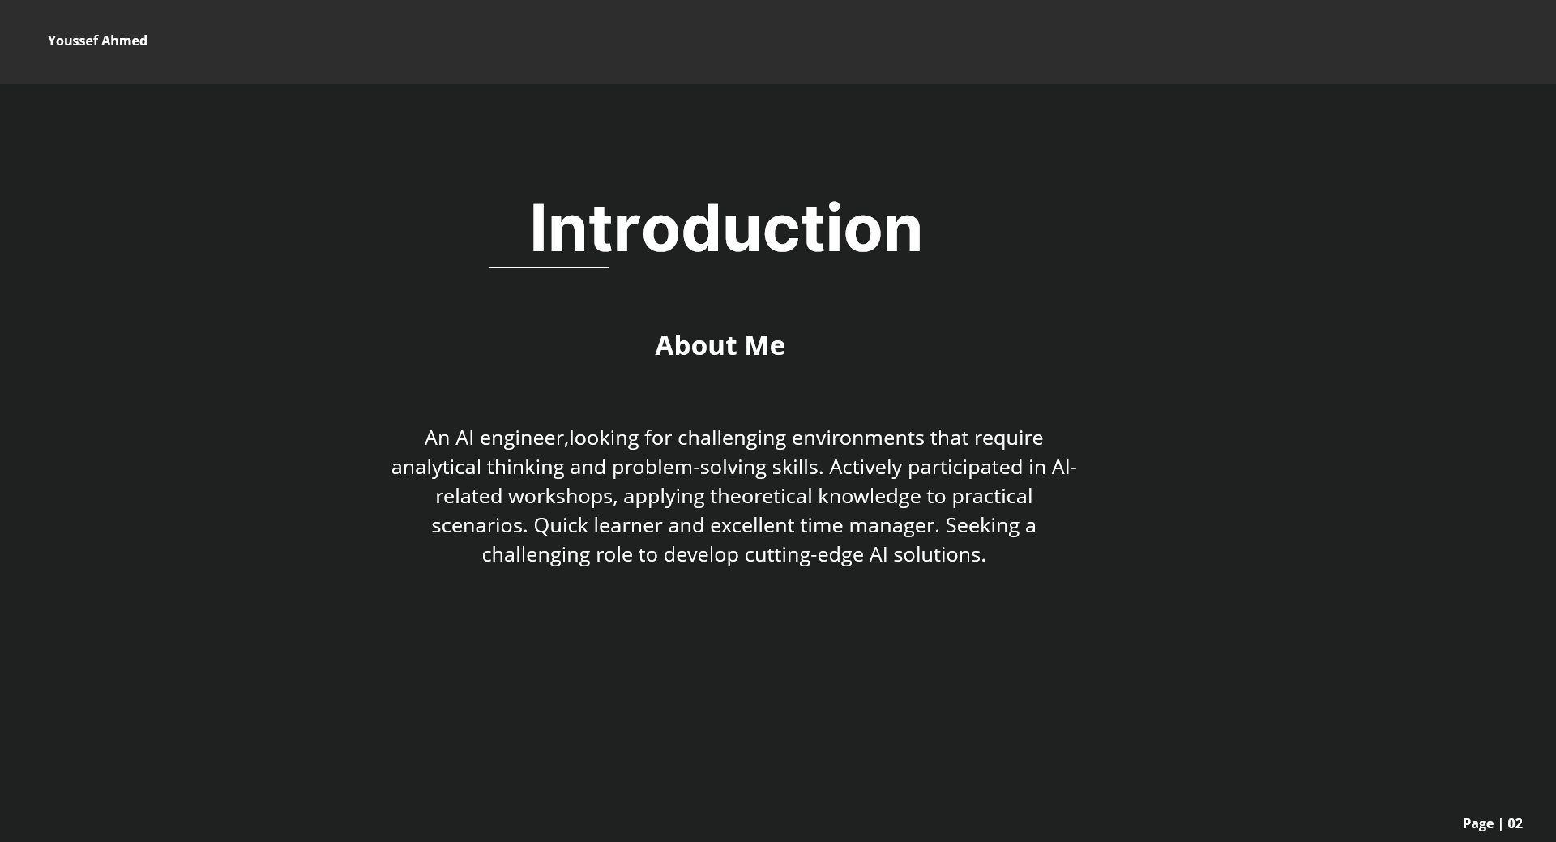

Slide 5
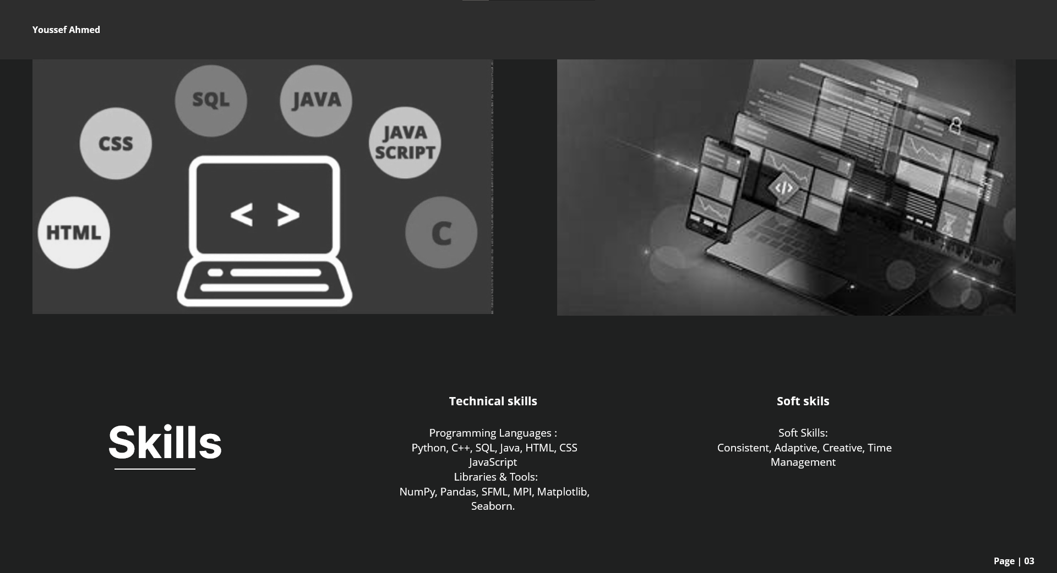

Slide 6
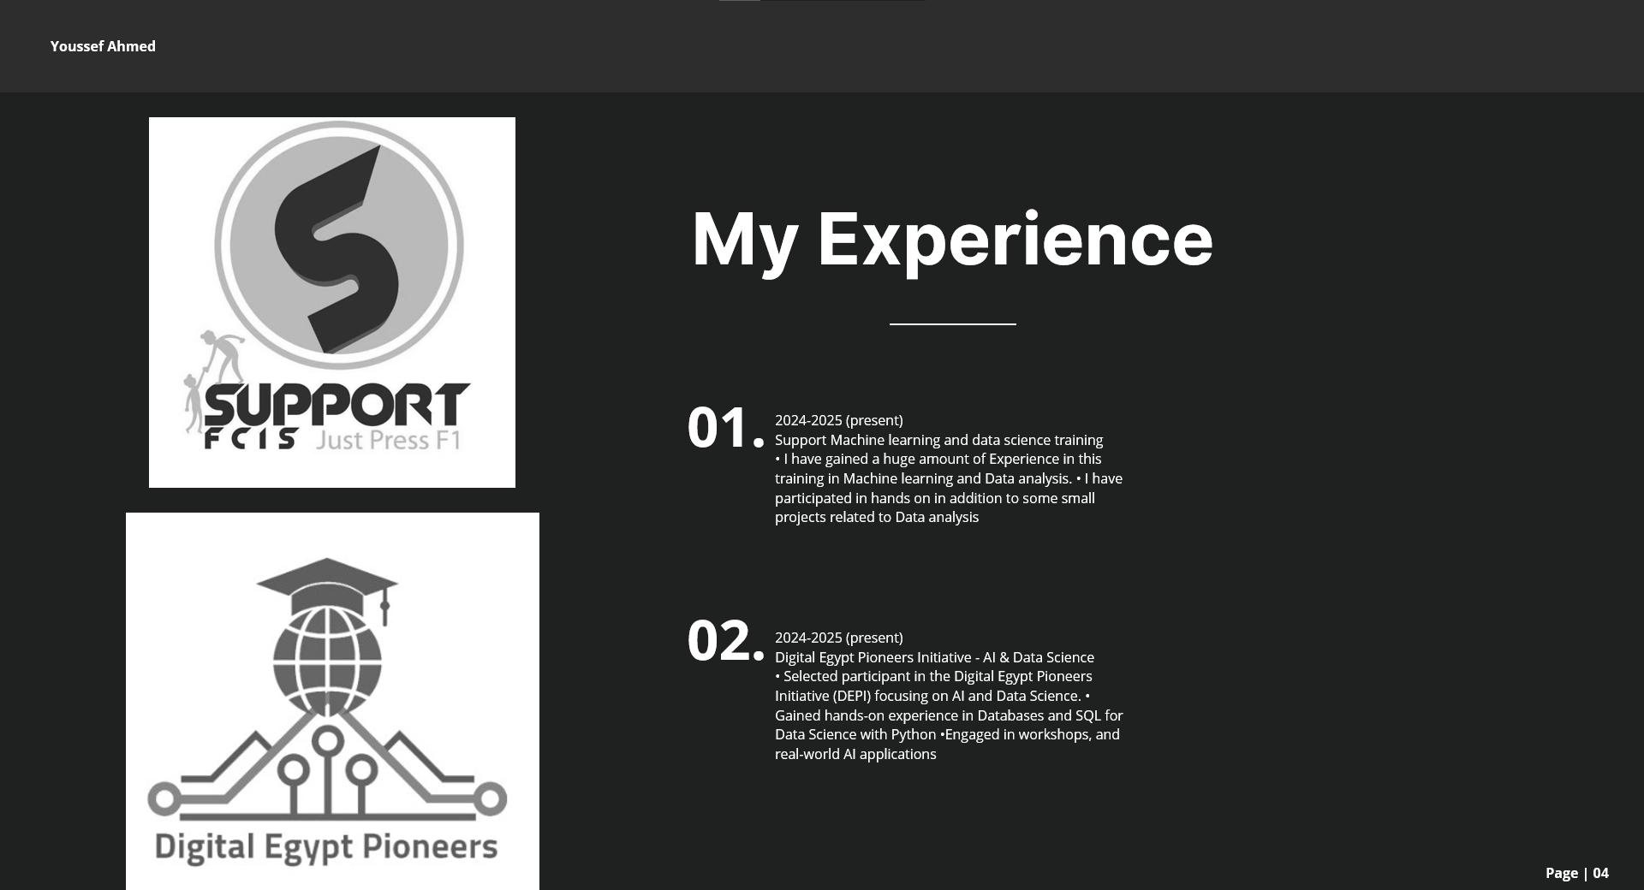

Slide 7
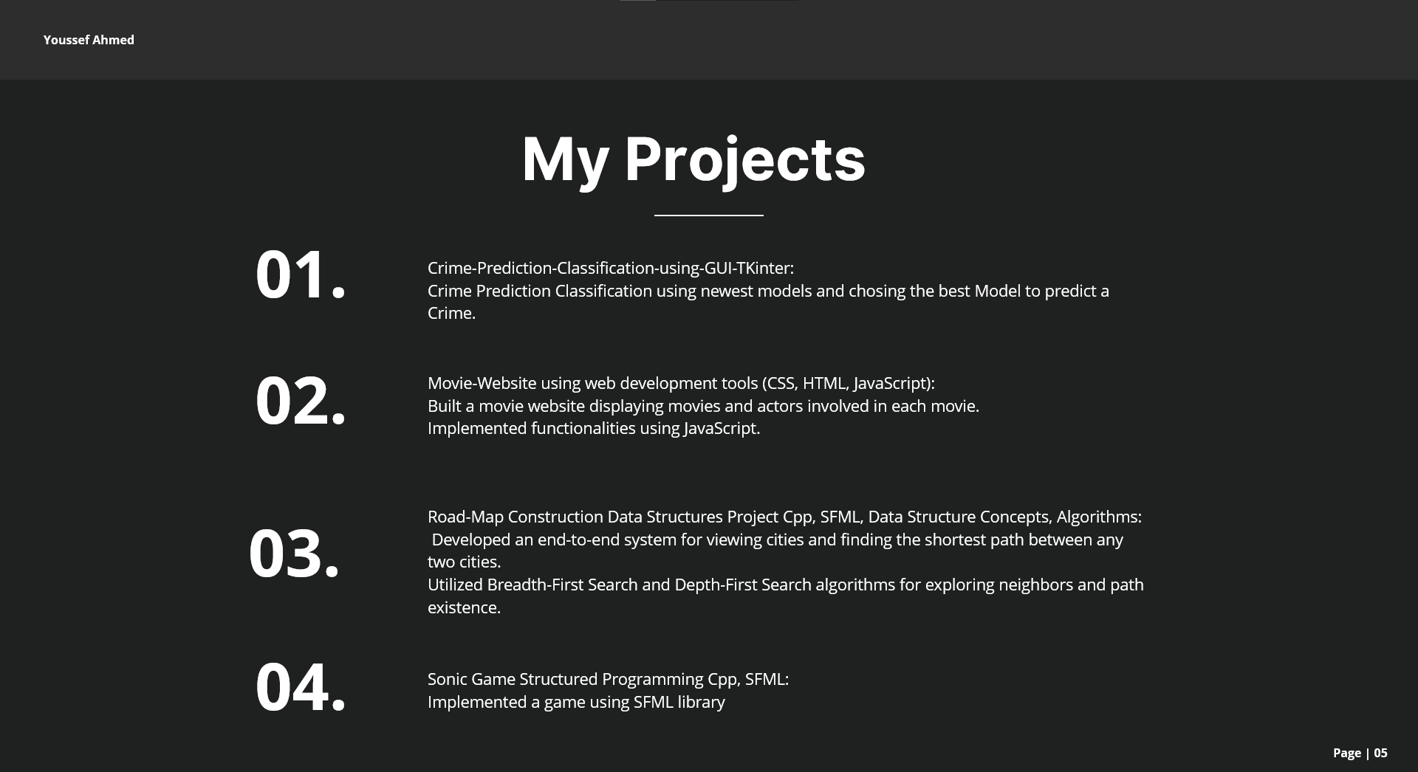

Slide 8


Slide 9


Slide 10
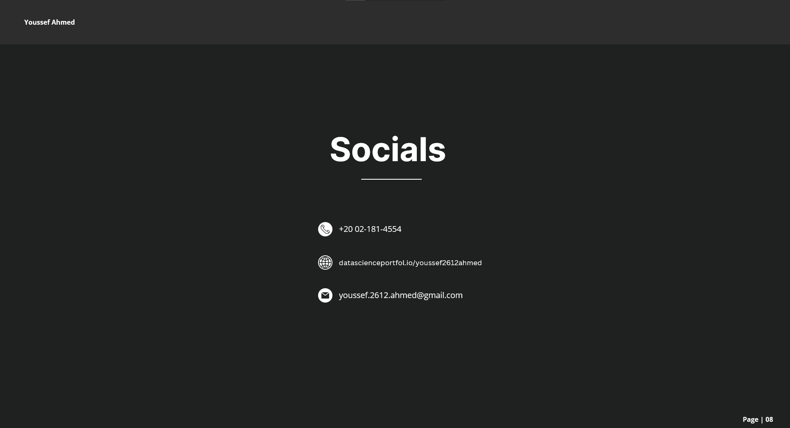

Slide 11


Slide 12
ACCOUNTS

Slide 13
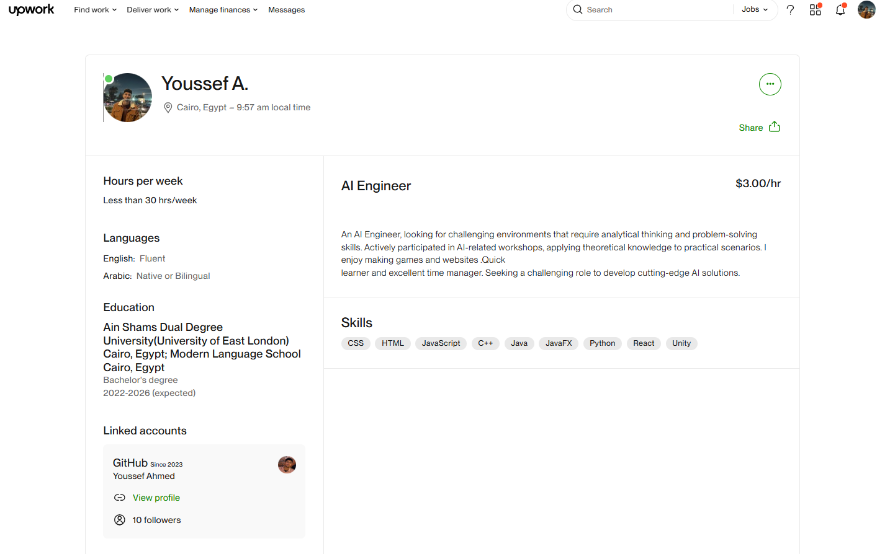
1-UpWork

Slide 14
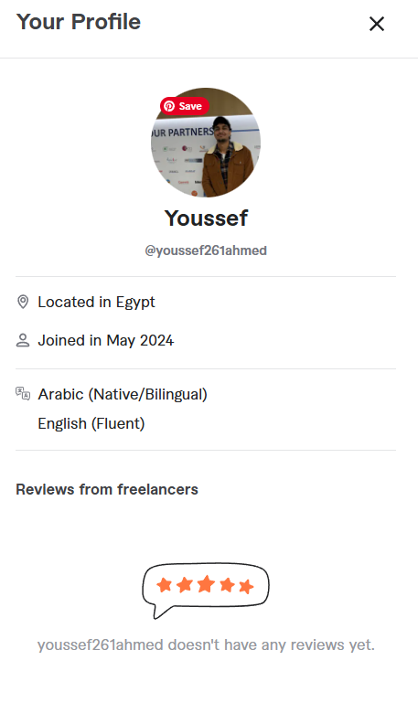
2-Fiverr

Slide 15
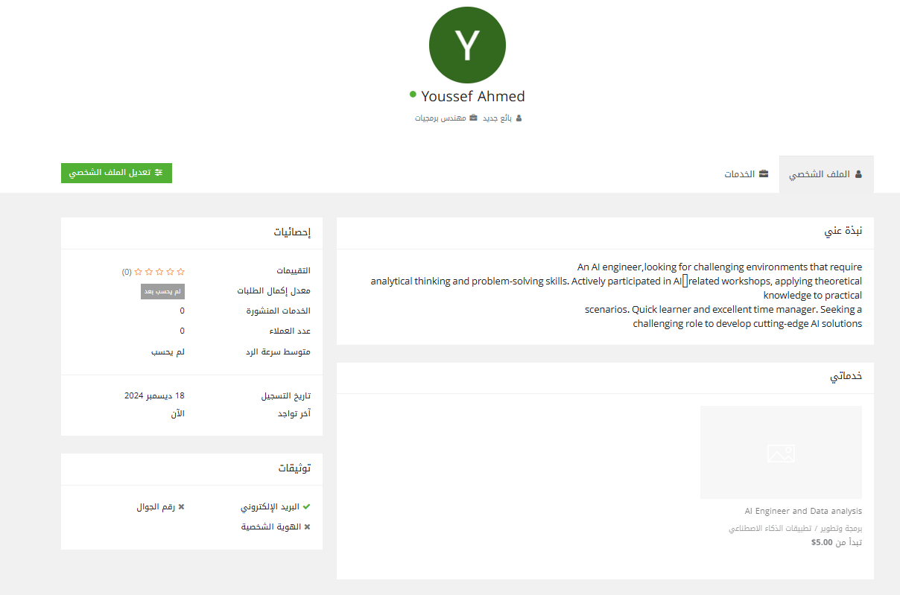
3-خمسات

Slide 16
PROPOSALS

Slide 17
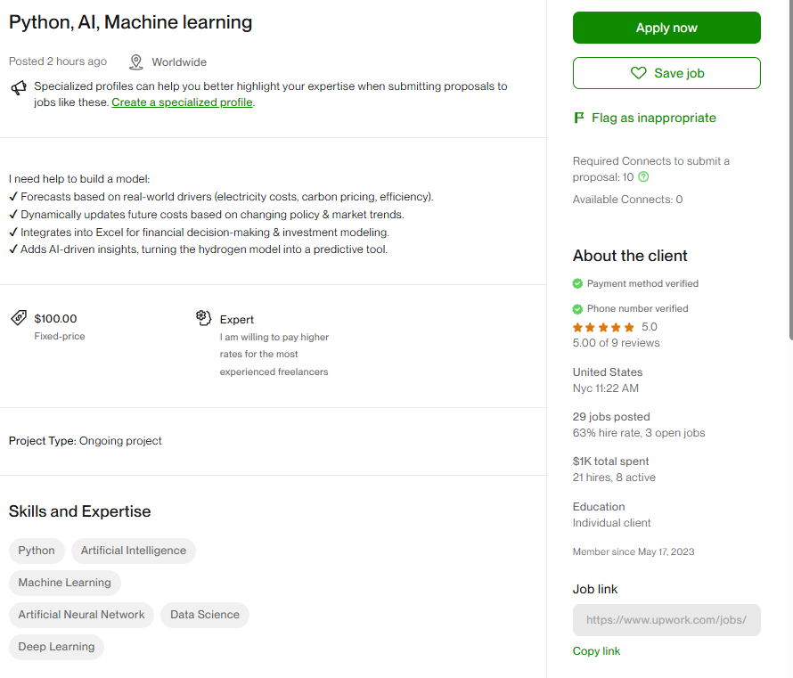
1-Project

Slide 18


Slide 19
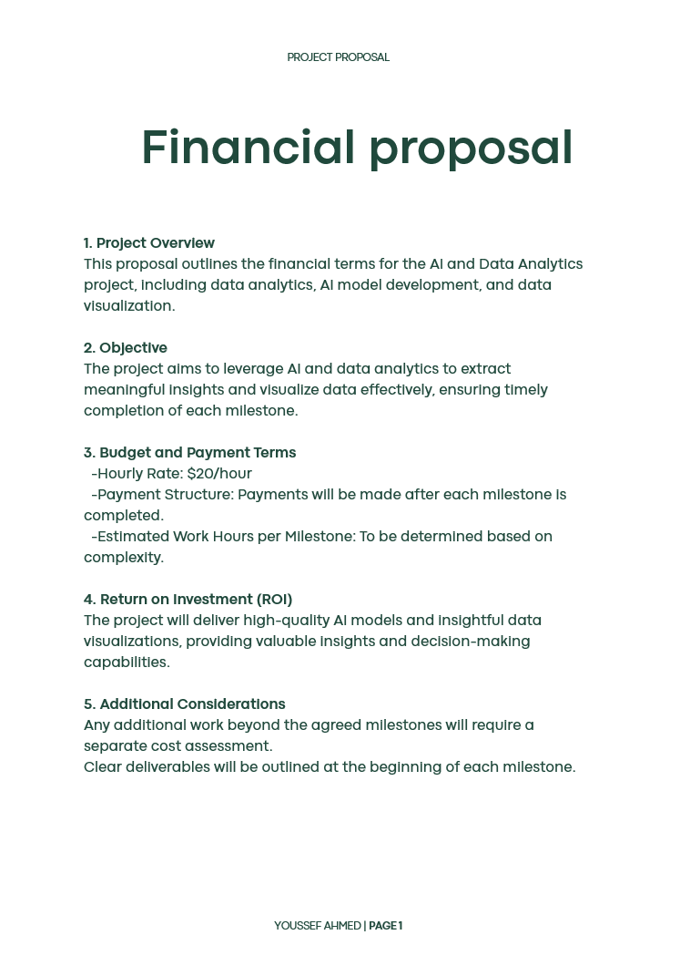

Slide 20
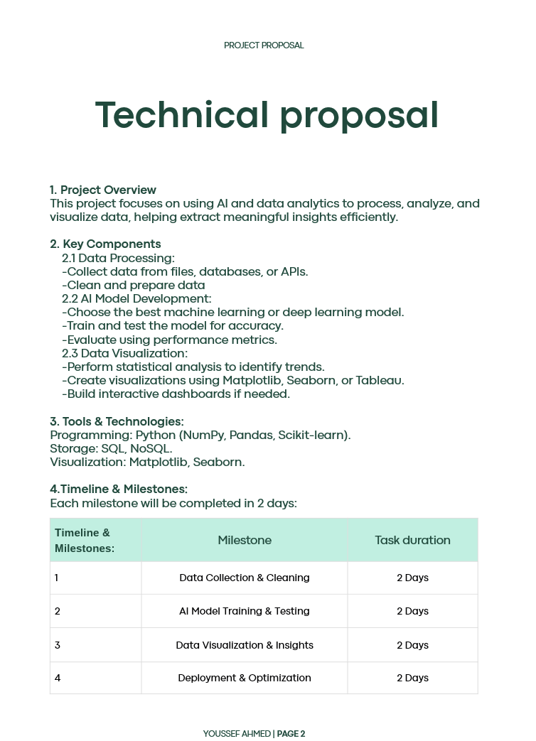

Slide 21
Payment Methods

Slide 22
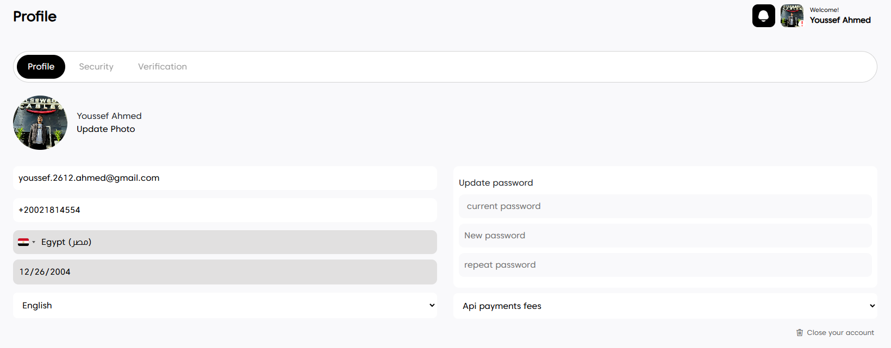
1-SPACEREMIT

Slide 23
THANK YOU
By Youssef Ahmed

