Slide 1
FINAL-YEAR GRADUATION PROJECT
Inflow
A Full-Stack Supply-Chain & Multi-Warehouse Inventory Management System
Presented by Youssef Ashraf
Next.js 16 + React 19 · Spring Boot 4 / Java 21 · PostgreSQL · 2026

Slide 2






OUTLINE
Presentation Agenda
01 Introduction
02 Architecture
Problem, objectives, scope & system overview
System design, tech stack, frontend & backend layers
03 Security & Access
04 Functional Modules
JWT authentication and role-based access control
Catalog, stock, sales, purchasing, returns, reports
05 Engineering & Delivery
06 Reflection
Data model, testing, CI/CD and deployment
Challenges, future work and conclusion
INFLOW · Supply-Chain & Inventory Management System
2 / 29

Slide 3




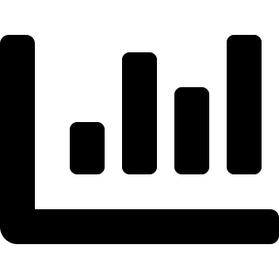

01 · INTRODUCTION
The Problem
Growing distribution businesses run their warehouses on spreadsheets, paper logs and disconnected tools — which breaks down as volume and locations scale.
No real-time stock visibility
Manual, error-prone processes
Weak access control
Quantities across multiple warehouses are never accurate at the same moment, causing stock-outs and dead stock.
Sales, purchases, transfers and returns are recorded by hand, so mistakes and mismatches are common.
Everyone shares the same access — no separation between admins, managers and warehouse staff.
No audit trail
Reporting is slow & reactive
Missed low-stock alerts
When stock or money changes, there is no reliable record of who did what, when, or why.
Insights require manually compiling data, so decisions are made too late to matter.
Nothing warns the team before an item runs out, so reordering is always last-minute.
INFLOW · Supply-Chain & Inventory Management System
3 / 29

Slide 4



01 · INTRODUCTION
Project Objectives
Build a single, secure, web-based platform that gives a distribution business end-to-end control of its inventory and the money that flows with it.
Centralise inventory
Digitise operations
Enforce security
Track every product across every warehouse from one source of truth.
Model sales, purchasing, transfers and returns as guided, validated workflows.
Protect data with JWT authentication and granular role-based permissions.
Build in accountability
Enable decisions
Scale cleanly
Record an immutable audit trail and stock-movement history for every change.
Surface real-time KPIs and on-demand reports for management.
Use a layered, modular architecture that is easy to extend and maintain.
INFLOW · Supply-Chain & Inventory Management System
4 / 29

Slide 5
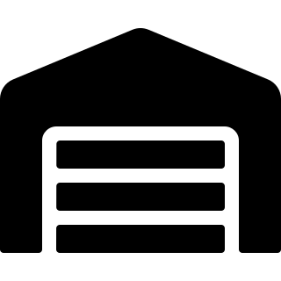
01 · INTRODUCTION
Scope & Target Users
Who uses Inflow
System Administrator
IN SCOPE
Manages users, roles and oversight — owns reporting and the audit log.
Multi-warehouse inventory & stock movements
Sales, purchasing, returns & internal transfers
Role-based access, audit logs & notifications
Dashboards and ten on-demand report types
Operational Manager
Runs the catalog, suppliers, warehouses and stock; approves orders & transfers.
OUT OF SCOPE (this phase)
Native mobile apps & barcode hardware
Third-party accounting / e-commerce integrations
Automated supplier procurement / EDI
Warehouse Manager
Handles customers and day-to-day sales, returns and stock requests on the floor.
INFLOW · Supply-Chain & Inventory Management System
5 / 29

Slide 6

01 · INTRODUCTION
System Overview
Inflow is a production-style web application that manages the full flow of goods — from receiving supplier orders, through multi-warehouse storage, to customer sales, returns and reporting — under one secure, role-aware interface.
31
25
19
3
10
14
Domain entities
REST controllers
Feature modules
User roles
Report types
DB migrations
One source of truth
Secure by design
Insight on demand
Every product, price and quantity lives in a single normalised PostgreSQL model.
Stateless JWT sessions, BCrypt hashing and permission checks enforced on the server.
Live dashboard KPIs plus exportable operational and financial reports.
INFLOW · Supply-Chain & Inventory Management System
6 / 29

Slide 7


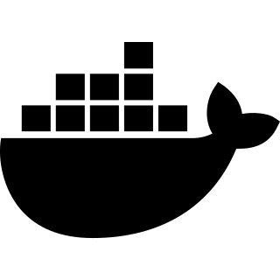
02 · ARCHITECTURE
Technology Stack
Frontend
Backend
Data & DevOps
Next.js 16 App Router, SSR
Java 21 Language
PostgreSQL 15+ Relational database
React 19 UI components
Spring Boot 4 Application framework
Docker Containerisation
TypeScript Type safety
Spring Security Auth & RBAC
Docker Compose Local orchestration
Tailwind CSS Styling
JPA / Hibernate ORM mapping
GitHub Actions CI pipeline
React Query Server state
Flyway Schema migrations
Vitest Frontend tests
Zustand Client state
Maven Build & dependencies
ESLint Linting
RHF + Zod Forms & validation
JWT (HMAC) Stateless tokens
Axios HTTP client
Recharts Data visualisation
JUnit Testing
Nginx / Caddy Reverse proxy
INFLOW · Supply-Chain & Inventory Management System
7 / 29

Slide 8
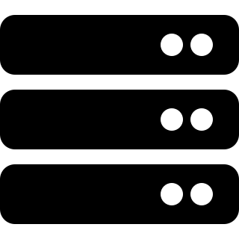
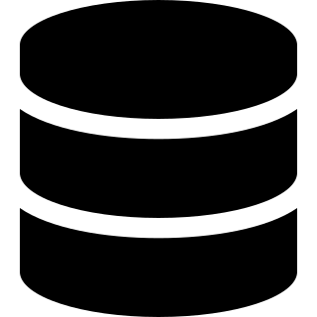

02 · ARCHITECTURE
System Architecture
A decoupled client–server design: a Next.js single-page client talks to a stateless Spring Boot REST API over JWT-secured HTTP, backed by PostgreSQL.
Presentation Tier
Application Tier
Data Tier
Next.js 16 App Router
React 19 + TypeScript UI
React Query data hooks
Role-aware routing & guards
Spring Boot 4 REST API
Controller → Service → Repository
Spring Security + JWT filter
DTOs, mappers & validation
PostgreSQL relational store
JPA / Hibernate ORM
Flyway versioned migrations
31 entities, normalised schema
HTTPS / JSON · Bearer JWT
Stateless · CORS allow-listed · BCrypt at rest
INFLOW · Supply-Chain & Inventory Management System
8 / 29

Slide 9
02 · ARCHITECTURE
Frontend Architecture
A Next.js App-Router project organised around a strict, repeatable data-flow pattern that keeps UI, server state and API calls cleanly separated.
Page
›
Hook
›
Service
›
Backend
src/app/(route)
src/hooks
src/services
REST API
UI route & layout
React Query data
Axios API calls
Spring Boot
App Router & layouts
Server state with React Query
Grouped (auth) and (dashboard) route trees; the dashboard layout guards every protected page.
25 typed hooks handle fetching, caching, pagination and cache invalidation across features.
Forms & validation
Role-aware UI
React Hook Form with Zod schemas gives type-safe, instantly-validated data entry.
A permission matrix hides controls the signed-in role cannot use — the server still enforces them.
INFLOW · Supply-Chain & Inventory Management System
9 / 29

Slide 10
02 · ARCHITECTURE
Backend Architecture
A classic layered Spring Boot service. Each request flows down well-defined layers, and every layer has a single responsibility.
1
Controller
Cross-cutting concerns
25 REST controllers — HTTP endpoints, request/response DTOs
Security JWT auth filter + Spring Security guard every endpoint.
2
Service
DTOs & Mappers Request/response objects keep the API contract stable.
Business logic, validation & transactions (16 services)
Flyway migrations 14 versioned scripts evolve the schema reproducibly.
3
Repository
Spring Data JPA — 24 repositories, query methods
Audit & movements Services log audit events and stock movements automatically.
4
Entity / DB
Notifications Domain events raise in-app notifications for users.
31 JPA entities mapped to PostgreSQL tables
INFLOW · Supply-Chain & Inventory Management System
10 / 29

Slide 11

05 · ENGINEERING
Database Design & Data Model
A normalised PostgreSQL schema of 31 entities, evolved through 14 Flyway migrations. Junction tables model the many-to-many links between invoices, products and warehouses.
Identity & Access
Catalog
Warehouses & Stock
Sales & Purchasing
users, roles, users_warehouses
products, categories, suppliers, customers
warehouses, products_warehouses, stock_movements
sales / purchase invoices + line items
Returns & Transfers
Requests & Workflow
Customers & Payments
Oversight
return invoices, internal invoices
stock_edit_requests, warehouse_stock_requests
customers, payments, balances
audit_logs, notifications
Referential integrity, check constraints and unique keys are enforced at the database level — not just in application code.
INFLOW · Supply-Chain & Inventory Management System
11 / 29

Slide 12



03 · SECURITY
Authentication & Security
Stateless JWT authentication flow
1 · Login
›
2 · Verify
›
3 · Issue JWT
›
4 · Authorise
User submits email + password to /auth/login
Server checks the BCrypt password hash (strength 12)
A signed HMAC token is returned to the client
Every request carries the token; a filter validates it
BCrypt password hashing
Signed HMAC JWTs
Stateless sessions
Passwords stored as salted BCrypt hashes (strength 12) — never in plain text.
Tokens signed with a 32-byte+ secret; the API refuses to start without it.
No server session state — sessions are STATELESS, enabling horizontal scaling.
CORS allow-list
Server-side authorisation
Audit logging
Only configured frontend origins may call the API; CSRF disabled for the token API.
Frontend role checks are UI-only; every endpoint is re-checked on the server.
Security-relevant actions are written to an immutable audit log.
INFLOW · Supply-Chain & Inventory Management System
12 / 29

Slide 13
03 · SECURITY
Role-Based Access Control
Three canonical roles map to ~55 granular permissions. The matrix below shows representative capabilities per role.
Capability | System Admin | Operational Manager | Warehouse Manager
User & role management | ● | — | —
Products · suppliers · warehouses | — | ● | —
Stock control & transfers | — | ● | —
Approve orders & stock requests | — | ● | —
Customers & sales invoices | — | — | ●
Sales returns | — | — | ●
Reports & financial reports | ● | ● | —
Audit log access | ● | ● | —
● Granted — Not granted
INFLOW · Supply-Chain & Inventory Management System
13 / 29

Slide 14
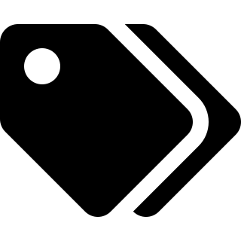
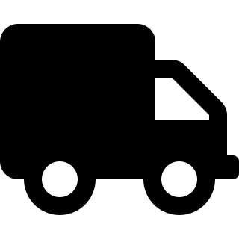


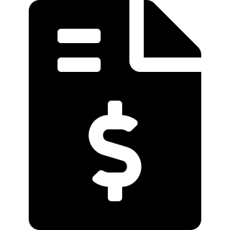




04 · FUNCTIONAL MODULES
Module Map
Nineteen feature modules cover the entire inventory lifecycle.
Dashboard
Products
Categories
Suppliers
Customers
Warehouses
Stock Control
Stock Transfers
Stock Requests
Sales
Purchasing
Receive Orders
Returns
Distribute
Payments
Reports
Audit Logs
Notifications
Users & Roles
Profile
INFLOW · Supply-Chain & Inventory Management System
14 / 29

Slide 15
04 · MODULES
Dashboard & Analytics
A real-time control centre. On login, managers see headline KPIs and twelve-month sales-vs-purchase trends pulled live from the API.
Total Sales
Monthly Sales vs Purchases (illustrative)
Live KPI on the dashboard
Total Purchases
Live KPI on the dashboard
Products in Catalog
Live KPI on the dashboard
Low-stock Products
Live KPI on the dashboard
INFLOW · Supply-Chain & Inventory Management System
15 / 29

Slide 16
04 · MODULES
Catalog: Products, Categories & Suppliers
The master data that everything else references — products and their pricing, the categories that organise them, and the suppliers behind them.
Products
Categories
Suppliers
Full CRUD with SKU, pricing, category and supplier links. Images are validated for safety before upload. Per-warehouse stock is tracked separately.
Group products for navigation, filtering and reporting. Drives the product-performance and stock reports.
Maintain supplier records and link them to the products they provide, feeding purchasing and supplier-performance analytics.
INFLOW · Supply-Chain & Inventory Management System
16 / 29

Slide 17
04 · MODULES
Multi-Warehouse & Stock Control
Inflow tracks stock per warehouse, not just globally — the products_warehouses junction holds an independent quantity for every product in every location.
Multiple warehouses
Per-warehouse stock
Stock movements
Create locations with capacity, status and contact details; assign staff to each.
Every product holds an independent quantity in each warehouse it is stored in.
Each change records type, quantity, unit cost, total value, actor and timestamp.
Low-stock alerts
Inter-warehouse transfers
Staff assignment
Items below their threshold are flagged on the dashboard and in reports.
Move stock between locations through an approved, auditable request.
Warehouse managers see and act only on the warehouses assigned to them.
INFLOW · Supply-Chain & Inventory Management System
17 / 29

Slide 18
04 · MODULES
Stock Workflows & Approvals
Sensitive stock changes never happen silently — they go through request-and-approve workflows that keep managers in control and leave an audit trail.
Stock-edit request · correcting an on-hand quantity
Raise request
Review
Approve / reject
Apply & log
Staff submit current vs requested qty + reason
Operational Manager inspects the difference
Decision is recorded with the approver
Stock adjusts; a movement is written
Warehouse stock-transfer request · moving goods between sites
Request transfer
OM selects source
Approve
Move & audit
Choose source, destination, product & quantity
Manager confirms or re-routes the source
Approved quantity is locked in
Stock leaves source, enters destination
Both workflows carry a status (PENDING → APPROVED / REJECTED) and an approver, so every adjustment is accountable.
INFLOW · Supply-Chain & Inventory Management System
18 / 29

Slide 19
04 · MODULES
Sales & Invoicing
Warehouse managers raise sales invoices against customers, with full payment tracking built in.
Multi-line invoices
Payment status
Void / cancel
Add multiple products with quantities and per-line pricing; totals computed automatically.
Track PAID, partial and unpaid states with paid amount and outstanding balance due.
Invoices can be voided with the actor and timestamp recorded for accountability.
Automatic stock decrement
Customer ledger
Feeds reporting
Confirming a sale reduces warehouse stock and writes a stock movement.
Each sale is tied to a customer, building purchase history and balances.
Sales flow straight into the sales-summary and customer-history reports.
INFLOW · Supply-Chain & Inventory Management System
19 / 29

Slide 20
04 · MODULES
Purchasing & Receive Orders
The inbound side: purchase invoices from suppliers, and a goods-receiving workflow that supports partial deliveries.
1
›
2
›
3
›
4
›
5
Create PO
Pending receipt
Receive (partial)
Approve
Stock in
Record supplier purchase invoice & expected lines
Order awaits goods arriving at the warehouse
Capture received quantity per line — supports short deliveries
Operational Manager approves the receipt
Quantities post to warehouse stock + movements
Receipt status tracking
Supplier-linked
Cost capture
Every order carries PENDING_RECEIPT → fully / partially received states.
Purchases tie back to suppliers, powering the supplier-performance report.
Unit costs recorded on receipt feed stock valuation and movement totals.
INFLOW · Supply-Chain & Inventory Management System
20 / 29

Slide 21
04 · MODULES
Returns & Internal Distribution
Goods don't only move forward. Inflow models returns in both directions and internal distribution between warehouses — each reversing or shifting stock correctly.
Sales returns
Purchase returns
Internal distribution
Customers return goods against a sales invoice; stock is added back and the customer balance adjusted.
Defective or excess stock is returned to suppliers, decrementing warehouse quantities.
Internal invoices move products between the company's own warehouses to balance stock.
Every return and transfer writes its own stock movement, so the on-hand quantity always reconciles with history.
INFLOW · Supply-Chain & Inventory Management System
21 / 29

Slide 22
04 · MODULES
Reporting, Audit & Notifications
Ten purpose-built report endpoints turn raw operations into decisions, while audit logs and notifications keep everyone informed and accountable.
Ten report types
Audit logs
1
Stock on hand Live quantities by product & warehouse
2
Low stock Items below reorder threshold
Immutable trail of who changed what, when — viewable by admins & managers.
3
Stock movements Full in/out movement ledger
4
Sales summary Revenue over time & by segment
Notifications
5
Purchase summary Spend and order volumes
6
Returns Sales & purchase returns analysis
In-app alerts for approvals, low stock and key events.
7
Product performance Best / worst selling products
8
Warehouse Utilisation & stock per site
Exportable
9
Supplier performance Reliability & volume by supplier
10
Customer history Purchase history per customer
Reports export to CSV for sharing and offline analysis.
INFLOW · Supply-Chain & Inventory Management System
22 / 29

Slide 23
04 · FUNCTIONAL MODULES
End-to-End: A Product's Journey
How the modules connect into one continuous flow of goods and data.
Procure
Receive
Store
Distribute
Sell
Analyse
Raise a purchase order to a supplier
Goods received into a warehouse
Per-warehouse stock updated & valued
Transfer between sites as needed
Customer sales invoice raised
KPIs & reports inform decisions
Every step is recorded. Stock movements, audit logs and notifications run underneath the entire flow — nothing changes without a trace.
INFLOW · Supply-Chain & Inventory Management System
23 / 29

Slide 24



05 · ENGINEERING
Quality Assurance & Testing
Quality is enforced automatically — code can't merge unless it lints, type-checks, tests and builds cleanly on both sides of the stack.
Static analysis
Frontend tests
Backend tests
ESLint and strict TypeScript type-checking catch errors before runtime.
Vitest unit tests cover constants, hooks and helper logic.
JUnit + Spring Boot tests run against a real PostgreSQL service in CI.
Dependency audit
Type-safe contracts
Definition of done
npm audit blocks builds on high-severity vulnerabilities.
Shared TypeScript types and Zod schemas keep client & API aligned.
Lint → type-check → test → build must all pass before completion.
INFLOW · Supply-Chain & Inventory Management System
24 / 29

Slide 25
05 · ENGINEERING
DevOps & Deployment
One command brings the whole system up. Docker Compose orchestrates the frontend, backend and database; GitHub Actions guards every push.
Continuous-integration pipeline
Checkout
›
Lint
›
Type-check
›
Test
›
Build
›
Audit
›
Backend + Postgres
Containerised deployment
Production-ready practices
Frontend Next.js container on port 3000
Flyway auto-migrates the schema on first boot
Secrets & origins supplied via environment variables
Reverse proxy (Nginx / Caddy) terminates HTTPS + HSTS
Seed admin & demo data for instant evaluation
Documented security & production checklist
Backend Spring Boot API on port 9090
Database PostgreSQL with persistent volume
INFLOW · Supply-Chain & Inventory Management System
25 / 29

Slide 26

06 · REFLECTION
Challenges & Solutions
Keeping stock consistent
Securing a stateless API
Challenge: Concurrent sales, transfers and returns risk drift.
Challenge: No sessions means each request must prove itself.
Solution: Every quantity change goes through a service that writes a matching stock movement inside a transaction.
Solution: A JWT filter validates a signed token on every call; permissions are re-checked server-side.
Modelling complex relationships
Granular permissions
Challenge: Invoices, products and warehouses are many-to-many.
Challenge: Three roles need very different, fine-grained access.
Solution: Dedicated junction entities with composite keys keep the schema normalised and queryable.
Solution: A ~55-permission matrix maps cleanly to roles and drives both UI and API authorisation.
INFLOW · Supply-Chain & Inventory Management System
26 / 29

Slide 27
06 · REFLECTION
Future Enhancements
Inflow's layered, modular design makes the following natural next steps.
Barcode & QR scanning
Smart reorder automation
Demand forecasting
Speed up receiving, counting and sales with hardware scanning.
Auto-generate purchase orders when stock hits reorder points.
Use sales history to predict demand and optimise stock levels.
Accounting & e-commerce APIs
Native mobile app
Advanced analytics & ML
Integrate with external finance and online-store platforms.
A warehouse-floor companion app for iOS and Android.
Anomaly detection on movements and richer BI dashboards.
INFLOW · Supply-Chain & Inventory Management System
27 / 29

Slide 28
06 · REFLECTION
Conclusion
Inflow delivers a complete, secure and production-style inventory platform — proving an end-to-end full-stack system from database schema to polished UI.
Full-stack delivery
Secure & accountable
A modern Next.js client and a layered Spring Boot API over a normalised PostgreSQL schema.
JWT auth, role-based access, audit logs and stock-movement history throughout.
Complete operations
Engineered to last
Catalog, multi-warehouse stock, sales, purchasing, returns, transfers and reporting.
Automated testing, CI/CD and Docker deployment — built to extend and maintain.
INFLOW · Final-Year Graduation Project · 2026

Slide 29
Thank You
Questions & Discussion
Youssef Ashraf
Inflow — Supply-Chain & Inventory Management System

