Slide 1







Chess-ETL
Youssef Atef
Extract
Transform
Quality Check
Load
Visualize

Slide 2
Database

Slide 3
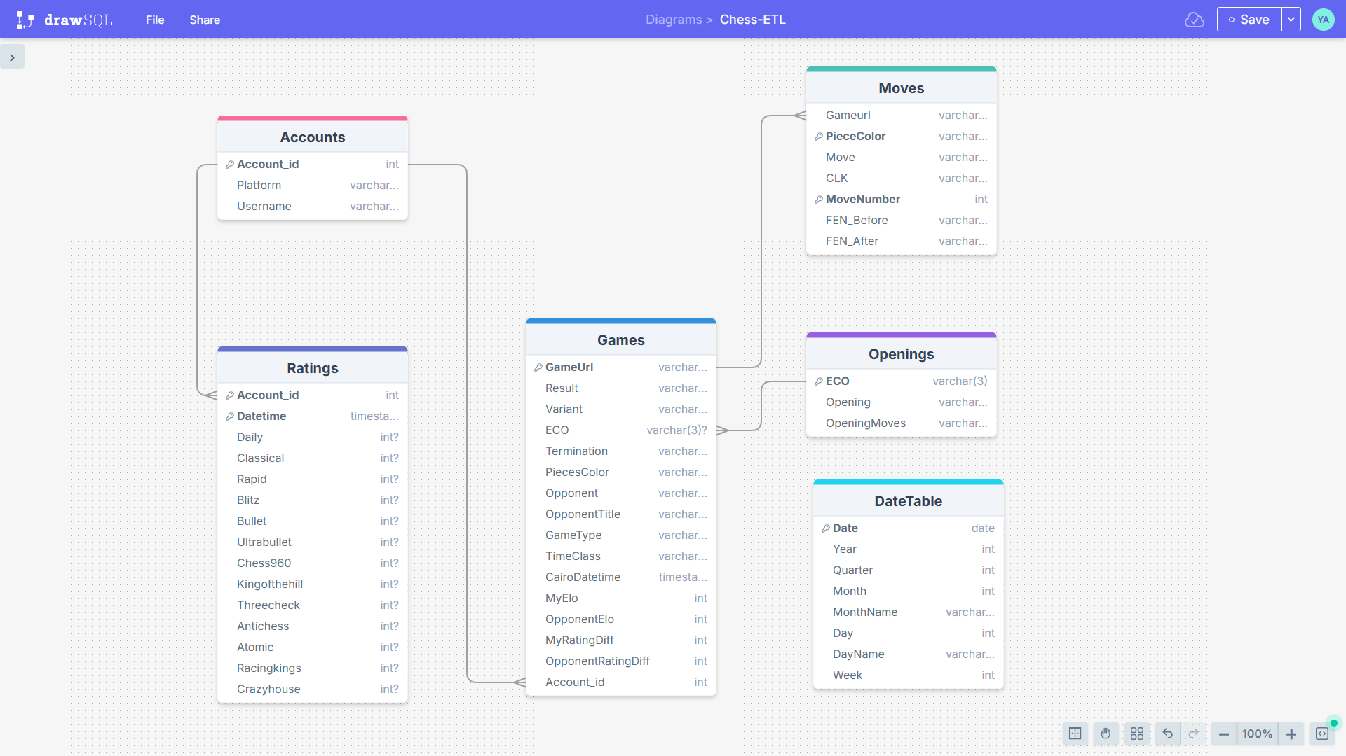

Slide 4
Workflow

Slide 5
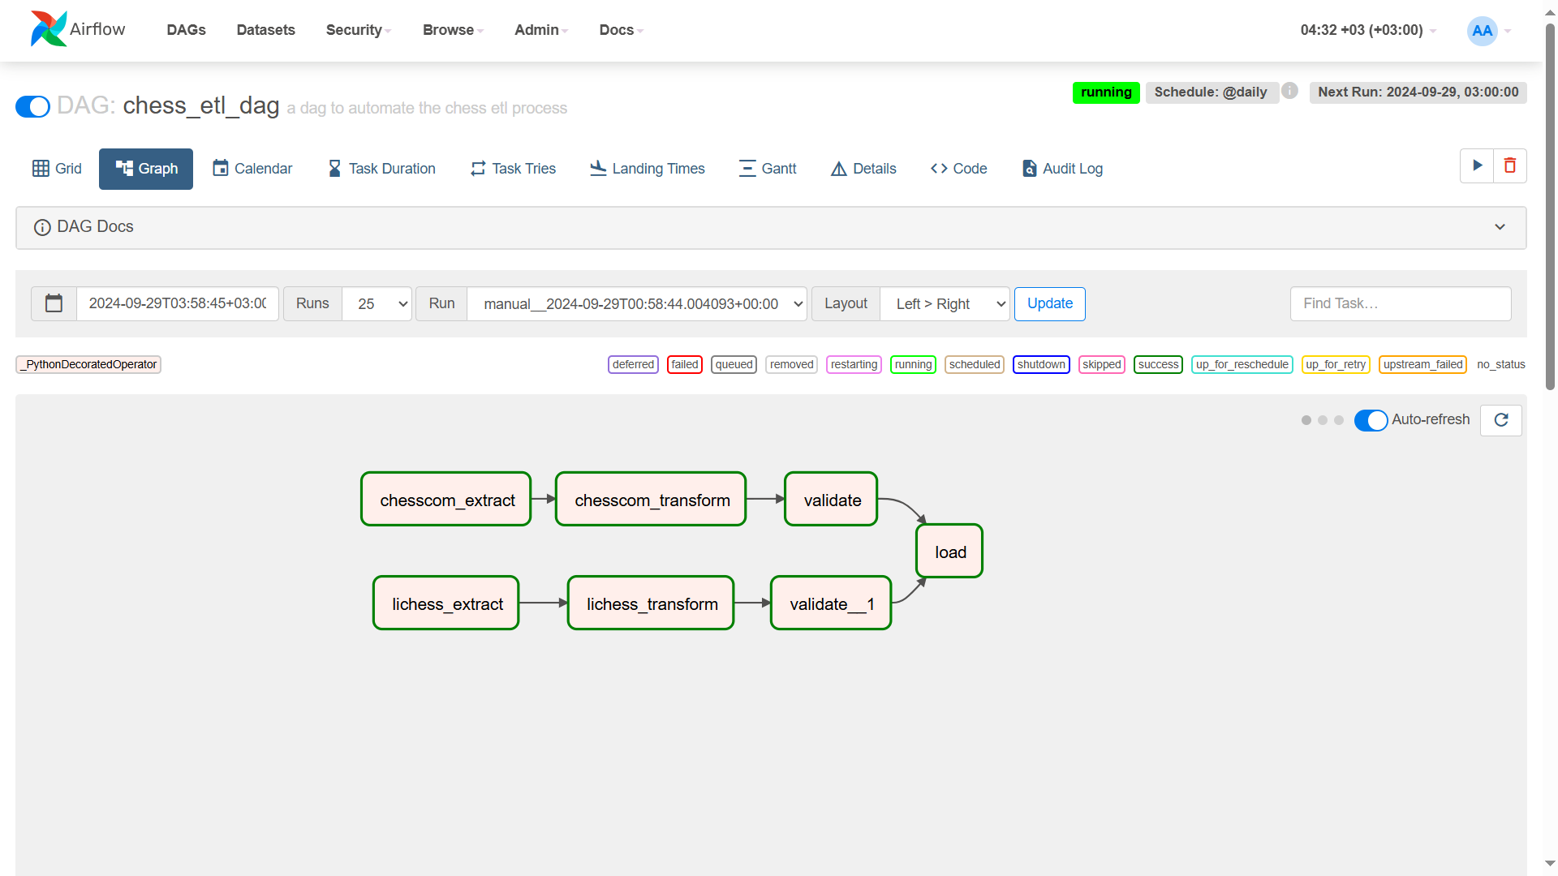

Slide 6
Dashboard

Slide 7
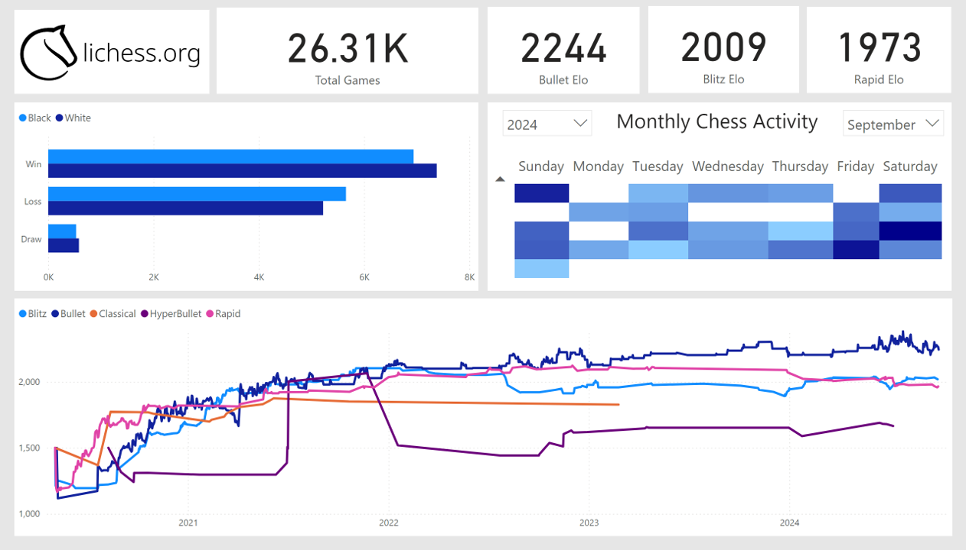

Slide 8
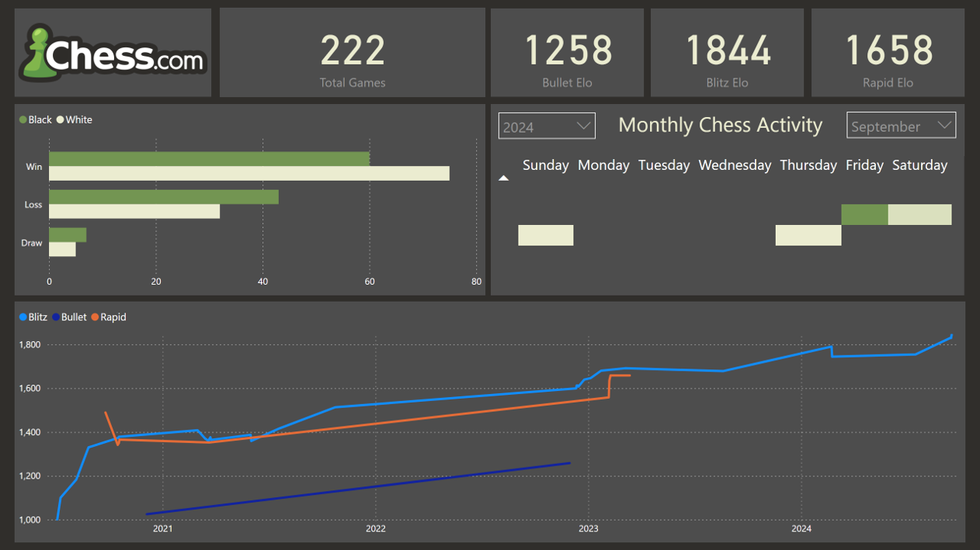

Slide 9
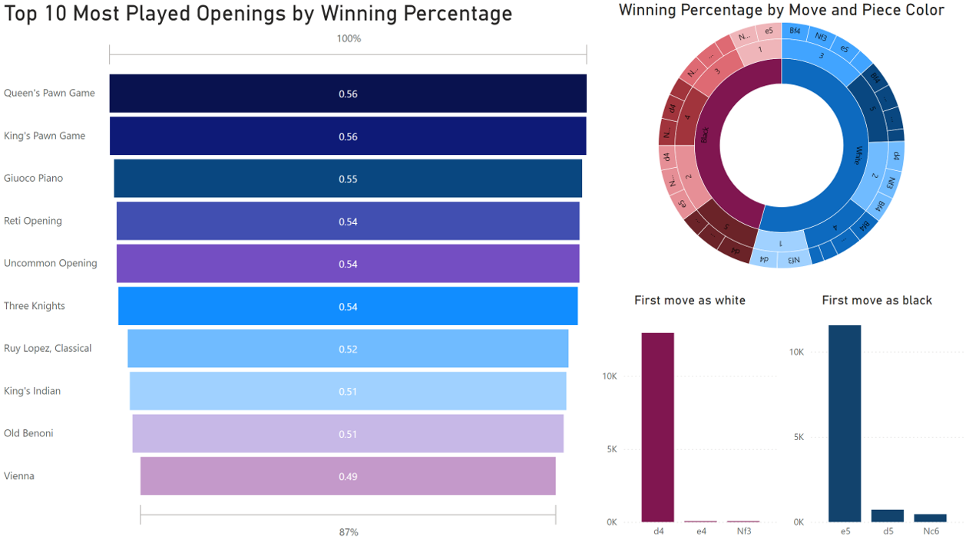

Slide 10
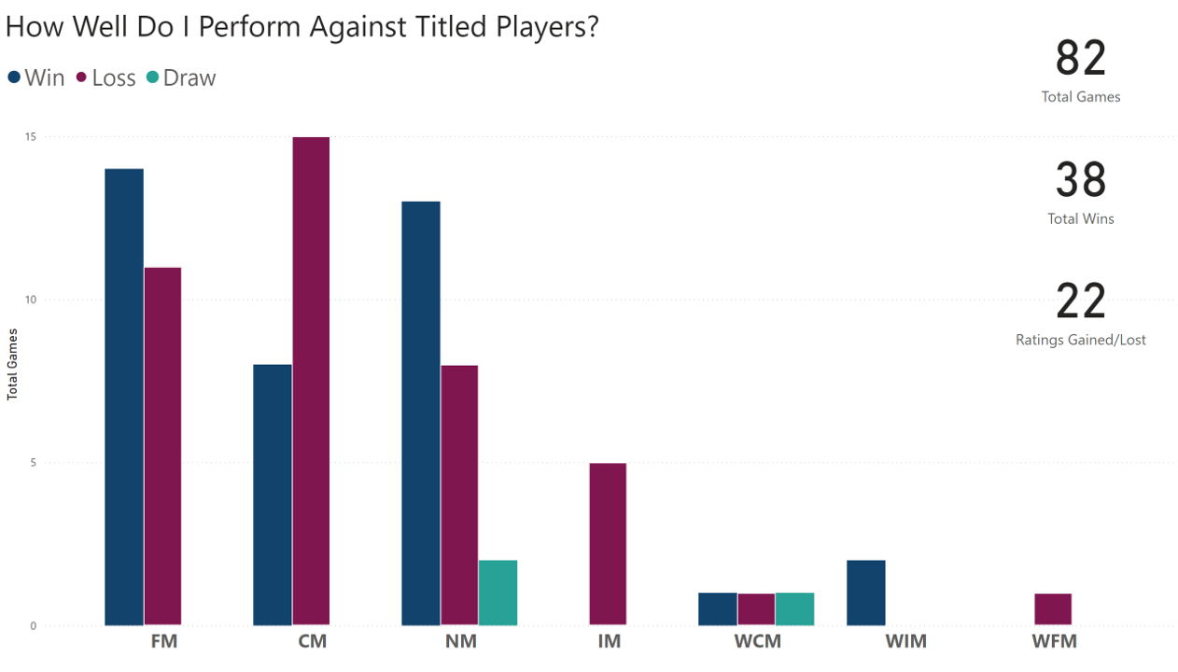

Slide 11
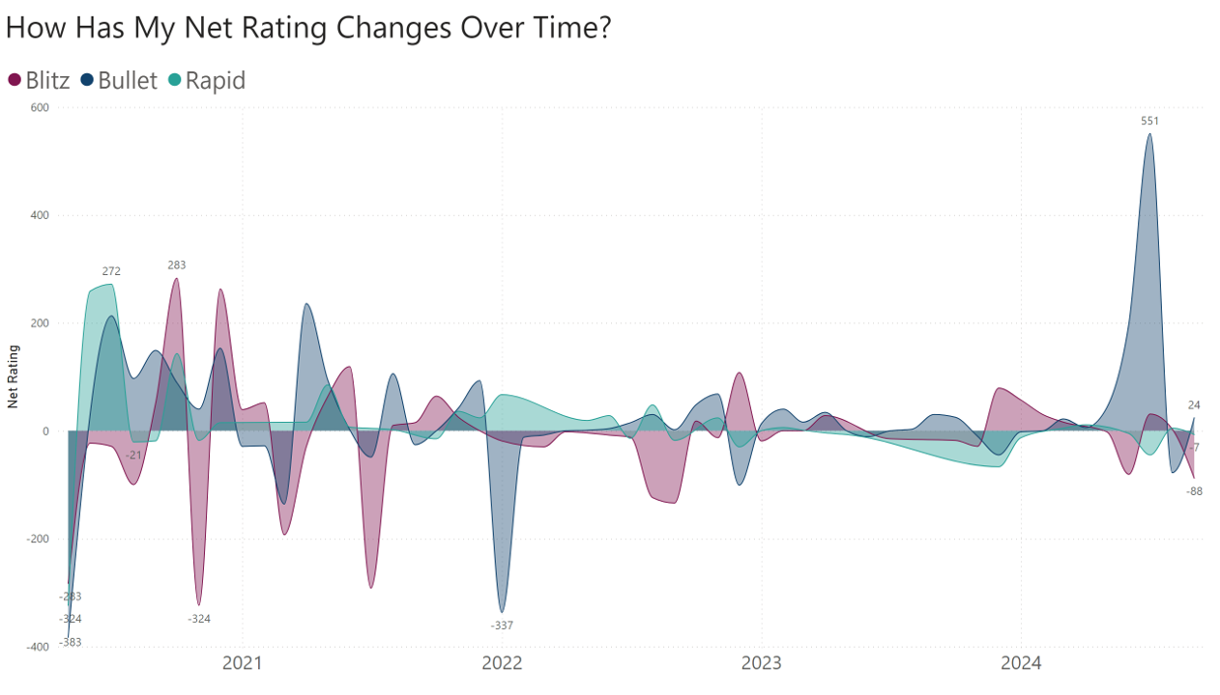

Slide 12
THANK
YOU

