Slide 1
Smart Transportation System
)Virginia Tech Joint Training)

Slide 2
Project Description
We aim to produce an enhanced smart transportation system
The project aim is to provide a better experience and service for students and staff.
We aim to minimize the errors in the human-dependent system.

Slide 3
How?
By creating an application that automates the service, providing many features that will make it easier for every one involved!
Features such as
Choosing routes, pickup points & schedules.
Having a real-time bus tracker and arrival information.
Rating drivers.
Making good use of resources.
Taking attendance through a smart card reader in the bus.

Slide 4
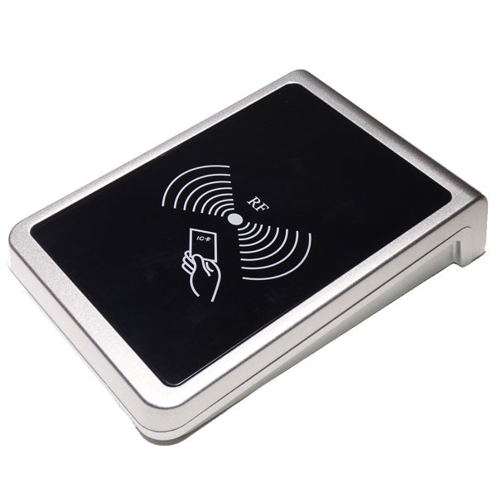
Physical Requirements
A smart card reader (RFID card reader) that will be synced to the software.

