Slide 1
Creating a SOAP WS
Eclipse JEE
Apache Axis
Creation of a Web Service
  From a Java class
  In the Tomcat runtime
  Generation of the WSDL file
Creation of a client application
  Generation of stubs from a WSDL file
  Programming of the client
Notes:
We use Eclipse JEE and Apache Axis which is available in Eclipse JEE.
Apache Axis is used to generate from a Java class a servlet which is installed in the Tomcat engine (the web server). It also generates the WSDL description which describes the interface of the WS.
On the client side, the WSDL description is used to generate stubs which are used to invoke the WS in a client program.

Slide 2
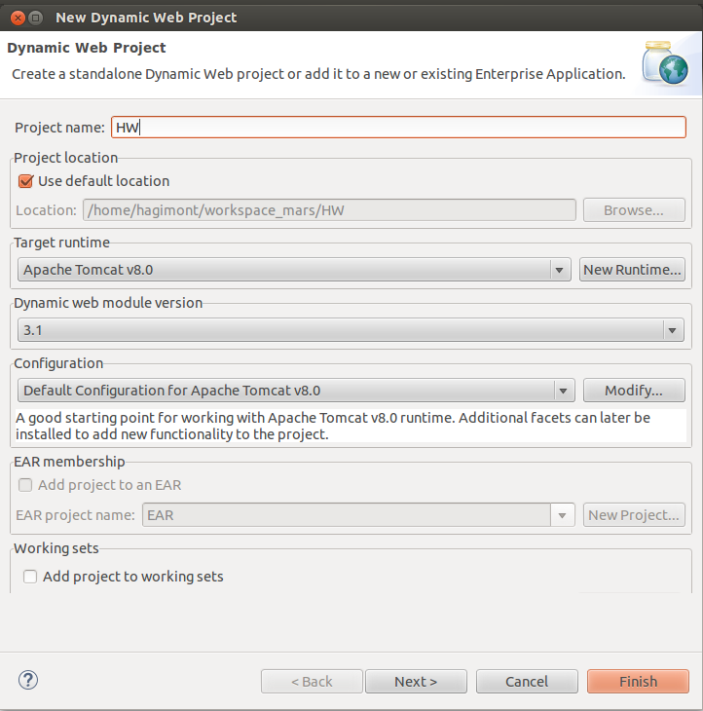
Create a Dynamic Web Project
Eclipse JEE
Open JEE perspective
Create a Dynamic Web Project
Add your Tomcat runtime
Notes:
In Eclipse, we create a dynamic web project (a project allowing the develop servlets) and add the Tomcat runtime.

Slide 3
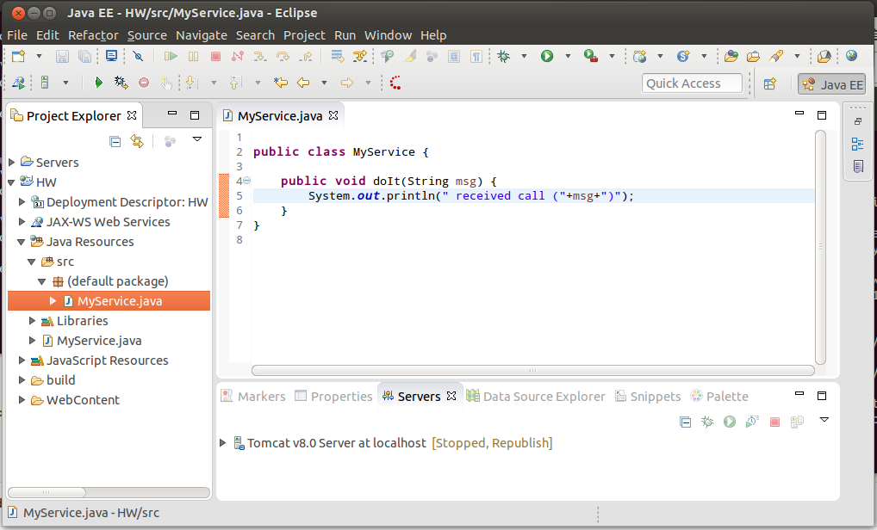
Create a Class
A Tomcat server was created in Eclipse
Notes:
In this project, we create a class.
Notice that a Tomcat server is running in Eclipse.

Slide 4
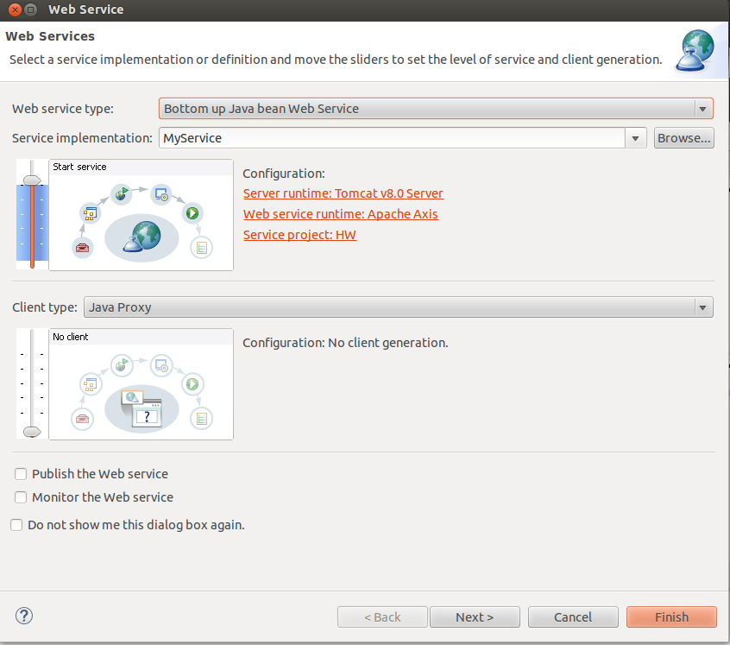
From source file : Web Service → create Web Service
Notes:
From the source file of the class, we can generate (right click) a WS from this file.

Slide 5
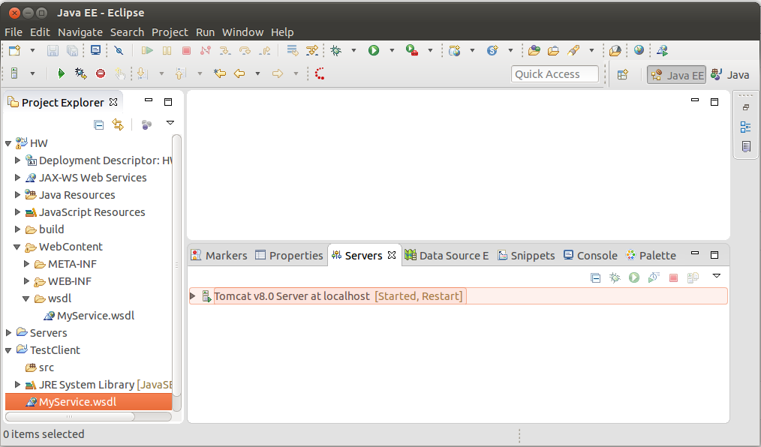
Copy the generated WSDL file in a new Java project
A servlet was deployed on the Tomcat server
Notes:
Then, we create a new Java project and copy the WSDL description in the new project.

Slide 6
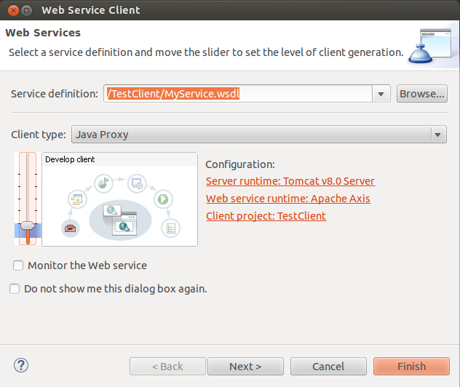
From the WSDL file
Web Service → Generate Client (Develop Client)
Notes:
In the new project, from the WSDL file, we generate (right click) the stubs (develop Client).

Slide 7
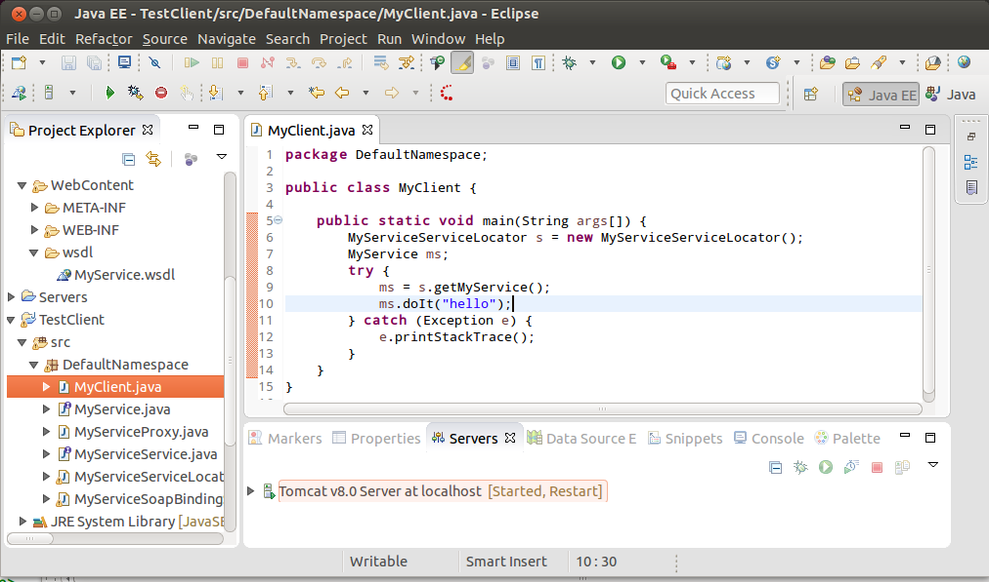
Program a client
Notes:
In the new project, we can program an application which makes an invocation of the WS.
The procedure to follow to invoke the WS depends on the tool used (here Apache Axis).

Slide 8
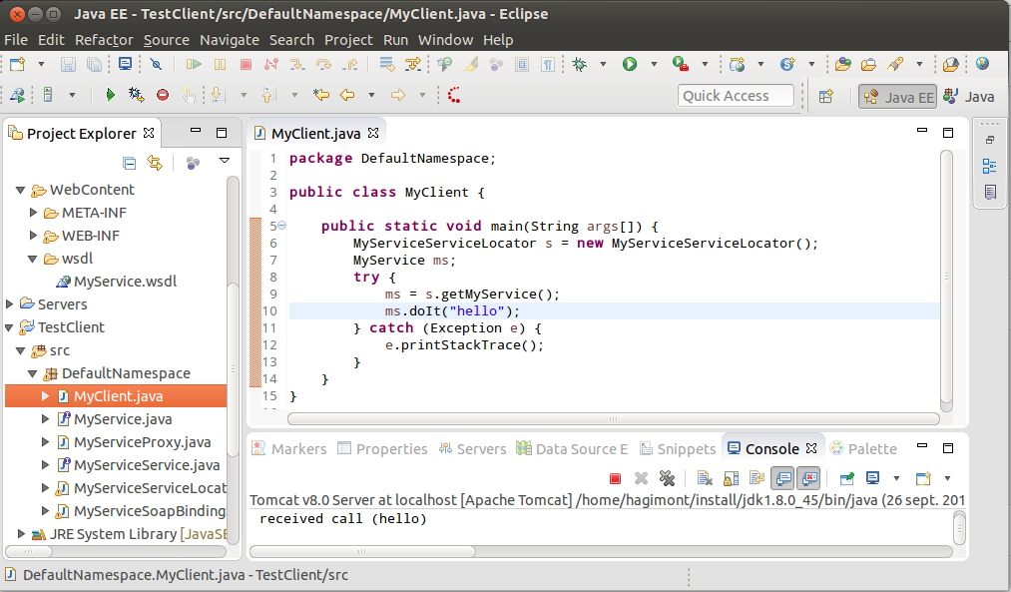
Run
Notes:
We can then run the client program which invokes the WS.

Slide 9
Creating a REST WS with resteasy
WS class
@Path("/rest")
public class Facade {
static Hashtable<String, Person> ht = new Hashtable<String, Person>();
@POST
@Path("/addperson")
@Consumes({ "application/json" })
public Response addPerson(Person p) {
ht.put(p.getId(), p);
return Response.status(201).entity("person added").build();
}
@GET
@Path("/getperson")
@Produces({ "application/json" })
public Person getPerson(@QueryParam("id") String id) {
return ht.get(id);
}
@GET
@Path("/listpersons")
@Produces({ "application/json" })
public Collection<Person> listPersons() {
return ht.values();
}
}
Receives a JSON
Deserialized into a Java object
void method
Returns an object
Serialized into a JSON
Receives an id HTTP parameter
Person is a simple POJO
Notes:
As for SOAP/WS, many tools were implemented to help developers.
Here, we present Resteasy (Jersey is also a very popular one you may look at).
On the server side, you can use annotations in a Java program to say :
- each method is associated with a path in the URL used to access the WS
- @Path : specifies the element of the path associated with the class or the method. Here method addPerson() is associated with path /addperson
- @POST or @GET : specifies which HTTP method is used. Notice that GET returns an object (data) while POST returns an HTTP code (and a message).
- @Consumes : specifies that we receive a JSON object which is deserialized into a Java object.
- @Produces : specifies that we return a Java object which is serialized into a JSON object.
- @QueryParam : the getPerson() method has an "id" parameter. The QueryParam annotation associates this parameter with an "id" HTTP parameter.

Slide 10
Creating a REST WS with resteasy
Add the RestEasy jars in Tomcat
In eclipse
  Create a Dynamic Web Project
  Add RestEasy jars in the buildpath
  Create a package
  Implement the WS class (Facade + Person)
  Add a class RestApp
public class RestApp extends Application {
private Set<Object> singletons = new HashSet<Object>();
public RestApp() {
singletons.add(new Facade());
}
public Set<Object> getSingletons() {
return singletons;
}
}
Notes:
To run this example :
- add the Resteasy jars in Tomcat and Eclipse
- create a dynamic web project (a servlet project)

Slide 11
Creating a REST WS with resteasy
  Add a web.xml descriptor in the WebContent/WEB-INF folder
Export the war in Tomcat
<?xml version="1.0" encoding="UTF-8"?>
<web-app xmlns:xsi="http://www.w3.org/2001/XMLSchema-instance"
xmlns="http://xmlns.jcp.org/xml/ns/javaee"
xsi:schemaLocation="http://xmlns.jcp.org/xml/ns/javaee
http://xmlns.jcp.org/xml/ns/javaee/web-app_3_1.xsd" version="3.1">
<display-name>essai-server</display-name>
<servlet>
<servlet-name>resteasy-servlet</servlet-name>
<servlet-class>
org.jboss.resteasy.plugins.server.servlet.HttpServletDispatcher
</servlet-class>
<init-param>
<param-name>javax.ws.rs.Application</param-name>
<param-value>pack.RestApp</param-value>
</init-param>
</servlet>
<servlet-mapping>
<servlet-name>resteasy-servlet</servlet-name>
<url-pattern>/rest/*</url-pattern>
</servlet-mapping>
</web-app>
Notes:
Add the descriptor and export a war

Slide 12
Creating a REST WS with resteasy
Just write a documentation which says that
  The WS is available at http://localhost:8080/rs-server-person/rest
  Method addperson with POST receives a person JSON :
  Method getperson with GET receives an HTTP parameter id and returns a person JSON
  Method listperson returns a JSON including a set of persons
A user may use any tool (not only RestEasy)
{
"id":"00000",
"firstname":"Alain",
"lastname":"Tchana",
"phone":"0102030405",
"email":"alain.tchana@enseeiht.fr"
}
Notes:
Publication of a REST WS is simply a document describing the interface.

Slide 13
Invoking a REST WS with resteasy
From the previous documentation, a client can write the interface
@Path("/rest")
public interface FacadeInterface {
@POST
@Path("/addperson")
@Consumes({ "application/json" })
public Response addPerson(Person p);
@GET
@Path("/getperson")
@Produces({ "application/json" })
public Person getPerson(@QueryParam("id") String id);
@GET
@Path("/listpersons")
@Produces({ "application/json" })
public Collection<Person> listPersons();
}
Notes:
On the client side, from the documentation, a user can write a Java interface with Resteasy annotations. Of course, it's very similar to what we wrote on the server side, but we could do it for a WS we don't know (we only have the documentation).

Slide 14
Invoking a REST WS with resteasy
And write a class which invokes the WS
public class Client {
public static void main(String args[]) {
final String path = "http://localhost:8080/rs-server-person";
ResteasyClient client = new ResteasyClientBuilder().build();
ResteasyWebTarget target = client.target(UriBuilder.fromPath(path));
FacadeInterface proxy = target.proxy(FacadeInterface.class);
Response resp;
resp = proxy.addPerson(new Person("007","James Bond"));
System.out.println("HTTP code: " + resp.getStatus()
+" message: "+resp.readEntity(String.class));
resp.close();
resp = proxy.addPerson(new Person("006","Dan Hagi"));
System.out.println("HTTP code: " + resp.getStatus()
+" message: "+resp.readEntity(String.class));
resp.close();
Collection<Person> l = proxy.listPersons();
for (Person p : l) System.out.println("list Person: "+p.getId()+"/"+p.getName());
Person p = proxy.getPerson("006");
System.out.println("get Person: "+p.getId()+"/"+p.getName());
}
}
Notes:
The previous annotated interface (FacadeInterface) makes it easy to invoke the service. We can build a proxy object of type FacadeInterface.
This proxy allows programming service invocations simply as method calls.

Slide 15
Invoking a REST WS with resteasy
In eclipse
  Create a Java Project
  Add RestEasy jars in the buildpath
  Implement the Java bean that correspond to the JSON
    Automatic generation with https://www.site24x7.com/tools/json-to-java.html
  Implement the interface and the client class (FacadeInterface + Client)
  Run
Notes:
This is the procedure to run the client.

