Slide 1
Introduce to class and object
Sections 9.1 and 9.2

Slide 2
Define individual methods vs. class
Both can increase code reusability.
Define methods in the class with main method is like to expand the company, but only to the level of consultant service. That is, given a request from user, provide service to satisfy that request (for example, given an integer, find out whether it is prime or not).
Many times we would like to concentrate on making a product. In those cases we need to define a class which combines attributes (properties describing products) and operations (methods) performed on the products .

Slide 3
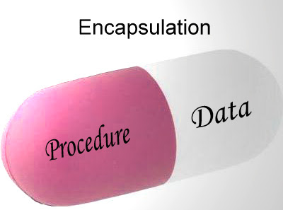
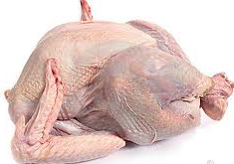

class = data + operations on data
class ThanksgivingDinner {
public: //operations
cookTurkey();
cookPie();
private: //data member
Turkey peace;
Pumpkin cuty;
}
class

Slide 4


Class = data + operation on data: II
other examples:
beef and receipt to cook beef
Chicken and receipt to cook chicken

Slide 5
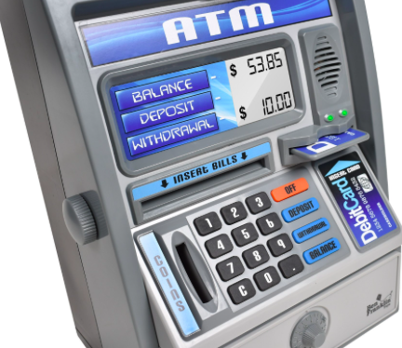
Example of encapsulation
Given a bank account, the data can be account name, pin, account number, and balance.
Operations can be log in (using your name and pin), balance inquiry, deposit and withdrawal.
ATM machine provides buttons for operations.
Notes:
Figure source: https://cdn.shopify.com/s/files/1/0765/2253/products/BF550.PT05_2048x2048.jpg?v=1476278164

Slide 6
Why Encapsulation?
Different objects have different attributes (properties common to objects of the same class) and different operations.
A person object has height attribute, and operations on this attribute can include
initialize (height-at-birth)
change (increase when young and shrink when one gets old)
get height

Slide 7
Why Encapsulation? II
A car has attribute current gas level in a fuel tank. Corresponding operations can be
Initialize current gas level
Increase gas level by pumping more oil or decrease gas level by driving
Get the current gas level
Different operations on different attributes.
Can you ask MPI of a person?
Can you ask IQ of a car?

Slide 8
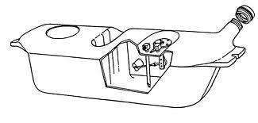
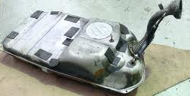
Class and Object
A class is the blueprint from which objects are made.
For example, class as blueprint of fuel tank of a car, while objects as the implemented fuel tanks.
Notes:
P107 Core Java
P34 Head first Java

Slide 9

Data member vs. methods
Things object knows are data members
Things object does are methods
Object
fuel tank
Data members
Current gas level
Methods
Fill tank with more gas
Send gas through the gas lines
Get current gas level of tank
Notes:
P34 Head first Java
http://www.ehow.com/how-does_4899947_cars-gas-tank-work.html

Slide 10
Encapsulation
Combine data members and methods in one package
Also called information hiding
encapsulation hides the implementation details from the user of the object.
One can use a fuel tank without knowing how it works.
current gas level
Fill tank with gas
Send gas through gas line
Get current level of tank
Do you need to be an auto engineer to operate the car?

Slide 11
Declare class FuelTank in FuelTank.h
class FuelTank {
public:
//function members (aka operations)
//1. Constructor(s): initialize data member
//2. fill gas to the fuel tank
//3. send gas from tank to gas line
//4. read the current gas level
//5. destructor:
//delete any dynamically allocated memory spaces.
private:
int currGasLevel;
};
Notes:
Difference of data member versus local variables: data members exist when the object was created. They stayed longer in the memory until the object expires.

Slide 12
Take home message – what is class?
class is the encapsulation of data members and methods performed on those data members.
Next task:
Define class FuelTank
Construct an object tank from class FuelTank
Use object tank
Notes:
For example, knead operation can be applied to flour, but not to person.
A person can have a name, change it if necessary, also can do things like think, talk, and walk, but not flour.

Slide 13
Define class FuelTank in FuelTank.cpp
//Every class has a default constructor.
//A constructor is a method with the same //name as the class, but no return type –
//not even void.
//Default constructor has no parameter.
FuelTank::FuelTank() {
currGasLevel = 0;
}
1. The first letter of class name is capital.
2. Data members can be accessed by every method/constructor of the same class directly.
3. So there is no need to pass data member as parameters in those methods/constructors.

Slide 14
Define class FuelTank: III
//Non-default constructor has at //least one parameter.
FuelTank::FuelTank(int startLevel) {
currGasLevel = startLevel;
}

Slide 15
Define class FuelTank: IV
//Fill gas to the fuel tank
void FuelTank::fillGas(int gallons) {
currGasLevel += gallons;
}

Slide 16
Define class FuelTank: V
//send gas from tank to gas line
void FuelTank::sendGas(int gallons)
{
if (currGasLevel >= gallons)
currGasLevel = currGasLevel –
numGallons;
//same as
//currGasLevel -= gallons;
}
Notes:
//Goal: Define class FuelTank
public class FuelTank {
int currGasLevel;
//Every class has a default constructor.
//A default constructor is a method with the same name
//as the class, but no return type -- not even void.
//Default constructor has no parameter.
public FuelTank() {
currGasLevel = 0;
}
//Non-default constructor has at least one parameter.
public FuelTank(int startLevel) {
currGasLevel = startLevel;
}

Slide 17
Define class FuelTank: VI
//Getting the current gas level
//is an accessor (or getter).
//add const means the function can //read but not modify data member.
int FuelTank::getGasLevel() const {
return currGasLevel;
}
Notes:
A "const function", denoted with the keyword const after a function declaration, makes it a compiler error for this class function to change a member variable of the class. However, reading of a class variables is okay inside of the function, but writing inside of this function will generate a compiler error.
https://stackoverflow.com/questions/3141087/what-is-meant-with-const-at-end-of-function-declaration

Slide 18
Use class FuelTank
Create an empty fuel tank.
Add 5 gallons of gas to it.
Find out how much gas in the tank. Print out the result to the screen.
Send 1 gallon of gas to gas line.
Find out how much gas in the tank. Print out the result to the screen.

Slide 19

FuelTankClient uses FuelTank
class FuelTankClient {
int main() {
//Create an empty fuel tank.
FuelTank tank;

Slide 20


FuelTankClient class: II
//Add 5 gallons of gas to the tank.
tank.fillGas(5);
//Find out how much gas in the tank.
int tankLevel = tank.getGasLevel();
//Print out the result to the screen.
cout << "The tank has " << tankLevel
<< " gallons of gas.";

Slide 21
FuelTankClient class: III
//Send 1 gallon of gas to gas line.
tank.sendGas(1);
//Find out how much gas in the tank.
tankLevel = tank.getGasLevel();
//Print out the result to the screen.
cout << "The tank has " << tankLevel
<< " gallons of gas.";
}
}
Notes:
public class FuelTankClient {
public static void main(String[] args) {
//Create an empty fuel tank.
FuelTank tank = new FuelTank();
//Add 5 gallons of gas to the tank.
tank.fillGas(5);
//Find out how much gas in the tank.
int tankLevel = tank.getGasLevel();
//Print out the result to the screen.
System.out.println("The tank has " + tankLevel + " gallons of gas.");
//Send 1 gallon of gas to gas line.
tank.sendGas(1);
//Find out how much gas in the tank.
tankLevel = tank.getGasLevel();
//Print out the result to the screen.
System.out.println("The tank has " + tankLevel + " gallons of gas.");
}
}

Slide 22

Hamburger
Suppose each hamburger has bun, vegetable, and meat layer.
data members are
bun
vegetable
Meat
constructors are like cashiers, who take the order to make a hamburger. It can be a default-configured hamburger (bun + lettuce + beef), or a customer-ordered one (whole-wheat bun + onion + chicken).

Slide 23
Hamburger: II
Assessors (getters) are like: get information of bun, meat, or vegetable layer, calculate calorie.
Modifiers (setters) are like: change bun, change meat, change vegetable

Slide 24
Envelop with filled form analog
A class is a blank form to fill in data information. For example, any person needs to fill in name, birth date.
An object of that class is a filled form. Your data will differ from mine (different names and/or birth dates).
……
Name
BirthDate
Name | Ann Smith
BirthDate | 1/1/80
Name | Bob West
BirthDate | 1/1/90

Slide 25

Envelop with filled form analog: II
Filled in form is put in envelop.
You can use extension number (like method name) to find information of data.
For example, get name extension 1, get birth date extension 2.
Different objects have different phone number (like object name).
For example, the first object has phone number 718-111-1111, the second object has phone number 516-123-4567.
Name | Ann Smith
BirthDate | 1/1/80
Name | Bob West
BirthDate | 1/1/90

Slide 26
Summary
How to create a fuel tank that starts with 10 gallons of gas?
Define class FuelTank once, then others can use the blueprint to implement many fuel tanks. This fulfills the goal of code reuse.

Slide 27
Summary II
Due to encapsulation, users can only access private data members through given methods, this will reduce the chance of errors in code.
For example, user can only select date to travel from a calendar. So the designer of booking system do not need to worry about wrong dates.
If a data member has wrong value, we only need to check those methods that can access the data member.
So it is easy to write and maintain bug-free code.

Slide 28
More good things coming out from Object Oriented Programming
Inheritance
Polymorphism

