Slide 1
GRADUATION PROJECT 2026
Smart Academic Advisor System
Project Team
Youssef Emad (225241)
Amr Hamdy (225182)
Zeyad Mostafa (225070)
Omar Tokal (225238)
Supervised By
Prof. Dr. Sameh Zarif
T.A. Mariam Haggag

Slide 2
Presentation Agenda
1
Introduction & Problem
Setting the stage for our research.
2
Motivation & Objectives
Why this project matters and what we aim to achieve.
3
Related Work & Business Model
Understanding the landscape and impact.
4
Methodology & Design
Our approach and detailed system design.
5
Requirements & Timeline
Defining what our system does and how it will be built.

Slide 3
Introduction
01
02
What is the System?
How Does It Function?
An intelligent academic guidance system designed to replicate and enhance the role of a human academic advisor, offering personalized support for university students.
Integrates Retrieval-Augmented Generation (RAG) for document retrieval, Knowledge Graphs for prerequisite reasoning, and Large Language Models (LLMs) for natural, context-aware conversations.
03
04
Where Is It Deployed?
Why Is It Essential?
Delivered via a Flutter mobile application connected to a Supabase backend and a robust FastAPI-based AI engine.
To provide always-available, consistent, and personalized advising, ensuring no student is left behind due to advisor unavailability.

Slide 4
The Need for Intelligent Academic Advising
Current Challenges
Impact & Opportunities
• Limited Advisor Capacity
Academic advisors are often overwhelmed with high caseloads, leading to long wait times and insufficient personalized attention for every student.
• Inconsistent Guidance
Advice can vary significantly across advisors and departments, creating confusion and potentially misguiding students on critical academic paths.
• Manual Degree Tracking
Navigating complex prerequisite chains, degree requirements, and course availability manually is time-consuming and prone to human error.
• Fragmented Information
Essential academic information is often scattered across disparate systems and static documents.
• Suboptimal Course Planning
Students may choose unsuitable courses, leading to imbalanced workloads or missed opportunities.
• Delayed Graduation
Errors in course selection or forgotten prerequisites can unnecessarily extend a student's time to degree completion.
• Decreased Student Satisfaction
Frustration from inaccessible or inconsistent advising can lead to disengagement and lower academic performance.
• Lack of Clarity
Students struggle to visualize their academic journey, making it difficult to confidently plan future semesters.

Slide 5
Motivation & Value Proposition
Understanding the core reasons behind the Smart Academic Advisor System and the unique benefits it offers.
Our Motivation
Our Value Proposition
• Equitable Access
Ensure every student receives timely, consistent, and personalized academic guidance.
• Enhanced Advisor Efficiency
Reduce administrative burden and empower advisors to focus on complex cases and mentorship.
• Actionable Knowledge
Transform static university resources into an interactive, queryable knowledge base.
• 24/7 Intelligent Advisor
Always-on AI assistant provides immediate, context-aware responses around the clock.
• Robust & Reliable Logic
Knowledge Graph ensures accuracy in prerequisite validation and degree tracking.
• Data-Driven Recommendations
All guidance grounded in official university documents and real-time student data.
• Seamless User Experience
Natural language chat interface integrated with each student's academic profile.

Slide 6
Related Work Summary
Scope
Recent research focuses on AI-based academic support systems that integrate LLMs, Knowledge Graphs, and RAG to improve accuracy, personalization, and trust.
Key Approaches
• Rule-based Chatbots: Reliable for fixed queries, but limited flexibility • LLM-based Advisors: Natural interaction, but risk hallucinations
• Knowledge Graph Reasoning: Ensures prerequisite correctness and explainability
Main Findings
LLMs improve usability but need grounding
RAG reduces hallucinations through retrieval
Knowledge Graphs improve decision correctness
Hybrid approaches achieve the highest reliability
Research Gap
Current systems often struggle with balancing natural conversation and reliable prerequisite-based course planning in one unified solution.
.

Slide 7
Business Model Overview
Value Proposition:
AI-powered, real-time academic advising that improves course planning accuracy, reduces advising delays, and enhances student satisfaction.
Customers:
Universities, academic advising departments, and students.
Channels:
Mobile chatbot application integrated with university systems.
Customer Relationship:
24/7 self-service advising with personalized, data-driven recommendations.
Revenue Model:
Institutional subscriptions, setup fees, and ongoing support services.
Key Enablers:
LLMs, Knowledge Graphs, RAG pipeline, academic data, and development team.
Partners & Costs:
Universities and academic advisors; costs include development, cloud infrastructure, and maintenance.

Slide 8
Methodology – Key Steps
01
Data Collection & Preparation
We initiate the process by meticulously collecting all relevant academic documentation, including course catalogs, university bylaws, and regulatory guidelines. This critical phase involves thorough text extraction and cleaning to ensure the reliability and accuracy of our data.
02
Knowledge Graph Construction
A robust Knowledge Graph is constructed to semantically model the intricate academic relationships. This includes detailed representations of courses, prerequisites, major requirements, and comprehensive graduation rules.
03
Retrieval-Augmented Generation (RAG)
To enhance query responses, we implement RAG. Academic documents are indexed using embedding-based retrieval techniques, allowing efficient fetching of relevant content. This grounding in official data significantly reduces AI hallucinations.

Slide 9
Methodology – Implementation & Deployment
01
02
03
Hybrid Reasoning Pipeline
System Deployment & Accessibility
Integration & Testing
A sophisticated hybrid reasoning pipeline combines the strengths of RAG results with the logical inference capabilities of the Knowledge Graph. This synergistic approach allows the system to deliver highly context-aware and personalized recommendations.
The system is deployed as a Flutter-based mobile chatbot application, providing an intuitive interface for students. All backend AI services operate seamlessly to ensure continuous functionality and 24/7 availability.
Comprehensive testing ensures all components work seamlessly together. The system undergoes rigorous validation to confirm accuracy, reliability, and user experience quality before full deployment.

Slide 10
Analysis and Design
1. Use Case Diagram
2. Activity Diagram
3. Data Flow Diagram
3.1 Context diagram
3.2 Level 0 diagram
3.3 Level 1 diagram
4. Entity Relationship Diagram
5. Class diagram
6. Sequence diagram

Slide 11
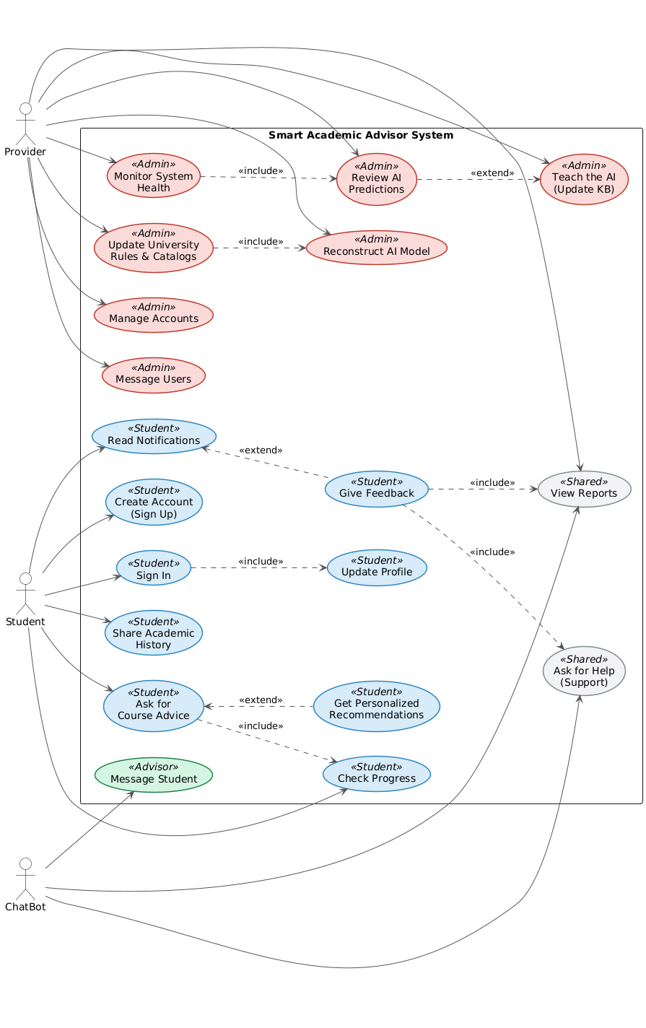
Use Case Diagram

Slide 12
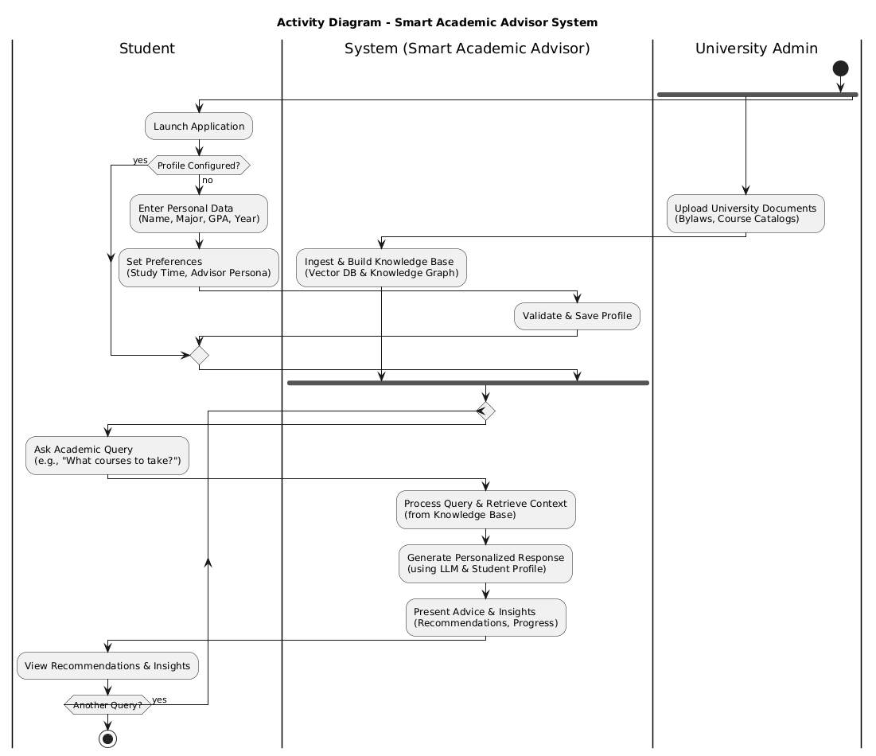
Activity Diagram

Slide 13
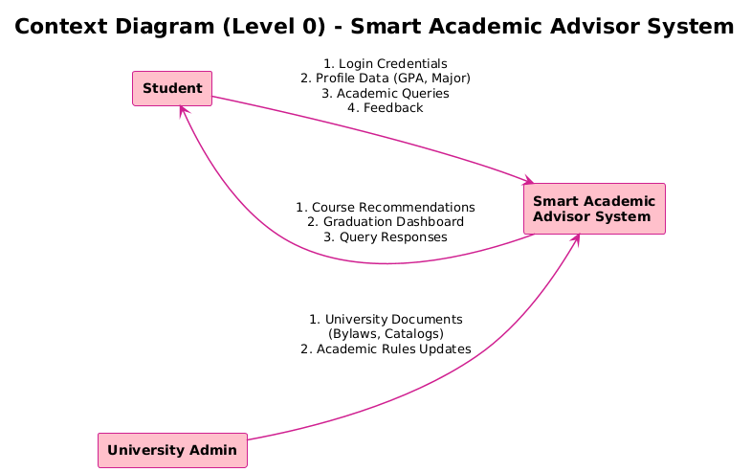
Data Flow Context Diagram Level 0

Slide 14
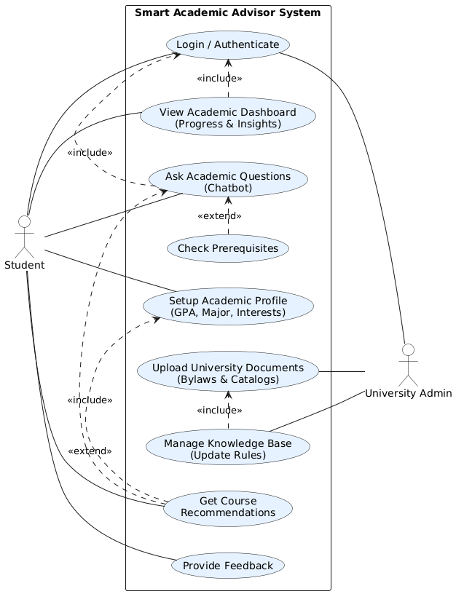
Data Flow Context Diagram Level 1

Slide 15
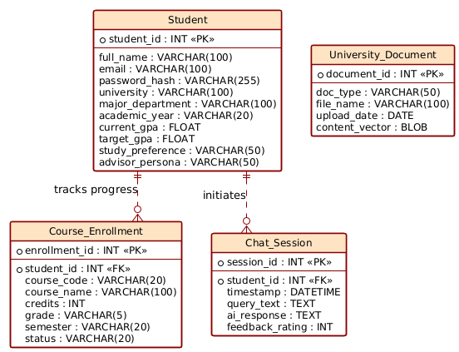
Entity Relationship Diagram

Slide 16
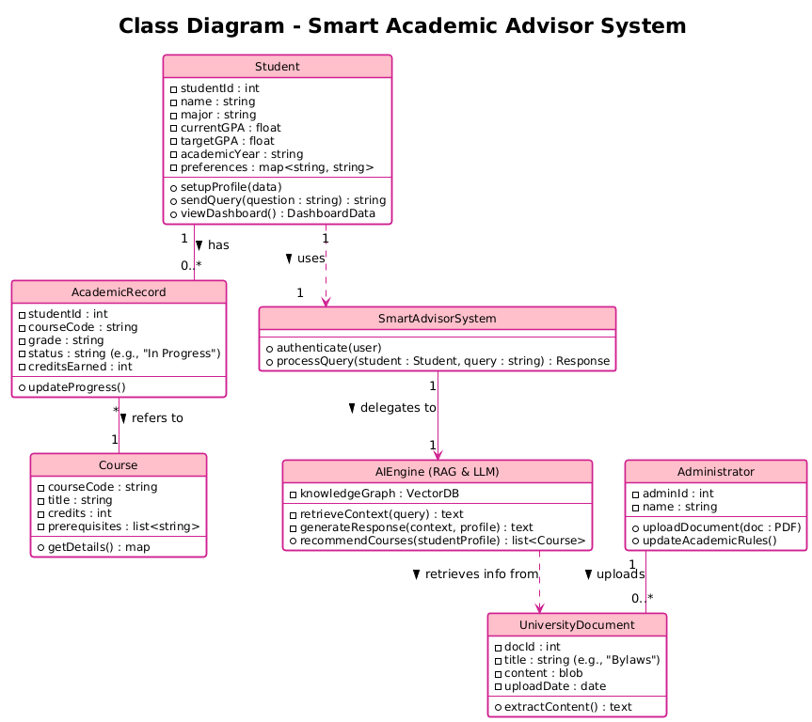
Class Diagram

Slide 17
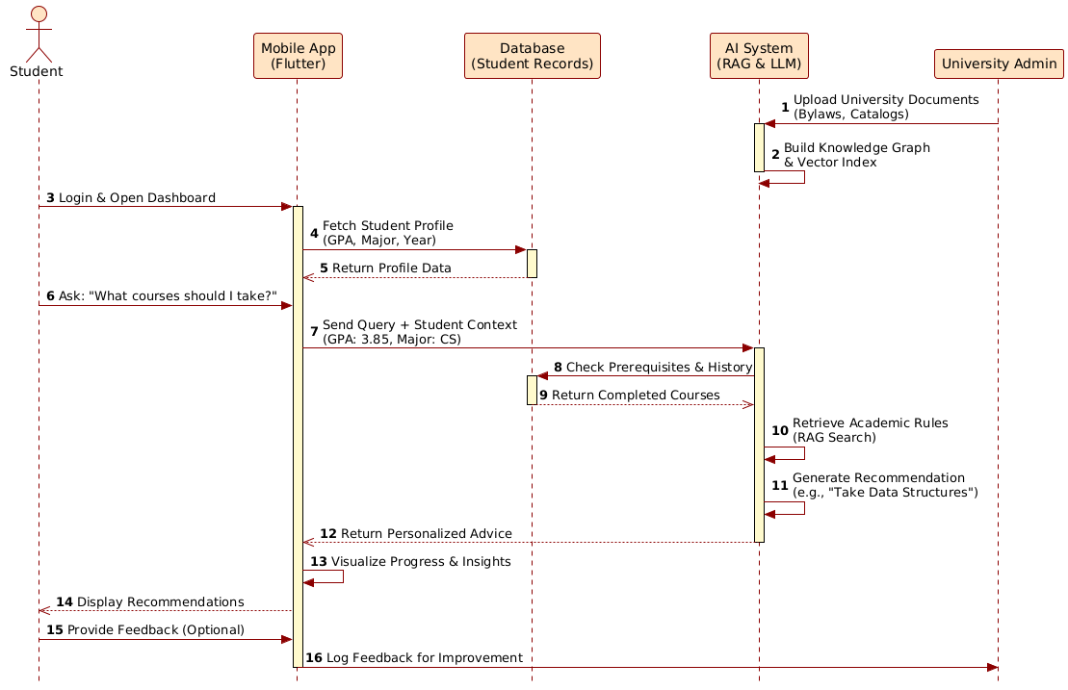
Sequence Diagram

Slide 18
Functional Requirements
• Intelligent Chatbot Interface
• Academic Policy Retrieval
Cross-platform mobile chatbot supporting natural language academic queries.
Retrieves and explains graduation requirements and academic rules.
• Course Recommendation & Selection
• Student Profile Analysis
Analyzes academic history for context-aware course recommendations
Analyzes individual student records and provides personalized academic planning.
• Prerequisite Tracking
• Knowledge Base Management
Automatically checks prerequisites using a Knowledge Graph.
Ingests university documents into a structured Knowledge Graph.

Slide 19
Non-Functional Requirements
Security
Usability
Protects sensitive student academic data and profiles through secure access.
Intuitive, accessible mobile chatbot interface requiring no technical expertise.
Performance
Scalability
Delivers real-time responses to queries with minimal latency.
Supports growing student populations and large course catalogs efficiently.
Reliability
Availability
Provides accurate, consistent, and trusted academic recommendations grounded in official data.
Offers 24/7 academic advising support, eliminating reliance on office hours.

Slide 20
GUI Representation & Demo
A visual demonstration of the Smart Academic Advisor System's chatbot interface.
📱 Live Demo / Screenshots Insert your mobile app screenshots or demo video here

Slide 21
AI Backend Development Phases (Dec – Mar)
Phase 1
Data Collection & Preparation
Collect and clean course catalogs, rules, and syllabi. Design Knowledge Graph schema and structured datasets.
Phase 2
Knowledge Graph Construction
Build nodes & relationships in Neo4j (Course, Prerequisite, Major). Connect KG with Python backend, test queries.
Phase 3
RAG Development
Chunk documents, create embeddings, and index in FAISS/Supabase. Ensure accurate retrieval of academic content.
Phase 4
Hybrid QA Pipeline Integration
Combine RAG + KG outputs with LLM for reasoning. Generate context-aware, structured answers.
Phase 5
Testing & Optimization
Evaluate accuracy, latency, and consistency. Prepare API endpoint for Flutter app integration.

Slide 22
Flutter Mobile App Development Phases (Feb – May)
Phase 1
Project Foundation
Set up Flutter environment, version control, app architecture. Design UI/UX layouts and chatbot interface.
Phase 2
Backend & Database Connection
Connect app to FastAPI & Supabase. Implement real-time chat and authentication.
Phase 3
Core App Development
Build main screens: dashboard, profile, courses, summary. Manage app state and secure API calls.
Phase 4
Chatbot Integration
Integrate QA chatbot (RAG + KG + LLM). Display contextual responses and save chat history.
Phase 5
Advanced Features & Analytics
Add personalization, analytics dashboard, and performance optimization.
Phase 6
Testing & Finalization
Conduct full testing, fix bugs, ensure security. Prepare demo video, documentation, and slides.

Slide 23
Thank You!
Any Questions?
Project Team:
Youssef Emad (225241)
Omar Tokal (225238)
Amr Hamdy (225182)
Zeyad Mostafa (225070)
Supervised By:
Prof. Dr. Sameh Zarif
T.A. Mariam Haggag

