Slide 1
K-MEANS CLUSTER
Satellite Image Segmentation • Intro to AI
Youssef Eslam Hussein | 231000070 | 9/10/2026

Slide 2
Introduction to K-Means
1
Initialization
K-Means clustering is an unsupervised machine-learning technique that groups data points into K distinct clusters based on similarity — no labeled training data required.
Select K and place initial centroids
2
Assignment
Calculate distance from every pixel to each centroid
Here, it becomes a satellite image cluster: pixels with similar spectral values are grouped into land-cover classes — water, vegetation, urban areas, bare soil.
3
Centroid Update
Recompute each centroid's position
4
Convergence Check
Stop once centroids stop moving
K-Means Clustering — Intro to AI
2

Slide 3
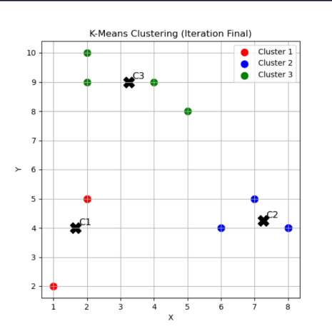
A Simple Example First
Before applying K-Means to pixels, here's what it looks like on plain 2D points — the same logic scales up to satellite imagery.
Each colored dot is a data point (x, y)
Black X marks are the final centroids
Points were assigned to the nearest centroid
Centroids converged after a few iterations
K-Means Clustering — Intro to AI
3

Slide 4
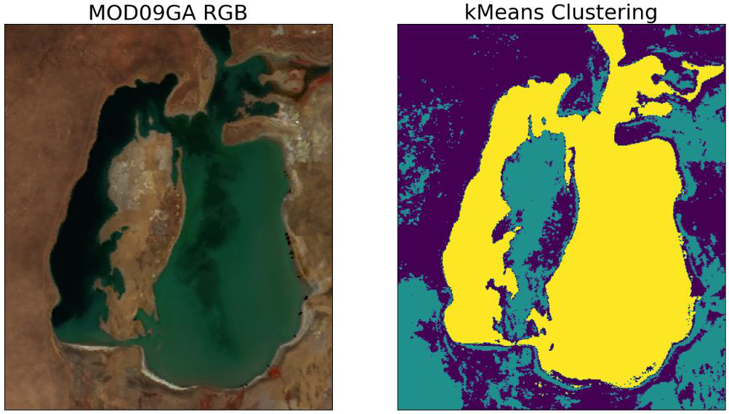
The Core Concept: Pixels as Data Points
Each pixel becomes a data point in color space. K-Means assigns every pixel to the nearest cluster center, then updates the centers — repeating until the groupings stop changing.
K-Means Clustering — Intro to AI
4

Slide 5
Impact of the 'K' Value
K is the hyperparameter that dictates how many segments the image is split into.
K = 3
K = 5
Macro-level overview
Granular segmentation
Forces the algorithm to classify the image into its three most dominant features — e.g. deep water, shallow water / vegetation, and desert / land.
Distinguishes subtler variation — different soil types, varying water depth or sediment levels, and dense vs. sparse vegetation.
K-Means Clustering — Intro to AI
5

Slide 6
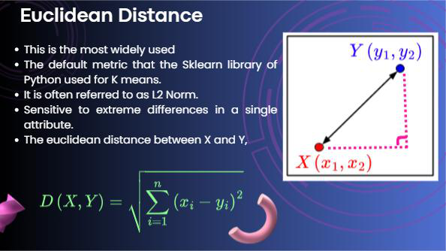
Distance Metrics: Euclidean
L2 Norm
Data Preparation
Reshape the image into a 2D array — one row per pixel, columns are R, G, B (or spectral bands).
Initialization
Choose K and place initial centroids in color space.
Distance
d(p, c) = √Σ(pᵢ − cᵢ)² — straight-line distance between a pixel and a centroid.
Update
Assign each pixel to its nearest centroid, then recompute centroids as the mean of assigned pixels.
Tends to form spherical clusters; heavily penalizes large single-channel differences due to squaring.
K-Means Clustering — Intro to AI
6

Slide 7
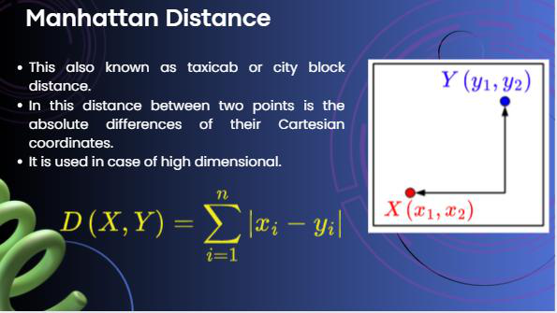
Distance Metrics: Manhattan
L1 Norm
Pixel Representation
Each pixel is a vector in a multi-dimensional space (R, G, B, or NIR bands).
Distance Formula
D = Σ|xᵢ − yᵢ| — sum of absolute differences, a.k.a. taxicab / city-block distance.
Centroid Update
Uses the median (not the mean) to strictly minimize the Manhattan objective.
Behavior
More robust to outliers than Euclidean; tends to form diamond-shaped clusters.
K-Means Clustering — Intro to AI
7

Slide 8
K-Means — Pseudocode
The same four steps from earlier, written as algorithmic pseudocode.
FUNCTION kmeans(data, K, metric, max_iters):
DIST(p, c, "euclidean")
centroids <- first K points of data
RETURN sqrt( SUM( (p[i] - c[i])^2 ) )
FOR iteration in 1 .. max_iters:
// 1. Assignment step
Update rule: new centroid = MEAN of assigned points
FOR each point p in data:
FOR each centroid c in centroids:
distance[p][c] <- DIST(p, c, metric)
cluster[p] <- argmin distance[p][*]
// 2. Update step
FOR each cluster k in 1 .. K:
DIST(p, c, "manhattan")
points_k <- all p where cluster[p] = k
new_centroids[k] <- MEAN(points_k)
RETURN SUM( |p[i] - c[i]| )
// 3. Convergence check
Update rule: new centroid = MEDIAN of assigned points (minimizes L1 exactly)
IF new_centroids ~= centroids:
BREAK
centroids <- new_centroids
RETURN cluster, centroids
K-Means Clustering — Intro to AI
8

Slide 9
Watch K-Means Converge
Same toy example as before, now animated — centroids start in the wrong place and walk toward the true cluster centers over several iterations. In PowerPoint, press Slide Show to see it play.
K-Means Clustering — Intro to AI
9

Slide 10
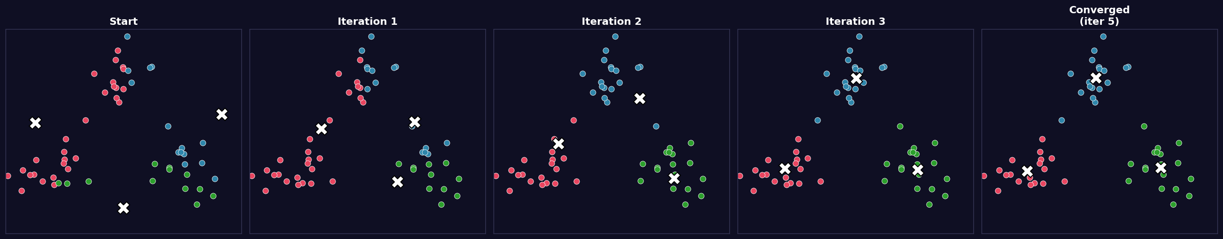
The Iterations, Frame by Frame
A static breakdown of the animation, for print or if GIF playback isn't available.
What's happening: centroids (white X) start in bad positions. Each iteration, every point joins its nearest centroid's color, then centroids jump to the average of their new group — the whole system settles once no point changes color.
K-Means Clustering — Intro to AI
10

Slide 11
Coding Structure
Layer | Function / Class | Responsibility | Key Techniques
Core AI Engine | kmeans() | Implements K-Means from scratch | Vectorized distance • Euclidean & Manhattan • Convergence check
Data Processing | generate_slide_figure() | Preprocesses images, runs segmentation | BGR→RGB • Resize • Reshape to (N,3) • Multi-plot figure
Render Bridge | fig_to_photoimage() | Converts plots for the GUI | Agg backend • RGBA buffer • LANCZOS downscale
User Interface | SlideshowApp | Interactive dark-themed slideshow | OOP Tkinter layout • Keyboard bindings • Responsive scale
Concurrency | threading.Thread | Keeps GUI responsive | Background daemon thread • root.after() thread-safe updates
K-Means Clustering — Intro to AI
11

Slide 12
Conclusion
By writing K-Means from scratch with pure NumPy matrix operations, this project applies theoretical ML concepts to real remote-sensing data. The vectorized implementation stays efficient even while computing distances for hundreds of thousands of pixels across every iteration.
K-Means Clustering — Intro to AI
12

