Slide 1
Section 1
Systems Programming ECE3502

Slide 2
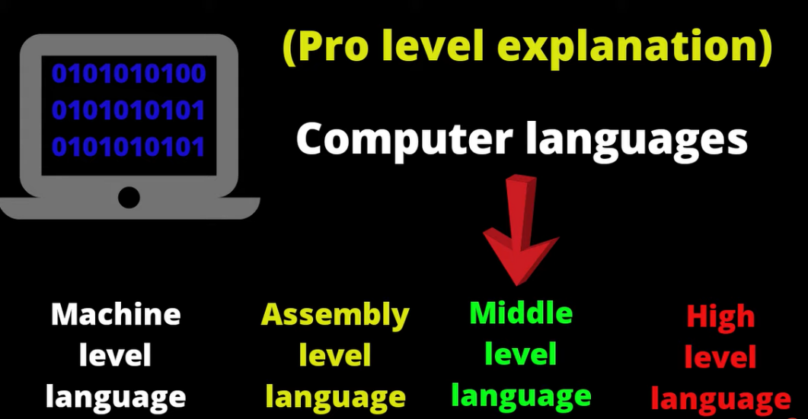


Translators
A translator or programming language processor that converts a computer program from language to another.
(convert the programming language into a machine language)
It takes a program written in source code and converts into machine code.
It discovers and identifies the error during translation.

Slide 3
Types of Translators
Assembler: the assembler is used to translate the program written in assembly language into machine level language.
Assembly Language
Assembler
Machine Code
(Source code)
(Translator)
(Object code)
Compilers: the compiler will read the complete source program written in high level language, if the code is error free then it will convert into machine level language.
Translators
Interpreter: just like compiler, it convert one at a time and reports errors detect once, while doing conversion (faster than a compiler).

Slide 4
SIC Machine
This machine has been designed to illustrate the most commonly encountered hardware features and concepts.
SIC (Simplified Instruction Computer) comes in two versions:
Standard model
Extra Expensive/ Extra Equipment/ XE version

Slide 5
SIC machine architecture
Memory
it consists of 8-bit bytes
3 consecutive byte from a word(24 bits)
Data Formats
Integers are stored as 24-bit binary numbers
2’S complement representation is used for negative values
Total of 32768 (2^15) bytes in the computer memory
Characters are stored using their 8-bit ASCII codes
No floating-point hardware on the standard version of sic

Slide 6
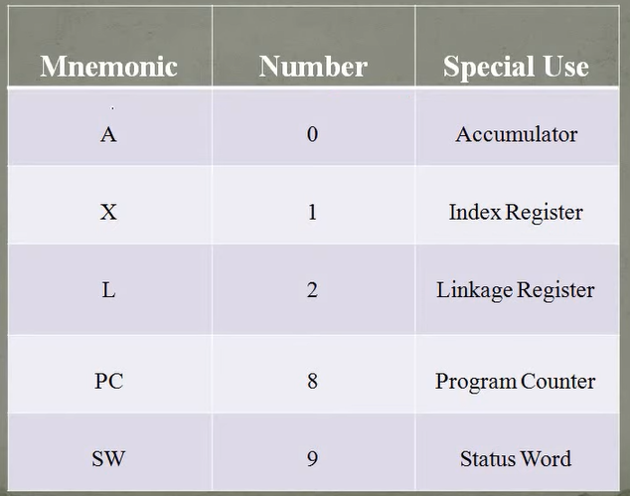
Registers
There are 5 registers

Slide 7
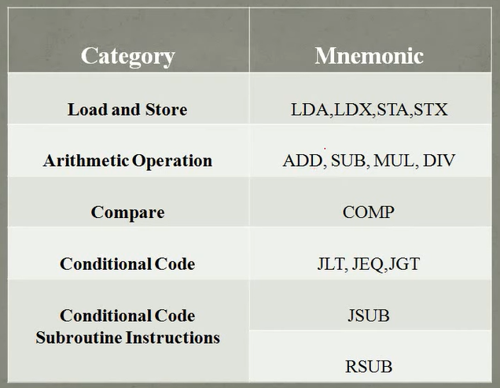
Instructions Set

Slide 8
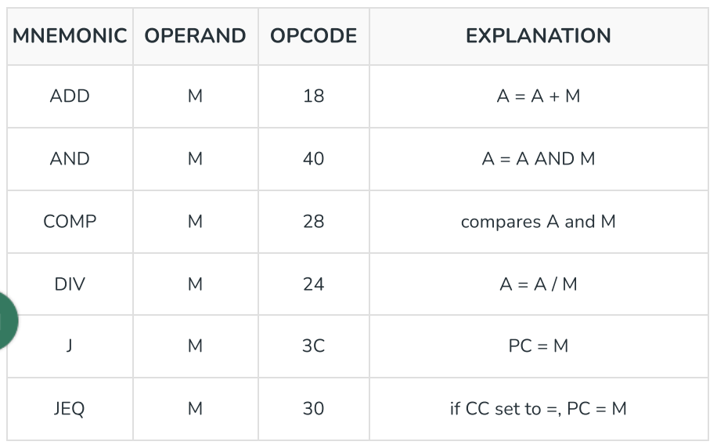
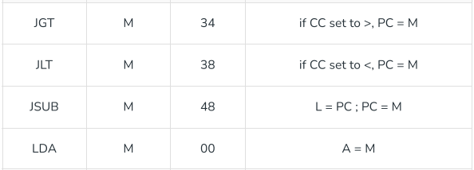
Instruction Set Sheet
A stands for Accumulator
M stands for Memory
CC stands for Condition Code
PC stands for Program Counter
RMB stands for Right Most Byte
L stands for Linkage Register

Slide 9
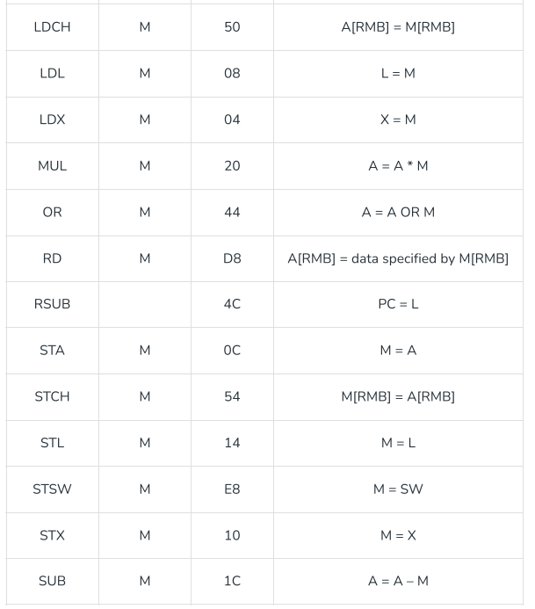
Instruction Set Sheet
A stands for Accumulator
M stands for Memory
CC stands for Condition Code
PC stands for Program Counter
RMB stands for Right Most Byte
L stands for Linkage Register

Slide 10
Assembler Directives
Basic assembler directives
END: Indicate the end of the source program, and (optionally) the first executable instruction in the program.
BYTE: Generate character or hexadecimal constant, occupying as many bytes as needed to represent the constant.
WORD: Generate one-word integer constant
RESB: Reserve the indicated number of bytes for a data area
RESW: Reserve the indicated number of words for a data area
START: Specify name and starting address for the program

Slide 11
Program 1:
LDA BETA
DIV GAMMA
STA ALPHA
:
:
ALPHA RESW 1
BETA WORD 10
GAMMA WORD 2
Trace the following assembly code for SIC

Slide 12
Program 2:
LDA FIVE
STA ALPHA
LDCH CHARZ
STCH C1
:
:
ALPHA RESW 1
FIVE WORD 5
CHARZ BYTE C’5’
C1 RESB 1
Trace the following assembly code for SIC

Slide 13
Program 3:
LDX ZERO
MOVECH LDCH STR1,X
STCH STR2,X
TIX ELEVEN
JLT MOVECH
:
:
STR1 BYTE C’TEST STRING’
STR2 RESB 11
ZERO WORD 0
ELEVEN WORD 11
Trace the following assembly code for SIC

Slide 14
Program 4:
LDA ALPHA
ADD INCR
SUB ONE
STA BETA
LDA GAMMA
ADD INCR
SUB ONE
STA DELTA
:
:
ONE WORD 1
ALPHA WORD 10
INCR WORD 2
BETA RESW 1
GAMMA WORD 15
DELTA RESW 1
Trace the following assembly code for SIC

Slide 15
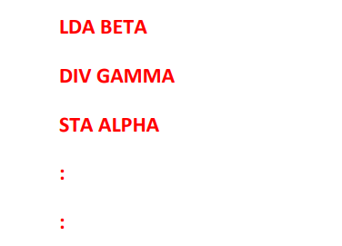
Sheet 1
Question 4
Write a sequence of instructions for SIC to set ALPHA equal to the integer portion of BETA ÷ GAMMA.
ALPHA RESW 1
BETA WORD 8
GAMMA WORD 4

Slide 16
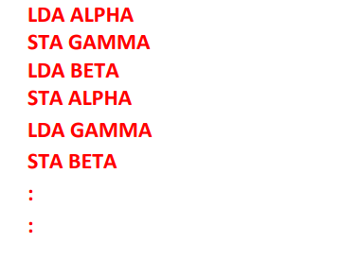
Sheet 1
Question 2
Write SIC instructions to swap the values of ALPHA and BETA
ALPHA WORD 8
BETA WORD 2
TEMP RESW 1

Slide 17
Sheet 1
Question 7
LDA BETA
MUL FOUR
SUB NINE
STA ALPHA
ALPHA RESW 1
BETA WORD 10
FOUR WORD 4
NINE WORD 9
Write a sequence of instructions to set ALPHA equal to 4 * BETA – 9. Assume that BETA is equal to 10

Slide 18
Sheet 1
Question 1
LDCH NCHAR
LDX ZERO
LOOP STCH ALPHA,X
TIX HUNDRED
JLT LOOP
:
:
ALPHA RESB 100
NCHAR BYTE C'N'
ZERO WORD 0
HUNDRED WORD 100
; Load ASCII value of ‘N’
; X = 0
; Store one character at ALPHA + X
; X = X + 1 and compare with 100
; If X < 100, continue loop
; Reserve 100 bytes (array)
; Character constant
Suppose that ALPHA is an array of 100 characters. Write a sequence of instructions for SIC to set all 100 elements of the array to letter “N”.

Slide 19
Subroutine Name
Sheet 1
Question 5
; X = 0 (index / counter)
; Read one character into A
; Compare with 00 (null)
; If null → end of record
; Store character in buffer
; X = X + 1, compare with 100
; If X < 100 → continue
; Store number of characters read
; Return to caller
; Buffer for 100 bytes
; Record length
; Example input device code
READREC LDX ZERO
LOOP RD INDEV
COMP ZERO
JEQ DONE
STCH BUFFER,X
TIX HUNDRED
JLT LOOP
DONE STX LENGTH
RSUB
BUFFER RESB 100
LENGTH RESW 1
ZERO WORD 0
HUNDRED WORD 100
INDEV BYTE X'F1’`
Write a subroutine for SIC that will read a record into a buffer. The record may be any length from 1 to 100 bytes. The end of record is marked with a “null” character (ASCII code 00). The subroutine should place the length of the record read into a variable named LENGTH.

Slide 20
LDX ZERO
LOOP LDA ALPHA,X
MUL FOUR
ADD BETA,X
STA GAMMA,X
LDA XREG
ADD THREE
STA XREG
LDX XREG
COMP THIRTY
JLT LOOP
RSUB
ZERO WORD 0
FOUR WORD 4
THREE WORD 3
THIRTY WORD 30
XREG WORD 0
ALPHA WORD 4,2,4,6,8,0,3,5,9,12
BETA WORD 10,2,9,1,5,7,15,4,4,1
GAMMA RESW 10
Sheet 1
Question 6
Suppose that ALPHA and BETA are the two arrays of 10 words each ( ALPHA = {4,2,4,6,8,0,3,5,9,12} and
BETA={10,2,9,1,5,7,15,4,4,1}).
Write an assembly code that computes another array GAMMA whose elements are obtained by multiplying the corresponding ALPHA element by 4 and adding the corresponding BETA elements.

