Slide 1
Section 2
Systems Programming ECE3502

Slide 2
SIC machine architecture
Memory
it consists of 8-bit bytes
3 consecutive byte from a word(24 bits)
Data Formats
Integers are stored as 24-bit binary numbers
2’S complement representation is used for negative values
Total of 32768 (2^15) bytes in the computer memory
Characters are stored using their 8-bit ASCII codes
No floating-point hardware on the standard version of sic
Notes:
Remember memory size is 2 to the power 15 bytes

Slide 3
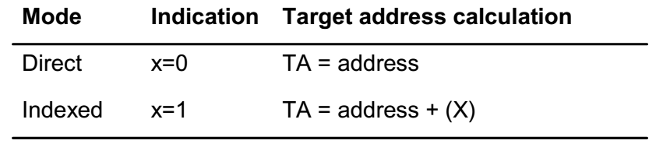
SIC machine architecture
Instruction formats
24-bit format
X is to indicate index-address mode
Addressing modes
LDA ALPHA → MEMORY[ALPHA]
LDA ALPHA,X → MEMORY[ALPHA+X]
Notes:
Remember memory size is 2 to the power 15 bytes

Slide 4
Assembler Directives
Pseudo-Instructions
Not translated into machine instructions
Providing information to the assembler
Basic assembler directives
START: Specify name and starting address for the program
END: Indicate the end of the source program, and (optionally) the first executable instruction in the program.
BYTE: Generate character or hexadecimal constant, occupying as many bytes as needed to represent the constant.
WORD: Generate one-word integer constant
RESB: Reserve the indicated number of bytes for a data area
RESW: Reserve the indicated number of words for a data area

Slide 5
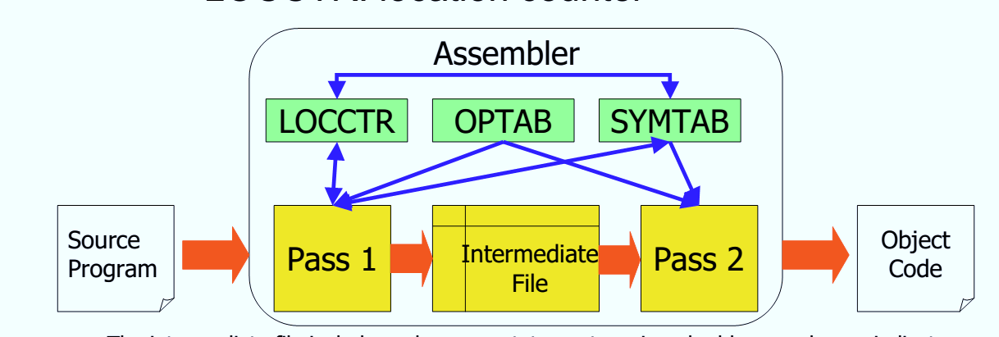
Assembler Data Structures
Operation Code Table (OPTAB)
Symbol Table (SYMTAB)
Location Counter (LOCCTR)

Slide 6
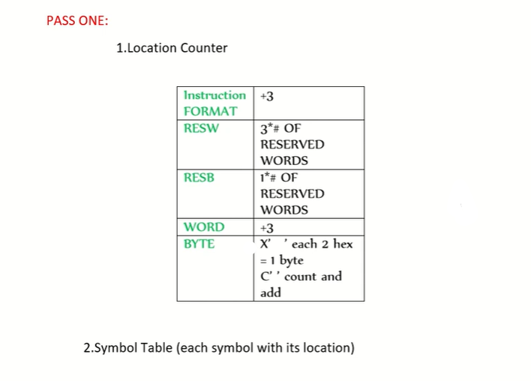
Pass One

Slide 7
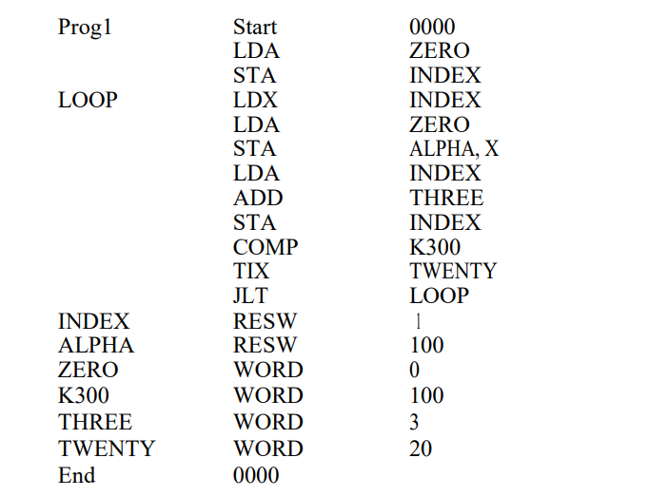
Pass One
Sheet 2 Question 1
Translate (by hand) the following assembly program to SIC object code. Which contains H record, T record, and E record.
Location Counter
Symbols Instructions Reference
Symbol Table
0000
0000
Symbol | Address
Prog1 | 0000
Loop | 0006
Index | 0021
Alpha | 0024
Zero | 0150
K300 | 0153
Three | 0156
Twenty | 0159
0000+3=0003
0003+3=0006
0006+3=0009
0009+3=000C
000C+3=000F
000F+3=0012
0012+3=0015
0015+3=0018
0018+3=001B
001B+3=001E
001E+3=0021
0021+3=0024
0024+(100*3)¹⁰ = 0150
0150+3=0153
0153+3=0156
0156+3=0159
0159+3=015C

Slide 8
Pass Two
Question 1
Location Counter
Symbols Instructions Reference
Obj. Code
0000
No obj. code
LDA ZERO
Address (15bits) | X | Opcode (8)
0150 | 0 | 00
0000 0001 0101 0000 | 0 | 0000 0000
0150 |  | 00
0000
000150
0003
0C0021
0006
0009
000C
000F
0012
0015
0018
001B
STA INDEX
Address (15bits) | X | Opcode (8)
0021 | 0 | 0C
0000 0000 0010 0001 | 0 | 0000 1100
0021 |  | 0C
001E
0021
0024
0150
0153
0156
0159
015C

Slide 9
Pass Two.
Question 1
Location Counter
Symbols Instructions Reference
Obj. Code
0000
No obj. code
LDX INDEX
Address (15bits) | X | Opcode (8)
0021 | 0 | 04
0000 0000 0010 0001 | 0 | 0000 0100
0021 |  | 04
0000
000150
0003
0C0021
0006
040021
0009
000150
000C
0C8024
000F
00 0021
0012
18 0156
0015
0C 0021
0018
28 0153
001B
2C 0159
STA ALPHA, X
Address (15bits) | X | Opcode (8)
0024 | 1 | OC
0001 0000 0010 0100 | 1 | 0000 1100
8024 |  | 0C
001E
38 0006
0021
No obj. code
0024
No obj. code
0150
000000
0153
000064
0156
000003
0159
000014
015C
No obj. code

Slide 10
Pass Two..
Question 1
H.T.E Record
H. program name(6). Starting address(6). Length(6)
H.XXProg1.000000.00015C
T. Starting address of each t record(6) . Size of instruction(2). obj. code of all inst(6)
T.000000.1E.000150.0C0021.040021.000150.0C8024.00021.180156.0C0021.280153.2C0159
T.00001E.03.380006
T.000150.0C. 0000000.000064.0000003.000014
E. Starting address(6)
E.000000

Slide 11
More Examples
Obj. Code | Reference | Instructions
BYTE X ’05’
05
BYTE C ’EOF’
454F46

Slide 12
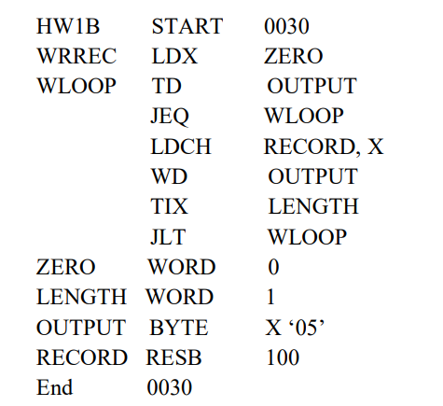
PASS ONE & TWO
Question 2
 |  |  |  | Location Counter
Address | Symbol
Symbols Instructions Reference
Obj. Code
WRREC 0030
0030
No Obj. code
WLOOP 0033
0030
04 0045
ZERO 0045
0033
E0 004B
LENGTH 0048
0036
30 0033
OUTPUT 004B
0039
50 804C
RECORD 004C
003C
DC 004B
2C 0048
H.HW1BXX.000030.000080
003F
040045.E0004B.300033.
50804C.DC004B.2C0048.380033.000000.
000001.05
T.000030.1C.
0042
38 0033
0045
000000
0048
000001
004B
05
E.000030
004C
No Obj. code
00B0
No Obj. code

