Slide 1
Section 3
Systems Programming ECE3502

Slide 2
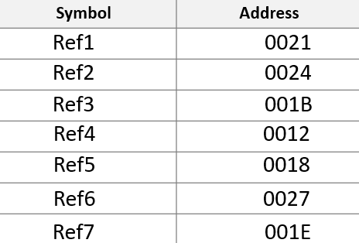
HCOPYXX000000001027
T0000001814002100002428001B3000120000180C002700001E0C0024
T00001809454F46000000000003
E00000
Question 1
Location Counter
Symbols Instructions Reference
Obj. Code
0000
0000
0003
0006
0009
000C
000F
0012
0015
0018
001B
001E
0021
0024
0027
1027
COPY START 0000
No obj. code
Disassemble the following object codes
STL Ref1
14 0021
LDA Ref2
00 0024
COMP Ref3
28 001B
JEQ Ref4
30 0012
LDA Ref5
00 0018
STA Ref6 0C 0027
Ref4
LDA Ref7
00 001E
STA Ref2
0C 0024
Ref5
BYTE C’EOF’
45 4F 46
Ref3
WORD 0 000000
Ref7 WORD 3 000003
No obj. code
Ref1 RESW 1
No obj. code
Ref2 RESW 1
Ref6 RESB 4096
No obj. code
END COPY
No obj. code

