Slide 1
Section 4
Systems Programming ECE3502

Slide 2
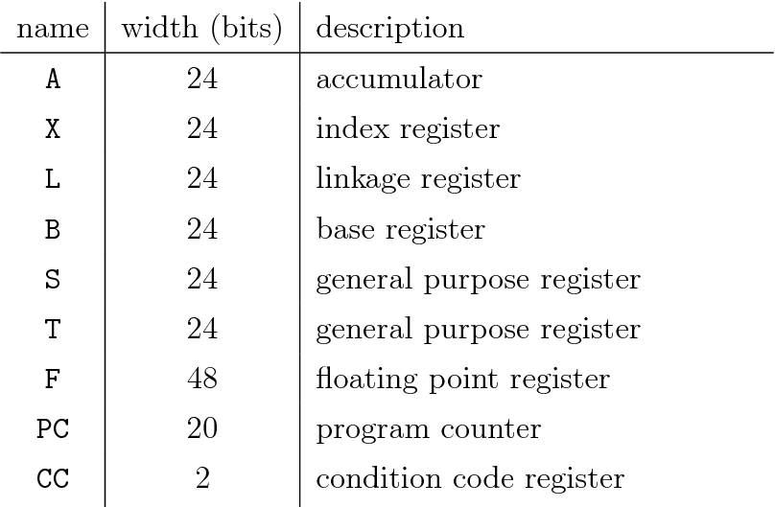
Memory formats
1 megabytes (2^20 bytes)
Registers
There are nine registers; each register is 24 bits in length except floating point register
Number
0
SIC/XE Machine Architecture
1
2
3
4
5
6
24
8
SW
24
Status Word
9

Slide 3
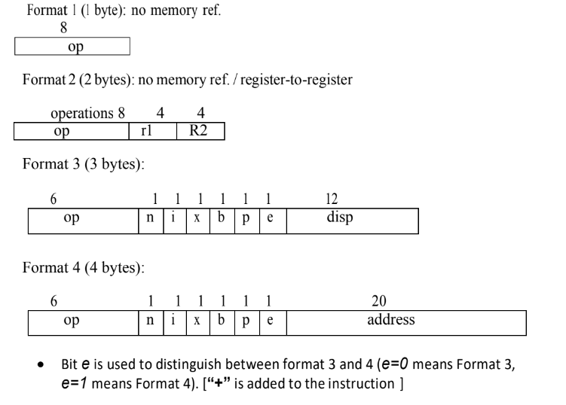
Instruction formats
Example: TIO
Example: ADDR S,T
Example: LDA #3
Example: +JSUB RDREC
Notes:
Remember memory size is 2 to the power 15 bytes

Slide 4
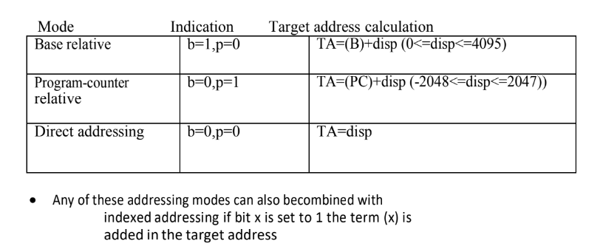
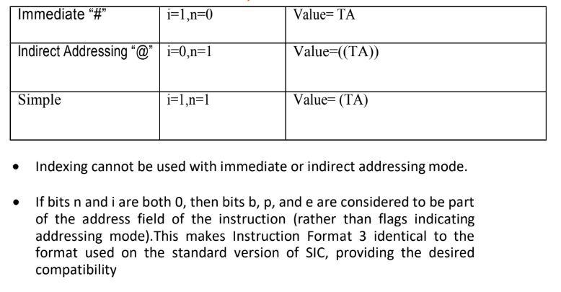
SIC/XE Addressing Modes

Slide 5
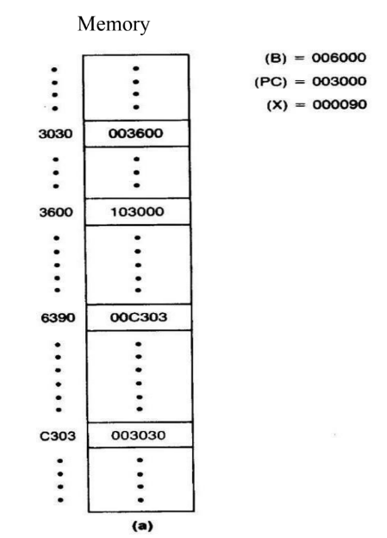
Sheet3, Q1)
Given the following memory structure calculate the target address and find the value loaded into register A for the following machine instructions:
032600
opcode | n | i | x | b | p | e | Disp.
0000 00 1 1
0 0 1 0
0110 0000 0000
1 Get address: (b,p,x)
TA=disp+ (PC)
TA=600+3000
2 Use address: (n,i)
TA=3600
Value=(TA)= (3600)
Value=103000
opcode | n | i | x | b | p | e | Disp.
03C300
0000 00 1 1
1 1 0 0
0011 0000 0000
1 Get address: (b,p,x)
TA=disp+ (B)+ (x)
TA=300+6000+90
2 Use address: (n,i)
TA=6390
Value=(TA)= (6390)
Value=00C303
Notes:
Remember memory size is 2 to the power 15 bytes

Slide 6
Sheet3, Q1)
opcode | n | i | x | b | p | e | Disp.
0000 00 1 0
0 0 1 0
0000 0011 0000
1 Get address: (b,p,x)
TA=disp+ (PC)
TA=030+3000
2 Use address: (n,i)
TA=3030
Value=((TA))= ((3030))
Value= (3600) = 103000
022030
opcode | n | i | x | b | p | e | Disp.
0000 00 0 1
0 0 0 0
0000 0011 0000
1 Get address: (b,p,x)
TA=disp
TA= 030
2 Use address: (n,i)
TA=030
Value=TA= 030
Value=000030
010030
Notes:
Remember memory size is 2 to the power 15 bytes

Slide 7
Sheet3, Q1)
opcode | n | i | x | b | p | e | Add.
0000 00 1 1
0 0 0 1
0000 1100 0011 0000 0011
0310C303
1 Get address: (b,p,x)
TA=address
TA=0C303
2 Use address: (n,i)
TA= 0C303
Value=(TA)= (0C303)
Value=003030
opcode | n | i | x | b | p | e | Add.
0000 00 0 0
0 0 1 1
0110 0000 0000
003600
Opcode(8) |  |  | x | Address(15)
0000 0000
0
011011000000000
1 Get address: (b,p,x)
TA=address
TA=3600
2 Use address: (n,i)
TA= 3600
Value=(TA)= (3600)
Value=103000
Notes:
Remember memory size is 2 to the power 15 bytes

