Slide 1
Section 5
Systems Programming ECE3502

Slide 2
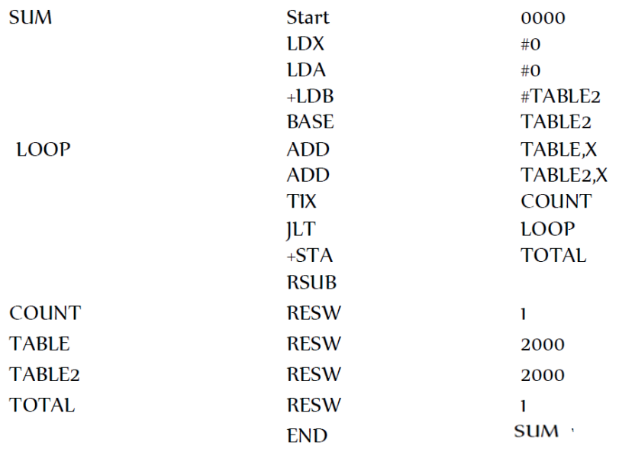
Sheet4, Q1) Pass 1
Location counter Symbols Instructions reference
0000
Symbol | Address
0000
0000+3=0003
0003+3=0006
SUM 0000
0006+4=000A
000A
LOOP 000A
000A+3=000D
000D+3=0010
COUNT 001D
0010+3=0013
0013+3=0016
TABLE 0020
0016+4=001A
001A+3=001D
TABLE2 1790
001D+(1*3)¹⁰=0020
TOTAL 2F00
0020+(2000*3)¹⁰=1790
1790+(2000*3)¹⁰=2F00
2F00+(1*3)¹⁰=2F03
Notes:
Remember memory size is 2 to the power 15 bytes

Slide 3
Sheet4, Q1) Pass 2
Location
counter Symbols Inst. Reference Obj. code
LDX #0
Opcode(6) | n | i | x | b | p | e | Disp(12)
0000
No Obj. code
0000
050000
04
0 1
0 0 0 0
0
0003
010000
0000 01 01
0000
0000 0000 0000
0006
69101790
050000
000A
No Obj. code
000A
LDA #0
Opcode(6) | n | i | x | b | p | e | Disp(12)
Opcode(6) | n | i | x | b | p | e | Disp(12)
000D
0010
00
0 1
0 0 0 0
0
0013
0000 00 01
0000
0000 0000 0000
0016
010000
001A
001D
+LDB #TABLE2
Opcode(6) | n | i | x | b | p | e | Address(20)
0020
1790
68
0 1
0 0 0 1
1790
2F00
0110 10 01
0001
0000 0001 0111 1001 0000
2F03
69101790
Notes:
Remember memory size is 2 to the power 15 bytes

Slide 4
Sheet4, Q1) Pass 2.
Location
counter Symbols Inst. Reference Obj. code
ADD TABLE,X
Opcode(6) | n | i | x | b | p | e | Disp(12)= TA – PC
0000
No Obj. code
0000
050000
18
1 1
1 0 1 0
0020-000D = 13
0003
010000
0001 10 1 1
1010
0000 0001 0011
0006
69101790
1BA013
000A
No Obj. code
ADD TABLE2,X
000A
1BA013
Opcode(6) | n | i | x | b | p | e | Disp(12) = = TA – PC B
000D
1BC000
0010
2F200A
18
1 1
1 1 0 0
1790-0010 = 1780 (6016) XX
1790-1790 = 0
0013
0000 0000 0000
0016
0001 10 1 1
1100
1BC000
001A
001D
TIX COUNT
Opcode(6) | n | i | x | b | p | e | Disp(12)= TA – PC
0020
1790
2C
1 1
0 0 1 0
001D -0013 = A
2F00
0010 11 11
0010
0000 0000 1010
2F03
2F200A
Notes:
Remember memory size is 2 to the power 15 bytes

Slide 5
Sheet4, Q1) Pass 2..
Location
counter Symbols Inst. Reference Obj. code
JLT LOOP
Opcode(6) | n | i | x | b | p | e | Disp(12)= TA – PC
0000
No Obj. code
0000
050000
38
1 1
0 0 1 0
000A-0016= FF4 (-12)
0003
010000
0011 10 11
0010
1111 1111 0100
0006
69101790
3B2FF4
000A
No Obj. code
000A
1BA013
+STA TOTAL
Opcode(6) | n | i | x | b | p | e | Address(20)
000D
1BC000
0010
2F200A
0C
1 1
0 0 0 1
2F00
0013
3B2FF4
0000 11 11
0001
0000 0010 1111 0000 0000
0016
0F102F00
0F102F00
001A
4F0000
001D
No Obj. code
RSUB
Opcode(6) | n | i | x | b | p | e | Disp(12)
0020
No Obj. code
1790
No Obj. code
4C
1 1
0 0 0 0
0
2F00
No Obj. code
0100 11 11
0000
0000 0000 0000
2F03
No Obj. code
4F0000
Notes:
Remember memory size is 2 to the power 15 bytes

Slide 6
H. program name(6). Starting address(6). Length(6)
H.SUMXXX.000000.002F03
T. Starting address of each t record(6) . Size of instruction(2). obj. code of all inst(6)
T.000000.1D.005000.001000.69101790.1BA013.1BC000.2F200A.3B2FF4.0F102F00.4F0000
H.T.M.E record
M. Location+1(6) . how many bit changed(2)
M.000007.05 (+LDB #TABLE2 69 1 01790)
M.000017.05 (+STA TOTAL 0F 1 02F00)
E. Starting address(6)
E.000000

Slide 7
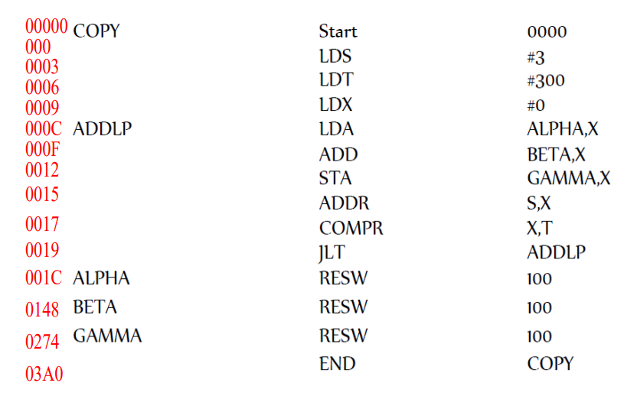
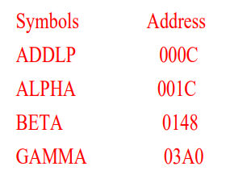
Sheet4, Q2) Translate (by hand) the following assembly program to SIC/XE object code. Which contains H record, T record, M record and E record.
ADDR S,X
Opcode(8) | R1(4) | R2(4)
18 | 4 | 1
0001 1000 | 0100 | 0001
1841
Notes:
Remember memory size is 2 to the power 15 bytes

