Slide 1
Section 6
Systems Programming ECE3502

Slide 2
Assembler Features
Machine Dependent Assembler Features
1) Instruction formats and addressing modes (SIC/XE)
2)Program relocation
Machine Independent Assembler Features
1) Literals
2) Symbol-defining statements
3) Expressions
4) Program blocks
5) Control sections and program linking
These are the features which do not depend on the architecture of the machine
Such features are more related to software than to machine architecture
Notes:
Remember memory size is 2 to the power 15 bytes

Slide 3
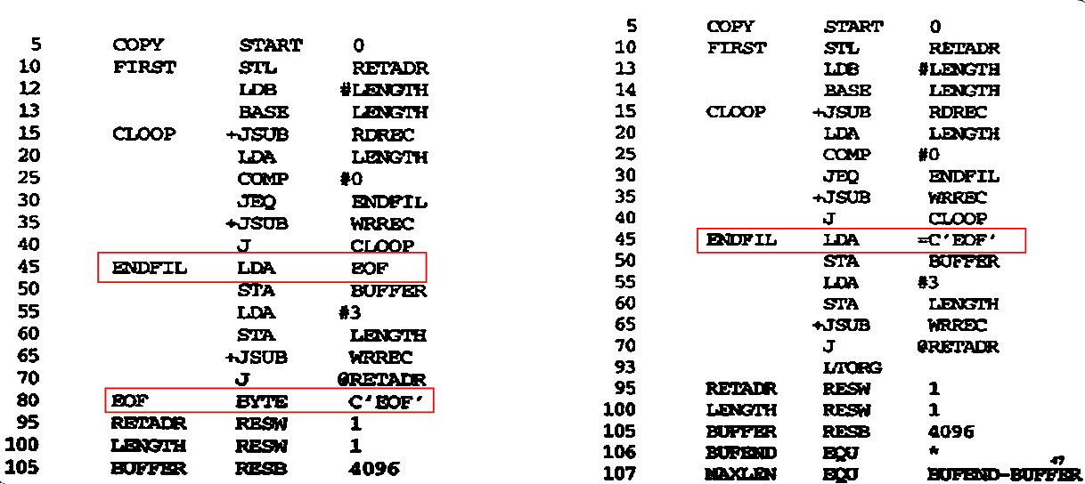
Literals
Notes:
Remember memory size is 2 to the power 15 bytes

Slide 4
Literals
It is easy for a programmer to write the value of a constant operand as part of the instruction that uses it.
This avoids defining the constant elsewhere in the program and making a label for it.
Such an operand is called a literal because the value is stated literally in the instruction.
A literal is defined with a prefix = followed by a specification of the literal value.
Example:
001A ENDFIL LDA =C’EOF’ 032010
.
002D * = C’EOF’ 454F46
Notes:
Remember memory size is 2 to the power 15 bytes

Slide 5
Difference between Literal and Immediate operand
In case of literals the assembler generates the specified value as a constant at some other memory location.
In the Immediate mode the operand value is assembled as part of the instruction itself.
Example:
0010 LDA #03 010003
….
001A ENDFIL LDA =C’EOF’ 032010
….
002D * = C’EOF’ 454F46
Notes:
Remember memory size is 2 to the power 15 bytes

Slide 6
Literal Pool
All the literal operands used in a program are gathered together into one or more literal pools.
This is usually placed at the end of the program.
Ex: 1076 * =X’05’
In some cases, it is placed at some other location in the object program. An assembler directive LTORG is used
Whenever LTORG is encountered, it creates a literal pool that contains all the literal operands used since the beginning of the program.
The literal pool definition is done after LTORG is encountered. It is better to place the literals close to the instruction
Notes:
Remember memory size is 2 to the power 15 bytes

Slide 7
Literal Pool
001A | ENDFIL | LDA | =C’EOF’
. . .
002A |  | J | RETADR
 |  | LTORG
002D | * | =C’EOF’
001A | ENDFIL | LDA | =C’EOF’
. . .
002A |  | J | RETADR
 |  | LTORG
002D | * | =C’EOF’
. . .
 |  | LDA | =C’EOF’
Opcode 6 bits |  |  |  |  |  | n | i | x | b | p | e | displacement
0 | 0 | 0 | 0 | 0 | 0 | 1 | 1 | 0 | 0 | 1 | 0 | (010)
2D-1D
We don’t need to generate another literal
Notes:
Remember memory size is 2 to the power 15 bytes

Slide 8
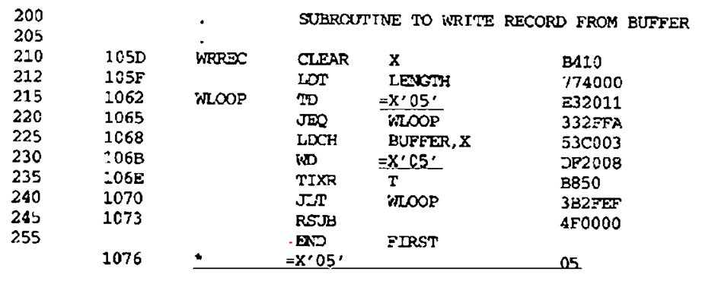
Recognizing Duplicate Literals
Duplicate literals can be identified by comparing character strings (If the literal text is exactly the same, the assembler recognizes it immediately.) Ex: X’05’.
Sometimes literals look different but represent the same value, thus the generated value can be compared.
Ex: The literals =C‘EOF’ and =X’454F46’ are identical operand values.
Notes:
Remember memory size is 2 to the power 15 bytes

Slide 9
Literals denoting the value of the location counter
Literals referring to the current value of the location counter ( denoted by the symbol *).
Such literals are useful for loading base registers.
Ex:101A BASE * BASE = 101A
101D LDA * Load A with the value stored at address 101D
1020 LDB =* load B with a literal equal to the current address ”1020”
:
LTORG
-------- * =1020
Such literal operands will have different values in different places of the program since they hold the current value of the location counter.
Notes:
Remember memory size is 2 to the power 15 bytes

Slide 10
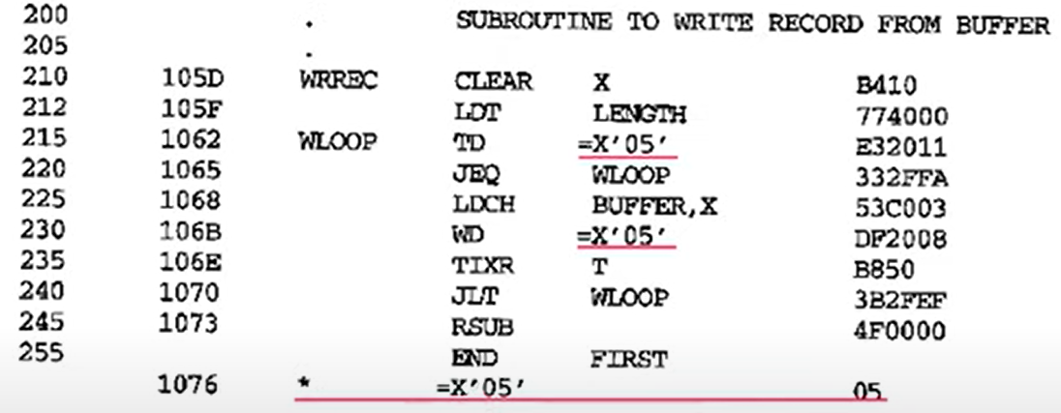
Literal Table
A literal table is created for the literals which are used in the program.
The literal table contains the literal name, operand value, length and the address assigned to the operand.
Handling Literals by the Assembler
TD =X'05'
Opcode(6) | n | i | x | b | p | e | Disp(12)
E0 | 1 | 1 | 0 | 0 | 1 | 0 | 1076- 1065=11
1110 00 11 |  |  | 0010 |  |  |  | 0000 0001 0001
E32011
WD =X'05'
Opcode(6) | n | i | x | b | p | e | Disp(12)
DC | 1 | 1 | 0 | 0 | 1 | 0 | 1076- 106E=8
1101 11 11 |  |  | 0010 |  |  |  | 0000 0000 1000
DF2008
LITTAB
Literal name | Value | Length | Address
=X'05' | 05 | 1 | 1076
Notes:
Remember memory size is 2 to the power 15 bytes

Slide 11
Symbol-Defining Statements (EQU/ORG)
EQU: Symbol EQU value
This statement defines the given symbol (i.e. enters it into the Symbol Table) and assigning to it the value specified.
The value can be a constant or an expression involving constants.
Can be used to improve readability in place of numeric values
Instead of:
+LDT #4096
We can write:
MAXLEN EQU 4096 = MAXLEN WORD 4096
+LDT # MAXLEN
Notes:
Remember memory size is 2 to the power 15 bytes

Slide 12
Symbol-Defining Statements (EQU/ORG)
One restriction with the usage of EQU is whatever symbol occurs in the right-hand side of EQU should be predefined.
Ex: the following statement is not valid
BETA EQU ALPHA
ALPHA RESW 1
As the symbol ALPHA is assigned to BETA before it is defined. The value of ALPHA is not known.
CORRECT:
1000 ALPHA RESW 1
BETA EQU ALPHA BETA=1000
Notes:
Remember memory size is 2 to the power 15 bytes

Slide 13
Symbol-Defining Statements (EQU/ORG)
ORG:
Can be used to indirectly assign values to the symbol (changes the value in the location counter).
ORG can be used in label definition.
While using ORG, the symbol occurring in the statement should be predefined as is required in EQU statement.
EX: ORG ALPHA
BYTE1 RESB 1
BYTE2 RESB 1 NOT ALLOWED, forward referencing
ORG
ALPHA RESB 1
Notes:
Remember memory size is 2 to the power 15 bytes

Slide 14
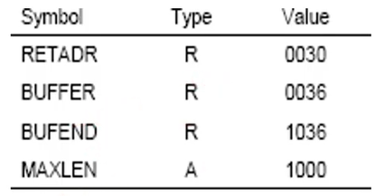
Expressions
Can be used in the place of operands in the instruction, it should be evaluated to generate a value or address.
Arithmetic operators: +, -, *, /
Expressions:
Absolute: Constant Value or relative terms
MAXLEN EQU 1000
MAXLEN EQU BUFEND – BUFFER (NO mul or div in relative terms)
Relative: Depends on the starting address of the program
MAXLEN EQU LENGTH+(BUFEND – BUFFER) (NO mul or div in relative terms)
Neither Absolute Nor Relative: Consider as errors
BUFEND + BUFFER
100 – BUFFER
3* BUFFER
Notes:
Remember memory size is 2 to the power 15 bytes

Slide 15
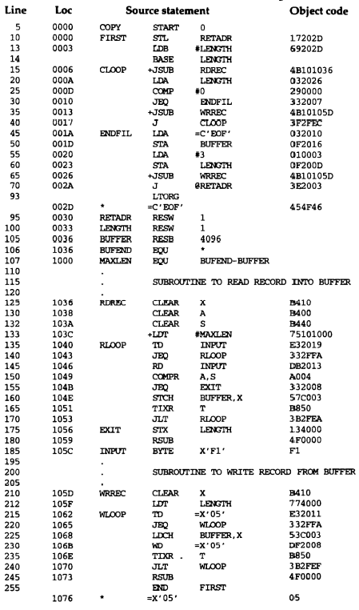
??
Pass One

Slide 16
??
Pass One

Slide 17
-----
??
Pass One

Slide 18
-----
??
Pass One

Slide 19
-----
??
Pass One

Slide 20
-----
??
??
Pass One

Slide 21
-----
??
-----
??
Pass One

Slide 22
-----
-----
??
Pass One

Slide 23
-----
-----
??
Pass One

Slide 24
-----
-----
??
Pass One

Slide 25
-----
-----
Pass One
??

Slide 26
-----
-----
Pass One
??

Slide 27
-----
-----
Pass One
??

Slide 28
-----
-----
Pass One
??

Slide 29
-----
-----
Pass One
-----
??

Slide 30
Pass Two
-----
Symbol Table
Symbol | Type | Value
FIRST | R | 0000
CLOOP | R | 0006
ENDFIL | R | 001A
RETADR | R | 0030
LENGTH | R | 0033
BUFFER | R | 1036
BUFFEND | R | 1036
MAXLEN | A | 1000
RDREC | R | 1036
RLOOP | R | 1040
EXIT | R | 1056
INPUT | R | 105C
WRREC | R | 105D
WLOOP | R | 1062
Literal Table
Name | value | Address
=C’EOF’ | 454F46 | 002D
=X’05’ | 05 | 1076
-----
-----
Notes:
Remember memory size is 2 to the power 15 bytes

Slide 31
Pass Two
-----
??
Symbol Table
Symbol | Type | Value
FIRST | R | 0000
CLOOP | R | 0006
ENDFIL | R | 001A
RETADR | R | 0030
LENGTH | R | 0033
BUFFER | R | 1036
BUFFEND | R | 1036
MAXLEN | A | 1000
RDREC | R | 1036
RLOOP | R | 1040
EXIT | R | 1056
INPUT | R | 105C
WRREC | R | 105D
WLOOP | R | 1062
Literal Table
Name | value | Address
=C’EOF’ | 454F46 | 002D
=X’05’ | 05 | 1076
-----
-----
Notes:
Remember memory size is 2 to the power 15 bytes

Slide 32
Pass Two
-----
-----
Symbol Table
Symbol | Type | Value
FIRST | R | 0000
CLOOP | R | 0006
ENDFIL | R | 001A
RETADR | R | 0030
LENGTH | R | 0033
BUFFER | R | 1036
BUFFEND | R | 1036
MAXLEN | A | 1000
RDREC | R | 1036
RLOOP | R | 1040
EXIT | R | 1056
INPUT | R | 105C
WRREC | R | 105D
WLOOP | R | 1062
Literal Table
Name | value | Address
=C’EOF’ | 454F46 | 002D
=X’05’ | 05 | 1076
??
-----
-----
Notes:
Remember memory size is 2 to the power 15 bytes

Slide 33
Pass Two
-----
-----
Literal Table
Name | value | Address
=C’EOF’ | 454F46 | 002D
=X’05’ | 05 | 1076
Opcode 6 bits | n | i | x | b | p | e | displacement
0000 00 | 1 | 1 | 0 | 0 | 1 | 0 | (010)H
-----
??
Address of literal – PC
Symbol Table
Symbol | Type | Value
FIRST | R | 0000
CLOOP | R | 0006
ENDFIL | R | 001A
RETADR | R | 0030
LENGTH | R | 0033
BUFFER | R | 1036
BUFFEND | R | 1036
MAXLEN | A | 1000
RDREC | R | 1036
RLOOP | R | 1040
EXIT | R | 1056
INPUT | R | 105C
WRREC | R | 105D
WLOOP | R | 1062
-----
Notes:
Remember memory size is 2 to the power 15 bytes

Slide 34
Pass Two
-----
-----
Symbol Table
Symbol | Type | Value
FIRST | R | 0000
CLOOP | R | 0006
ENDFIL | R | 001A
RETADR | R | 0030
LENGTH | R | 0033
BUFFER | R | 1036
BUFFEND | R | 1036
MAXLEN | A | 1000
RDREC | R | 1036
RLOOP | R | 1040
EXIT | R | 1056
INPUT | R | 105C
WRREC | R | 105D
WLOOP | R | 1062
Literal Table
Name | value | Address
=C’EOF’ | 454F46 | 002D
=X’05’ | 05 | 1076
-----
-----
??
-----
Notes:
Remember memory size is 2 to the power 15 bytes

Slide 35
Pass Two
-----
-----
Symbol Table
Symbol | Type | Value
FIRST | R | 0000
CLOOP | R | 0006
ENDFIL | R | 001A
RETADR | R | 0030
LENGTH | R | 0033
BUFFER | R | 1036
BUFFEND | R | 1036
MAXLEN | A | 1000
RDREC | R | 1036
RLOOP | R | 1040
EXIT | R | 1056
INPUT | R | 105C
WRREC | R | 105D
WLOOP | R | 1062
Literal Table
Name | value | Address
=C’EOF’ | 454F46 | 002D
=X’05’ | 05 | 1076
The ASCII values of EOF
-----
-----
??
-----
Notes:
Remember memory size is 2 to the power 15 bytes

Slide 36
Pass Two
-----
-----
Symbol Table
Symbol | Type | Value
FIRST | R | 0000
CLOOP | R | 0006
ENDFIL | R | 001A
RETADR | R | 0030
LENGTH | R | 0033
BUFFER | R | 1036
BUFFEND | R | 1036
MAXLEN | A | 1000
RDREC | R | 1036
RLOOP | R | 1040
EXIT | R | 1056
INPUT | R | 105C
WRREC | R | 105D
WLOOP | R | 1062
Literal Table
Name | value | Address
=C’EOF’ | 454F46 | 002D
=X’05’ | 05 | 1076
-----
-----
-----
??
-----
Notes:
Remember memory size is 2 to the power 15 bytes

Slide 37
Pass Two
-----
-----
Symbol Table
Symbol | Type | Value
FIRST | R | 0000
CLOOP | R | 0006
ENDFIL | R | 001A
RETADR | R | 0030
LENGTH | R | 0033
BUFFER | R | 1036
BUFFEND | R | 1036
MAXLEN | A | 1000
RDREC | R | 1036
RLOOP | R | 1040
EXIT | R | 1056
INPUT | R | 105C
WRREC | R | 105D
WLOOP | R | 1062
Literal Table
Name | value | Address
=C’EOF’ | 454F46 | 002D
=X’05’ | 05 | 1076
-----
-----
-----
-----
??
-----
Notes:
Remember memory size is 2 to the power 15 bytes

Slide 38
Pass Two
-----
-----
Symbol Table
Symbol | Type | Value
FIRST | R | 0000
CLOOP | R | 0006
ENDFIL | R | 001A
RETADR | R | 0030
LENGTH | R | 0033
BUFFER | R | 1036
BUFFEND | R | 1036
MAXLEN | A | 1000
RDREC | R | 1036
RLOOP | R | 1040
EXIT | R | 1056
INPUT | R | 105C
WRREC | R | 105D
WLOOP | R | 1062
Literal Table
Name | value | Address
=C’EOF’ | 454F46 | 002D
=X’05’ | 05 | 1076
-----
-----
-----
-----
-----
??
-----
Notes:
Remember memory size is 2 to the power 15 bytes

Slide 39
Pass Two
-----
-----
Symbol Table
Symbol | Type | Value
FIRST | R | 0000
CLOOP | R | 0006
ENDFIL | R | 001A
RETADR | R | 0030
LENGTH | R | 0033
BUFFER | R | 1036
BUFFEND | R | 1036
MAXLEN | A | 1000
RDREC | R | 1036
RLOOP | R | 1040
EXIT | R | 1056
INPUT | R | 105C
WRREC | R | 105D
WLOOP | R | 1062
Literal Table
Name | value | Address
=C’EOF’ | 454F46 | 002D
=X’05’ | 05 | 1076
-----
-----
-----
-----
-----
-----
??
-----
Notes:
Remember memory size is 2 to the power 15 bytes

Slide 40
Pass Two
-----
-----
Symbol Table
Symbol | Type | Value
FIRST | R | 0000
CLOOP | R | 0006
ENDFIL | R | 001A
RETADR | R | 0030
LENGTH | R | 0033
BUFFER | R | 1036
BUFFEND | R | 1036
MAXLEN | A | 1000
RDREC | R | 1036
RLOOP | R | 1040
EXIT | R | 1056
INPUT | R | 105C
WRREC | R | 105D
WLOOP | R | 1062
Literal Table
Name | value | Address
=C’EOF’ | 454F46 | 002D
=X’05’ | 05 | 1076
-----
-----
-----
-----
-----
-----
-----
??
-----
Notes:
Remember memory size is 2 to the power 15 bytes

Slide 41
Pass Two
-----
-----
Symbol Table
Symbol | Type | Value
FIRST | R | 0000
CLOOP | R | 0006
ENDFIL | R | 001A
RETADR | R | 0030
LENGTH | R | 0033
BUFFER | R | 1036
BUFFEND | R | 1036
MAXLEN | A | 1000
RDREC | R | 1036
RLOOP | R | 1040
EXIT | R | 1056
INPUT | R | 105C
WRREC | R | 105D
WLOOP | R | 1062
Literal Table
Name | value | Address
=C’EOF’ | 454F46 | 002D
=X’05’ | 05 | 1076
-----
-----
-----
-----
-----
-----
-----
??
-----
Notes:
Remember memory size is 2 to the power 15 bytes

Slide 42
Pass Two
-----
-----
Literal Table
Name | value | Address
=C’EOF’ | 454F46 | 002D
=X’05’ | 05 | 1076
-----
-----
Symbol Table
Symbol | Type | Value
FIRST | R | 0000
CLOOP | R | 0006
ENDFIL | R | 001A
RETADR | R | 0030
LENGTH | R | 0033
BUFFER | R | 1036
BUFFEND | R | 1036
MAXLEN | A | 1000
RDREC | R | 1036
RLOOP | R | 1040
EXIT | R | 1056
INPUT | R | 105C
WRREC | R | 105D
WLOOP | R | 1062
-----
-----
-----
-----
-----
1076-1065 =011
Address of literal – PC
Opcode 6 bits |  |  |  |  |  | n | i | x | b | p | e | displacement
1 | 1 | 1 | 0 | 0 | 0 | 1 | 1 | 0 | 0 | 1 | 0 | (011)
??
-----
Notes:
Remember memory size is 2 to the power 15 bytes

Slide 43
Pass Two
-----
-----
Literal Table
Name | value | Address
=C’EOF’ | 454F46 | 002D
=X’05’ | 05 | 1076
-----
-----
Symbol Table
Symbol | Type | Value
FIRST | R | 0000
CLOOP | R | 0006
ENDFIL | R | 001A
RETADR | R | 0030
LENGTH | R | 0033
BUFFER | R | 1036
BUFFEND | R | 1036
MAXLEN | A | 1000
RDREC | R | 1036
RLOOP | R | 1040
EXIT | R | 1056
INPUT | R | 105C
WRREC | R | 105D
WLOOP | R | 1062
-----
-----
-----
-----
-----
1076-106E =008
Address of literal – PC
Opcode 6 bits |  |  |  |  |  | n | i | x | b | p | e | displacement
1 | 1 | 0 | 1 | 1 | 1 | 1 | 1 | 0 | 0 | 1 | 0 | (008)
-----
??
Notes:
Remember memory size is 2 to the power 15 bytes

Slide 44
Pass Two
-----
-----
Symbol Table
Symbol | Type | Value
FIRST | R | 0000
CLOOP | R | 0006
ENDFIL | R | 001A
RETADR | R | 0030
LENGTH | R | 0033
BUFFER | R | 1036
BUFFEND | R | 1036
MAXLEN | A | 1000
RDREC | R | 1036
RLOOP | R | 1040
EXIT | R | 1056
INPUT | R | 105C
WRREC | R | 105D
WLOOP | R | 1062
Literal Table
Name | value | Address
=C’EOF’ | 454F46 | 002D
=X’05’ | 05 | 1076
-----
-----
-----
-----
-----
-----
-----
-----
-----
??
Notes:
Remember memory size is 2 to the power 15 bytes

Slide 45
Pass Two
-----
-----
Symbol Table
Symbol | Type | Value
FIRST | R | 0000
CLOOP | R | 0006
ENDFIL | R | 001A
RETADR | R | 0030
LENGTH | R | 0033
BUFFER | R | 1036
BUFFEND | R | 1036
MAXLEN | A | 1000
RDREC | R | 1036
RLOOP | R | 1040
EXIT | R | 1056
INPUT | R | 105C
WRREC | R | 105D
WLOOP | R | 1062
Literal Table
Name | value | Address
=C’EOF’ | 454F46 | 002D
=X’05’ | 05 | 1076
-----
-----
-----
-----
-----
-----
-----
-----
-----
Notes:
Remember memory size is 2 to the power 15 bytes

