Slide 1
A HANDS-ON ANGULAR WORKSHOP
Angular Fundamentals
Data Binding · Pipes · Routing
Taught live inside a real, running Angular application — Nightfall Stream, a movie & series watchlist.
For fresh graduates & junior developers
who know HTML, CSS, JS & basic TypeScript
Angular Fundamentals Workshop
01 / 41
Notes:
Title slide. Before diving in, give a 5-minute live tour of the running Nightfall Stream app so every concept has a visual anchor.

Slide 2
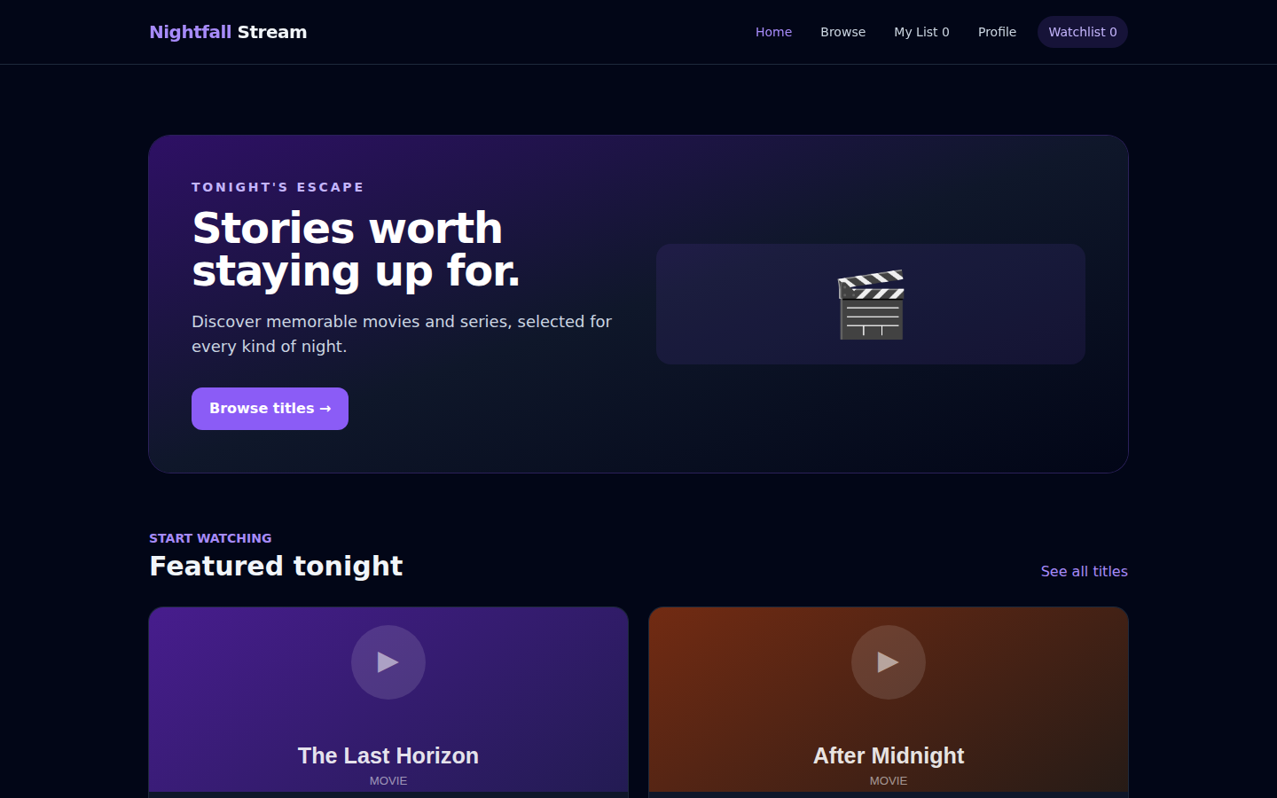
BEFORE WE WRITE A LINE OF CODE
Meet the app we’ll be building with.
This is Nightfall Stream — a real, already-implemented Angular app, not a slide mockup.
Every binding, pipe, and route you see today exists in this exact codebase.
Home, Browse, Title Details, Profile, and My List — five pages, one shared navigation.
We’ll flip between these slides and the real app all workshop long.
Orientation
02 / 41
Notes:
Show the real app live if possible (npm start). The screenshot here is the actual Home page render — same markup, same data, same Tailwind classes as the running app.

Slide 3
MODULE 1
Problem
Concept
Visual
Example
Code
Result
Real-world
Exercise
Apply
Static HTML can’t keep up with changing data.
A plain HTML product card has to be hand-edited every time the name, price, or stock changes.
Real apps show live data: prices update, stock runs out, users type into forms.
We need a way to connect TypeScript data straight into the HTML template — in both directions.
<h3>Product Name</h3>
<p>$0.00</p>
Frozen. Never updates.
Module 1 · Data Binding
03 / 41
Notes:
Frame the problem before naming the solution — static markup vs. live product data.

Slide 4
Problem
Concept
Visual
Example
Code
Result
Real-world
Exercise
Apply
Interpolation: { { } }
Double curly braces read a TypeScript value and print it as text inside the template.
Angular re-renders it automatically whenever the underlying data changes.
It only works for text content — not attributes (that’s next).
product.name is TypeScript data
{{ product.name }}
renders as → The Last Horizon
Module 1 · Data Binding
04 / 41
Notes:
Keep this simple: interpolation is a one-way read from the component into the DOM as text.

Slide 5
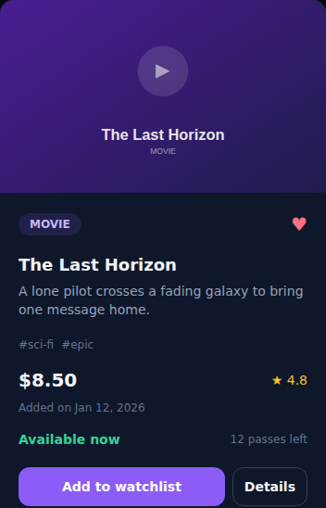
Problem
Concept
Visual
Example
Code
Result
Real-world
Exercise
Apply
Interpolation, in the real card template.
product-card.component.ts
<h3 class="mt-4 text-lg font-bold">
{{ product.name }}
</h3>
<p class="mt-1 text-sm text-slate-400">
{{ product.description }}
</p>
Module 1 · Data Binding
05 / 41
Notes:
The name and description on the real card come straight from these two interpolation bindings — zoomed screenshot of the actual rendered card.

Slide 6
Problem
Concept
Visual
Example
Code
Result
Real-world
Exercise
Apply
Everywhere on Products, this pattern repeats.
Product name and description — every card, Home and Products alike.
The live Watchlist and My List counters in the nav bar.
The user’s name and email on the Profile preview panel.
{{ cart.count() }} · {{ favorites.ids().length }}
src/app/core/layout/navbar.component.ts
Module 1 · Data Binding
06 / 41
Notes:
The nav bar counters are interpolation too — reading signal values straight out of CartService and FavoritesService.

Slide 7
Problem
Concept
Visual
Example
Code
Result
Real-world
Exercise
Apply
Property binding: [ ]
Interpolation only prints text — it can’t set an image source or disable a button.
Square brackets bind a DOM property directly to a TypeScript expression.
The browser element updates live whenever that expression changes.
[src]
="product.imageUrl"
[disabled]
="product.stock === 0"
Module 1 · Data Binding
07 / 41
Notes:
Contrast with interpolation: brackets target a property, not text content.

Slide 8
Problem
Concept
Visual
Example
Code
Result
Real-world
Exercise
Apply
Dynamic image + a button that disables itself.
product-card.component.ts
<img [src]="product.imageUrl"
[alt]="product.name"
class="h-52 w-full object-cover" />
<button [disabled]="product.stock === 0">
Add to watchlist
</button>
"Wildflower House" (Browse page) is sold out — its button is greyed out and disabled, live.
Module 1 · Data Binding
08 / 41
Notes:
Point out the sold-out card in the Browse screenshot on the next module recap for the disabled-button proof.

Slide 9
Problem
Concept
Visual
Example
Code
Result
Real-world
Exercise
Apply
Event binding: ( )
So far, data flows one way: component → template.
Parentheses listen for a DOM event and call a component method when it fires.
This is how a click, a keystroke, or a submit becomes real app behavior.
(click)="toggleFavorite()"
user clicks the heart → method runs
Module 1 · Data Binding
09 / 41
Notes:
Event binding closes the loop — user action into component logic.

Slide 10
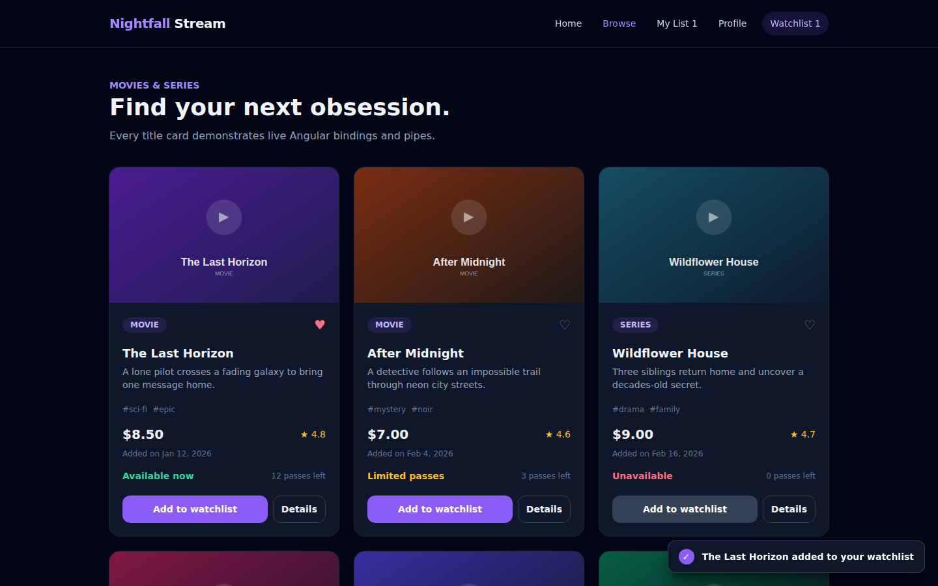
Problem
Concept
Visual
Example
Code
Result
Real-world
Exercise
Apply
Clicking "Add to watchlist" — for real.
product-card.component.ts
<button (click)="addToCart(product)">
Add to watchlist
</button>
addToCart(product: Product): void {
this.cart.add(product);
this.toast.show(
`${product.name} added to your watchlist`
);
}
Module 1 · Data Binding
10 / 41
Notes:
This screenshot is a real click result: the Watchlist counter is now 1 and the toast confirms the exact message the component builds.

Slide 11
Problem
Concept
Visual
Example
Code
Result
Real-world
Exercise
Apply
Two-way binding: [ ( ) ]
A form needs both directions at once: show the current value AND update it as the user types.
That’s property binding + event binding fused into one syntax — the "banana in a box".
[(ngModel)] needs FormsModule imported into the standalone component.
[(ngModel)]="user.name"
type in the field → preview updates instantly
Module 1 · Data Binding
11 / 41
Notes:
"Banana in a box" — the mnemonic students remember: ( ) inside [ ].

Slide 12
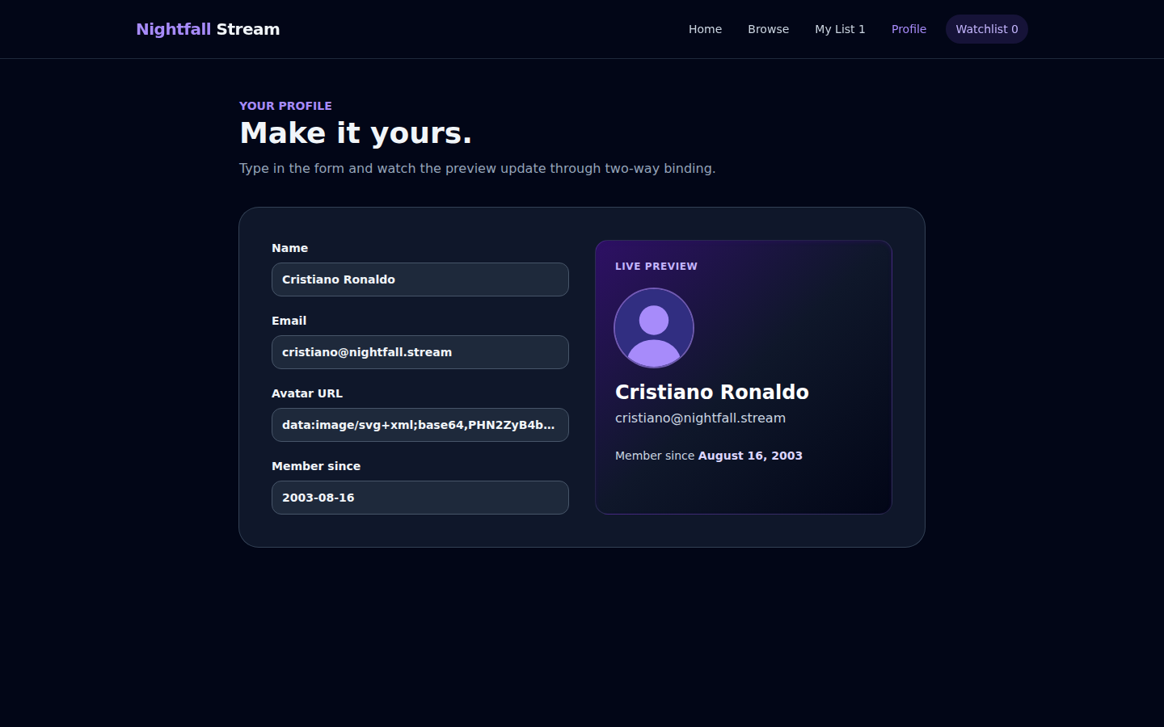
Problem
Concept
Visual
Example
Code
Result
Real-world
Exercise
Apply
The Profile form, live-previewing itself.
profile.component.ts
imports: [FormsModule, DatePipe]
<input [(ngModel)]="user.name" name="name" />
<h2>{{ user.name }}</h2>
<p>{{ user.email }}</p>
Module 1 · Data Binding
12 / 41
Notes:
The right-hand aside is bound to the exact same `user` object the form inputs write into — no extra wiring needed.

Slide 13
Problem
Concept
Visual
Example
Code
Result
Real-world
Exercise
Apply
Four bindings, one product card.
{{ }}
Interpolation
Name & description text
[ ]
Property binding
Image src, disabled state
( )
Event binding
Add-to-watchlist, favorite toggle
[( )]
Two-way binding
Profile form (not on this card)
Module 1 · Data Binding
13 / 41
Notes:
Every binding type students just learned is visible on this single real card, at once.

Slide 14
TRY IT
Problem
Concept
Visual
Example
Code
Result
Real-world
Exercise
Apply
Mini exercise: wire up the wishlist heart.
Add (click) on the heart button to call toggleFavorite() — it already exists on ProductCardComponent.
Use [class.text-rose-400] to swap the heart’s color when favorited.has(product.id) is true.
Show the live count with {{ favorites.ids().length }} in the nav bar.
Reveal: this is exactly what product-card.component.ts already does — compare your solution to it.
Module 1 · Data Binding
14 / 41
Notes:
Give learners 8-10 minutes. Then reveal the real toggleFavorite() implementation on screen.

Slide 15
Module 1 — key takeaways
{{ }} — one-way, component to text
[ ] — one-way, component to any DOM property
( ) — one-way, DOM event to component method
[( )] — both directions, fused, needs FormsModule
Up next
Pipes
Raw data isn’t presentable on its own — dates, prices, and text need formatting before users should see them.
Module 1 · Data Binding
15 / 41
Notes:
Bridge slide into Module 2.

Slide 16
MODULE 2
Problem
Concept
Visual
Example
Code
Result
Real-world
Exercise
Apply
Raw data is correct. It just isn’t readable.
product.addedOn stores "2026-01-12" — a machine-friendly ISO date.
product.price stores 8.5 — a plain number, no currency symbol.
We need to transform values for display, without changing the underlying data.
RAW
2026-01-12
8.5
FORMATTED
Jan 12, 2026
$8.50
Module 2 · Pipes
16 / 41
Notes:
Set up the transform-for-display idea before naming pipes.

Slide 17
Problem
Concept
Visual
Example
Code
Result
Real-world
Exercise
Apply
A pipe is a small transform, right in the template.
value | pipeName:arg
The vertical bar "pipes" a value through a small, single-purpose transform function.
Angular ships several built-in pipes; you can also write your own (coming up).
Pipes never mutate the original data — they only change what’s displayed.
Module 2 · Pipes
17 / 41
Notes:
The mental model: a pipeline of small text transforms, applied at render time.

Slide 18
Problem
Concept
Visual
Example
Code
Result
Real-world
Exercise
Apply
Built-in pipes we’ll use today.
currency
date
uppercase
lowercase
{{ price | currency }}
{{ addedOn | date:'mediumDate' }}
{{ category | uppercase }}
{{ tag | lowercase }}
$8.50
Jan 12, 2026
MOVIE
#sci-fi
Module 2 · Pipes
18 / 41
Notes:
All four are used on the real product card and product-details page — next slides show exactly where.

Slide 19
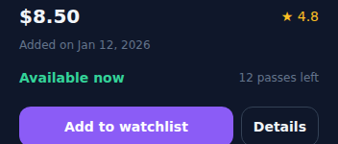
Problem
Concept
Visual
Example
Code
Result
Real-world
Exercise
Apply
Date pipe: three format strings, three moods.
various component templates
{{ product.addedOn | date:'mediumDate' }}
→ Jan 12, 2026 (product cards)
{{ product.addedOn | date:'fullDate' }}
→ Monday, January 12, 2026
(title details)
{{ user.memberSince | date:'longDate' }}
→ August 16, 2003 (profile preview)
"Added on Jan 12, 2026" — real, rendered dateMedium output on the card.
Module 2 · Pipes
19 / 41
Notes:
One pipe, three different named formats depending on where it’s used in the app.

Slide 20
Problem
Concept
Visual
Example
Code
Result
Real-world
Exercise
Apply
Currency pipe: one word, correct formatting.
product-card.component.ts
<strong class="text-xl">
{{ product.price | currency }}
</strong>
// 8.5 becomes $8.50
// 11 becomes $11.00
Every price across Home, Products, Details, and Favorites uses this single pipe.
Module 2 · Pipes
20 / 41
Notes:
No manual toFixed(2) or string concatenation — the pipe handles rounding and the currency symbol.

Slide 21
Problem
Concept
Visual
Example
Code
Result
Real-world
Exercise
Apply
Text-case pipes: badges vs. tags.
product-card.component.ts
<span class="... text-violet-300">
{{ product.category | uppercase }}
</span>
<span class="text-xs text-slate-500">
#{{ tag | lowercase }}
</span>
Module 2 · Pipes
21 / 41
Notes:
MOVIE badge is uppercase; #sci-fi tag chips are lowercase — same product data, two different pipes.

Slide 22
Problem
Concept
Visual
Example
Code
Result
Real-world
Exercise
Apply
No built-in pipe knows "stock status".
We need business-specific logic: turn a raw stock number into a human label.
0 passes → "Unavailable". Under 5 → "Limited passes". Otherwise → "Available now".
When Angular’s built-ins don’t cover a case, you write your own pipe — a plain class.
Module 2 · Pipes
22 / 41
Notes:
Custom pipes are just classes implementing PipeTransform — nothing exotic.

Slide 23
Problem
Concept
Visual
Example
Code
Result
Real-world
Exercise
Apply
stockStatus — the app’s one custom pipe.
src/app/pipes/stock-status.pipe.ts
@Pipe({ name: 'stockStatus', standalone: true })
export class StockStatusPipe
implements PipeTransform {
transform(stock: number): string {
if (stock === 0) return 'Unavailable';
if (stock < 5) return 'Limited passes';
return 'Available now';
}
}
{{ product.stock | stockStatus }}
Green "Available now", amber "Limited passes", rose "Unavailable" — color comes from a class binding alongside it.
Module 2 · Pipes
23 / 41
Notes:
Point out it’s registered as standalone: true, then imported directly into each component that uses it.

Slide 24
TRY IT
Problem
Concept
Visual
Example
Code
Result
Real-world
Exercise
Apply
Mini exercise: format a date, build a pipe.
On Profile, change the "Member since" pipe format from longDate to mediumDate — compare the output.
Write a second custom pipe, initials, that turns a full name into avatar initials ("CR").
Register it standalone: true and import it into ProfileComponent to try it on user.name.
Reveal: compare your transform() logic to the real StockStatusPipe’s structure.
Module 2 · Pipes
24 / 41
Notes:
This exercise reuses the exact PipeTransform pattern just shown for stockStatus.

Slide 25
Module 2 — key takeaways
value | pipeName — transforms display, never the source data
date, currency, uppercase, lowercase ship with Angular
A custom pipe is a class with @Pipe() and a transform() method
stockStatus turns a number into a business-meaningful label
Up next
Routing
One HTML page, five different screens. How does Nightfall Stream move between Home, Browse, and a specific title’s details?
Module 2 · Pipes
25 / 41
Notes:
Bridge slide into Module 3.

Slide 26
MODULE 3
Problem
Concept
Visual
Example
Code
Result
Real-world
Exercise
Apply
One index.html. Five different screens.
Nightfall Stream never reloads the page — Home, Browse, Details, Profile, My List all live in one bundle.
The URL still needs to change, be bookmarkable, and support the browser’s back button.
That’s client-side routing: Angular’s Router swaps components in and out based on the URL.
Module 3 · Routing
26 / 41
Notes:
Define the SPA problem before showing the Router API.

Slide 27
Problem
Concept
Visual
Example
Code
Result
Real-world
Exercise
Apply
A route is just a path-to-component map.
''
→
HomeComponent
'products'
→
ProductsComponent
'products/:id'
→
ProductDetailsComponent
'profile'
→
ProfileComponent
'favorites'
→
FavoritesComponent
'**'
→
NotFoundComponent
Module 3 · Routing
27 / 41
Notes:
Walk the six real routes top to bottom before showing the raw file.

Slide 28
Problem
Concept
Visual
Example
Code
Result
Real-world
Exercise
Apply
app.routes.ts — the real route table.
src/app/app.routes.ts
export const routes: Routes = [
{ path: '', component: HomeComponent },
{ path: 'products', component: ProductsComponent },
{ path: 'products/:id',
component: ProductDetailsComponent },
{ path: 'profile', component: ProfileComponent },
{ path: 'favorites', component: FavoritesComponent },
{ path: '**', component: NotFoundComponent },
];
Module 3 · Routing
28 / 41
Notes:
Every route also sets a title string in the real file — worth a mention for SEO/tab-title awareness.

Slide 29
Problem
Concept
Visual
Example
Code
Result
Real-world
Exercise
Apply
RouterOutlet: the slot content swaps into.
src/app/app.html
app-navbar
stays fixed on every page
<router-outlet />
is where Home, Products, etc. get inserted
<app-navbar />
<main>
<router-outlet />
</main>
<app-toast />
Module 3 · Routing
29 / 41
Notes:
The Router reads the current URL, matches it against app.routes.ts, and renders the matching component inside <router-outlet>.

Slide 30
Problem
Concept
Visual
Example
Code
Result
Real-world
Exercise
Apply
RouterLink: navigation without a page reload.
src/app/core/layout/navbar.component.ts
<a routerLink="/products"
routerLinkActive="text-violet-400">
Browse
</a>
<a routerLink="/"
routerLinkActive="text-violet-400"
[routerLinkActiveOptions]="{exact:true}">
Home
</a>
Module 3 · Routing
30 / 41
Notes:
routerLink replaces a plain href — no full-page reload. routerLinkActive styles the currently active link automatically.

Slide 31
Problem
Concept
Visual
Example
Code
Result
Real-world
Exercise
Apply
The nav bar always knows where you are.
"Browse" lights up violet — routerLinkActive matched the current URL.
Home uses [routerLinkActiveOptions]="{exact:true}" so it isn’t active on every sub-route.
This exact bar renders identically on all five pages.
Module 3 · Routing
31 / 41
Notes:
This is a real screenshot with the Browse route active.

Slide 32
Problem
Concept
Visual
Example
Code
Result
Real-world
Exercise
Apply
Sometimes you navigate from code, not a link.
product-card.component.ts
product-details.component.ts
private router = inject(Router);
viewDetails(): void {
this.router.navigate(['/products',
this.product.id]);
}
backToProducts(): void {
this.router.navigate(['/products']);
}
"Details" button and "Back to Products" both call Router.navigate() instead of using routerLink.
Module 3 · Routing
32 / 41
Notes:
Use programmatic navigation when the destination is computed, or navigation happens as a side effect of other logic (like after adding to cart).

Slide 33
Problem
Concept
Visual
Example
Code
Result
Real-world
Exercise
Apply
Route parameters: one route, many titles.
We don’t want a hand-written route for every single title in the catalog.
A colon marks a segment of the URL as a variable Angular captures for us.
products/:id matches products/25, products/26, products/30 — anything.
products/:id
products/25
→ The Last Horizon’s Title Details page
Module 3 · Routing
33 / 41
Notes:
/products/25 is a real, working URL in the app — id 25 is "The Last Horizon" in the real product data.

Slide 34
Problem
Concept
Visual
Example
Code
Result
Real-world
Exercise
Apply
ActivatedRoute reads that captured parameter.
ActivatedRoute is a service Angular injects with details about the current route.
Its paramMap holds every :param segment matched for this navigation.
ProductDetailsComponent reads the id, then asks ProductService for that exact product.
Module 3 · Routing
34 / 41
Notes:
Frame it as "the component's way of asking: which URL got me rendered, and what was in it?"

Slide 35
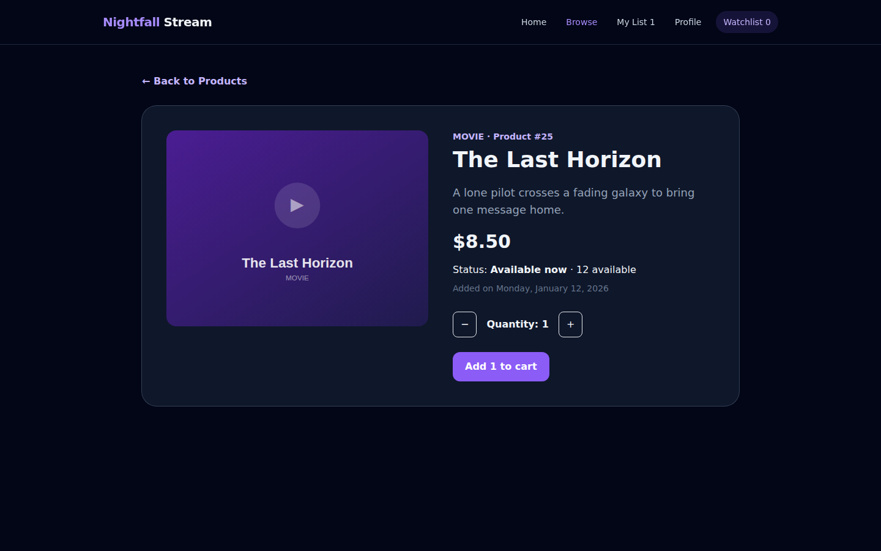
Problem
Concept
Visual
Example
Code
Result
Real-world
Exercise
Apply
/products/25 resolves to a real product.
product-details.component.ts
private route = inject(ActivatedRoute);
private products = inject(ProductService);
readonly product = this.products.getById(
Number(this.route.snapshot.paramMap.get('id'))
);
Module 3 · Routing
35 / 41
Notes:
This is a live screenshot of the real /products/25 route — "MOVIE · Product #25", matching the id read from the URL.

Slide 36
Problem
Concept
Visual
Example
Code
Result
Real-world
Exercise
Apply
How the five pages connect.
routerLink
/products/:id
Home
→
Browse
→
Title Details
→
Profile
My List
Not Found (**)
All five reachable from the nav bar on every page · wildcard ** catches anything else
Module 3 · Routing
36 / 41
Notes:
This mirrors app.routes.ts exactly — six entries, five reachable pages plus the wildcard catch-all.

Slide 37
TRY IT
Problem
Concept
Visual
Example
Code
Result
Real-world
Exercise
Apply
Mini exercise: get lost, then get home.
Visit a nonsense URL like /watch-now and confirm NotFoundComponent renders via the ** wildcard.
Read takeMeHome() on NotFoundComponent — it uses Router.navigate(['/']), not routerLink.
Add your own button anywhere that calls router.navigate(['/profile']) to feel the difference.
Reveal: compare against the real not-found.component.ts implementation.
Module 3 · Routing
37 / 41
Notes:
This reinforces route matching order and programmatic navigation together.

Slide 38
Module 3 — key takeaways
Routes map a URL path to a component, in app.routes.ts
<router-outlet /> is where the matched component renders
routerLink navigates declaratively; Router.navigate() does it from code
:id captures a URL segment; ActivatedRoute reads it back
Module 3 · Routing
38 / 41
Notes:
Bridge slide into the capstone challenge.

Slide 39
FINAL CHALLENGE
Build the "My List" page — on your own.
The route and navbar link already exist: /favorites, "My List" — your job is the page content.
Data binding: reuse the product card pattern to render each favorited title.
Pipes: show price with currency and "favorited on" with date.
Routing: each card links back to its own /products/:id Title Details page.
Stretch: reuse the stockStatus pipe here too, exactly as on Browse.
Capstone
39 / 41
Notes:
This is intentionally under-specified on markup — students should recognize and reapply patterns from all three modules.

Slide 40
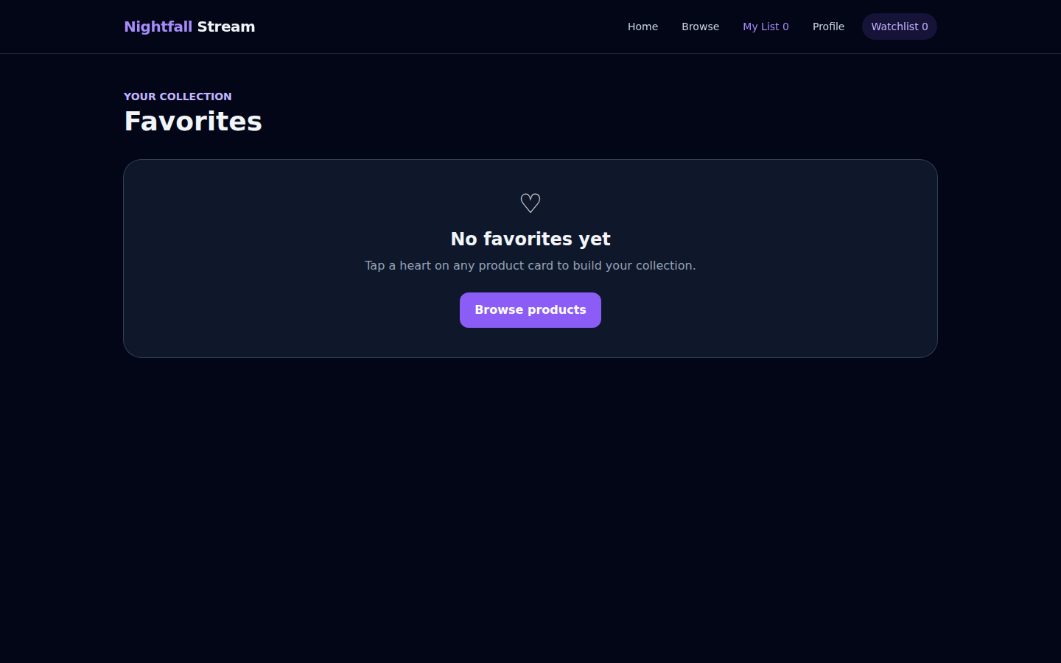
What "done" looks like — the real page.
Empty state: a friendly message + a link back to Browse (see screenshot).
Populated state: each card shows name, price, stock status, and the date it was favorited.
A "View details →" link on every card, using routerLink with the product id.
No console errors, no broken routerLink — check both empty and populated states.
src/app/pages/favorites/favorites.component.ts — the real, already-built solution
Capstone
40 / 41
Notes:
Favorites is already implemented in the real app — use it as the answer key after students attempt their own version.

Slide 41
WORKSHOP RECAP
You just learned Angular by shipping it.
Data binding — {{ }}, [ ], ( ), [( )] — connecting TypeScript and the DOM, both ways.
Pipes — built-in formatting plus one custom business rule, stockStatus.
Routing — routes, RouterOutlet, RouterLink, route params, and ActivatedRoute.
Next up
Reactive Forms
Services & Dependency Injection
HttpClient
Signals in depth
Capstone
41 / 41
Notes:
Close by pointing at the real, running app one more time — everything taught today is already shipped in it.

