Slide 1

LEVEL 2 SUMMER TRAINING · GRADUATION PROJECT
Hardware Technical Documentation
RAG Assistant
A local Retrieval-Augmented Generation system that answers hardware
questions using grounded, cited answers from official technical documentation.
Youssef Farid Ramzy Haddad
Presented to Information Technology Institute (ITI)

Slide 2








WHAT WE'LL COVER
Agenda
01
Project Goal & Requirements
05
Knowledge Base
02
Solution Overview & Features
06
RAG Pipeline: Load → Chunk → Embed → Store
03
System Architecture
07
Retrieval, Generation, Backend & Frontend
04
Technology Stack
08
Live Demo, API, Evaluation & Future Work
Youssef Farid Ramzy Haddad | ITI Graduation Project
2

Slide 3

ITI GRADUATION PROJECT BRIEF
Project Goal & Requirements
DELIVERABLES REQUIRED
Notebook: clean, chunk, embed & store data, then build and evaluate a RAG pipeline with a local Ollama LLM
THE GOAL
“Build a complete AI product — from raw documents to a working RAG web application — and publish it on GitHub.”
FastAPI backend that serves the RAG pipeline
Frontend (Streamlit) showing a grounded, cited answer
Track: Core Track — text-based RAG assistant
Mode: Individual project
Everything published to GitHub with a professional README
Youssef Farid Ramzy Haddad | ITI Graduation Project
3

Slide 4




WHAT WAS BUILT
Solution Overview
A local RAG assistant that answers technical hardware questions for three platforms using official documentation — grounded entirely in retrieved content, never the model’s general knowledge.
Multi-document knowledge base
Semantic vector retrieval
Local LLM via Ollama (Qwen 3 8B)
Persistent Chroma vector database
Source-aware, cited answers
Grounding to reduce hallucination
FastAPI backend service
Streamlit chat interface
Youssef Farid Ramzy Haddad | ITI Graduation Project
4

Slide 5

END-TO-END DATA & QUERY FLOW
System Architecture
OFFLINE INDEXING · NOTEBOOK
→
→
→
Technical PDFs
Parse & Chunk
Embeddings
Chroma Vector Store
Arduino · Pico · Ender-3
1000 / 200 overlap
all-MiniLM-L6-v2
Persisted to disk
ONLINE QUERY · FASTAPI
→
→
→
User Question
FastAPI /query
Retrieve Top-8
Qwen 3 8B
Streamlit frontend
Loaded once at startup
Semantic similarity
Local via Ollama
Grounded Answer + Sources → displayed in the Streamlit chat interface
Youssef Farid Ramzy Haddad | ITI Graduation Project
5

Slide 6
TOOLS POWERING THE ASSISTANT
Technology Stack
Component | Technology
Programming Language | Python 3.10+
LLM | Qwen 3 8B
LLM Runtime | Ollama (local)
Embeddings | all-MiniLM-L6-v2
Vector Database | ChromaDB
PDF Processing | pypdf
Component | Technology
Text Splitting | LangChain Recursive Character Splitter
Backend | FastAPI
Frontend | Streamlit
HTTP Client | Requests
Configuration | python-dotenv / Pydantic Settings
Testing | Pytest + HTTPX
Youssef Farid Ramzy Haddad | ITI Graduation Project
6

Slide 7



THREE HARDWARE PLATFORMS INDEXED
Knowledge Base
Arduino Uno Rev3
Raspberry Pi Pico
Creality Ender-3 S1
Pin definitions
GPIO & I2C
Assembly & wiring
Operating voltage & memory
USB
Auto leveling
Analog & digital pins
Python / MicroPython usage
Filament loading
Interfaces & limitations
Board-level specifications
Troubleshooting & operation
Youssef Farid Ramzy Haddad | ITI Graduation Project
7

Slide 8




NOTEBOOK PHASE 2: LOAD, CHUNK, EMBED, STORE
Data Pipeline — Overview
1
2
3
4
Load & Inspect
→
Chunking
→
Embeddings
→
Vector Store
3 PDFs parsed with pypdf into 91 text-extractable pages
Recursive character splitter — 1000 chars, 200 overlap
Each chunk vectorized with all-MiniLM-L6-v2 (384-dim)
189 chunks persisted to ChromaDB on disk
The next three slides walk through each stage in detail, straight from the pipeline notebook.
Youssef Farid Ramzy Haddad | ITI Graduation Project
8

Slide 9
NOTEBOOK PHASE 2.1
Load & Inspect
arduino_uno.pdf
raspberry_pi_pico.pdf
ender3_s1.pdf
91
Text-Extractable Pages Loaded
3 / 3
PDFs Parsed Successfully
Format
Parsing Status
All three documents are digital PDF manuals with fully extractable text layers.
All 3 PDFs parsed successfully via pypdf; a minor object-reference warning appeared but did not block extraction.
OCR
Metadata
Not required — every document already contains an extractable text layer, so no scanned-page handling was needed.
Each page is stored with its source filename and page number, so retrieved chunks trace back to their original source.
Youssef Farid Ramzy Haddad | ITI Graduation Project
9

Slide 10
NOTEBOOK PHASE 2.2
Chunking Strategy
Strategy used: RecursiveCharacterTextSplitter (LangChain) — splits at natural boundaries such as paragraphs, lines, and words, keeping related technical explanations and procedures together rather than cutting mid-sentence.
Chunk Size — 1000 characters
Overlap — 200 characters (20%)
Large enough to keep a full pinout, specification, or troubleshooting procedure together, while staying focused on a single topic.
Preserves context across chunk boundaries, reducing the chance an important sentence is separated from its surrounding explanation.
91 Pages → 189 Chunks
Chunks are persisted with source & page metadata for full traceability.
Youssef Farid Ramzy Haddad | ITI Graduation Project
10

Slide 11
NOTEBOOK PHASE 2.3
Embeddings & Vector Store
Embedding Model
Vector Store
sentence-transformers/all-MiniLM-L6-v2
ChromaDB — PersistentClient
• Maps chunks into 384-dimensional dense vectors
• Captures semantic relationships across technical descriptions, pinouts & specifications
• Data stored locally on disk, no re-indexing needed on backend startup
• Persists embeddings, chunk text & metadata (source, page, chunk_id)
384
Vector Dimensions
189
Chunks Indexed
Persisted at: backend/data/vector_store/chroma_db
Youssef Farid Ramzy Haddad | ITI Graduation Project
11

Slide 12


TURNING A QUESTION INTO A GROUNDED ANSWER
Retrieval & Generation
Semantic Retrieval
Grounded Generation
The user’s question is embedded and compared against the Chroma vector store; the top 8 most relevant chunks are retrieved for context.
The retrieved context and question are combined into a prompt and sent to Qwen 3 8B, running locally through Ollama.
PROMPT GROUNDING RULES
Use the provided context as the source of truth
Avoid unsupported claims beyond the retrieved chunks
Always provide source document references
Refuses when unsupported: “I don’t know based on the provided documents.”
Youssef Farid Ramzy Haddad | ITI Graduation Project
12

Slide 13
SERVING THE RAG PIPELINE AS AN API
Backend — FastAPI
backend/ PROJECT STRUCTURE
API ENDPOINTS
backend/
├── app/
│ ├── main.py
│ ├── api/routes/query.py
│ ├── core/config.py
│ ├── schemas/query.py
│ ├── services/
│ │ ├── retrieval.py
│ │ └── generation.py
│ └── utils/logging_config.py
├── data/vector_store/
├── tests/test_query.py
├── requirements.txt
├── .env.example
└── Dockerfile
GET /health
Simple liveness check for the running service.
POST /query
Request: { "question": str }
Response: { "answer": str, "sources": [str] }
Retrieves context, builds the prompt, calls the LLM, and returns a grounded answer.
Vector store & LLM connection loaded once at startup (FastAPI lifespan)
CORS middleware enabled for the frontend origin
Youssef Farid Ramzy Haddad | ITI Graduation Project
13

Slide 14
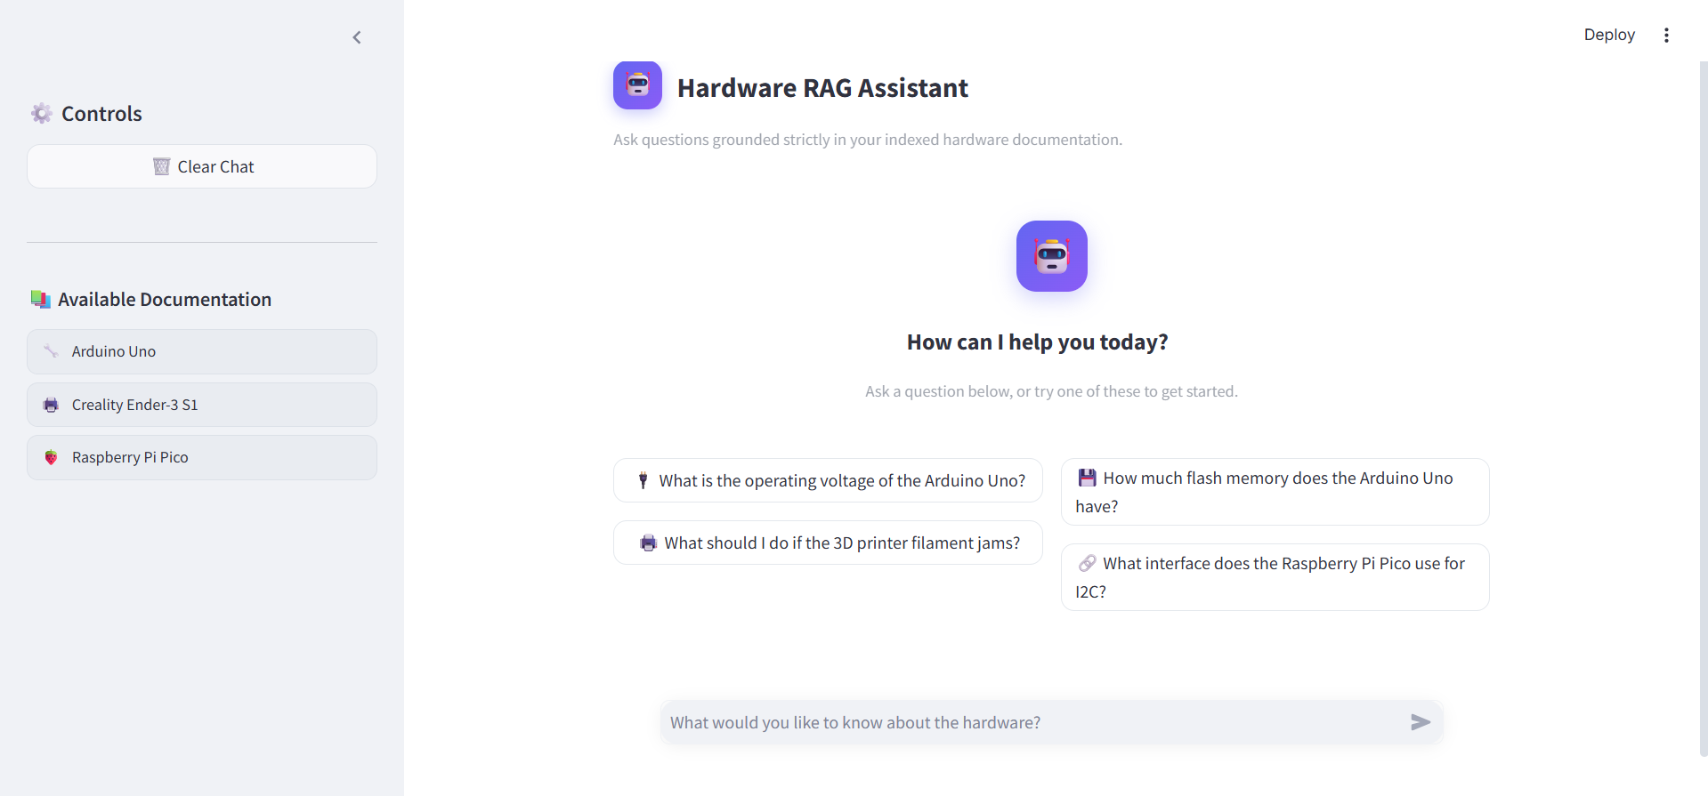

THE USER-FACING CHAT EXPERIENCE
Frontend — Streamlit
Chat-style Q&A
Cited sources shown
URL from env variable
Friendly error handling
Youssef Farid Ramzy Haddad | ITI Graduation Project
14

Slide 15
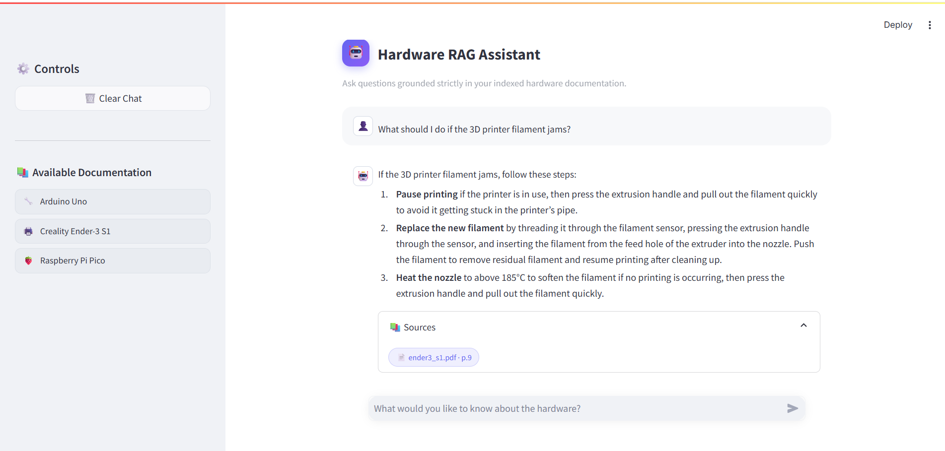
A REAL QUESTION, ANSWERED FROM THE DOCUMENTATION
Live Demo — Grounded Answer
Cited source: ender3_s1.pdf · p.9 · Structured, step-by-step answer grounded entirely in the manual
Youssef Farid Ramzy Haddad | ITI Graduation Project
15

Slide 16
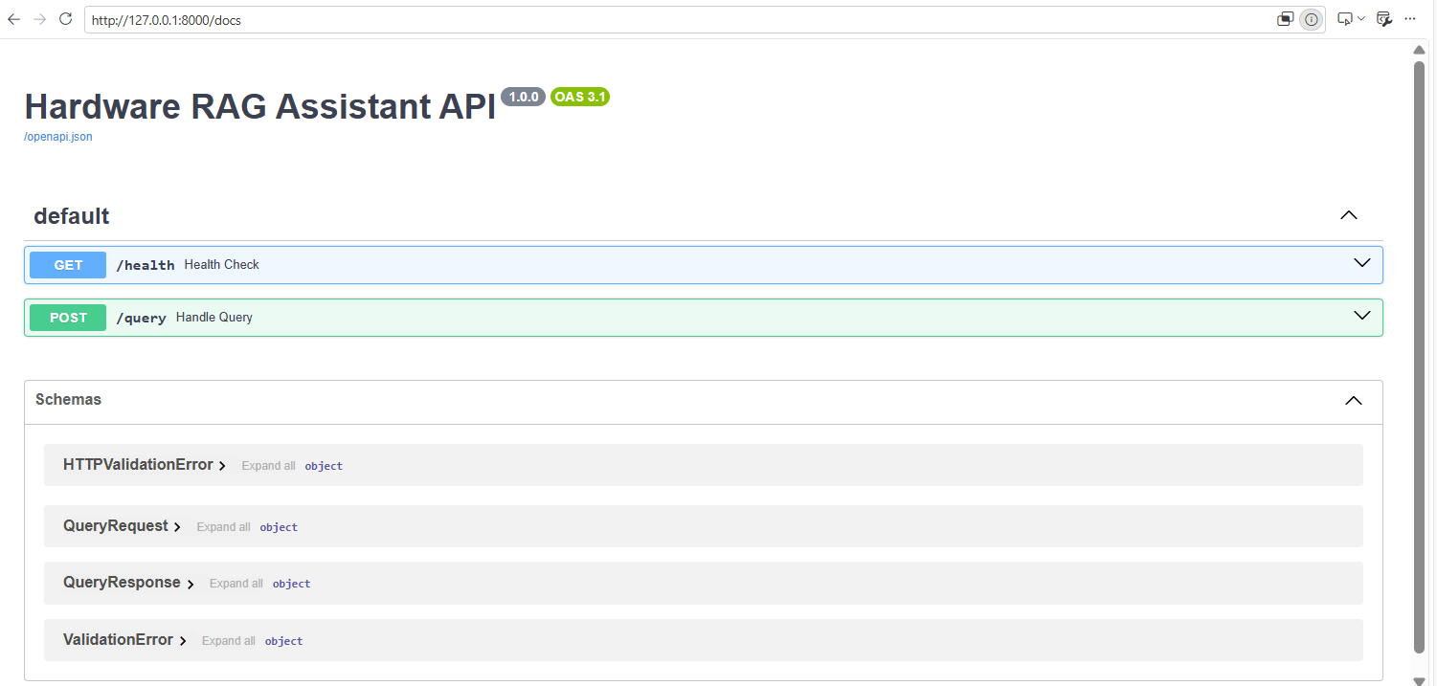
INTERACTIVE SWAGGER DOCUMENTATION
API Reference — Endpoints
FastAPI auto-generates this OpenAPI 3.1 documentation from the route definitions and Pydantic schemas.
Youssef Farid Ramzy Haddad | ITI Graduation Project
16

Slide 17
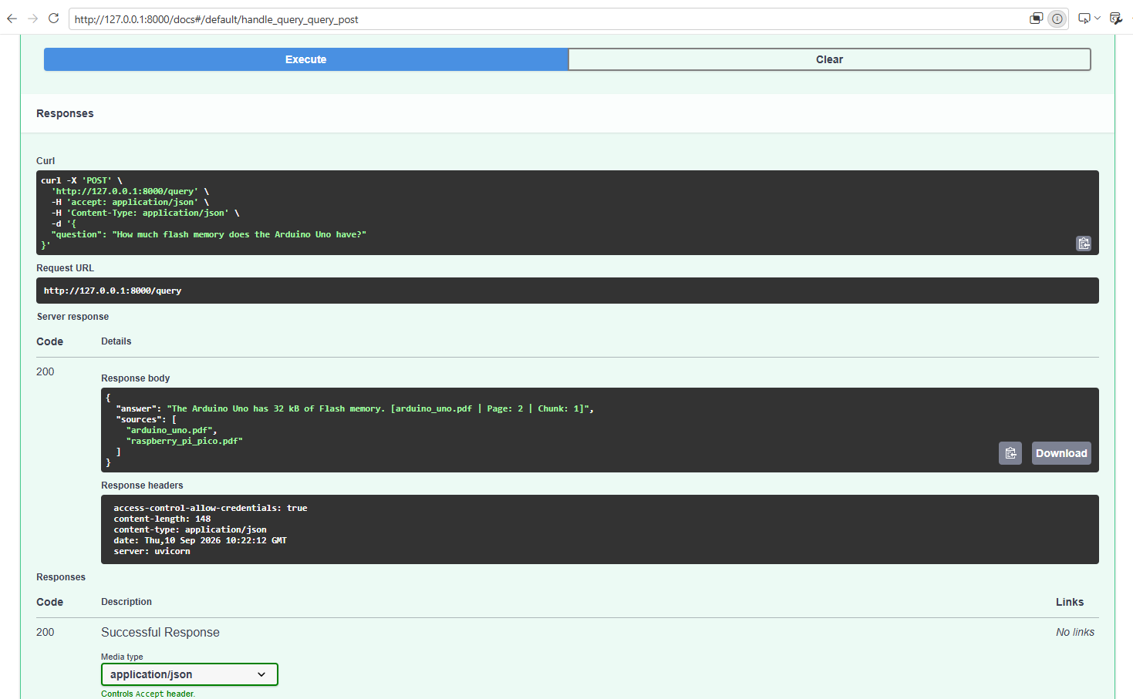
POST /QUERY EXECUTED FROM SWAGGER UI
API Reference — Live Request
A real call returns a grounded answer with page-level citations and the exact source documents used.
Youssef Farid Ramzy Haddad | ITI Graduation Project
17

Slide 18
10 HAND-TESTED QUESTIONS ACROSS THE KNOWLEDGE BASE
Evaluation Results
10
Total Test Questions
6
Grounded & Correct Answers
4
Correctly Refused (Unsupported)
Every response is grounded in retrieved documentation, or explicitly refused — no hallucinated answers observed.
Youssef Farid Ramzy Haddad | ITI Graduation Project
18

Slide 19
SAMPLE ROWS FROM THE 10-QUESTION TEST SET
Example Evaluated Questions
Question | Result
How do I level the Ender-3 S1 bed? | ✓ Correct
What should I do if the Ender-3 S1 filament jams? | ✓ Correct
How much Flash memory does the Arduino Uno have? | ✓ Correct
What interface does the Raspberry Pi Pico use for I2C? | ✓ Correct
What are the Arduino Uno analog input pins? | ✓ Correct
What type of USB connection does the Arduino Uno use? | ✓ Correct
What is the Ender-3 S1 build volume? | ⛨ Refused
Does the Ender-3 S1 have a filament sensor? | ⛨ Refused
What is the default Arduino Uno baud rate? | ⛨ Refused
What microcontroller chip does the Raspberry Pi Pico use? | ⛨ Refused
Youssef Farid Ramzy Haddad | ITI Graduation Project
19

Slide 20


KEEPING ANSWERS HONEST AND RELIABLE
Grounding, Limitations & Testing
LIMITATIONS
MITIGATIONS
Irrelevant retrieved chunks
Semantic retrieval with multiple (top-8) chunks
Missing information in source documents
Explicit grounding instructions in the prompt
Ambiguous user questions
Source references returned with every answer
Similar information overlapping across documents
Refusal behavior for unsupported questions
AUTOMATED TESTING — PYTEST
3 passed
Health endpoint · Successful query · Invalid query validation (422)
Kernel → Restart & Run All verified for the notebook end-to-end
Youssef Farid Ramzy Haddad | ITI Graduation Project
20

Slide 21


PUBLISHING THE PROJECT AND WHAT'S NEXT
Deployment & Future Work
VERSION CONTROL & DEPLOYMENT
FUTURE IMPROVEMENTS
Public GitHub repository with a clean commit history
Hybrid keyword + semantic retrieval, with reranking
.gitignore excludes .venv, .env, caches, logs & large vector store
Larger, more extensive evaluation dataset
Dockerfile included for the backend service
Conversation-aware retrieval & streaming responses
README includes complete setup and usage instructions
Authentication, user management & cloud deployment
Multimodal / Computer Vision integration (Extended Track)
Runs fully locally today — no cloud dependency — with a clear roadmap toward production hardening.
Youssef Farid Ramzy Haddad | ITI Graduation Project
21

Slide 22
Thank You
Questions & Demo
Youssef Farid Ramzy Haddad
Level 2 Summer Training · Graduation Project · Information Technology Institute (ITI)

