Slide 1
Affective computing and interface design
measuring emotions

Slide 2
Emotions
Some define it as the physiological changes caused in our body, while the others treat it as purely intellectual thought-process.
Emotions are closely related to perception. We understand each other’s emotions through visual, auditory and tactile senses. Lack of sensory data causes misunderstandings.
Understanding emotion also has to do with getting to know a person. We can assume the emotions of a person we know. We have built some kind of emotional model of that person on which we can reflect the situation.

Slide 3
Emotions
Emotions are much more fundamental in human behaviour than intellect.
They can hijack our rationality in situations of fear, panic, or love. They can strongly affect our decision making even in normal situations – someone might be called very emotional person. Evidence indicates that laws and rules do not operate without emotion in two highly cognitive tasks: decision making and perception.

Slide 4
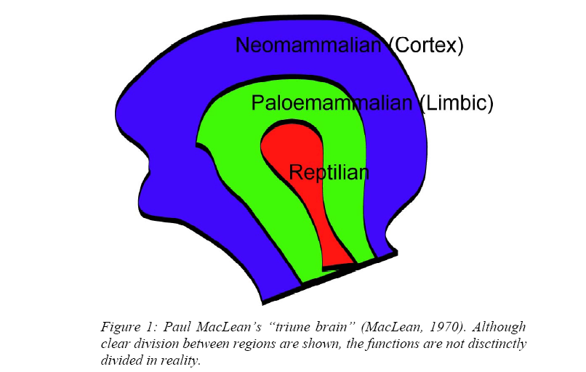


Slide 5
Emotions
The actual seat of emotion in human brain is not unambiguous, but we know something about it.
Paul MacLean has modeled the human brain as three regions: neocortex, limbic system(s), and reptilian brain (MacLean, 1970).
The neocortex is traditionally the best studied, and contains the visual cortex and auditory cortex; it is where the majority of perceptional processing has been assumed to occur. The limbic system is the primary seat of emotion, attention, and memory.

Slide 6
Decision Making
Antonio Damasio (1994) made remarkable findings for the paradigm shift for importance of emotions in thinking processes. His patients have frontal-lobe disorders, affecting a key part of the cortex that communicates with the limbic system, causing certain lack of emotional capabilities. Otherwise, the patients appear to have normal intelligence. At first encounter, they appear like Star Trek’s Mr. Spock: unexpressive of emotions and unusually rational.
One might expect them to be also highly intelligent, like Spock. But in real life, Damasio’s patients make disastrous decisions. Losing money with an investment, a healthy people would learn it’s a bad one and stop investing in it. But the patients would continue investing until all the money is gone. (no fear)

Slide 7
Learning
Emotions play an important role in human learning by creating an emotion for learning (Mowrer, 1960). Consider a rat that learns to leave his box upon hearing a tone after being experienced that tone paired with a painful shock.
  First, the rat learns to fear the tone, and
  second, upon hearing the tone tries to reduce the fear.
The emotional state of fear motivates the rat to seek methods of escape. This more flexible theory of learning explains how a rat might develop alternative solutions for the situation, but always motivated by its emotional state.

Slide 8
Memory
emotion influences memory retrieval. Scientists believe that emotional valence attaches to concepts, ideas, plans, and every experience stored in our memories.
Good feelings likely encode knowledge of effectiveness, familiarity, opportunity, and associations with positive outcomes.
Bad feelings likely encode knowledge of ineffectiveness, unfamiliarity, risk, and associations with negative outcomes.
Because memory is intricately involved in decision-making and almost every aspect of cognition, it may be that the way in which emotion works so many of its influences is via its influence on memory.
The findings of Bower and Cohen (1982) on mood-congruent memory retrieval and learning have influenced several models representing emotion-memory interactions and their impact on cognitive processes.

Slide 9
Emotion and affect in human behavior
Basic emotions:
  fear, anger, happiness, sadness, surprise, disgust
Short episode of synchronized system activity triggered by event:
  subjective feelings (the emotion we normally refer to),
  tendency to do something (action preparation),
  facial expressions,
  evaluation of the situation (cognitive evaluation, thinking),
  physiological arousal (heartbeat, alertness).

Slide 10
Affect = related to emotion, mood and attitudes:
  emotion: object directed, short term, high intensity, action oriented, differentiated.
  mood: unattributed, undifferentiated, longer term, low intensity.
  attitude: affect permanently associated with an object/person
  affect: abstraction of emotion/mood in terms of, positiveness/negativeness and activation/deactivation (e.g., Russell, Rolls).

Slide 11
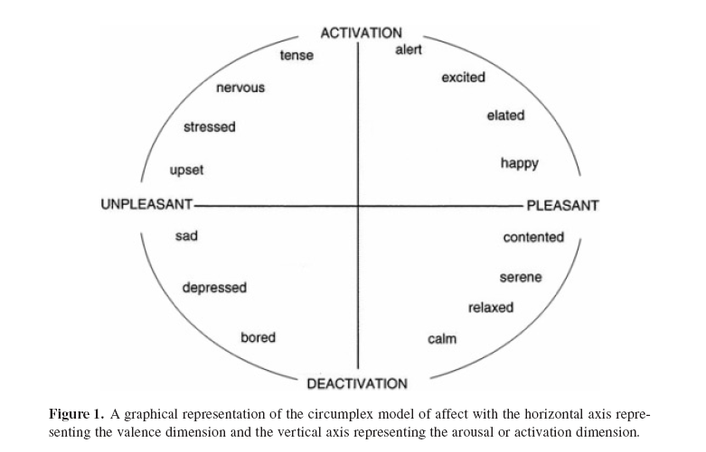

Slide 12
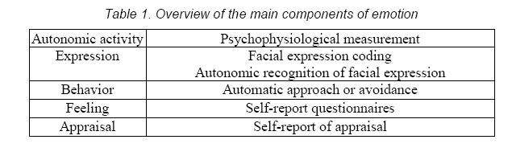
Main Components of emotions

Slide 13
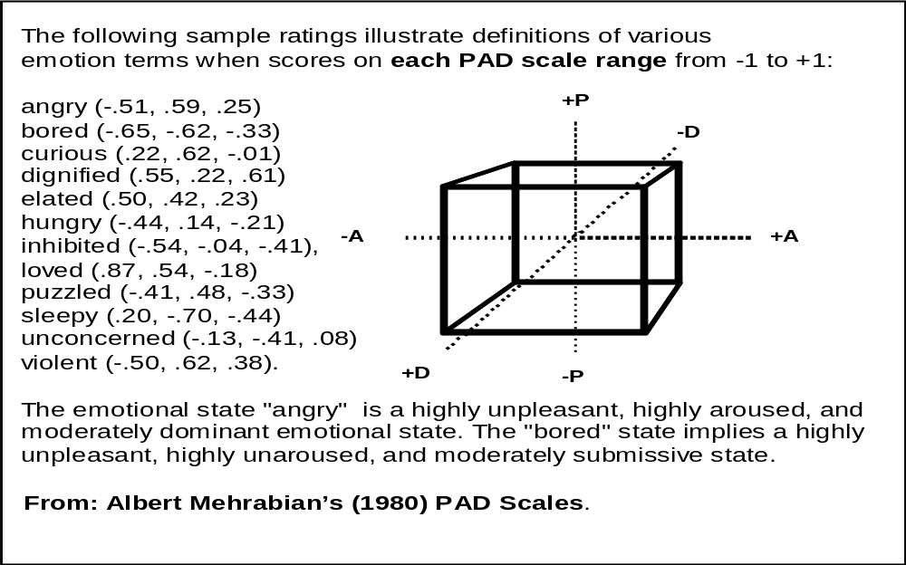
Emotion: dimensions (PAD)

Slide 14
Emotion: categories
Category is a typical “emotion syndrome”
  A complex of physiology, expression, behavior, and feeling
Sadness:
  Low arousal
  Face: sad
  Avoid
  Bad feeling
Anger:
  High arousal
  Face: angry
  Approach
  Bad feeling
Joy:
  High arousal
  Face: happy
  Play
  Good feeling

Slide 15
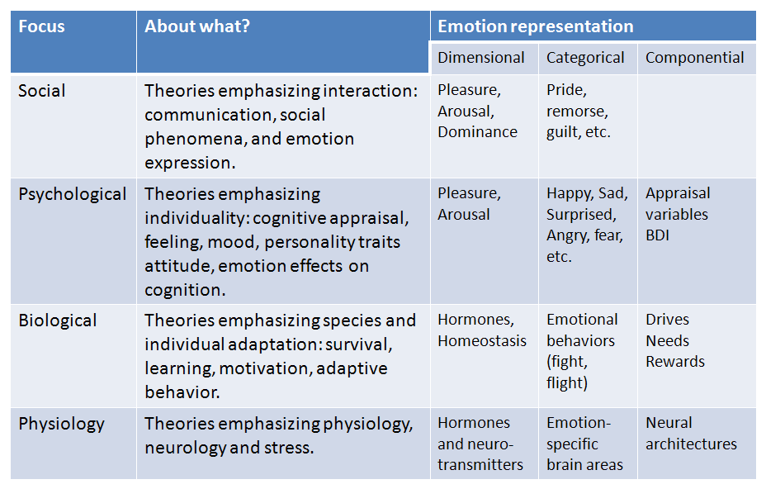
Emotion: summary

Slide 16
Emotion and affect in human behavior
Many relations between affect and cognition:
Mood influences information processing style
  Top-down (positive) versus bottom-up (negative)
  Heuristic/generic/assuming/creative processing (positive) versus detail/feature/critical/procedural processing (negative)
Mood influences learning
  Flow, boredom, frustration , etc.
Emotion influences information processing
  Strong (arousing) emotions hamper processing in general.

Slide 17
Affective computing
Affective computing mainly work consists of emotion recognition technology, computational modeling of causal factors of emotion and emotion expression in virtual characters and robots.
http://www.ted.com/talks/don_norman_on_design_and_emotion.html

Slide 18
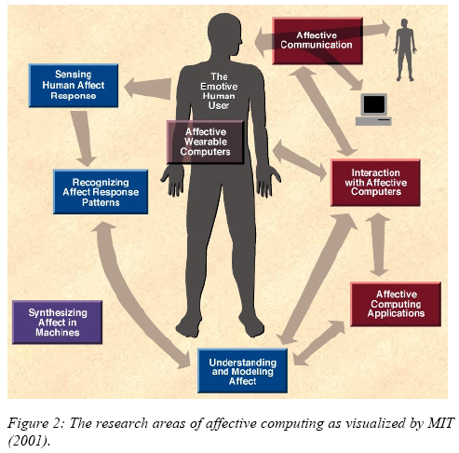

Slide 19
Affective Computing
Computing that relates to, arises from, or deliberately influences emotions (Picard, 1997).
Different types of computational approaches:
  recognize or measure human emotions (recognition).
  interpret human emotion (perception, processing).
  represent human emotion
  elicit emotions (cognitive modeling, motivations, feedback).
  represent system emotion.
  emotional influence on behavior and functioning (adaptation, attention, actions).
  show system emotions (expression).
  Influence human emotion (induction).
a robot, a virtual character, a tutor agent, a fridge, etc…

Slide 20
Affect measurement and recognition

Slide 21
Affect measurement and recognition: why?
Living Lab experiments
  Evaluate products, test hypotheses about emotion theory, etc.
Social software
  Human communication, expression, etc.
Software that uses affect feedback for functioning
  Recommendation, (serious) games, tutor agents, VR training, etc.

Slide 22
Affect measurement and recognition: how?
Implicit (automated affect recognition)
  Physiological:
    Galvanic Skin Response, Heart rate, muscle tone, EEG
  Behavior-based:
    Facial expression analysis, body posture, gestures, sound, speech, mouse movement, keyboard presses.

Slide 23
Affect measurement and recognition: how?
Issues
  Deception/ Display rules
  Ambiguity (context) and precision/range
  Noise
  Positioning
  Invasiveness
  One modality problematic (multi-modal needed)
  Time-scales
  Type of affect recognized (mood/emotion/mixed/intensity?)

Slide 24
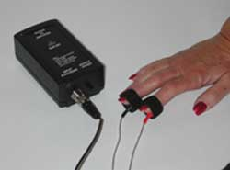
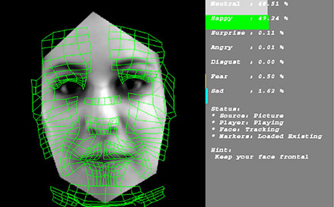
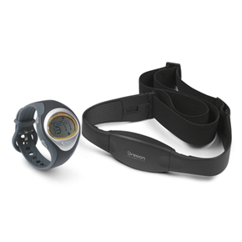

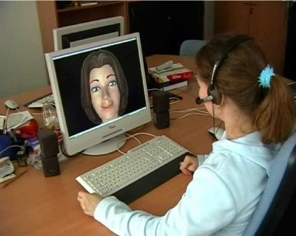
Examples of implicit feedback

Slide 25
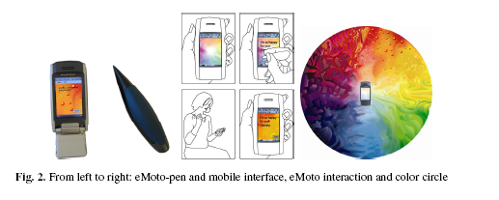
Affect measurement and recognition: how (2)?
Explicit (affective feedback)
  Ask affective feedback
    Free text, questionnaires, emotion words, experience sampling, experience clips
  Affect dimension-based
    Affect questionnaires, SAM, AffectButton, prEmo, EmoCards, etc.
  Facial-expression-based
    Emoticons, basic emotion icons, etc.
  Text-based (actual in between explicit and implicit):
    websites, blogs, documents, tags
  Haptics
    SEI, EmoPen, Emoto

Slide 26
Affect measurement and recognition: how (2)?
Issues
  Verbal report
  Subjective interpretation bias / cultural bias
  Validity and reliability.
  Deception / social conformation
  Ambiguity (context) and precision/range
  Useability/learnability
  Type of affect recognized (mood/emotion/mixed/intensity?)

Slide 27
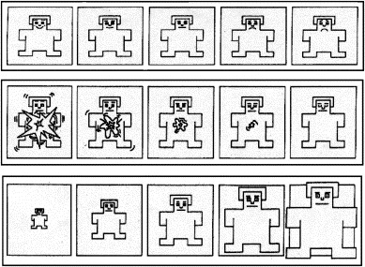
Examples of explicit feedback
Self-Assessment Manikin (SAM) (Bradley&Lang 1994)
Purely dimension-based (Please Arousal Dominance)

Slide 28
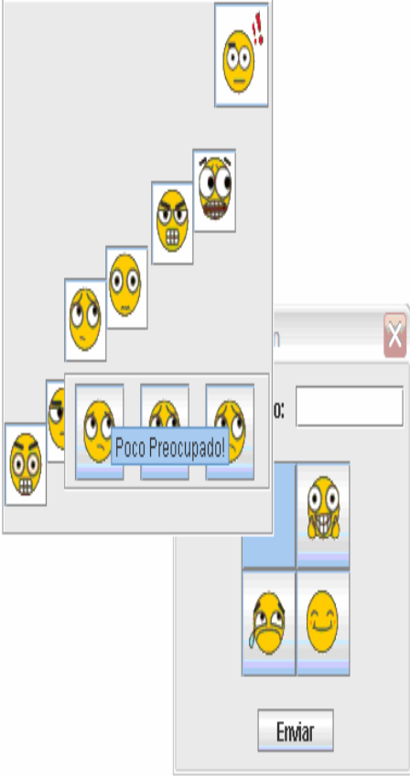
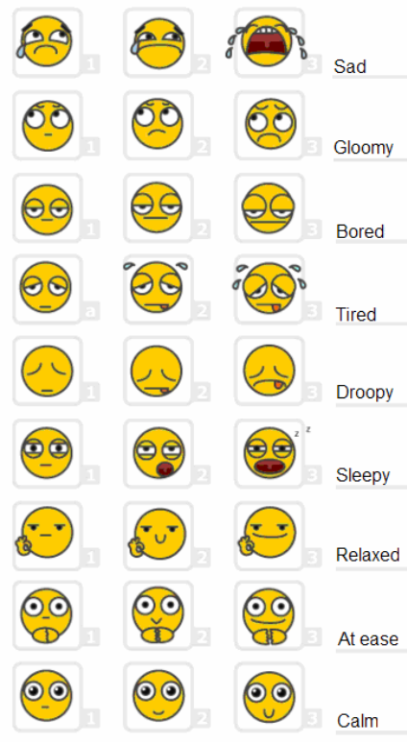
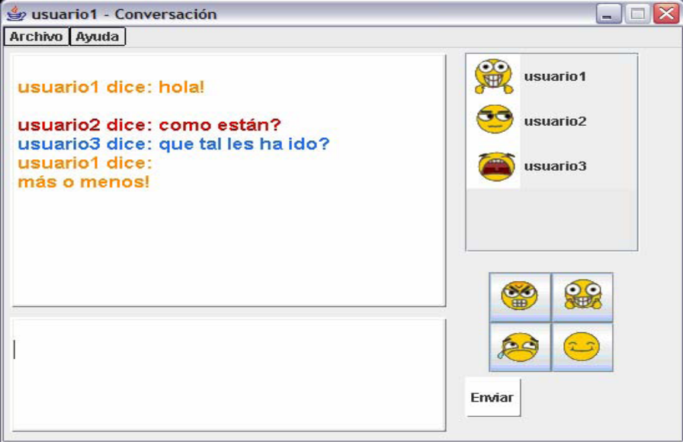
Examples of explicit feedback
(Sanchez et al 2006)
Dimension-based + labels (Pleasure, Arousal, Dominance)

Slide 29
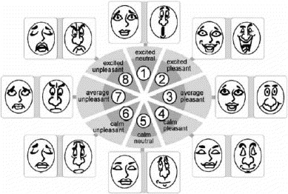
Examples of explicit feedback
EmoCards (Desmet, 2001)
Dimension-based + labels (Pleasure, Arousal)

Slide 30
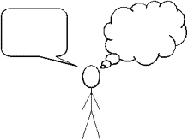
Examples of explicit feedback
Experience drawing (Tahti & Arhippainen, 2004)
Bounded form of experience expression by user.

Slide 31
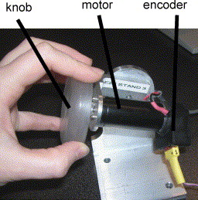
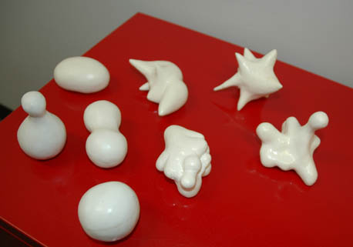
Examples of explicit feedback
Haptic feedback (Smith & MacLean, 2007)
Sensual Evaluation Instrument (Hook et al, 2005)

Slide 32
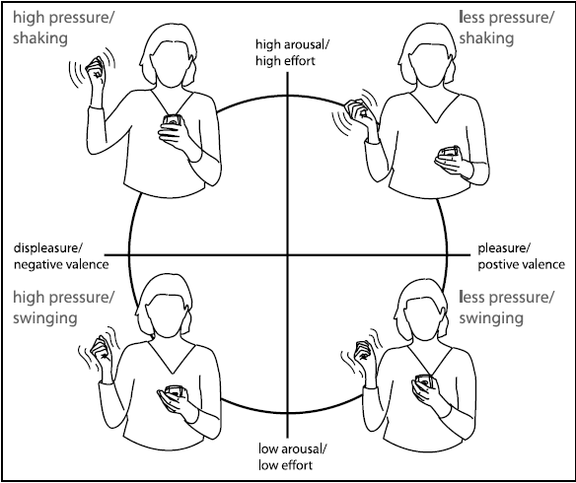
Examples of explicit feedback
Affective gestures (Fagerberg, Stahl, Hook, 2004)
Accelerometer and a pressure sensor attached to stylus pen.

Slide 33
Affect representation and modeling

Slide 34
Affect representation and modeling
How to represent (human) affect in a system?
Remember: different views on emotion
  Dimensional (valence, arousal, dominance)
  Categorical (happy, angry, sad, etc.)
  Componential(novelty, attribution, agency, etc.)
Use these views as representational basis.

Slide 35
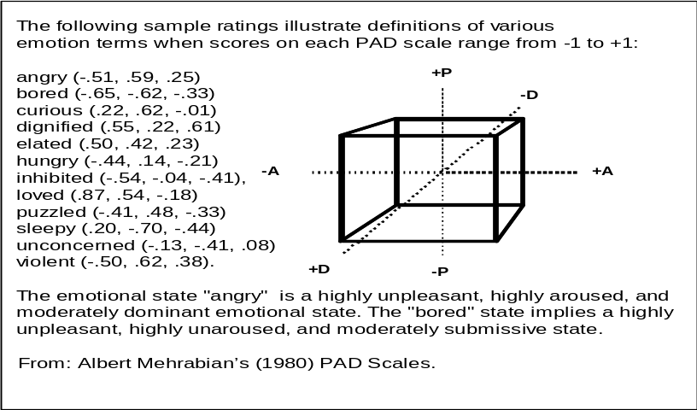
Emotion: dimensions
Extract Pleasure, Arousal, Dominance from input signal, e.g.,
In text (e.g. websites, blogs):
  Map words to PAD using empirical date, integrate triples.
In video/images/speech/physiological (e.g., movies, foto’s):
  Correlate features to PAD, or classify objects in +/-
Explicit (interface component):
  Directly ask dimensions (SAM),
  use mapping from faces to PAD.
Key benefit: easy to compute with,
mixed emotions make sense
Key problem: ambiguity and specificity

Slide 36
Emotion: categories
Extract emotion categories from input signal, e.g.,
In text (e.g. websites, blogs):
  Map words to Happy, Sad, Angry, etc.. using empirical date, integrate emotion vector, select most important one.
In video/images/speech/physiological (e.g., movies, foto’s):
  Classify objects in emotion categories
Explicit (interface component):
  Directly ask emotions
Key benefit: easy to understand for users and developers
Key problem: computation with mixed
emotions and intensities
Sadness:
  Low arousal
  Face: sad
  Avoid
  Bad feeling
Anger:
  High arousal
  Face: angry
  Approach
  Bad feeling
Joy:
  High arousal
  Face: happy
  Play
  Good feeling

Slide 37
Emotion: components
Ask user for explanation
Extract goals, needs, desires from human
Interpret situation and context
Derive emotion from the above using appraisal theory.
See e.g., the GATE project (Wherle, Kaiser, Scherer, etc.)
Key benefit: detailed emotion
Key problem: not many approaches exist,
not clear how all this should be done
Novelty
Pleasantness
Goal/Need conduciveness
Coping potential
Sensory-Motor level
Sudden, intense stimulation
Innate preferences/ aversions
Basic needs
Available energy
Schematic level
Familiarity: schema matching.
Learned preferences or aversions
Acquired needs motives
Body schema
Conceptual level
Expectations: cause/effect, probability
Recalled, anticipated, or derived positive-negative estimates
Conscious goals, plans
Problem-solving ability.

Slide 38
Applications

Slide 39
Applications
What to do with the emotion?
Feedback and communication
  feedback to learning system/robot (Broekens, 2007: EXPLAINED IN DETAIL LATER)
  robot communication (Breazeal)
Persuasive design
  in VR training, tutor agents (Gratch & Marsella, Nijholt)
  Treatment of emotion-related disorders such as ASD (de Silva et al , 2007)
  emotions in simulated-agent plans (e.g., human-like reasoning) (Gratch & Marsella),
  robot acceptance (Heerink)
Affect-based adaptation
  Affect-adaptive gaming and entertainment (Hudlicka, Yannakakis, Gilleade & Dix)
  Affect-based music adaptation (Livingstone & Brown)
  Emotional tagging and rating in recommenders (LeSaffre et al 2006)
  Interactive TV (Hsu et al, 2007)
Analysis and design
  Web-site analysis (Grefenstette et al, 2004)
  Inform design process (Desmet, Hook)
  Living labs (Mulder)
Etc…

Slide 40
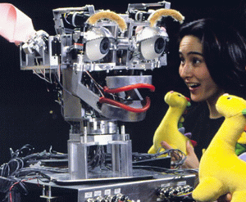
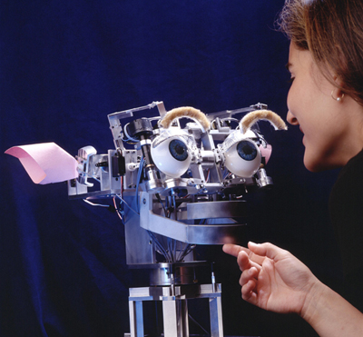
Kismet (Breazeal)
Social: Kismet, A framework, using a humanoid head expressing emotions, to study:
  effect of emotions on human-machine interaction.
  learning of social robot behaviors during human-robot play.
  joint attention.

Slide 41
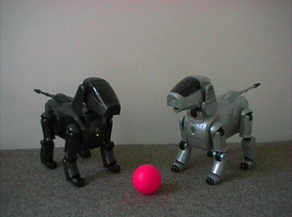
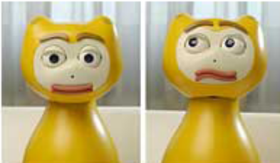
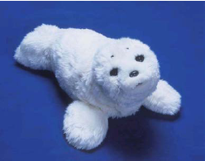
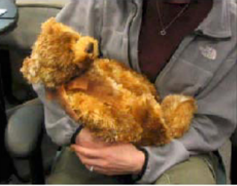
Companion Robots
Aibo (Sony, Japan)
Entertainment robot
I-Cat (Philips, NL)
Robot assistant for elderly people
Paro (Wada et al, Japan)
Robot companion for elderly
Huggable (MIT, USA)
Robot companion for elderly

Slide 42

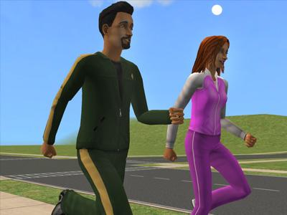
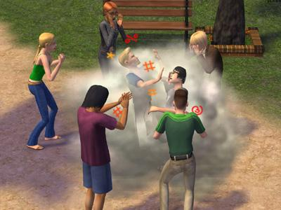
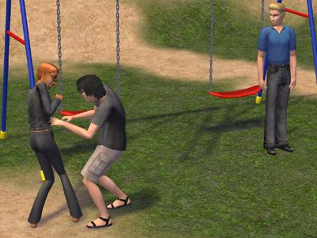
SIMS 2 (Electronic Arts)
Entertainment: emotions are used to provide entertainment value.

Slide 43
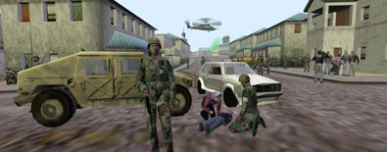
Mission Rehearsal Exercise
(Gratch & Marsella)
Cognitive: study the influence of artificial emotions on
  planning mechanism of virtual characters,
  training effect on trainees (emotion might enhance effect)

Slide 44
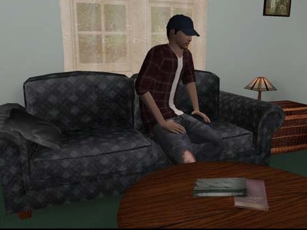
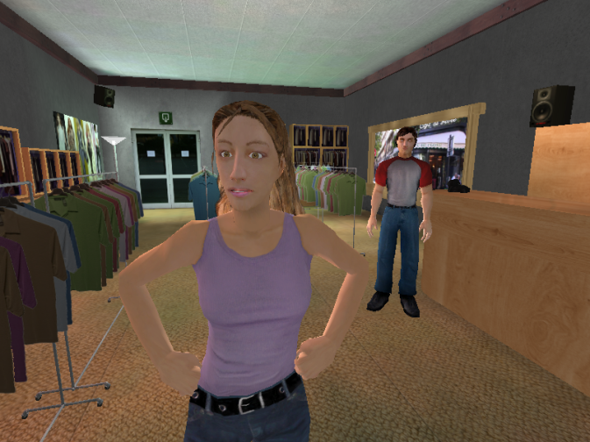
Virtual Training and Virtual Therapy
Therapist skill training using virtual characters (Kenny et al, left)
Social phobia training (at TU Delft, right)

Slide 45
Emotion Measurement
AffectButton: user friendly affect feedback

Slide 46
AffectButton: Why?
Pleasure-Arousal-Dominance-Based Feedback
  Data is “computation friendly” and continuous
Static element in interface
  No unfolding, easy to place in an interface
Easy to use
Easy to learn
  Emotion selection time < 5 sec
Valid and reliable feedback
  Users agree on meaning of button, and are consistent.

Slide 47
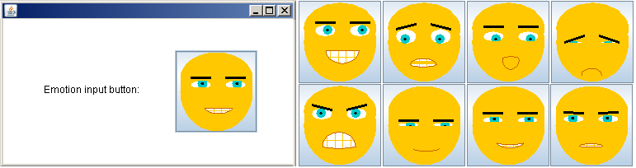
AffectButton: experiment
Users match a given emotion word with the AffectButton
Emotion word has validated PAD values (Mehrabian, 1980)
Use these values to correlate with user feedback
Example:
  Happy (p=.8, a=.4, d=.5)
  Face in AffectButton should be selected matching these values

Slide 48
Validity and Reliability
Validity:
  Concurrent validity between feedback by users, and
  Existing P, A, D scores for words.
  Correlate
  P = .9, A= .8, D=.81
Reliability: cronbach!
  Inter-rater consistency: users are assumed to be raters
  alpha is used as measure of agreement between raters for each emotion word.
  Alpha was 0.97, 0.94, and 0.96 for Pleasure, Arousal and Dominance respectively

Slide 49
Problems/Questions!
What did we measure?
  Own feeling about word? Attitude about word?
  What about mood induction influences?
How to further evaluate reliability and validity?
  We need broader cultural coverage with respect to evaluation.
  We need more subjects.
  Does the AffectButton have face validity?
Can we express all important emotions with it?
  Problem: complex emotions are difficult (guilt, jealousy, happy-for)
Suggestions welcome: to download and play with it: http://www.joostbroekens.com .

Slide 50
Useful introductory sources
To feel or not to feel: The role of affect in human-computer interaction (Hudlicka, 2003).
  And the accompanying Special Issue in the same journal.
A survey of Affect Recognition Methods: Audio, Visual, and Spontaneous Expressions (Zeng, Pantic, Roisman, Huang, 2009)
Experimental evaluation of five methods for collecting emotions in field settings with mobile applications (Isomursu, Tähti, Väinämö, Kuuti, 2007)
Joost Broekens
Delft University

