Slide 1
Evaluation 2
Dr. Ann Nosseir
Ch 26 & 27

Slide 2


Books
Designing Interactive Systems Benyon, Turner and Turner
Handbook of Usability Testing
Rubin and Chisnell

Slide 3
Creating the Evaluation
Plan for Heuristic Inspection
Choosing the Heuristics
The Inspectors
  Should be experts in HCI
  Expert in the system’s domain

Slide 4
Inspection of the User Interface
Heuristics – set of design principles
Heuristic Inspection (Heuristic evaluation)

Slide 5
Nielson’s Heuristics (1993)
Visibility of system status
Match between system and real world
User control and freedom
Consistency and standards
Error prevention
Recognition rather than recall
Flexibility and efficiency of use
Aesthetic and minimalist design
Help users recognize, diagnose, and recover from errors
Help and documentation

Slide 6
Heuristic Evaluation
Conducting a Heuristic Inspection
  Task Descriptions
  The Location of the Evaluation Session
  Collecting Evaluation Data

Slide 7
Heuristic Evaluation
Analysis of heuristic inspection data
Interpretation of heuristic inspection data
Benefits and limitations of heuristic evaluations

Slide 8
Heuristic Evaluation
Benefits:
  Less expensive than user observation
  Inspectors may suggest solutions
  Helps reveal obvious defects
Limitations
  Do not involve real users
  Differ in levels of importance of features
  Inspectors may have built-in bias
  Relies on inspectors’ skills

Slide 9
Variations of Usability Inspection
Participatory Heuristic Evaluations
  Users as inspectors
Guideline Reviews
  Uses guides other than sets of heuristics
Standards Inspections – i.e., may use ISO 9241
Cognitive Walkthrough – discovers users mental processes
Peer Reviews – review by colleague

Slide 10
A Comparison of User Observation and Heuristic Inspection
Users attempt tasks to comment Evaluator observes Ask participants to describe their thoughts in think aloud or retrospective protocol Measure: Effectiveness (can users do this task?); efficiency (how long does it take?) | Experts consider each heuristic to justify any defects Inspectors observer themselves Inspectors ask themselves How many violations of the heuristics are there in the UI?

Slide 11
The Elements of Evaluation
Observe,
  Evaluator observe the participants
  Inspectors observe themselves
Listen,
  Think aloud, retrospective protocol
  Inspectors ask themselves
Compare, (with usability requirements )
  Participants personal standard of a good interface
  List of heuristics
Measure
  Time task
  Number of heuristics are violated

Slide 12
Usability evaluation techniques
User observation
Usability inspections
Performance measurements
Remote evaluation
Guide reviews
Cognitive walkthrough
Standards inspection
Heuristic inspection
Peer reviews
Participatory Heuristic evaluation

Slide 13
Variations and more complex evaluations
Varying Other Aspects of the Evaluation
  Actual users ----------------------user representation
  Actual tasks------------------------task description
  Real environment -------------controlled environment
  Actual with domain knowledge -------people without

Slide 14
Variations of User Observations
Remote Moderated Testing
  Video conferencing
  Instrumented remote evaluation: data log
  Remote questionnaire
Performance Measurement Evaluations
  It compares the performance of two different versions of interface, for example.

Slide 15
Obtaining Opinions and Ideas
Focus Groups
  About 8 people are led to discuss a mock UI, a storyboard, or a tangible product
Card Sorting
  To explore how people categorize items, functions, products, etc

Slide 16
Evaluations without People
Accessibility Checkers and HTML Validators
Usability Checkers
Hybrid Methods

Slide 17
Different Purposes of Evaluations
Exploratory Evaluations
  In early development and often use low fidelity prototype
Validation Evaluation
  Towards the end of the development cycle or once the system is used
Assessment Evaluation
  In early and midway stage in the design life cycle
Comparison Evaluation
  To compare two different interaction style

Slide 18
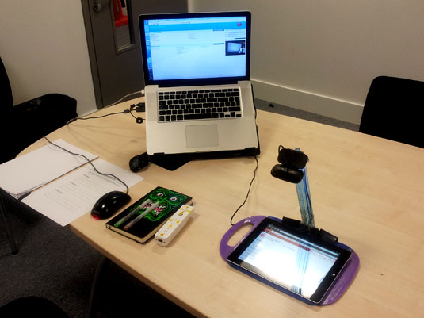


Slide 19
