Slide 1
ALX1_AIS4_M2e
Microsoft Data Engineer
Final project BY:
Anas Osama Ali Attya Dorgham
Ahmed Abd El-Mohsen Abd El-Raheem Hussein
Youssef Mahmoud Elsayed Abd Elkader
Marawan Attya Mamdouh
Mohammad Shaaban Mustafa abdulhameed

Slide 2
Project Agenda
Part 1: Environment Setup
Setting up Azure resources and environment.
Part 2: Data Ingestion
Ingesting data using Azure Data Factory.
Part 3: Data Transformation
Transforming data with Azure Databricks.
Part 4: Data Loading
Loading data into Azure Synapse Analytics.
Part 5: Data Reporting
Creating reports using Power BI.
Part 6: End-to-End Testing
Testing the complete pipeline with new data.

Slide 3
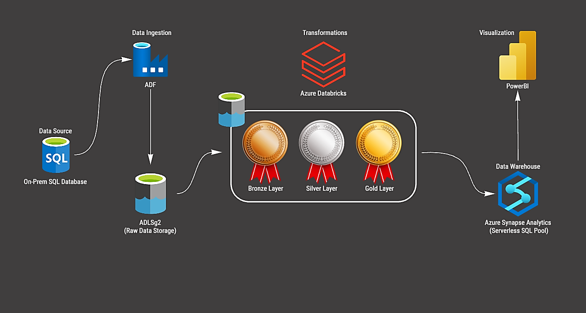

Slide 4
Key Azure Tools
Azure Data Factory: An ETL tool for data ingestion from onpremise SQL Server database to Azure.
Azure Synapse Analytics: Analytics service to create databases and tables for storing transformed data.
Azure Databricks: Big data analytics tool for transforming raw data into curated data.
Azure Data Lake Gen 2: Storage solution for storing ingested data.

Slide 5
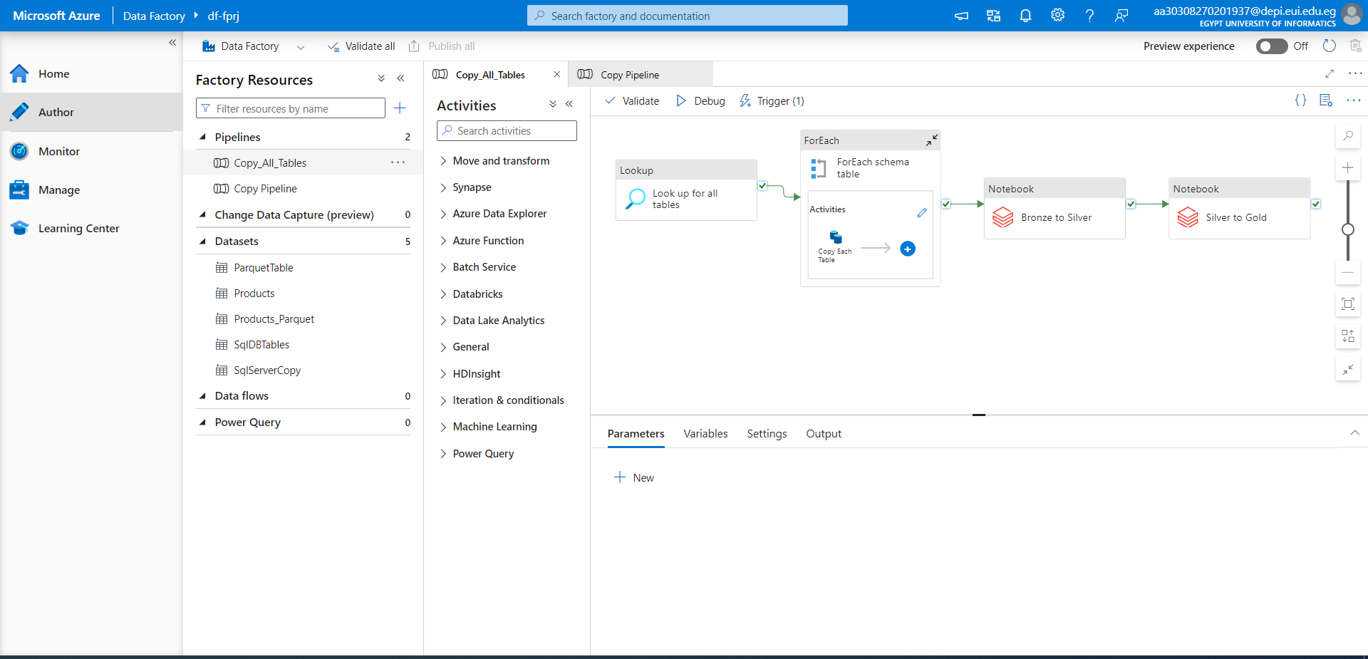

Slide 6
Data Ingestion
Using Azure Data Factory:
Connects to onpremise SQL Server to copy data to Azure Data Lake Gen 2.
Data Storage:
Data is stored in Azure Data Lake Gen 2 in the bronze layer.

Slide 8
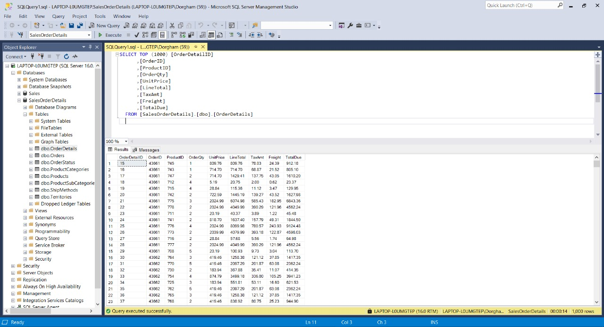

Slide 9
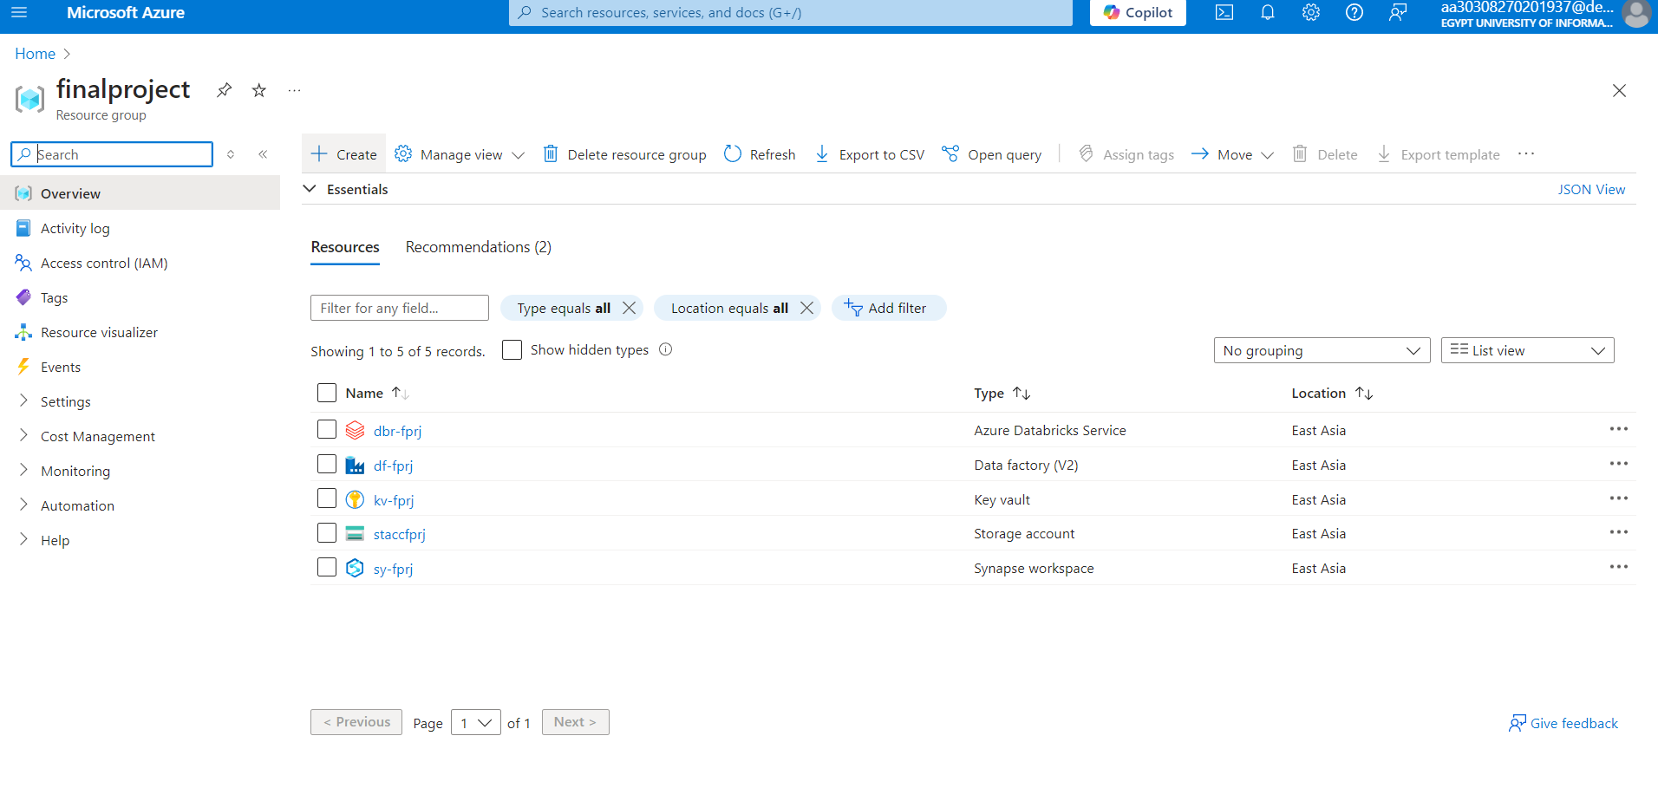

Slide 10
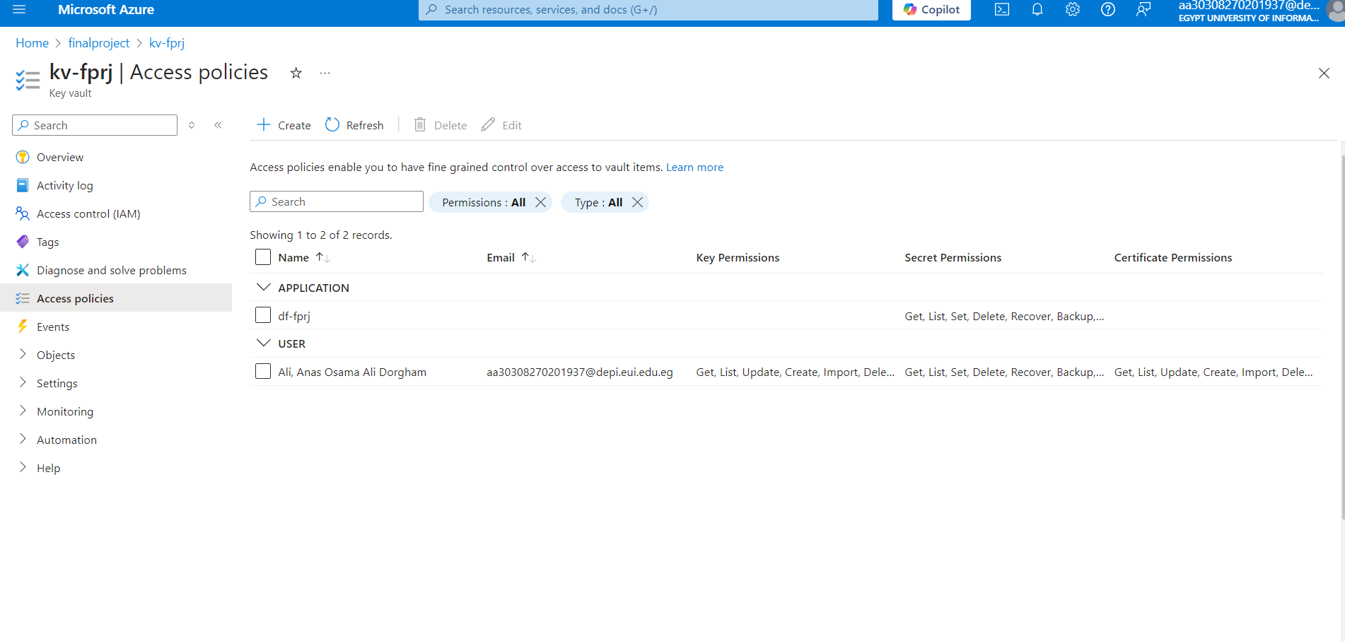

Slide 11
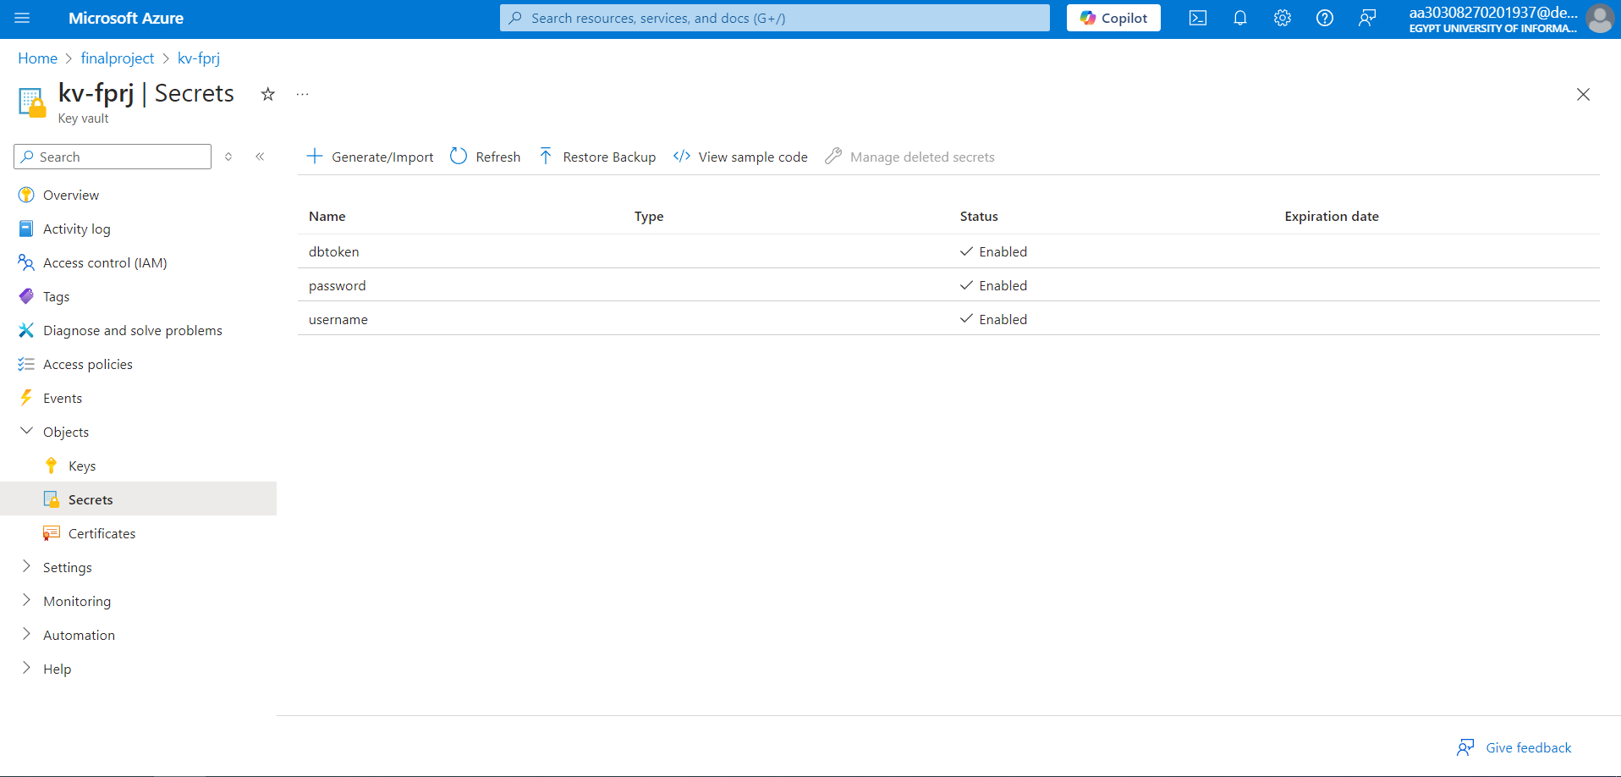

Slide 12
Data Transformation
Bronze Layer:
Initial raw data as ingested from the source.
Silver Layer:
Transformed data with minimal changes like data type conversions.
Gold Layer:
Final cleaned and curated data for analysis.

Slide 14
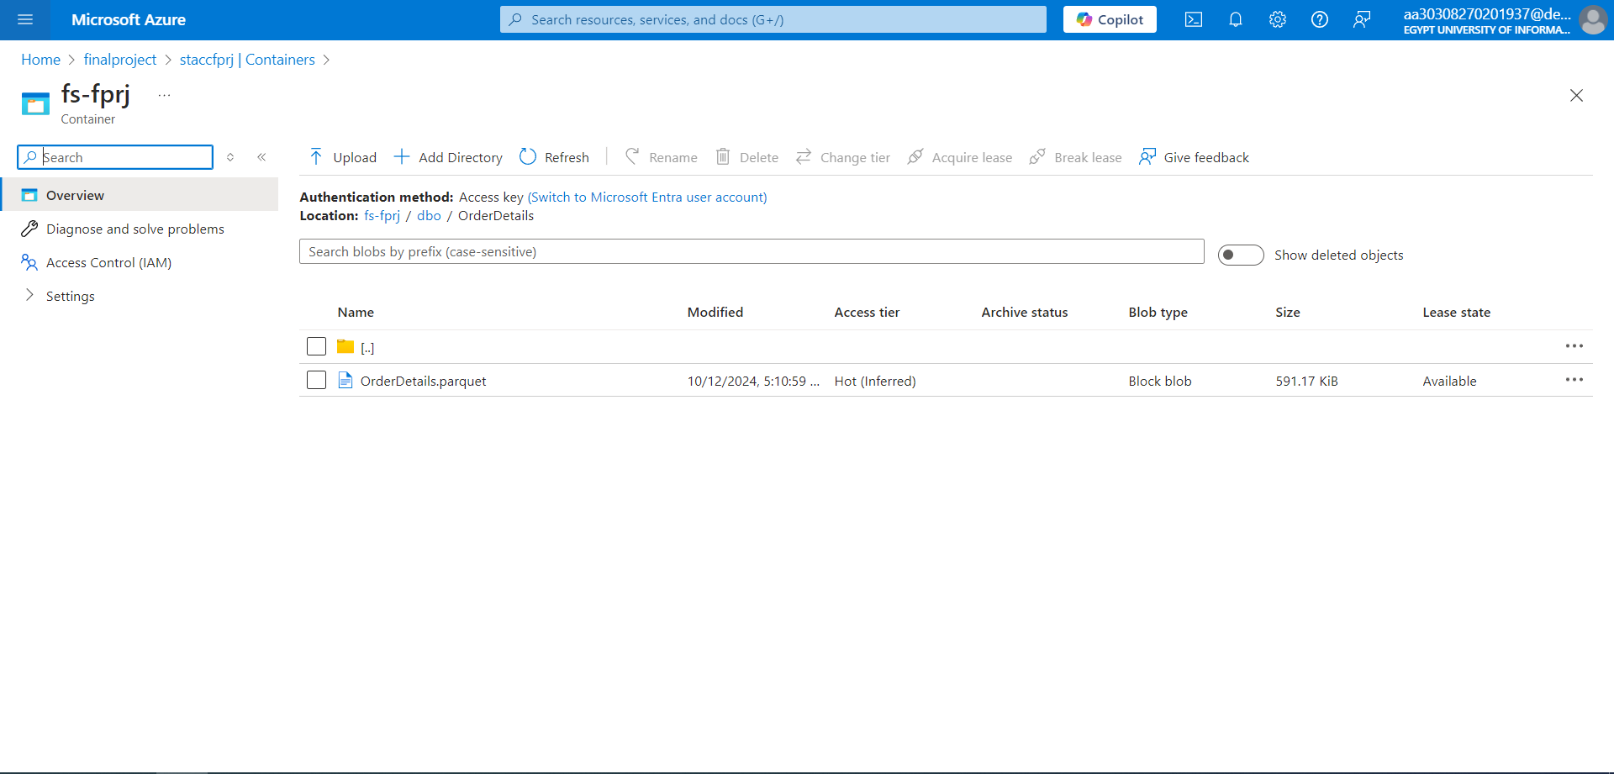

Slide 15
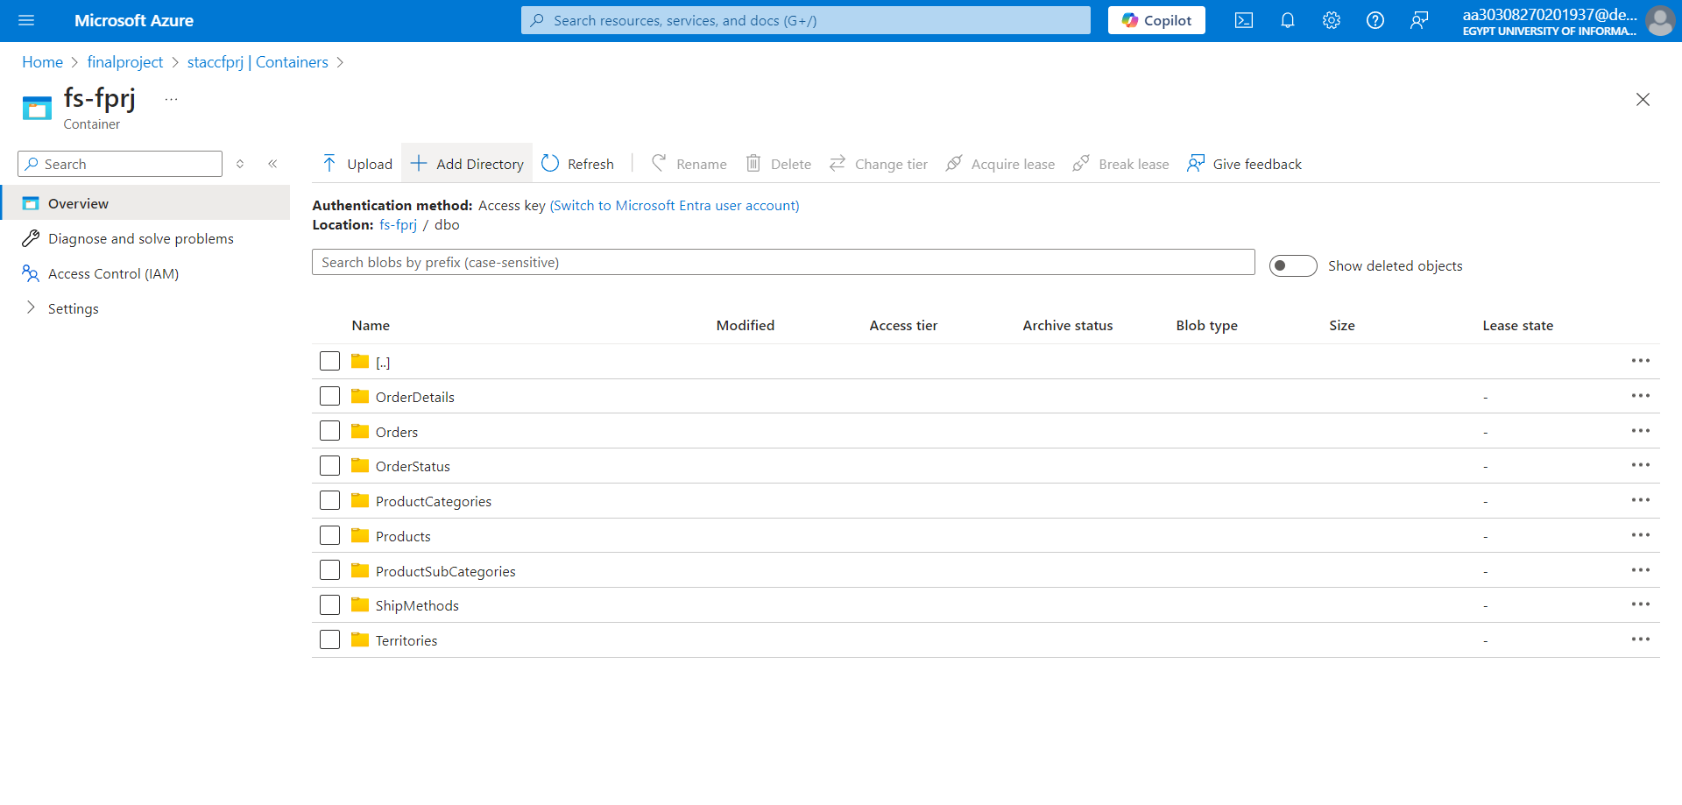

Slide 16
Data Transformation
Bronze Layer:
Initial raw data as ingested from the source.
Silver Layer:
Transformed data with minimal changes like data type conversions.
Gold Layer:
Final cleaned and curated data for analysis.

Slide 18


Slide 19
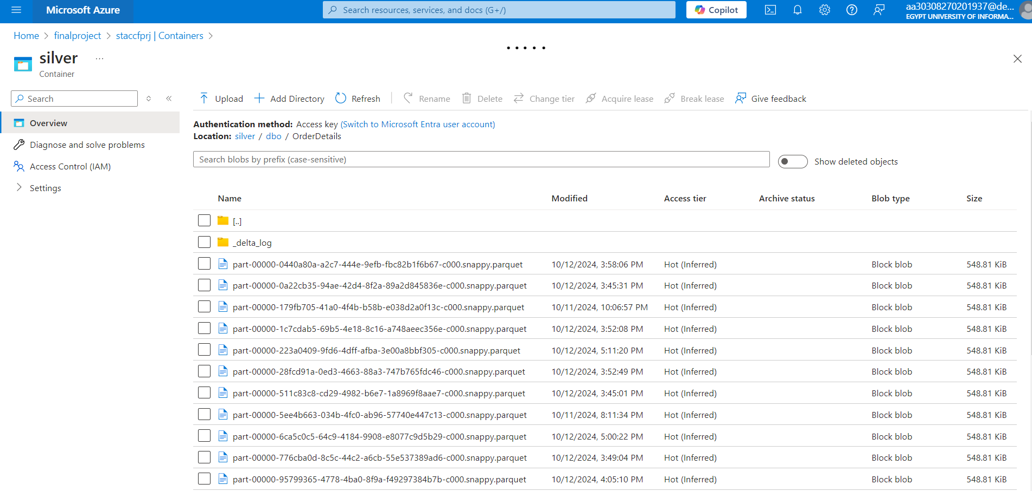

Slide 20
Data Transformation
Bronze Layer:
Initial raw data as ingested from the source.
Silver Layer:
Transformed data with minimal changes like data type conversions.
Gold Layer:
Final cleaned and curated data for analysis.

Slide 22


Slide 23
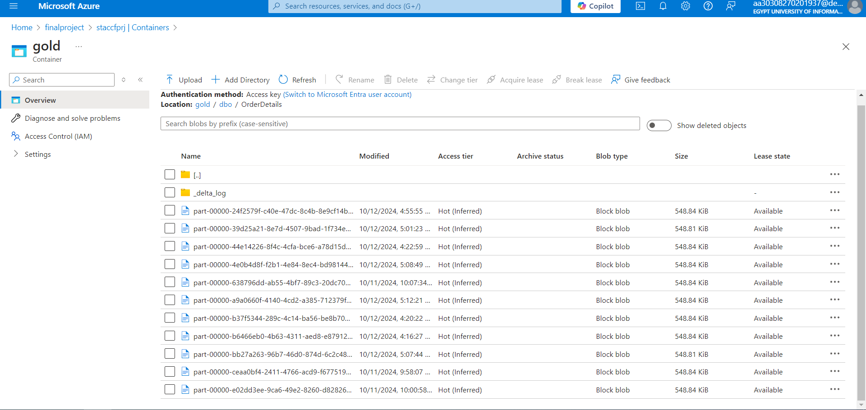

Slide 24
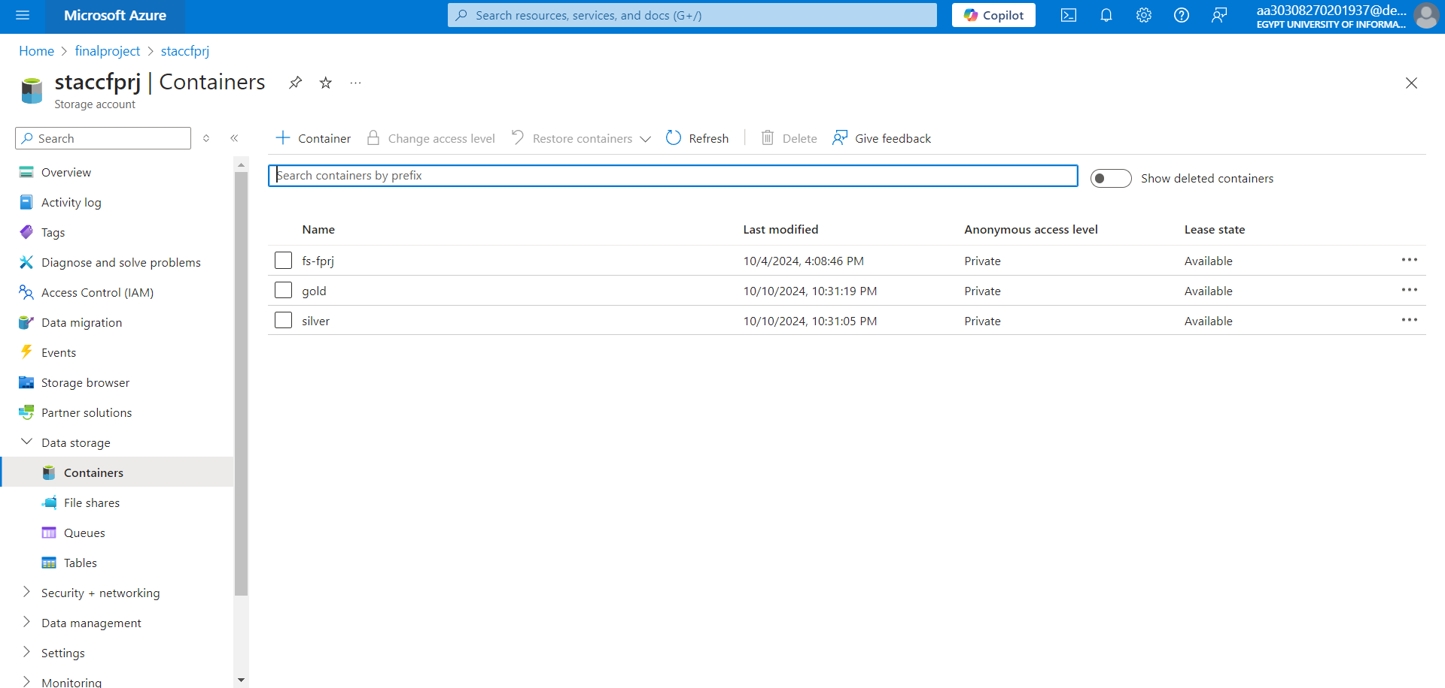

Slide 26
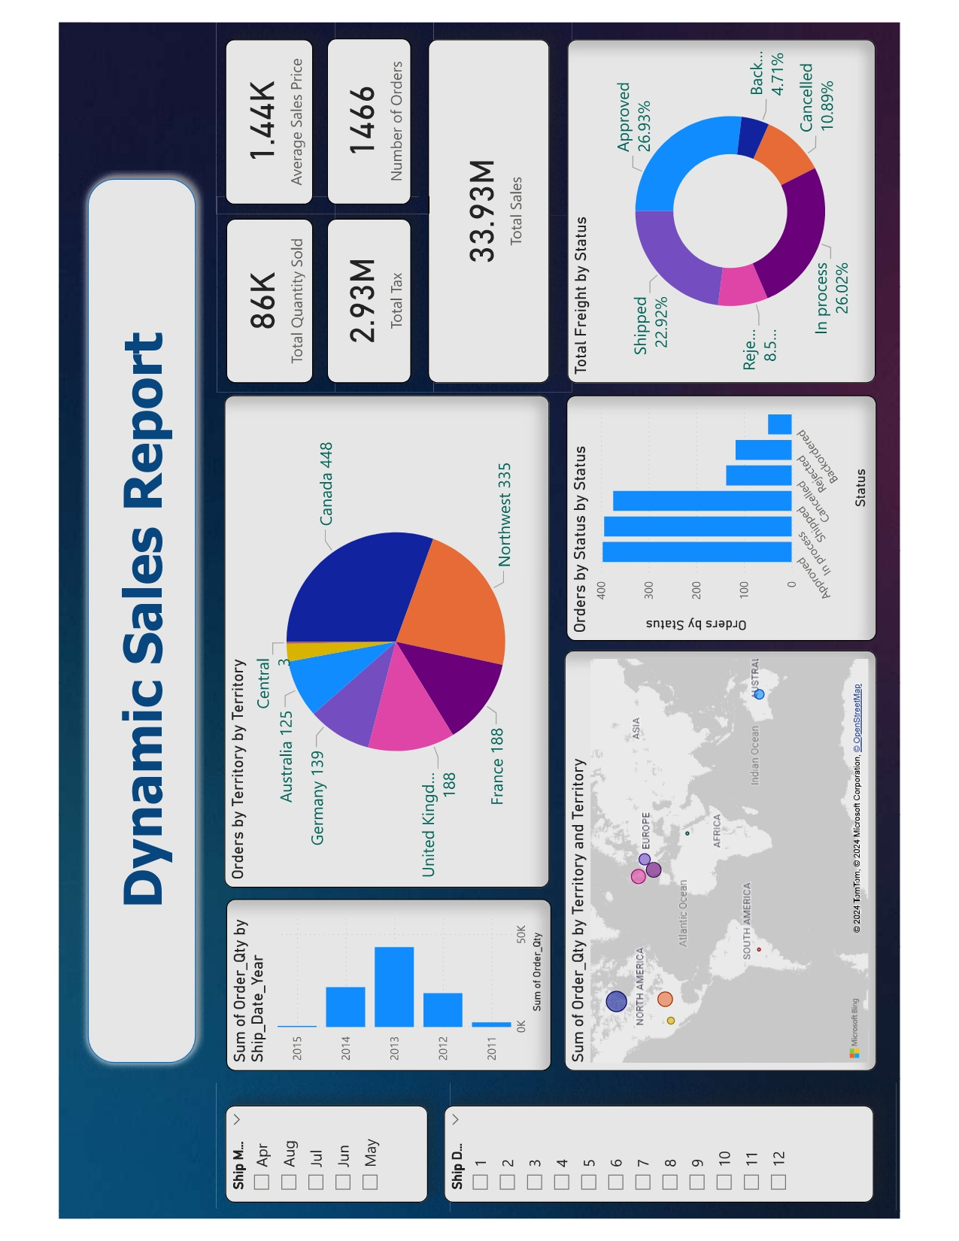

Slide 27
TESTING PREVIEW
Click me to see the testing video

