Slide 1

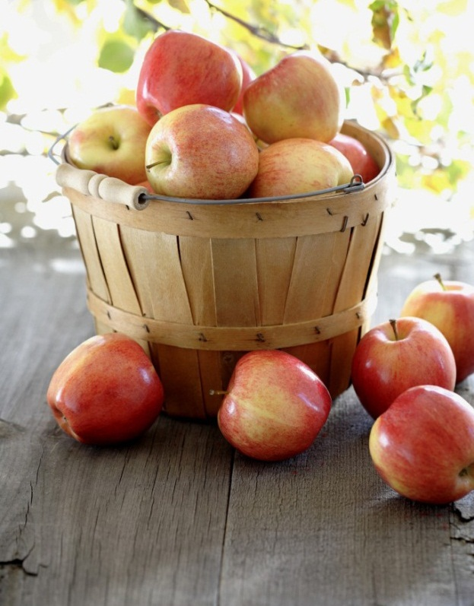



“Count memories, not calories”
Yummies Food
Notes:
NOTE: To replace a picture, just select and delete it. Then use the Insert Picture icon to replace it with one of your own!

Slide 2
Yummies Food
Yummies is a new restaurant opened with such a creative, simple idea of combining both online restaurant and take away. It is simply allowing users to set their orders through our online app and specify whether it’s delivered to you or take it from our takeaway post when it’s done.
“The chief ingredient in yummy food is love ❤️”
Objectives: Customer side: Ease food ordering process Minimize the waiting time Staff side: Ease for the chef to manage the orders Facilitate the tasks for the delivery guy Allow the manager to view the staff progress and status through online platform

Slide 3



Logo

Slide 4
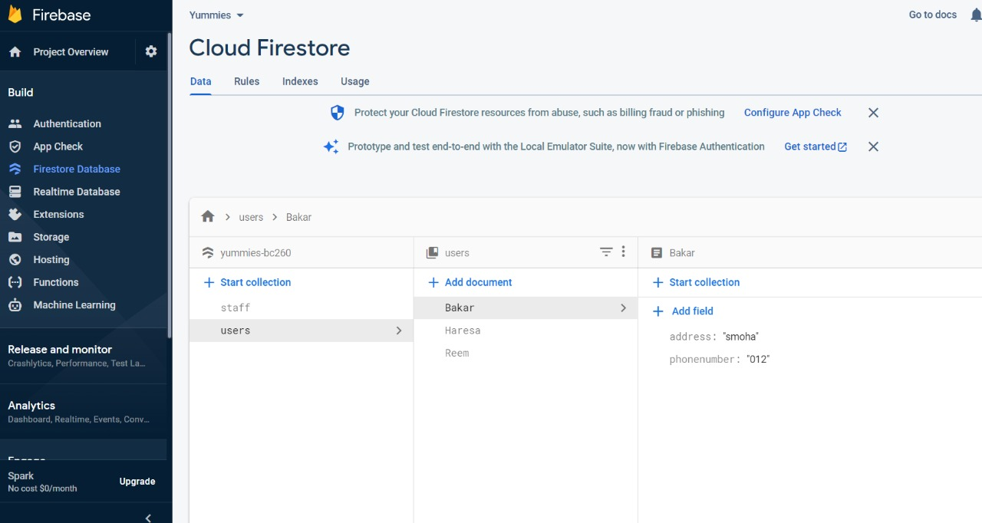
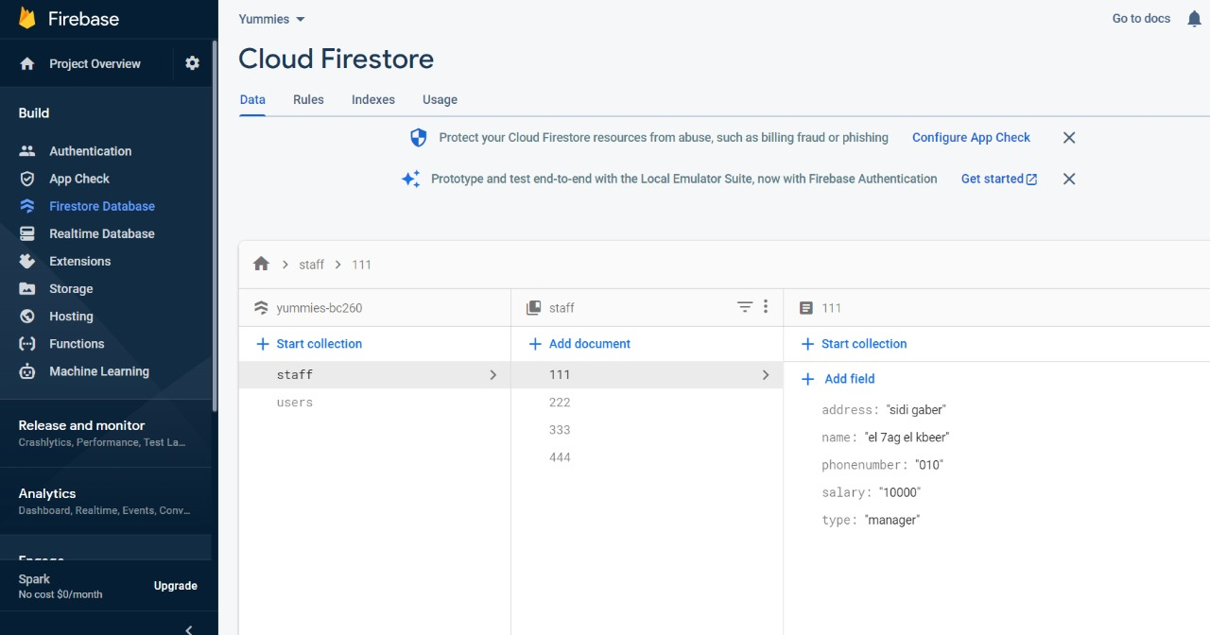
For database we have used Firebase(Google API) to be easier in usage for adding , deleting staff And login for customer form. We have added two tables → one for the customer data and another one for the staff data.
Database

Slide 5

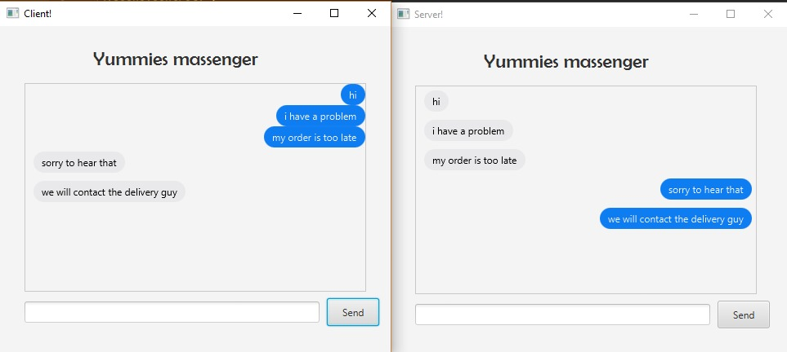
As we care about our customers and their opinions so we have added chatting section to communicate with our customers and receive their Complaints and suggestions.
Chatting system

Slide 6

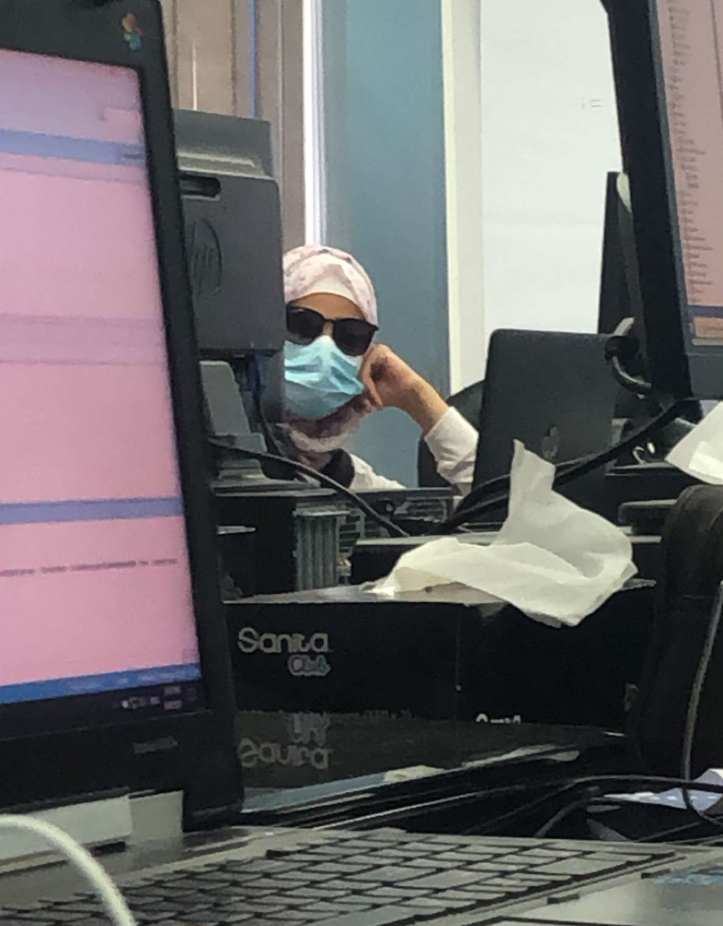

Thank You
Youssef Mahmoud Farouk
19100489
Reem osama Hassan
19103183
Abdullah Yehia Awad
19103937

