Slide 1
Quick-Select Algorithm
By: Youssef Mohamed Fouad Maklad 224207

Slide 2
Agenda
Strategy
03
01
Problem Definition
02
Algorithm Steps
04
Visualization
05
Code Implementation
06
Time Complexity Analysis

Slide 3
Problem Definition
Given an unsorted array "arr" of distinct elements and an integer k (where 1 ≤ k ≤ len(arr)), the goal is to find the kth largest/smallest element in the array. In other words, rearrange the elements in the array such that the kth element is in its sorted position if the array were sorted in ascending order.

Slide 4
Strategy
The Quick-Select Algorithm employs a "Decrease and Conquer by Variable" strategy to efficiently find the kth largest/smallest element in an unsorted array. By repeatedly partitioning the array and adjusting the search space based on the relative position of the pivot element, the algorithm effectively decreases the problem size. The variables left and right dynamically define the current search range, allowing the algorithm to progressively focus on the relevant subarray (in place).

Slide 5
Algorithm Steps
Initialization
Main Loop
01
02
Assign variables (left and right) denoting the search range of the array, initially to 0 and the len(arr) respectively
Continuously choose a pivot returned and chosen from the lomuto’s partitioning algorithm
Lomuto’s Partitioning
Is Found kth element?
Choosing the pivot as the first element of the given array, and get hold of it’s index (p), loop through the element of the array and check if any element smaller than the pivot value, if found, increment the p and swap the values, finally swap the first element of the array with the current pivot index, return the p (denotes the current chosen pivot).
03
04
Check if the chosen pivot from the lomuto’s partitioning algorithm is the kth element, if true then return it, otherwise, update the left and right variables, and perform another iteration in the main loop.

Slide 6
Visualization
7
10
4
3
20
15

Slide 7
Visualization
7
10
4
3
20
15
K = 4
P: 0
Pivot: 7
Notes:
$∴$ means therefore

Slide 8
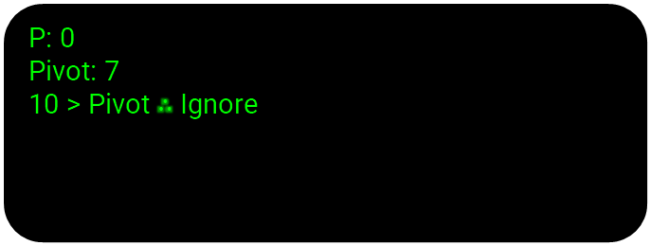
Visualization
7
10
4
3
20
15
P: 0
Pivot: 7
10 > Pivot $∴$ Ignore
Notes:
$∴$ means therefore

Slide 9
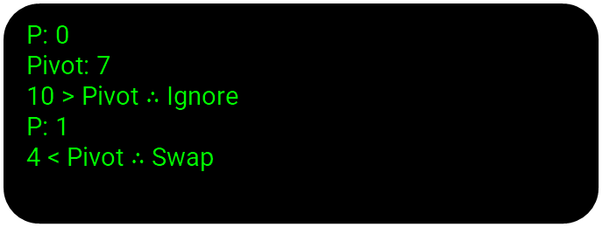
Visualization
7
4
10
3
20
15
P: 0
Pivot: 7
10 > Pivot $∴$ Ignore
P: 1
4 < Pivot $∴$ Swap
Notes:
$∴$ means therefore

Slide 10
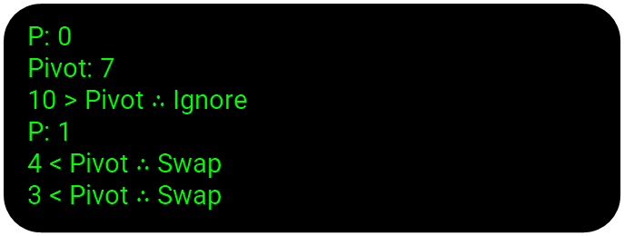
Visualization
7
4
10
3
20
15
P: 0
Pivot: 7
10 > Pivot $∴$ Ignore
P: 1
4 < Pivot $∴$ Swap
3 < Pivot $∴$ Swap
Notes:
$∴$ means therefore

Slide 11
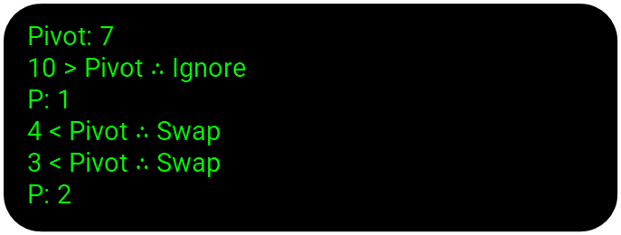
Visualization
7
4
3
10
20
15
Pivot: 7
10 > Pivot $∴$ Ignore
P: 1
4 < Pivot $∴$ Swap
3 < Pivot $∴$ Swap
P: 2
Notes:
$∴$ means therefore

Slide 12
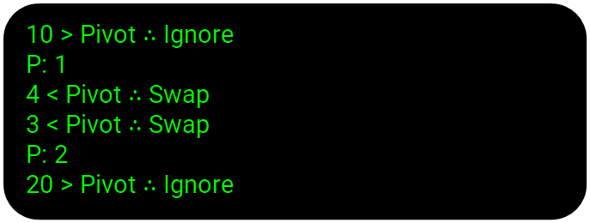
Visualization
7
4
3
10
20
15
10 > Pivot $∴$ Ignore
P: 1
4 < Pivot $∴$ Swap
3 < Pivot $∴$ Swap
P: 2
20 > Pivot $∴$ Ignore
Notes:
$∴$ means therefore

Slide 13
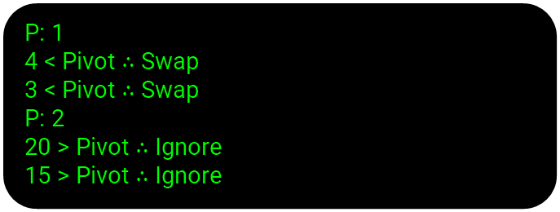
Visualization
7
4
3
10
20
15
P: 1
4 < Pivot $∴$ Swap
3 < Pivot $∴$ Swap
P: 2
20 > Pivot $∴$ Ignore
15 > Pivot $∴$ Ignore
Notes:
$∴$ means therefore

Slide 14
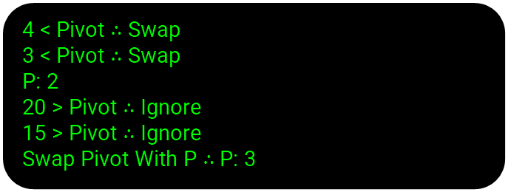
Visualization
7
4
3
10
20
15
4 < Pivot $∴$ Swap
3 < Pivot $∴$ Swap
P: 2
20 > Pivot $∴$ Ignore
15 > Pivot $∴$ Ignore
Swap Pivot With P $∴$P: 3
Notes:
$∴$ means therefore

Slide 15
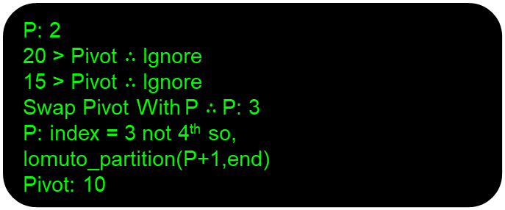
Visualization
3
4
7
10
20
15
P: 2
20 > Pivot $∴$ Ignore
15 > Pivot $∴$ Ignore
Swap Pivot With P $∴$P: 3
P: index = 3 not 4th so, lomuto_partition(P+1,end)
Pivot: 10
Notes:
$∴$ means therefore

Slide 16
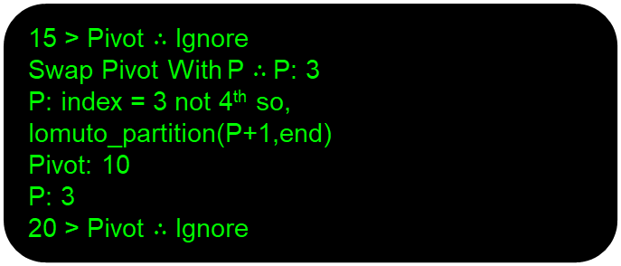
Visualization
3
4
7
10
20
15
15 > Pivot $∴$ Ignore
Swap Pivot With P $∴$P: 3
P: index = 3 not 4th so, lomuto_partition(P+1,end)
Pivot: 10
P: 3
20 > Pivot ∴ Ignore
Notes:
$∴$ means therefore

Slide 17
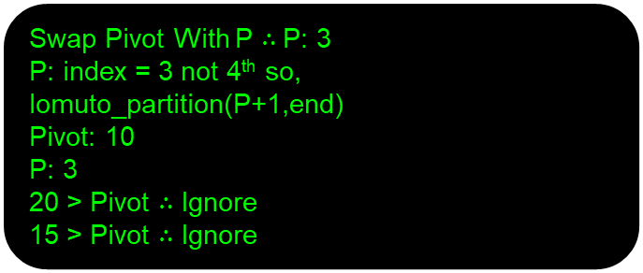
Visualization
3
4
7
10
20
15
Swap Pivot With P $∴$P: 3
P: index = 3 not 4th so, lomuto_partition(P+1,end)
Pivot: 10
P: 3
20 > Pivot ∴ Ignore
15 > Pivot $∴$ Ignore
Notes:
$∴$ means therefore

Slide 18
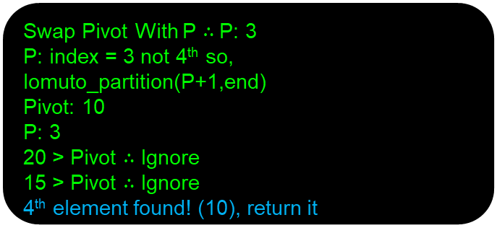
Visualization
3
4
7
10
20
15
Swap Pivot With P $∴$P: 3
P: index = 3 not 4th so, lomuto_partition(P+1,end)
Pivot: 10
P: 3
20 > Pivot ∴ Ignore
15 > Pivot $∴$ Ignore
4th element found! (10), return it
Notes:
$∴$ means therefore

Slide 19
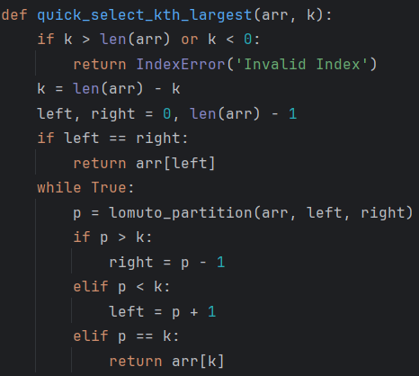
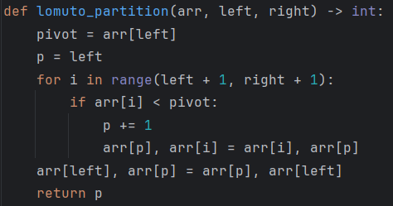
Python Code Implementation

Slide 20
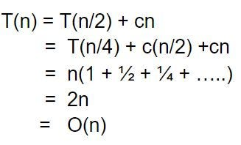
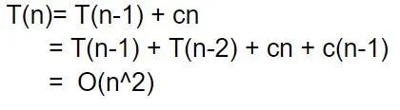
Time Complexity Analysis
Average Case
Worst Case
The Worst-Case scenario occurs when the partitioning consistently reduces the search space by only one element, this occurs when the pivot is consistently chosen as the smallest or largest element. Resulting in a quadratic time complexity of O(n^2)
On Average, Quick-Select achieves a linear time complexity of O(n). This is based on the assumption that the partitioning process evenly divides the array into two roughly equal parts in each iteration.

Slide 21
Thank You

