Slide 1
DIGITAL
CLOCK
Programming in C

Slide 2
MODULE SPECIFICATIONS
Team members:
1- Mohammed Ihab 223199
2- Youssef Mohamed 219563
3- Mohamed Wael 221029
Group: A-1
Academic Year: (2022/2023)
Module Code: 21MTRN10C
Module Leader: Prof. Nourhan Zayed

Slide 3
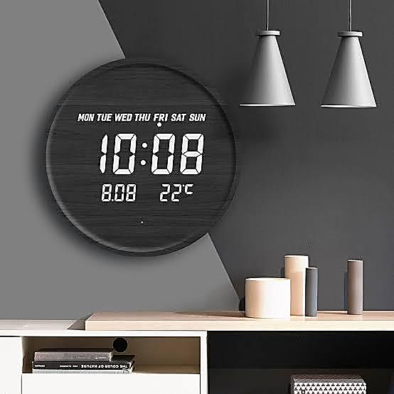
FUNCTIONS OF DIGITAL CLOCKS
This program's goal is to offer users a variety of functions that they may use on a regular basis, such as a clock, stopwatch, and timer.

Slide 4
DESIGNING
WRITING
PROCESS
TESTING
DEBUGGING
Drawing a mind map of how the code should flow.
Converting the flowcharts into a code using the language syntax.
Steps of making the program
Running the code
Solving the errors after testing

Slide 5
01
DESIGNING

Slide 6
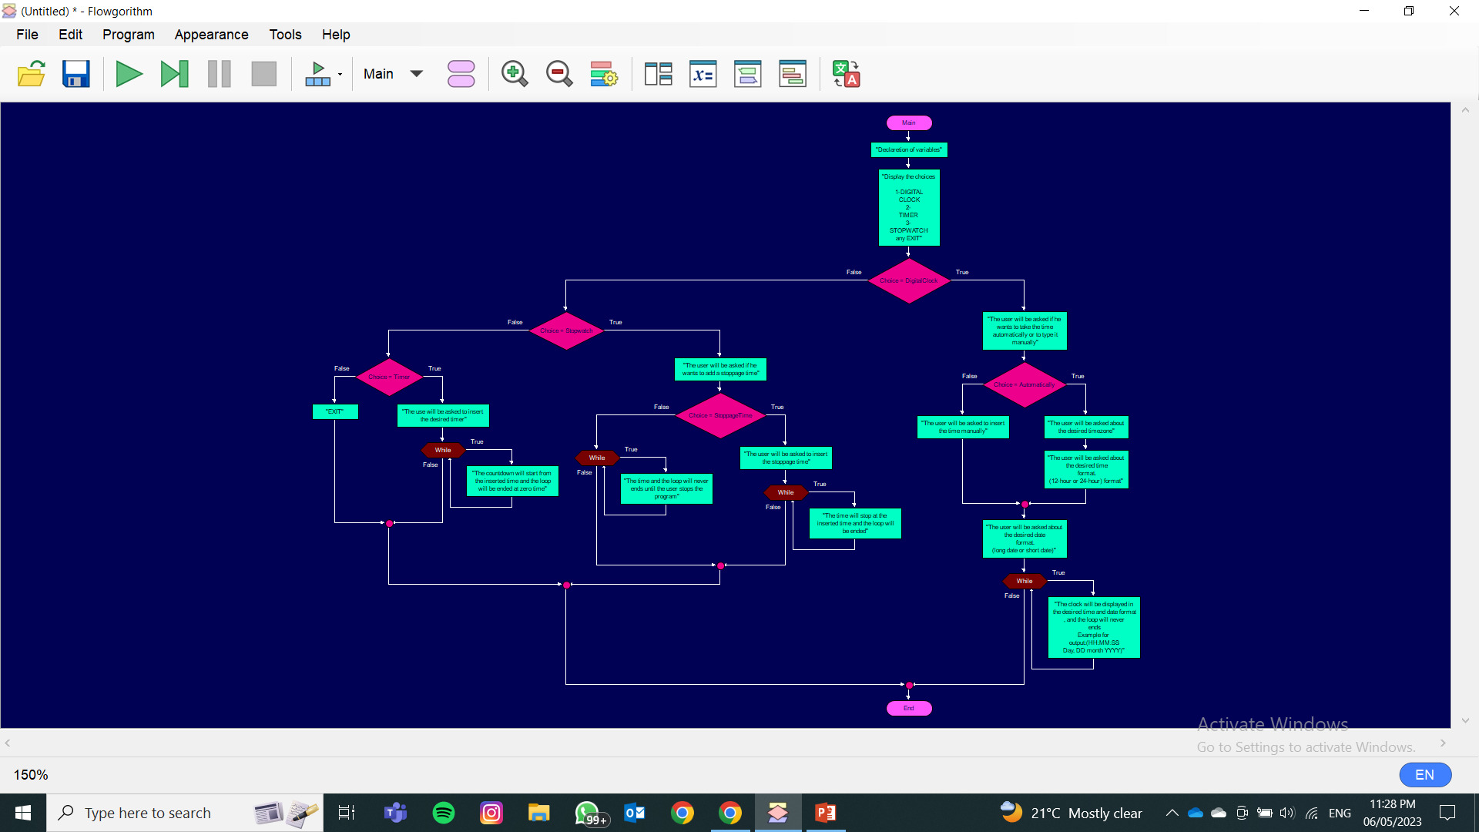
FLOWCHARTS FULL-VIEW

Slide 7
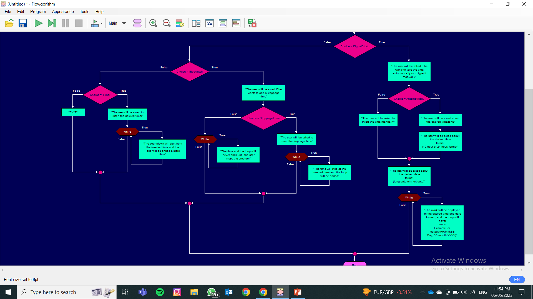
1ST CHOICE {DIGITAL CLOCK}

Slide 8
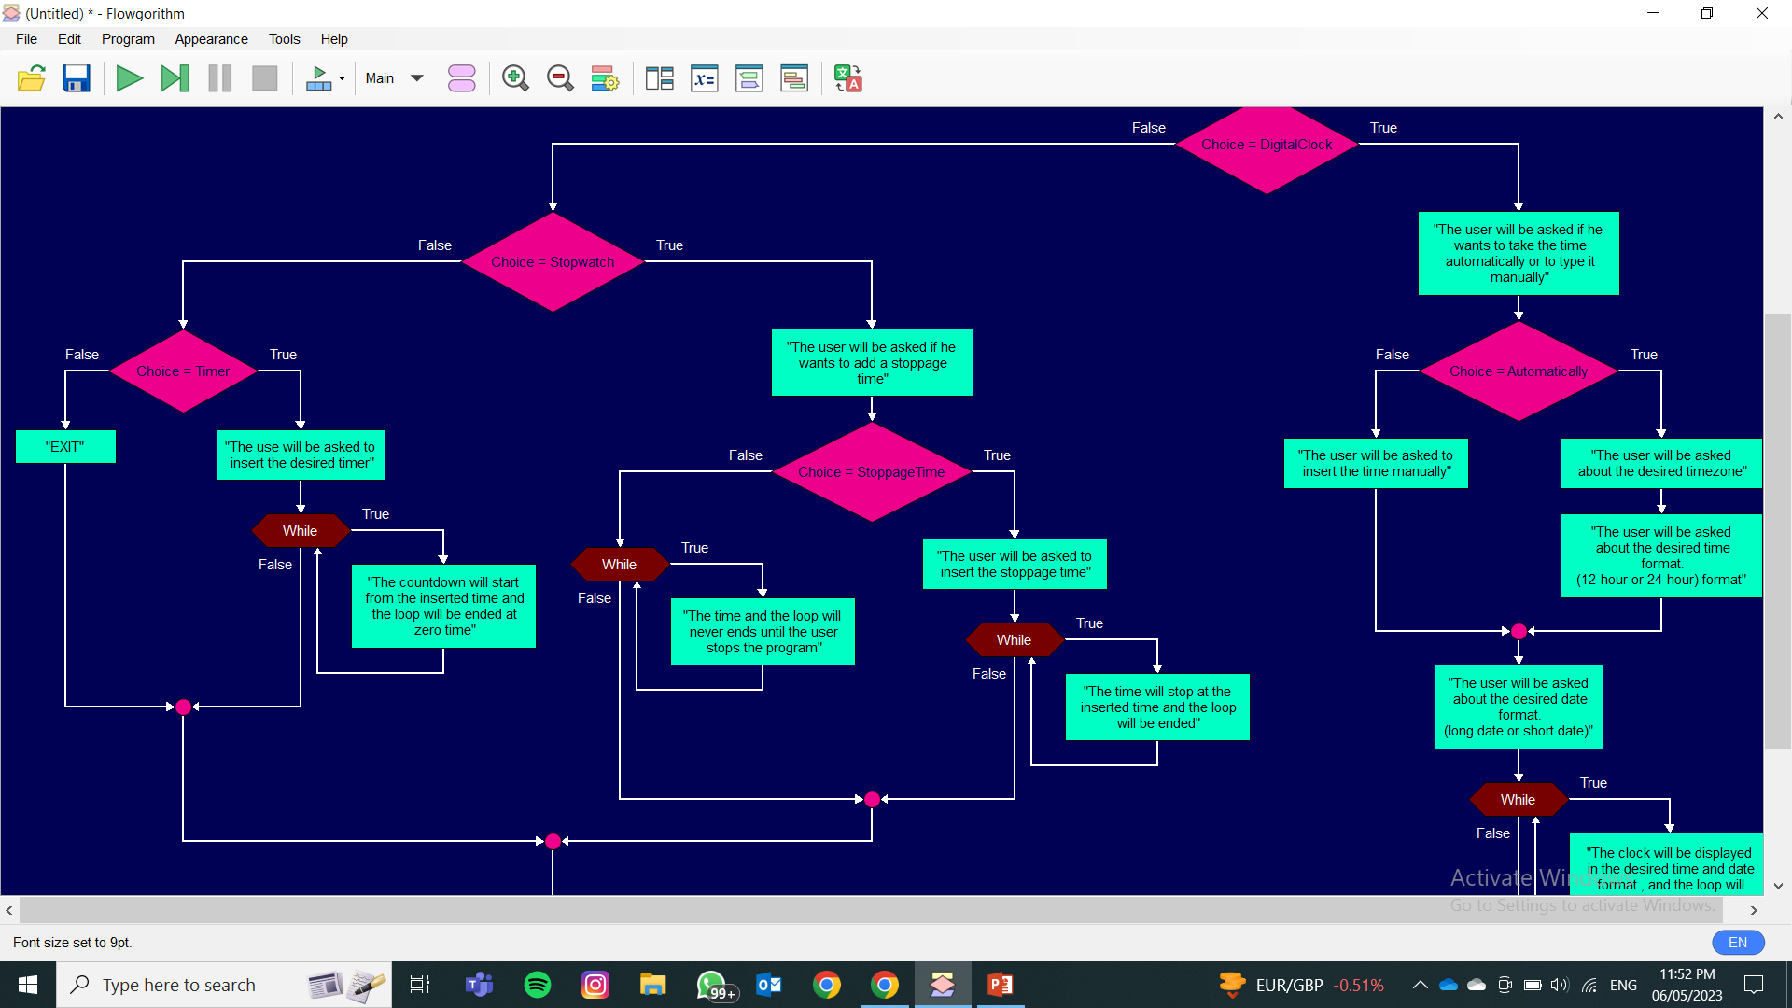
2ND CHOICE {STOPWATCH}

Slide 9
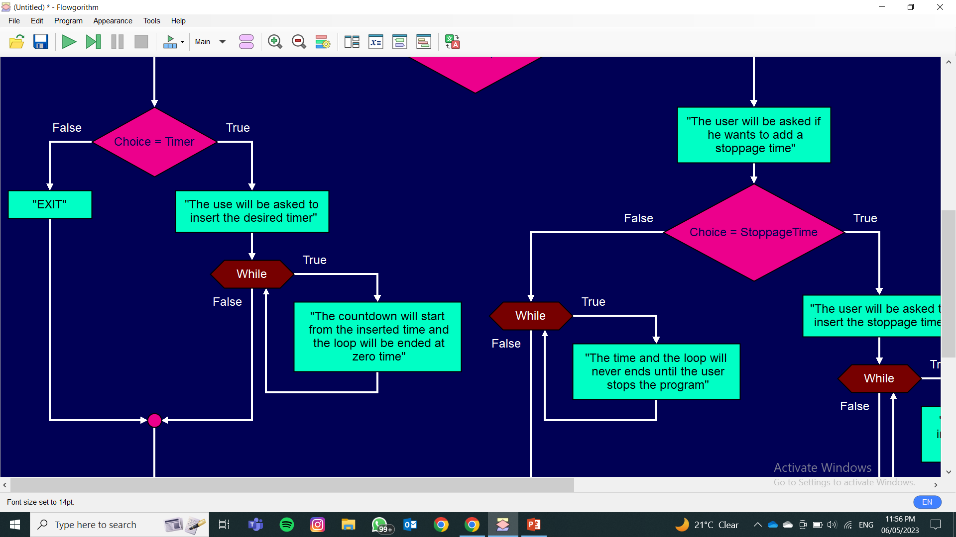
3RD CHOICE {TIMER}

Slide 10
02
WRITING

Slide 11
CHALLENGES
FINDING THE SUITABLE FUNCTIONS
DISPLAYED OUTPUT
1ST
2ND
3RD
4TH
FEATURES
USER ERROR

Slide 12
THE CODE IN C
Notes:
Description

Slide 13
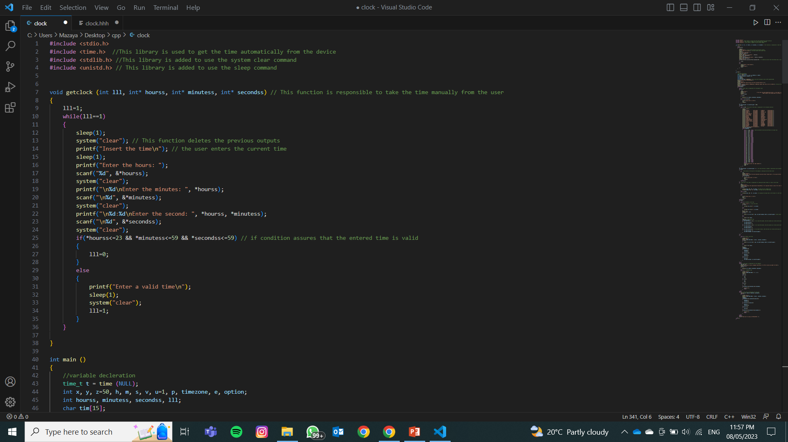
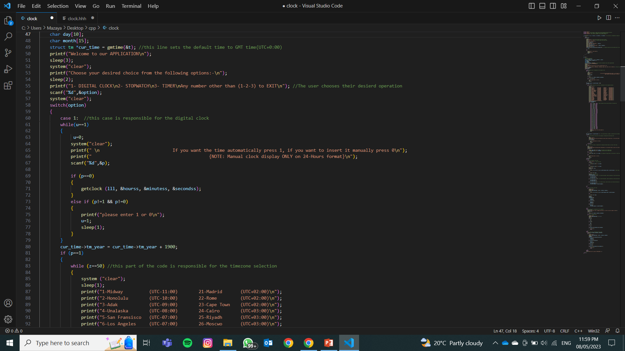

Slide 14
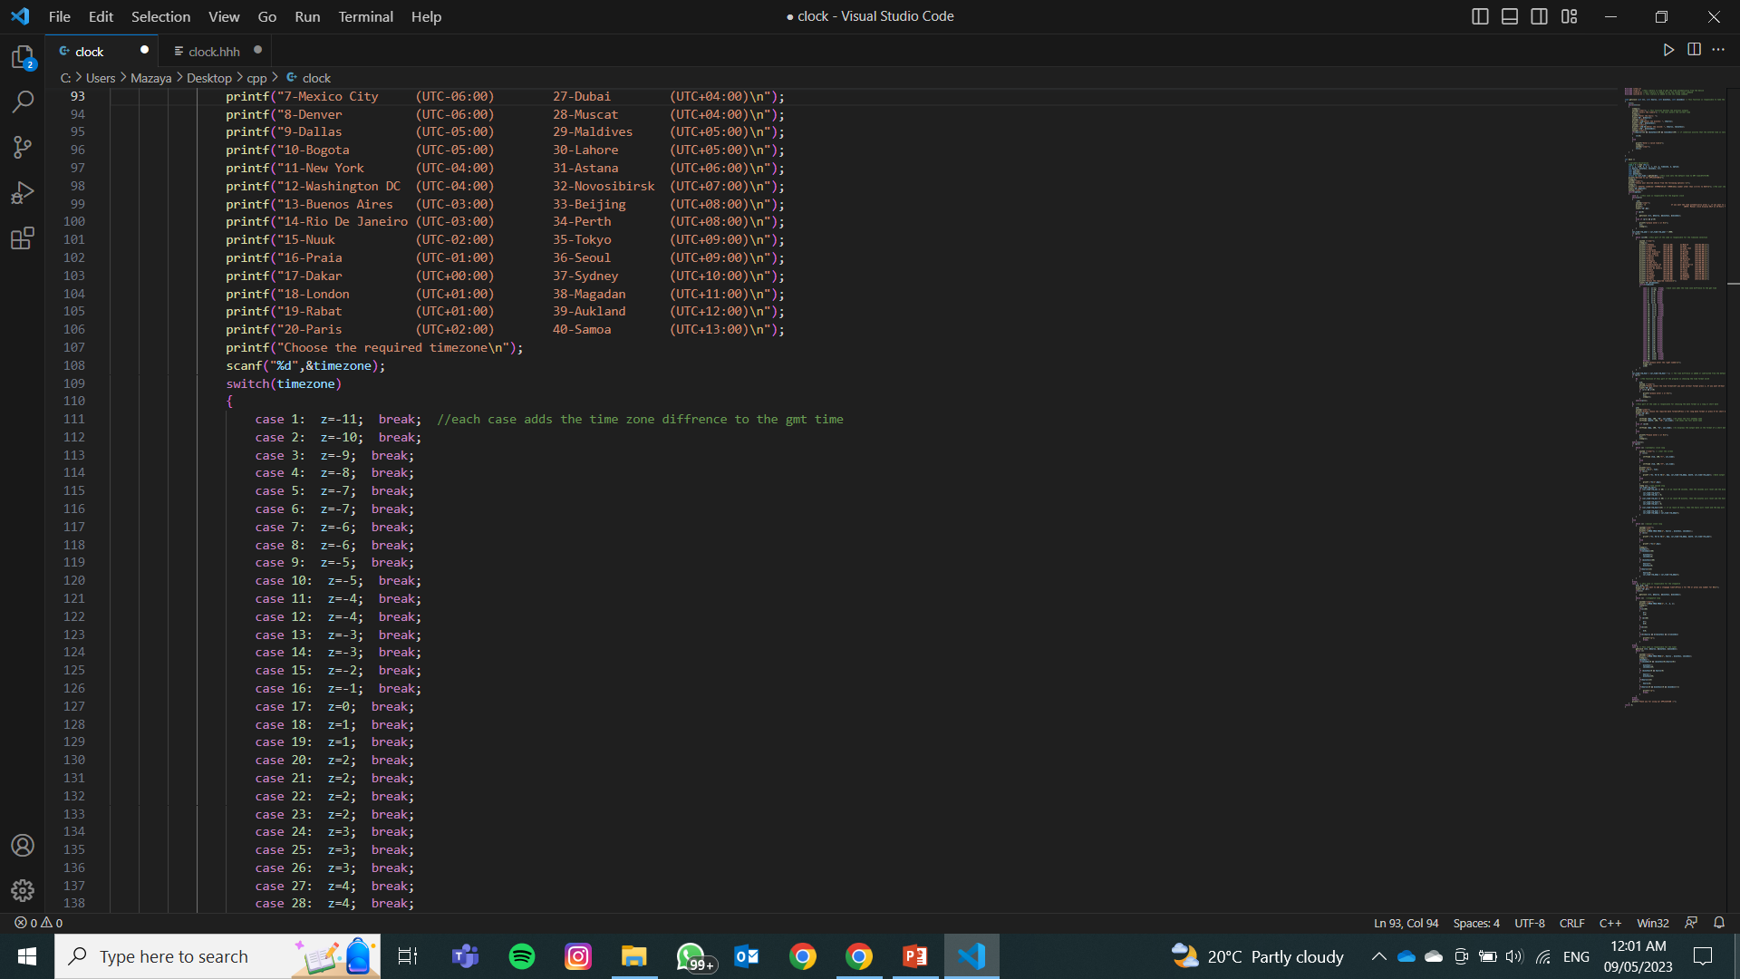
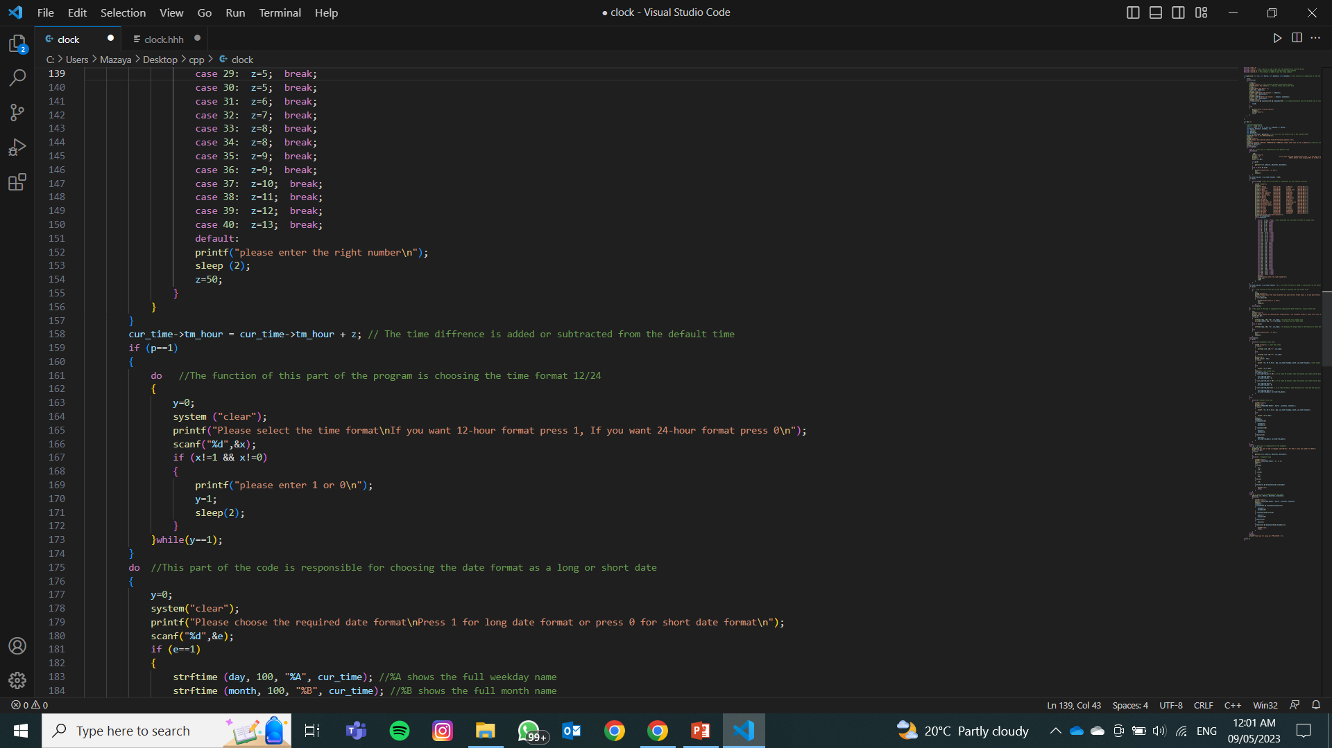

Slide 15
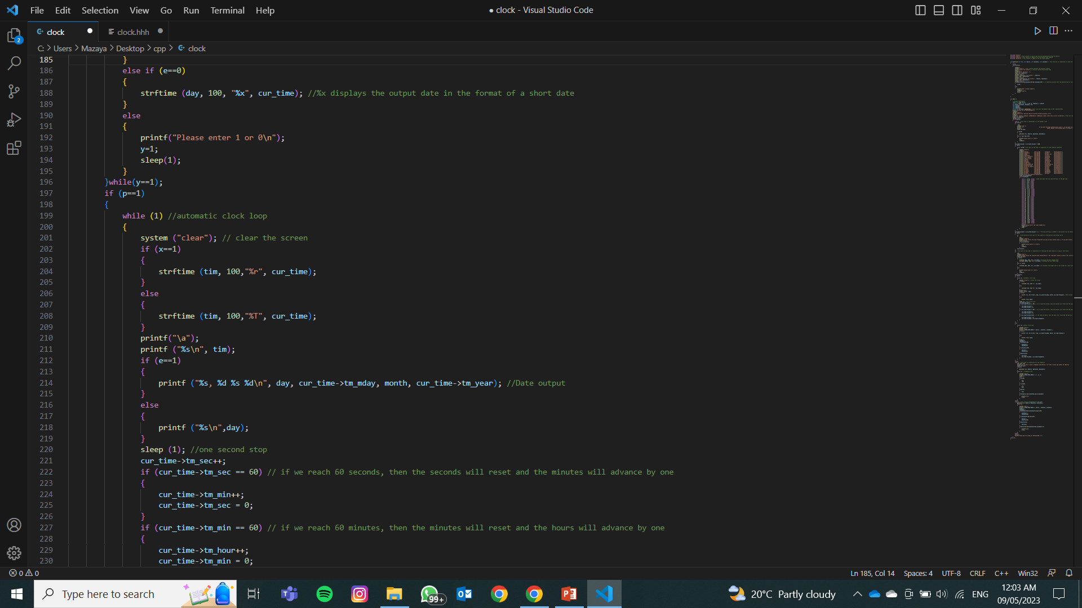
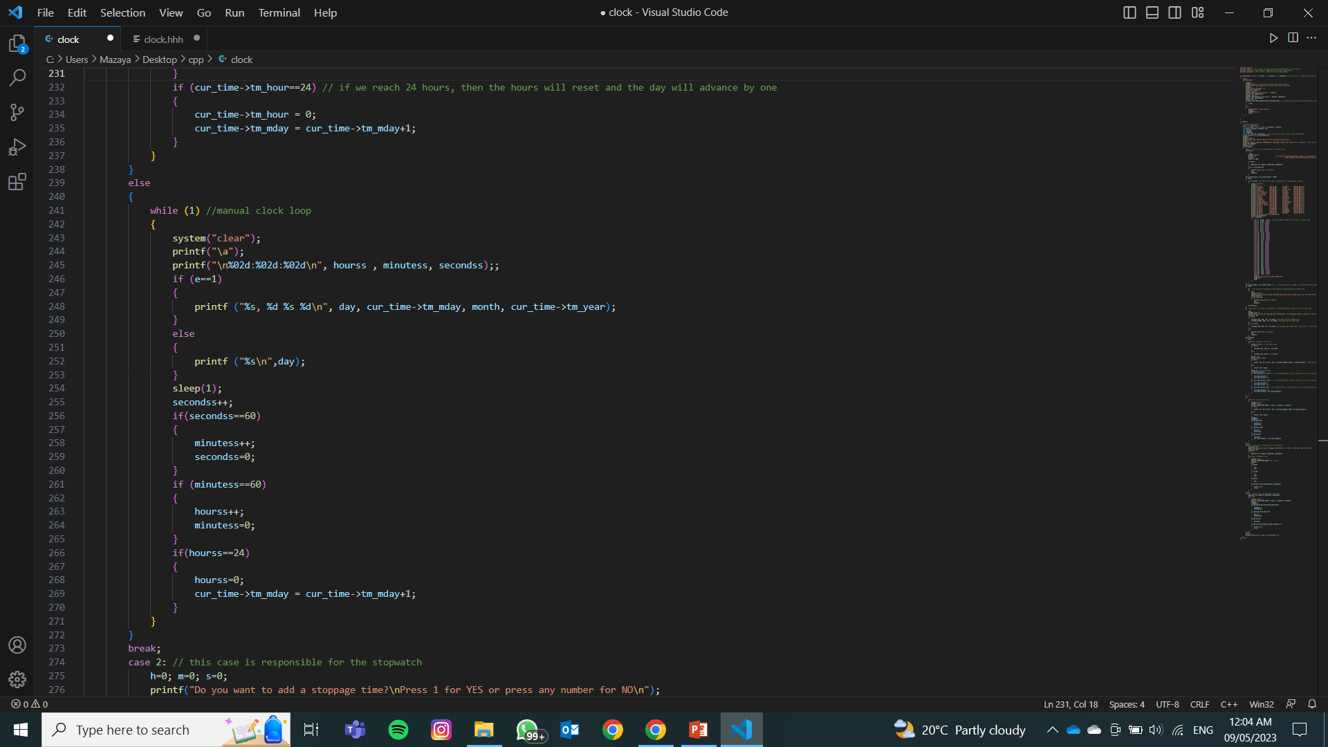

Slide 16
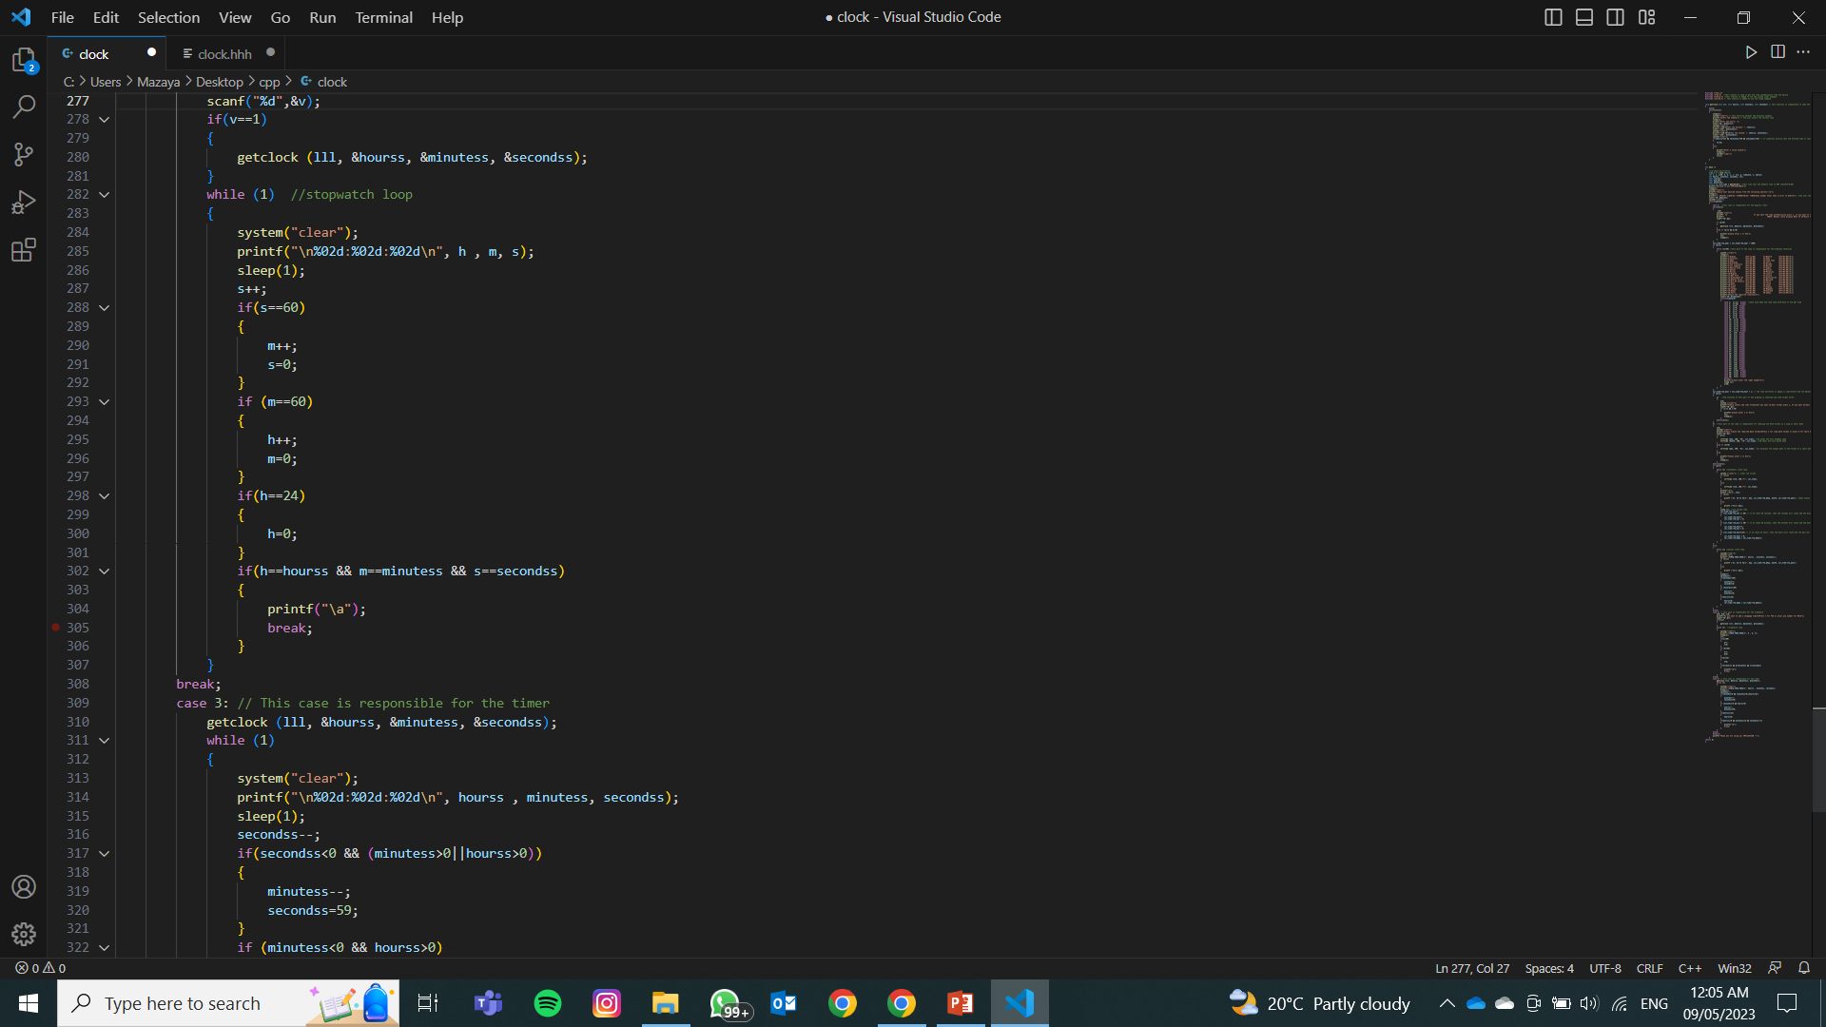
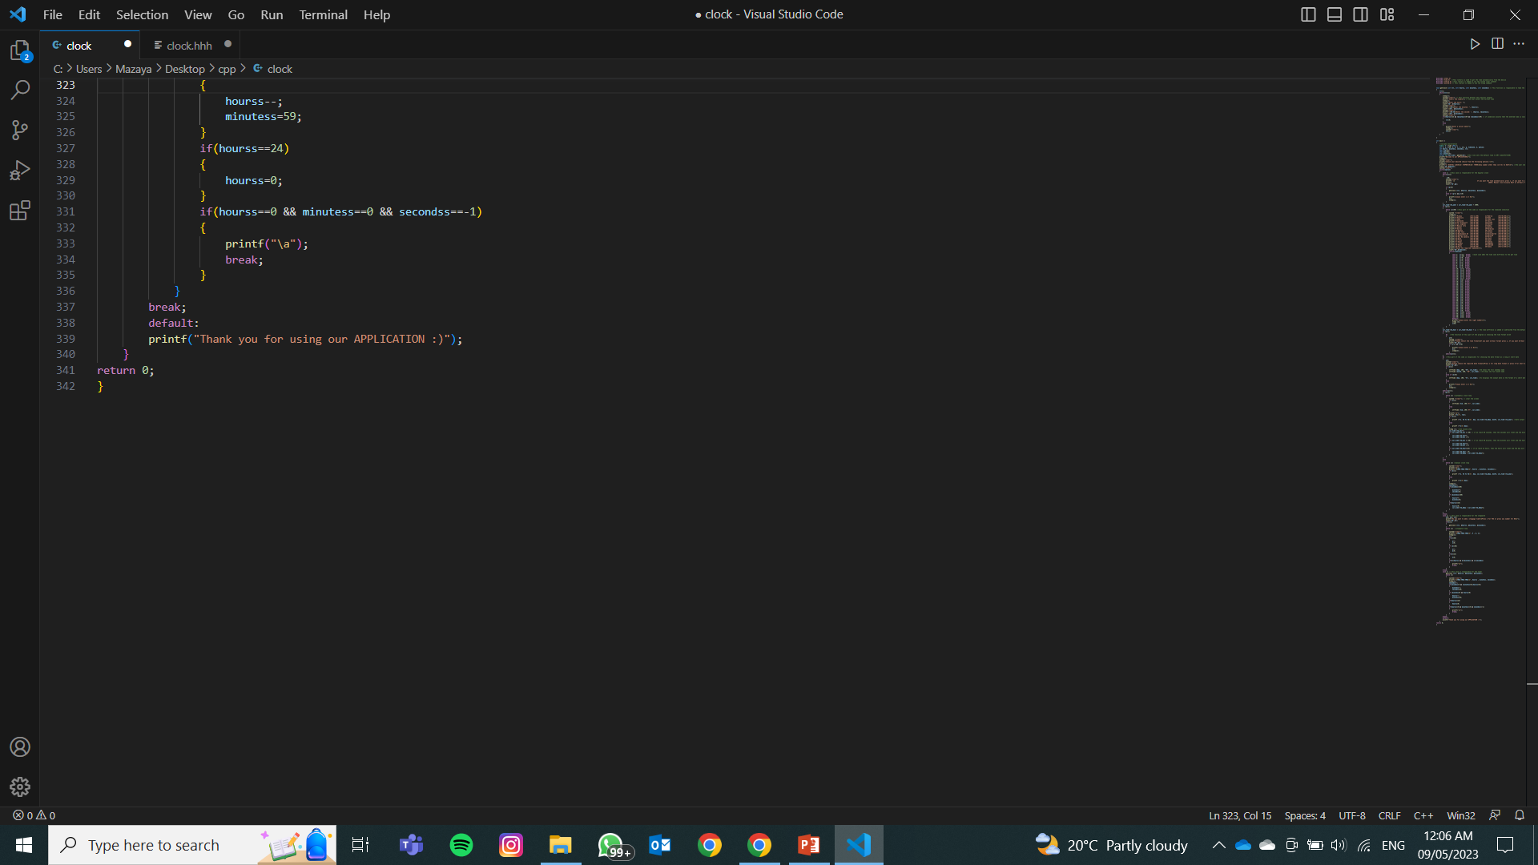

Slide 17
EXAMPLES FOR TIME ZONE
NEW YORK
UTC (-04:00)
CAPE TOWN
UTC (+02:00)

Slide 18
03
TESTING AND DEBUGGING

Slide 19
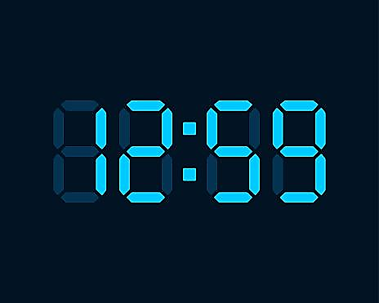
RUNNING THE CODE

Slide 20
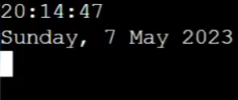
DIGITAL CLOCK OUTPUT

Slide 21

DIGITAL CLOCK WITH DIFFERENT FORMAT

Slide 22
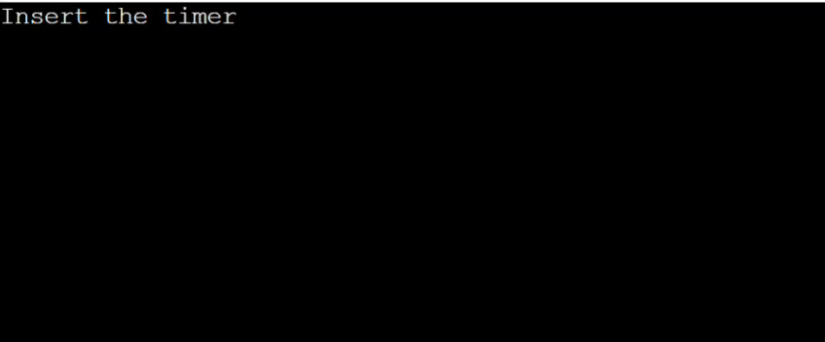
TIMER OUPUT

Slide 23
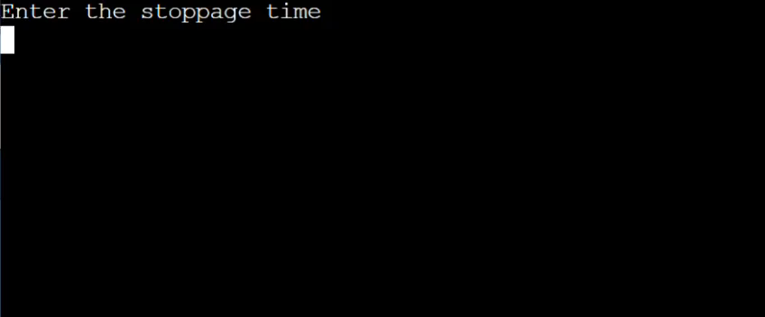
STOPWATCH OUTPUT

Slide 24
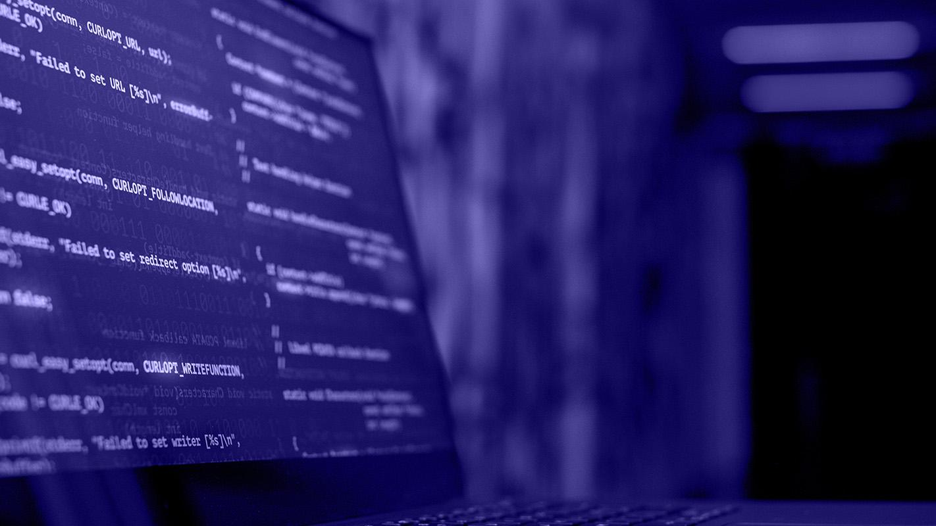
THANK YOU

