Slide 1
NLP Project
Medical Agentic Chatbot

Slide 2


Agenda
Introduction
System Architecture
System Components
Results
Conclusion

Slide 3
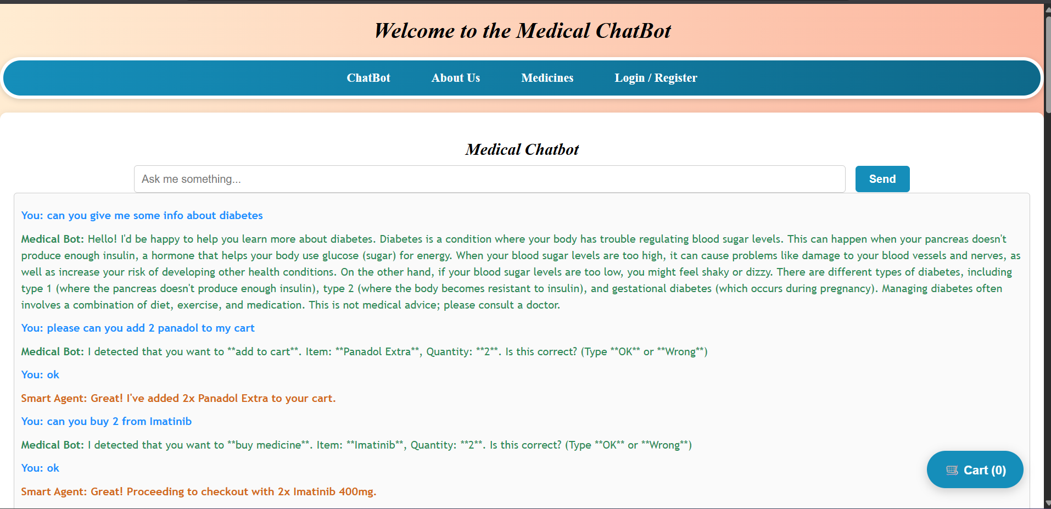
Introduction
We developed A medical chatbot Web Application that can ask him about medical information and make it order for you medicines or add to cart your orders

Slide 4
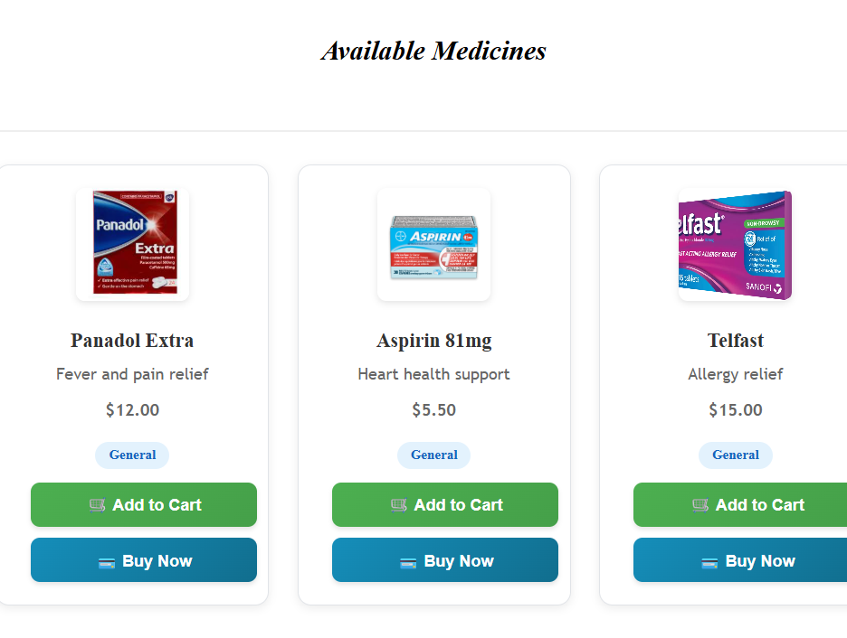
Introduction
We introduce some medicines for different categories of diseases .
The user can order them .
The user can login and signup
The data is saved locally storage

Slide 5
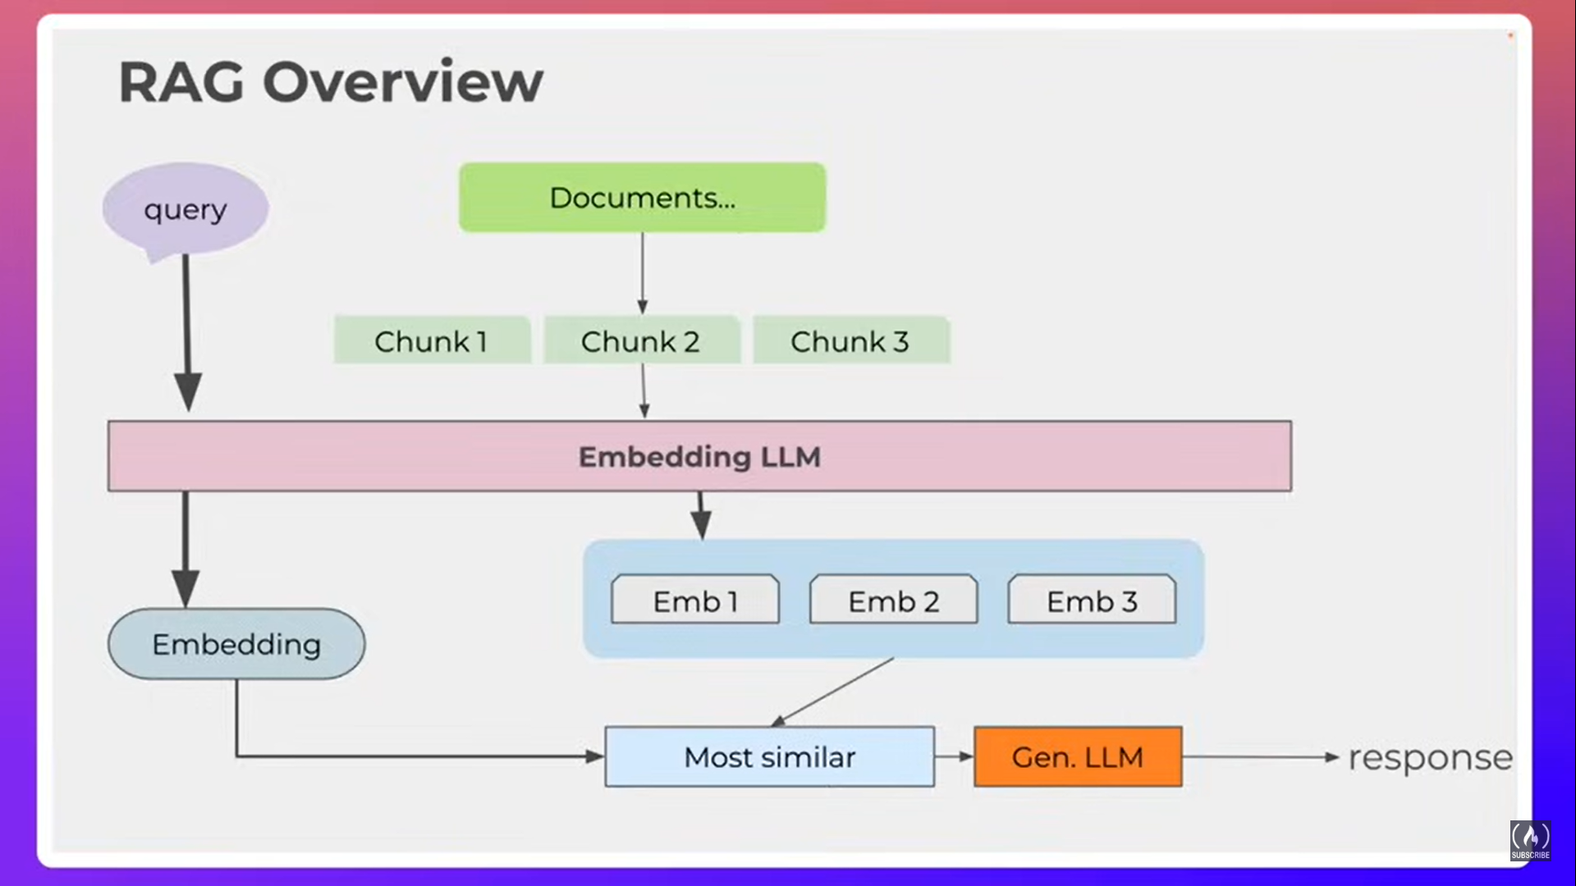
System Architecture
1- we use an Api that fetch medical information rather than documents
2- we use OLLama 3.2 as LLM (Open source)
3- we user nomic-embed-text for Embedding

Slide 6
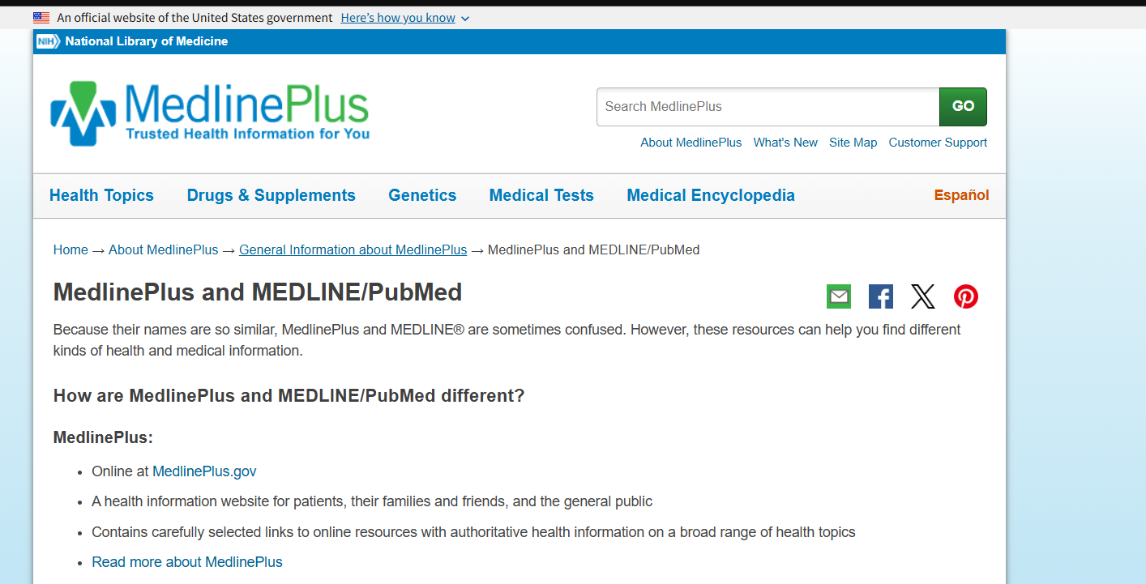
Knowledge Base
We use two sources :-
MedLinePlus
PubMed

Slide 7
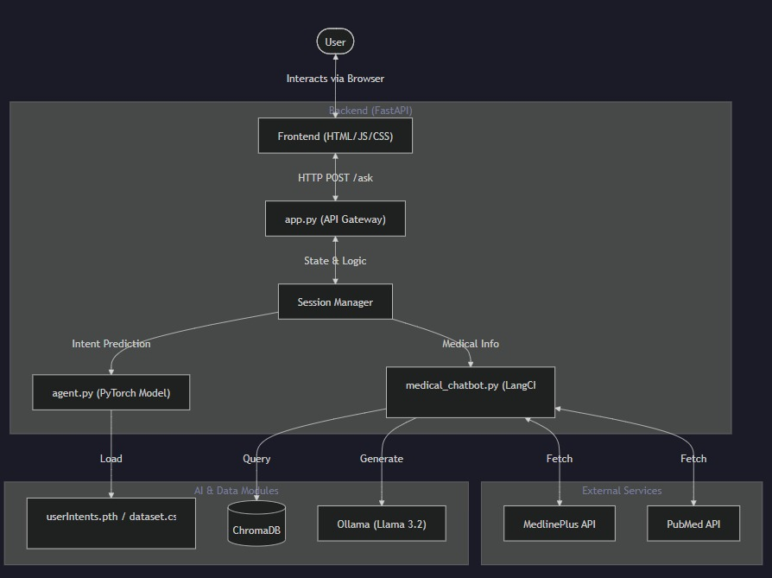
System Design

Slide 8
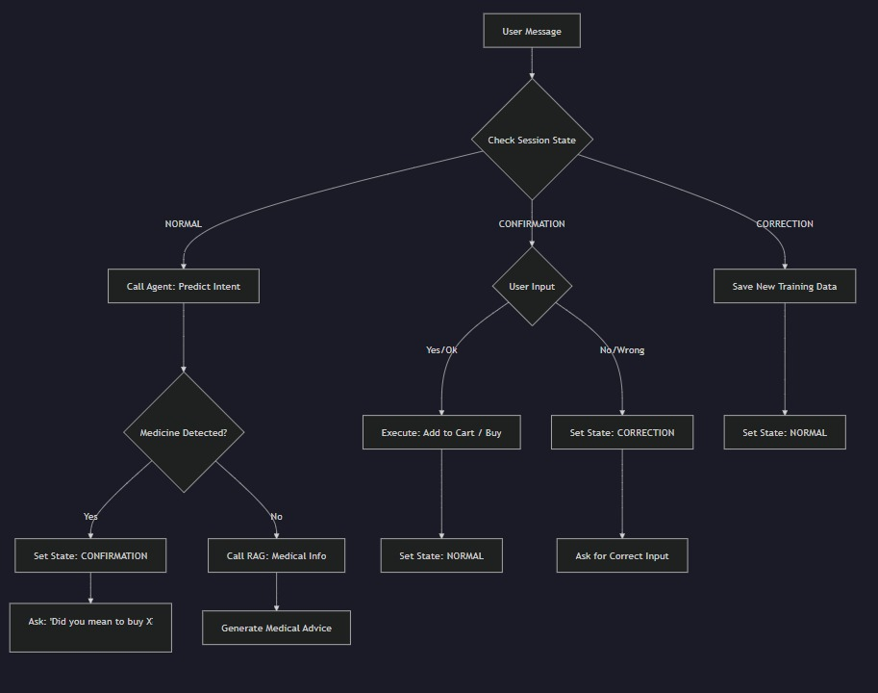
EndPoints

Slide 9
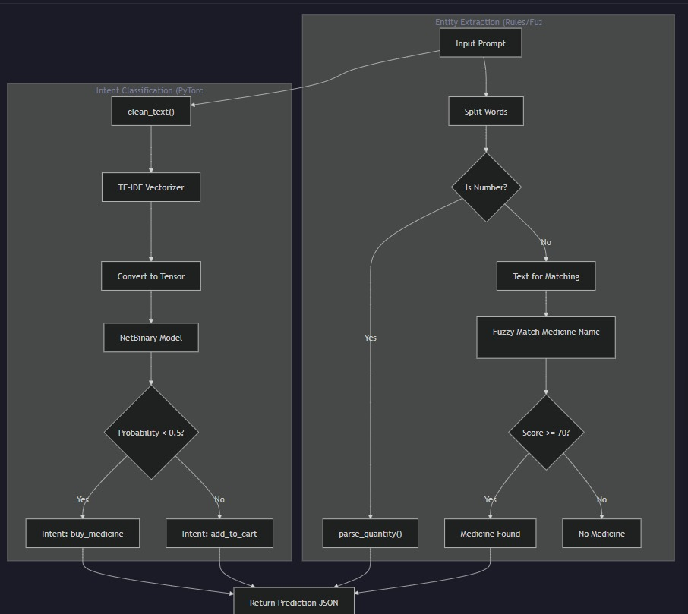
System Architecture

Slide 10
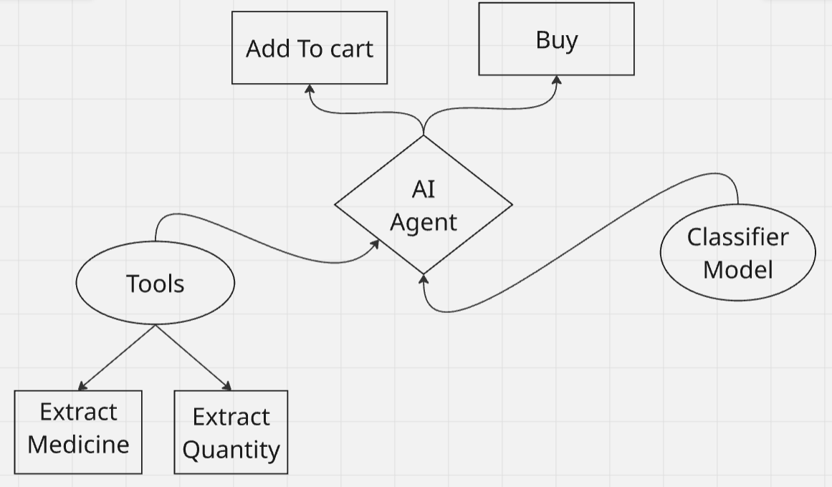
System Architecture
Our AI Agent can take actions
But it needs The Classifier Model to detect the user prompt if (BUY or Add to cart)
Then it had tools to extract Medicine name and Quantity
Then it can take actions based on this inputs

Slide 11
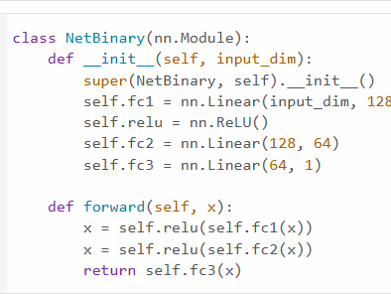
System Components
The Classifier Model :-
we generated our dataset that consists of two columns one column for user prompts and another one for labels (Add to cart or Buy medicine)

Slide 12
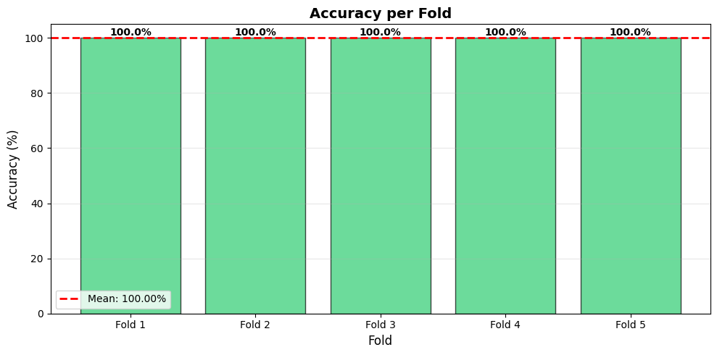
System components
We tried to avoid The overfitting problems
Buy Applying Cross Validation technique (KFold)

Slide 13
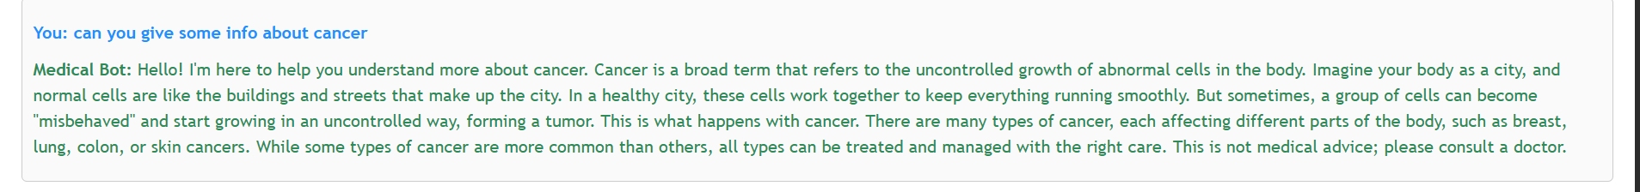
Results
The RAG could give us highly friendly and accurated results from his Knowledge base

Slide 14
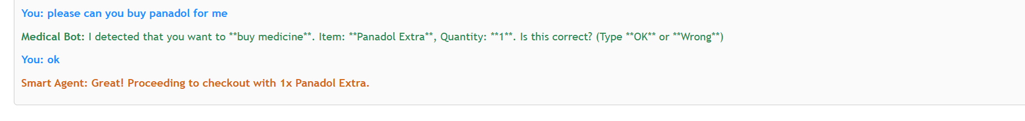
Results
our System can distinguish between answering task or tacking Actions
So as we see our Agent can take an action to when the user order him to buy medicine .
After that he check if his predict is ok or wrong
If it is wrong we will ask from user to
enter the prompt again and the label
To add this again to the dataset.csv

Slide 15
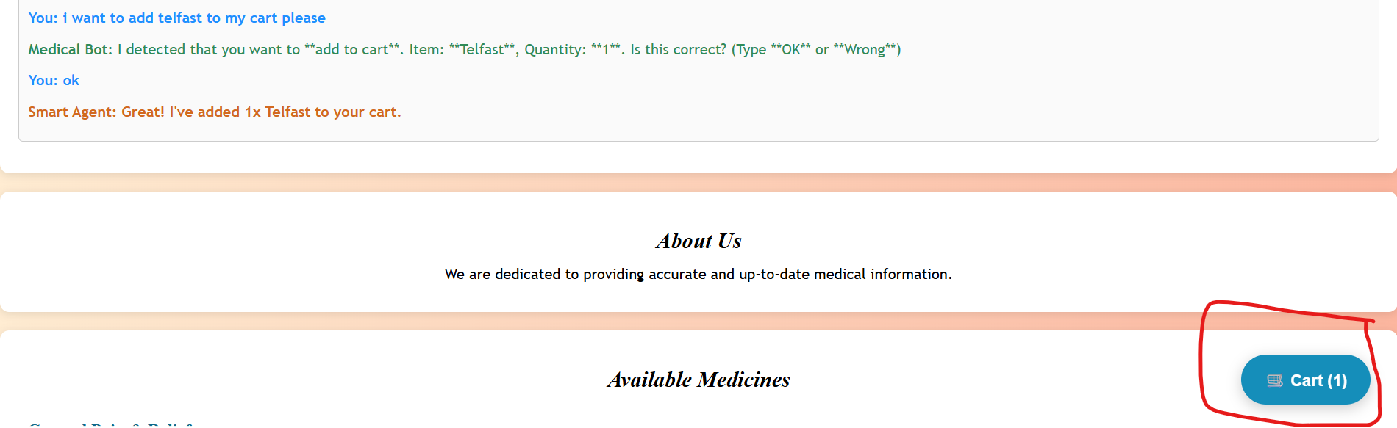
Results
The Agent can update the cart of the user when he takes the confirmation from The user

Slide 16
Challenges

Slide 17
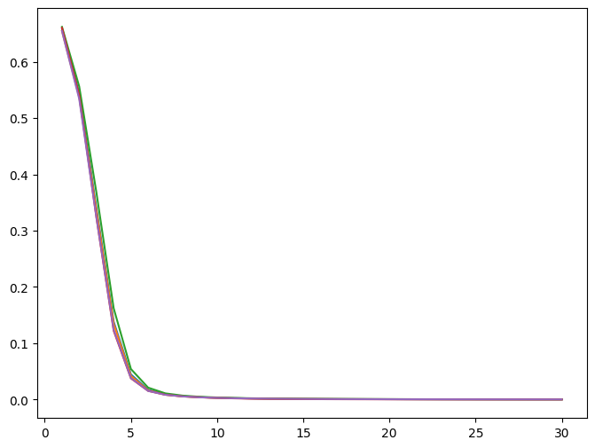
1- Overfitting
we Applied Kfold Techique for cross Validation it takes some time but we got great results

Slide 18
2- The Agent get Confusing
The Agent suffered from lack of information he need some information like
1- medicine name
2- quantity
3- correct prediction from The Classifier Model

Slide 19
2- The Agent get Confusing
We can Handle This by Providing The Model some Tools (Functions) To extract and clean The Prompt of the user
so now The Agent has its all information and he already to take actions

Slide 20
3- The Dataset
The Problem How to generate accurate and suitable data for our case

Slide 21
3- The Dataset
1- we decided first The medicines names that our website can introduce them
2- we generate our prompts based on names of our medicines
3- we focus on The Quantity That user need it

Slide 22
Conclusion
We aimed to introduce An AI-powered chatbot that provides reliable medical information in real-time. Built with FastAPI, LangChain, Chroma DB, and Ollama, it lets users ask health-related questions through a clean web interface, get intelligent answers, and experience smooth interactions with a modern chat design.

Slide 23
Thanks
By :-
Ahmed Mourad Abdelhamid
Marwan Tarek Embaby
adham moatez mohamed
Youssef Mohamed Helmy Ahmed
Ahmed Ehab Abdelhalem

