Slide 1
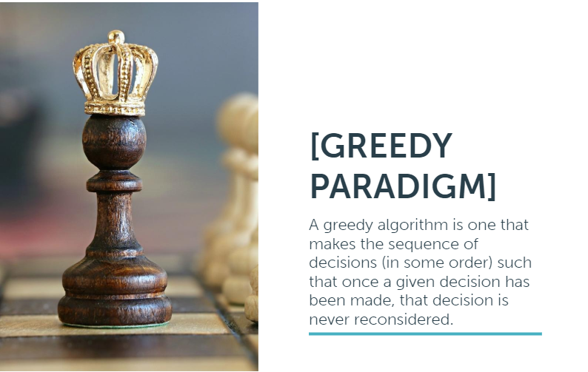

Slide 2
The Following questions are examples that can be solved by brute force and greedy solutions , ideas for solving using brute force
are discussed first then the greedy solutions , so that the difference between ways of thinking becomes more obvious .
Note that the following questions are simplified versions (in terms of the problems statements) from another problems, so if
there is something unclear in the problem statement you can check the last slide for the original resources.

Slide 3
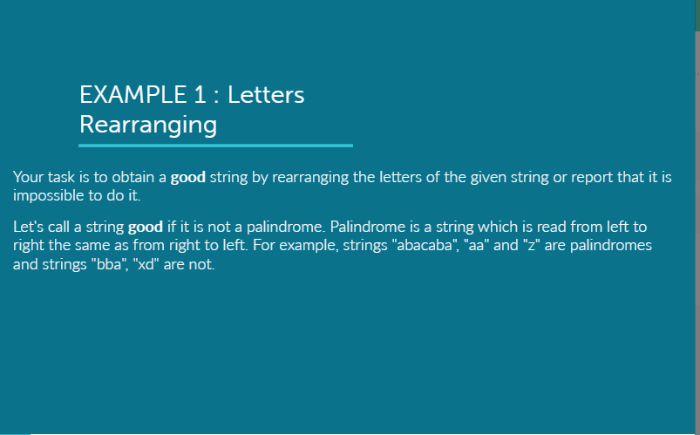

Slide 4
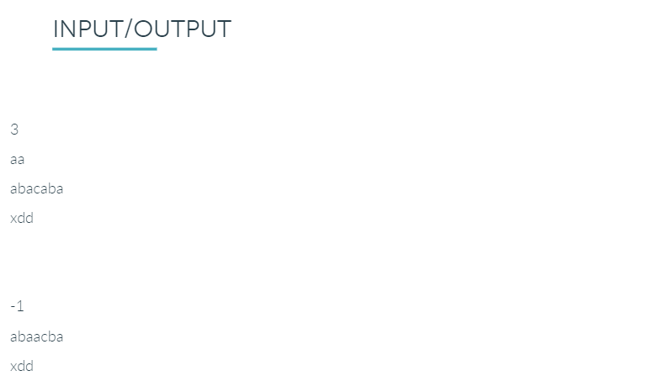

Slide 5
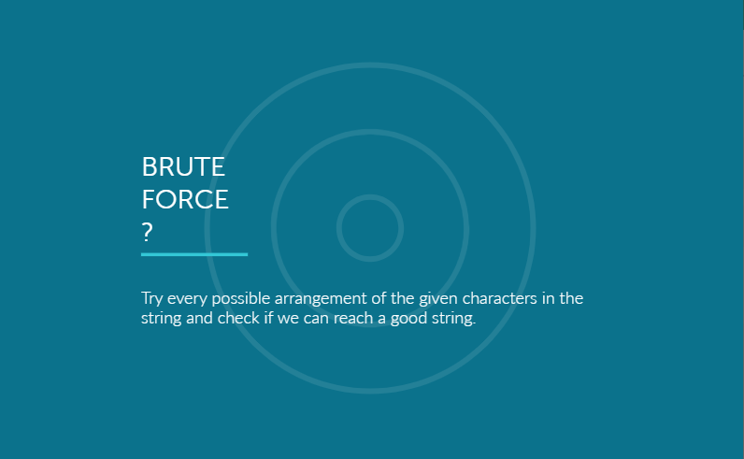

Slide 6
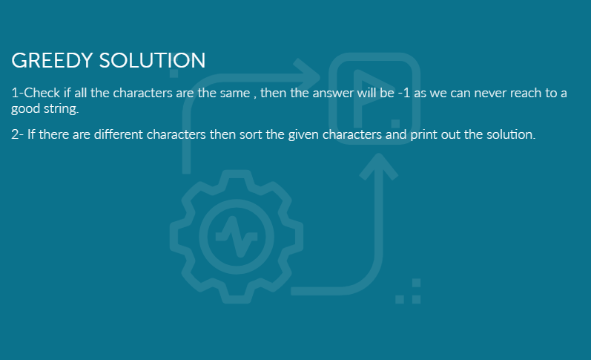

Slide 7
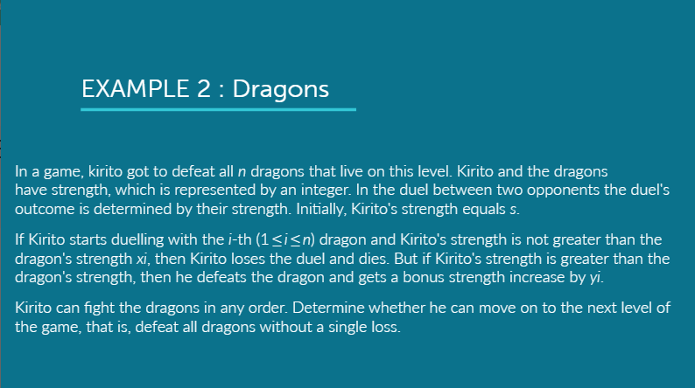

Slide 8
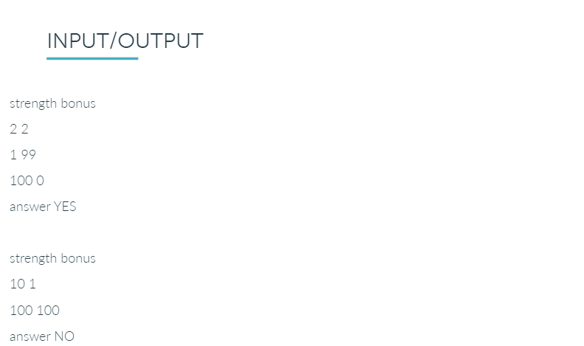
Kirito Strength Number of dragons
Dragon Strength Bonus
Dragon Strength Bonus
Kirito Strength Number of dragons
Dragon Strength Bonus

Slide 9


Slide 10
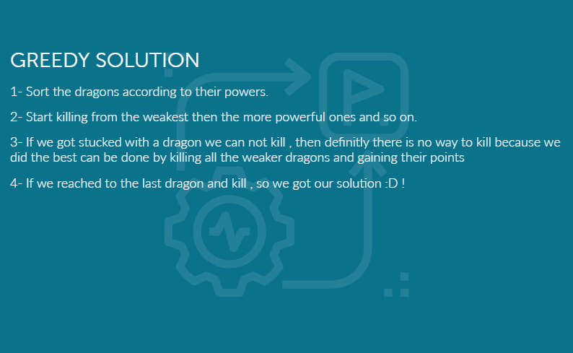

Slide 11
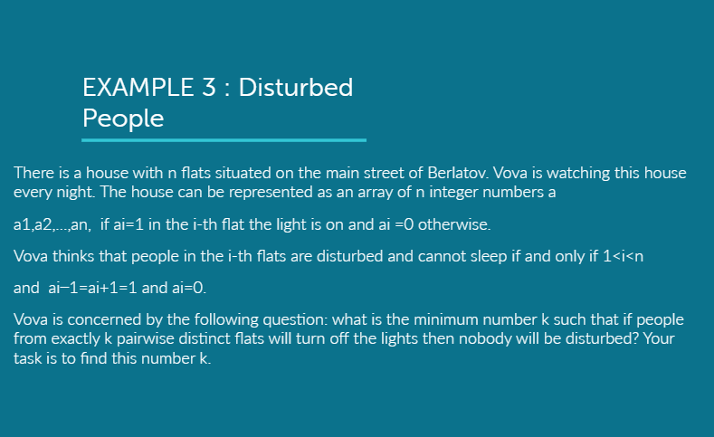

Slide 12
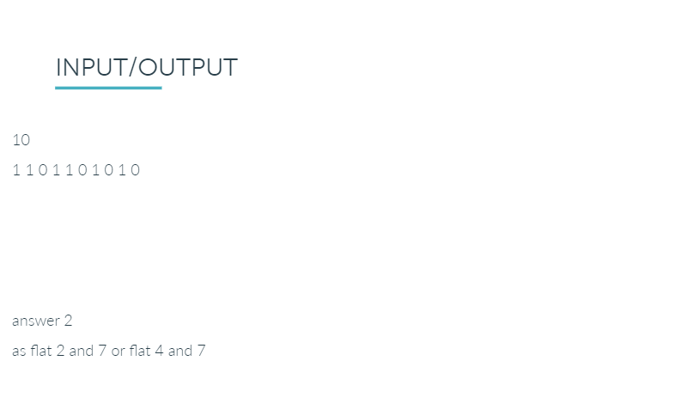

Slide 13
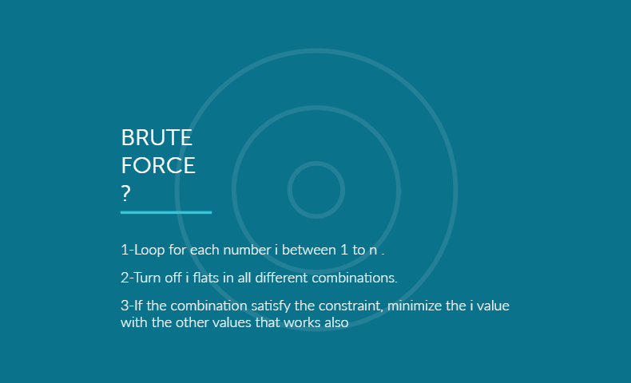

Slide 14
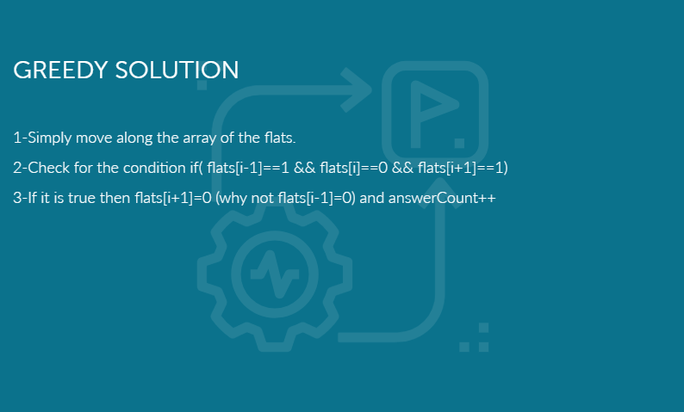

Slide 15
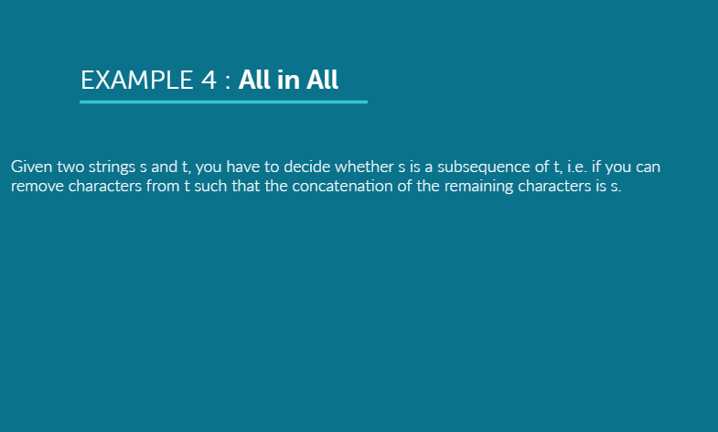

Slide 16
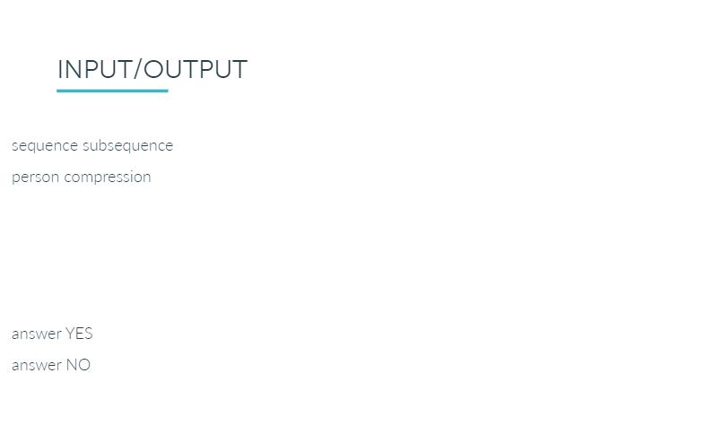

Slide 17
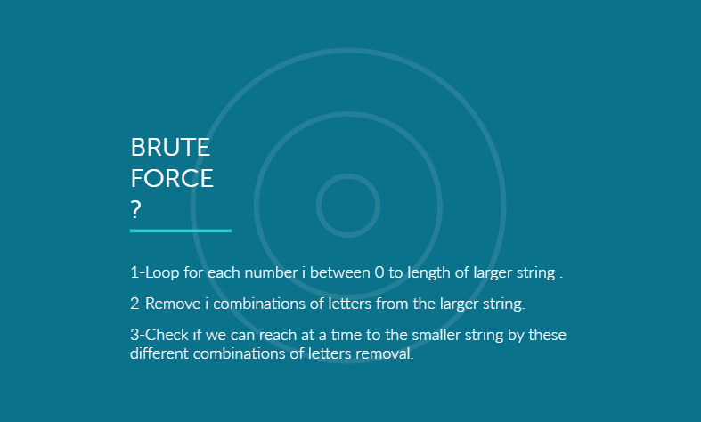

Slide 18
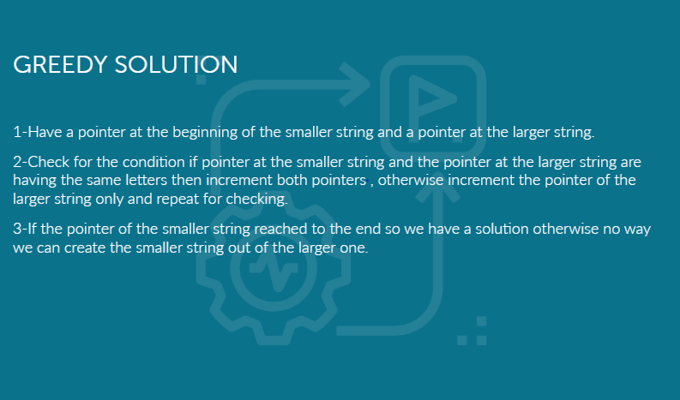

Slide 19
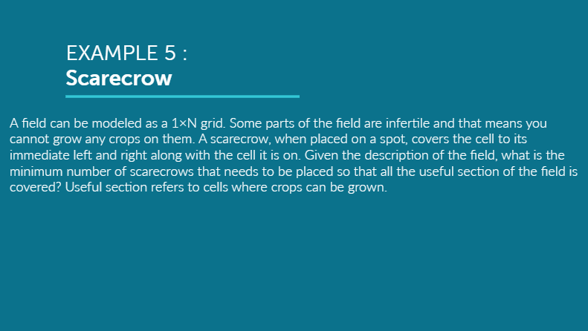

Slide 20
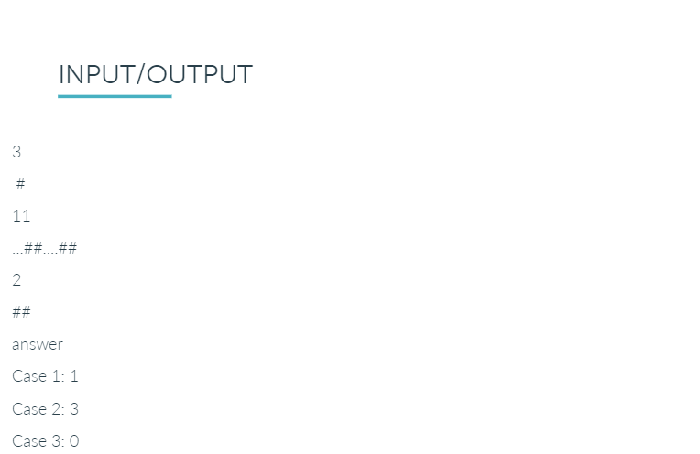

Slide 21
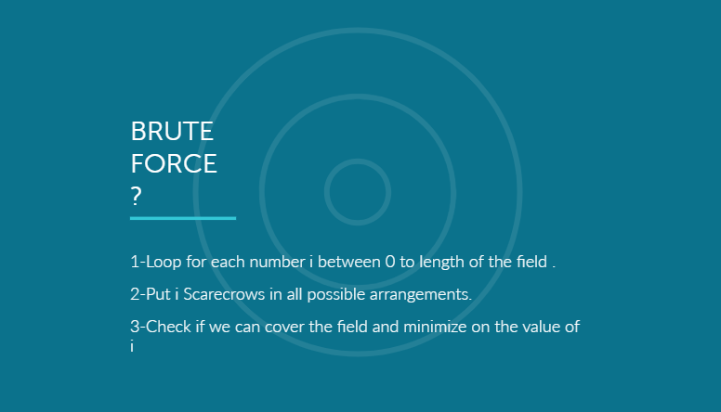

Slide 22
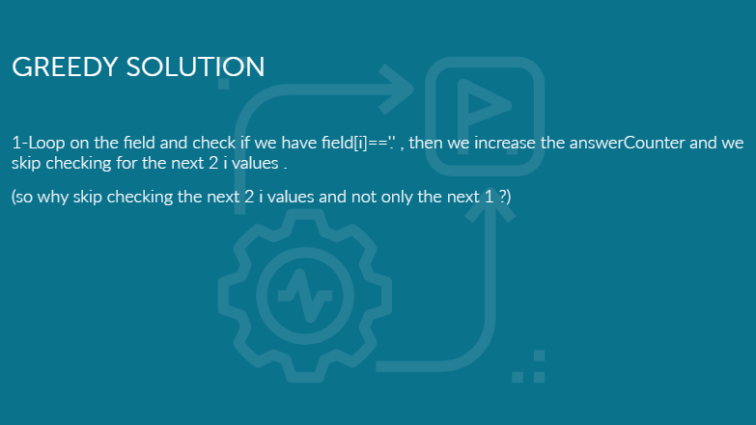

Slide 24
Resources and Extra problems
https://codeforces.com/contest/230/problem/A
https://codeforces.com/contest/1093/problem/B
https://codeforces.com/contest/1077/problem/B
https://uva.onlinejudge.org/index.php?option=com_onlinejudge&Itemid=8&page=show_problem&problem=1281
https://uva.onlinejudge.org/index.php?option=com_onlinejudge&Itemid=8&page=show_problem&problem=3836
https://codeforces.com/problemset/problem/413/C
https://codeforces.com/contest/1101/problem/B
https://codeforces.com/contest/1173/problem/B

