Slide 1

Cyber Threat Intelligence Data Platform
Batch & Streaming Data Pipeline for Vulnerability Management
Ahmed Waheed, Aya Gamel, Mahmmoud Abdelbary, Mostafa Ahmed, Youssef Mostafa
13 - 6 - 2026 · ITI

Slide 2
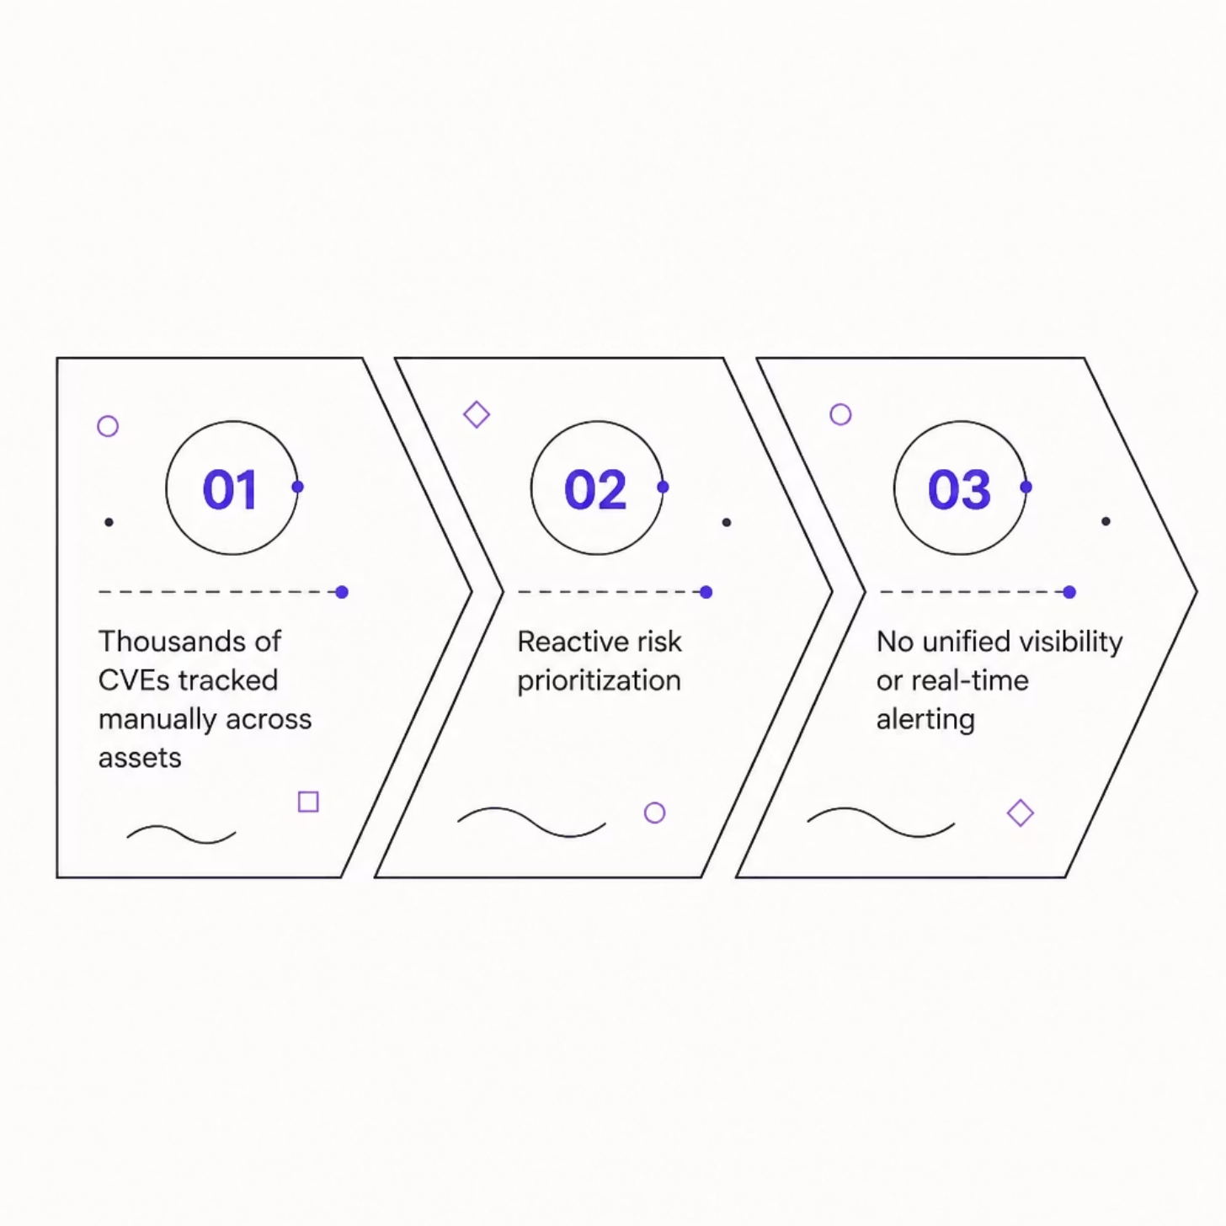
PROBLEM STATEMENT
Manual CVE Tracking Is a Critical Gap
Security teams manually track thousands of CVEs across distributed assets — no centralized source of truth
Risk prioritization is reactive, not predictive — patches arrive after exploits surface
No unified data lake, real-time alerting, or executive reporting layer

Slide 3
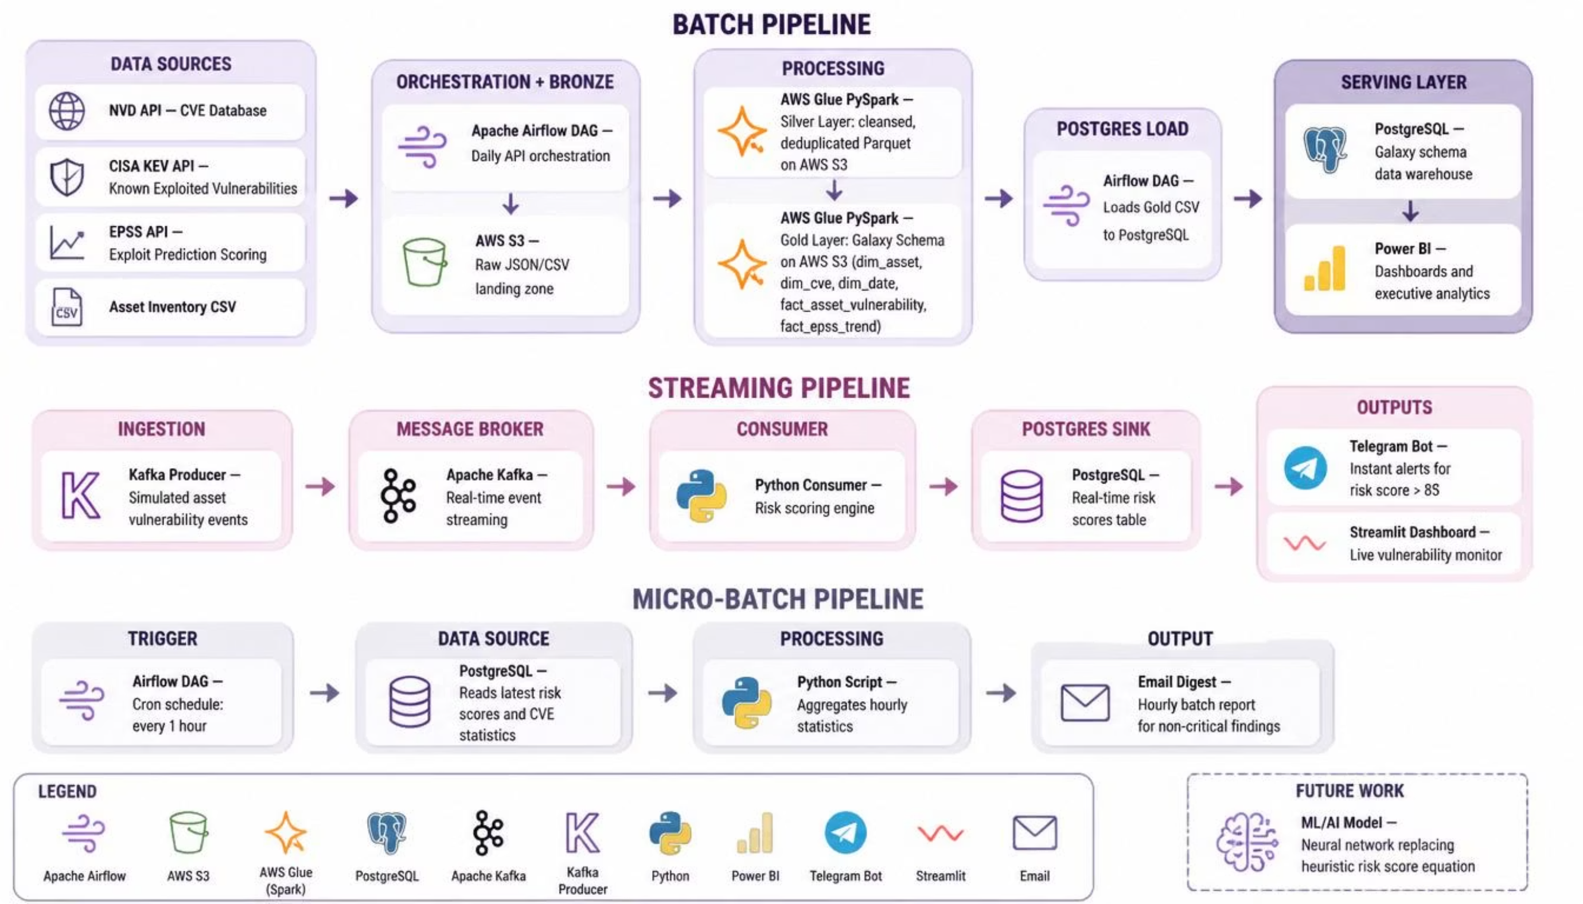
ARCHITECTURE OVERVIEW
Hybrid Pipeline: Batch + Real-Time Streaming

Slide 4








TECHNOLOGY STACK
Tools Chosen for Scale & Reliability
AWS S3
AWS Glue
Immutable raw data lake — Bronze layer storage
Serverless PySpark ETL — Silver & Gold transforms
Apache Airflow
PostgreSQL
DAG orchestration — batch scheduling & dependency management
Gold layer serving DB — BI queries & alert engine
Apache Kafka
Python
Real-time asset event streaming — sub-second ingestion
Consumer logic, risk scoring, Telegram API integration
Power BI
Telegram API & Email Digests
Executive reporting — Gold layer analytics & slicing
Critical CVE push alerts — risk threshold triggered
Hourly batch for non-critical findings and micro-batch alerts

Slide 5

BATCH PIPELINE · BRONZE LAYER
Raw Ingestion via Airflow DAG
Asset Inventory
NVD API
Full or daily incremental
Full or daily incremental
Bronze Layer Raw Ingestion
EPSS Scores
CISA KEV
Full or daily incremental
Full or daily incremental
Airflow DAG orchestrates parallel pulls from NVD, CISA KEV, EPSS, and internal asset inventory — landing raw JSON in S3. S3-aware branching detects initial vs. incremental loads to avoid reprocessing.

Slide 6
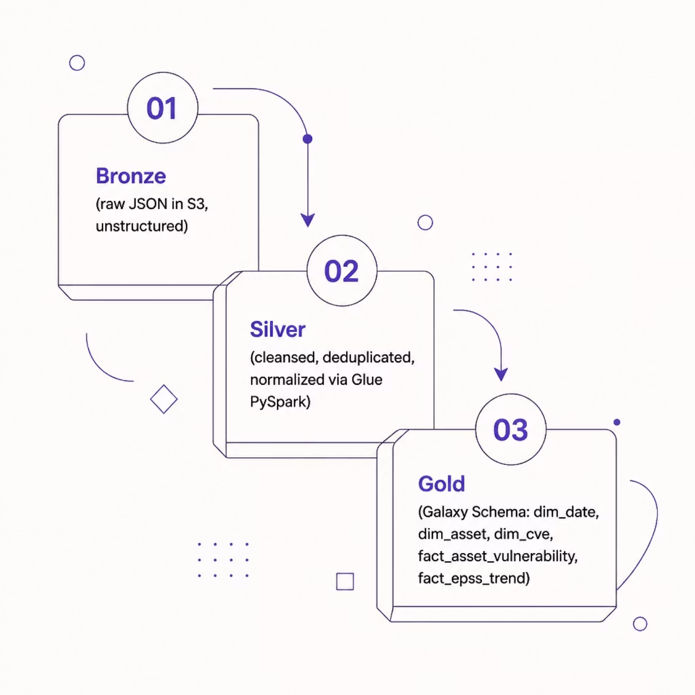
BATCH PIPELINE · SILVER & GOLD
Glue PySpark: Cleanse → Model → Serve
Silver: Deduplication, schema enforcement, CVE normalization, date parsing
Gold: Galaxy Schema — 3 dimensions + 2 fact tables optimized for BI
Partitioned by date for query performance; written to Postgres for serving

Slide 7
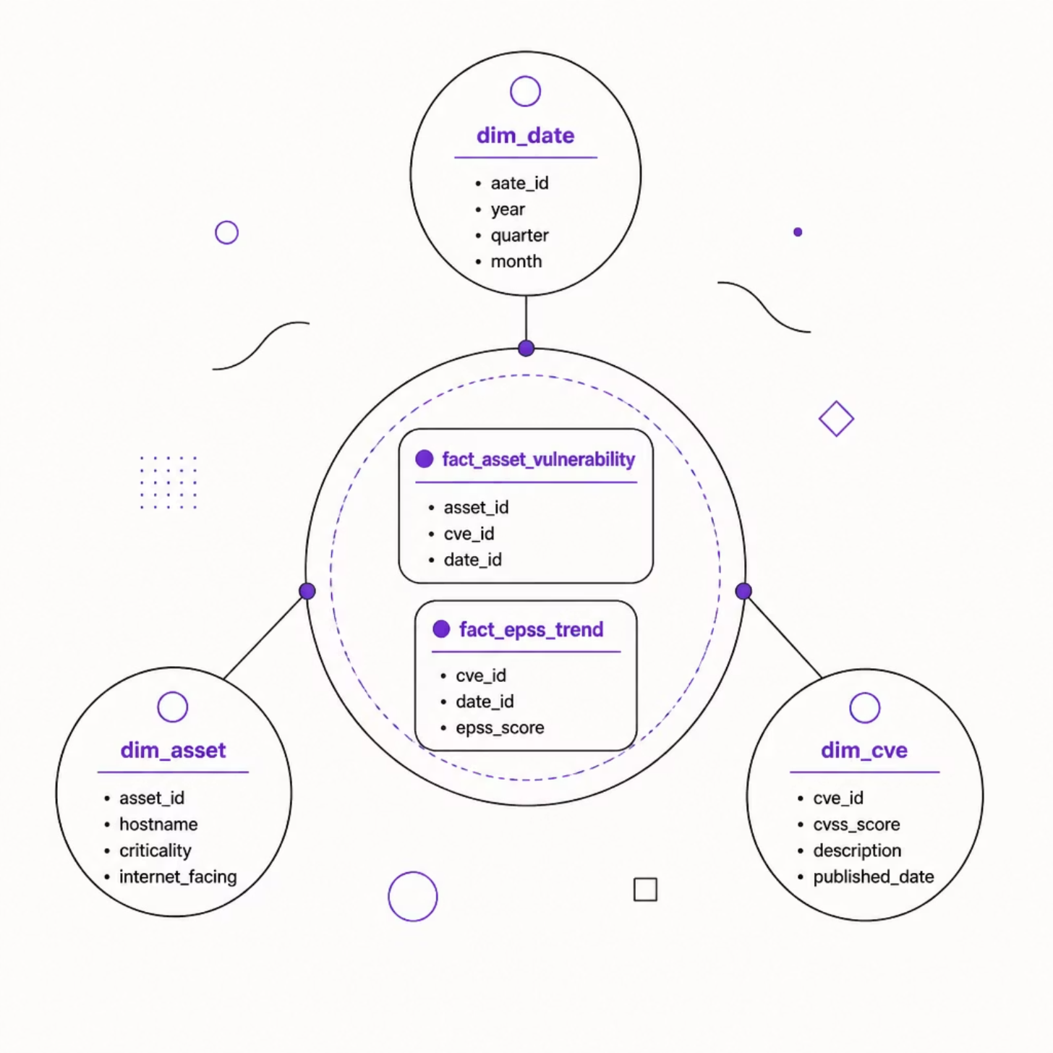
DATA MODEL
Galaxy Schema — Optimized for BI Slicing
dim_date — Time intelligence for trend analysis
dim_asset — Hostname, criticality, internet-facing flag
dim_cve — CVSS, description, published date
fact_asset_vulnerability — Asset-to-CVE bridge with risk score
fact_epss_trend — EPSS probability over time per CVE

Slide 8
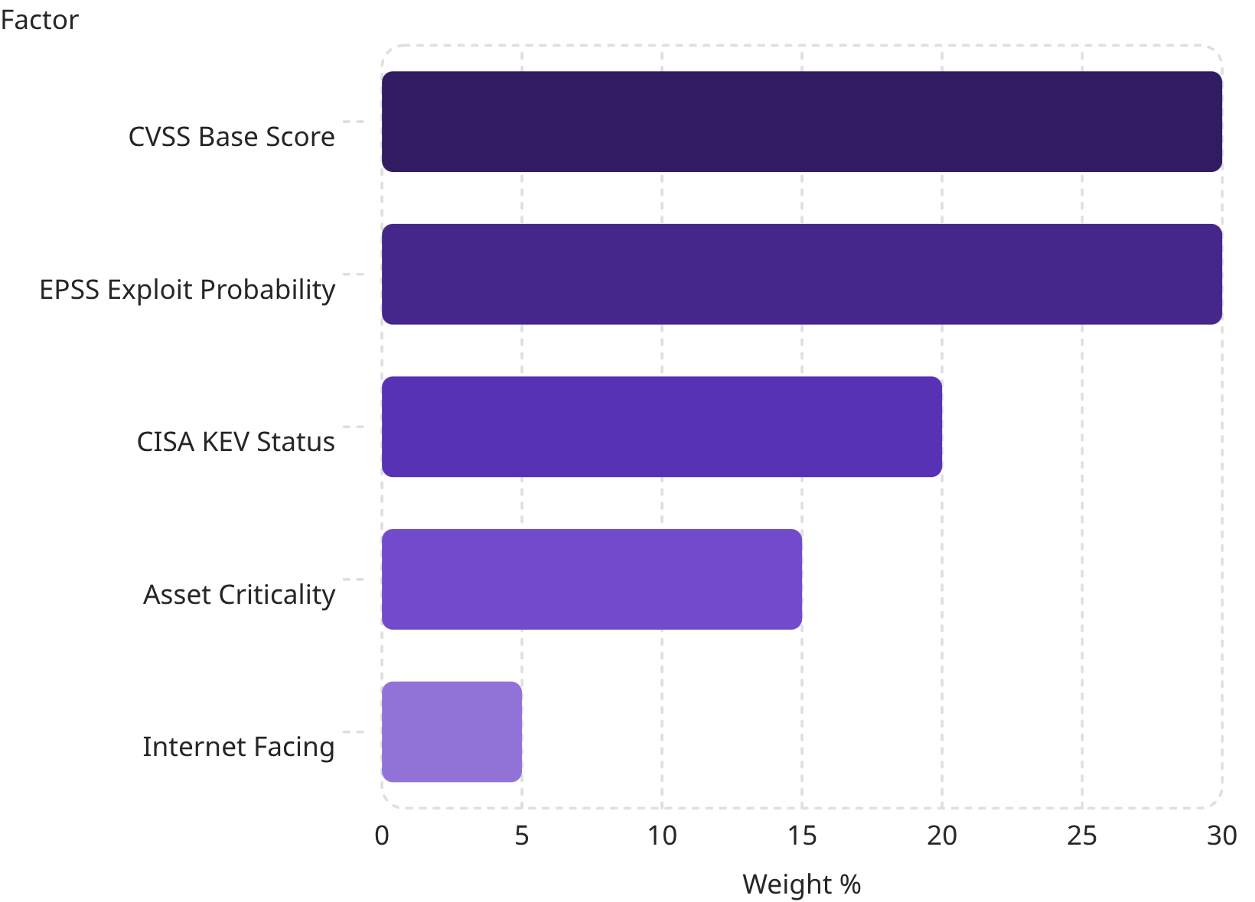
RISK ENGINE
Composite Risk Score: 0–100
Weighted heuristic combines exploit likelihood, severity, and asset exposure
Score ≥ 85 or CISA KEV match → Urgent patch + Telegram alert
Score 65–84 → High; 40–64 → Medium; below 40 → Low

Slide 9

STREAMING PIPELINE
Kafka → Python Consumer → Alert
Producer
Kafka Topic
Python Consumer
Alert Branch
Simulated asset events flow through Kafka; the Python consumer normalizes payloads, computes risk scores in real time, and persists to Postgres. Critical findings trigger immediate Telegram alerts; non-critical findings are batched into hourly email digests.

Slide 10
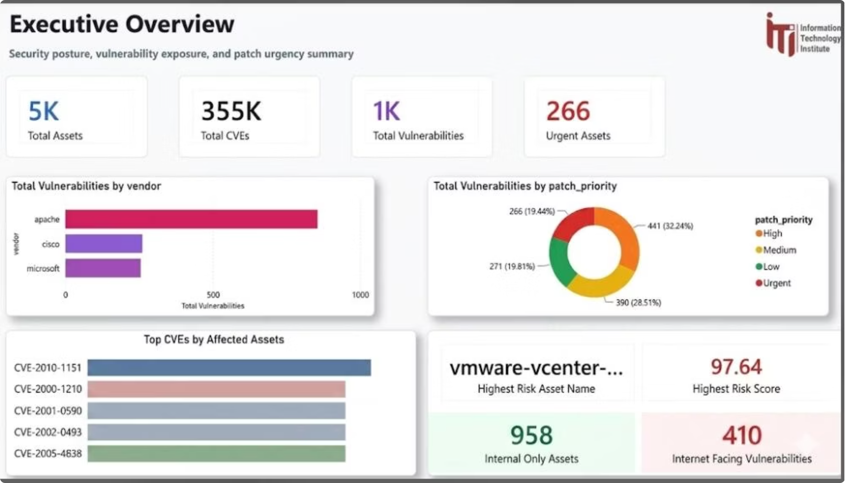
VISUALIZATION & ALERTING
Executive Dashboards + Push Notifications

Slide 11
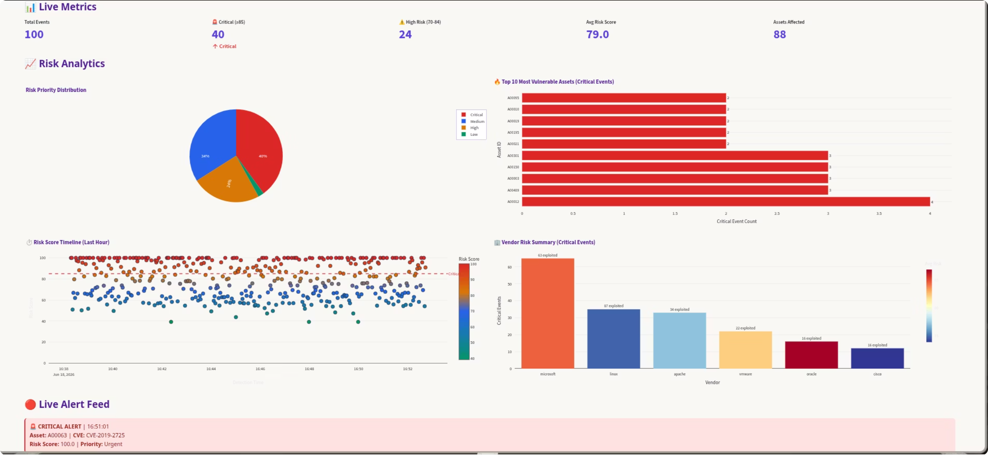
REAL-TIME MONITORING
SOC Dashboard: Live Threat Detection

Slide 12
Questions?
Let’s discuss how to strengthen your vulnerability management and threat intelligence capabilities.

