Slide 1


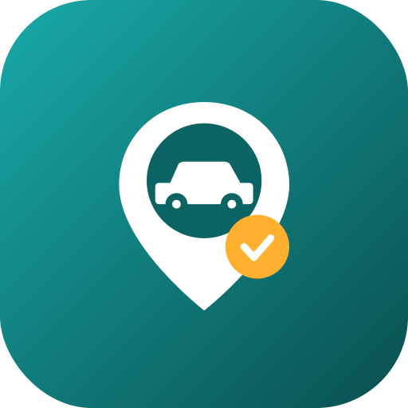
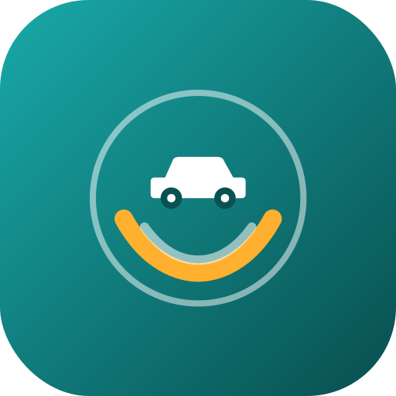

Rebrand & Product Strategy
A new name and identity for the “CarCare” graduation project — with the market gap, a sharpened MVP, and a backend recommendation.
Prepared for Dpharma-IT · June 2026 · Launch market: Egypt · EN / العربية
Notes:
Open: CarCare is a strong product with a generic name. This deck proposes a rebrand to Garagy, locates the Egypt market gap, sharpens the MVP, and recommends a backend. Recommendation in one line: Garagy + map-first verified discovery + Supabase backbone with a Laravel·Filament admin.

Slide 2



WHY REBRAND
A great product with a forgettable name
CarCare → Garagy
Descriptive
Crowded
Undersells
Hard to trademark or rank in app stores — “CarCare” is a category, not a brand.
Already used by detailing shops and apps worldwide; you’d fight for every search.
Says nothing about the real product: trusted, map-first discovery + booking + memory.
A good name here works in Egyptian Arabic and English, is short and ownable, and hints at the product’s soul — your car, looked after, nearby.

Slide 3

01 · THE MARKET
A big, offline market — nobody has organised it by trust
~6M
$1.5–1.6B
~35,000
$600+
registered passenger cars (≈10.4M vehicles)
aftermarket today → ~$2.3–2.5B by 2030
workshops & service providers, mostly offline
average spend per car, every year
The opportunity isn’t “another car app.”
It’s becoming the trusted layer between millions of owners and tens of thousands of workshops — the connective tissue that doesn’t exist yet.
Notes:
Egypt: ~6M cars, aftermarket ~$1.5–1.6B growing ~6–7% to ~$2.3–2.5B by 2030, ~35k workshops mostly offline. Sources: TechSci/GMI research, fleet stats — in the report appendix.

Slide 4
01 · THE MARKET
Everyone owns one lane — the trusted middle is empty
Mtor
Drop
Mismar
AUTO-PARTS (B2B)
ON-DEMAND WASH & REPAIR
SERVICE AGGREGATOR
Parts marketplace + mechanic app. No consumer discovery or booking.
Home wash + repair booking. Service-led, not trust-ranked discovery.
Owner ↔ provider matching. No map-first, vehicle-aware ranking.
MAYDAY · Beliaa
Petromin · Nacita
Yellow Pages · Google
ROADSIDE ASSISTANCE
SINGLE CHAINS
STATIC LISTINGS
Emergencies only — not planned maintenance or booking.
One provider — not an open, comparable marketplace.
Names & phones. No verification, fair pricing, booking or memory.

Slide 5




01 · THE GAP
The job nobody is doing well
“I don’t know which workshop near me I can trust with my specific car, at a fair price — and I have no record of what’s already been done to it.”
Trust
Fit
Memory
Is this mechanic honest and competent? Badges, real reviews, verification.
Does he know my make/model and have the right parts? Vehicle-aware matching.
No service history today — so resale and planning suffer. Garagy remembers.
Positioning: Garagy is the map-first app that shows verified service centres, fair prices and live booking — and remembers your car’s history.

Slide 6

02 · NEW NAME
Garagy — “your garage,” in your pocket
Runner-ups
Sanad · سَنَد
Trust-first, premium. Means “trusted backing” — the whole thesis in one word.
جراجي
MotorMap
Coined from “garage” + the possessive “-y.” Reads instantly as cars in both languages, means “my garage,” and maps onto the in-app Garage where your cars and history live. Short, warm, ownable.
Maximum clarity. Says the strategy out loud; descriptive, so harder to own.
Tagline & trust line
“Your trusted garage, on the map.”
جراجك الموثوق على الخريطة
Find · Book · Track اعرف · احجز · تابع

Slide 7
02 · NEW NAME
The full shortlist — a mix across three styles
Invented / brandable
Arabic-rooted
English descriptive
MOST OWNABLE
LOCAL & TRUST-LED
INSTANTLY CLEAR
Garagy
Sanad
MotorMap
“my garage” · recommended
“trusted backing”
map = the product
Revvo
Maalem
AutoPin
engine “rev” · energetic
“landmark” + “the master”
auto + map pin
Motary
Sanaya
PitStop
“motor” + “-y” · platform
“the craftsman”
quick expert service
Recommended: Garagy. Clear in both languages, ownable, and it reinforces the in-app “Garage.”

Slide 8
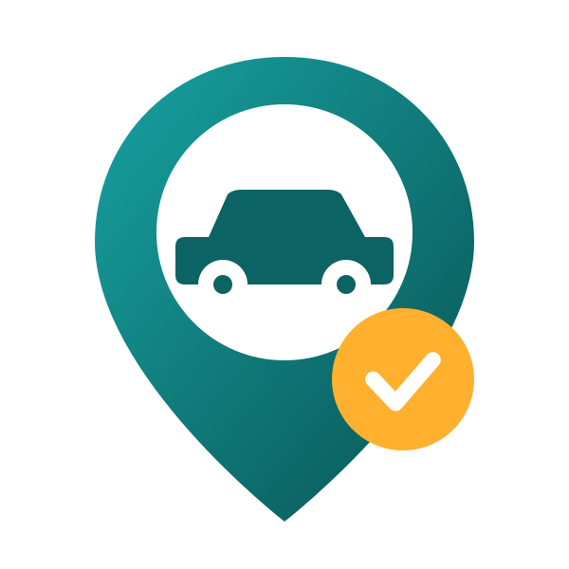


03 · NEW LOGO
One idea, three directions — built around the verified check
A · Pin-Car
B · Gauge-G
C · Care roundel
Map-first. A pin holds the car; amber = verified. Recommended.
Minimal monogram / car-health gauge. The most “tech.”
Closest refresh of today’s logo — the car cradled by hands.

Slide 9
03 · NEW LOGO
The brand system
Typography
Latin — Poppins. Geometric, friendly, modern.
Arabic — Cairo / Tajawal. Clean RTL companion for جراجي.
Colour
App icon
Deep teal
Teal
Bright
Amber
Ink
#0A4F50
#0E7C7B
#17A2A2
#FFB02E
#0B2027
Amber is used only for the verified check and primary actions — so it stays meaningful.
Mark = pin + car + check. Don’t recolour the check or add effects.

Slide 10




04 · FEATURES
Five layers — a wedge now, a moat later
① Discovery & map
Smart map with categories, trust filters, 6-axis & car-specific reviews.
MVP
THE WEDGE
② Booking & operations
Book from a pin, 10-min hold, status tracking, auto-invoice.
MVP
TWO-SIDED ENGINE
③ Car memory
Garage, auto-logged maintenance, reminders, health score, expenses.
MVP→P2
RETENTION ENGINE
④ Trust & safety
3 badges (Authorized / Verified / Community) + verification + disputes.
MVP
THE MOAT
⑤ Growth & “wow”
Offers, referrals, roadside ETA, AI scanners, OBD, parts marketplace.
P3–5
LATER

Slide 11
05 · MVP
The smallest thing that proves the wedge — in ~13 weeks
✓ In the MVP
✗ Deliberately out (Phase 2+)
One city (Greater Cairo), 50–100 hand-verified centres
Map-first discovery: pins, filters, search, directions
Verified profiles: badges, transparent prices, reviews
Booking happy-path: service → slot → confirm, 10-min hold
Cash-on-service first (no in-app cards yet)
Garage + auto-logged maintenance + basic reminders
B2B: onboarding, dashboard, accept/reject, complete
Admin: verification queue (a Filament web panel)
In-app card payments, payouts, commission engine
Customer CRM, promotions, business tiers
Deep expense/fuel analytics, health score, documents
Roadside / emergency dispatch & live ETA
AI scanners (warning-light, damage), OBD-II
Parts marketplace, community, multi-city, web clients
In-app chat (use call + SMS instead)

Slide 12
05 · MVP
North-star & success metrics
North-star: completed, verified bookings per month in the launch city.
50+
1,000+
500+
≥30%
verified service centres
active car owners
completed bookings / month
log a 2nd service in 60 days
Two decisions de-risk launch: start cash-first (defer payments/PCI), and seed the first 50–100 centres by hand — trust is the product.

Slide 13
06 · BACKEND
Laravel·Filament vs Firebase vs Supabase
What the product needs | Supabase | Firebase | Laravel + Filament
Geospatial “centres near me” (map-first core) | native PostGIS | geohash hacks | you build it
Realtime (booking → live dashboard) | built-in | core strength | add Reverb
Time-to-MVP (5 Flutter devs, no backend) | strong | strong | needs backend dev
Admin back-office (verify / disputes / payouts) | Studio + app | console only | Filament ✦
Local payments (Paymob / Fawry) & webhooks | Edge Fns | Cloud Fns | most direct
Cost, portability, vendor lock-in | open Postgres | NoSQL lock-in | self-host ops
Hiring in Egypt (talent pool) | ok | ok | huge PHP pool
Full 9-criterion scorecard in the report. Geospatial + realtime are what define a map-first product.

Slide 14



06 · BACKEND
Recommendation: Supabase backbone + a Filament admin
Use Supabase as the backbone, add a Laravel + Filament web admin on the same database, and use Firebase only for push (FCM).
Mobile apps
Web back-office
Why not Firebase-primary
Flutter × 3 surfaces → Supabase: Postgres + PostGIS, Auth, Realtime, Storage, Edge Functions. FCM for push.
Laravel + Filament on the same Postgres: verification, disputes, payouts, moderation, payment webhooks.
Weak native geo is disqualifying for a map-first product; NoSQL modelling + cost & lock-in add drag.
Carry into build: Stripe is limited in Egypt — plan for a local gateway (Paymob / Fawry / Kashier), server-side, when in-app payments switch on in Phase 2.

Slide 15

Garagy
your trusted garage, on the map
Next steps: clear the name & trademark · lock Direction A · spin up Supabase + a Filament admin · seed 50–100 verified centres · build the 13-week MVP.
Prepared for Dpharma-IT · June 2026

