Slide 1
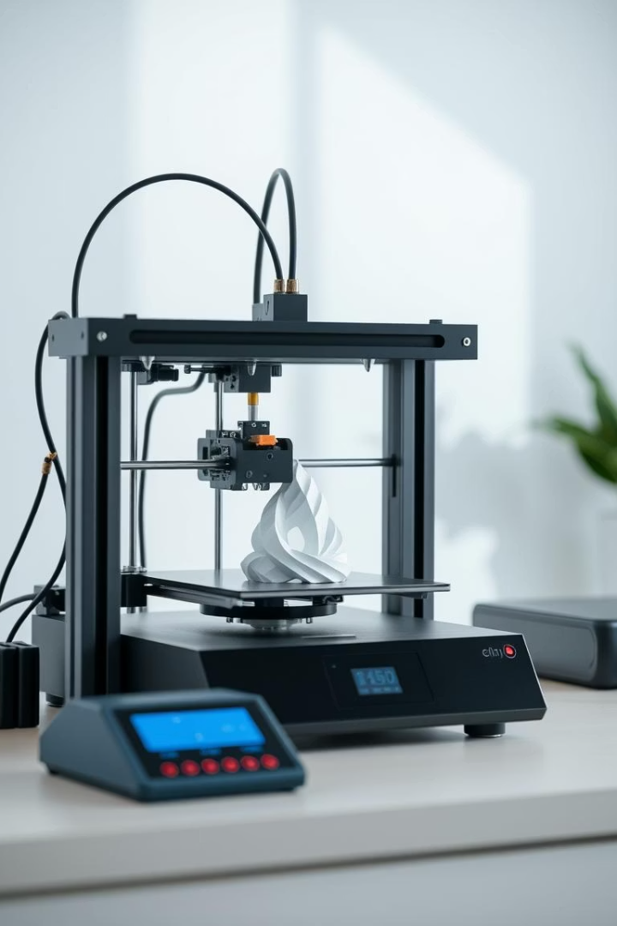
Custom 3D-Printed Products
Personalized, affordable 3D printing for inventors and hobbyists.
by youssef shaher
Yassin Hazem
Youssef Ahmed Kamel
Youssef Amr Eldeab
Seif Eldeen Ahmed

Slide 2
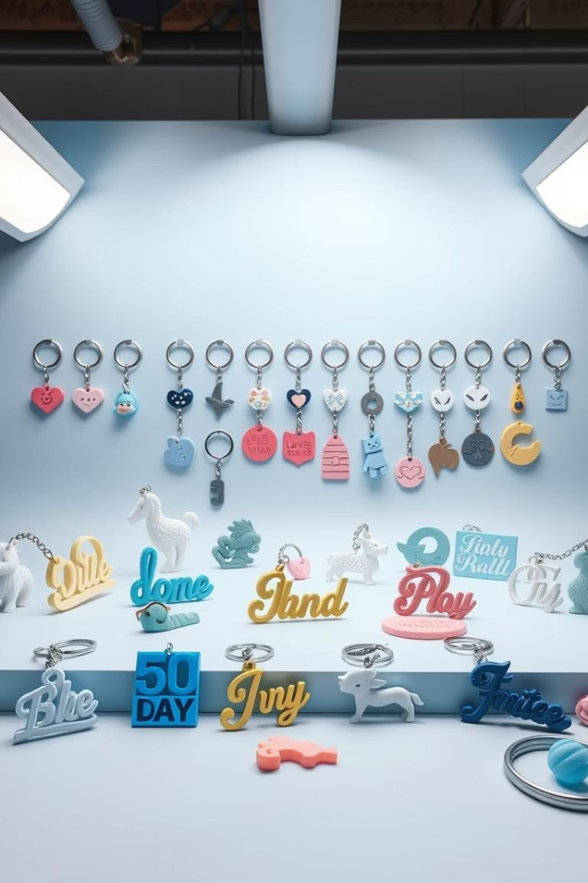
Value Proposition
Custom Products
Personalized items like jewelry and keychains
Small-Batch Manufacturing
On-demand printing reduces waste
Augmented Design
Flexible creation without drawing skills
Problem & Solution
Decline in anime figures; 3D printing offers variety

Slide 3
Customer Segments
Hobbyists & Makers
Engineers & Designers
Educational Institutions
Gift Seekers
Creative individuals and small businesses
Personalized gift buyers
Prototyping and product development
Schools and universities for learning

Slide 4
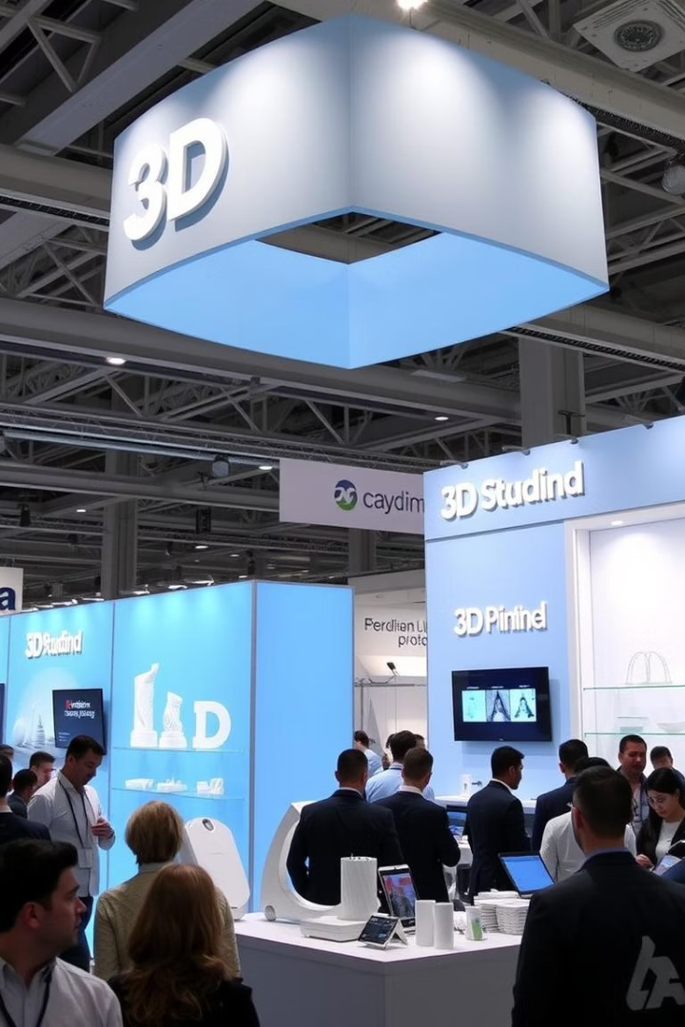
Channels
Online Store
Amazon and personal website
Social Media
Instagram, TikTok promotions
Events & Markets
Trade shows and local markets
Partnerships
Schools and companies collaborations

Slide 5

Customer Relationships
Personalized Service
Custom design collaborations
Loyalty Programs
Discounts and free maintenance offers
Community Engagement
User testimonials and newsletters
Excellent Support
Quick response and assistance

Slide 6
Revenue Streams
Product Sales
Design Services
Subscriptions
Workshops
3D printed custom items
Prototyping and modeling
Monthly printing plans
3D modeling and printing classes

Slide 7

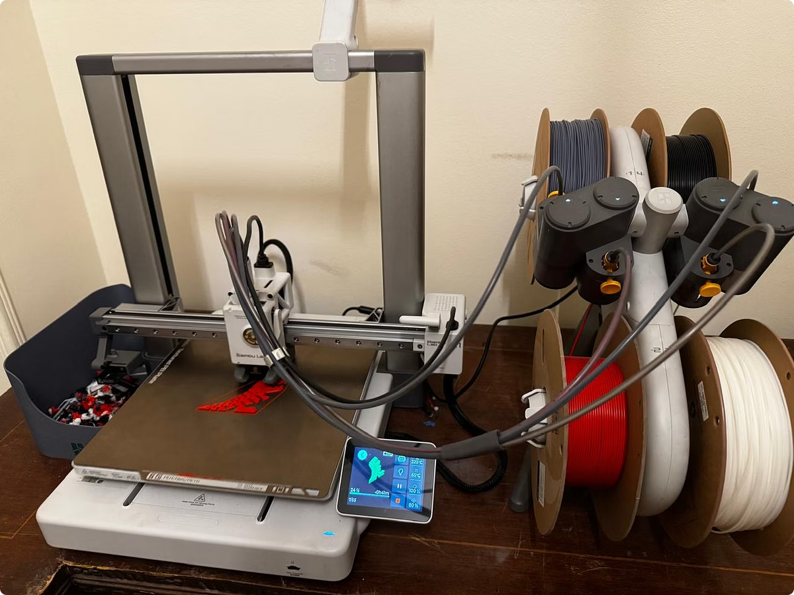
Key Resources
3D Printers
25-30 high-resolution machines
Materials
Filaments and printing supplies
Skilled Personnel
Designers and technicians
Website & Platform
Online sales and support system

Slide 8

Key Activities
Order Printing
Processing and manufacturing
Design Modification
Customizing 3D models
Customer Communication
Support and feedback
Marketing
Social media and promotions

Slide 9
Key Partners
Material Suppliers
Software Providers
Delivery Companies
Content Creators
Filament and printing supplies
Design and modeling tools
Logistics and shipping
Marketing influencers

Slide 10
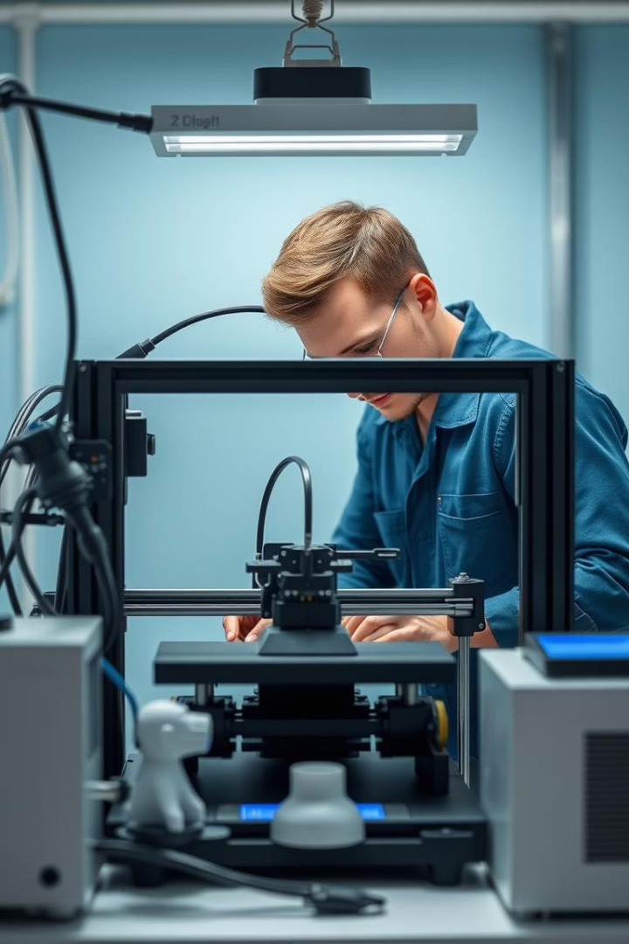
Cost Structure
Equipment
Purchase and maintenance
Materials
Filament and supplies
Utilities
Electricity and hosting
Labor & Shipping
Staff wages and packaging

Slide 11
Thank You
We appreciate your time and attention today.
Looking forward to partnering in innovation and creativity.

