Slide 1

University Attendance & Timetable Management System
Presented by: Youssef Shaher Shokry & Nour Eldein Mohamed

Slide 2

The Problem: Manual Inefficiencies
Manual Errors
Schedule Conflicts
Universities struggle with manual attendance and timetable systems, leading to frequent errors.
Lack of a centralized system causes conflicts in course scheduling and room assignments.
Slow Reporting
Missing records and slow reporting hinder administrative efficiency and decision-making.

Slide 3

Our Solution: A Centralized Database
We designed a database-driven system to streamline university operations.
Centralized Data
Conflict-Free Timetables
All student, instructor, course, and schedule data in one place.
Automated scheduling ensures organized, conflict-free timetables.
Accurate Attendance
Automatic recording of attendance with quick report generation.

Slide 4






Key Entities in the System
Department
Student
UserAccount
Instructor
Schedule
Course

Slide 5
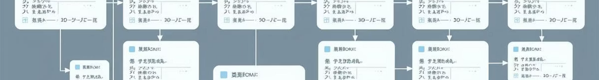
Core Entities & Their Attributes
Department
Course
department_id (PK)
course_id (PK)
name
course_name
Student
credit_hours
department_id (FK)
student_id (PK)
first_name, last_name
Enrollment
email
enrollment_id (PK)
department_id (FK)
student_id (FK)
Instructor
course_id (FK)
instructor_id (PK)
Room
first_name, last_name
room_id (PK)
email
building, room_number
department_id (FK)
capacity

Slide 6

Attendance & Scheduling Details
Attendance
Schedule
attendance_id (PK)
schedule_id (PK)
class_id (FK)
offering_id (FK)
student_id (FK)
room_id (FK)
date
day_of_week
status (Present/Absent/Late)
start_time, end_time
Semester
AttendanceType
semester_id (PK)
type_id (PK)
name (e.g., Fall 2025)
type_name (Present, Absent, Late, Excused)
start_date, end_date
Program
program_id (PK)
program_name
degree_type (BSc, MSc)

Slide 7

User Management & Leadership
UserAccount
user_id (PK)
username, password_hash
role (student/instructor/admin)
linked_id (student_id or instructor_id)
DepartmentHead
head_id (PK)
instructor_id (FK)
department_id (FK)
start_date, end_date

Slide 8
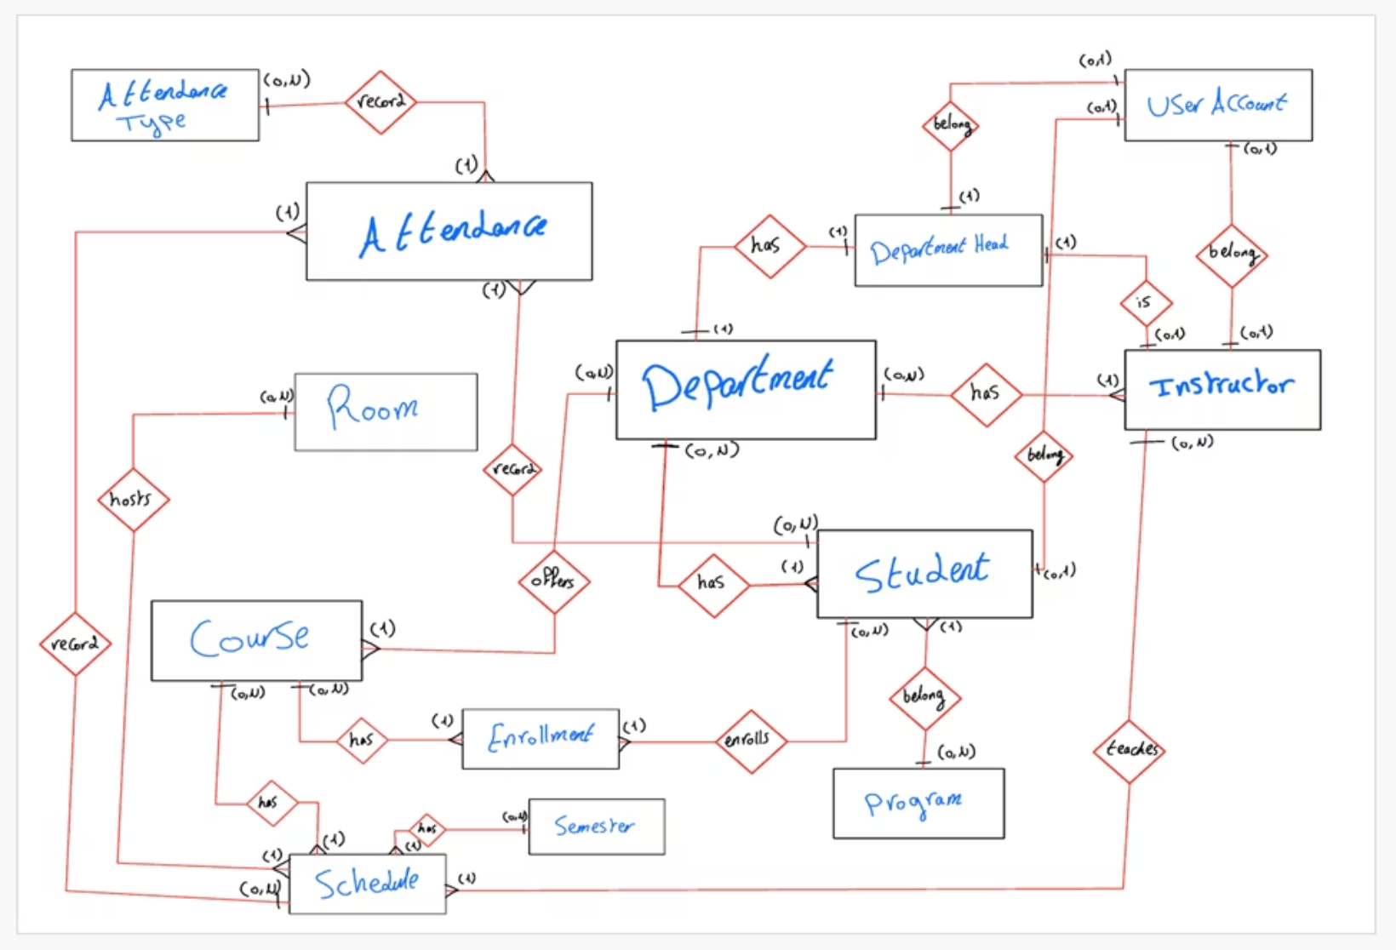
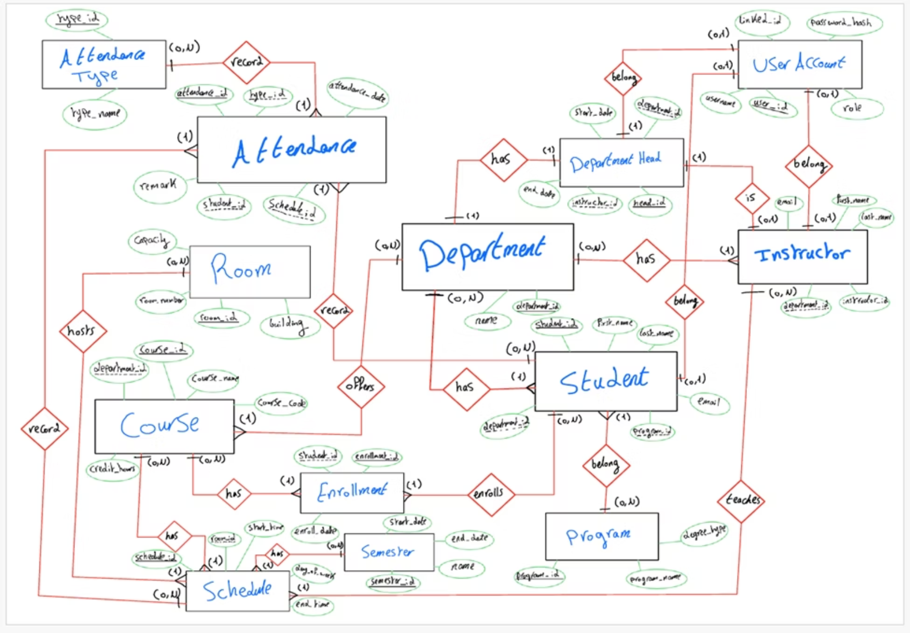
Database Schema Overview

Slide 9
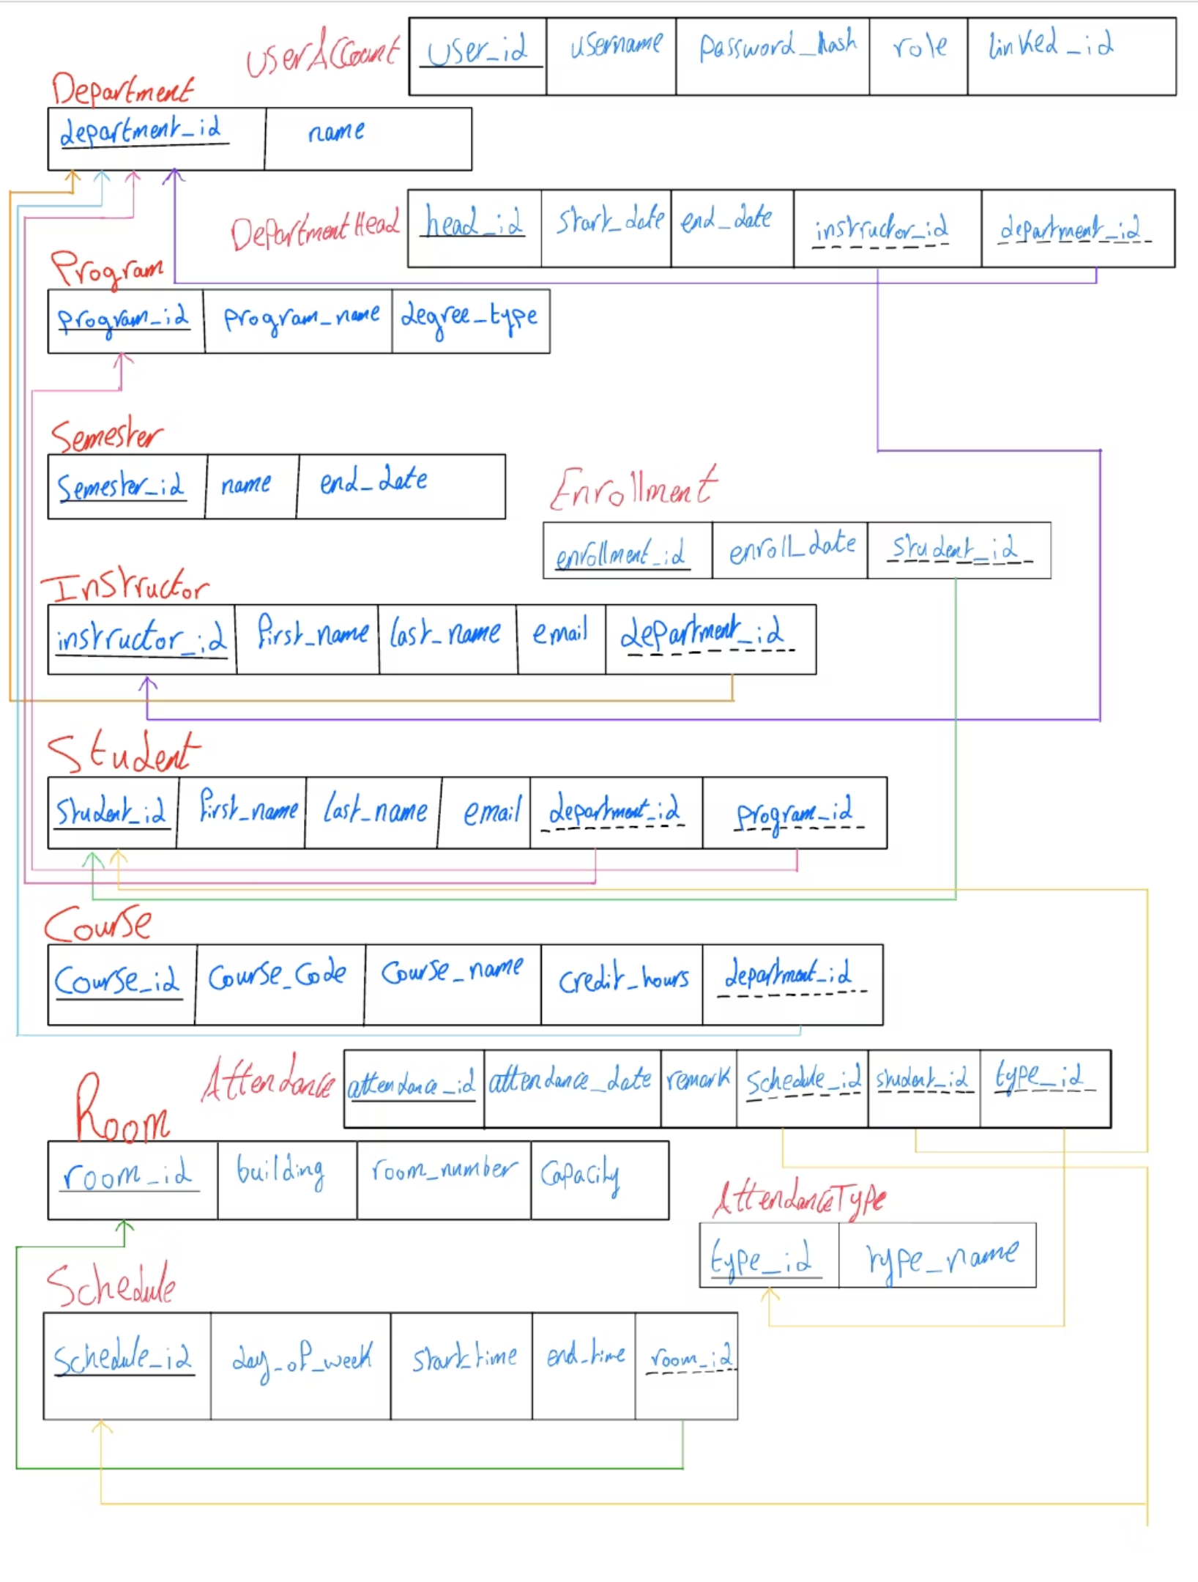

Slide 10

Advanced Data Operations: Joins & Aggregates
Joins
Supports Inner, Left, Right, and Full Outer Joins for comprehensive data integration.
Aggregate Functions
Enables SUM, AVG, COUNT, MIN, MAX for powerful data analysis and reporting.

