Slide 1
Country Development & Economic Performance Analysis
Mini-Project 3 — Interactive Power BI Dashboard
Junior Business Intelligence Analyst | Dataset: Country Data Comparison
238
7
5
countries analysed
world regions
report pages
Notes:
Introduce the project: a centralized dashboard to monitor and compare development indicators across countries and regions.

Slide 2
Business scenario and objectives
1
Compare economic performance between countries
Who it is for
Monitor development indicators
Senior management at an international economic research organization who need one interactive report instead of scattered spreadsheets.
2
3
Identify high-growth and low-growth regions
4
Link health, population and economic factors
5
Support policy and investment decisions
Notes:
Read the five management needs from the brief and link them to the dashboard pages.

Slide 3
Data preparation in Power Query
1
2
3
4
5
Import
Clean
Standardize
Enrich
Model
Country Data Comparison.csv loaded into Power BI
Remove duplicates, handle missing values, fix data types
Rename columns, unify country and region names, drop unused columns
GDP Category, Population Category, Development Level, Growth Indicator Category
Region → Country hierarchy, map-ready geography fields
Notes:
Walk through the Power Query steps. Adjust wording to match the exact steps in your Applied Steps pane.

Slide 4
KPIs and DAX measures
243bn
67.65
6bn
DAX toolkit
SUM, AVERAGE, DIVIDE
CALCULATE with FILTER
RANKX for country ranking
IF for Trade Balance (Surplus / Deficit)
Dynamic titles with SELECTEDVALUE
Average GDP
Average life expectancy
Total population
11.8T
-3.60
Highest GDP (United States)
Lowest inflation
(Nauru)
Notes:
KPI values are read from the Executive Overview page. Make sure the Highest GDP and Lowest Inflation cards show country names in the final .pbix.

Slide 5
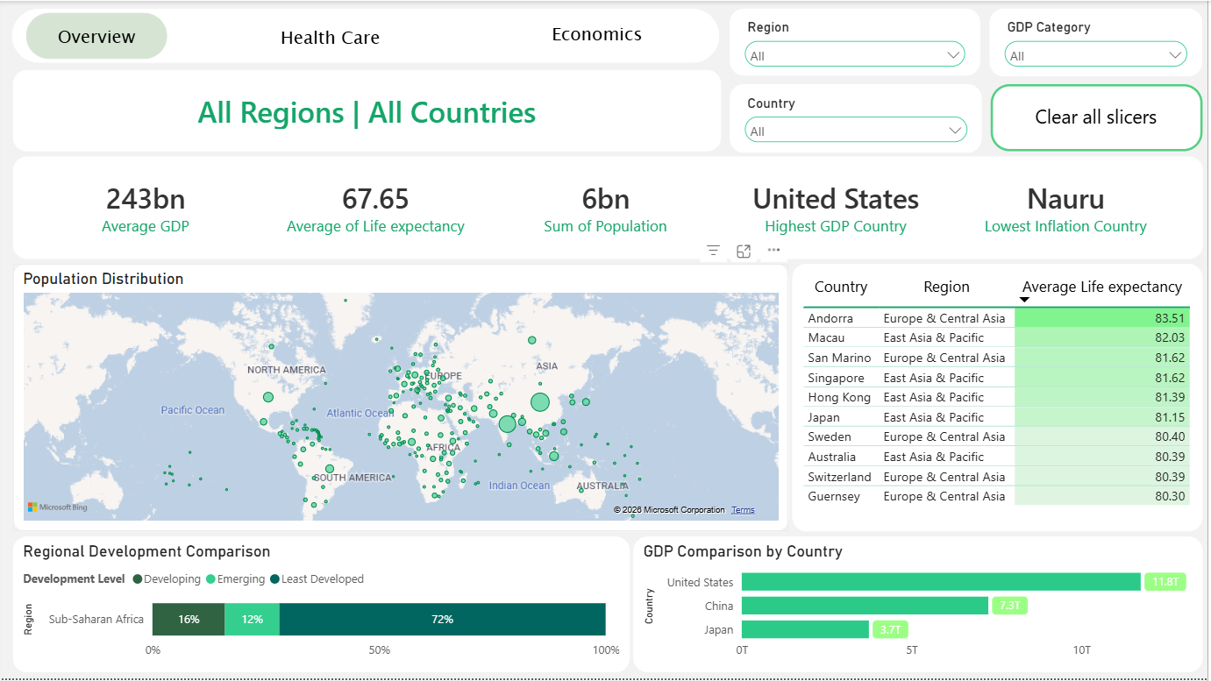
Executive Overview: the global picture
Five KPI cards: GDP, life expectancy, population
Map and table show population spread and life expectancy ranking
Region, Country and GDP Category slicers with Clear all
Notes:
Page 1. Fix the Regional Development Comparison visual so it shows all regions before taking final screenshots.

Slide 6
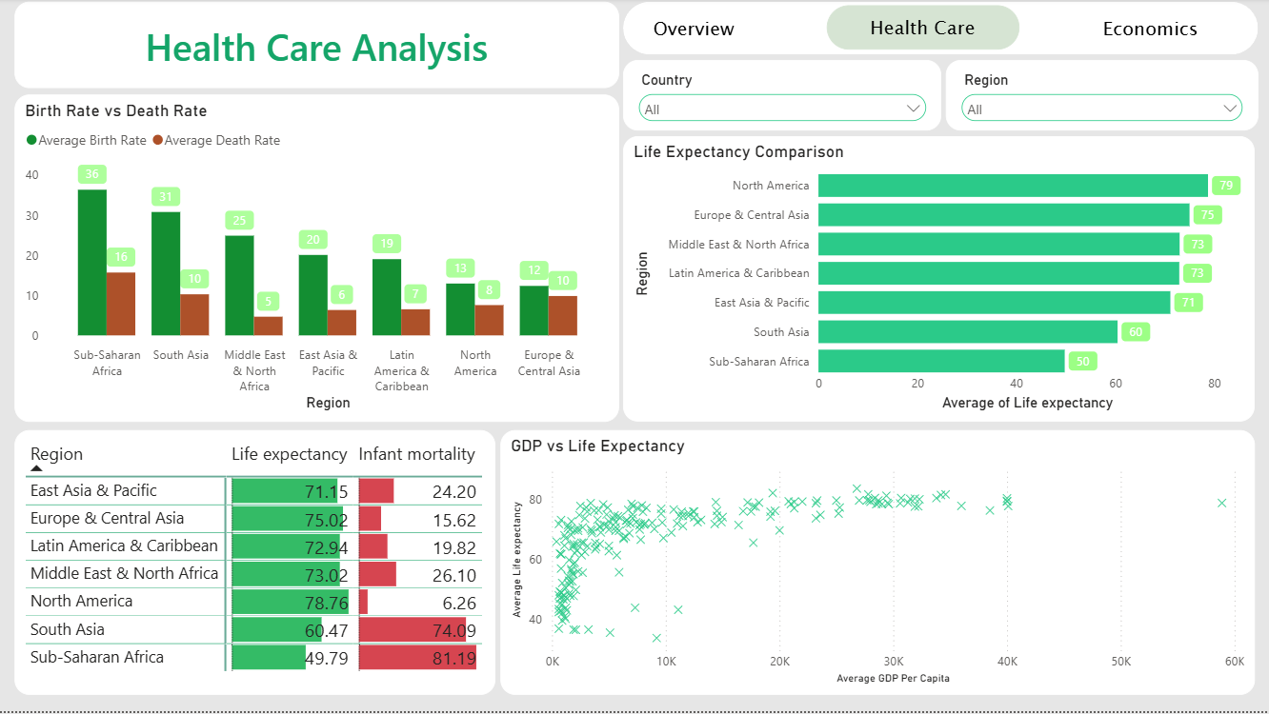
Health Care: where development lags
Life expectancy runs from 49.8 to 78.8 years by region
Scatter plot: life expectancy flattens as GDP per capita rises
Infant mortality bars highlight the weakest regions
Notes:
Page 2. Birth vs death rates, life expectancy comparison, infant mortality table and GDP vs life expectancy scatter.

Slide 7
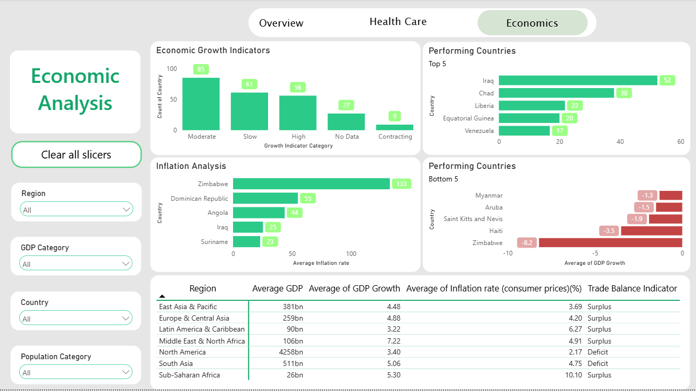
Economics: growth, inflation and trade
Growth categories and top / bottom 5 performers
Inflation hotspots such as Zimbabwe (133%)
Regional table with Trade Balance Indicator
Notes:
Page 3. Includes the Population Category slicer and Clear all slicers button.

Slide 8
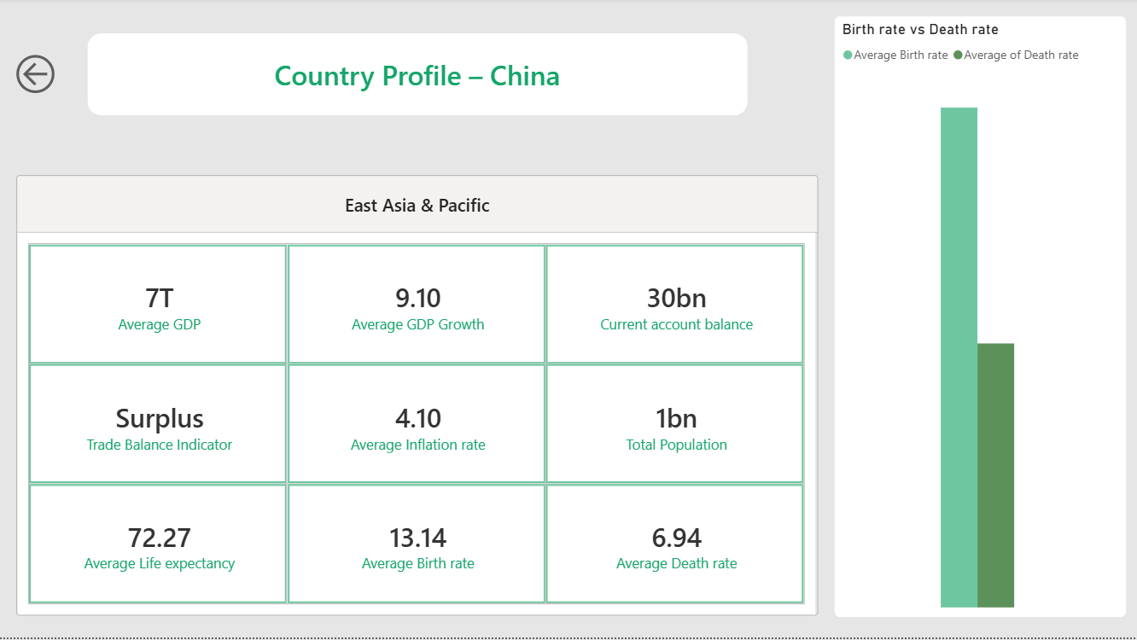
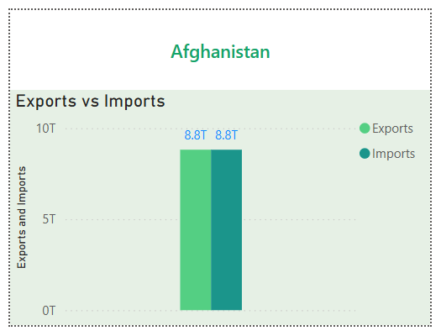
Drill-through and tooltip pages
Drill-through: Country Profile
Tooltip: Exports vs Imports
Right-click a country to open its KPIs and birth vs death rate.
Hover over a country to see its trade balance.
Notes:
Retake these two screenshots after fixing the Country filter so the KPIs and tooltip show the selected country only.

Slide 9
Insight 1: a 29-year life expectancy gap
North America averages 78.8 years, Sub-Saharan Africa only 49.8. Infant mortality shows the same split: 81.2 vs 6.3.
So what
Health outcomes separate regions sharply. South Asia (60.5) is the next weakest.
Notes:
Values from the Health Care Analysis page (table and Life Expectancy Comparison chart).

Slide 10
Insight 2: income lifts health, then levels off
In the GDP vs life expectancy scatter, life expectancy rises steeply at low income and flattens near 80 years at higher income.
< $10K
GDP per capita: life expectancy varies widely, about 40 to 75 years
$10–20K
The curve bends sharply upward
So what
Extra income matters most in poorer countries, so targeted health spending has the highest return there.
~80 yrs
Plateau for countries above roughly $30K
Notes:
Thresholds are approximate readings from the scatter plot, not calculated values.

Slide 11
Insight 3: population growth is concentrated
Sub-Saharan Africa has 36 births vs 16 deaths per 1,000 people. Europe & Central Asia is almost balanced at 12 vs 10.
So what
Fast-growing regions need schools, jobs and health capacity. Ageing regions need productivity and workforce policy.
Notes:
Values read from the Birth Rate vs Death Rate chart on the Health Care page.

Slide 12
Insight 4: growth is broad, few economies shrink
Of 238 countries, 141 show moderate or high growth. Only 9 are contracting and 27 have no growth data.
So what
Momentum is positive overall, but the 27 countries with no data are a blind spot for monitoring.
Notes:
Counts from the Economic Growth Indicators chart on the Economic Analysis page.

Slide 13
Insight 5: high inflation signals instability
Sub-Saharan Africa averages 10.1% inflation, over four times North America at 2.2%. Zimbabwe pairs 133% inflation with -8.2% growth.
So what
Prices and output often move badly together. Iraq shows 52% growth alongside 25% inflation, so growth alone is not safety.
Notes:
Regional averages from the Economic Analysis table; country figures from the Inflation Analysis and Performing Countries charts.

Slide 14
Strategic recommendations
1
2
3
Target health investment
Stabilize high-inflation economies
Invest with a risk-adjusted lens
Prioritize primary care and infant-mortality programs in Sub-Saharan Africa and South Asia, where life expectancy is below 61 years.
Offer macroeconomic support and monitoring to countries above 20% inflation, such as Zimbabwe, Angola and Suriname.
Screen opportunities on growth, inflation and trade balance together. East Asia & Pacific pairs 4.5% growth with 3.7% inflation and a surplus.
Track: life expectancy, infant mortality
Track: inflation, GDP growth
Track: growth category, trade balance
Notes:
Each recommendation links back to an insight: 1 to Insight 1 and 2, 2 to Insight 5, 3 to Insights 4 and 5.

Slide 15
Key takeaways
Health and income gaps between regions remain large. Sub-Saharan Africa and South Asia lag most.
Growth is widespread, but inflation and missing data weaken the picture in some places.
The dashboard lets decision-makers filter, compare and drill into any country.
Thank you

