Slide 1





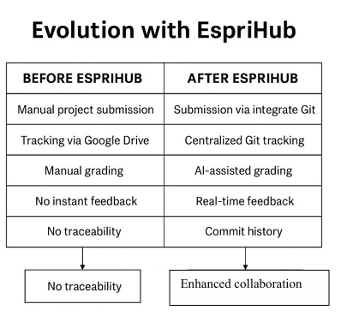


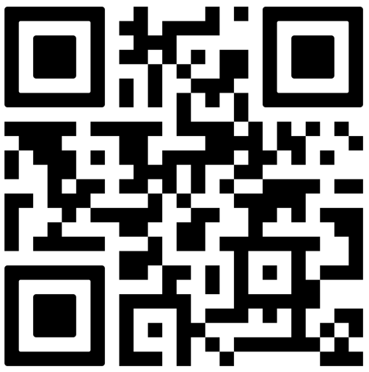
EspriHub: A Git-based Academic Platform for Project and Evaluation Management
POSTER ID27
Author Name¹, Co-Author Name², Third Author¹
contact@esprit.tn, contact@esprit.tn, contact@esprit.tn
ESPRIT School of Business¹, ESPRIT School of Engineering
1
Context & Problem
Project-based learning is central to engineering education at Esprit University, involving large cohorts of students working collaboratively on software projects. While platforms such as GitHub and GitLab are widely used for version control, they are not designed for academic evaluation workflows. Teachers face fragmented processes for repository creation, submission tracking, contribution monitoring, and grading. These limitations increase administrative workload and reduce assessment transparency. EspriHub is a platform that integrate software development tools with institutional structures, pedagogical requirements, and scalable evaluation mechanisms.
2
Research Problem: Importance & Relevance
3
Approach & Methodology
Reduces manual repository creation, submission tracking, and monitoring workload
Improves feedback timeliness, transparency, and visibility of individual contributions
Supports scalable management of project-based learning in high-enrollment programmes.
Leverages AI-assisted evaluation while preserving human decision-making
EspriHub aligns with the future-oriented agenda of building efficient, intelligent, and human-centered higher education systems.
Preferred formats: diagram · workflow · pedagogical schema — avoid dense text.
[ Insert: Diagram / Workflow / Pedagogical Schema / AI Tools Map ]
System design and workflow: 1) Full-stack architecture: Angular frontend + Spring Boot backend + PostgreSQL/Redis via Docker for scalable classroom deployment. 2) Academic domain model: role-based modules (ADMIN, CHIEF, TEACHER, STUDENT), task entities, group/class assignment, and submission lifecycle tracking. 3) GitHub integration pipeline: OAuth authentication, repository linking, webhook subscription, signature validation (HMAC SHA-256), and event-driven data sync. 4) Automation layer: schedulers for webhook health checks, failed-subscription retry, and stale webhook cleanup to ensure reliability over time. 5) AI-assisted evaluation support: submission file ingestion, commit-context visibility, and teacher-centered grading support (human-in-the-loop). 6) Governance and security: JWT stateless auth, endpoint authorization by role, secure headers, and validation of OAuth state and institutional email constraints.
4
Innovation & Contribution ⭐ — What is new?
Pedagogical Innovation
Scientific Contribution
Originality vs. Existing Practice
Integrating version control enables transparent assessment in project-based learning. It improves the visibility of individual contributions within group projects.
An AI-enabled academic Git platform that bridges software engineering tools with pedagogy while offering insights into scalable academic project management.
Unlike GitHub or GitLab, EspriHub natively supports academic structures, automated submissions, deadline enforcement, and AI-powered grading assistance tailored to higher education.
5
Results & Evidence
6
Implications & Best Practices
Early-stage work: preliminary observations, student feedback, prototype.
Practice-based work: results, impact metrics, concrete examples.
Start with institutional alignment before technical deployment
Maintain human-in-the-loop for AI-based grading
Ensure clear role definitions and access control
Easily transferable to other engineering programs
Use dashboards ti support both formative and summative assessement
Design for scalability , especially in programmes with large numbers of project-based courses
Evidence from implemented prototype and platform behavior: 1) End-to-end operational prototype delivered: repository browsing, commit/history tracking, submission workflows, notifications, and admin management are integrated in one platform. 2) Webhook reliability improved through self-healing operations: automatic subscription, periodic health checks, retry policies, and cleanup routines reduce manual intervention needs. 3) Monitoring visibility strengthened: admin views expose webhook status, failures, and repository-level synchronization signals for faster troubleshooting. 4) Assessment traceability increased: task assignment, submission attempts, commit hashes, and grading metadata are centrally recorded for auditability. 5) Risk analytics capability added: a Deadline Risk Radar endpoint aggregates overdue tasks, due-soon tasks, repository staleness, token availability, and inactivity signals. 6) Security posture established for academic deployment: signature-verified webhooks, role-based access control, JWT flows, and production hardening checklist documented. 7) Practical impact observed (qualitative): reduced repetitive manual coordination for teachers, improved transparency of student contribution signals, and better readiness for large-cohort project monitoring.
[ Chart · Table · Key Metrics · Student Quotes ]
7
Ethical & Responsible AI Considerations
8
Key Takeaways
AI provides recommendations, not final grades
Transparency in evaluation criteria and data usage
Protection of student data and privacy (internal hosting)
Mitigation of bias through teacher validation
Clear communication and consent regarding AI use
🔑 EspriHub shows how AI may significantly improve academic assessment without taking the place of teachers
🎯 Reduces faculty workload in large project-based course ✅ Improves fairness and traceability of assessment 🔁 Transferable to other universities and training contexts 🌱 Supports a sustainable vision of the AI-enabled University of the Future
9
References
10
Scan for More
[1] Dabbish, L., Stuart, C., Tsay, J., & Herbsleb, J. (2012). Social coding in GitHub: Transparency and collaboration in an open software repository
[2] Holmes, W., Bialik, M., & Fadel, C. (2019). Artificial Intelligence in Education: Promises and Implications for Teaching and Learning. Center for Curriculum Redesign
[3] Luckin, R., Holmes, W., Griffiths, M., & Forcier, L. B. (2016). Intelligence Unleashed: An argument for AI in Education. Pearson.
[4] Zawacki-Richter, O., Marín, V. I., Bond, M., & Gouverneur, F. (2019). Systematic review of research on artificial intelligence applications in higher education.
QR
QR
QR
Extended
Abstract
Slides /
Demo
Full Paper
or Dataset
WEITA 2026 • April 17–18, 2026 • Tunis, Tunisia
AI and the University of the Future: Shaping Sustainable Impact

