Slide 1
Netflix Catalog Analysis
Content mix, catalog trends, and a key statistical finding
Youssef Tharwat 24-101128
Saifeldeen Abdallah 24-101154
Bassem Tarek 24-101021
Karim Wael 24-101546
1 / 10
Notes:
Good morning. This presentation summarizes our analysis of the uploaded Netflix dataset. We will move from the study objective, to descriptive findings, to visuals, and end with the main statistical conclusion we can discuss with the doctor.

Slide 2
Objective and Analytical Focus
Objective: analyze Netflix catalog structure and trends
Dataset: uploaded netflix_titles.csv file
Focus areas: type, ratings, genres, and yearly additions
Hypothesis test: compare movies and TV shows by average recency
2 / 10
Notes:
This slide frames the study. We are not trying to analyze user behavior or revenue. Instead, we are examining what the catalog looks like, how it changed over time, and whether movies and TV shows differ in release recency.

Slide 3
Dataset Scope
8,807
6,131 movies were included
2,676 TV shows were included
Netflix titles analyzed
3 / 10
Notes:
The first takeaway is scale. The dataset contains 8,807 titles, giving us a broad enough sample to describe the Netflix catalog and compare major content groups with confidence.

Slide 4
Catalog Mix: Movies vs. TV Shows
Movies
TV Shows
6,131 titles in the catalog
Largest share of Netflix content
2,676 titles in the catalog
Newer on average than movies
4 / 10
Notes:
This comparison shows the basic structure of the platform. Movies clearly dominate the catalog by count, while TV shows are fewer but stand out in the later statistical finding as newer on average.

Slide 5
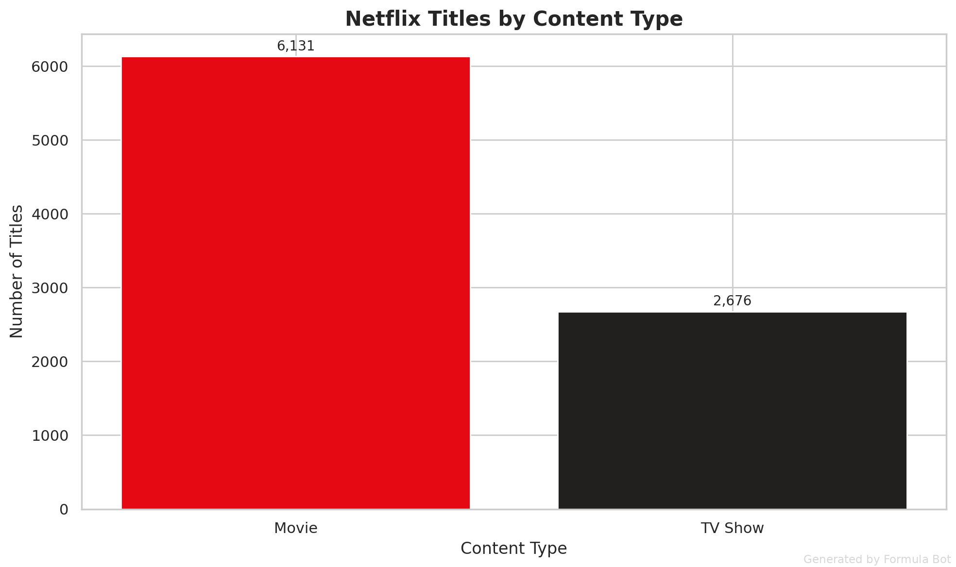
Content Type Distribution
Movies dominate the overall content mix
TV shows account for a smaller share
5 / 10
Notes:
This visual reinforces the count split we just saw. It is an effective chart to discuss early because it gives the audience an immediate understanding of how the Netflix catalog is weighted toward films.

Slide 6
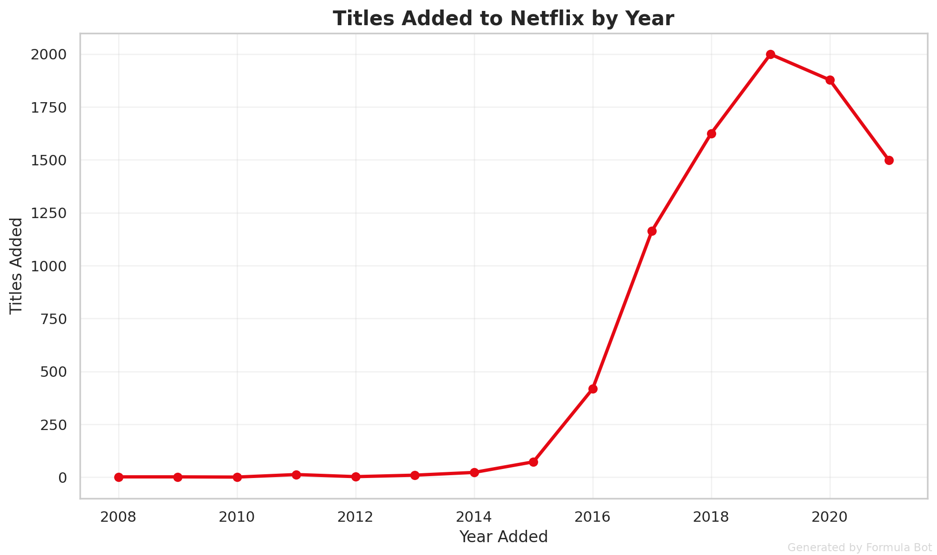
Titles Added to Netflix by Year
2019 and 2020 were peak years for additions
Yearly additions rose before reaching that peak
6 / 10
Notes:
This slide tells the catalog growth story. The main point is not just that additions were high, but that they concentrated around 2019 and 2020, which suggests a period of especially strong expansion in the dataset.

Slide 7
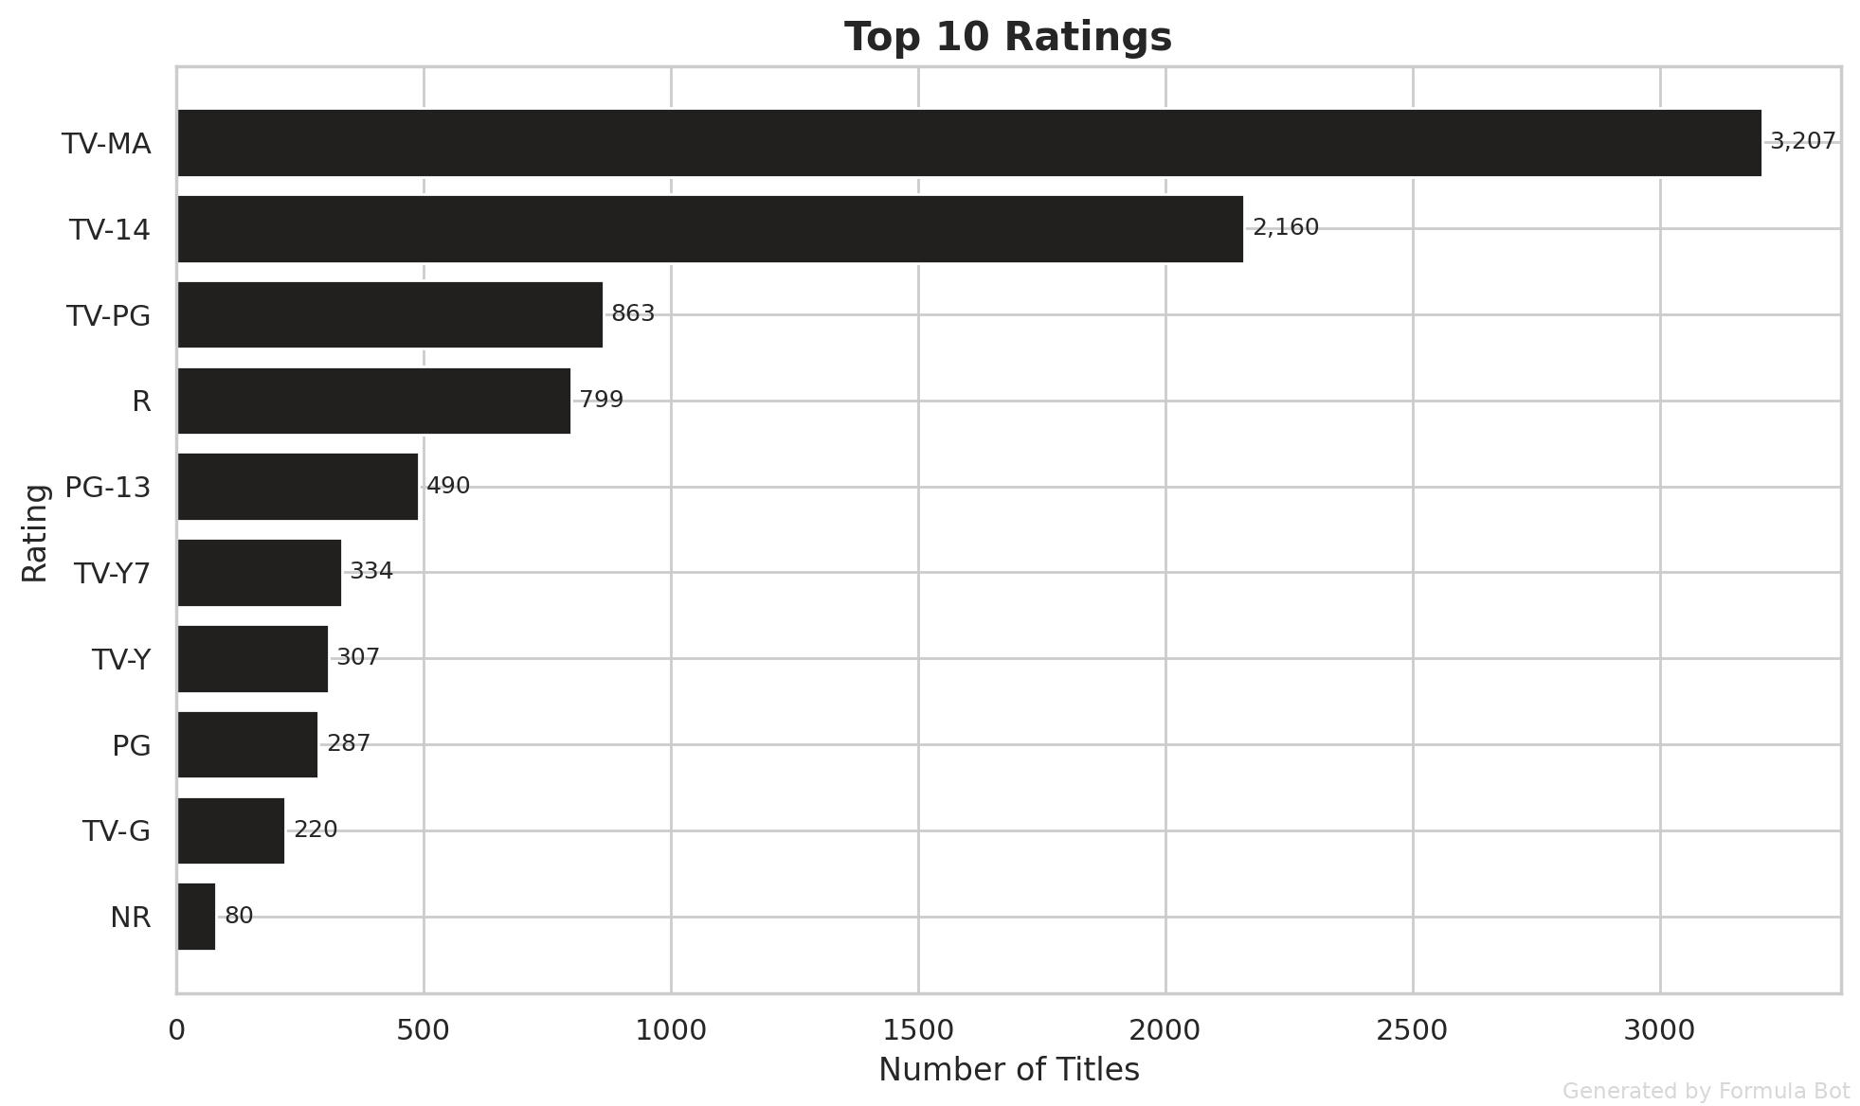
Most Common Ratings
TV-MA appears most frequently
TV-14 is also highly represented
7 / 10
Notes:
Ratings help us describe the maturity profile of the catalog. In presenting this slide, emphasize that these are the most common rating categories observed in the dataset, not a measure of popularity or viewership.

Slide 8
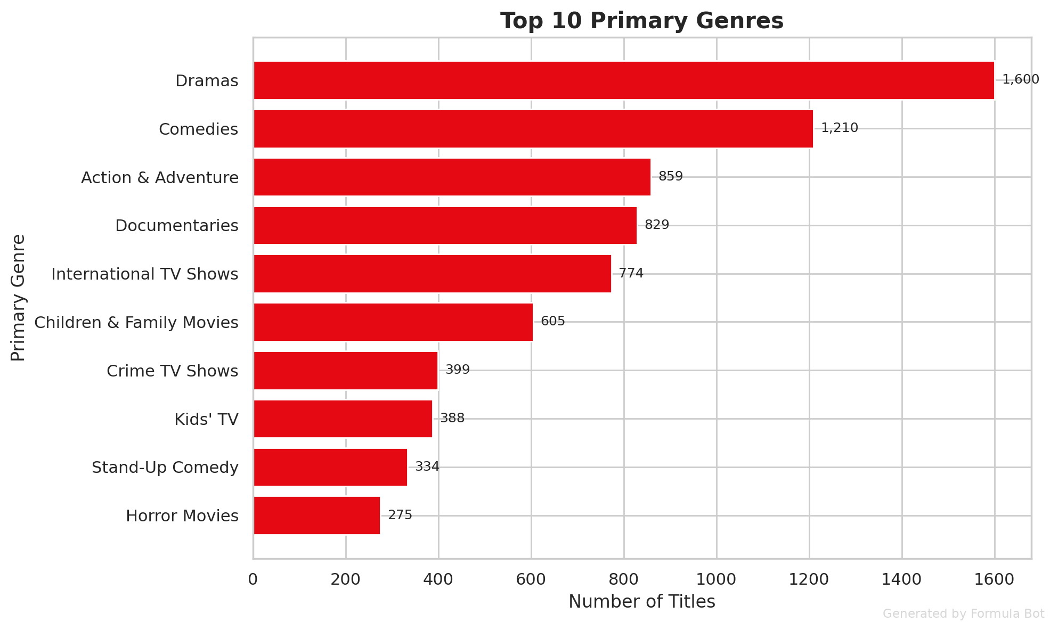
Most Common Genres
Dramas lead genre representation
Comedies and Action & Adventure are also prominent
8 / 10
Notes:
This chart highlights the strongest genre concentrations in the catalog. When discussing it, connect the genre mix back to the platform’s breadth and explain that these categories dominate the available titles in the dataset.

Slide 9
“
TV shows were newer on average than movies, and the result was statistically significant.
— Key Statistical Finding
9 / 10
Notes:
This is the strongest analytical conclusion from the hypothesis test. It moves us beyond description and shows that the difference between content types was meaningful enough to be statistically significant in the analysis.

Slide 10
Key Takeaways
8,807 titles were analyzed from the Netflix dataset
Movies dominate the catalog with 6,131 titles
Catalog additions peaked around 2019 and 2020
TV-MA and TV-14 are the most common ratings
TV shows are newer on average than movies
10 / 10
Notes:
To conclude, the dataset shows a movie-heavy catalog, strong growth in additions up to 2019 and 2020, concentrated rating and genre patterns, and one important statistical result: TV shows are newer on average than movies. These are the points we should emphasize in front of the doctor.

