Slide 1
N
Netflix Movie Duration
Analysis
Analyzing Trends in Netflix Movie Runtime Over Time

Slide 2
Project Objective
🔍 Main Research Question
Have Netflix movie durations decreased over time?
Goals
Analyze Netflix movie data
Study runtime trends across years
Use statistical analysis to validate findings
"The goal is to determine whether Netflix movie durations changed over the years using data analysis and hypothesis testing."

Slide 3
Dataset Overview
Netflix Titles Dataset
Column | Description
type | Movie or TV Show
release_year | Release year of the content
duration | Movie duration in minutes
listed_in | Genre categories
director | Director of the content
"The dataset contains Netflix content including movie duration, genres, release years, and directors."

Slide 4
Data Preprocessing
1
Removed TV Shows — Kept movies only
2
Removed Missing Values — Ensured data completeness
3
Converted Duration to Numeric — Parsed string values to integers
4
Removed Outliers — Eliminated extreme runtime values
5
Filtered Years After 2000 — Focused on modern Netflix era
Purpose: To improve data quality and analysis accuracy.

Slide 5
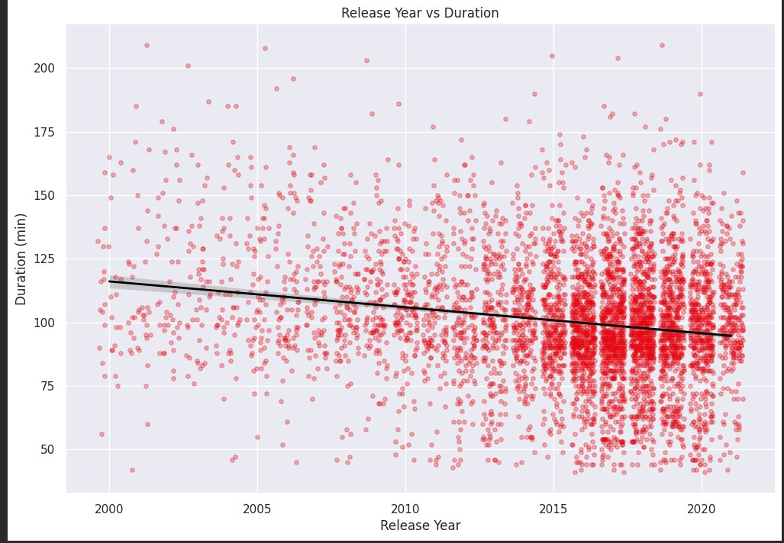
Regression Analysis — Runtime Trend
Downward Trend
Regression line shows decreasing runtime over years
Gradual Change
The decrease is steady, not sudden or dramatic
Modern Movies
Post-2015 films average shorter than pre-2005 films
"The visualization suggests a negative relationship between release year and movie duration."

Slide 6
Hypothesis Testing
Null Hypothesis (H₀)
Alternative Hypothesis (H₁)
There is NO relationship between release year and movie duration.
Movie durations DECREASE over time.
Statistical Tests Used
Test | Purpose
Pearson Correlation | Measure linear relationship between year and duration
Spearman Correlation | Capture general monotonic trend (robust to outliers)
Independent T-Test | Compare early movies vs. recent movies directly

Slide 7
Statistical Results
Correlation Tests
Mean Duration Comparison
Test | Result
Pearson r | -0.1939
Spearman rho | -0.1392
T-test p-value | 0.0000 ✓ Significant
Group | Avg Duration
Early Movies (pre-2010) | 109.01 min
Recent Movies (post-2010) | 97.40 min
Difference | ~11.6 min shorter
-0.19
p<0.001
~12 min
Pearson r
T-test Result
Avg Reduction

Slide 8
Interpretation of Results
📉 Negative Correlations
Both Pearson (r = -0.19) and Spearman (rho = -0.14) show negative values, indicating shorter runtimes in more recent years.
✅ Statistical Significance
p-value < 0.05 confirms the observed trend is not due to random chance — the relationship is statistically real.
⏱️ Practical Significance
Recent movies are approximately 12 minutes shorter on average, a meaningful difference for streaming viewers.
"Statistical analysis confirmed a significant decreasing trend in Netflix movie durations."

Slide 9
Conclusion
✅ Netflix movie durations have decreased over time.
Key Takeaways
Data analysis strongly supports the original hypothesis
Multiple statistical tests confirmed significance (p < 0.05)
Modern Netflix movies are ~12 minutes shorter on average
Both Pearson and Spearman correlations showed consistent negative trends

Slide 10
Thank You
Netflix Movie Duration Analysis
Questions?

