Slide 1



Project name :
[Real estate sale and rent system]
Graduation Project 2023

Slide 2
Supervised by:
Dr. Mohamed Marie
ـــــــــــــــــــــــــــــــــــــــــــــــــــــــــــــ ـ
Team Members :
1-karim khaled tawfek Abdelaziz
2-Abdelaziz Yousef Abdelaziz Mahmoud
3-Mina Shafek Riad Shafik
4-Mostafa Hassan Mohamed Nashat
5-Osama Saleh El-Sayed El-Atwy

Slide 3

Project Idea

Slide 4

Our project helps people to
Finde houses for rent or sale easily
increase the economic for user
avoid the real estate broker
Reduce congestion in cities

Slide 5

Where is Problem ?

Slide 6
Problem
Exploiting the merchants
cost of sale and rent
the real estate broker
The people who scammers “الشخص المحتال"

Slide 7
Related Apps

Slide 8
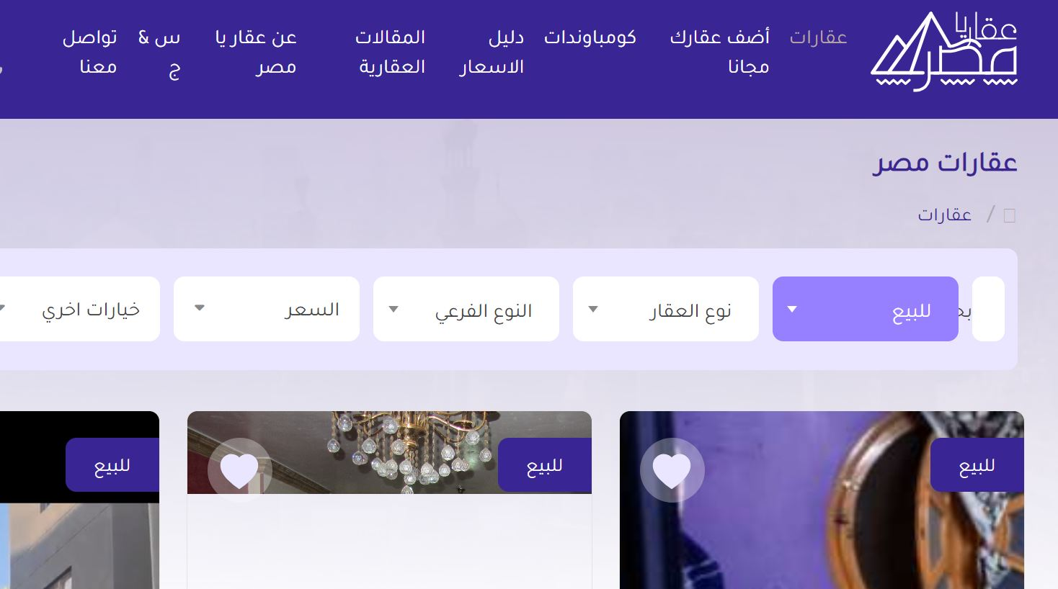
Aqar ya masr :

Slide 9
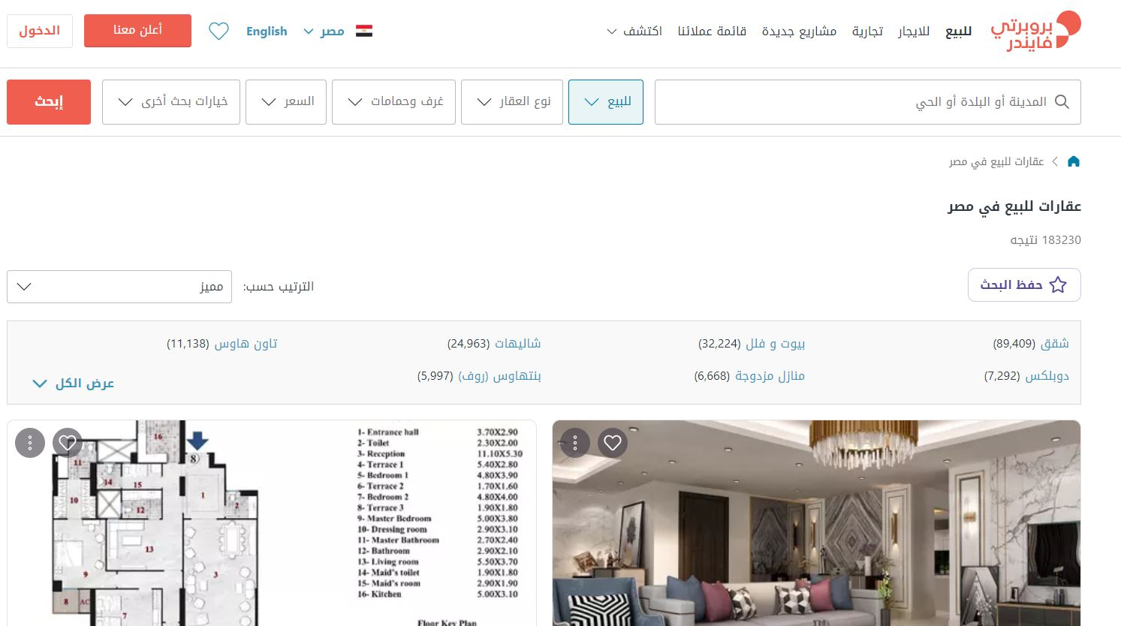
property finder:

Slide 10
The main purpose of our web app.
Our goal is to create an electronic real estate market through which we simplify the shopping and real estate marketing processes
away from the hands of brokers and intermediaries in order to preserve prices

Slide 11
What makes it better?
Our app is better since:
It is easy to use .
User Friendly.
The user interface is simple.
There are a variety of places to choose from.
Go away from hands brokers

Slide 12
objectives

Slide 13

Our aim:
1. Increase Awareness: Raise awareness about the multifaceted nature of the real estate industry, emphasizing its role in meeting societal needs, contributing to the economy, and shaping development.
2. Highlight Economic Significance: Showcase the economic importance of real estate by demonstrating its impact on job creation, investment opportunities, and wealth accumulation Illustrate how real estate markets function as platforms for transactions and capital flow

Slide 14


Slide 15
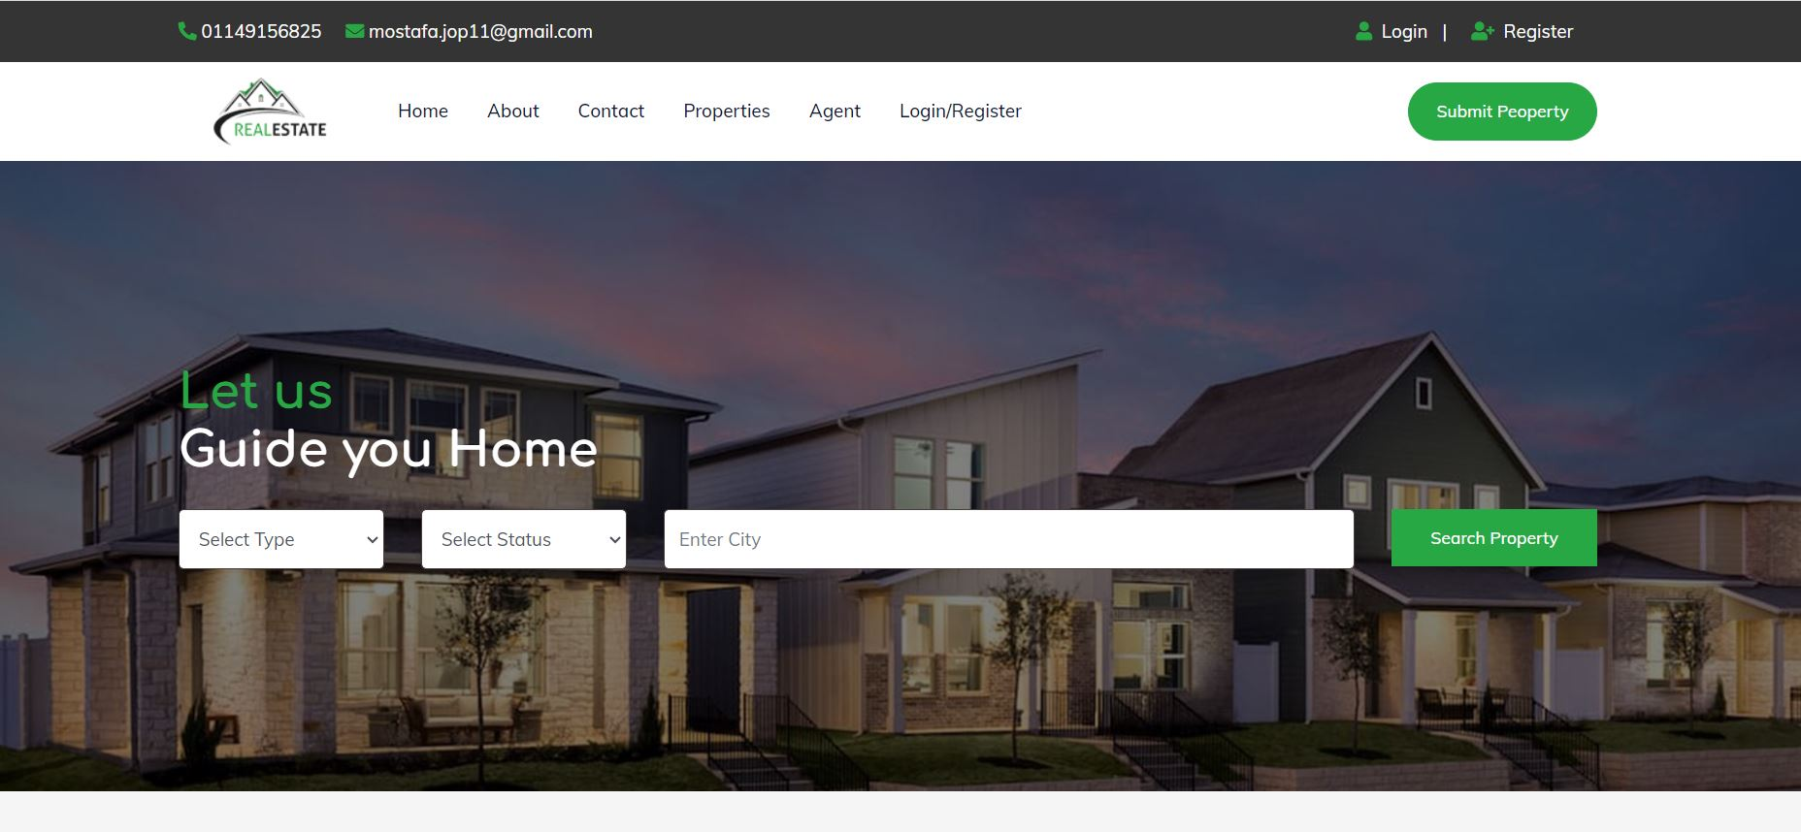
Home page :

Slide 16
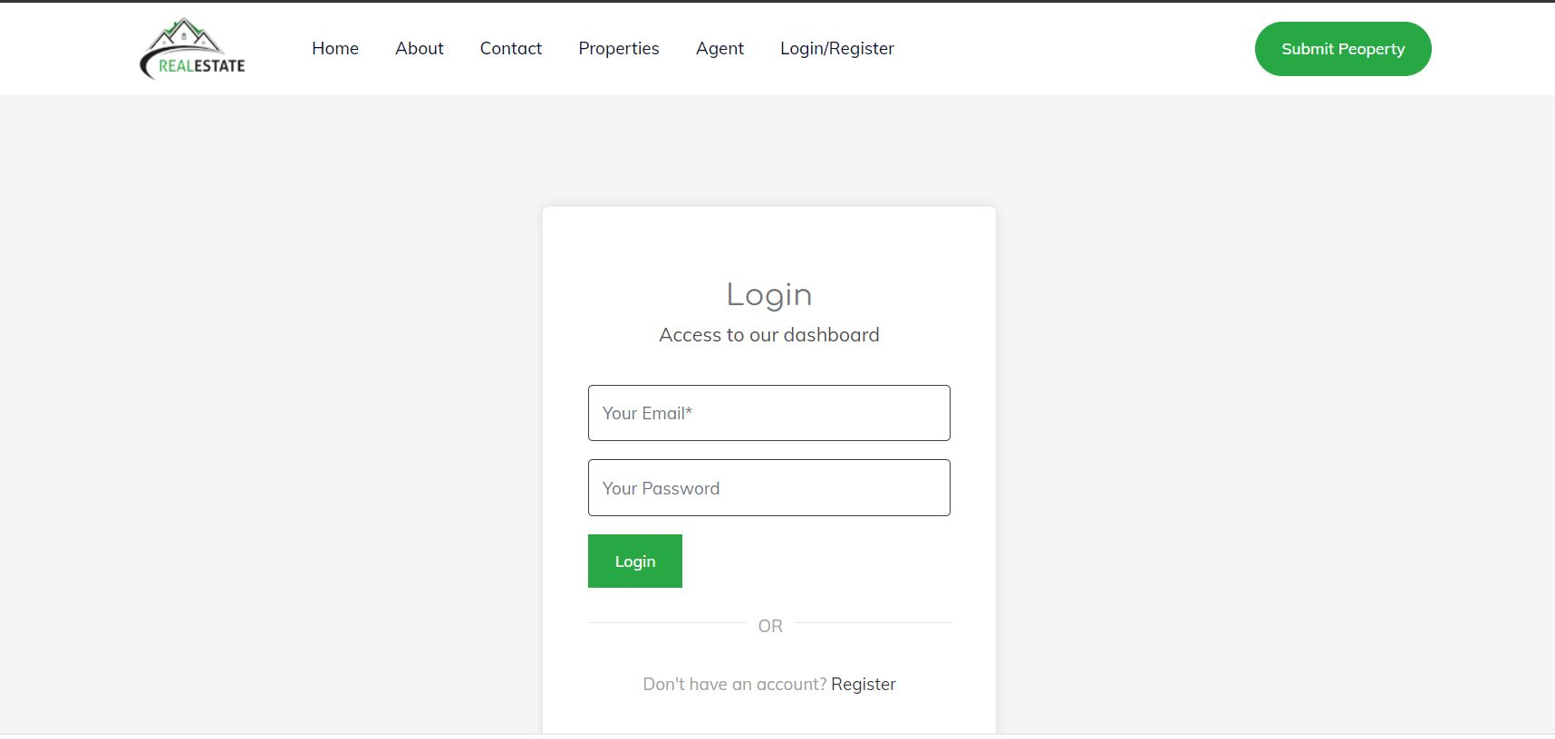
LogIn page :

Slide 17
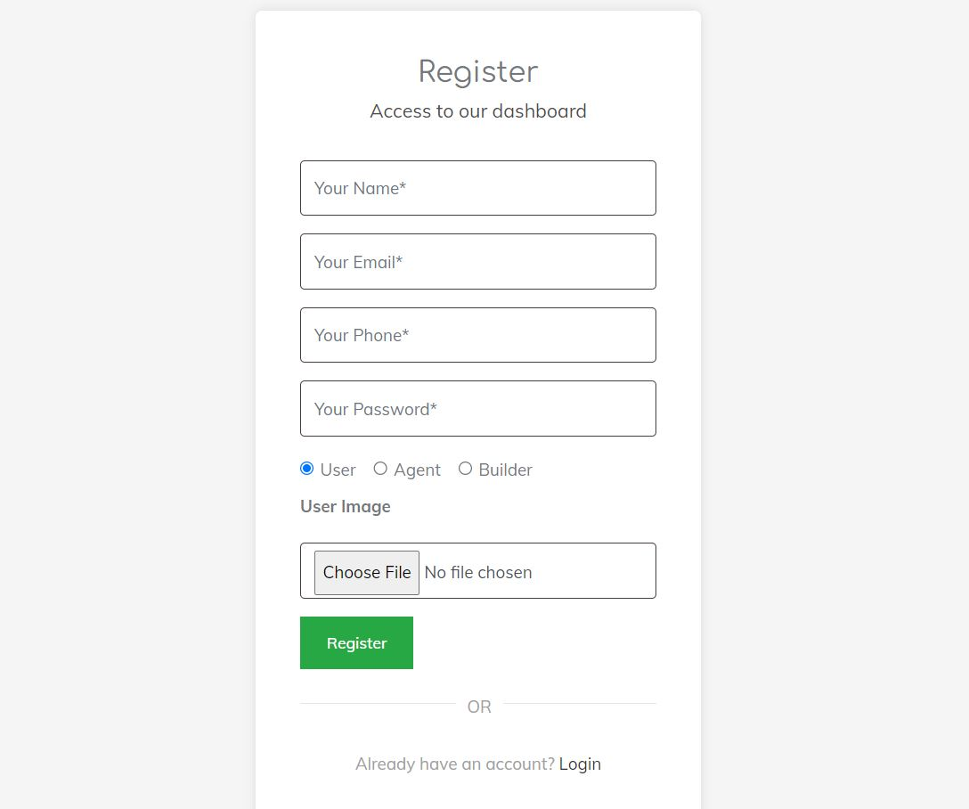
Register page :

Slide 18
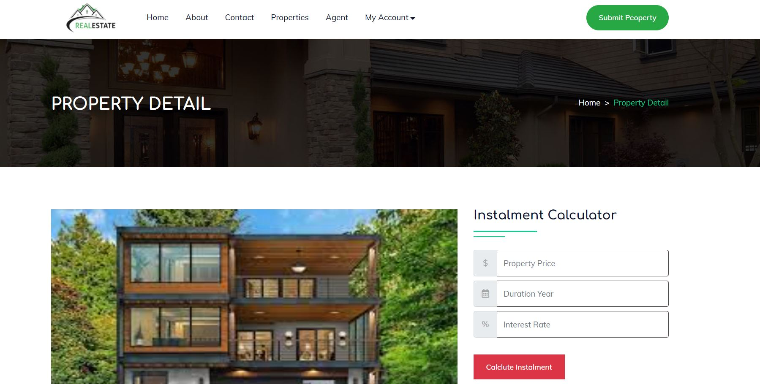
property page :

Slide 19


Slide 20
We are going to add more and more features to our application such as:
1.Adding other features to support users
3.add feature night mode
2.Expansion of the project to become global
3. Chat Room To Communication between the user and the owner

Slide 21


