Slide 1
EDA_project Student Performance
6th Grade

Slide 2
Table of contents
01
02
03
04
understand columns
check data types
Data Cleaning
describe numerical columns
05
06
Questions
describe categorical columns

Slide 3
Introduction
In high school and middle school math lessons, students delve into various engaging topics. They explore problem-solving strategies, honing critical thinking and logical reasoning skills. Additionally, at that age, math lessons focus on the practical application of mathematics, revealing its role in everyday life
From mathematical modeling to the integration of technology tools, these lessons empower students to appreciate the versatility and relevance of mathematics across diverse contexts. Through this comprehensive approach, students not only master mathematical concepts but also develop essential skills for navigating the complexities of the modern world

Slide 4
01
Understand columns

Slide 5
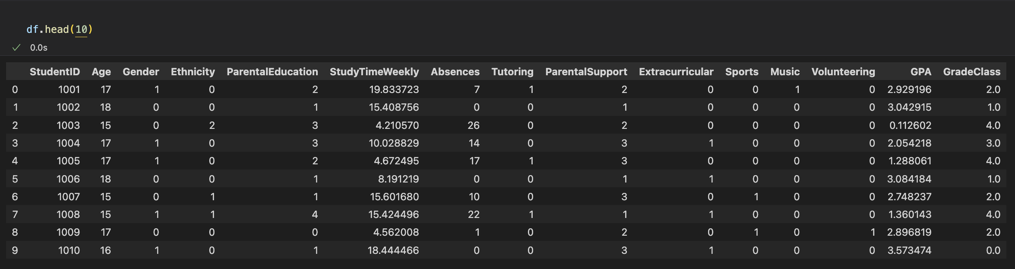
Understand columns
StudentID: A unique identifier assigned to each student (1001 to 3392).
Age: The age of the students ranges from 15 to 18 years.
Gender: Gender of the students, where 0 represents Male and 1 represents Female.
Ethnicity: The ethnicity of the students, is coded as follows:
0: Caucasian 1: African American 2: Asian 3: Other

Slide 6
Understand columns
ParentalEducation: The education level of the parents, coded as follows:
0: None 1: High School 2: Some College 3: Bachelor’s 4: Higher
StudyTimeWeekly: Weekly study time in hours, ranging from 0 to 20.
Absences: Number of absences during the school year, ranging from 0 to 30.
Tutoring: Tutoring status, where 0 indicates No and 1 indicates Yes.

Slide 7
Understand columns
ParentalSupport: The level of parental support, is coded as follows:
0: None 1: Low 2: Moderate 3: High 4: Very High
Extracurricular: Participation in extracurricular activities, where 0 indicates No and 1 indicates Yes.
Sports: Participation in sports, where 0 indicates No and 1 indicates Yes.
Music: Participation in music activities, where 0 indicates No and 1 indicates Yes.

Slide 8
Understand columns
Volunteering: Participation in volunteering, where 0 indicates No and 1 indicates Yes.
GPA: Grade Point Average on a scale from 2.0 to 4.0, influenced by study habits, parental involvement, and extracurricular activities.
GradeClass: Classification of students' grades based on GPA:
0: 'A' (GPA >= 3.5) 1: 'B' (3.0 <= GPA < 3.5) 2: 'C' (2.5 <= GPA < 3.0) 3: 'D' (2.0 <= GPA < 2.5). 4: 'F' (GPA < 2.0)

Slide 9
02
Check data types

Slide 10
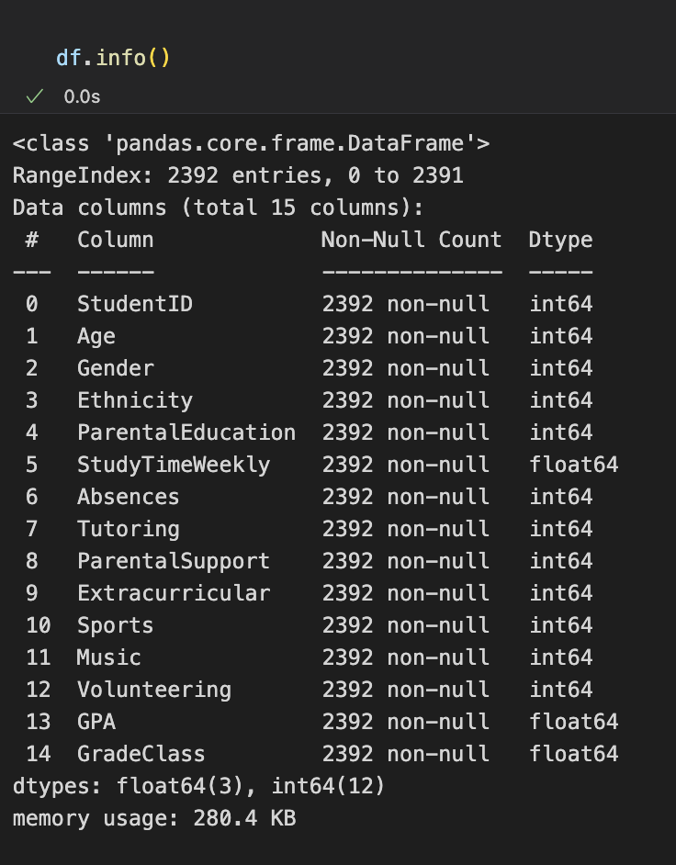
Check data types
Data types of all columns

Slide 11
03
Data Cleaning

Slide 12
Categorical Encoding

Slide 13
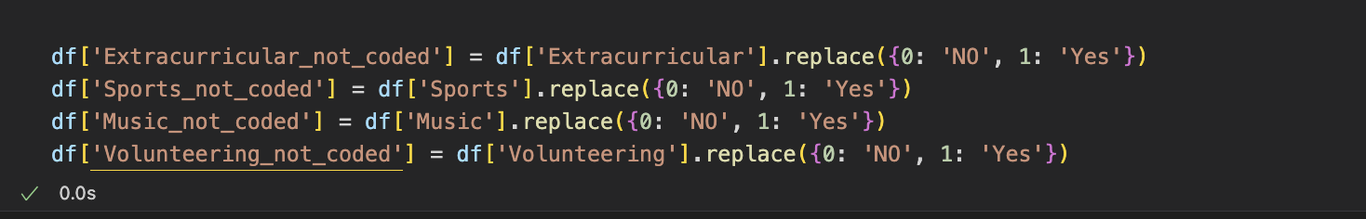
Categorical Encoding

Slide 14
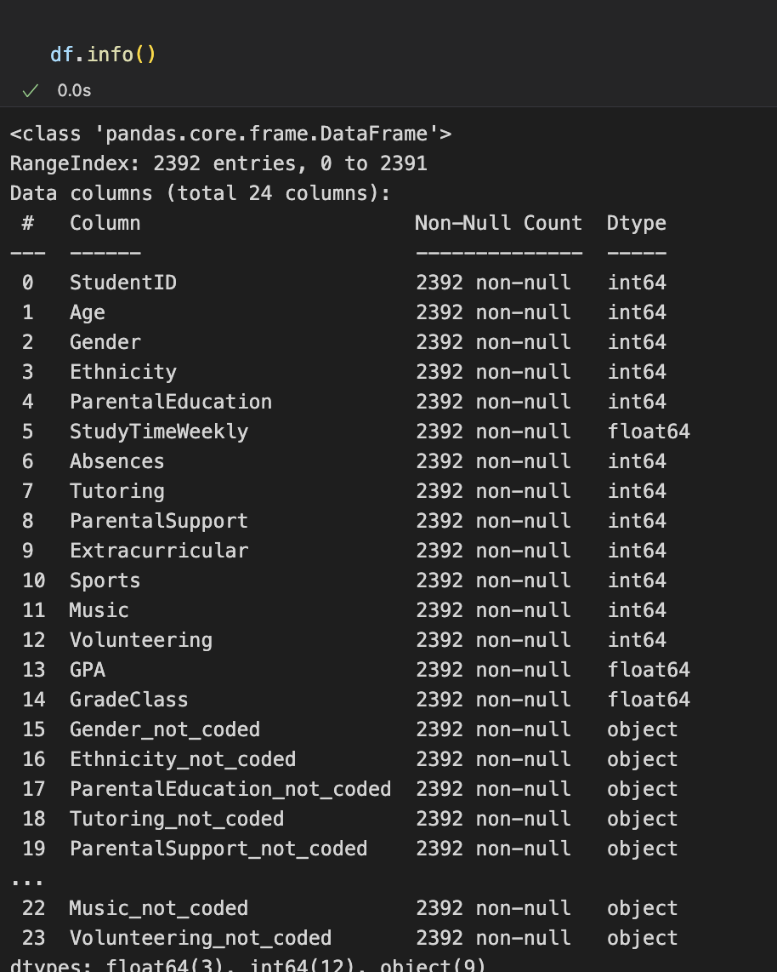
Data types
Data types of all columns after encoding

Slide 15
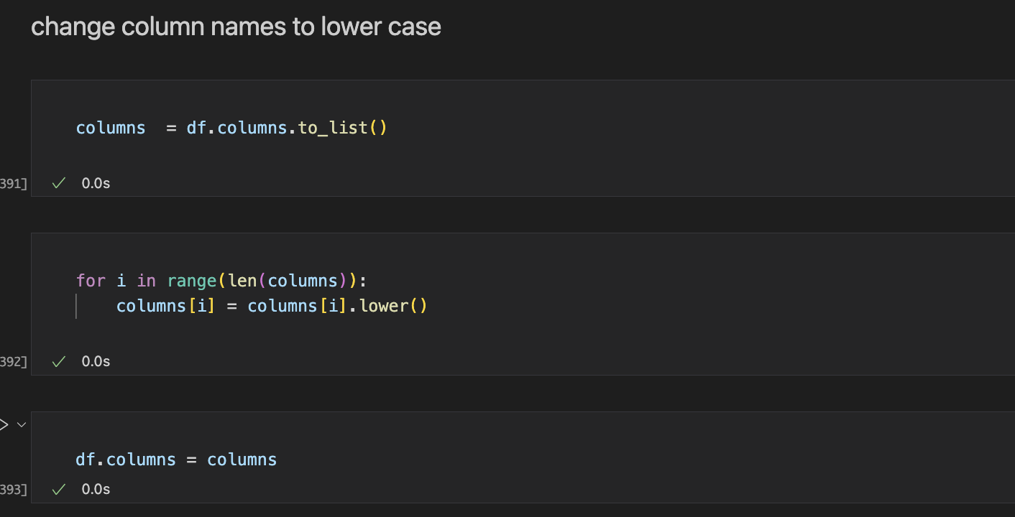
Change column names to lower case

Slide 16
04
Describe numerical columns

Slide 17
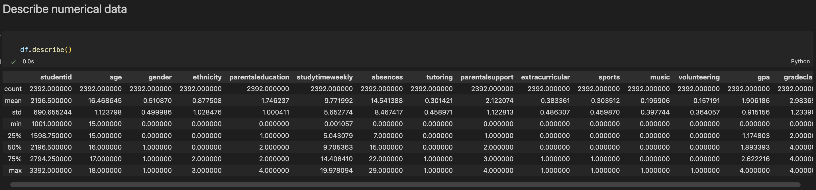
Describe numerical columns

Slide 18
05
Describe Categorical columns

Slide 19
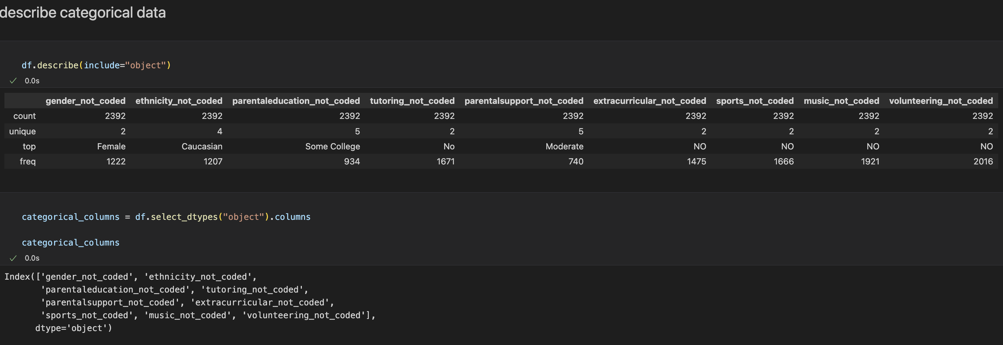
Describe Categorical columns

Slide 20
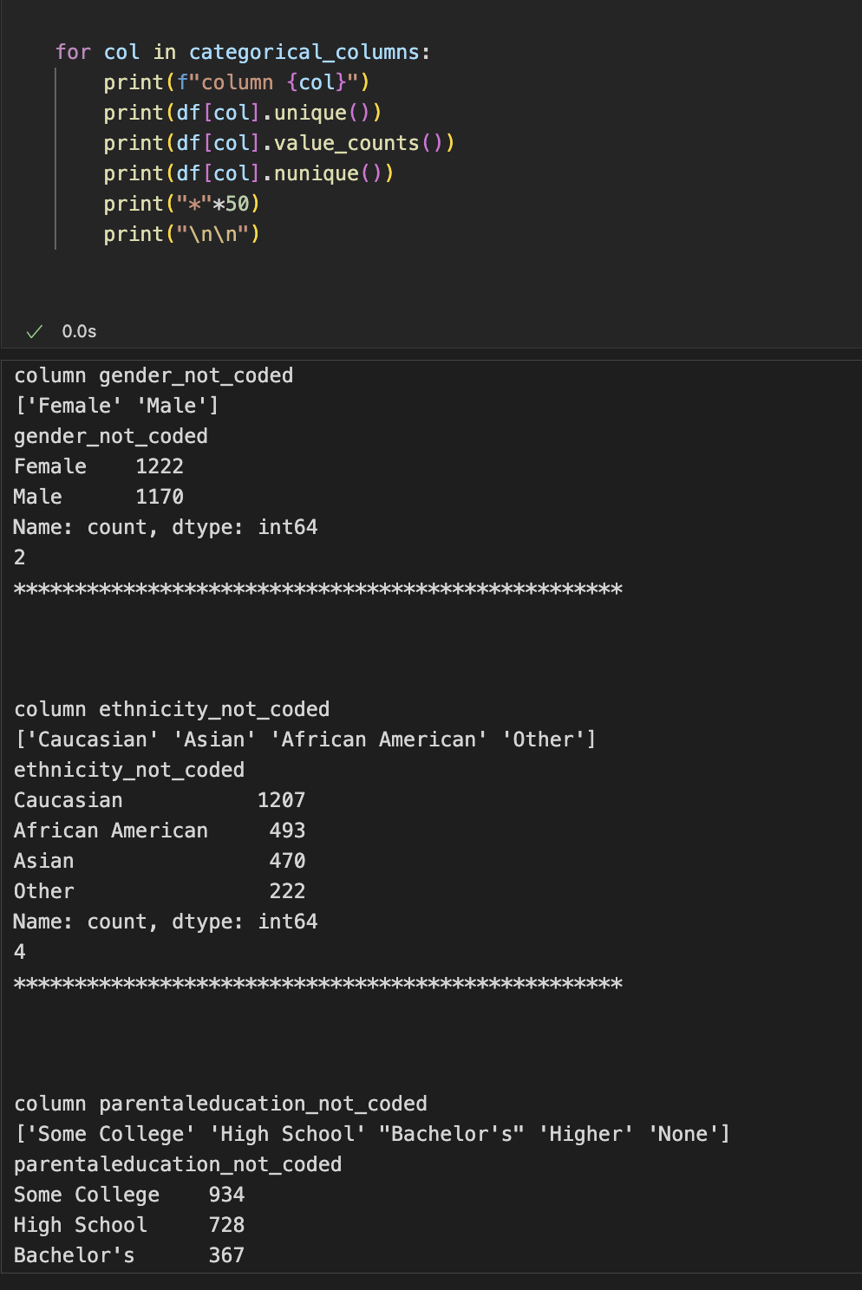
Describe Categorical columns
More explanations for the categorical columns

Slide 21
06
Questions

Slide 22
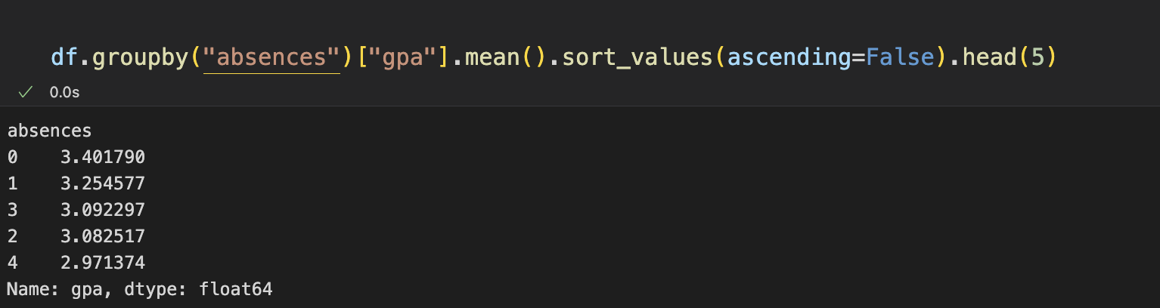
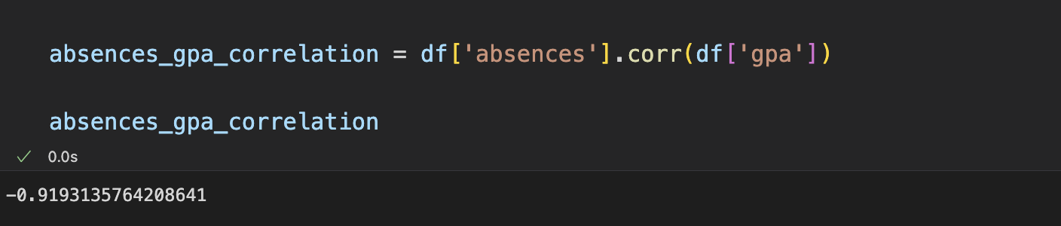
1) does students with fewer absences generally have a higher average GPA?
strong negative correlation indicates that when the absences rate increases the GPA decrease

Slide 23
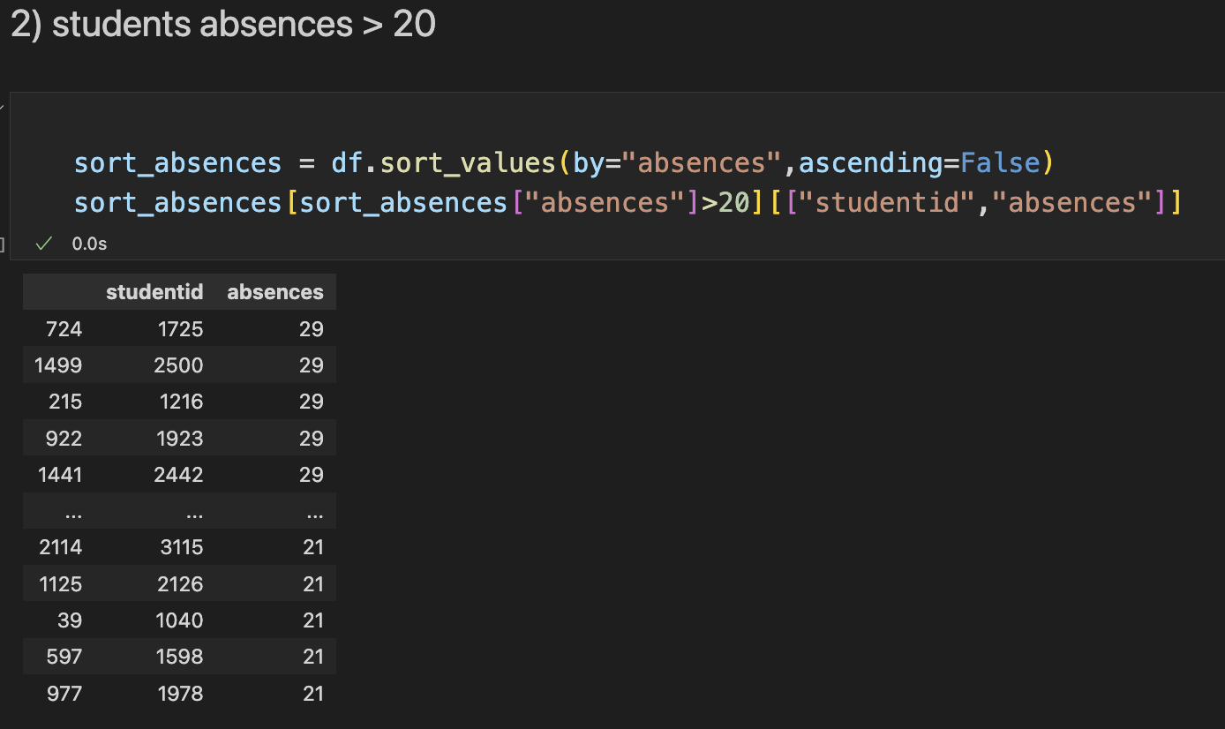
students absences > 20
these students should decrease their absence rate to increase their academic performance

Slide 24
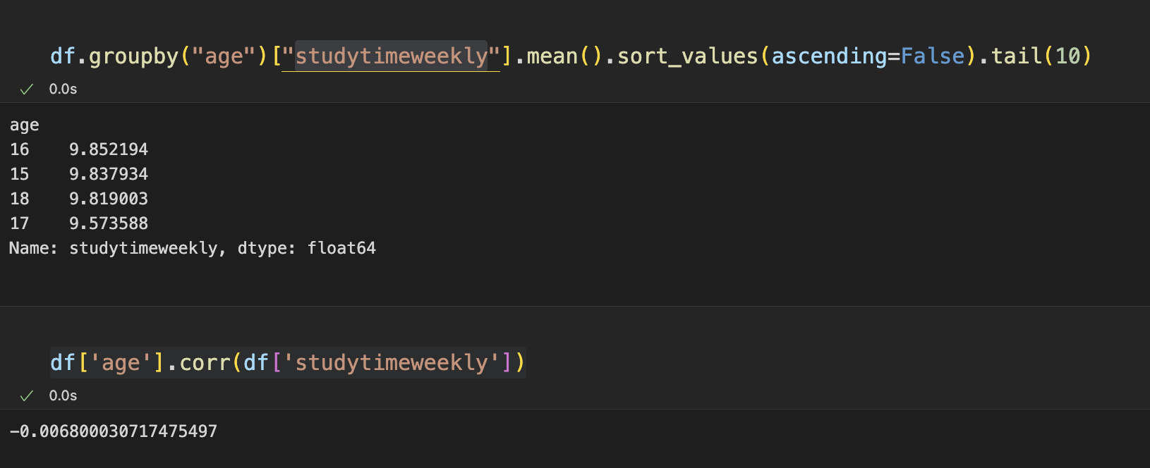
2) average study hours by age group
age does not appear to have a significant effect on weekly study time.

Slide 25
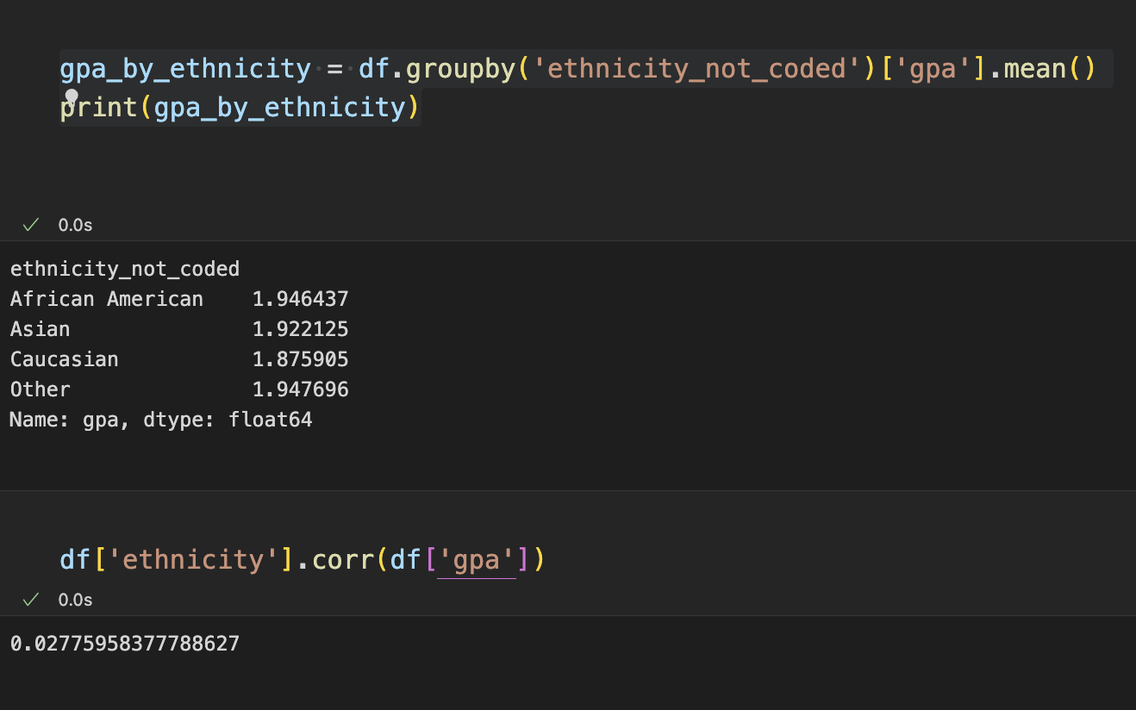
3) Does ethnicity affect GPA
ethnicity group does not appear to have a significant effect on gpa.

Slide 26
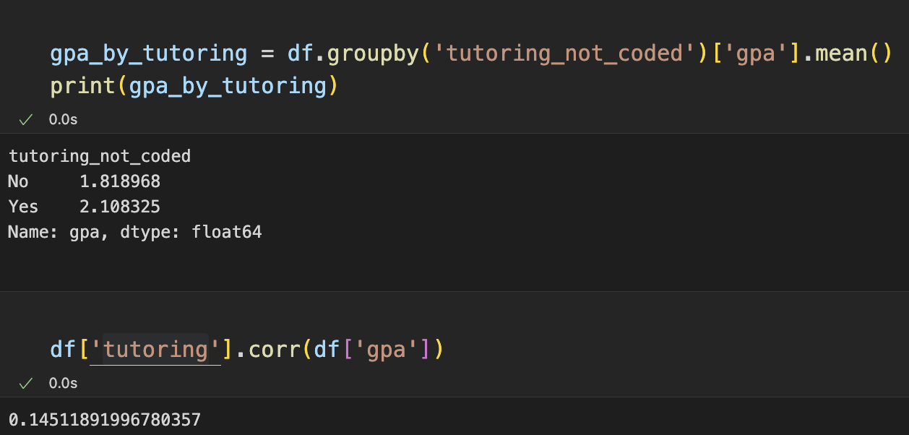
4) Is there relationship between tutoring and gpa
while there is a slight tendency for students with tutoring to have higher GPAs, the relationship is not very strong.

Slide 27
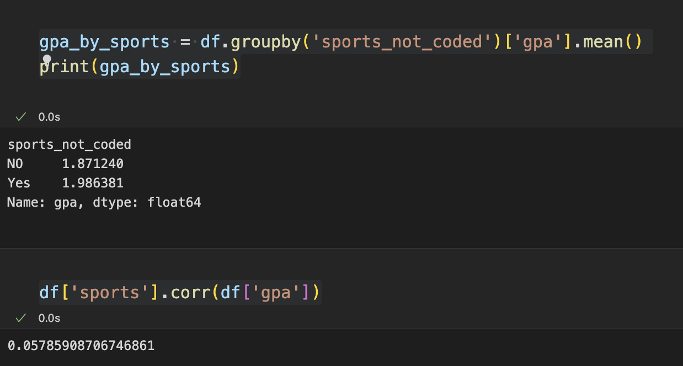
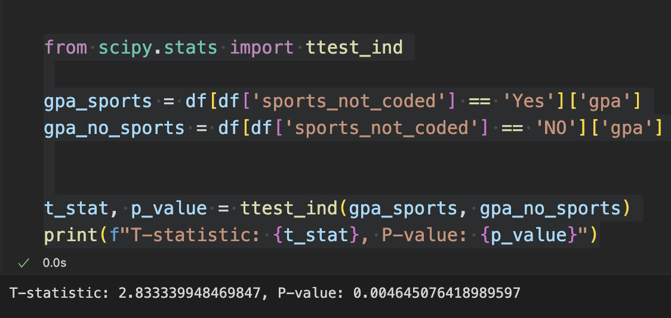
5) Does Sports Involvement affect Academic Performance
The analysis indicates that while there is a statistically significant difference in GPA between students who participate in sports and those who do not, the practical significance of this difference is relatively small, and the relation is not strong

Slide 28
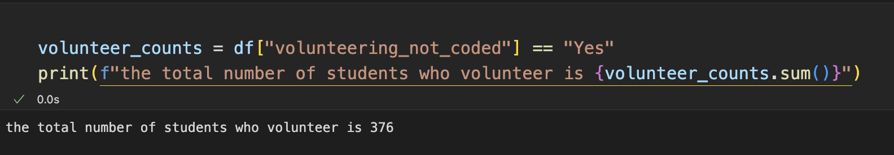
6) How many students volunteer?

Slide 29
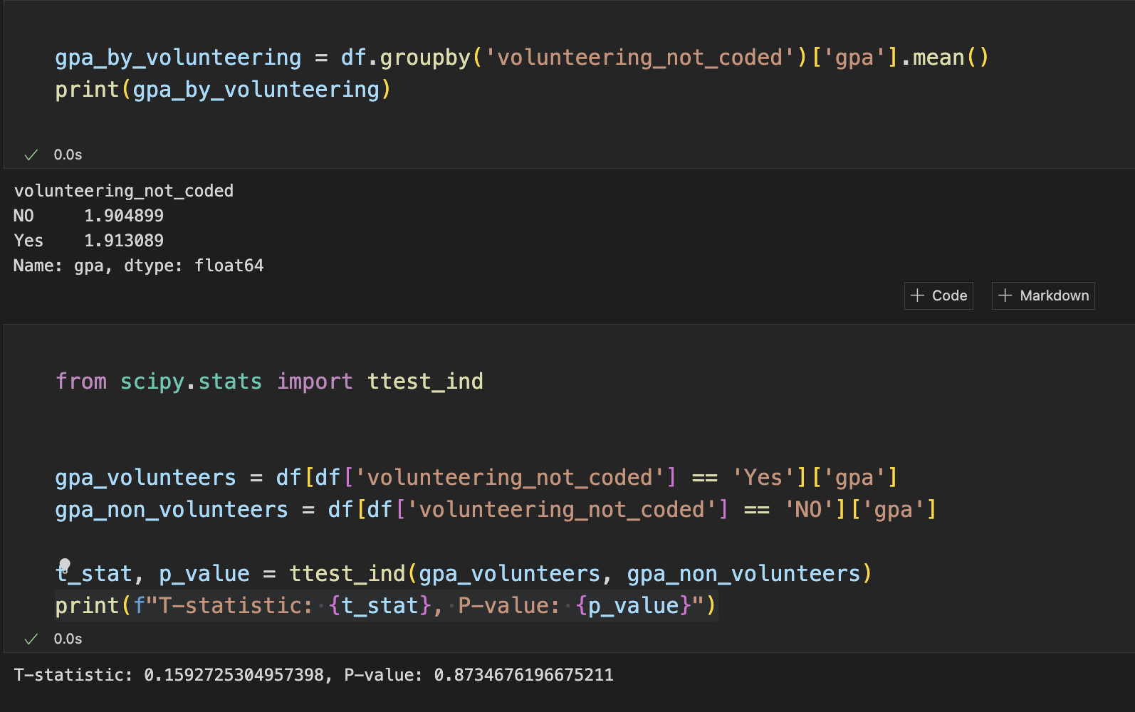
7) Does volunteering affect Academic Performance
While there is a small difference in average GPA, this difference is not large enough to be considered statistically significant based on the t-test results.

Slide 30
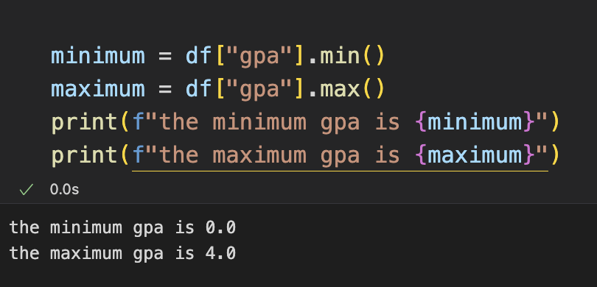
8) what is the minimum and maximum gpa

Slide 31
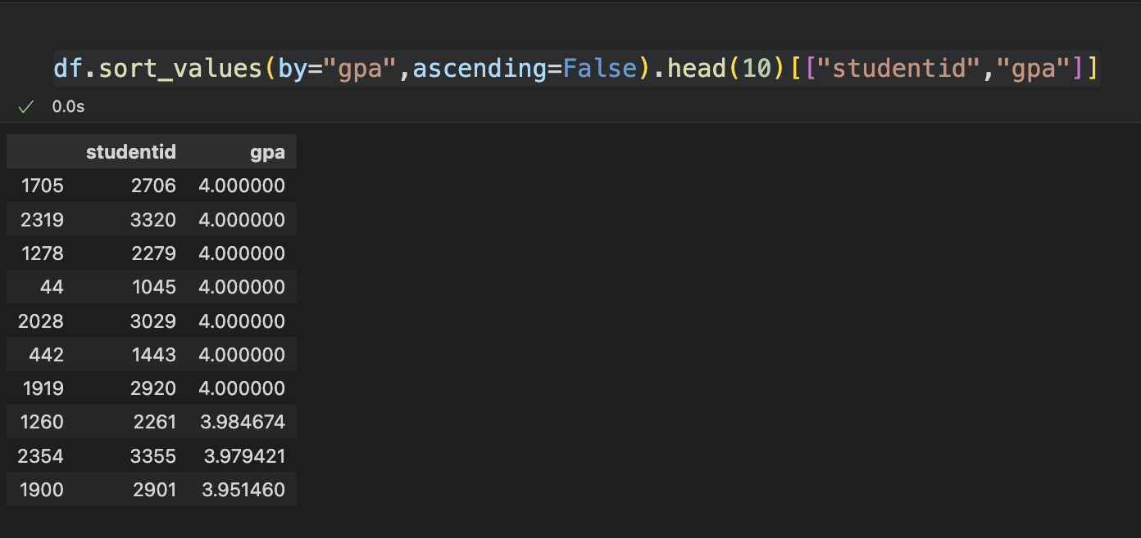
9) Top 10 students per GPA

Slide 32
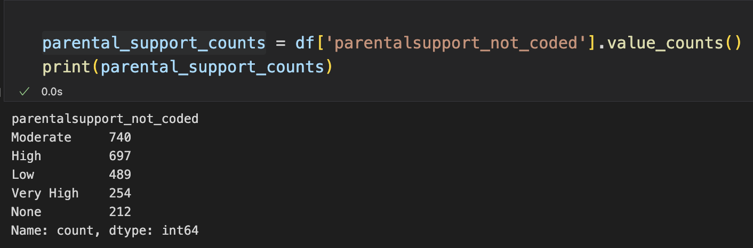
10) How many students have each level of parental support?

Slide 33
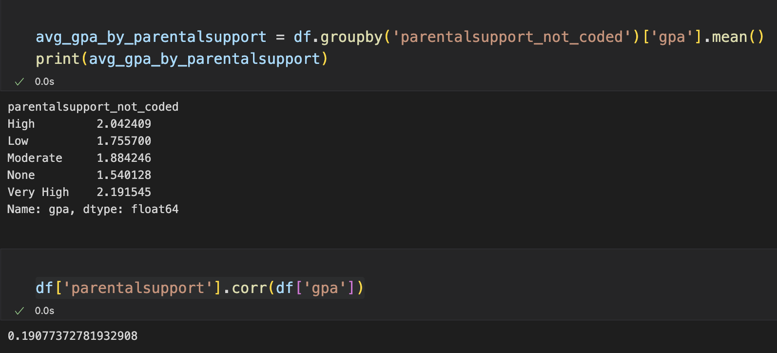
11) does parental support affect GPA
The analysis suggests that higher levels of parental support are associated with higher GPA. However, the weak correlation implies that parental support is just one of many factors affecting academic performance

Slide 34
Git hub link
https://github.com/Youssefabdelwahabb/EDA_project.git

Slide 35
Thanks!

