Slide 1


Checkpoint :
This project will be containing 3 main subjects in which I am going to give some brief ideas and develop informations. These subjects are:
- How does the web work?
-What do you need to be a web developer?
-What is the role of a web developer?
Web Fundamentals
Project :
By: Youssef Ben Amira

Slide 2
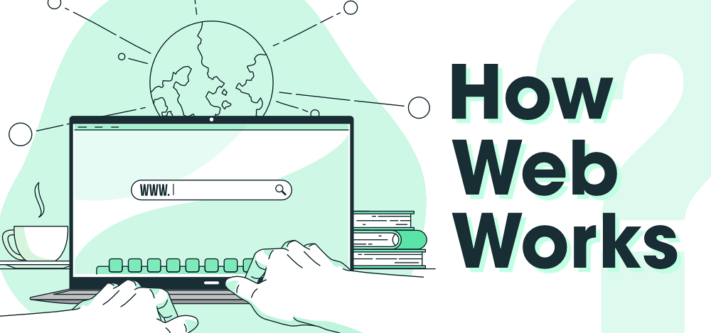
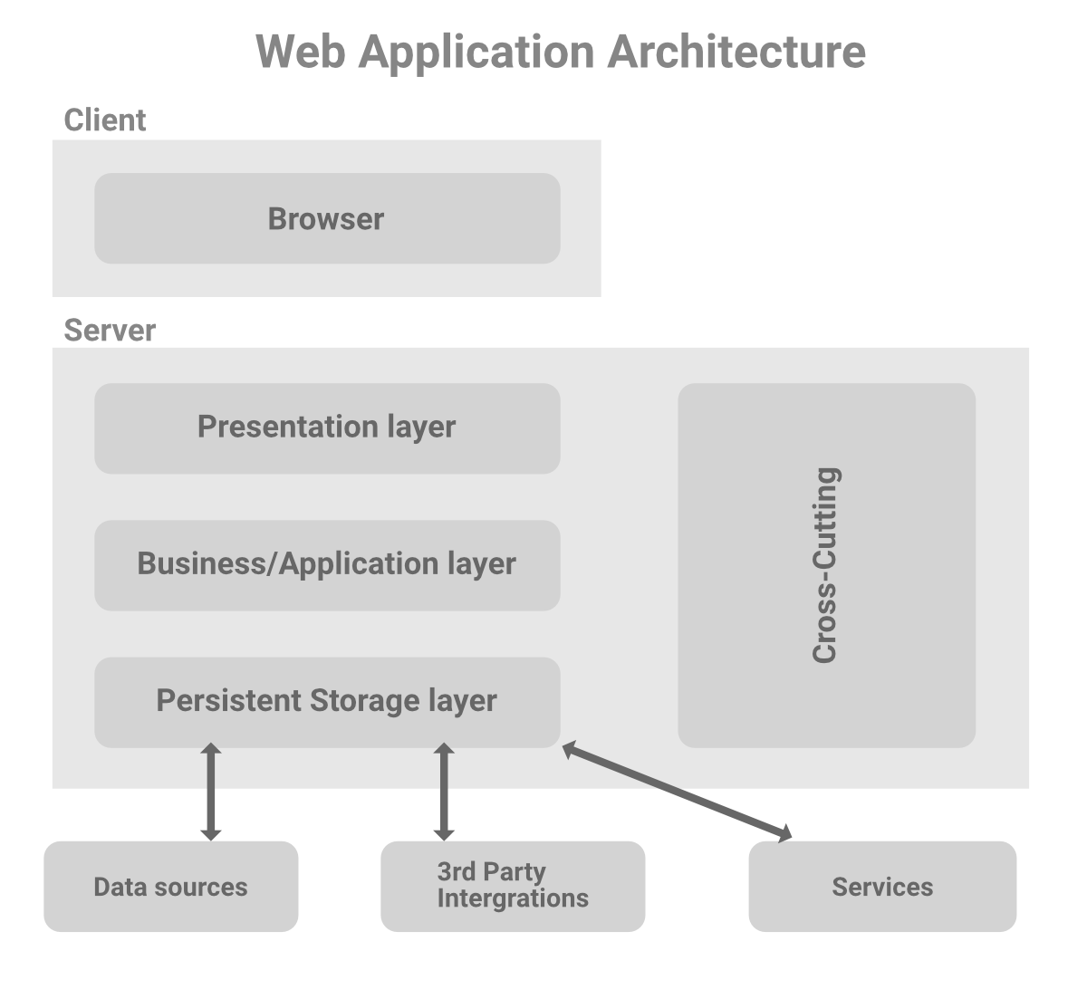
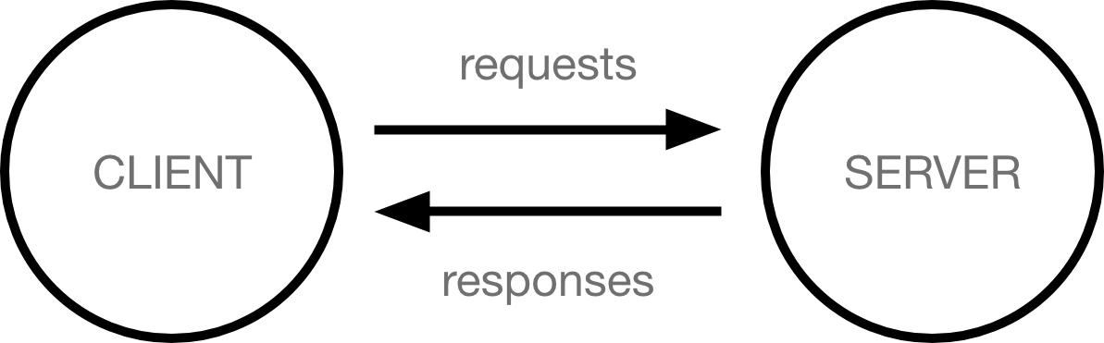
In addition to the client and the server, we also need to say hello to:
Your internet connection: Allows you to send and receive data on the web. It's basically like the street between your house and the shop.
TCP/IP: Transmission Control Protocol and Internet Protocol are communication protocols that define how data should travel across the internet. This is like the transport mechanisms that let you place an order, go to the shop, and buy your goods. In our example, this is like a car or a bike
DNS: Domain Name System is like an address book for websites. When you type a web address in your browser, the browser looks at the DNS to find the website's IP address before it can retrieve the website. The browser needs to find out which server the website lives on, so it can send HTTP messages to the right place (see below). This is like looking up the address of the shop so you can access it.
HTTP: Hypertext Transfer Protocol is an application protocol that defines a language for clients and servers to speak to each other. This is like the language you use to order your goods.
Component files: A website is made up of many different files, which are like the different parts of the goods you buy from the shop. These files come in two main types:
Code files: Websites are built primarily from HTML, CSS, and JavaScript, though you'll meet other technologies a bit later.
Assets: This is a collective name for all the other stuff that makes up a website, such as images, music, video, Word documents, and PDFs.
How the web works provides a simplified view of what happens when you view a webpage in a web browser on your computer or phone.
Clients and servers :
Computers connected to the web are called clients and servers. A simplified diagram of how they interact might look like this:
Web application architectural patterns are separated into many different layers or tiers which is called Multi- or Three-Tier Architecture. You can easily replace and upgrade each layer independently.

Slide 3

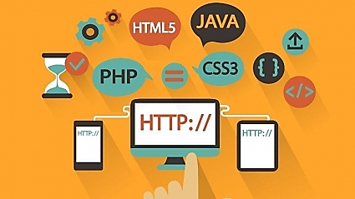
What qualifications do you need to become a web developer?
While there are no formal or specific qualifications required to become a web developer, a numerate degree in a subject such as maths or science will be useful.
You should also ideally have an aptitude for - or experience of - elements such as :
-User experience (UX)
-User interface (UI)
-Visual design
-Coding languages including HTML and CSS
-Frontend web programing languages and skills such as JavaScript, Ajax and web animation techniques
-Backend web programing languages such as C# or Java, PHP and Ruby
-Design software like Photoshop and Illustrator and Sketch
-An understanding of SEO
-Web servers and how they function.
What skills do you need to become a web developer?
Key skills to be successful in web development include:
-Computer literacy
-Strong numeracy skills
-Strong creative ability
-Attention to detail
-Strong communication skills
-Excellent problem-solving skills
-A logical approach to work
-The ability to explain technical matters clearly
-A keen interest in technology

Slide 4
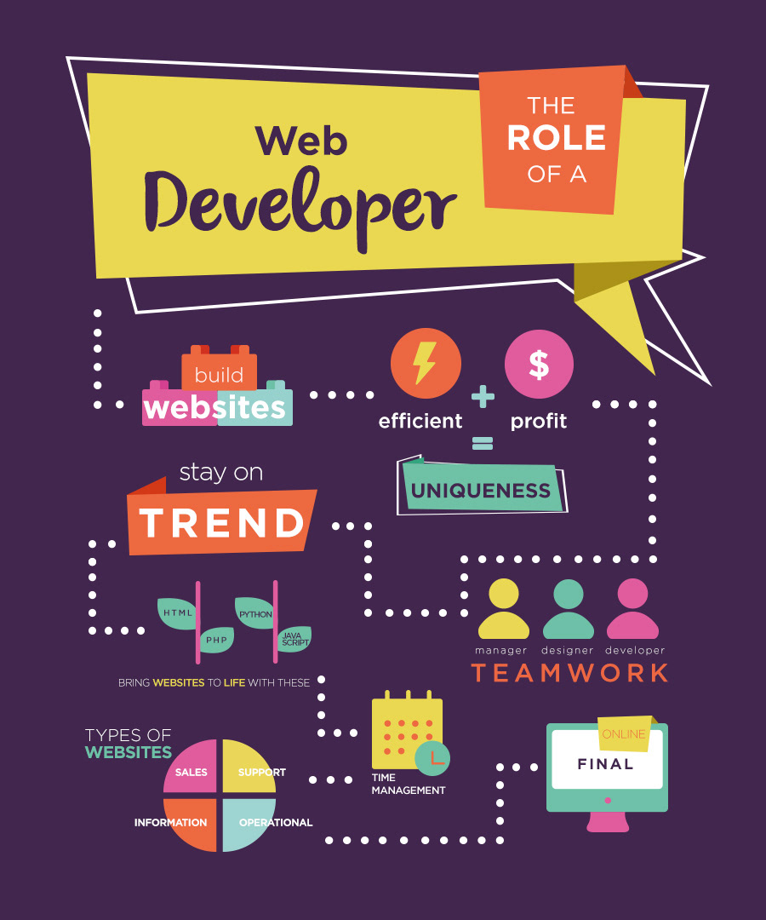
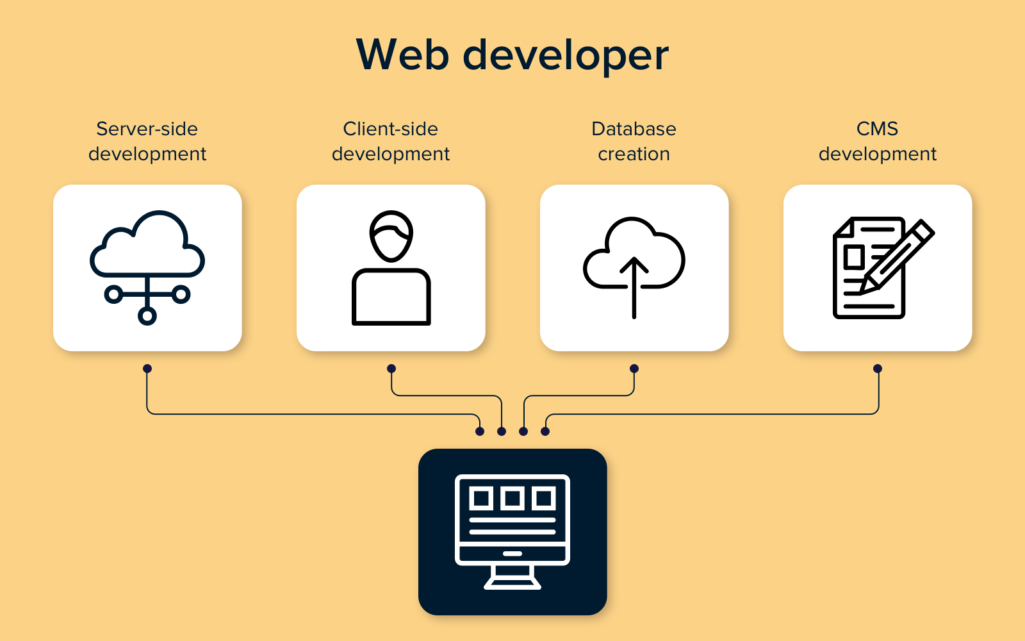
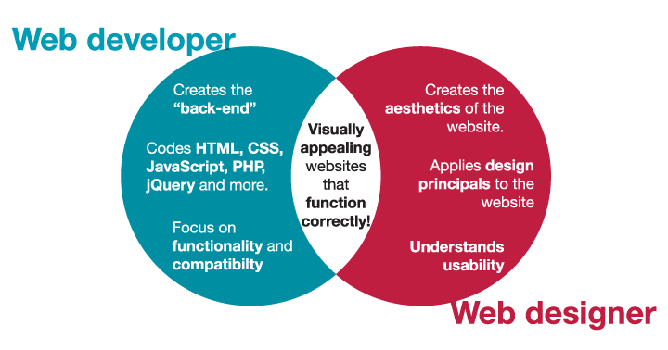
What is the role of a web developer?
-Designing user interfaces and navigation menus.
-Writing and reviewing code for sites, typically HTML, XML, or JavaScript.
-Integrating multimedia content onto a site.
-Testing web applications.
-Troubleshooting problems with performance or user experience.
-Collaborating with designers, developers, and stakeholders.
A web developer’s job is to create websites. While their primary role is to ensure the website is visually appealing and easy to navigate, many web developers are also responsible for the website’s performance and capacity.
Web developer tasks and responsibilities
As a web developer, you could work for a company or agency, or as a freelancer taking on projects for individual clients. Your tasks will vary depending on your work situation, but day-to-day responsibilities might generally include:

