Slide 1
Library management system

Slide 2
Who do What :
Youssef hamdi abdelaziz
Abdelrahman Mahmoud Ramadan
Rowan ibrahim
Hazem Hossam eldin

Slide 3
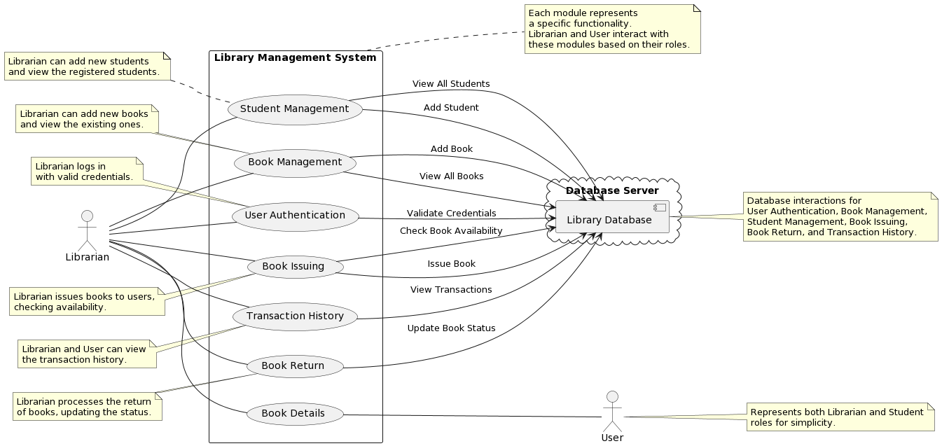
Functional Requirements:
Non-functional Requirements
User Authentication
Performance
Book Management
Scalability
Book Issuing
Data Backup
Book Return
Reporting
Transaction History
User Interface
Use case Diagram

Slide 4
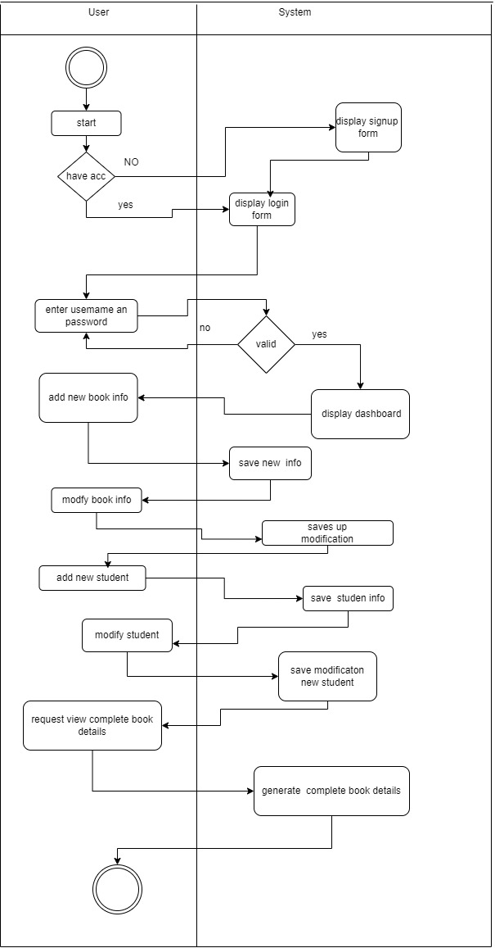
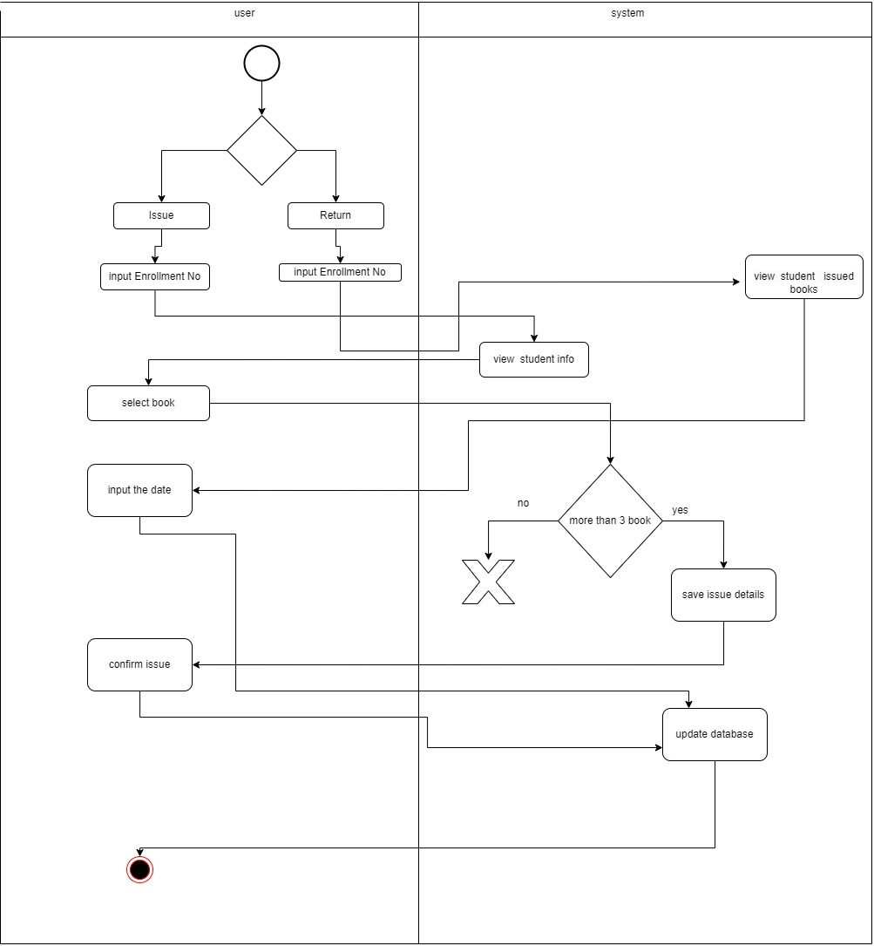
Activity Diagram

Slide 5
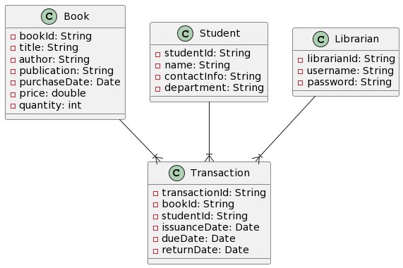
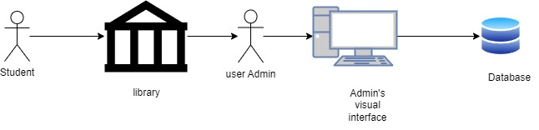
Database Specification
System Architecture

Slide 6
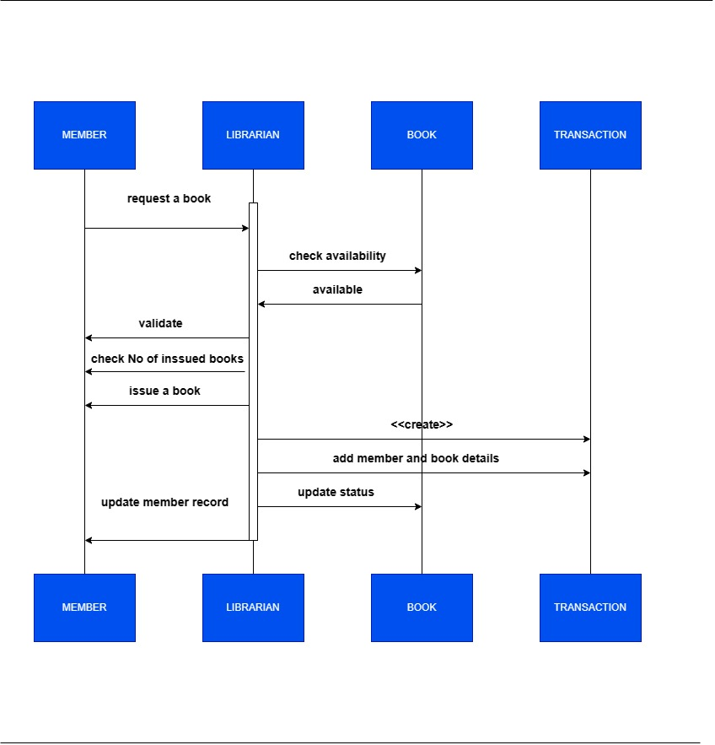
Sequence Diagram

Slide 7
Thank you

