Slide 1
Giude To install Tensorflow GPU
Definition :
TensorFlow is an end-to-end open source platform for machine learning from Google. If you want to study Ai or work on Ai project, setting up an development env with TensorFlow at a local machine will help you have smooth sailing. GPU (Graphics processing unit) is a specialized processor originally designed to process data simultaneously. It helps to speed up computation of your deep learning code. This is a complete guide to install TensorFlow GPU on windows in 2023. The installation involves many steps. Let’s get started.[1]
1) Download Nvidia Graphics Driver
Data science workflows have traditionally been slow and cumbersome, relying on CPUs to load, filter, and manipulate data and train and deploy models. With NVIDIA AI software, including RAPIDS™ open-source software libraries, GPUs substantially reduce infrastructure costs and provide superior performance for end-to-end data science workflows. GPU-accelerated data science is available everywhere—on the laptop, in the data center, at the edge, and in the cloud. .[2]

Slide 2
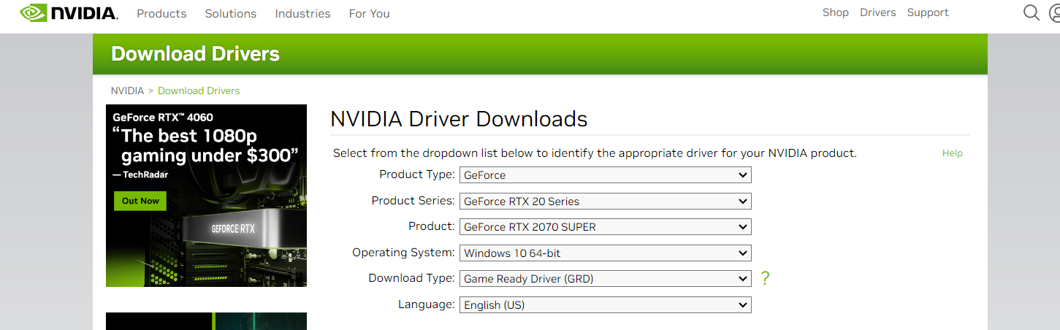

If you just got a new PC with Nvidia GPU, you go to Nvidia driver download and download the graphic card driver. After download, you run exe file to install. In my case
[Press]
[Press]

Slide 3
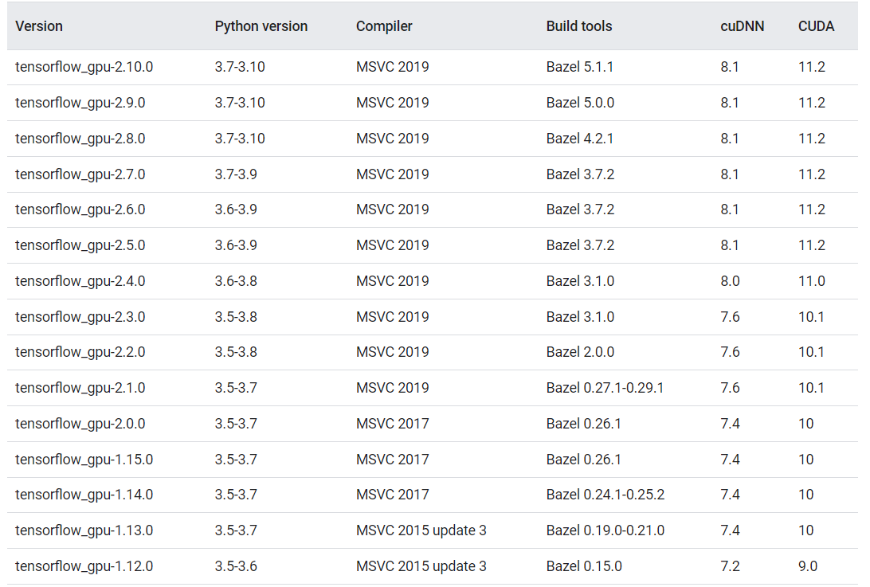
2) Compatibilities of Tensorflow
Note: GPU support on native-Windows is only available for 2.10 or earlier versions, starting in TF 2.11, CUDA build is not supported for Windows. For using TensorFlow GPU on Windows, you will need to build/install TensorFlow in WSL2 or use tensorflow-cpu with TensorFlow-DirectML-Plugin [3]

Slide 4
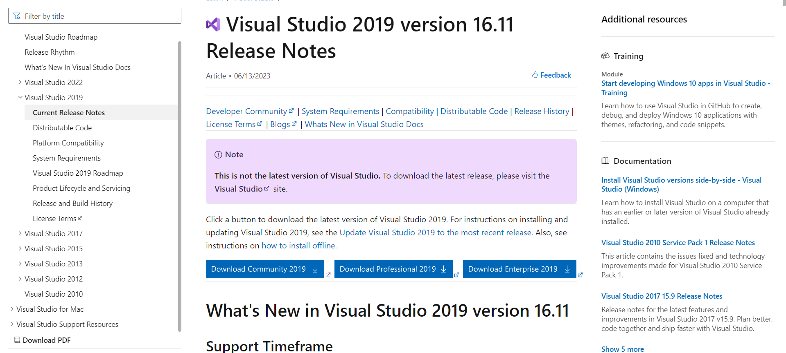
Now when we know the requirement to install Tensorflow-gpu
3) Install Visual Studio Community 2019
TensorFlow install guide says “Windows Native Requires Microsoft Visual C++ Redistributable for Visual Studio 2015, 2017 and 2019.” Please note it is not latest version 2022. You go to Visual Studio old downloads to get 2019. After we sign in, we will select community 2019 and download. Just we going to

Slide 5
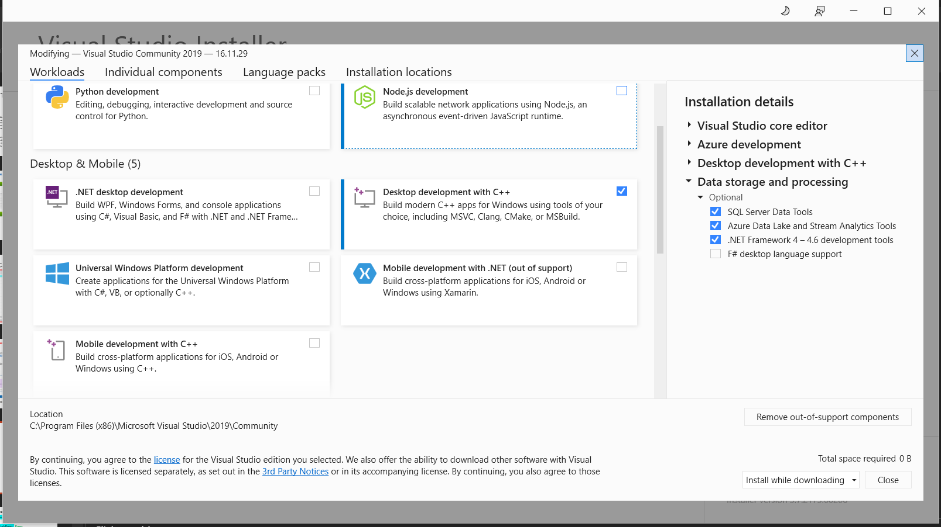
Just i Will select Desktop development with c++

Slide 6
4) Install CUDA Toolkit 11.2
CUDA is a parallel computing platform and programming model developed by NVIDIA for general computing on its own GPUs (graphics processing units). CUDA enables developers to speed up compute-intensive applications by harnessing the power of GPUs for the parallelizable part of the computation.
While there have been other proposed APIs for GPUs, such as OpenCL, and there are competitive GPUs from other companies, such as AMD, the combination of CUDA and NVIDIA GPUs dominates several application areas, including deep learning, and is a foundation for some of the fastest computers in the world.
The origin of CUDA
In 2003, a team of researchers led by Ian Buck unveiled Brook, the first widely adopted programming model to extend C with data-parallel constructs. Buck later joined NVIDIA and led the launch of CUDA in 2006, the first commercial solution for general purpose computing on GPUs.
CUDA in deep learning
Deep learning has an outsized need for computing speed. For example, to train the models for Google Translate in 2016, the Google Brain and Google Translate teams did hundreds of one-week TensorFlow runs using GPUs; they had bought 2,000 server-grade GPUs from NVIDIA for the purpose. Without GPUs, those training runs would have taken months rather than a week to converge. For production deployment of those TensorFlow translation models, Google used a new custom processing chip, the TPU (tensor processing unit).
In addition to TensorFlow, many other deep learning frameworks rely on CUDA for their GPU support, including Caffe2, Chainer, Databricks, H2O.ai, Keras, MATLAB, MXNet, PyTorch, Theano, and Torch. In most cases they use the cuDNN library for the deep neural network computations. That library is so important to the training of the deep learning frameworks that all of the frameworks using a given version of cuDNN have essentially the same performance numbers for equivalent use cases. When CUDA and cuDNN improve from version to version, all of the deep learning frameworks that update to the new version see the performance gains. Where the performance tends to differ from framework to framework is in how well they scale to multiple GPUs and multiple nodes.

Slide 7
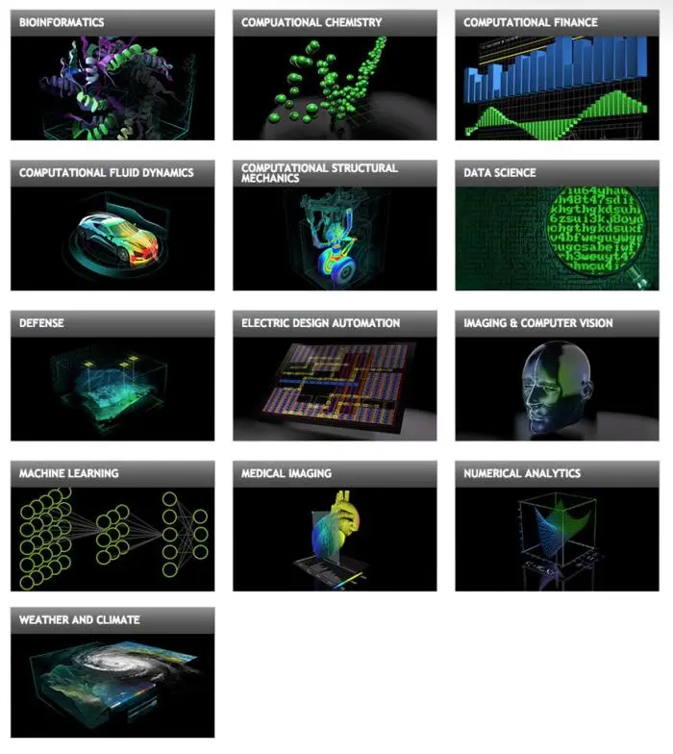
CUDA application domains

Slide 8
In my case i Will download and install CUDA 11.2.0
CUDA Toolkit Archive
Previous releases of the CUDA Toolkit, GPU Computing SDK, documentation and developer drivers can be found using the links below. Please select the release you want from the list below, and be sure to check www.nvidia.com/drivers for more recent production drivers appropriate for your hardware configuration.[6]

Slide 9
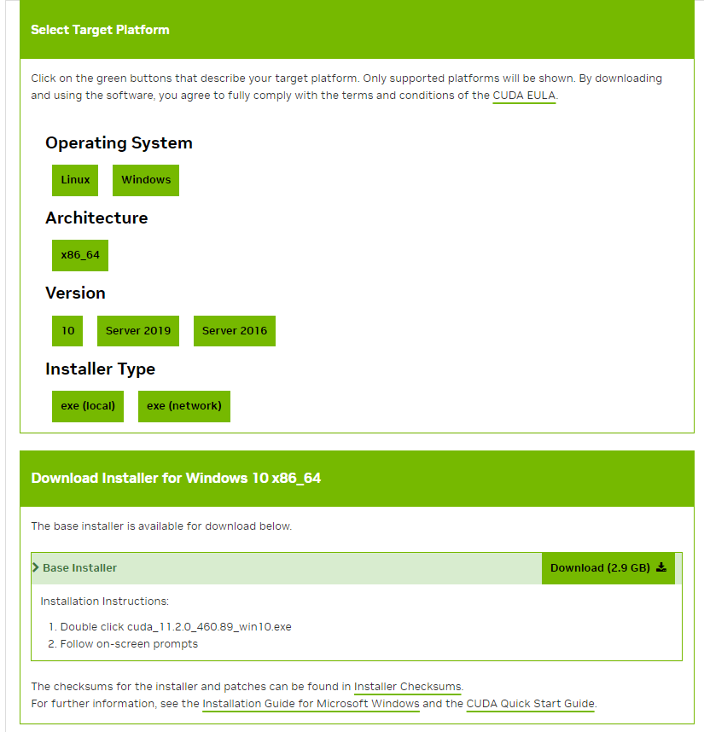

Slide 10
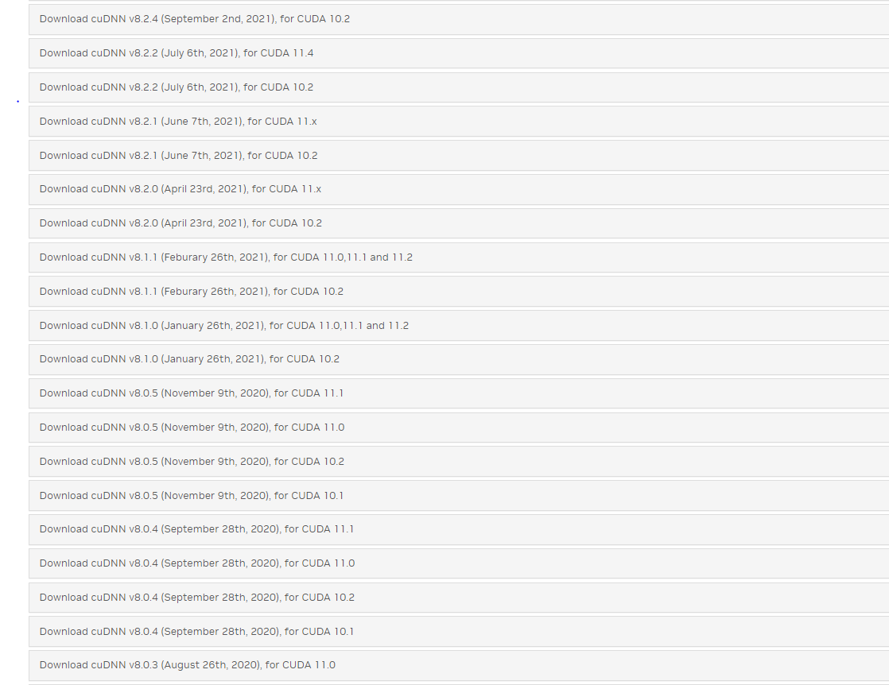
Now let ´s move to the next step :
5) Install cuDNN 8.2
NVIDIA CUDA Deep Neural Network (cuDNN) is a GPU-accelerated library of primitives for deep neural networks. It provides highly tuned implementations of routines arising frequently in DNN applications. These release notes describe the key features, software enhancements and improvements, and known issues for the NVIDIA cuDNN 8.9.4 and earlier releases.
Keep in mind that you should sign in to download the cudnn, in our case the version that corresponds to CUDA 11.2 is CUDNN 8.1,so

Slide 11
Extract the downloaded zip file and copy three sub folders, i.e. include, lib and bin.

Slide 12
Pen Environment Variables window, add following new two paths:
“C:\Program Files\NVIDIA GPU Computing Toolkit\CUDA\v11.2\bin”
“C:\Program Files\NVIDIA GPU Computing Toolkit\CUDA\v11.2\libnvvp”
6)Install Anaconda
What is Anaconda for Python?
Anaconda Python is a free, open-source platform that allows you to write and execute code in the programming language Python. It is by continuum.io, a company that specializes in Python development. The Anaconda platform is the most popular way to learn and use Python for scientific computing, data science, and machine learning. It is used by over thirty million people worldwide and is available for Windows, macOS, and Linux.[8]
People like using Anaconda Python because it simplifies package deployment and management. It also comes with a large number of libraries/packages that you can use for your projects. Since Anaconda Python is free and open-source, anyone can contribute to its development.

Slide 13
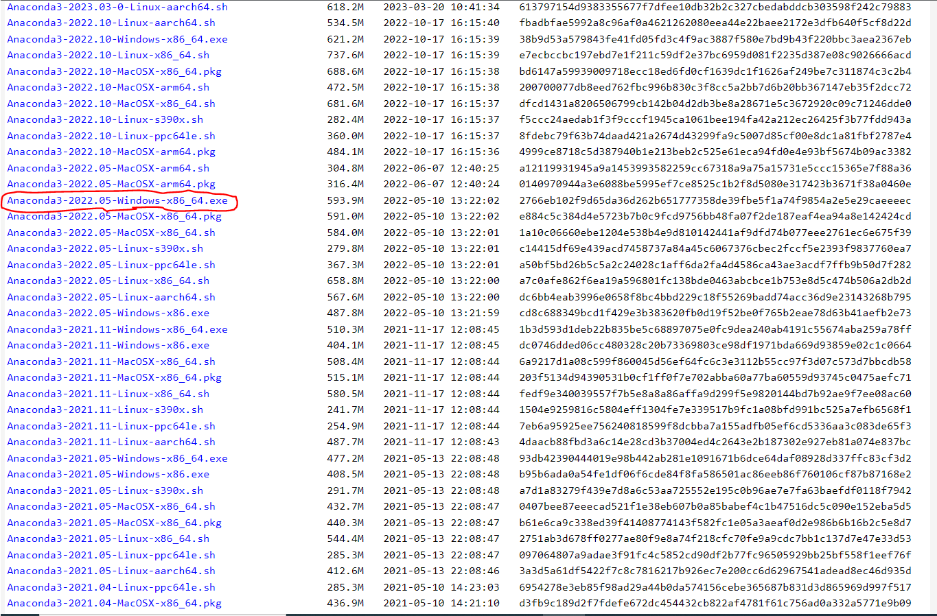
in my case i prefer to download an older version to avoid problems related of confusion

Slide 15
Reference
Install TensorFlow GPU on Windows – A complete guide 2023 Press
GPU-Accelerate Your Data Science Workflows Press
Install TensorFlow with pip Press
How to Install Visual Studio 2019 Community – The Best IDE for Press
What is CUDA? Parallel programming for GPUs Press
CUDA Toolkit Archive Press
NVIDIA cuDNN Press
What is Anaconda for Python & Why Should You Learn it? Press
Installing previous versions of Anaconda Distribution Press

